Slide 1

R Project
Arpi Dharia

Slide 2
Cryosleep per homeplanet
HomePlanet Cryosleep_count
1 Earth 1382
2 Europa 911
3 Mars 669
4 NA 75

Slide 3
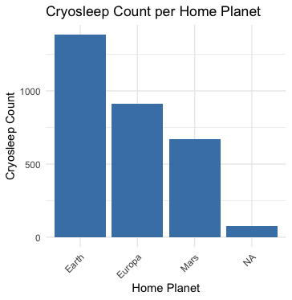

Slide 4
Spa’s and shopping mall per Homeplanet
HomePlanet spa_count shopping_mall_count
1 Earth 642946 601088
2 Europa 1769044 314054
3 Mars 189912 531452
4 NA 45889 27498

Slide 5
