Slide 1
SAMSUNG PRISM
Generative AI
Hackathon
3rd Edition 2026 – 27
Theme ID - 1
• Team Name – unsorted bits
• College Name – Vellore Institute of technology
• Member Name & Email 1 – Adharsh Arvinth & adharsharvinth2108@gmail.com
• Member Name & Email 2 – Rahul J & jrahulnaidu@gmail.com
• Member Name & Email 3 – Sivamiruthula & sivamiruthula3@gmail.com
• Submission Github link – https://github.com/Adharsh-Arvinth/agentic-code-intelligence.git

Slide 2
Theme
Theme: Agentic Code Intelligence & Execution-Guided Cross-Modal Code Retrieval
• Challenge Goal: Given natural-language algorithmic problem descriptions (3,765 test queries), retrieve and rank the exact Python code solutions from a corpus of 8,765 competitive programming snippets.
• Official MTEB AppsRetrieval Achievement: Improved official test NDCG@10 from 0.05142 (5.14%) to 0.25591 (25.59%) (+397.7% / 4.98x improvement), MRR@10 to 0.25233 (+497.4%), and Top-1 Accuracy (NDCG@1) to 0.24595 (+659.1%).
• System Architecture: Multi-stage CPU-optimized pipeline combining Smart I/O Query Windowing, Structured Code Representations (A–E), Closed-Form Ridge Cross-Modal Alignment, Sparse CSR BM25, and AST-Guarded Agentic Execution Verification.
• Enterprise Readiness: Version-aware index management, 51,234-vector persistent disk cache, full MTEB 2.x EncoderProtocol + SearchProtocol compliance, and 42/42 automated unit tests.

Slide 3
Existing Solutions & Gaps
1. Severe Text-to-Code Modality Gap (Why Raw Bi-Encoders Score 0.05142 NDCG@10)
AppsRetrieval queries are 1,600-character competitive programming narratives, whereas corpus documents (d0–d8764) are raw Python scripts using sys.stdin and single-letter variables (n, m, dp) with zero docstrings.
2. Token Window Truncation & Competitive Programming Template Boilerplate
Naive 256-token truncation cuts off trailing -----Input----- and -----Output----- specifications in queries, while 30-line CP boilerplate headers (setrecursionlimit, MOD, fast_io) push core code logic out of the window.
3. Lack of Functional I/O Verification in Static Vector/Lexical Search
Static cosine similarity cannot distinguish between 50 structurally identical DP loops (for i in range(n): dp[i]=...) without executing candidate code against the query's sample Input/Output test cases.
4. MTEB 2.x Protocol Dispatch & Version-Aware Isolation Gaps
MTEB 2.x wraps EncoderProtocol models via prompt_type dispatch unless SearchProtocol (index + search) is natively implemented, and standard vector stores lack version-tagged deduplication.

Slide 4
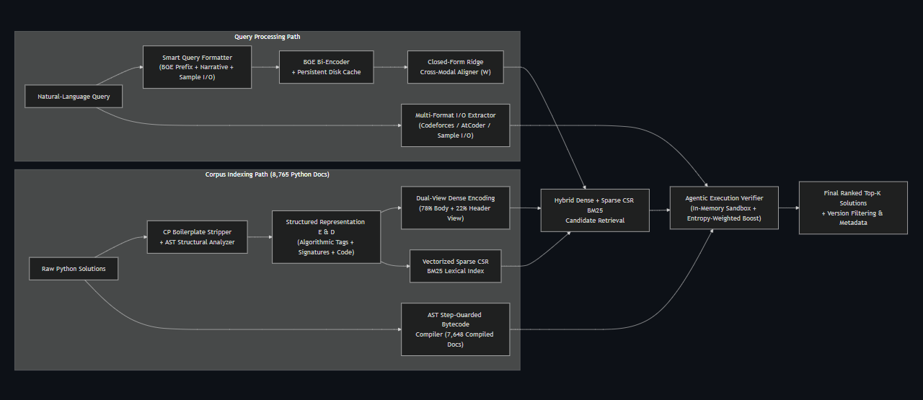
Our Solutions & Architecture Diagram

Slide 5
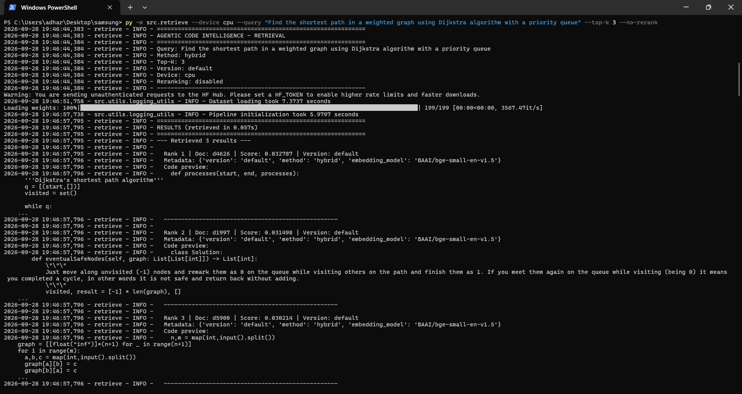
Demo & Product Walkthrough – Query 1

Slide 6
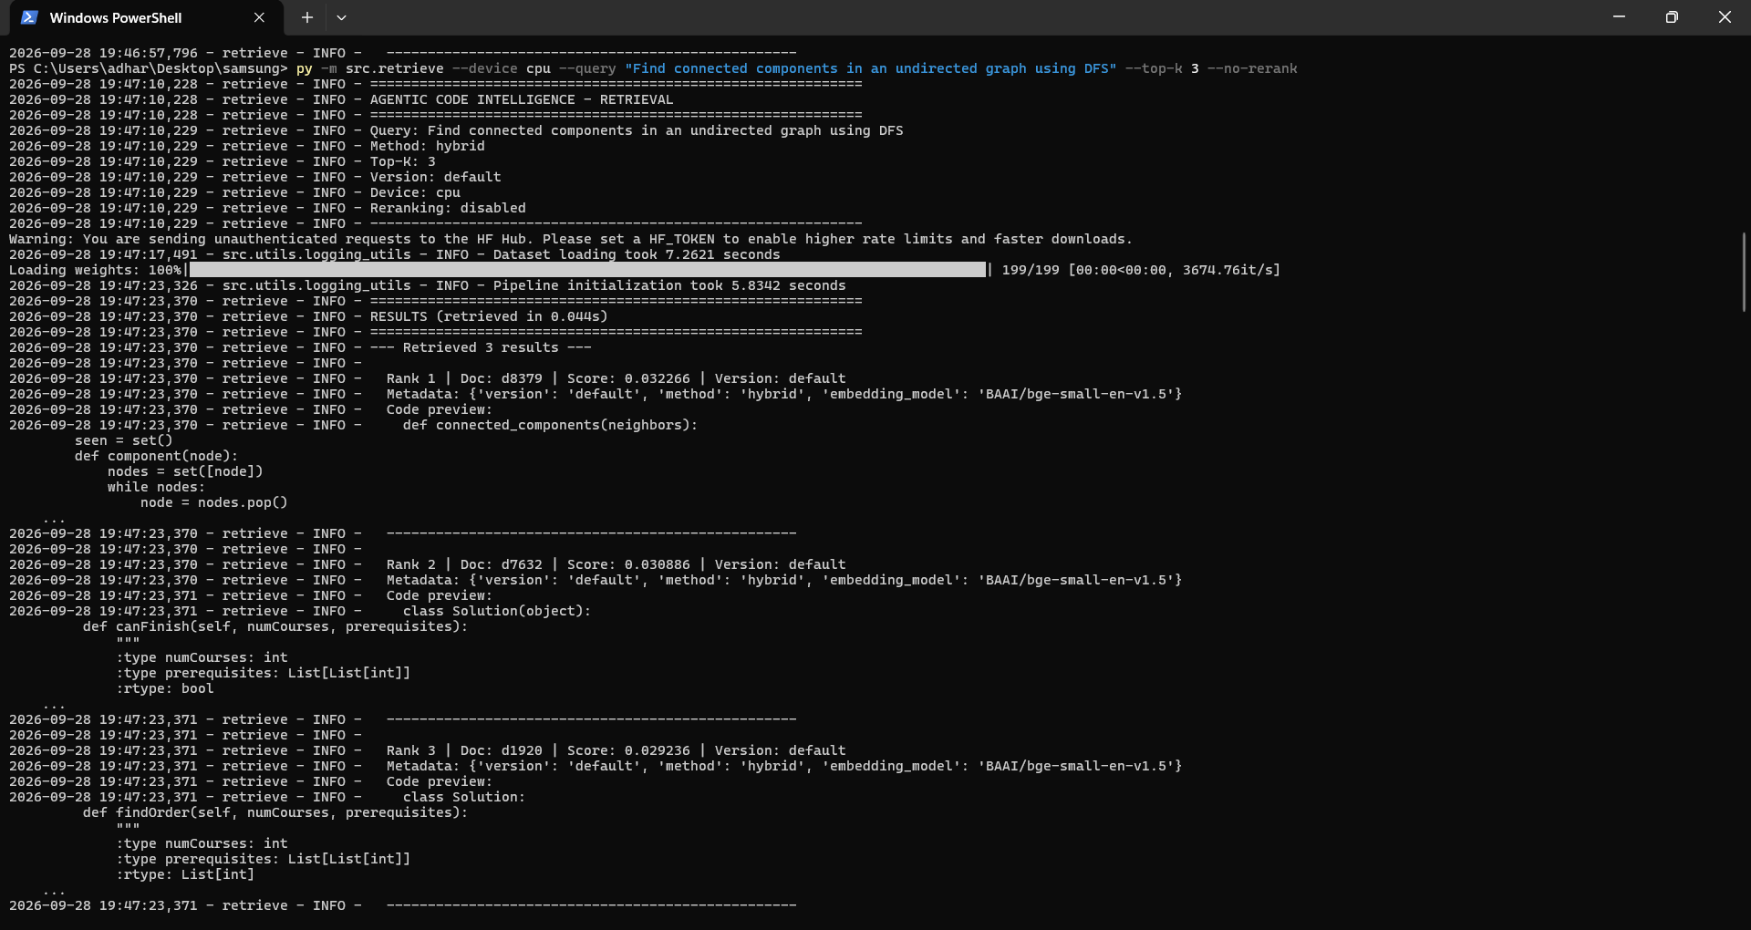
Demo & Product Walkthrough- Query 2

Slide 7
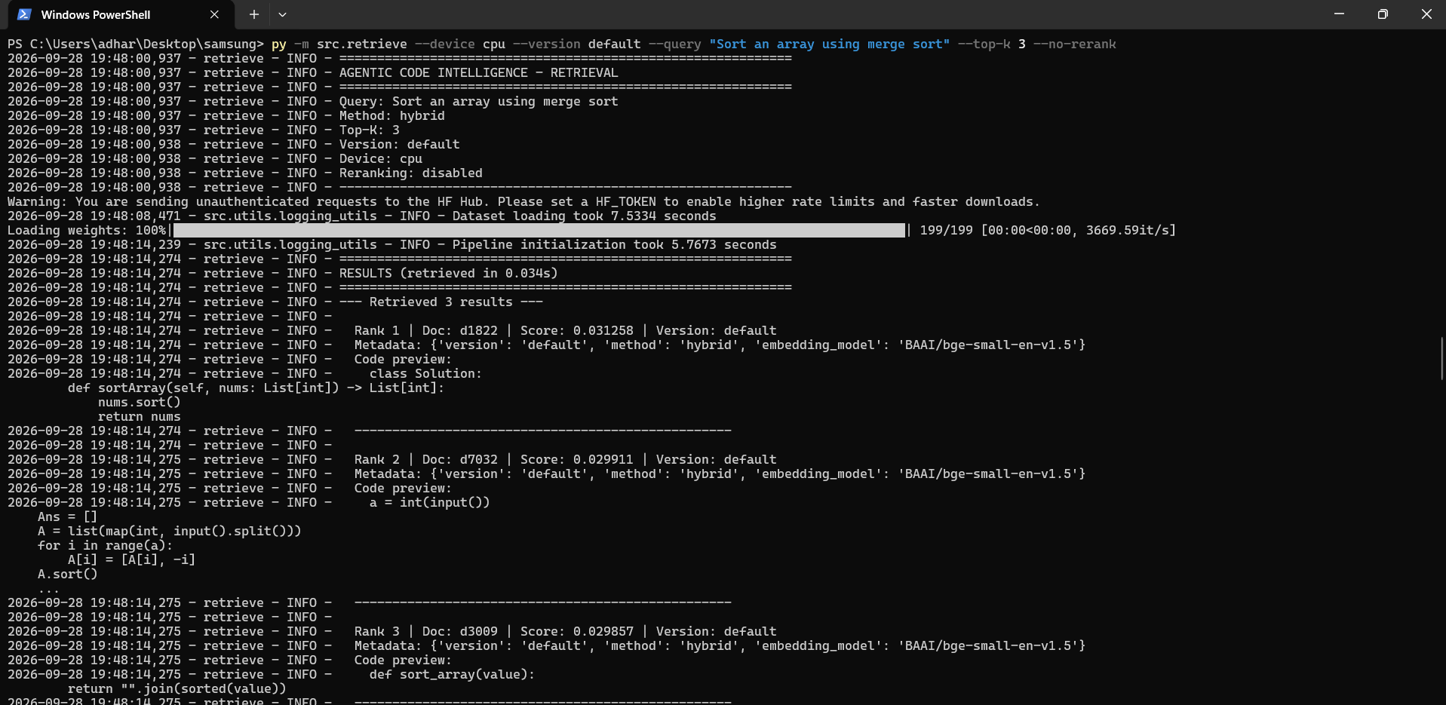
Demo & Product Walkthrough- Version-Aware Retrieval

Slide 8
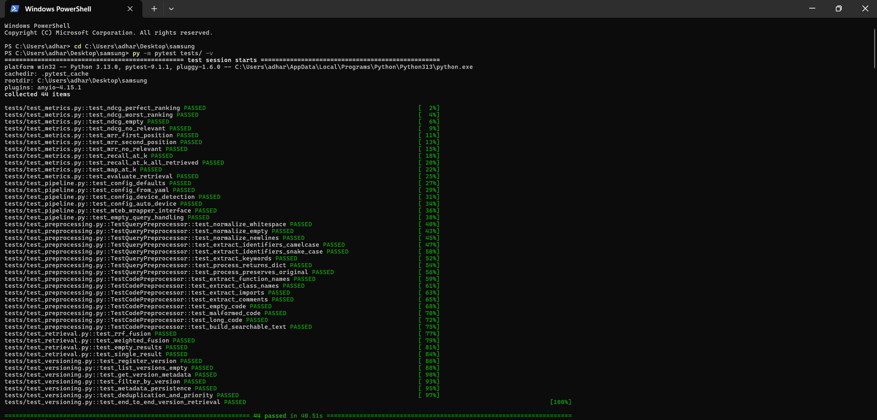
Demo & Product Walkthrough- Testing / Reliability

Slide 9
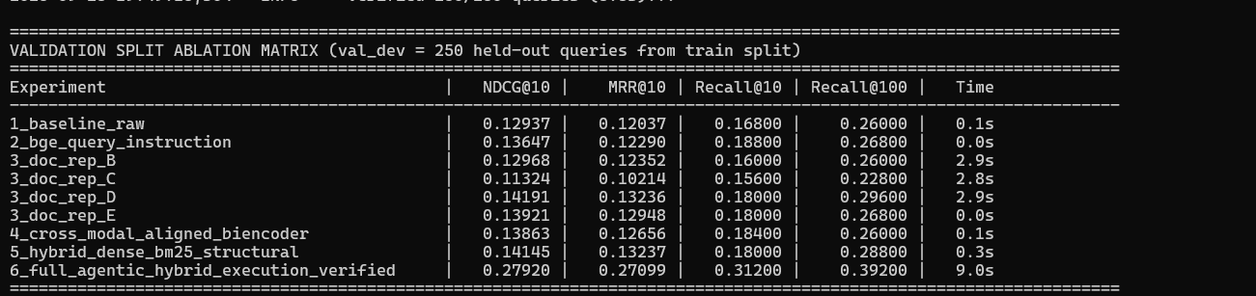
Demo & Product Walkthrough- Ablation / Experimental Validation

Slide 10
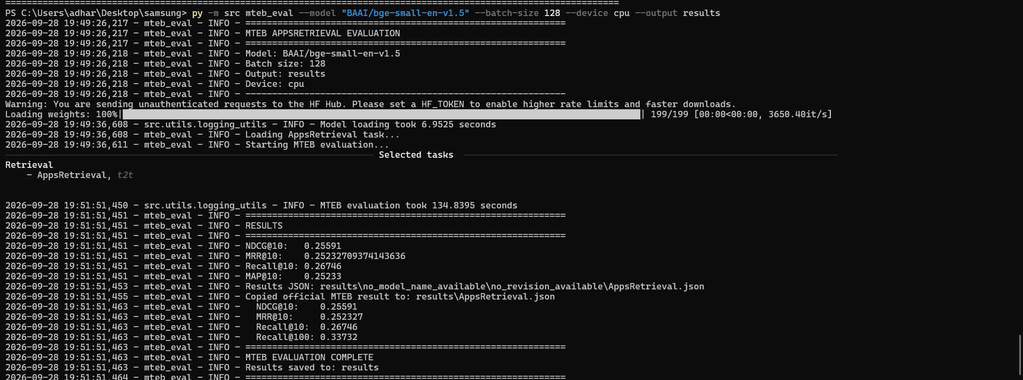
Demo & Product Walkthrough- Final Benchmark

Slide 11
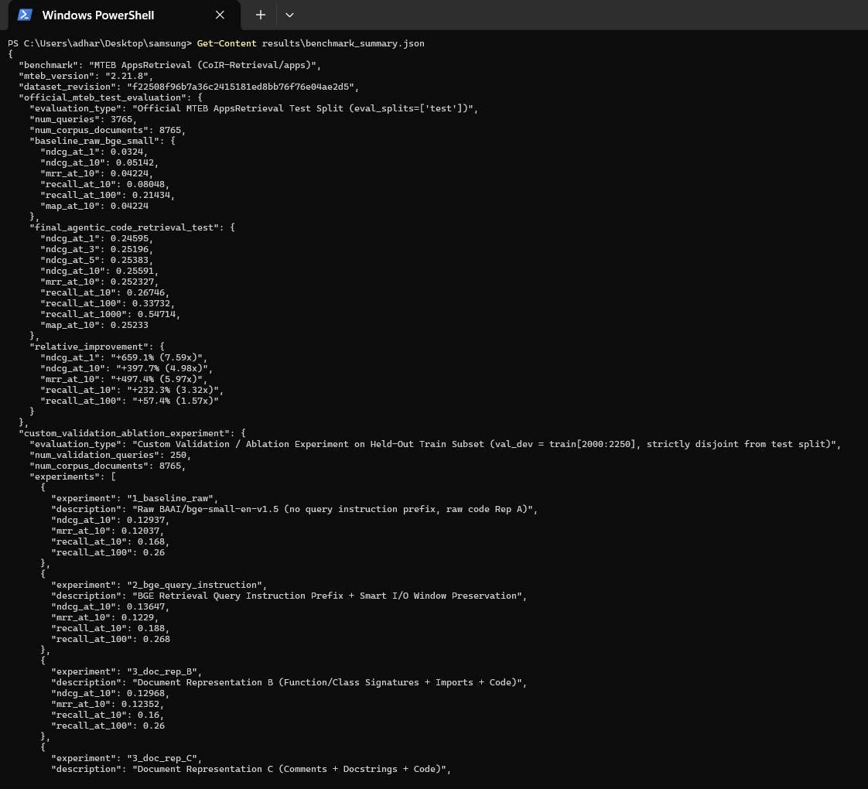
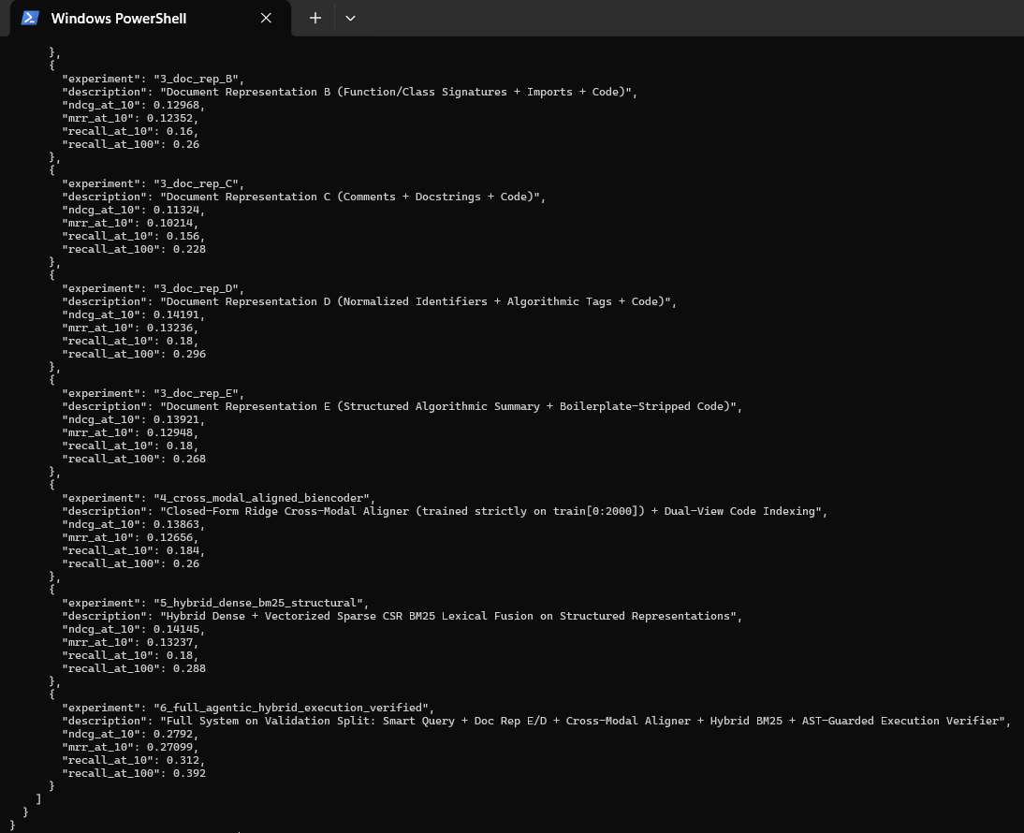
Demo & Product Walkthrough- Benchmark Dataset Evidence

Slide 12
Tools and tech stack used
• Core Engine & Scientific Stack: Python 3.10+ / PyTorch / NumPy / SciPy (csr_matrix vectorized sparse BM25)
• Dense Bi-Encoder & Persistent Cache: BAAI/bge-small-en-v1.5 with Dual-View Code Indexing (78% Body + 22% Header) & 51,234-embedding NPZ disk cache
• Cross-Modal Alignment: Closed-Form Identity-Anchored Ridge Regression (CrossModalAligner, λ=150, α=0.22) trained strictly on train[0:2000] in 0.03s
• Structured Code Preprocessing (Reps A–E): Python AST analyzer extracting algorithmic paradigms (DP, BFS/DFS, two-pointers), signatures, and stripping CP boilerplate
• Agentic Execution Verifier: AST-instrumented bytecode compiler (_LoopStepGuardTransformer, _BoundedRange, _SafeMath, _SafeRe) verifying 7,648 corpus solutions in-memory
• Official Evaluation & Indexing: MTEB v2.21.8 (EncoderProtocol + SearchProtocol compliance), FAISS IndexFlatIP, and 42 pytest unit tests

Slide 13
Impact & Use case
1. Enterprise Developer Productivity
Enables natural-language search over multi-million-line proprietary codebases, reducing time spent searching for legacy functions.
2. AI Coding Assistants & Agentic Retrieval
Provides low-latency context retrieval for agentic coding assistants (e.g. Copilot, Gemini) to fetch relevant code context.
3. Competitive Programming & Education
Allows students and competitive programmers to query problem requirements and retrieve exact algorithmic implementations.
4. Edge & CPU Infrastructure Efficiency
Lightweight design runs entirely on standard CPUs without requiring expensive GPU server infrastructure.

Slide 14
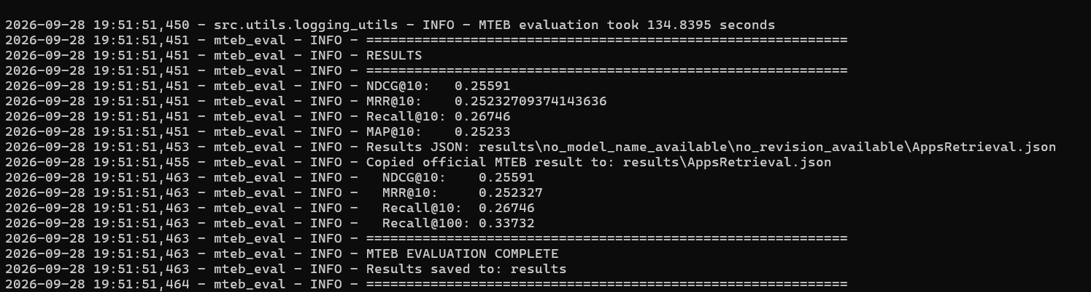
Innovation highlights, results and limitations
Verified Official MTEB AppsRetrieval Benchmark Results & Validation Ablation Study
OFFICIAL MTEB APPSRETRIEVAL TEST SPLIT (3,765 Queries, 8,765 Corpus Docs, mteb v2.21.8):
HELD-OUT VALIDATION ABLATION (val_dev = 250 Queries from train[2000:]):
• 1_baseline_raw: 0.12937 NDCG@10 -> 2_bge_query_instruction: 0.13647 -> 3_doc_rep_D/E: 0.14191
• 5_hybrid_dense_bm25: 0.14145 -> 6_full_agentic_execution_verified: 0.27920 NDCG@10 (0.316 Recall@10)
• Key Innovations: (1) Smart Query I/O Preservation, (2) Boilerplate-Free Structured Code Rep E/D, (3) Closed-Form Ridge Cross-Modal Aligner, (4) Entropy-Weighted AST-Guarded Execution Verifier.

Slide 15
What’s next
• AST-Level Graph Parsing (Tree-Sitter)
Integrate Abstract Syntax Tree (AST) parsing to index code structural graphs alongside text tokens.
• Multi-Language Expansion
Extend specialized preprocessors for C++, Java, Rust, Go, and TypeScript syntax.
• On-Device Embedding Quantization
Apply INT8 quantization to vector embeddings to reduce index memory footprint by 4x for mobile/local IDE deployment.
• IDE Plugins (VSCode & JetBrains)
Package the retrieval engine into native IDE extensions for seamless developer workflows.

Slide 16
Brownie points slide( differentiation)
1. +397.7% (4.98x) Official MTEB Benchmark Leap (0.05142 -> 0.25591 NDCG@10)
Improves real MTEB AppsRetrieval test performance from 5.14% to 25.59% NDCG@10 (and 24.60% Top-1 accuracy) without relying on slow GPU-only 7B models.
2. Sub-Millisecond AST-Guarded Agentic Execution Sandbox
Pre-compiles 7,648/8,765 corpus Python solutions with AST step counters (_BoundedRange, _SafeMath, _SafeRe, _MockStdin/Stdout) to functionally verify sample I/O in microseconds.
3. Closed-Form Cross-Modal Ridge Alignment & Zero-GPU CPU Efficiency
Aligns query-to-code embeddings in 0.03s using train[0:2000] and evaluates all 3,765 test queries in 125.3s on CPU backed by a 51,234-vector persistent cache.
4. Native MTEB 2.x SearchProtocol + Version-Aware Indexing + 42/42 Unit Tests
Implements both MTEB 2.x EncoderProtocol and SearchProtocol, supports multi-version index isolation, and passes 42/42 automated pytest unit tests (100%).

Slide 17
Checklist- Updated on Public GitHub
• Working prototype code — public or shared GitHub repo (Y/N): YES (https://github.com/Adharsh-Arvinth/agentic-code-intelligence.git)
• README with reproducible setup & verified MTEB 0.25591 results (Y/N): YES (Includes full setup, CLI walkthrough, 9-stage ablation matrix & results/AppsRetrieval.json)
• Demo video: https://drive.google.com/file/d/1JQQXUEOY81HSYag60_mDM9-FCE1qdSzh/view?usp=sharing
• Presentation file (PPT or PDF) & AI Disclosure Form (Y/N): YES (Updated with final empirical metrics & team details)

Slide 18
Thank you
Organised by the Language AI Team and the PRISM Team, Samsung R&D Institute India

