Slide 1
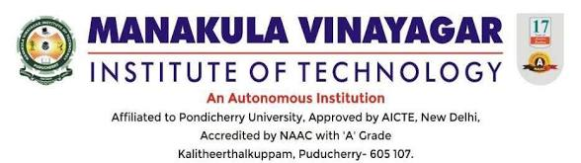
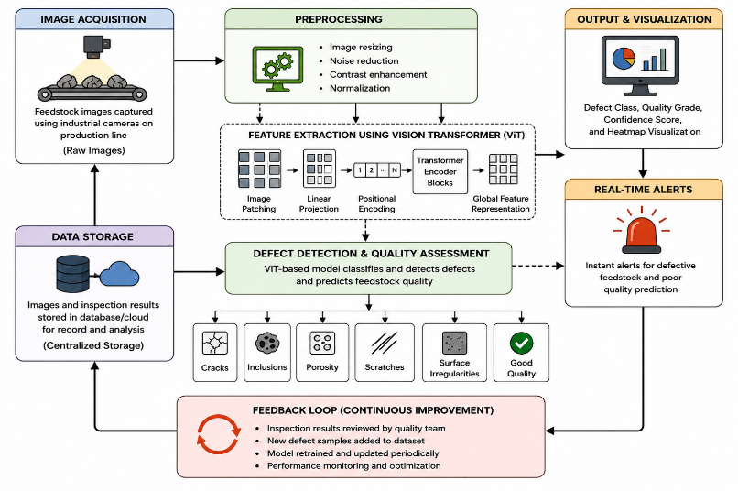
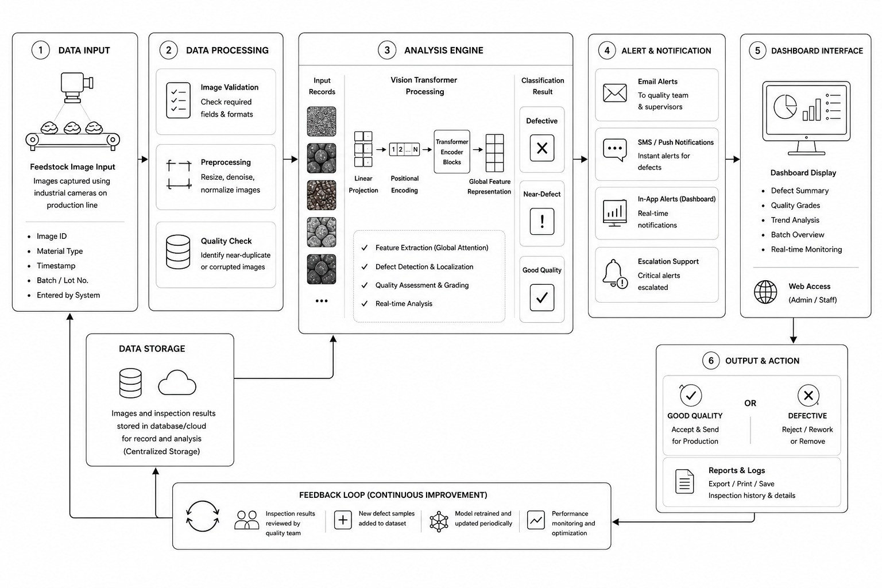


FEEDSTOCK QUALITY ASSESSMENT AND DEFECT DETECTION
Department of Artificial Intelligence and Machine Learning
Name of the Students : B. Adharssh Kumar, Prasana. B, Jai Akash. S, A. Shaik Roshith
Dept/Year/Sec. : AI&ML /III/A
Name of the Guide : Mr. S. Balaji, Assistant Professor / AI&ML
ABSTRACT
The proposed Intelligent Vision Transformer-Based Feedstock Quality Assessment and Defect Detection System addresses the growing demand for accurate, automated, and real-time quality inspection in modern Industry 4.0 production environments. This study presents an advanced AI-driven solution that utilizes Vision Transformer (ViT) architecture and computer vision techniques to analyze feedstock surface images for quality evaluation and defect identification with high precision. The system integrates industrial camera-based image acquisition with OpenCV-powered preprocessing and deep learning-based feature extraction to enable fully contactless and non-invasive inspection. Captured images are processed to identify texture inconsistencies, surface irregularities, cracks, inclusions, and other manufacturing defects in real time. The proposed framework ensures consistent quality monitoring across varying lighting conditions and production speeds while minimizing human intervention and manual calibration. By leveraging transformer-based global attention mechanisms, the model achieves superior contextual understanding and defect localization compared to traditional CNN-based inspection systems
EXISTING WORK
PROPOSED WORK
Traditional feedstock quality inspection in industrial manufacturing is primarily performed through manual observation, sensor-based analysis, or conventional CNN-based image processing systems. These methods require continuous human supervision and frequent calibration to maintain inspection accuracy across production lines. Manual inspection processes are often time-consuming, inconsistent, and highly dependent on operator expertise, leading to variations in defect identification and material grading.
The proposed system utilizes a Vision Transformer-based deep learning model integrated with OpenCV and advanced image processing techniques to perform automated, real-time, and contactless feedstock quality assessment and defect detection in Industry 4.0 production environments. The system captures and analyzes feedstock surface images to identify defects, texture inconsistencies, and material irregularities with high precision and reliability. By leveraging transformer-based global feature extraction and intelligent visual analysis, the proposed solution ensures accurate quality grading, reduced human intervention, and improved operational efficiency across automated industrial production lines.
OBJECTIVE
The objective of the proposed Feedstock Quality Assessment and Defect Detection System is to develop an intelligent Vision Transformer-based platform capable of performing automated, real-time, and contactless inspection of industrial feedstock materials. The system aims to accurately analyze surface characteristics, identify defects, and evaluate material quality using advanced deep learning and computer vision techniques.
INNOVATION
CONCLUSION
The system uniquely integrates Vision Transformer-based deep learning, intelligent image processing, and automated quality grading mechanisms to deliver accurate defect localization and reliable feedstock quality assessment with minimal human intervention. It enables real-time, contactless inspection by analyzing surface features, texture variations, and visual inconsistencies across production lines.
The proposed solution provides an intelligent and automated approach for industrial feedstock quality assessment and defect detection through Vision Transformer-based deep learning and real-time image analysis. By enabling contactless and continuous inspection, the system eliminates dependency on manual observation and reduces inconsistencies caused by human error. The integration of AI-driven defect localization, automated quality grading, and real-time monitoring enhances production efficiency, accuracy, and operational reliability across industrial environments. Its scalable architecture supports seamless deployment in Industry 4.0 production systems, enabling faster decision-making, improved quality control, and optimized manufacturing processes. The system is capable of analyzing complex surface textures, identifying minute defects, and maintaining consistent inspection performance under varying lighting conditions and production speeds. Compared to conventional inspection methods, the proposed approach offers higher precision, improved adaptability, reduced operational cost, and enhanced manufacturing consistency. Furthermore, the system establishes a strong foundation for future advancements such as predictive quality analytics, adaptive learning models, edge-based deployment, cloud-integrated monitoring, and fully autonomous smart manufacturing solutions. By combining artificial intelligence, computer vision, and industrial automation technologies, the proposed framework contributes toward the development of smarter, safer, and more efficient next-generation manufacturing ecosystems aligned with the goals of Industry 4.0 and intelligent industrial transformation.
SDG GOALS
The system integrates Vision Transformers, intelligent image processing, and automated quality grading to deliver accurate defect localization with minimal human intervention.
The proposed solution improves industrial quality monitoring through automated and scalable AI-driven inspection, reducing manual effort while increasing accuracy and consistency.

