Slide 1

DEPARTMENT OF ARTIFICIAL INTELLIGENCE AND MACHINE LEARNING
TITLE:IMPLEMENTATION OF AN INTELLIGENT VISION TRANSFORMER-BASED DEEP LEARNING MODEL FOR FEEDSTOCK QUALITY ASSESSMENT AND DEFECT DETECTION IN INDUSTRY 4.0 PRODUCTION SYSTEMS
BATCH NO: 10
TEAM MEMBERS: PROJECT GUIDE:
    B ADHARSSH KUMAR [23TN0016] Mrs. S. BALAJI
    PRASNAN B [23TN0063] AP/AIML
    JAI AKASH S [23TN0036]
    SHAIK ROSHITH A [23TN0001]

Slide 2
OBJECTIVE:
An intelligent Vision Transformer-based model automatically analyzes feedstock images to assess quality and detect defects with high precision. It enables real-time, contactless, and consistent inspection across production lines, enhancing efficiency and scalability in Industry 4.0 environments.

Slide 3
PROBLEM STATEMENT:
Traditional feedstock inspection methods rely heavily on manual observation and sensor-based testing, leading to inconsistency, slow processing, and human error. There is a need for an automated, contactless, and intelligent system capable of accurately detecting defects and predicting material quality in real time for Industry 4.0 production environments

Slide 4
INTRODUCTION:
• Uses AI and Vision Transformers to assess raw material quality.
• Works without manual inspection or physical sensors.
• Provides real-time defect detection and grading.
• Ensures consistency and reliability in production lines.
• Requires only a camera setup and trained model.
• Can be deployed on industrial systems or edge devices for automated quality monitoring.

Slide 5
Domain and Sub-Domain:
Domain:
Artificial Intelligence and Computer Vision
Sub-Domain:
Deep Learning–based Visual Inspection and Quality Prediction
• Application Area: Smart Manufacturing and Industrial Automation (Industry 4.0)
• Technology Used: Vision Transformer (ViT), OpenCV, and Image Processing Techniques
• Focus: Automated Detection of Surface Defects and Feedstock Quality Assessment
• Objective: To develop a contactless, real-time, and intelligent system for accurate material quality evaluation and defect identification.

Slide 6
EXISTING SYSTEM:
• Existing systems use Convolutional Neural Networks (CNNs) and image processing techniques to inspect feedstock surfaces and detect visible defects.
• These systems analyze texture, shape, and color variations to classify material quality into predefined categories.
• Operate in real time but often require frequent calibration and human supervision to maintain accuracy.
• Performance can be affected by lighting changes, shadows, and reflective surfaces during inspection.
• While effective for basic detection, they lack adaptability and deep contextual understanding needed for complex industrial environments.

Slide 7
EXISTING EXPLANATION:
The existing feedstock inspection systems primarily rely on traditional image processing and Convolutional Neural Network (CNN) techniques to identify surface defects and assess material quality. These systems capture images using industrial cameras and analyze visual patterns such as color, texture, and shape to detect irregularities. Although they can perform basic defect identification in real time, their accuracy is limited under poor lighting, motion, or reflective conditions. Additionally, they require manual calibration and human intervention, making them less reliable and inefficient for large-scale, automated industrial environments.

Slide 8
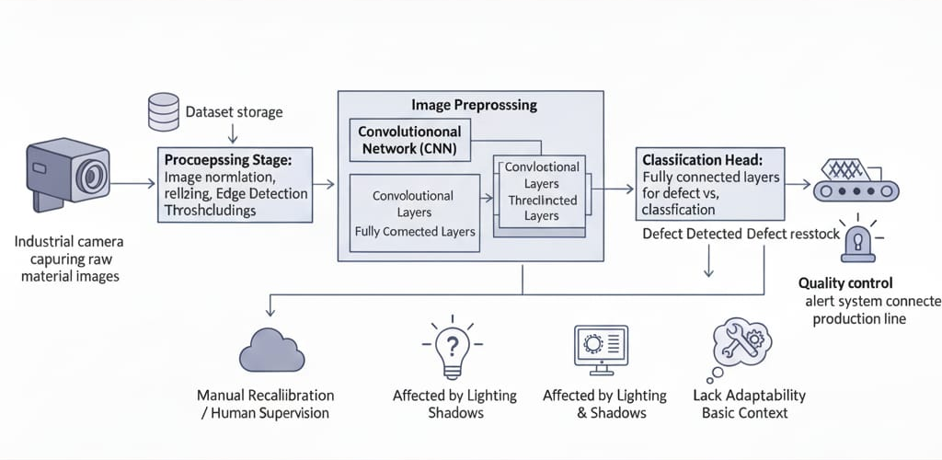
EXISTING DIAGRAM:

Slide 9
DRAWBACKS:
• Highly sensitive to lighting variations and reflections, causing inconsistent defect detection results.
• Limited accuracy due to dependence on basic CNN and image processing models.
• Performance varies across different material types, textures, and surface conditions.
• Requires frequent manual calibration and supervision to maintain reliability.
• Lacks adaptability to dynamic industrial environments and varying production speeds.
• Struggles with noise, motion blur, and environmental interference during inspection.

Slide 10
LITERATURE SURVEY:
• Traditional inspection relies on manual checks and sensors, which can be inconsistent and time-consuming.
• Modern systems use cameras and deep learning for automated, contactless quality evaluation.
• Vision Transformer-based models provide accurate, real-time, and non-invasive defect detection.
• Improve efficiency and ensure consistent production standards.
• Require continued optimization for precision and data security.
• Aim to make industrial quality control smarter, faster, and more reliable.

Slide 11
LITERATURE SURVEY WITH COMPARISON TABLE:
Approach / Method | Manual / Sensor-Based Inspection | Camera-Based (Conventional CNN) | Vision Transformer-Based Model (Proposed)
Contact Requirement | Requires human operators and physical sensors | Requires camera setup | Fully automated and contactless
Speed of Operation | Slow and time-consuming | Moderate processing time | High-speed, real-time evaluation
Accuracy and Consistency | Prone to human error | Good but limited by CNN’s feature scope | Highly accurate with global attention mechanism
Complexity | Simple but inefficient | Moderate complexity | Advanced architecture, self-attention driven
Scalability | Not scalable for industrial automation | Scalable with limitations | Highly scalable for Industry 4.0 systems
Maintenance | Requires frequent calibration and manpower | Requires regular retraining | Minimal maintenance with self-adaptive models
Environment Sensitivity | Affected by operator fatigue and lighting | Sensitive to lighting variation | Robust under varying lighting and material conditions
Output Type | Manual grading / subjective results | Automated detection with limited insight | Automated quality grading and detailed defect localization

Slide 12
PROPOSED SYSTEM:
• Uses an AI-based Vision Transformer model for automated feedstock quality assessment and defect detection.
• Captures and analyzes raw material images using OpenCV for real-time, contactless inspection.
• Extracts texture, color, and surface features to classify quality levels accurately.
• Enhances precision, reduces human effort, and supports Industry 4.0 automation.
• Provides a scalable and intelligent solution adaptable to various industrial environments.

Slide 13
ALGORITHM EXPLANATION:
• Use OpenCV to capture raw material images and isolate regions of interest on the feedstock surface.
• Analyze surface texture, color variations, and visual inconsistencies to identify possible defects.
• Employ Vision Transformer-based deep learning for feature extraction and noise reduction during quality prediction.
• Classification output provides the quality grade or defect type of the feedstock.
• Advantages: Real-time, contactless, accurate, and compatible with standard industrial cameras.
• Limitations: Performance can vary under poor illumination, image blur, or extreme surface irregularities.

Slide 14
MODEL USAGE:
• AI models (like Vision Transformers) reduce image noise and enhance surface detail in real time.
• Machine learning algorithms detect pixel-level variations caused by defects or irregular textures.
• Temporal learning improves consistency and accuracy in continuous quality assessment.
• Models adapt to different material types, lighting conditions, and production environments.

Slide 15
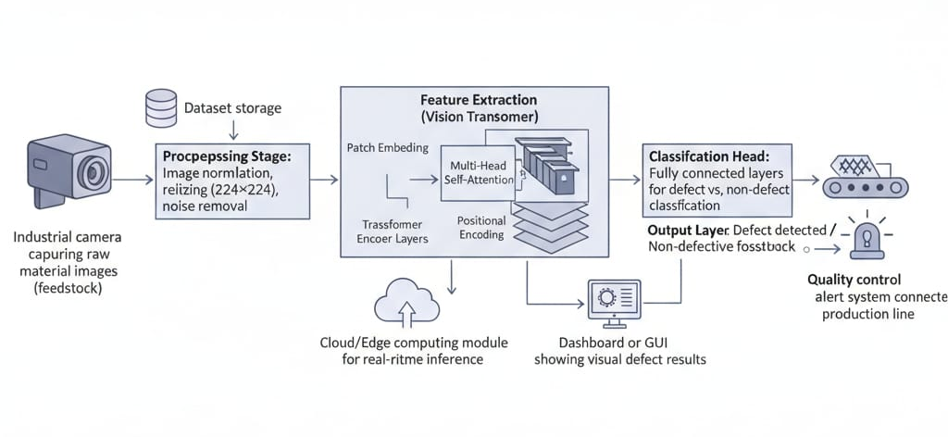
ARCHITECTURE DIAGRAM:

Slide 16
WORKING METHODOLOGY:
Image Capture: Camera acquires high-resolution images of the feedstock surface in real time.
Object Detection: AI-based vision system identifies and isolates the target raw material region.
ROI Extraction: Selects relevant surface areas for defect and texture pattern analysis.
Feature Processing: Applies preprocessing, filtering, and normalization to remove background noise.
Quality Prediction: Vision Transformer model analyzes feature embeddings to classify quality grade or detect defects.
Output Display: Displays real-time quality results and defect locations on an industrial monitoring dashboard.

Slide 17
MODULES DESCRIPTION:
Image Capture & Detection: Captures and identifies the feedstock surface through camera input.
ROI Processing: Tracks texture and color variations across selected surface regions.
Filtering: Removes background noise and enhances significant visual features.
Quality Estimation: Converts processed visual data into defect probability and quality score.
Visualization: Displays real-time quality grading and defect mapping on the system interface.

Slide 18
ADVANTAGES:
• Provides higher accuracy through Vision Transformer-based feature extraction compared to traditional CNN models.
• Performs real-time and contactless inspection, reducing manual effort and human error.
• Maintains consistent performance under varying lighting and environmental conditions.
• Offers automated and scalable operation suitable for Industry 4.0 production systems.
• Reduces dependency on manual calibration and supervision required in older systems.
• Ensures faster processing and better defect localization for improved quality control.

Slide 19
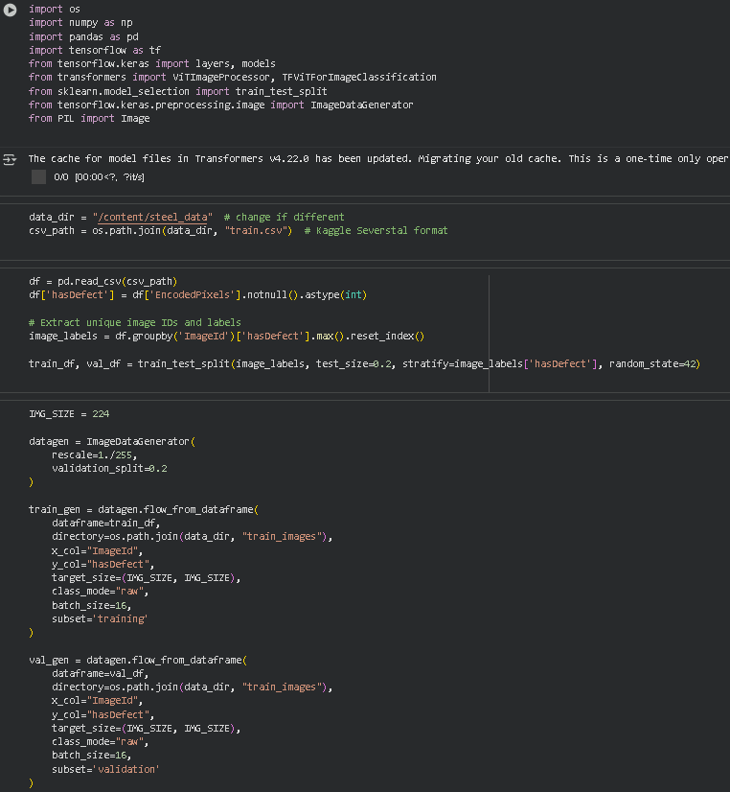
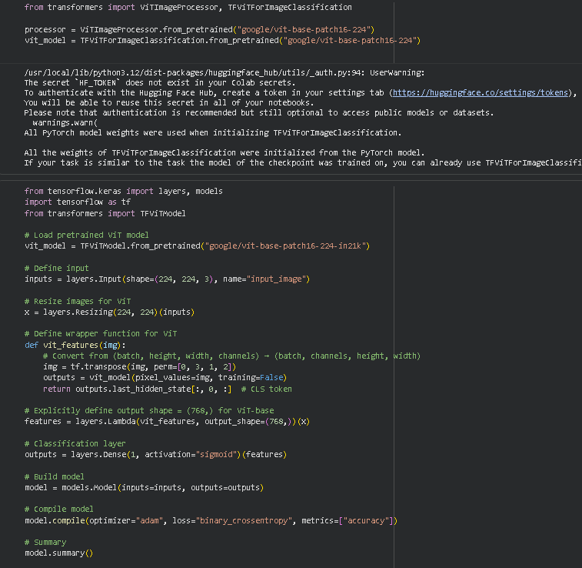
RESULT SCREENSHOOT(DEMO):
CODE:

Slide 20
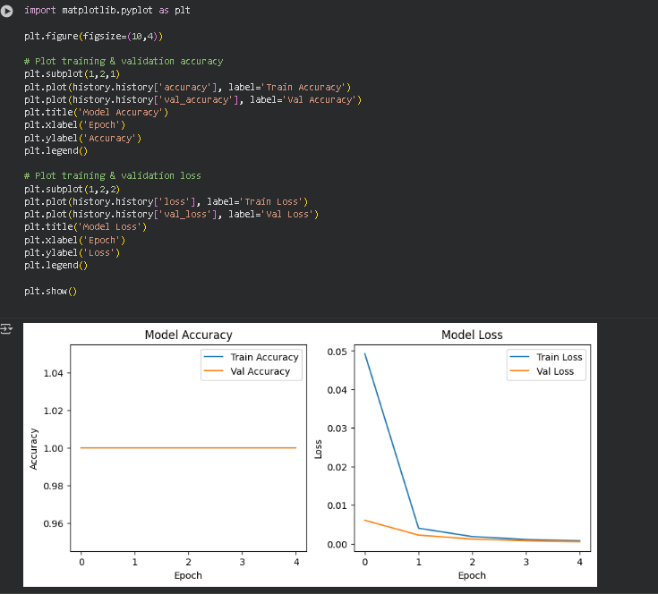
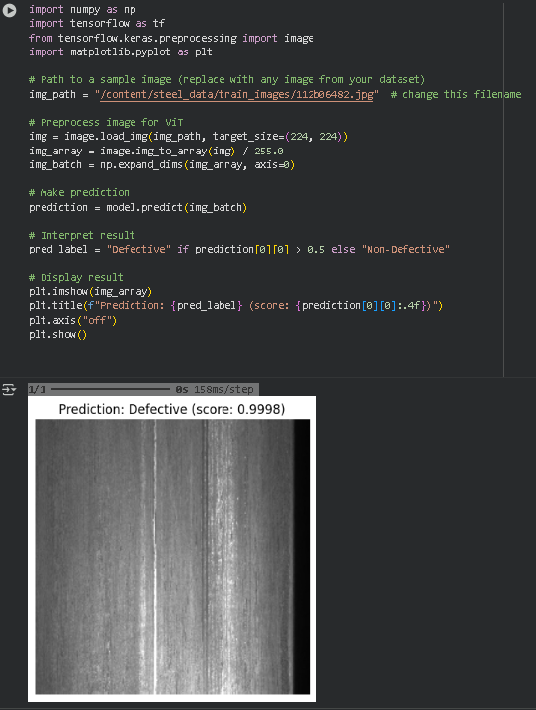
RESULT SCREENSHOOT(DEMO):
OUTPUT:

Slide 21
DATASET EXPLANAION:
Source:
Kaggle – Severstal: Steel Defect Detection
https://www.kaggle.com/competitions/severstal-steel-defect-detection/data
Explanation:
This dataset contains high-resolution images of steel surfaces collected from an industrial production line. Each image is annotated with four types of surface defects such as cracks, inclusions, pits, and rolled-in scales. It is used for defect detection and segmentation tasks, helping train AI models to automatically identify and localize minute defects in raw materials—enhancing quality control and automation in Industry 4.0 manufacturing systems.

Slide 22
DATASET EXPLANAION:
Domain: Industrial surface inspection (steel manufacturing)
Images: ~12,568 high-resolution steel surface images
Image Size: 256 × 1600 pixels (RGB)
Defect Types: 4 classes – cracks, inclusions, pits, rolled-in scale
Annotations: Pixel-wise defect masks (RLE encoded)
Goal: Detect and localize surface defects using deep learning
Project Use:
  Train model for feedstock quality assessment
  Enable automated defect detection in Industry 4.0 systems

Slide 23
CONCLUSION:
The proposed system delivers a fully automated, non-contact, real-time solution for feedstock quality assessment and defect detection using Vision Transformer-based deep learning. By eliminating the need for manual inspection and physical sensors, the system enhances operational efficiency, hygiene, and process reliability within industrial environments. It ensures consistent quality evaluation across varying lighting and material conditions, providing faster and more precise results than traditional methods. Furthermore, its scalable architecture allows seamless integration with AI-driven production systems and Industry 4.0 frameworks, enabling future expansion toward predictive maintenance, process optimization, and intelligent manufacturing analytics.

Slide 24
REFERENCE:
A. Dosovitskiy et al., “An Image is Worth 16x16 Words: Transformers for Image Recognition at Scale,” International Conference on Learning Representations (ICLR), 2021.
(Introduced the Vision Transformer (ViT) model, forming the foundation for transformer-based visual inspection systems.)
Z. Liu et al., “Swin Transformer: Hierarchical Vision Transformer using Shifted Windows,” IEEE/CVF International Conference on Computer Vision (ICCV), 2021.
(Enhanced transformer architecture for image classification and defect detection tasks.)
Y. Zhang et al., “Deep Learning-Based Surface Defect Detection for Industrial Manufacturing,” IEEE Transactions on Industrial Informatics, 2020.
(Focuses on industrial defect detection using computer vision and deep learning.)
H. Chen and P. Li, “Vision Transformer for Industrial Inspection: A Comparative Study,” Journal of Manufacturing Systems, 2022.

Slide 25
REFERENCE:
M. Singh et al., “AI-Driven Quality Inspection in Smart Manufacturing,” IEEE Access, 2023.
(Covers AI-based inspection and defect analysis techniques for intelligent factories.)
R. K. Sharma and A. Kumar, “Automated Visual Quality Control Using Deep Learning and Computer Vision,” International Journal of Advanced Computer Science and Applications, 2021.
(Presents a practical implementation framework for automated visual inspection.)
T. Li et al., “Defect Detection of Metal Surfaces Using Vision Transformer Networks,” Sensors, MDPI, 2023.
(Applies Vision Transformers specifically for industrial surface defect detection tasks.)

