Slide 1

BitForecast: The Future of Bitcoin
By Adharsha Velen(AXG230033)

Slide 2
An Overview of Bitcoin:
Bitcoin is a digital currency, often referred to as cryptocurrency, which operates independently of a central bank. It's a decentralized form of money that can be sent from user to user on the peer-to-peer bitcoin network without the need for intermediaries. Bitcoin is hailed for its blockchain technology, which ensures security and transparency in financial transactions.

Slide 3
Dataset Coverage: The dataset encompasses price data from 2014 to the present, providing a comprehensive view of Bitcoin's price fluctuations over a significant period.
Dataset Structure:
Number of Entries: 3,464
Number of Attributes: 7
Attributes:
Date: Recording date (converted from string to datetime format for time series analysis).
Open: Opening price of Bitcoin for the day.
High: Highest price of Bitcoin on the day.
Low: Lowest price of Bitcoin on the day.
Close: Closing price of Bitcoin at the end of the day.
Adj Close: Adjusted closing price, accounting for any corporate actions.
Volume: Number of shares or contracts traded in a day.

Slide 4
Price Range and Averages:
Open Price: Ranges from a minimum of $176.90 to a maximum of $69,025.92, with an average of $15,261.98.
High Price: Ranges from $211.73 to $70,083.05, averaging $15,618.98.
Low Price: Ranges from $171.51 to $68,053.13, with an average price of $14,885.11.
Close Price: Ranges from $178.10 to $68,498.88, averaging $15,280.06.
Key Insights:
The dataset provides critical insights into the volatility and price dynamics of Bitcoin, reflecting its growth phases and market corrections.
The adjusted closing price is particularly useful for historical performance analysis, offering insights for long-term investment and trading strategies.
Target Variable
Adj Close: The primary variable of interest for modeling and analysis, reflecting finalized daily prices adjusted for any corporate actions.

Slide 5
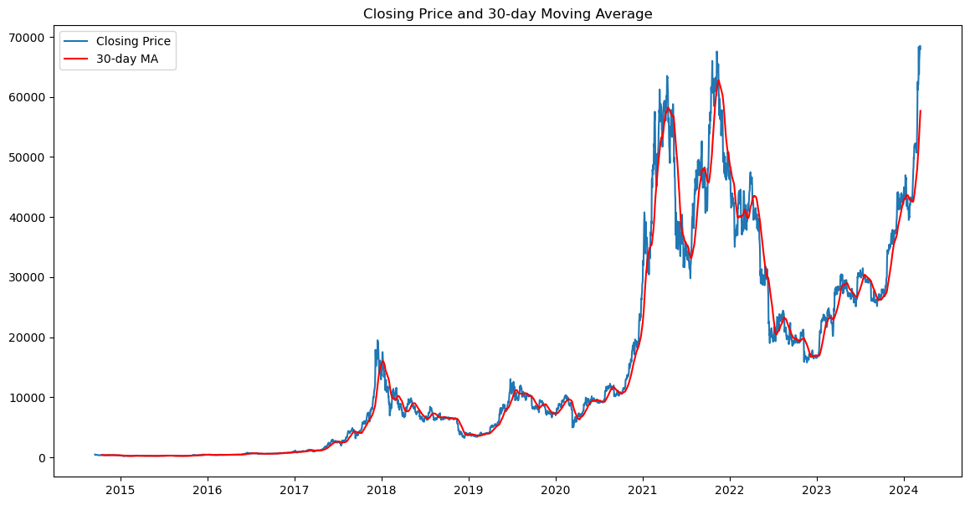
Analysis of Bitcoin's Closing Price and 30-Day Moving Average
The purpose of this analysis is to provide a clear visualization of Bitcoin's price trends over time, supplemented by the 30-day moving average to highlight underlying trends and potential market signals.

Slide 6
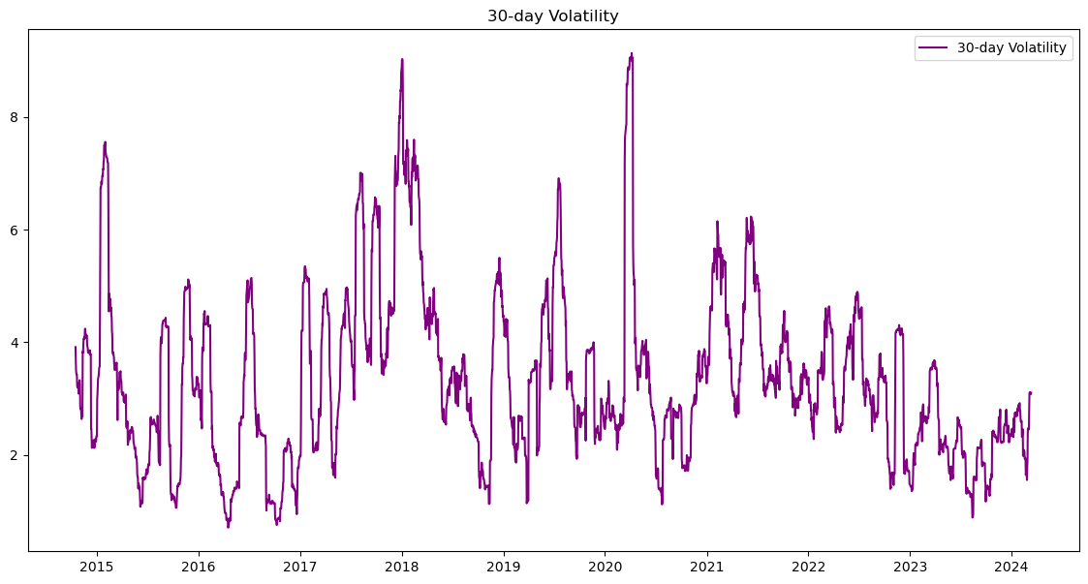
Understanding Bitcoin's 30-Day Volatility
The purpose of this analysis is to measure the fluctuation in Bitcoin's daily returns over a 30-day rolling period, providing insights into the risk and stability of Bitcoin as an investment. The chart displays several spikes in volatility, particularly notable during late 2017 and early 2018, and again in early 2020 and 2021. These peaks correspond to periods of significant price movement and market uncertainty.

Slide 7
Conclusion
The dual analysis of Bitcoin's 30-day moving average and volatility offers a deep dive into the cryptocurrency's price behavior. It aids investors in understanding not just price trends but also the risk involved, enabling more informed decision-making in a highly volatile market. The analysis provides a comprehensive view of the market dynamics, offering investors tools to gauge sentiment and react proactively to market changes.

Slide 8
Future Directions in Bitcoin Price Analysis
ARIMA (AutoRegressive Integrated Moving Average):
ARIMA is particularly suited for time series data like stock prices, making it ideal for predicting trends and potential turning points in Bitcoin's price movements.
GARCH (Generalized Autoregressive Conditional Heteroskedasticity)
GARCH will allow us to predict periods of high volatility, which are crucial for setting optimal buying and selling points and for hedging strategies.

Slide 9
Thank You

