Slide 1
Multi-Cloud Hybrid Strategy for Healthcare
Ensuring Data Safety Through Redundancy, Failover & Cloud Integration
Presented by: Adharv Shyam

Slide 2
Contens
1. Introduction & Problem Statement
2. Objectives
3. Technologies Used
4. System Architecture
5. Project Structure & Modules
6. Dataset Description
7. Backup Engine & Workflow
8. Cloud Integration (Google Drive & AWS S3)
9. Data Integrity & Security
10. Failover & Retry Mechanism
11. Logging & Monitoring
12. Results & Output
13. Future Enhancements

Slide 3
Introduction & Problem Statement
▸ Healthcare data is highly sensitive and critical for patient care
▸ Data loss can lead to misdiagnosis, legal issues, and compliance violations
▸ Single-point storage creates risk of total data loss
▸ Healthcare institutions need robust, redundant backup strategies
▸ This project simulates a Multi-Cloud Hybrid Backup System using Python
▸ Backs up healthcare data to Local Storage, Google Drive, and AWS S3
▸ Implements integrity checks, retry logic, and automatic failover

Slide 4
Objectives
▸ Build an automated healthcare data backup system using Python
▸ Implement multi-cloud redundancy (Local + Google Drive + AWS S3)
▸ Ensure data integrity using SHA-256 hash verification
▸ Implement retry mechanism for failed cloud uploads
▸ Provide automatic failover when all cloud providers fail
▸ Create comprehensive logging of all backup operations
▸ Develop a real-time monitoring dashboard
▸ Schedule automatic periodic backups every 10 minutes

Slide 5
Technologies Used
Languages & Libraries
Tools & Platforms
▸ Python 3.x — Core programming language
▸ google-api-python-client — Google Drive API
▸ google-auth-oauthlib — OAuth2 authentication
▸ boto3 — AWS S3 SDK for Python
▸ schedule — Task scheduling library
▸ Faker — Synthetic data generation
▸ hashlib — SHA-256 hashing
▸ Chart.js — Dashboard visualizations
▸ Google Drive API v3
▸ AWS S3 (ap-south-1 region)
▸ VS Code — Development IDE
▸ Git & GitHub — Version control
▸ HTML/CSS/JS — Web dashboard
▸ JSON — Configuration & status files

Slide 6
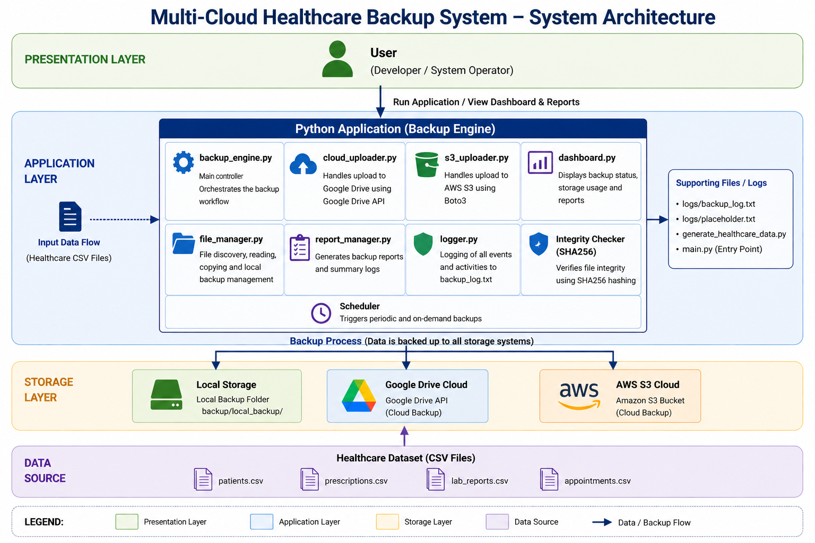
System Architecture
End-to-end data flow from source to multi-cloud destinations

Slide 7
Project Structure & Modules
Directory Layout
Source Modules (src/)
▸ main.py — Entry point & scheduler
▸ generate_healthcare_data.py — Data generator
▸ dashboard.html — Web monitoring UI
▸ status.json — Real-time backup status
▸ config/ — API keys & credentials
▸ data/healthcare_data/ — Source CSV files
▸ backup/local_backup/ — Local copies
▸ logs/ — Backup activity logs
▸ src/ — Core source modules
▸ backup_engine.py — Orchestrates full backup
▸ cloud_uploader.py — Google Drive integration
▸ s3_uploader.py — AWS S3 integration
▸ file_manager.py — File scanning & hashing
▸ logger.py — Timestamped event logging
▸ report_manager.py — Backup summary reports
▸ dashboard.py — Terminal dashboard display

Slide 8
Healthcare Dataset
Generated using generate_healthcare_data.py with Faker library
▸ Simulated realistic healthcare data generated using Faker library
▸ 4 CSV files with thousands of records:
📋 patients.csv — 1,000 records (ID, name, age, gender, blood group, disease, doctor, city)
📅 appointments.csv — 1,500 records (appointment ID, patient ID, doctor, date, time, status)
🔬 lab_reports.csv — 799 records (report ID, patient ID, test name, result, date)
💊 prescriptions.csv — 1,199 records (prescription ID, patient ID, medicine, dosage, doctor)
▸ Covers 25 diseases, 13 medical tests, 13 medicines, 50 doctors
▸ Total dataset size: ~278 KB across 4 files

Slide 9
Backup Engine & Workflow
Orchestrated by backup_engine.py → perform_backup()
Step 1: Scan all healthcare files in data/healthcare_data/
Step 2: Copy each file to backup/local_backup/ (local backup)
Step 3: Generate SHA-256 hash of original and backup file
Step 4: Verify integrity — compare hashes for corruption detection
Step 5: Verify file sizes match between source and backup
Step 6: Upload to Google Drive (Healthcare_Backups folder)
Step 7: Upload to AWS S3 (healthcare-backup-adharv bucket)
Step 8: If both cloud uploads fail → trigger failover (retain locally)
Step 9: Log every event with timestamp to backup_log.txt
Step 10: Generate status.json and print backup summary report

Slide 10
Cloud Integration
Google Drive API
AWS S3
▸ Uses OAuth 2.0 for secure authentication
▸ Credentials stored in config/credentials.json
▸ Token cached in config/token.pickle
▸ Creates 'Healthcare_Backups' folder automatically
▸ Supports file update (overwrite existing files)
▸ Uses MediaFileUpload for efficient transfers
▸ Scope: drive.file (limited access)
▸ Uses boto3 SDK for Python
▸ Config stored in config/aws_config.json
▸ Bucket: healthcare-backup-adharv
▸ Region: ap-south-1 (Mumbai)
▸ Uses IAM access key authentication
▸ Direct file upload with upload_file()
▸ Error handling with descriptive messages

Slide 11
Data Integrity & Security
▸ SHA-256 Hashing:
— Generates cryptographic hash of every file before and after backup
— Compares hashes to detect any corruption during copy/transfer
— Uses 4096-byte chunks for memory-efficient processing
▸ Size Verification:
— Compares file sizes of source and backup as additional integrity check
▸ Secure Credential Management:
— Google OAuth tokens stored as encrypted pickle files
— AWS credentials stored in separate JSON config
— Credentials excluded from version control via .gitignore
▸ Every verification result is logged for audit trail

Slide 12
Failover & Retry Mechanism
▸ Multi-tier upload strategy:
Tier 1 — Google Drive upload attempt
Tier 2 — AWS S3 upload attempt (always attempted independently)
Tier 3 — Failover: data retained locally if both clouds fail
▸ Each cloud provider has independent try-except error handling
▸ Failure of one provider does NOT block the other
▸ Failover counter tracks how many files couldn't reach any cloud
▸ System guarantees:
— Local backup ALWAYS succeeds (first priority)
— At least one copy of data is always preserved
— All failures are logged with error details for troubleshooting

Slide 13
Logging & Monitoring System
▸ Centralized logging via src/logger.py
▸ Log file: logs/backup_log.txt
▸ Format: [YYYY-MM-DD HH:MM:SS] Event message
▸ Events logged:
✅ Local backup success/failure
✅ Integrity check pass/fail
✅ Size verification pass/fail
✅ Google Drive upload success/failure
✅ AWS S3 upload success/failure
✅ Failover triggers
✅ Dashboard status updates
▸ Terminal dashboard shows last 5 events after each backup run
▸ Scheduler runs backups every 10 minutes automatically

Slide 14
Results & Output
▸ Backup Summary (last run: 2026-04-28):
📁 Total Files Processed: 4
💾 Local Backups: 4/4 (100% success)
☁️ Cloud Uploads: 8 (4 Google Drive + 4 AWS S3)
🔄 Retries: 0
⚠️ Failovers: 0
▸ All 4 healthcare files backed up to 3 destinations each
▸ SHA-256 integrity checks passed for all files
▸ Size verification passed for all files
▸ System status: OPERATIONAL
▸ Dashboard displays real-time metrics and color-coded logs

Slide 15
Future Enhancements
▸ Encryption — AES-256 encryption for sensitive healthcare data at rest
▸ Azure Blob Storage — Add Microsoft Azure as a third cloud provider
▸ Incremental Backups — Only backup changed files to save bandwidth
▸ Email/SMS Alerts — Notify admins on backup failures or degraded status
▸ HIPAA Compliance — Implement healthcare data protection standards
▸ Database Integration — Store backup metadata in PostgreSQL/MongoDB
▸ Role-Based Access Control — Admin, viewer, operator permission levels
▸ Compression — Reduce file sizes before upload using gzip/zlib
▸ Docker Deployment — Containerize the system for easy deployment
▸ CI/CD Pipeline — Automated testing and deployment via GitHub Actions

