Slide 1

LPG Gas Leakage Detection and Protection System
19EEE381- OPEN LAB

Slide 2
Group Members:
Adhavan K | CB.EN.U4EEE21002
Mukilan R | CB.EN.U4EEE21030
Sree Varshan S | CB.EN.U4EEE21048
Sri Charan V S | CB.EN.U4EEE21049

Slide 3
Abstract:
This project addresses the urgent need for increased safety measures in Liquefied Petroleum Gas (LPG) usage, a versatile yet highly flammable energy source. It introduces an integrated solution emphasizing early leak detection to prevent disasters. Using gas sensors, the system swiftly identifies leaks and automatically closes the cylinder valve, limiting gas release. Real-time alerts via GSM SIM and audible alerts further enhance safety. This comprehensive approach enhances safety protocols, fostering a proactive safety culture and contributing significantly to household and commercial establishment security reliant on LPG.

Slide 4
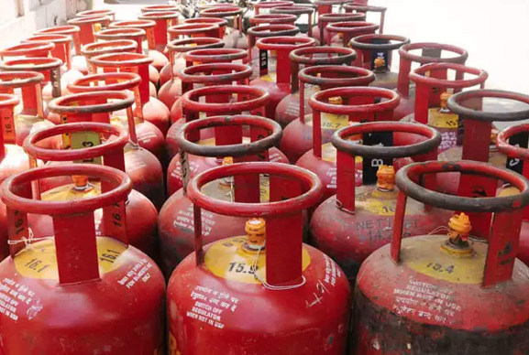
Problem Statement:
Liquefied Petroleum Gas (LPG) carries significant flammability risks, with gas leaks posing potential disasters such as fires and explosions. Current detection methods often fall short, lacking timely alerts and integration with response systems. This system must swiftly detect leaks, initiate automatic responses, and notify users in real-time while being user-friendly and cost-effective. Improving safety measures is essential for preventing disasters and ensuring a secure environment for LPG usage.

Slide 5
Methodology:
System Design:
Key components like gas sensors, valves, and communication modules are carefully selected for optimal performance and compatibility.
Integration of sensors with Microcontroller:
The next phase involves configuring these sensors with an Arduino UNO microcontroller. Project development will continue with writing code in the Arduino IDE, ensuring seamless integration of sensors.
Software Development:
Control algorithms and user interfaces are developed to enable seamless communication between hardware components and provide user-friendly interaction using GSM module.
System Integration:
Hardware and software components are integrated and tested to verify interoperability and effectiveness in detecting and responding to gas leaks.
Field Testing:
The system undergoes real-world testing to identify potential issues, refine algorithms, and validate reliability under actual operating conditions.

Slide 6
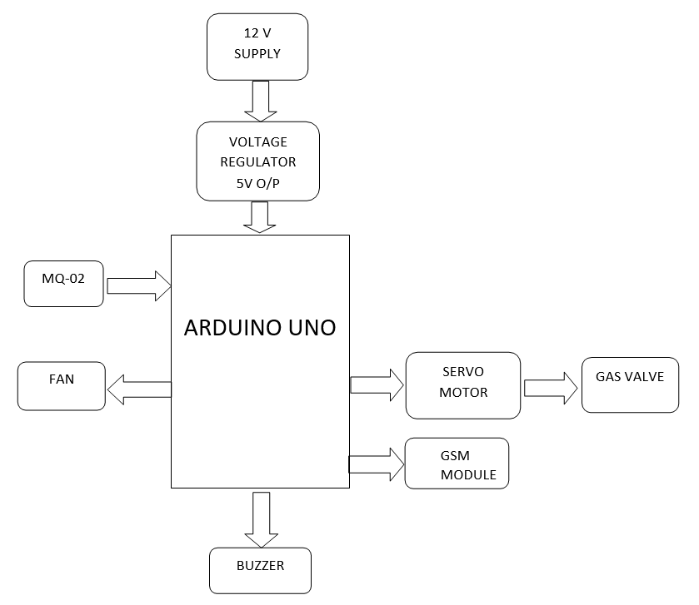
Block Diagram:

Slide 7
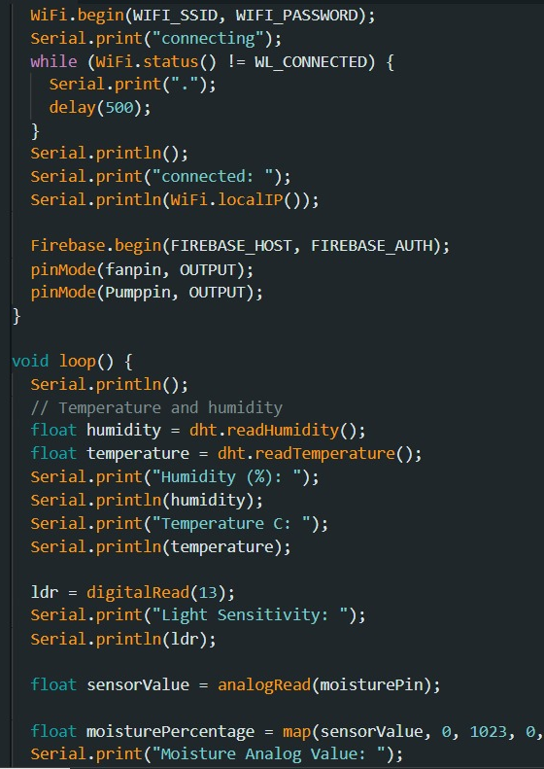
Arduino Setup:
1. **Setup**:
- Initializes serial communication for debugging.
- Initializes a SoftwareSerial instance (`mySerial`) for communication with a GSM module.
- Attaches a servo motor to pin 11 and sets its initial position.
- Sets pin modes for LED (pin 12), buzzer (pin 13), and the gas sensor.
2. **Loop**:
- Reads the digital signal from the gas sensor.
- If gas is detected (`LPG_detected == 1`):
- Turns on the LED and buzzer to indicate a gas leak.
- Rotates the servo motor, possibly to close a valve, assuming a position `pos + 160`.
- Sends an SMS alert using the GSM module with the message "GAS LEAKAGE" to a specified phone number.
- If no gas is detected (`LPG_detected == 0`):
- Turns off the LED and buzzer.
- Resets the servo motor to its initial position (`pos`).

Slide 8
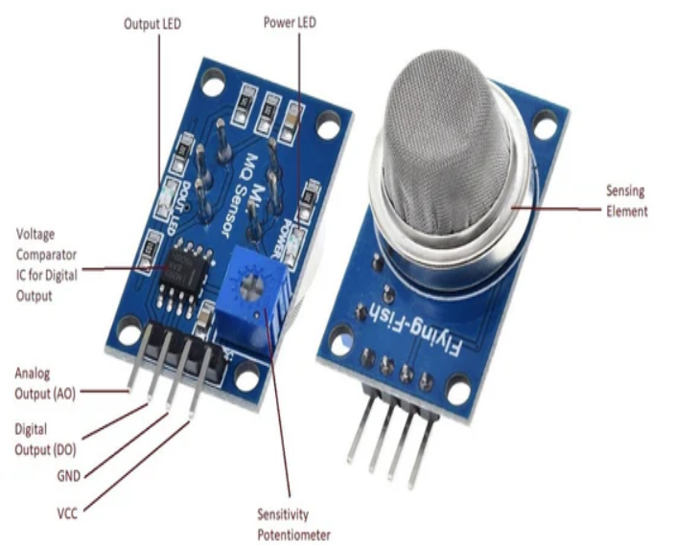
LPG concentration in various scenarios:
In a well-ventilated area with no leaks: Less than 10 ppm
Near a typical LPG leak in a household or commercial setting: 100-500 ppm
Near a high-concentration LPG leak or in an enclosed space: Above 1000 ppm
If you need more accurate measurements of LPG concentration, it's essential to use calibrated gas detection equipment specific to LPG and follow appropriate safety procedures.
As our Mq2 sensor comes under the range of 200 to 10000 ppm, it will easily detect gas leakage at every cases.

Slide 9
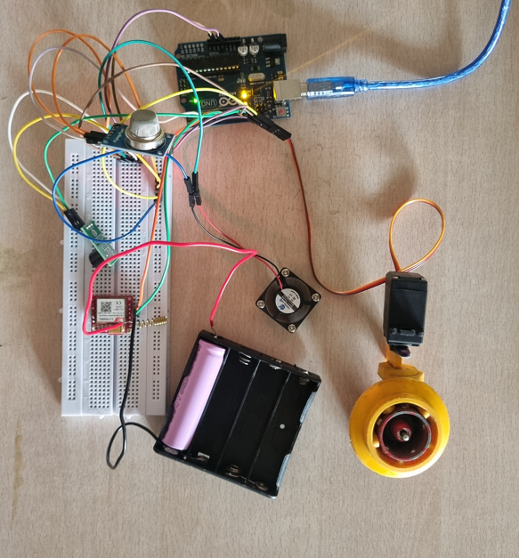
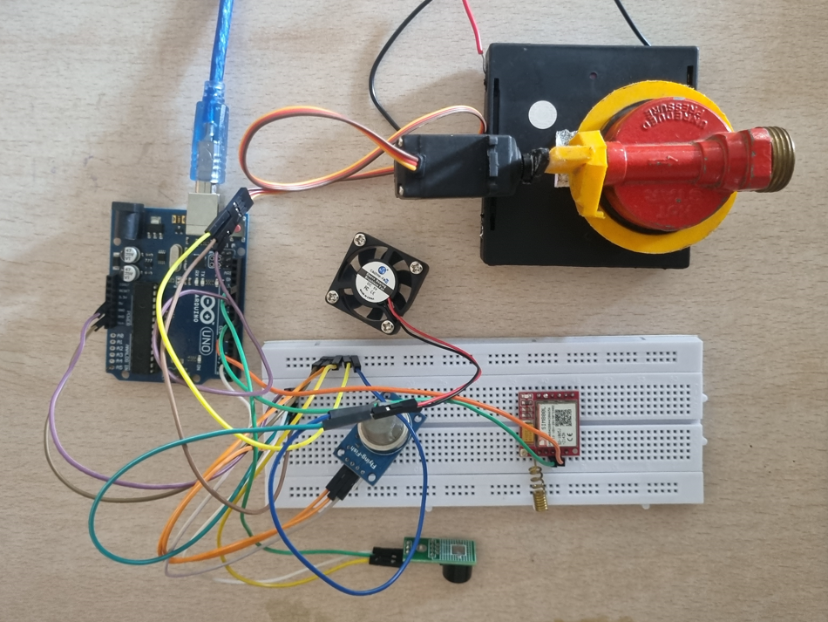
Hardware Setup: Gas leakage detection

Slide 10
Conclusion:
The Gas Leakage Detection and Protection System is a pivotal advancement in LPG safety protocols, offering early detection and rapid response capabilities to prevent disasters. Through cutting-edge sensor technology, intelligent controls, and instant communication, it proactively mitigates risks. Automatic valve closure and immediate user alerts ensure swift action during gas leaks, reducing fire and health hazards. Positive user feedback underscores its reliability, efficiency, and ease of use, affirming its indispensable role in enhancing safety and instilling confidence in LPG environments.

