Slide 1
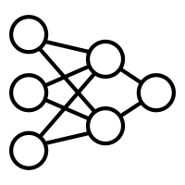






MixCycle Unsupervised Speech Separation
$$s_{i k}$$
$${\hat{s}}_{i k}$$
$$+$$
$$f_{θ}$$
$${\hat{s}}_{j k}$$
$$s_{j k}$$
Adhémar de Senneville

Slide 2
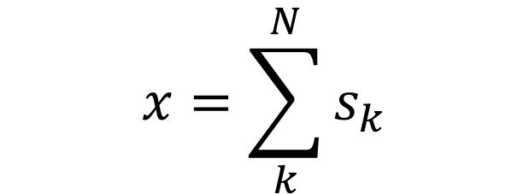
Introduction to the Problem
$$x=\sum_{k}^{N}{s_{k}}$$
Audio are Statistically Independent.
We will consider only 2 sources.
We will use Deep Learning.

Slide 3
Supervised Training

Slide 4





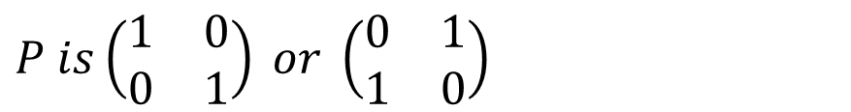








Permutation Invariant Training (PIT)
$${\hat{s}}_{i 1}$$
$$SISNR$$
$$s_{i 1}$$
$$x_{i}$$
$$f_{θ}$$
$$×$$
$$+$$
$${\hat{s}}_{i 2}$$
$$SISNR$$
$$s_{i 2}$$
$$P$$
$$Gradient$$
$$Audio$$
$$P is\left(\begin{matrix}1 & 0 \\ 0 & 1\end{matrix}\right) or \left(\begin{matrix}0 & 1 \\ 1 & 0\end{matrix}\right)$$
P is a 2 × 2 permutation matrix
Supervised

Slide 5













PIT with Dynamic Mixing (PIT-DM)
$$s_{i k}$$
$${\hat{s}}_{i k}$$
$$SISNR$$
$$s_{i k}$$
$$+$$
$$f_{θ}$$
$$×$$
$$+$$
$${\hat{s}}_{j k}$$
$$SISNR$$
$$s_{j k}$$
$$s_{j k}$$
$$P$$
Improves a lot performances
Low cost

Slide 6
Unsupervised Training

Slide 7
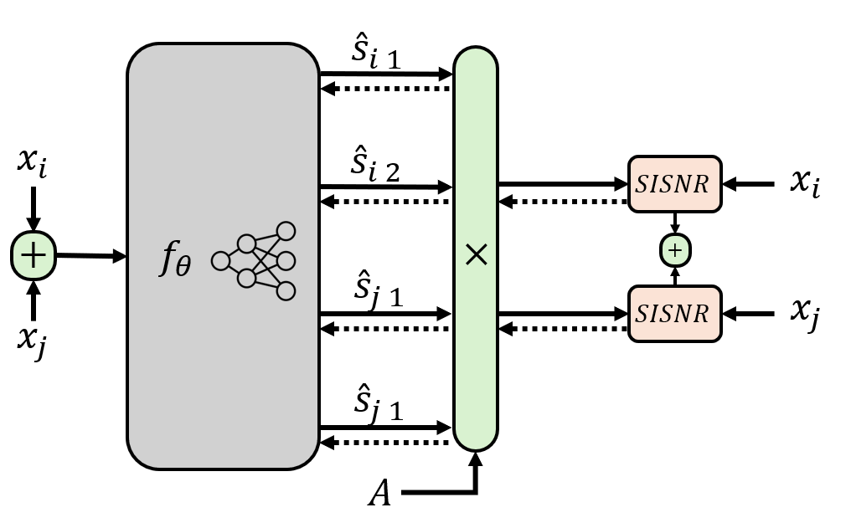
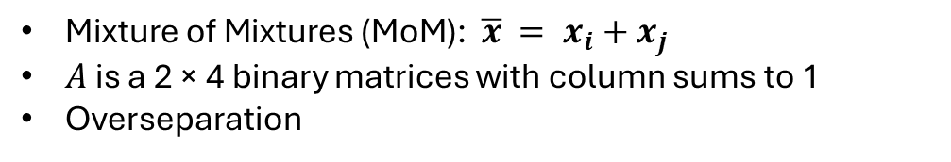
Mixing Invariant Training (MixIT)
$\text{Mixture} \text{of} \text{Mixtures}\text{ (}\text{MoM}\text{): }\overline{x} = x_{i}+x_{j}$
$A$ is a 2 × 4 binary matrices with column sums to 1
Overseparation
Here, $A is \left(\begin{matrix}1 & 1 & 0 & 0 \\ 0 & 0 & 1 & 1\end{matrix}\right)$

Slide 8





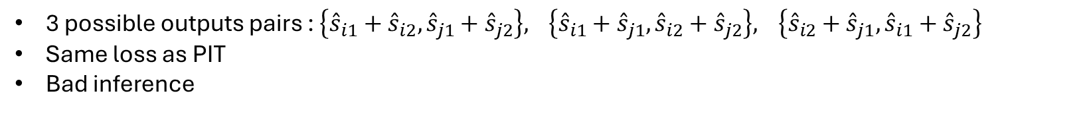






Mixing PIT (MixPIT)
proposed
$$x_{i}$$
$${\hat{x}}_{i}$$
$$SISNR$$
$$x_{i}$$
$$+$$
$$f_{θ}$$
$$×$$
$$+$$
$${\hat{x}}_{j}$$
$$SISNR$$
$$x_{j}$$
$$x_{j}$$
$$P$$
3 possible outputs pairs : $\left\{{\hat{s}}_{i1}+{\hat{s}}_{i2},{\hat{s}}_{j1}+{\hat{s}}_{j2}\right\},$ $\left\{{\hat{s}}_{i1}+{\hat{s}}_{j1},{\hat{s}}_{i2}+{\hat{s}}_{j2}\right\},$ $\left\{{\hat{s}}_{i2}+{\hat{s}}_{j1},{\hat{s}}_{i1}+{\hat{s}}_{j2}\right\}$
Same loss as PIT
Bad inference

Slide 9
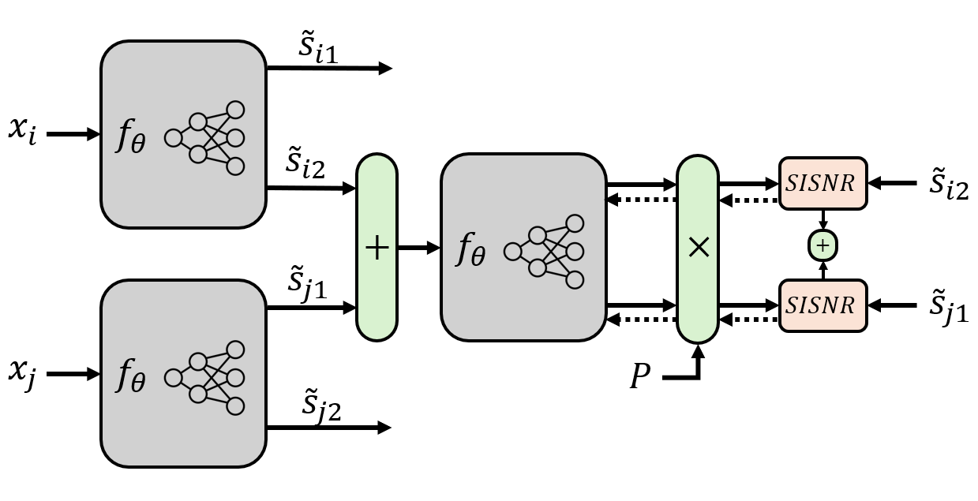
proposed
Cyclic Mixing (MixCycle)
Inspired by PIT-DM
Teacher model
Better inference
Instability

Slide 10
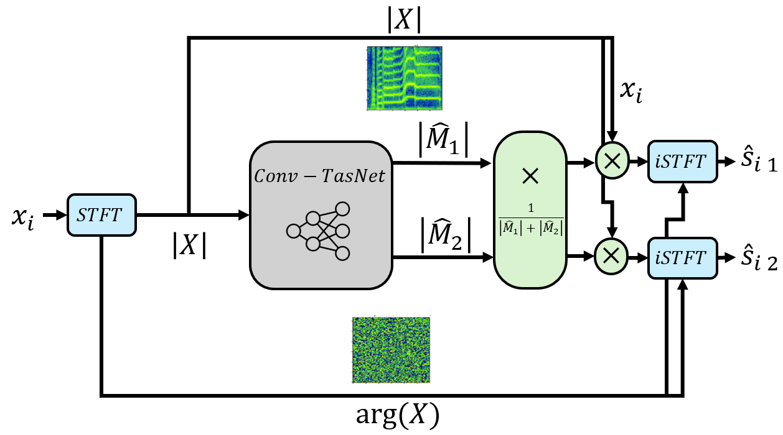

Model
Mask the Amplitude
${\hat{s}}_{i1}+{\hat{s}}_{i2}=x_{i}$
Stability
Unchanged Phase
IMR

Slide 11
Experiments
Breaking Hypothesis

Slide 12
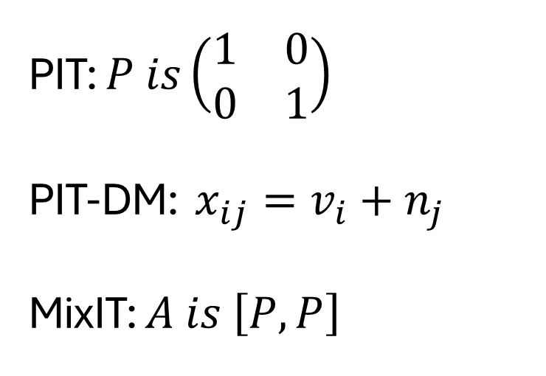
Voice Denoising
$$x=v+n$$
PIT: $P is\left(\begin{matrix}1 & 0 \\ 0 & 1\end{matrix}\right)$
PIT-DM: $x_{ij}=v_{i}+n_{j}$
MixIT: $A is \left[P,P\right]$
Statistically Independent

Slide 13
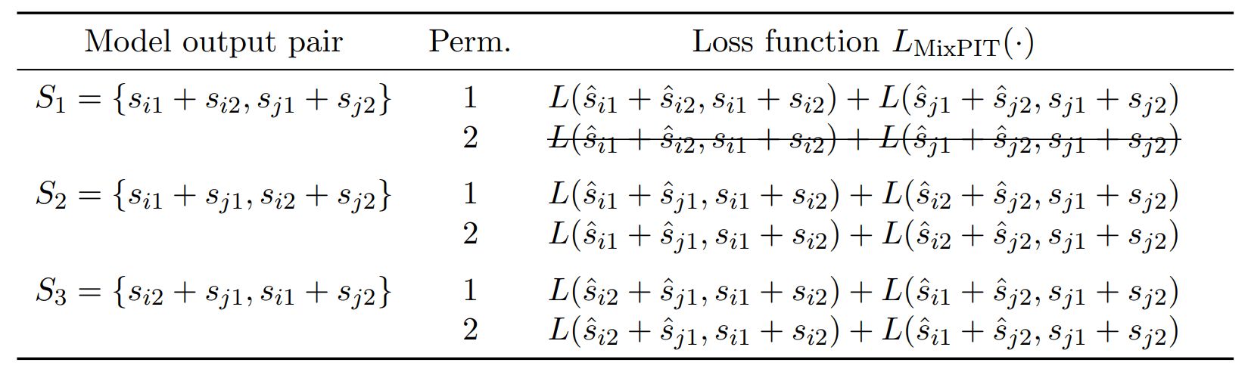
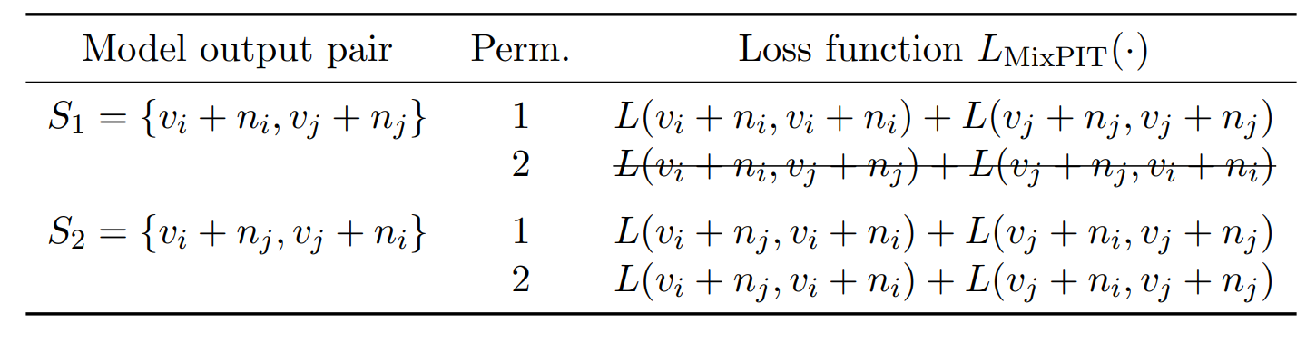
Voice Denoising
$$x=v+n$$
MixPIT

Slide 14
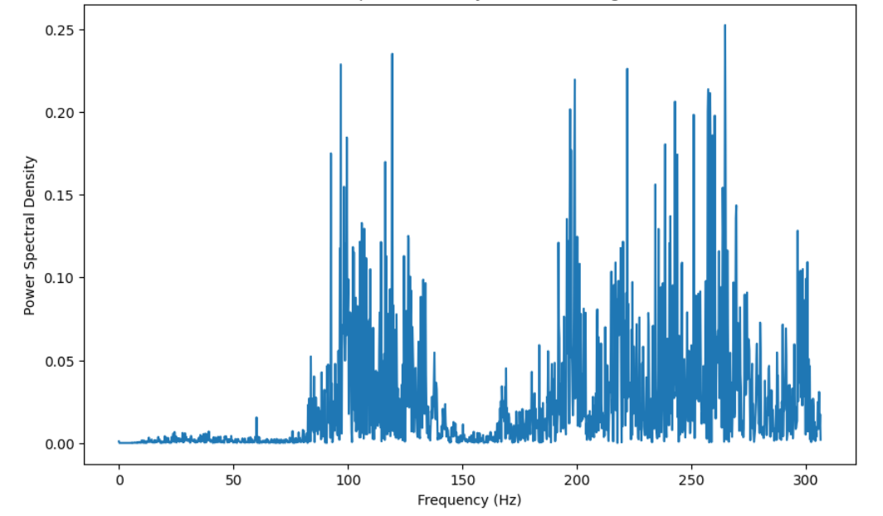
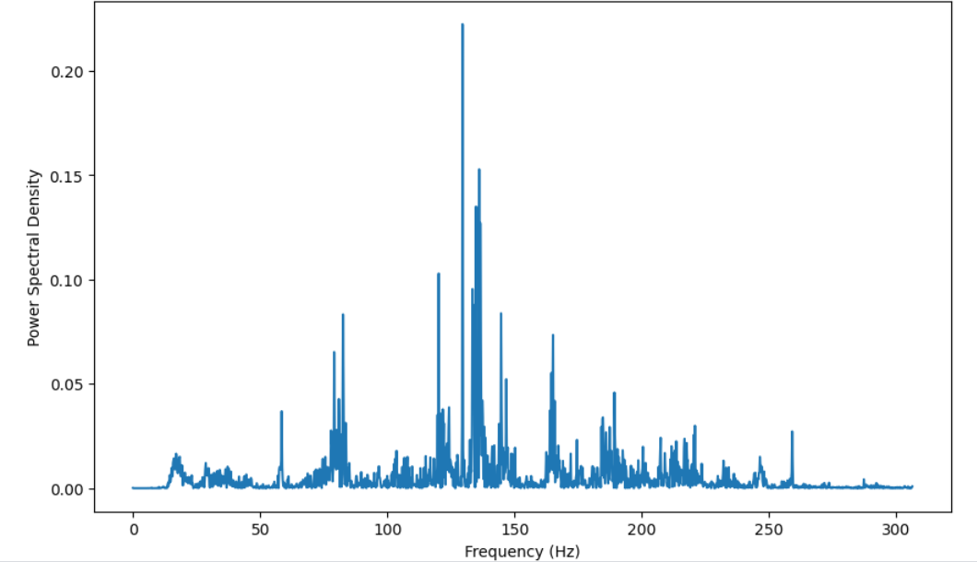


Experiment : Wiener Filter
$$PSD(v)$$
$$PSD(n)$$

Slide 15
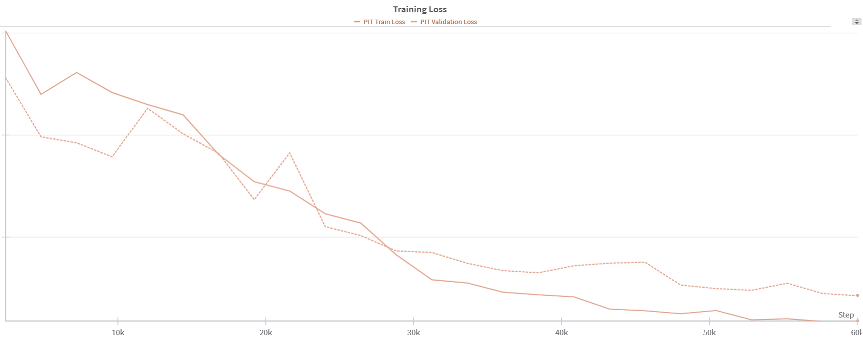
Experiment : PIT

Slide 16
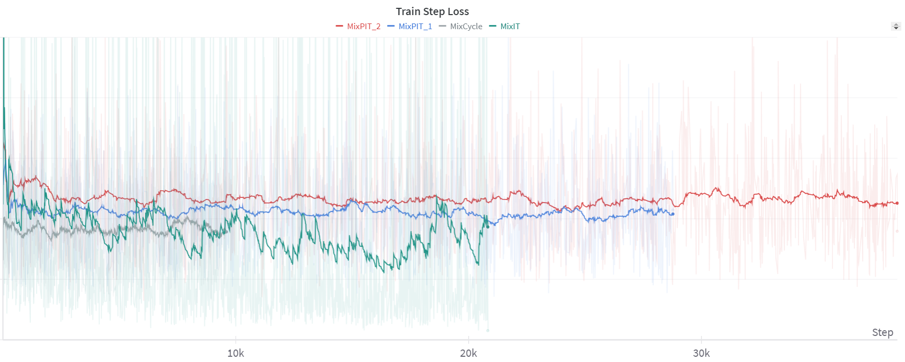
Experiment : MixIT – MixPIT - MixCycle

Slide 17
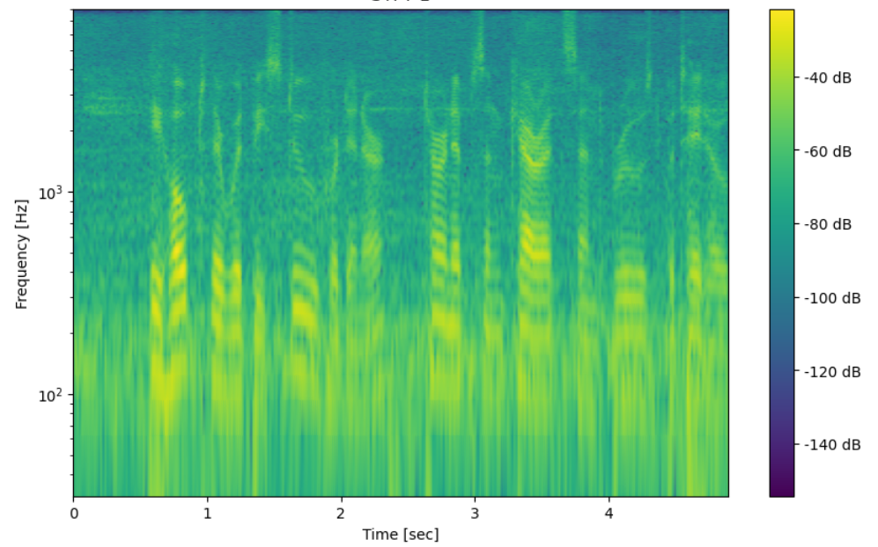
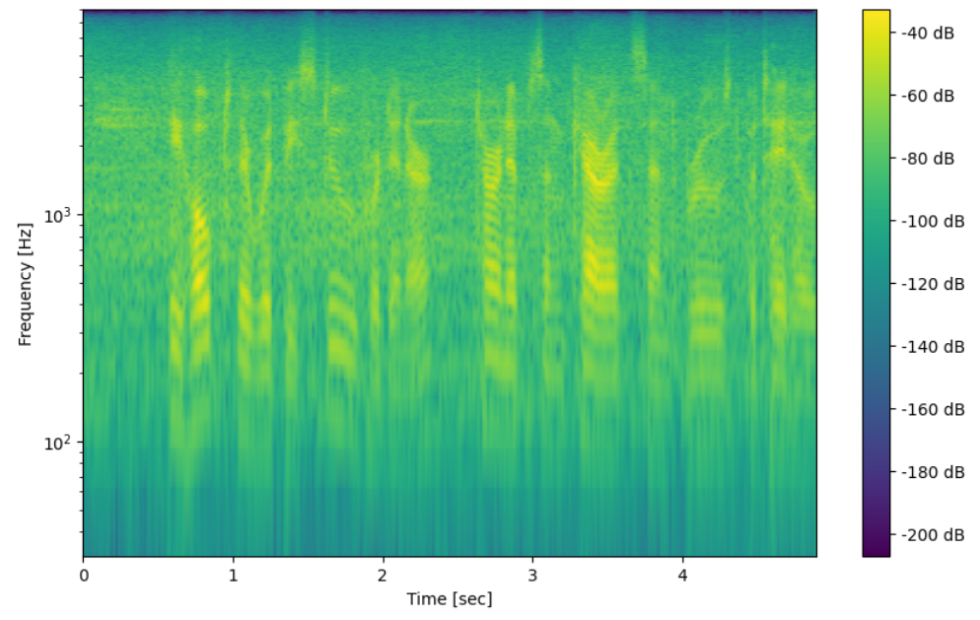
Simulate different microphone qualities
No Filter
Filtered

Slide 18
Conclusion

Slide 19
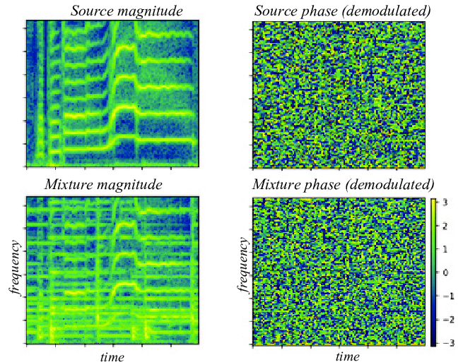


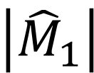

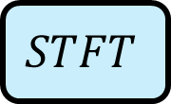



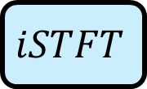





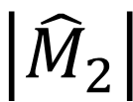


$$\left|X\right|$$
$$x_{i}$$
$$\left|{\hat{M}}_{1}\right|$$
$$×$$
$$iSTFT$$
$${\hat{s}}_{i 1}$$
$$×$$
$$Conv−TasNet$$
$$x_{i}$$
$$STFT$$
$$\frac{1}{\left|{\hat{M}}_{1}\right|+\left|{\hat{M}}_{2}\right|}$$
$$\left|{\hat{M}}_{2}\right|$$
$$\left|X\right|$$
$$×$$
$$iSTFT$$
$${\hat{s}}_{i 2}$$
$$arg⁡(X)$$

Slide 20

















$${\tilde{s}}_{i1}$$
$$x_{i}$$
$$f_{θ}$$
$${\tilde{s}}_{i2}$$
$$SISNR$$
$${\tilde{s}}_{i2}$$
$$+$$
$$f_{θ}$$
$$×$$
$$+$$
$${\tilde{s}}_{j1}$$
$$SISNR$$
$${\tilde{s}}_{j1}$$
$$x_{j}$$
$$f_{θ}$$
$$P$$
$${\tilde{s}}_{j2}$$

Slide 21















$${\hat{s}}_{i 1}$$
$$x_{i}$$
$${\hat{s}}_{i 2}$$
$$SISNR$$
$$x_{i}$$
$$+$$
$$f_{θ}$$
$$×$$
$$+$$
$${\hat{s}}_{j 1}$$
$$SISNR$$
$$x_{j}$$
$$x_{j}$$
$${\hat{s}}_{j 1}$$
$$A$$

