Slide 1
Source:
https://parse.com/docs/js/guide
https://parse.com/docs/js/api/
http://adherencepillproject.parseapp.com/parseDemo.html

Slide 2
Demo Data
Object Name: ParseDemo
Column Name | Type | Out-Of-Box | Can Modify
name | String | No | Yes
age | Number | No | Yes
registrationDate | Date | No | Yes
approved | Boolean | No | Yes
objectId | String | Yes | No
createdAt | Date | Yes | No
updatedAt | Date | Yes | No
ACL | ACL | Yes | Yes

Slide 3
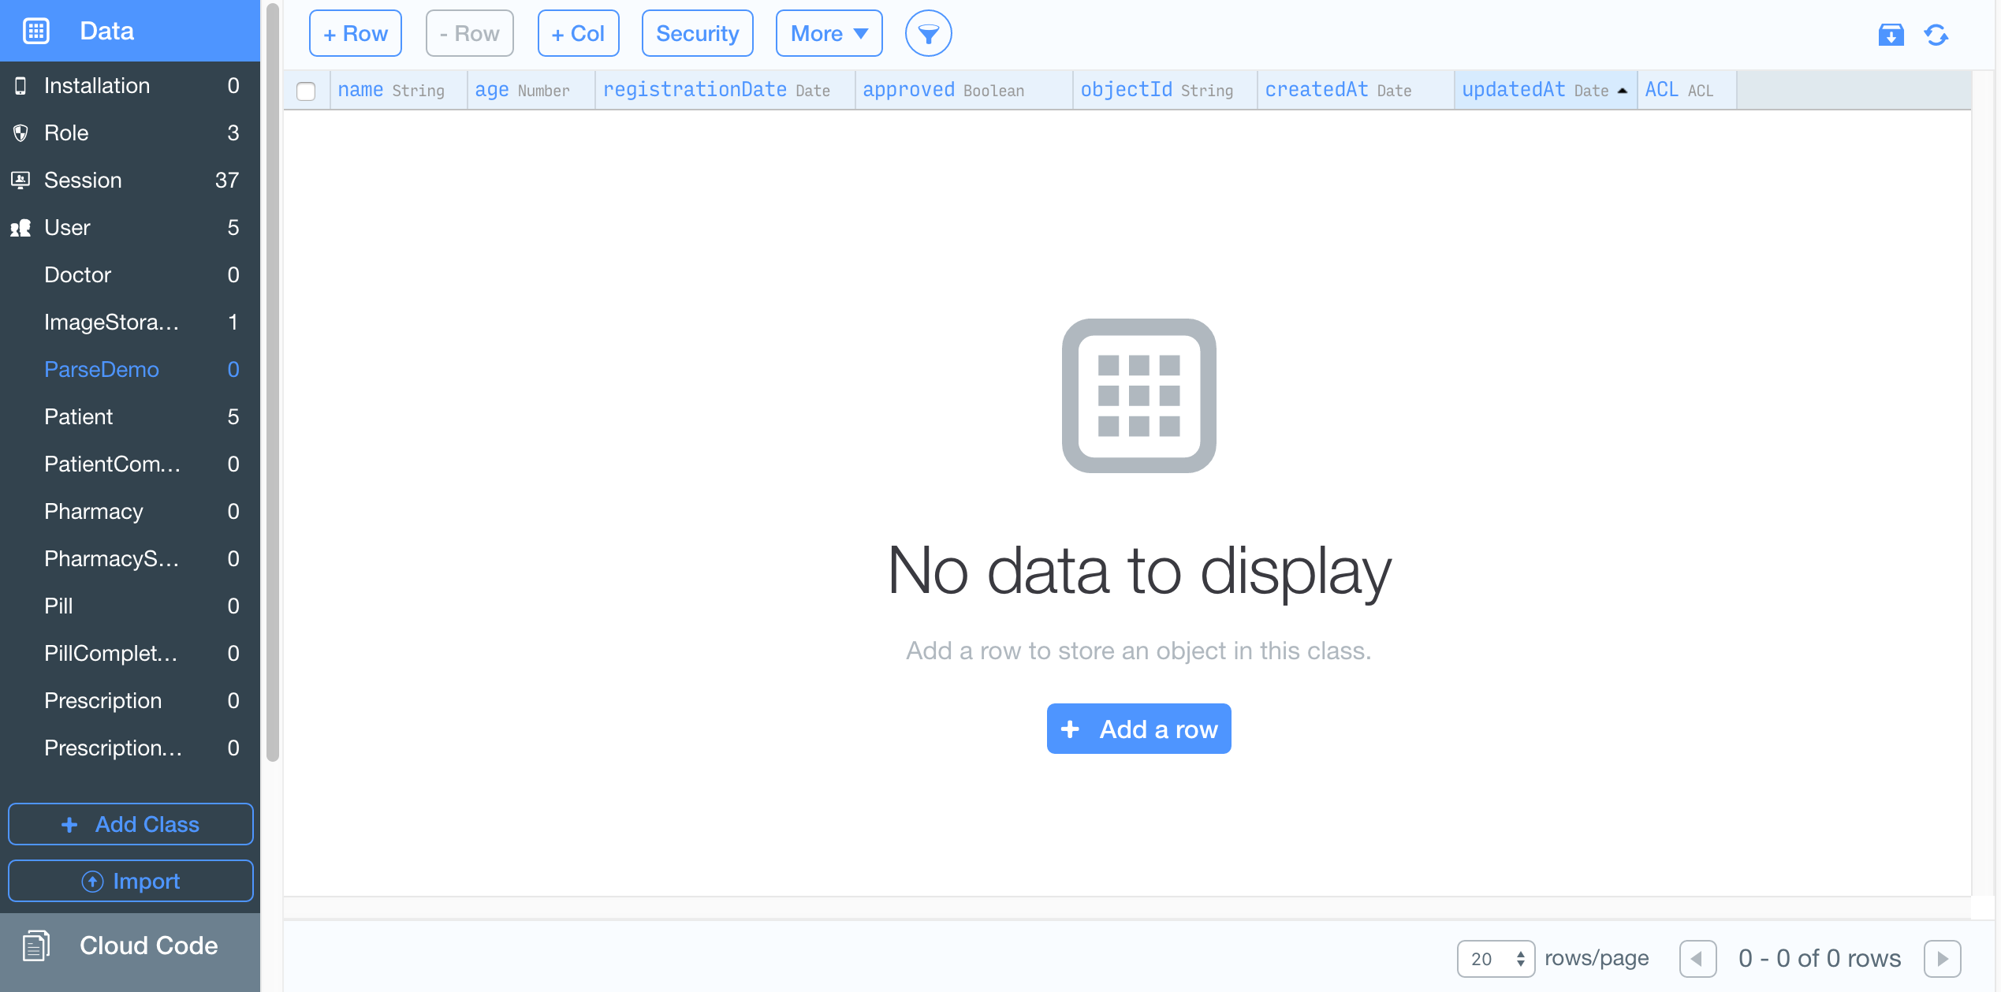
Demo Data
Object Name: ParseDemo

Slide 4
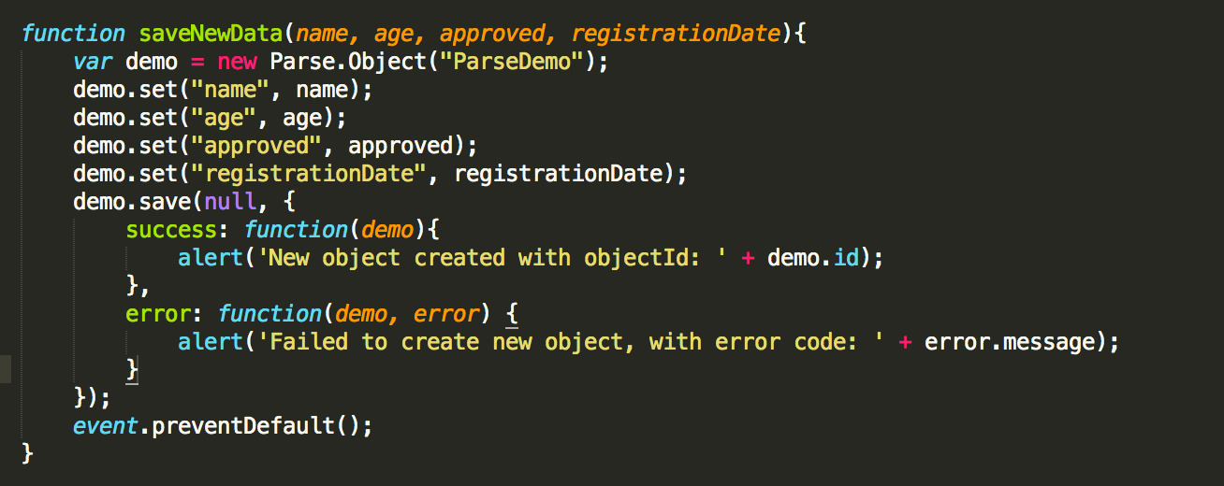
Save Data To Parse
(Javascript)

Slide 5
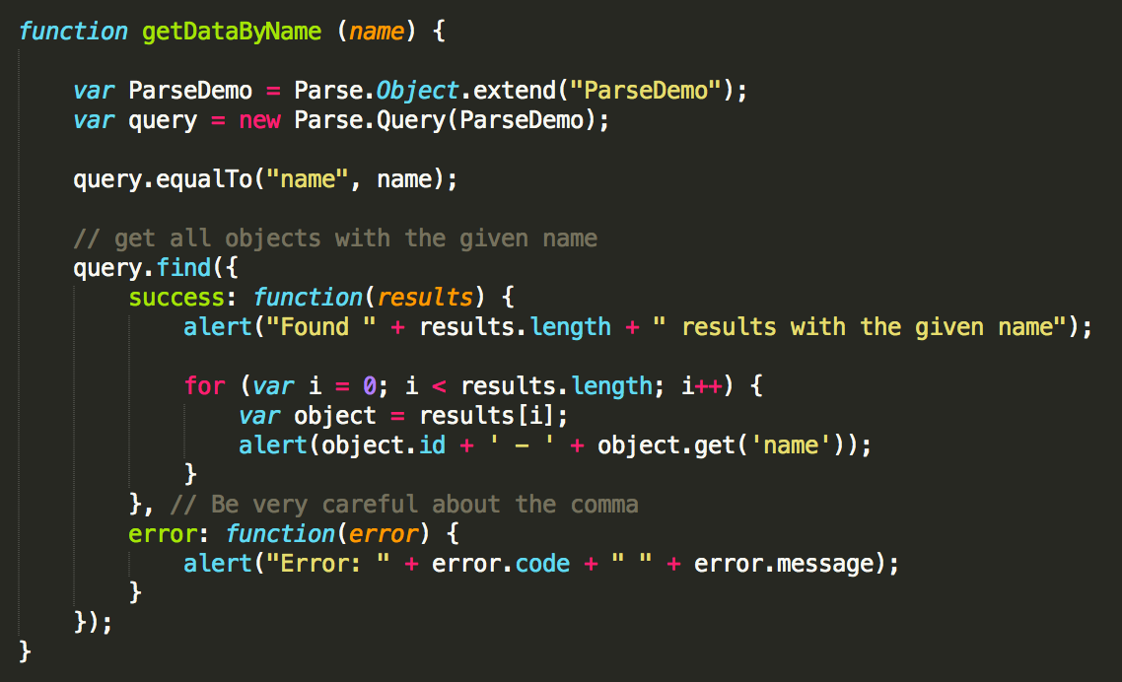
Get Data By Name
(Javascript)

Slide 6
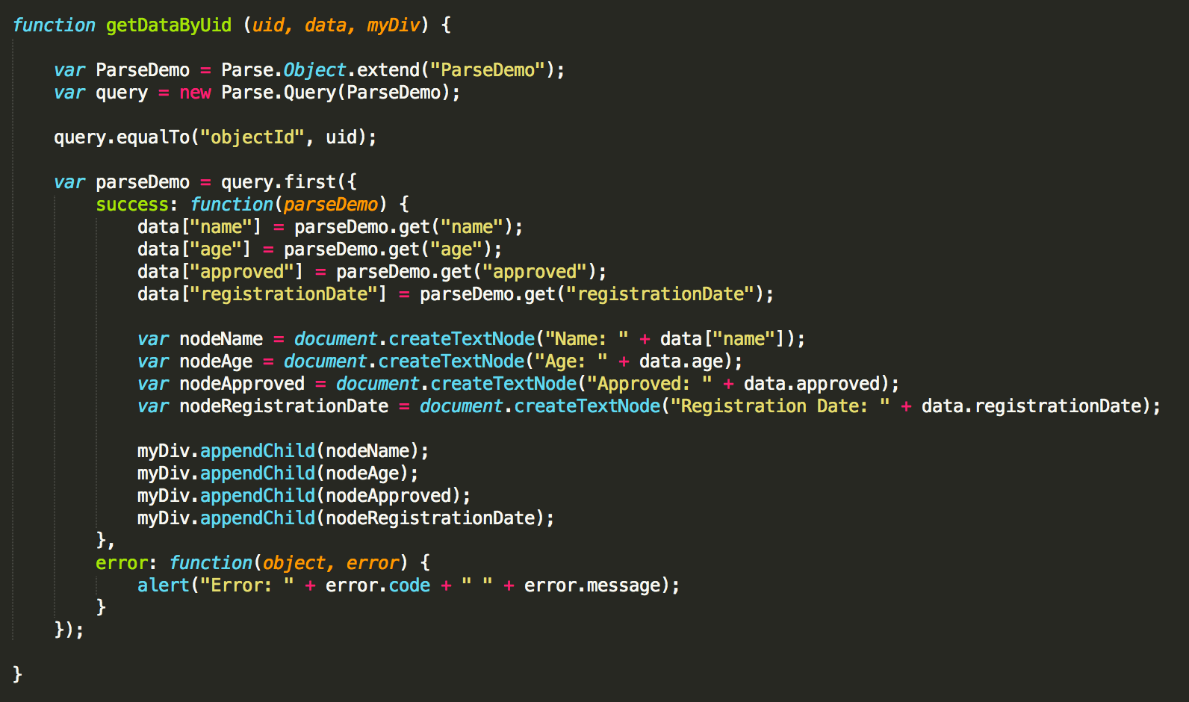
Get Data By ObjectId
(Javascript)

Slide 7
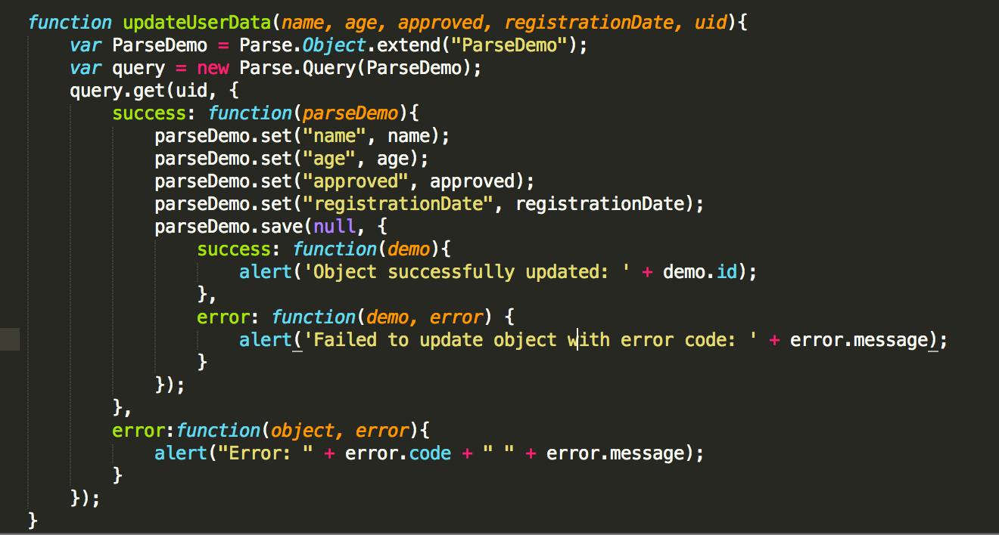
Update Data By ObjectId
(Javascript)

