Slide 1
Secure Data Hiding In Images Using Steganography
CAPSTONE PROJECT
Presented By:
Student Name : LP ADHITHYA
College Name & Department : JERUSALEM COLLEGE OF ENGINEERING/ COMPUTER SCIENCE AND BUSINESS SYSTEM

Slide 2
OUTLINE
Problem Statement
Technology used
Wow factor
End users
Result
Conclusion
Git-hub Link
Future scope

Slide 3
Problem Statement
In today’s digital age, ensuring data security and privacy is a top priority. Traditional encryption methods are often prone to detection and interception. Our project tackles this challenge by using steganography to hide secret messages within images. This method offers a covert communication channel, enhancing data confidentiality without raising suspicion.

Slide 4
Technology used
Programming Language: Python
Libraries:
OpenCV for image processing
Tkinter (with ttk) for the GUI
NumPy for efficient array manipulation
Platform: Windows
Tools: IDLE PYTHON

Slide 5
Wow factors
Implements robust LSB steganography that embeds both the passcode and message length in the image header.
Uses lossless PNG format to preserve hidden data integrity.
Features a modern, user-friendly GUI for both encryption and decryption processes.
Combines advanced image processing techniques with secure data transmission.

Slide 6
End users
Security professionals and cybersecurity enthusiasts.
Journalists, activists, and government agencies needing secure communication channels.
Students and researchers interested in data privacy and steganography.
General users looking for enhanced digital security.

Slide 7
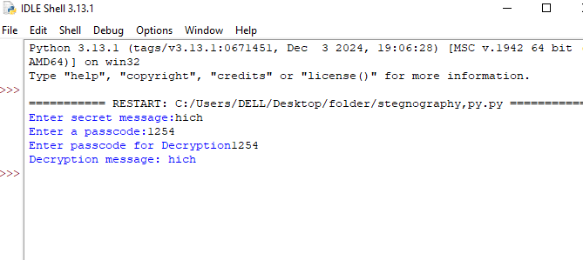
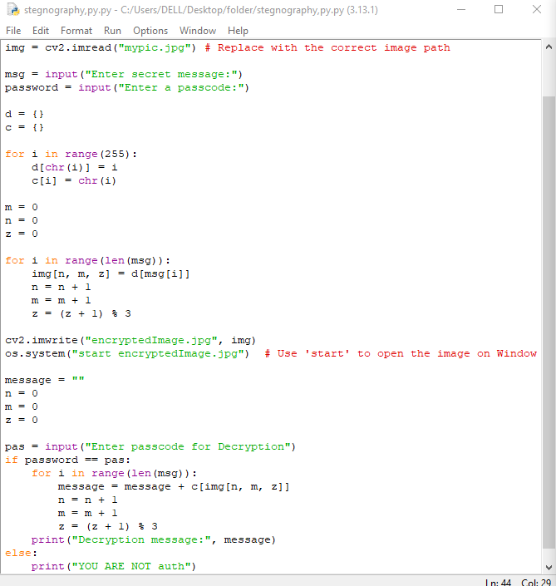
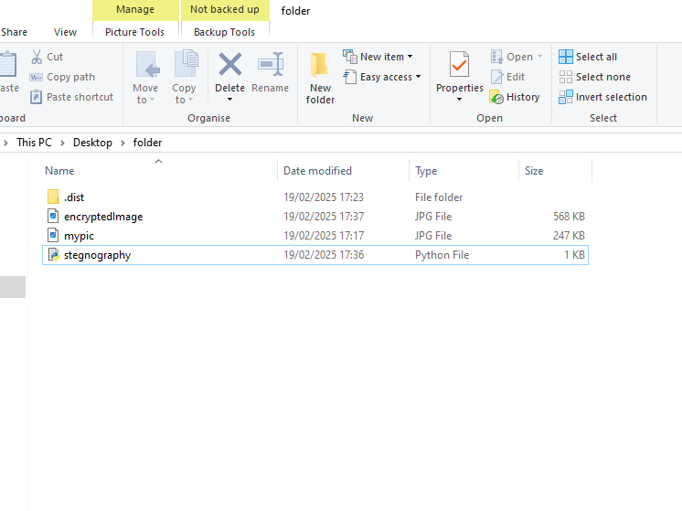
Results
Screenshots of the outcome (min 3)

Slide 8
Conclusion
Our project successfully demonstrates a novel approach to data security by hiding information within an image using LSB steganography.
The technique is both secure and undetectable, thanks to embedding critical header information such as passcode and message lengths.
This project contributes to the broader field of digital privacy and secure data transmission.

Slide 9
GitHub Link
https://github.com/Adhi-1235/stegnography.git

Slide 10
Future scope(optional)

Slide 11
THANK YOU

