Slide 1
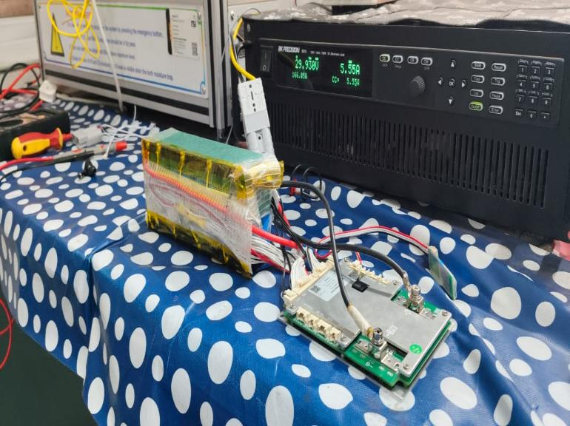
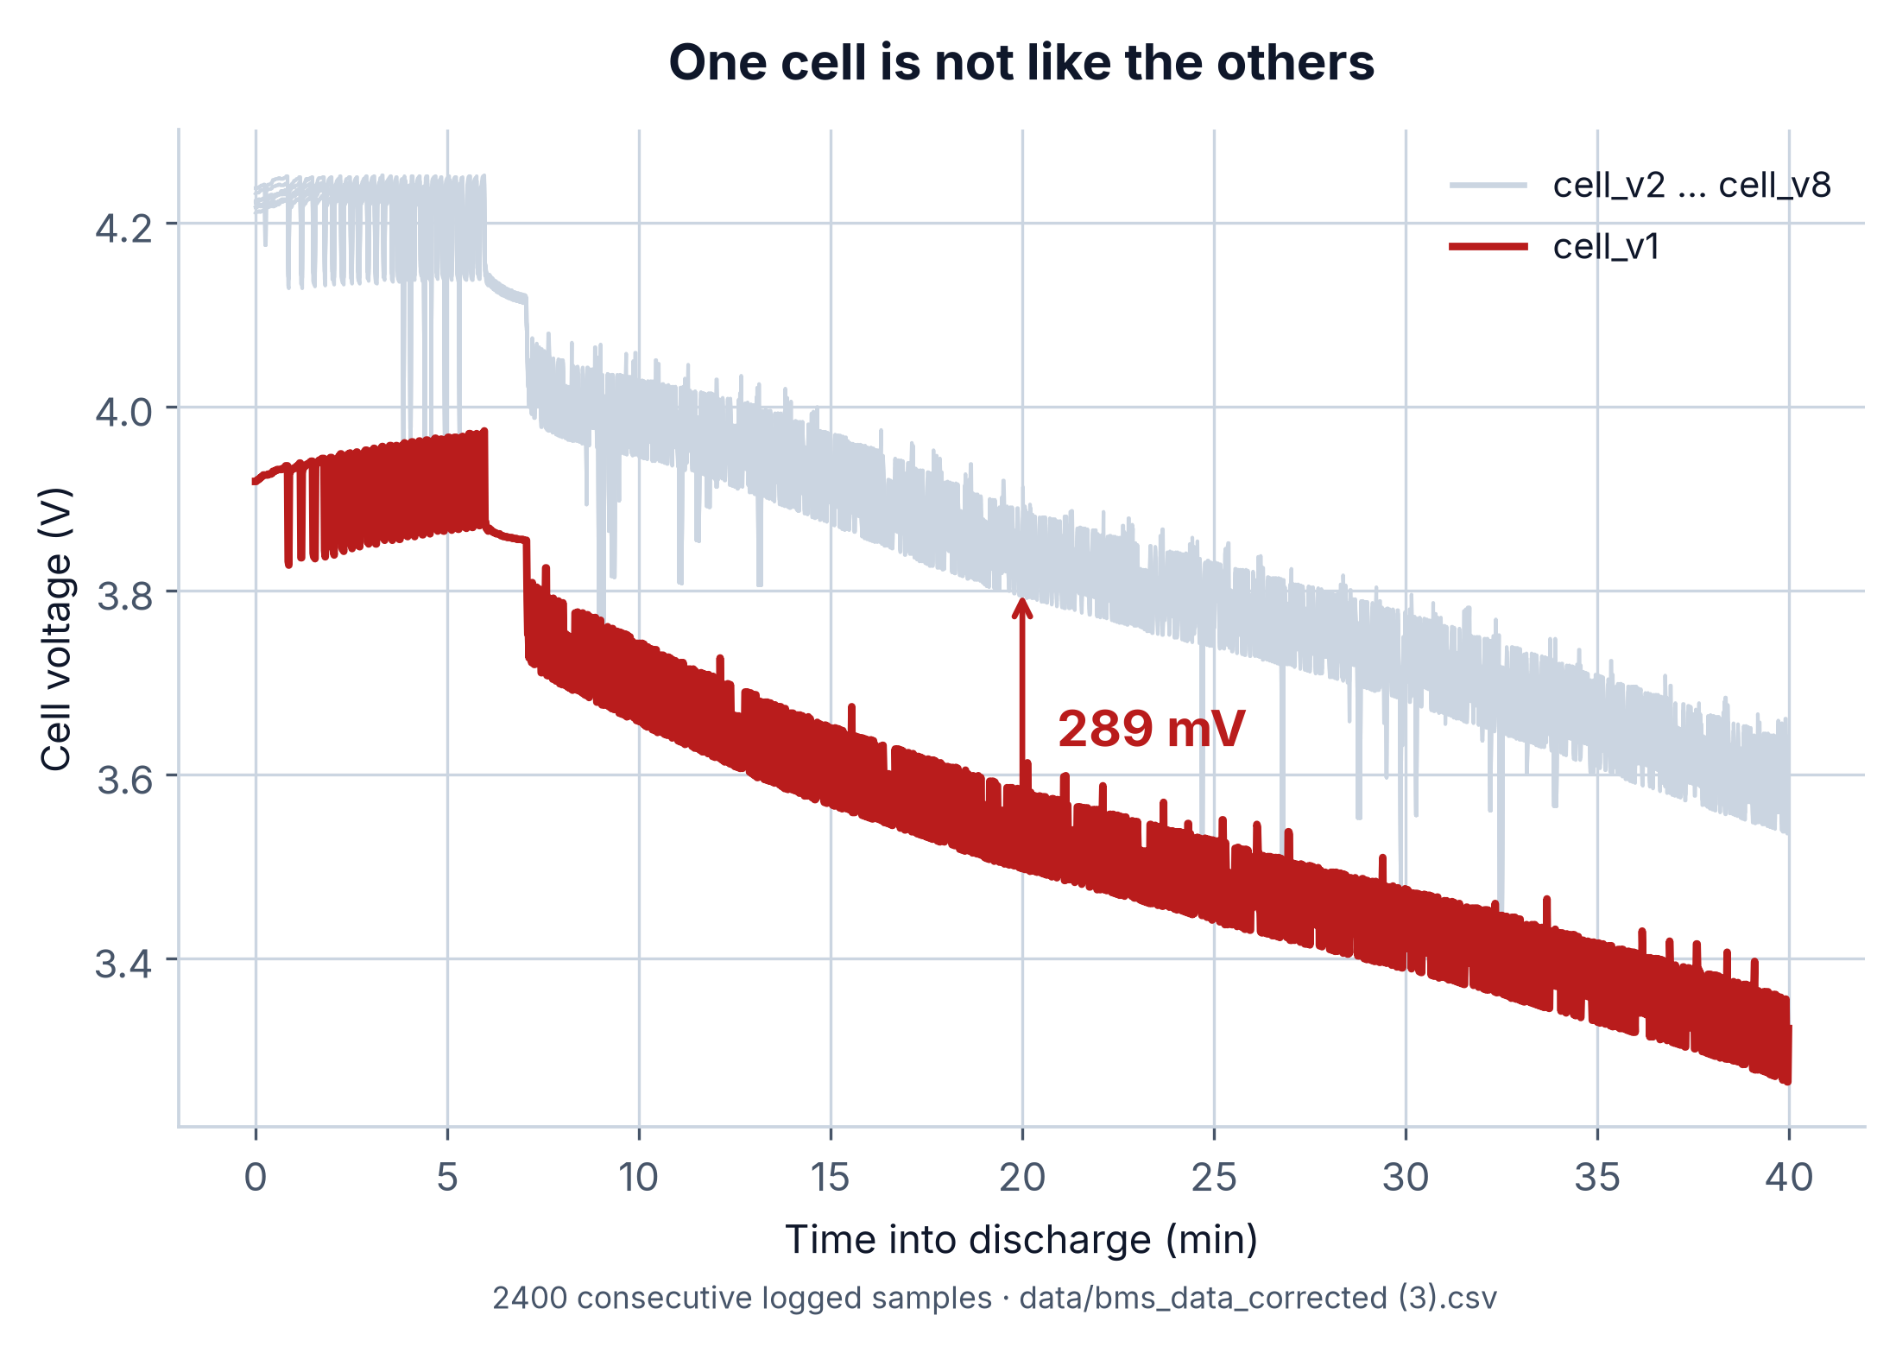
AI-PBMS — AI-Powered Predictive Battery Management System · Team ANS_4X · PSG iTech
We could not buy this dataset, so we built it
Public BMS datasets hide per-cell voltages behind pack totals.
Imbalance and weak-cell faults are invisible at pack level.
So we instrumented a physical 8S2P NMC pack end to end.
Programmable supply charges; electronic load drives discharge.
~50
~3 hrs
>100 hrs
~155,000
cycles
each
logged
rows
WHAT THE DATA SHOWED
Cell 1 runs 289 mV below its neighbours in every cycle. A pack-level voltmeter reads 30.5 V and calls this healthy.
AI-PBMS · Team ANS_4X
1
Notes:
Every public battery dataset reports pack-level voltage and current, which is
useless to us: imbalance and weak-cell faults only show in the spread between
individual cells. So we built the dataset — an 8S2P NMC pack, a JBD BMS on all
eight taps, roughly fifty cycles and 155,000 rows. The chart bottom right is
what a hundred hours bought us: seven cells tracking together, and cell one
sitting 289 millivolts below them for the entire discharge. That one defect
shaped everything that follows.

Slide 2
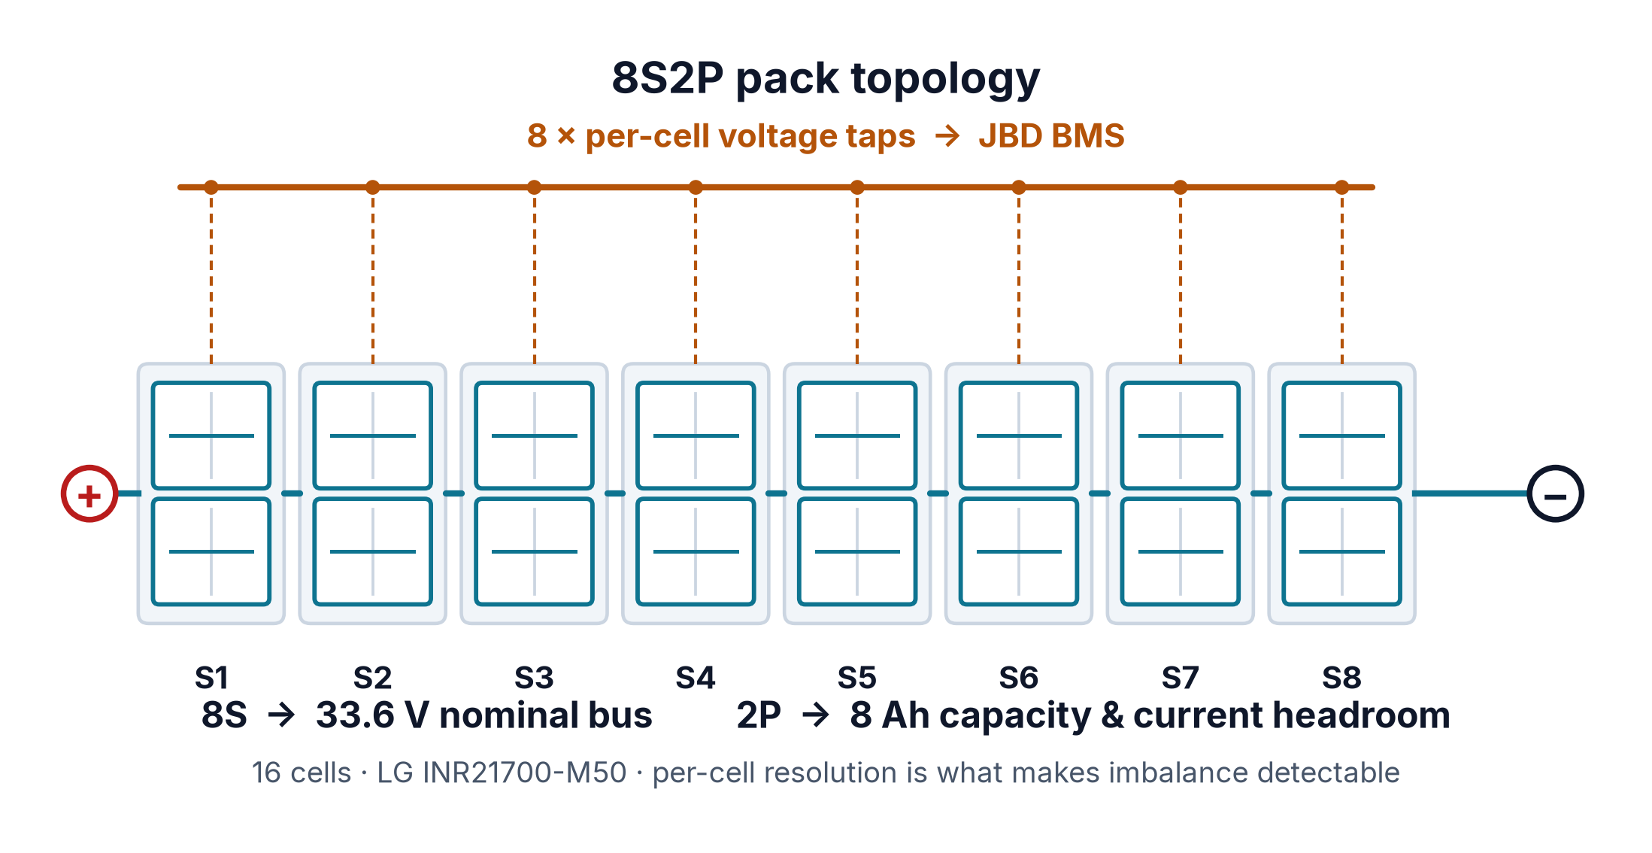
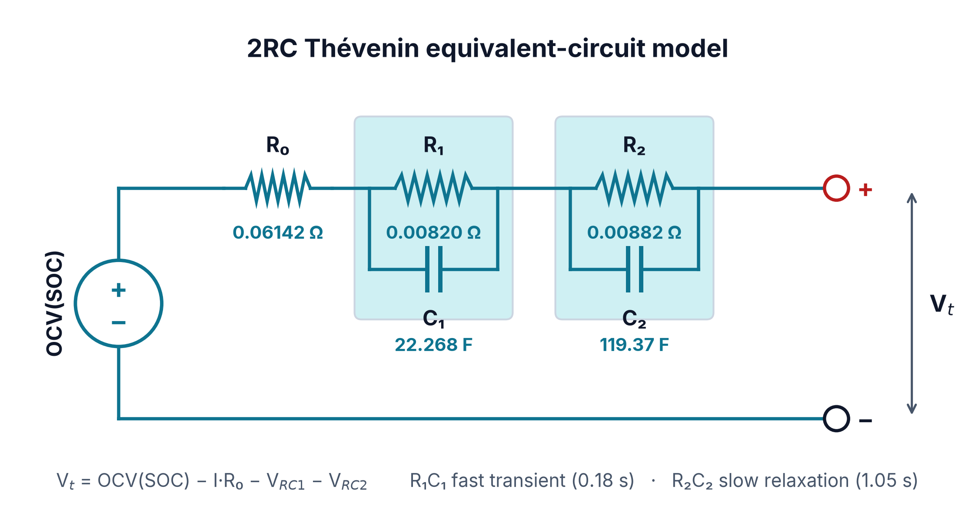
The pack, and the model of the pack
8S sets the 33.6 V nominal bus voltage.
2P buys 8 Ah and current headroom.
Sixteen LG INR21700-M50 cells.
Eight taps make imbalance observable.
Four NTCs give thermal resolution.
1RC missed the slow relaxation.
2RC PARAMETERS — FITTED ON THE 0–4000 s HPPC SEGMENT
R₀ 0.06142 Ω
R₁ 0.00820 Ω
C₁ 22.268 F
ohmic drop
fast branch
τ₁ ≈ 0.18 s
R₂ 0.00882 Ω
C₂ 119.37 F
13.4 mV
slow branch
τ₂ ≈ 1.05 s
per 1% SOC
Vt = OCV(SOC) − I·R₀ − V_RC1 − V_RC2
AI-PBMS · Team ANS_4X
2
Notes:
Eight in series gives the 33.6-volt bus the drivetrain wants; two in parallel
gives eight amp-hours and the current headroom for realistic profiles. Eight
series groups means eight sense taps, so imbalance is measured rather than
inferred. On modelling, one RC branch caught the instant ohmic drop but missed
the slow recovery after a load step, so we went to two — fast at 0.18 seconds,
slow at 1.05. All five parameters were fitted on a clean HPPC segment, and the
same estimation gave us the OCV curve: 13.4 millivolts per percent of charge.

Slide 3
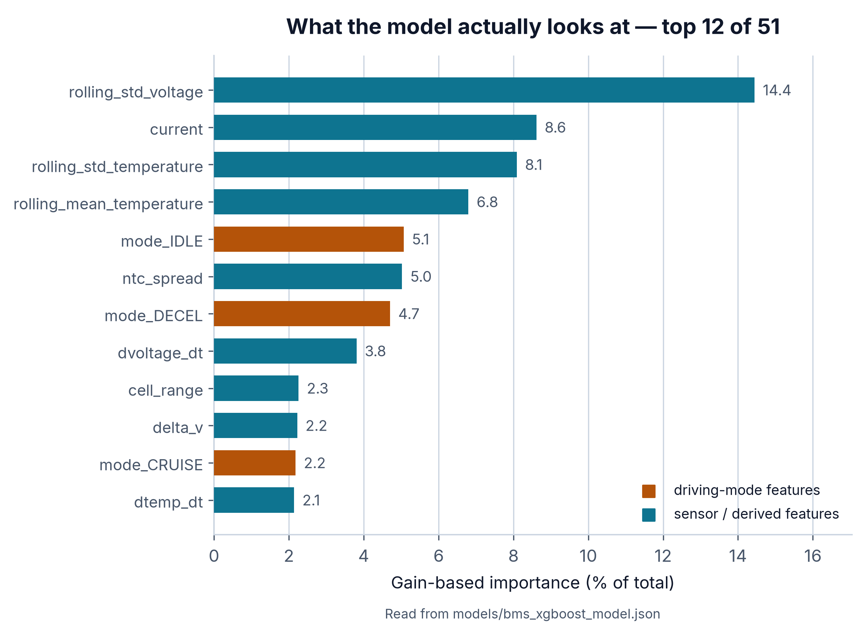
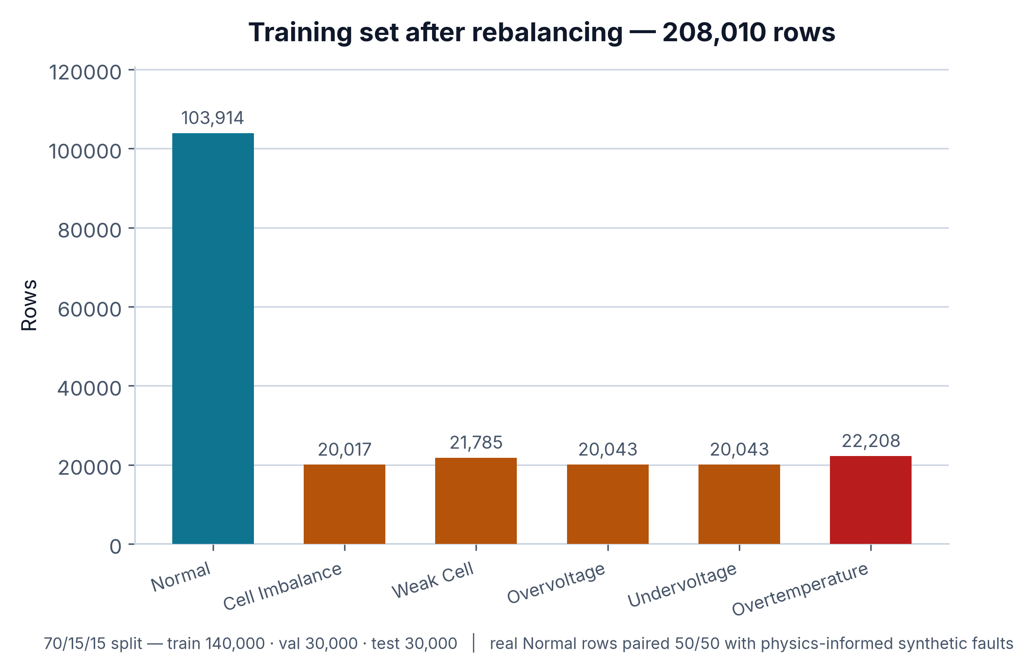
From BLE frames to a balanced training set
JBD BMS → BLE (bleak) → jbd_logger v9.
Fragmented BLE frames reassembled first.
NTC byte-offset fix realigned four channels.
17 raw channels become 51 features.
Rolling stats, derivatives, per-cell rates.
cell_v1 skew labelled 70.2% Cell Imbalance.
HANDLING THE SKEW
Physics-informed synthetic faults generated against datasheet limits, then balanced to an equal count per class — 50/50 real to synthetic.
LEAKAGE CONTROL
Windows and derivatives computed inside each (split, label) group, so none straddles a train/test boundary. 208,010 rows, 70/15/15.
AI-PBMS · Team ANS_4X
3
Notes:
The pipeline is short on purpose. Two things bit us: BLE fragments long
responses across frames, so early logs were silently truncated, and the four
thermistors were read at the wrong byte offset. From seventeen raw channels we
derive fifty-one features — rolling statistics, first derivatives, per-cell rise
and drop rates, driving-mode flags. The chart top right is read out of the
trained model, not our opinion. Because cell one is chronically low, a
rule-based labeller marked seventy percent of rows as imbalance, so we balanced
with physics-informed synthetic faults rather than discarding real data.

Slide 4
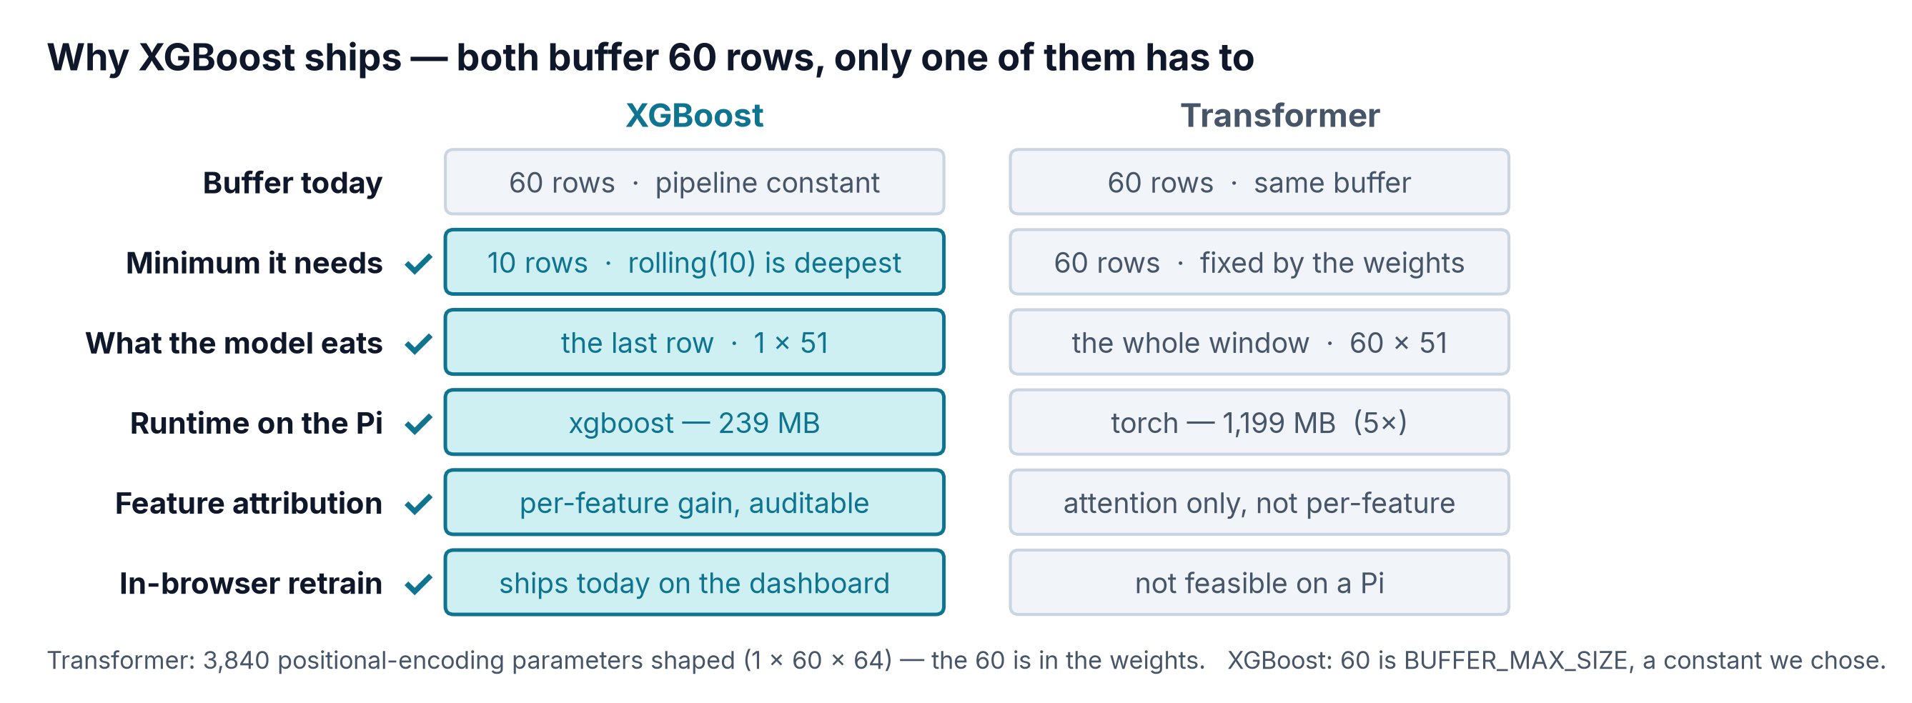
We benchmarked all six — XGBoost still ships
Model
Accuracy
Macro F1
Latency
Size
Edge
Verdict
XGBoost
94.19%
0.905
0.462 ms
1.40 MB
Yes
Deployed — 1-row input, 10-row context
Transformer
95.11%
0.918
0.419 ms
0.31 MB
Warn
+0.92% acc; 60 rows locked in
LSTM
87.03%
0.776
0.532 ms
0.28 MB
Warn
Sequential, weakest F1
Random Forest
89.37%
0.824
33.770 ms
176.41 MB
No
176 MB, 73× the latency
SVM (RBF)
88.53%
0.807
0.568 ms
2.82 MB
Yes
Would not scale past 20k rows
Rule-based BMS
22.09%
0.224
5 µs
~0 MB
Yes
0% recall on Weak Cell
All six trained and scored on the identical 30,000-row held-out split with the same 51 features; latency is the median single-row prediction on a 4-core CPU, not a Pi 5. Both models sit behind the same 60-row pipeline buffer, but XGBoost consumes only the last row and its deepest feature is a 10-sample rolling window, so that 60 is a constant we chose; the Transformer consumes all 60 and its positional encoding fixes the length in the weights. SVM trained on a stratified 20k subsample: full-data RBF did not converge.
AI-PBMS · Team ANS_4X
4
Notes:
We did not argue about which model to use — we trained all six on the identical
split and measured them. Two rows matter. The bottom one: a conventional
rule-based BMS scores twenty-two percent, because cell one’s chronic gap puts
eighty-four percent of healthy rows over the imbalance threshold. It false-alarms
constantly and never detects a weak cell at all. And the second row: the
Transformer edges us by under a point — but look at what it costs. Both models
sit behind the same sixty-row buffer in our pipeline. The difference is that
XGBoost only eats the last row of it, and its deepest feature is a ten-sample
rolling window, so that sixty is a constant we chose and could shorten to ten
tomorrow. The Transformer eats all sixty, and its positional encoding fixes that
length inside the weights — you cannot shorten it without retraining. On top of
that, torch is five times the runtime footprint of xgboost on the Pi, it gives no
per-feature attribution an engineer can audit, and it cannot be retrained from
the browser the way our configurator retrains XGBoost today. That is why it
ships.

Slide 5
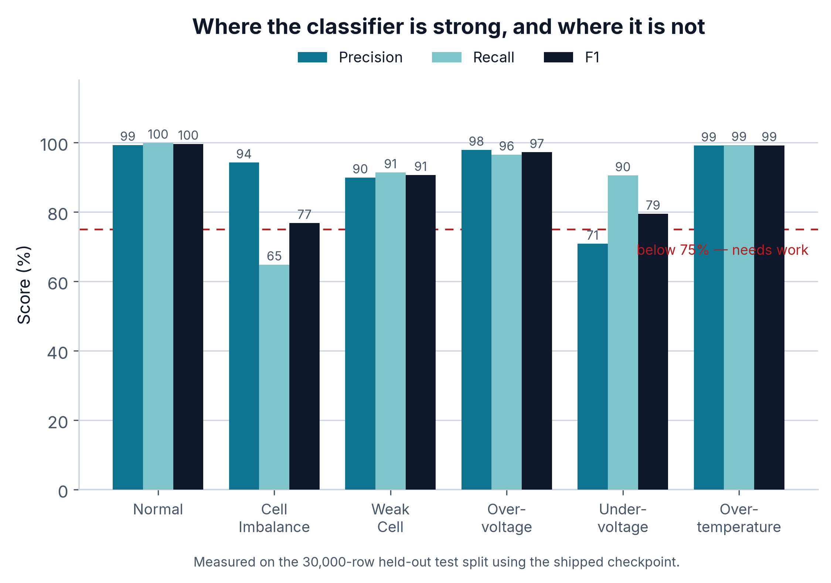
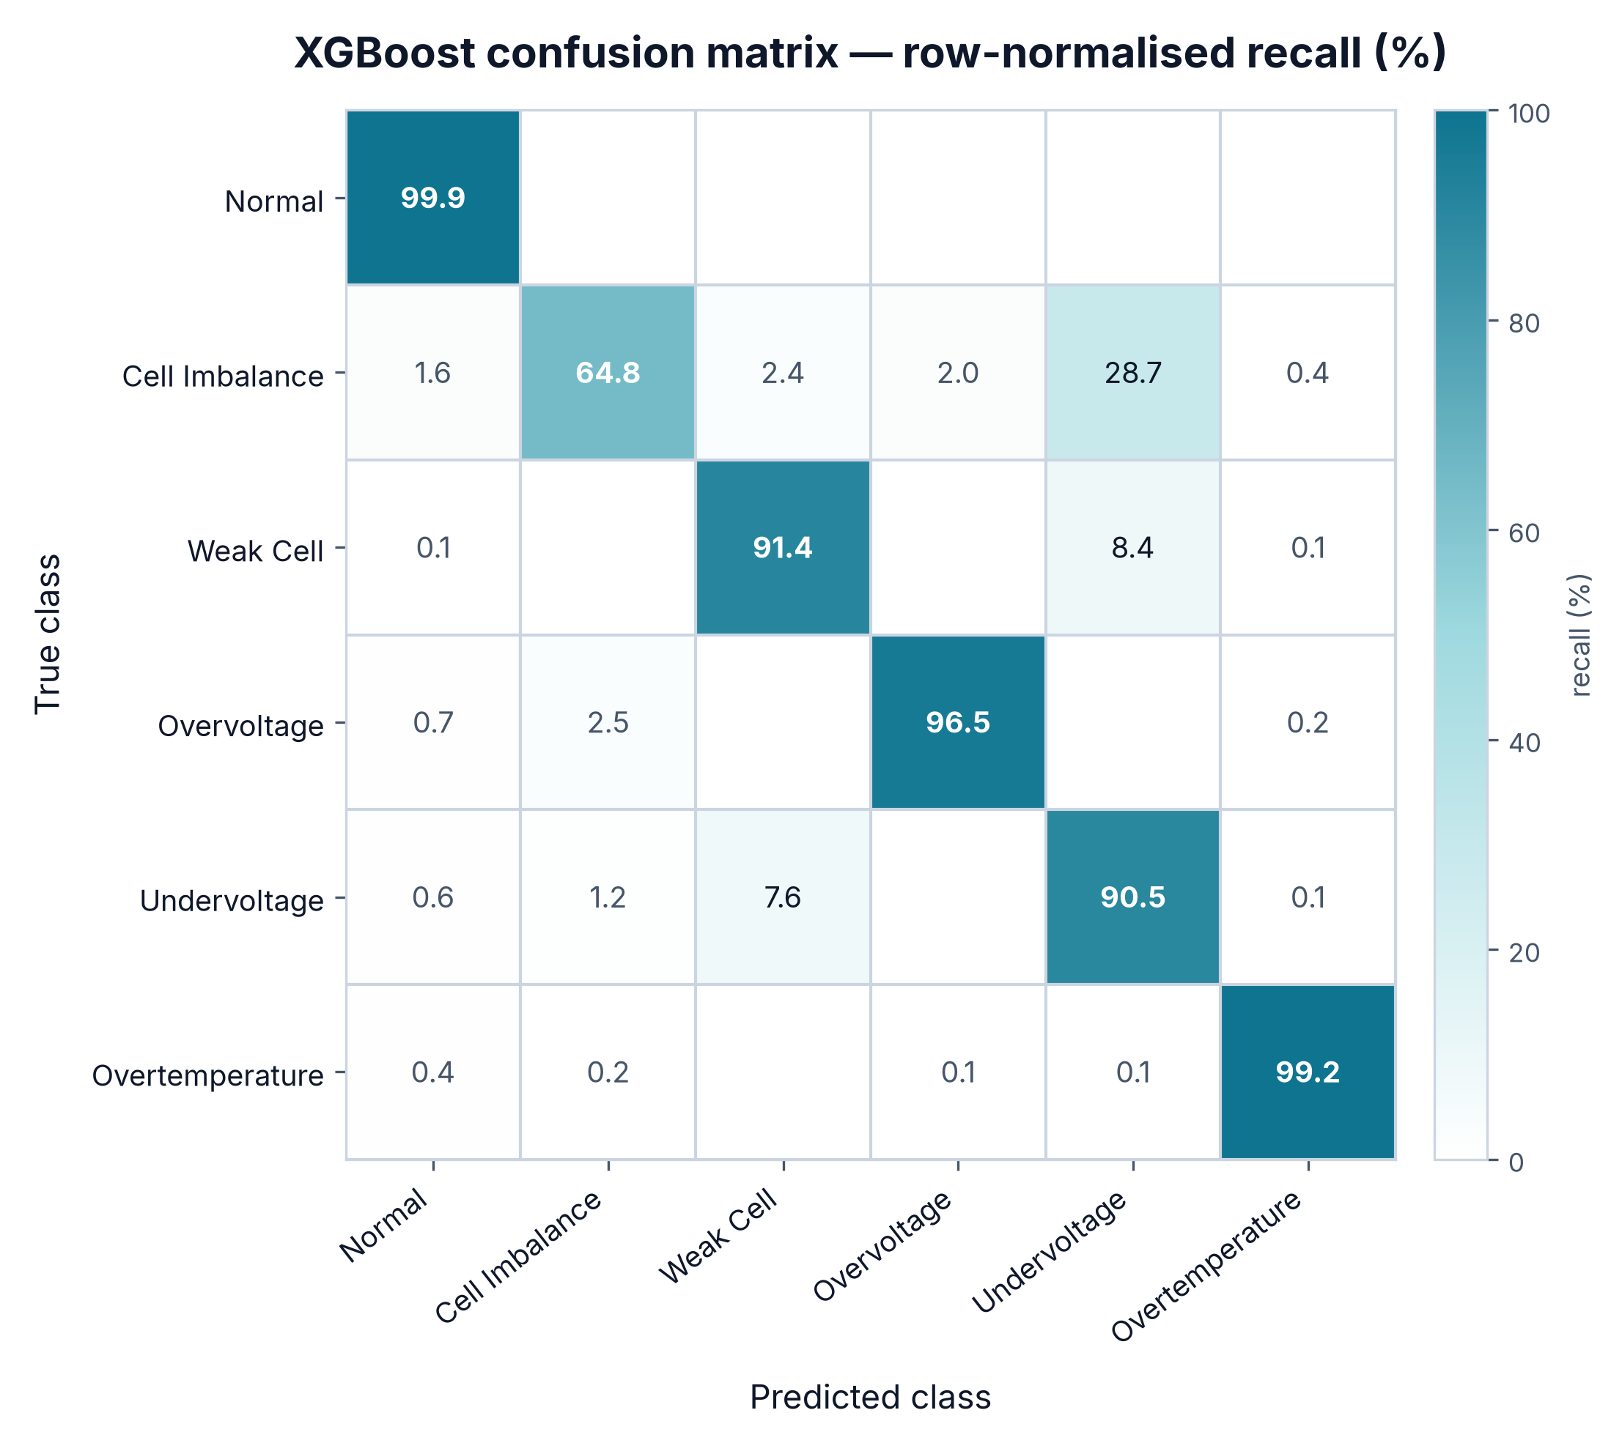
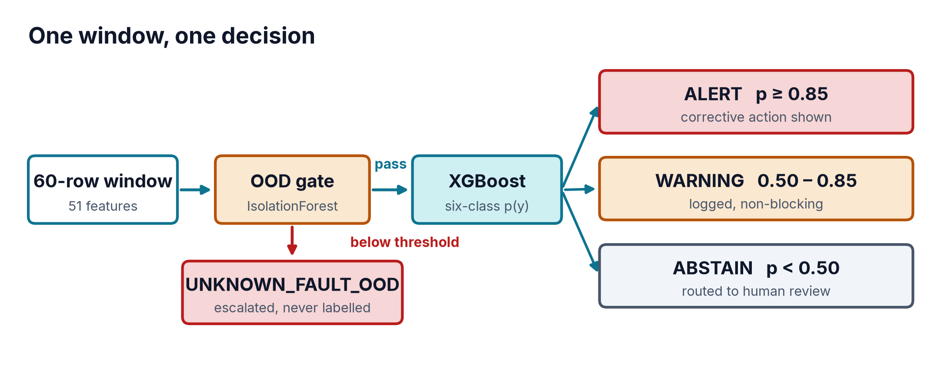
Six classes, honest confidence, one gate
Normal, Overvoltage, Overtemp clear 97% F1.
Cell Imbalance recall 65% — the weak spot.
Misses land on Undervoltage, physically adjacent.
Below 0.50 the model abstains outright.
0.50–0.85 warns; above 0.85 alerts.
An IsolationForest gate runs before the classifier.
0.913
100%
0.0%
24.5%
OOD AUROC
OOD precision
false positives
OOD recall
WE ARE NOT HIDING THIS
28.7% of true Cell Imbalance samples are predicted Undervoltage — one cell drops, pack voltage follows. Separating them needs more real imbalance events, not more synthetic ones. A confident wrong answer is worse than an honest abstention.
AI-PBMS · Team ANS_4X
5
Notes:
Normal, Overvoltage and Overtemperature all clear ninety-seven percent F1. Cell
Imbalance recall is sixty-five, and that is the weakest number here — its misses
go to Undervoltage, which is physically sensible: one cell drops and pack
voltage follows. Around the classifier we wrap two things. A confidence band:
below zero-point-five we abstain, up to zero-eight-five we warn, above that we
alert. And in front of it, an IsolationForest gate for failure modes we have
never seen — AUROC nine-one-three, a hundred percent precision, zero false
positives, catching one unknown in four. Tuned that way deliberately.

Slide 6
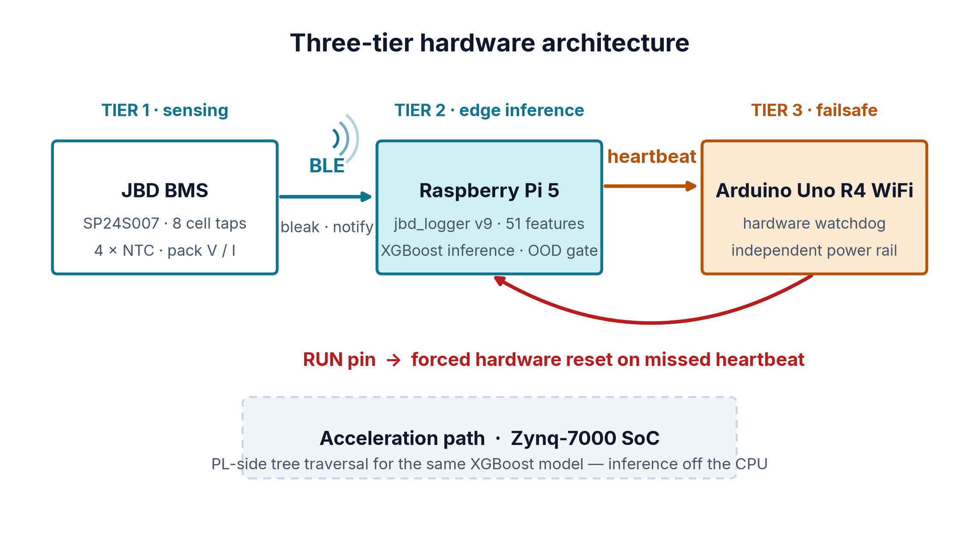
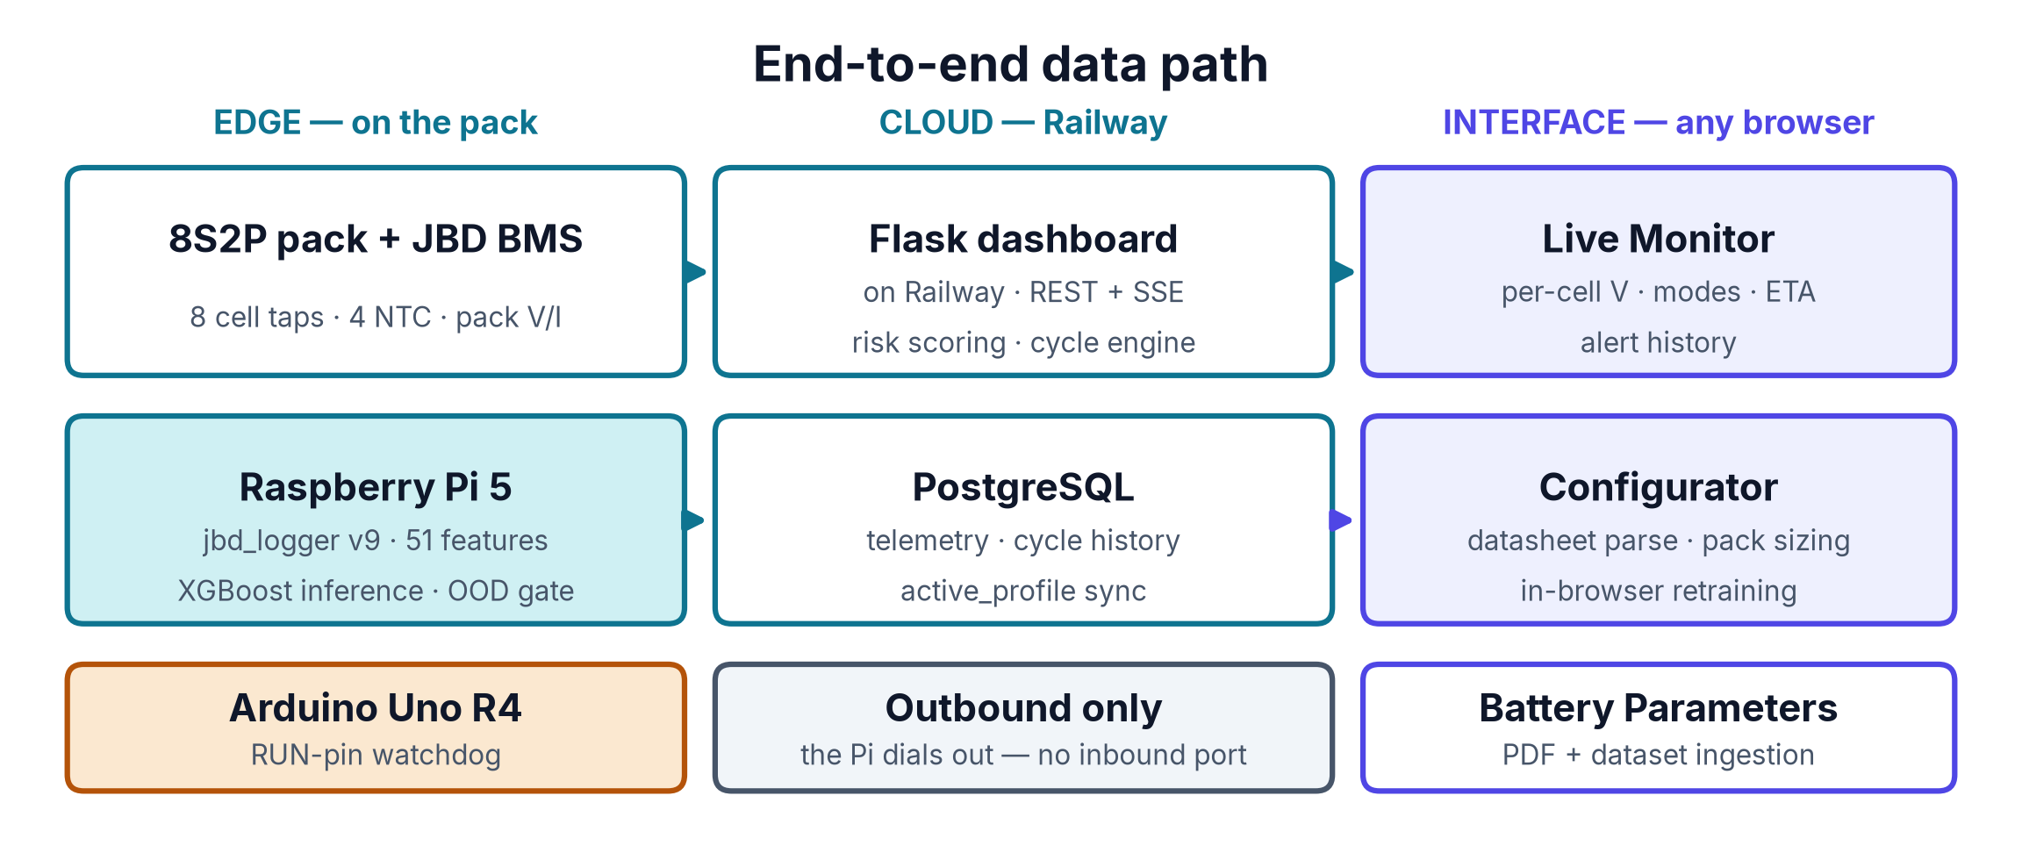
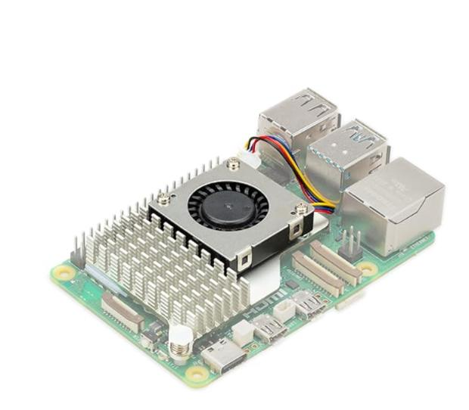
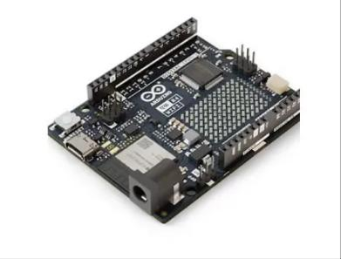
Three tiers at the edge, three surfaces in the browser
JBD BMS senses eight taps and four NTCs.
Pi 5 runs the logger and XGBoost inference.
Arduino R4 watches the Pi's heartbeat.
Missed beat pulls RUN pin, resets the Pi.
Inference stays local: no link, no safety gap.
Pi dials out to Railway — no inbound port.
ACCELERATION PATH
Zynq-7000 SoC moves the same tree traversal into programmable logic, freeing the CPU for the logger and the BLE link.
Raspberry Pi 5
Arduino Uno R4 WiFi
AI-PBMS · Team ANS_4X
6
Notes:
Three tiers, each doing what the others cannot. The BMS senses, the Pi 5 runs
the logger and the inference, and an Arduino on its own power
rail watches for a heartbeat — if it stops, it pulls the Pi's RUN pin and forces
a reset. Inference sits at the edge deliberately: push it to a server and every
network hiccup becomes an unmonitored window. The lower diagram is the whole
data path. Inference happens on the Pi; the dashboard is a Flask service
deployed on Railway, and the Pi pushes results up to it. Because the Pi only ever
dials out, we never open an inbound port on the pack itself.

Slide 7
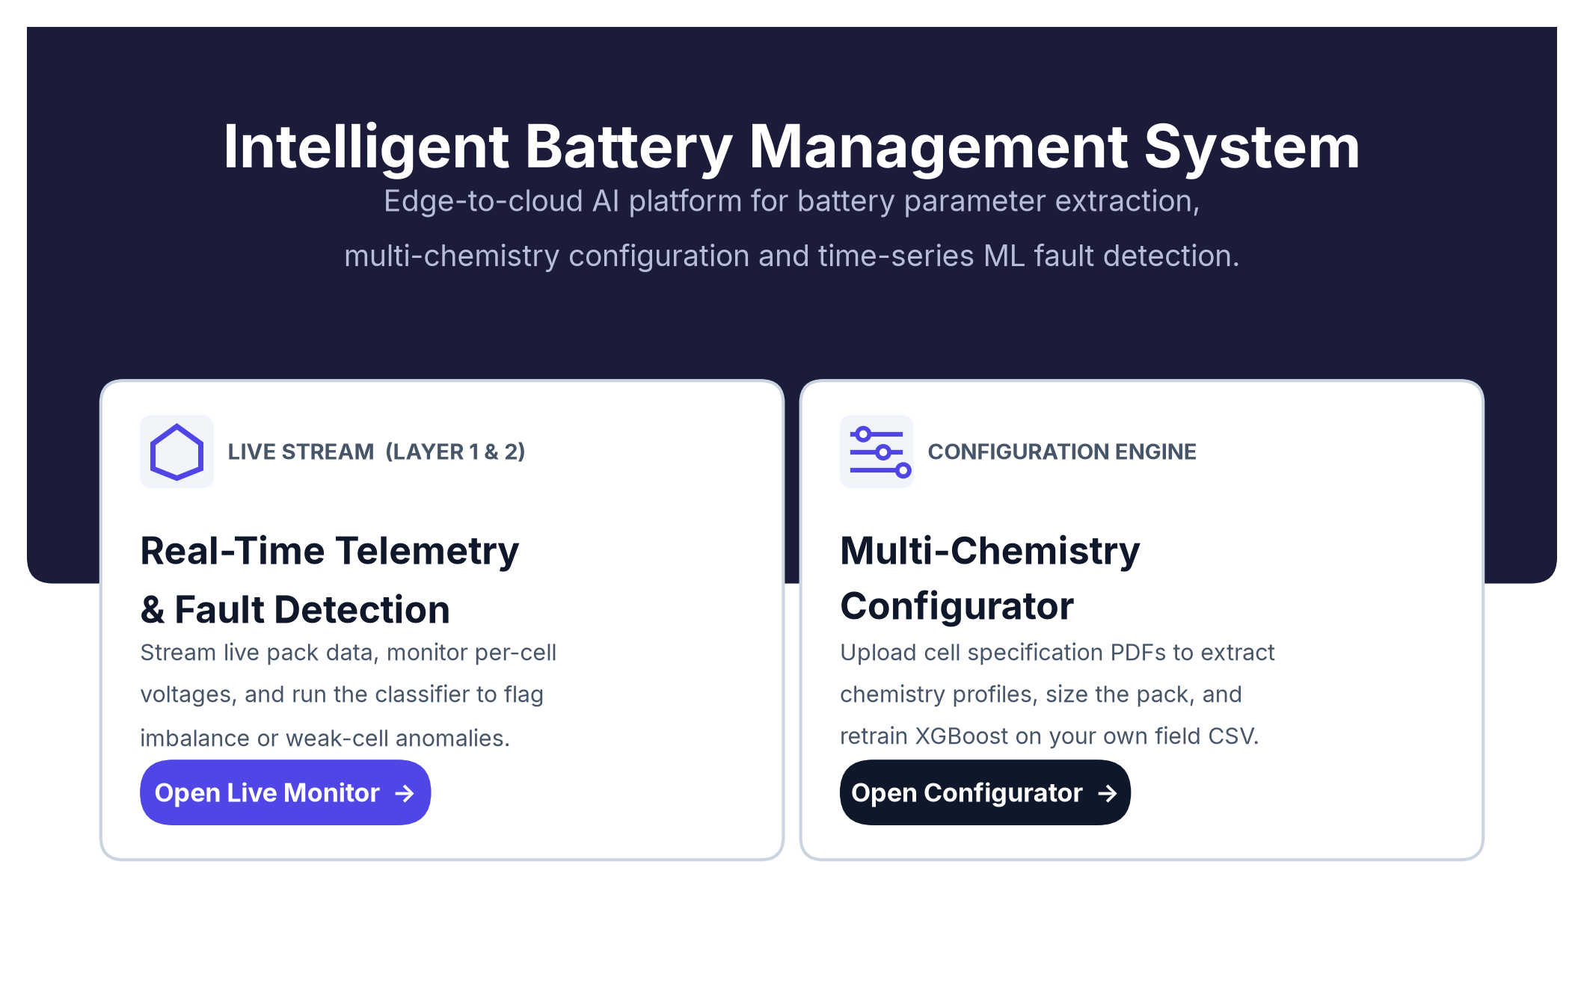
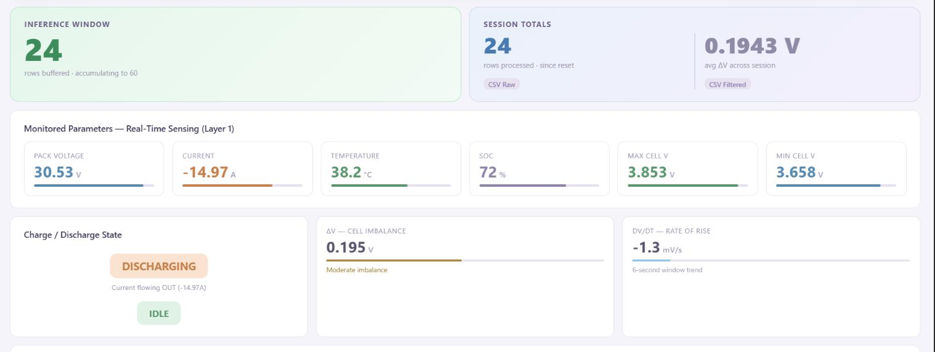
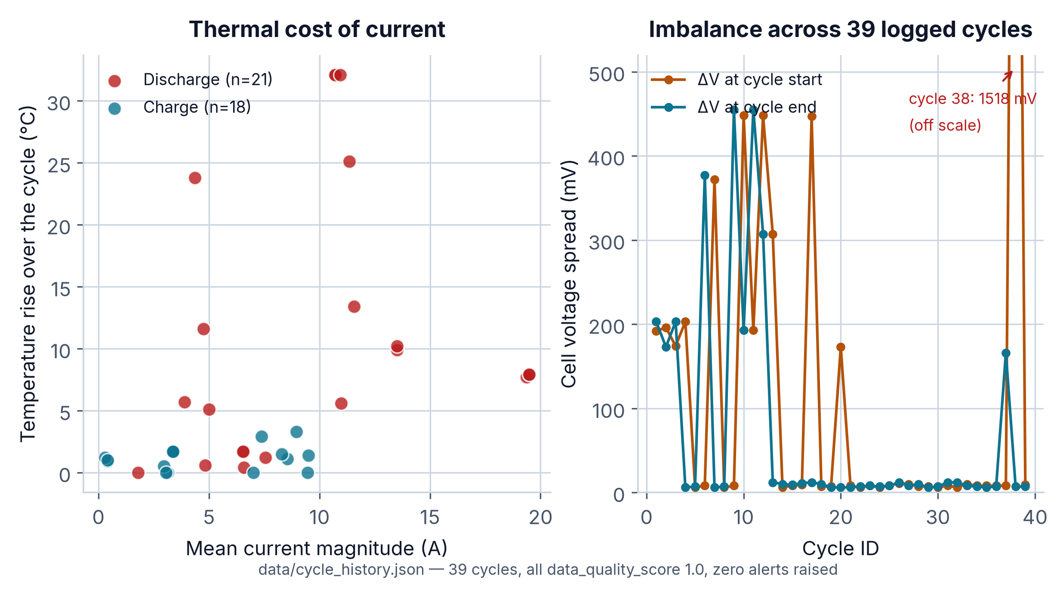
The platform an operator actually uses
Flask dashboard on Railway, live per-cell voltages.
Pack current and four temperature zones.
Charge/discharge ETA smoothed by EMA.
Four driving modes from |I(T)| vs |I(T-1)|.
39 cycles compared against their own history.
Alert log: value, threshold, severity, resolution.
IDLE
ACCEL
CRUISE
DECEL
CONTEXT IS A FEATURE
A sag under ACCEL is normal; the same sag at IDLE is a fault, so thresholds follow the mode. The three mode flags carry 12.4% of the model's total gain and ntc_spread another 5.0% — nearly a fifth of the decision comes from context pack-level sensors cannot provide.
AI-PBMS · Team ANS_4X
7
Notes:
The Pi runs the classifier locally and pushes results to a Flask
dashboard deployed on Railway, which is what you open in a browser. It is
operator-facing: live per-cell voltages, pack current with direction, four
thermal zones, and an ETA smoothed with an EMA so it does not jitter. The piece
worth calling out is driving context — four modes derived from the change in
current magnitude, because a voltage sag under hard acceleration is normal and
the same sag at idle is a fault. And the cycle engine compares each live cycle
against the average of all thirty-nine before it, so degradation shows up before
any absolute threshold is breached.

Slide 8
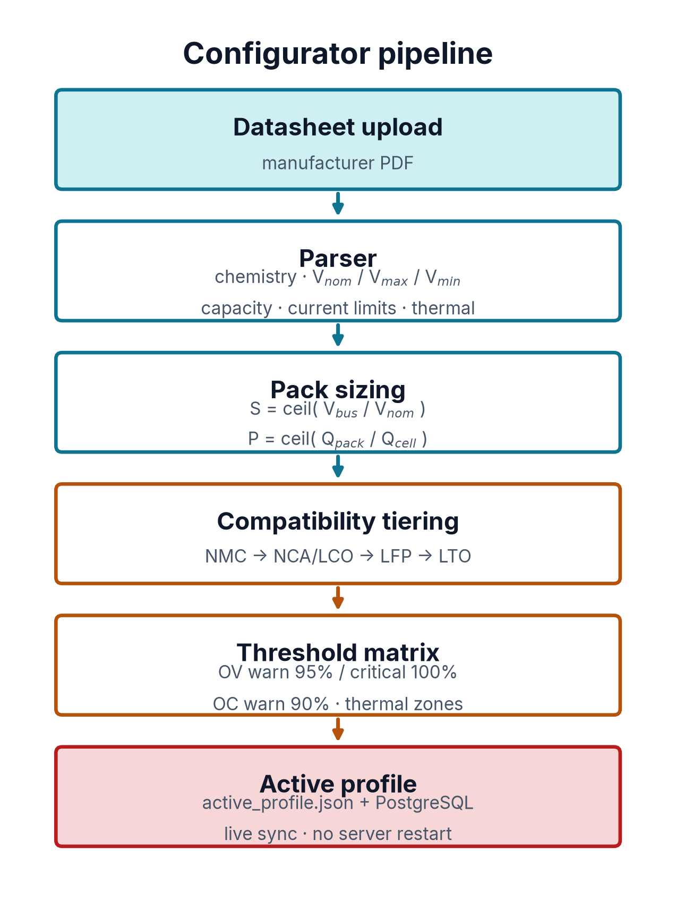
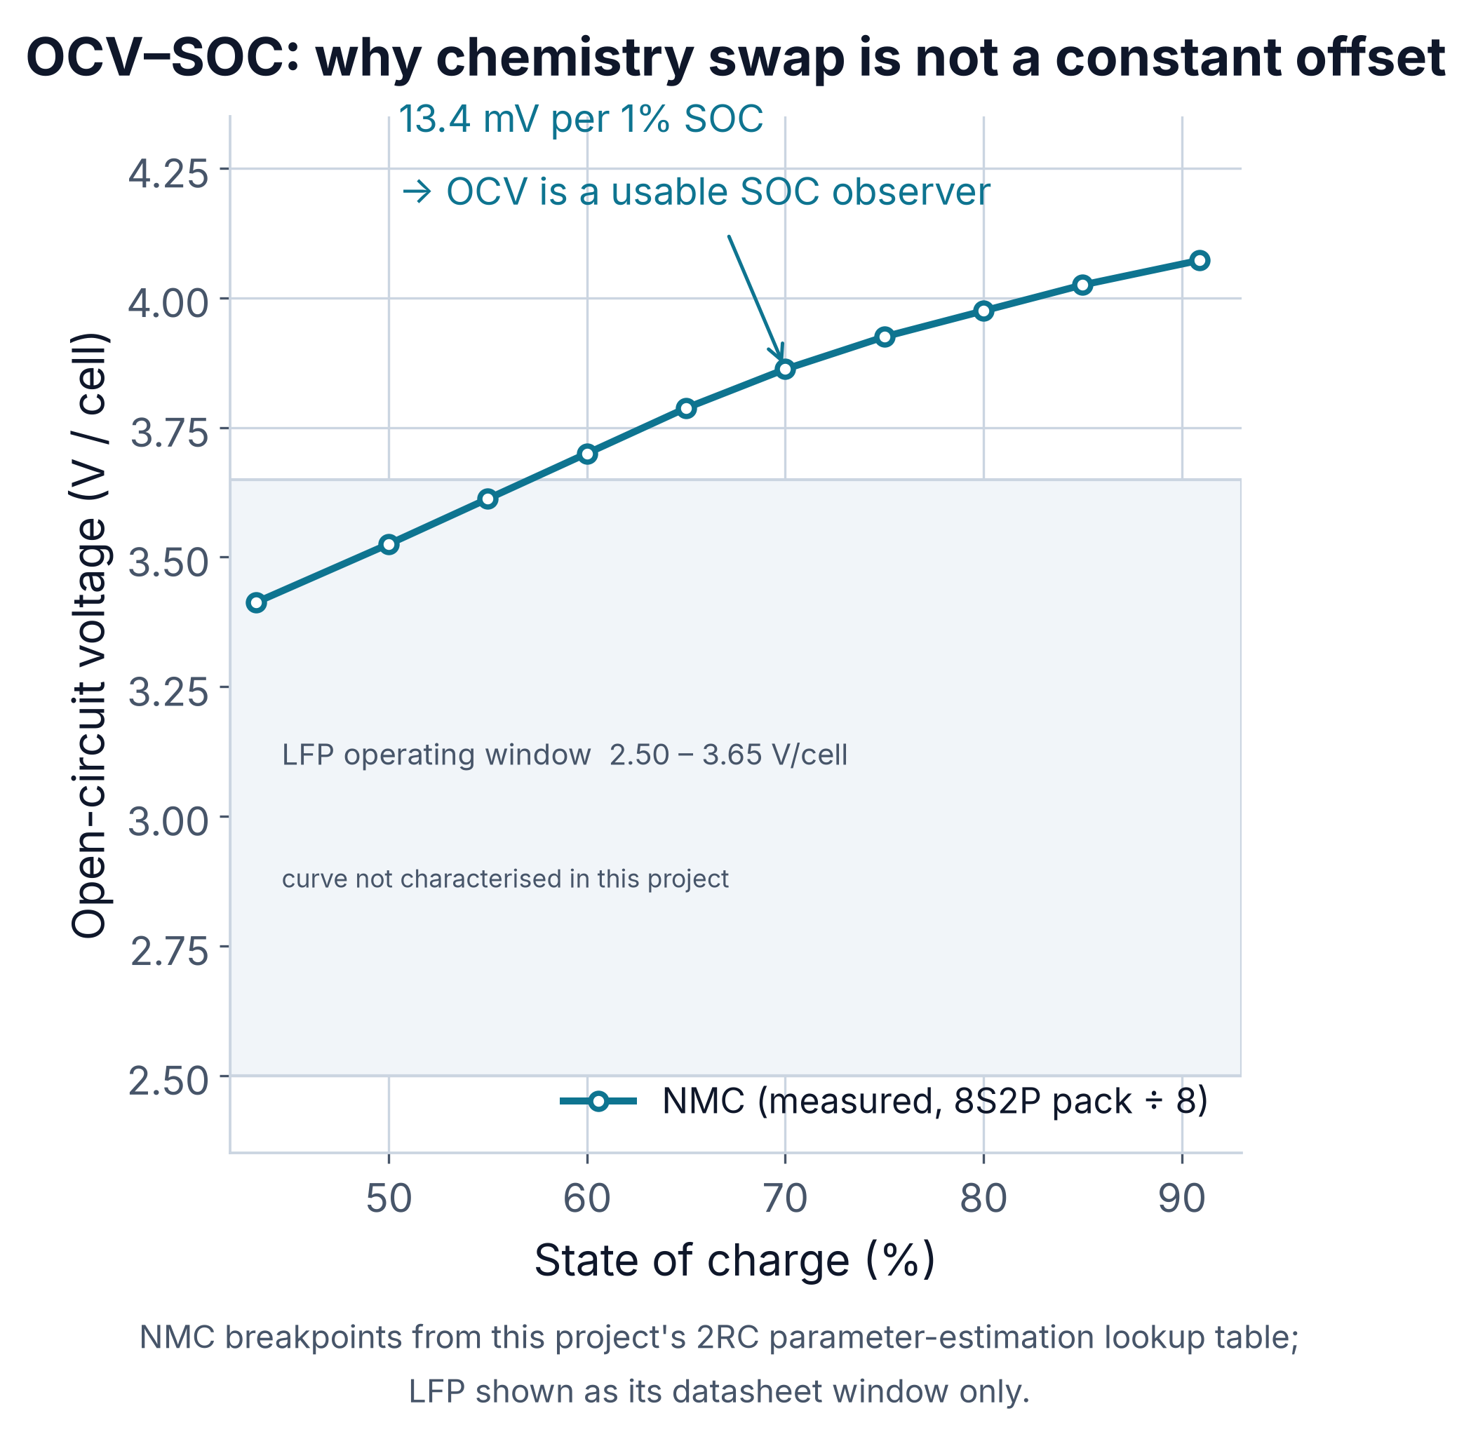
Swap the chemistry, not the codebase
Upload a datasheet PDF; the parser reads limits.
V_nom, V_max, V_min, capacity, current, thermal.
Pack sizing derives S and P from the bus target.
NMC reuse → NCA/LCO shift → LFP remap → LTO rescale.
Overvoltage warns 95%, critical 100%.
active_profile.json + PostgreSQL sync, no restart.
IN-BROWSER RETRAINING
Upload field telemetry from the new pack and retrain XGBoost from the dashboard — the adaptation loop closes without a developer.
WHAT WE WOULD BUILD NEXT
Why LFP needs a remap, not an offset
Close the Cell Imbalance gap
Lift OOD recall above 24.5%
Move inference onto the Zynq-7000
Characterise LFP on a real bench
SOH and remaining useful life from dV/dt
AI-PBMS · Team ANS_4X
8
Notes:
The last piece is what makes this reusable. Upload the manufacturer datasheet,
the parser pulls chemistry and every limit, pack sizing derives the series and
parallel counts, and the chemistry gets tiered: NMC is direct reuse, NCA and LCO
share the ceiling so they only shift, LFP needs a genuine remap to 2.50 to 3.65
volts because of that flat OCV curve, and LTO needs everything rescaled. And you
can retrain on your own field telemetry from the browser. What is not finished:
imbalance recall, OOD recall, the Zynq path, a real LFP bench, and state of
health. Thank you — happy to take questions.

Slide 9
References
LITERATURE — SOC, RUL AND FAULT GRADING
PRIMARY SOURCES — MANUFACTURER DATASHEETS
1
Bimodal images + BFRN
LG Energy Solution INR21700-M50
cell used in the 8S2P pack
Energy, 2024 · doi.org/10.1016/j.energy.2024.131700
DMEGC INR21700-45E
alternate NMC cell, parsed
2
Single-cycle charging
Energy, 2025 · doi.org/10.1016/j.energy.2025.138351
Panasonic NCR18650B
NCA tier reference
3
Multidomain features + CatBoost
P3 3232 LFP 26650
LFP tier reference
Energy Science & Engineering, 2023 · doi.org/10.1002/ese3.1506
JBD SP24S007 V1.1
BMS protocol + registers
4
CNN-BiLSTM-BiGRU with attention
Journal of Energy Storage, 2024 · doi.org/10.1016/j.est.2024.113074
METHODS
5
Yang, S., Xu, B., Peng, H. — “Isolation and Grading of Faults in
Battery Packs Based on Machine Learning Methods”
Chen, T. & Guestrin, C.
“XGBoost: A Scalable Tree Boosting System”, KDD 2016
Liu, F. T., Ting, K. M. & Zhou, Z.-H.
Electronics, 11(9), 1494, 2022 · mdpi.com/2079-9292/11/9/1494
“Isolation Forest”, ICDM 2008
Vaswani, A. et al.
“Attention Is All You Need”, NeurIPS 2017
Pedregosa, F. et al.
“Scikit-learn: Machine Learning in Python”, JMLR 12, 2011
STACK
xgboost 3.2.0 · scikit-learn 1.9.1 · torch 2.14.0 · numpy 2.4.6
bleak · Flask · PostgreSQL · Railway · MATLAB / Simulink
AI-PBMS · Team ANS_4X
9
Notes:
Five papers shaped the approach. The first four are the state-of-the-art we
benchmarked our thinking against for state-of-charge and remaining-useful-life
prediction — bimodal image encoding, single-cycle charging features, multidomain
features with CatBoost, and the CNN-BiLSTM-BiGRU attention stack. The fifth,
Yang, Xu and Peng in Electronics, is where our confidence-scoring and fault
grading framework comes from — that is the source of the three-tier abstain,
warn, alert structure on slide five. On the right are the primary sources: the
manufacturer datasheets the threshold matrix is parsed from, and the JBD
protocol spec the logger was written against. Happy to take questions.

