Slide 1
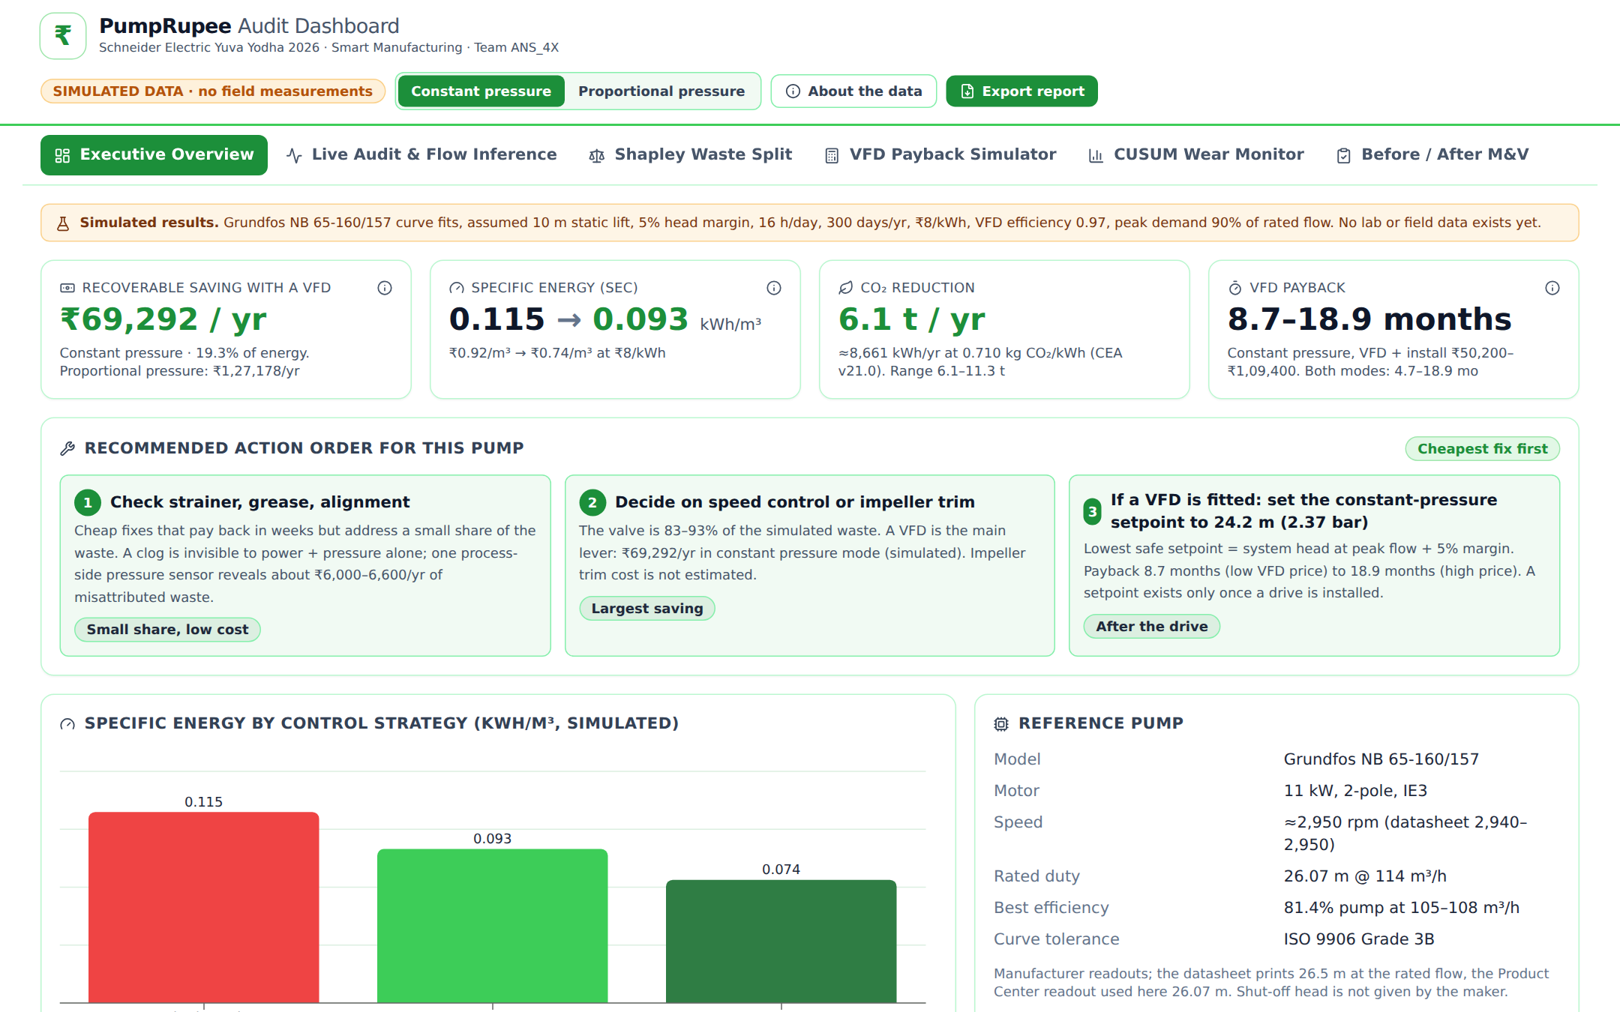

PumpRupee
pumprupee-dashboard.vercel.app
Find the rupees your pumps waste, before you buy a VFD
No flow meter
No shutdown
₹ waste by cause
Team ANS_4X
Schneider Electric Yuva Yodha Energy Tech Hackathon 2026
Track: Smart Manufacturing · Electrify · Automate · Digitalise
Working prototype dashboard · simulated data
Live prototype dashboard
https://pumprupee-dashboard.vercel.app/
Simulated data · scan the QR code
All results are simulated (Grundfos NB 65-160/157, 11 kW). Prices are indicative, not quotes.
Notes:
Open the live dashboard from the QR code. Simulated data throughout. One sentence: PumpRupee tells an MSME owner how many rupees a pump wastes, why, and whether a VFD will pay back for that pump, using a cheap clamp-on kit and no flow meter.

Slide 2







Problem Statement
Oversized pumps run throttled. The extra energy is burnt across a valve, every hour, and nobody sees it.
Oversized pump
Sized above the real duty
Valve half shut
Throttled to hold flow
Energy lost as heat
Head burnt in the valve
₹ leaking
On every bill
You pay for the pump AND for fighting the valve.
Oversizing is common
Flow is hard to measure
Audits miss small plants
An energy-audit practitioner: wrong sizing leading to throttling is the most common cause.
Ultrasonic meters: 30–40% of readings go wrong (practitioner report). Pressure and power are easy.
Full audits are a poor fit for small plants; very small plants rarely prioritise this.
Head (pressure) and electrical power are cheap to measure. Flow is not. PumpRupee infers flow from the two that are.
Notes:
Anchor on the owner being blind. The 30-40% figure is an audit practitioner's report about ultrasonic meters, not our measurement.

Slide 3
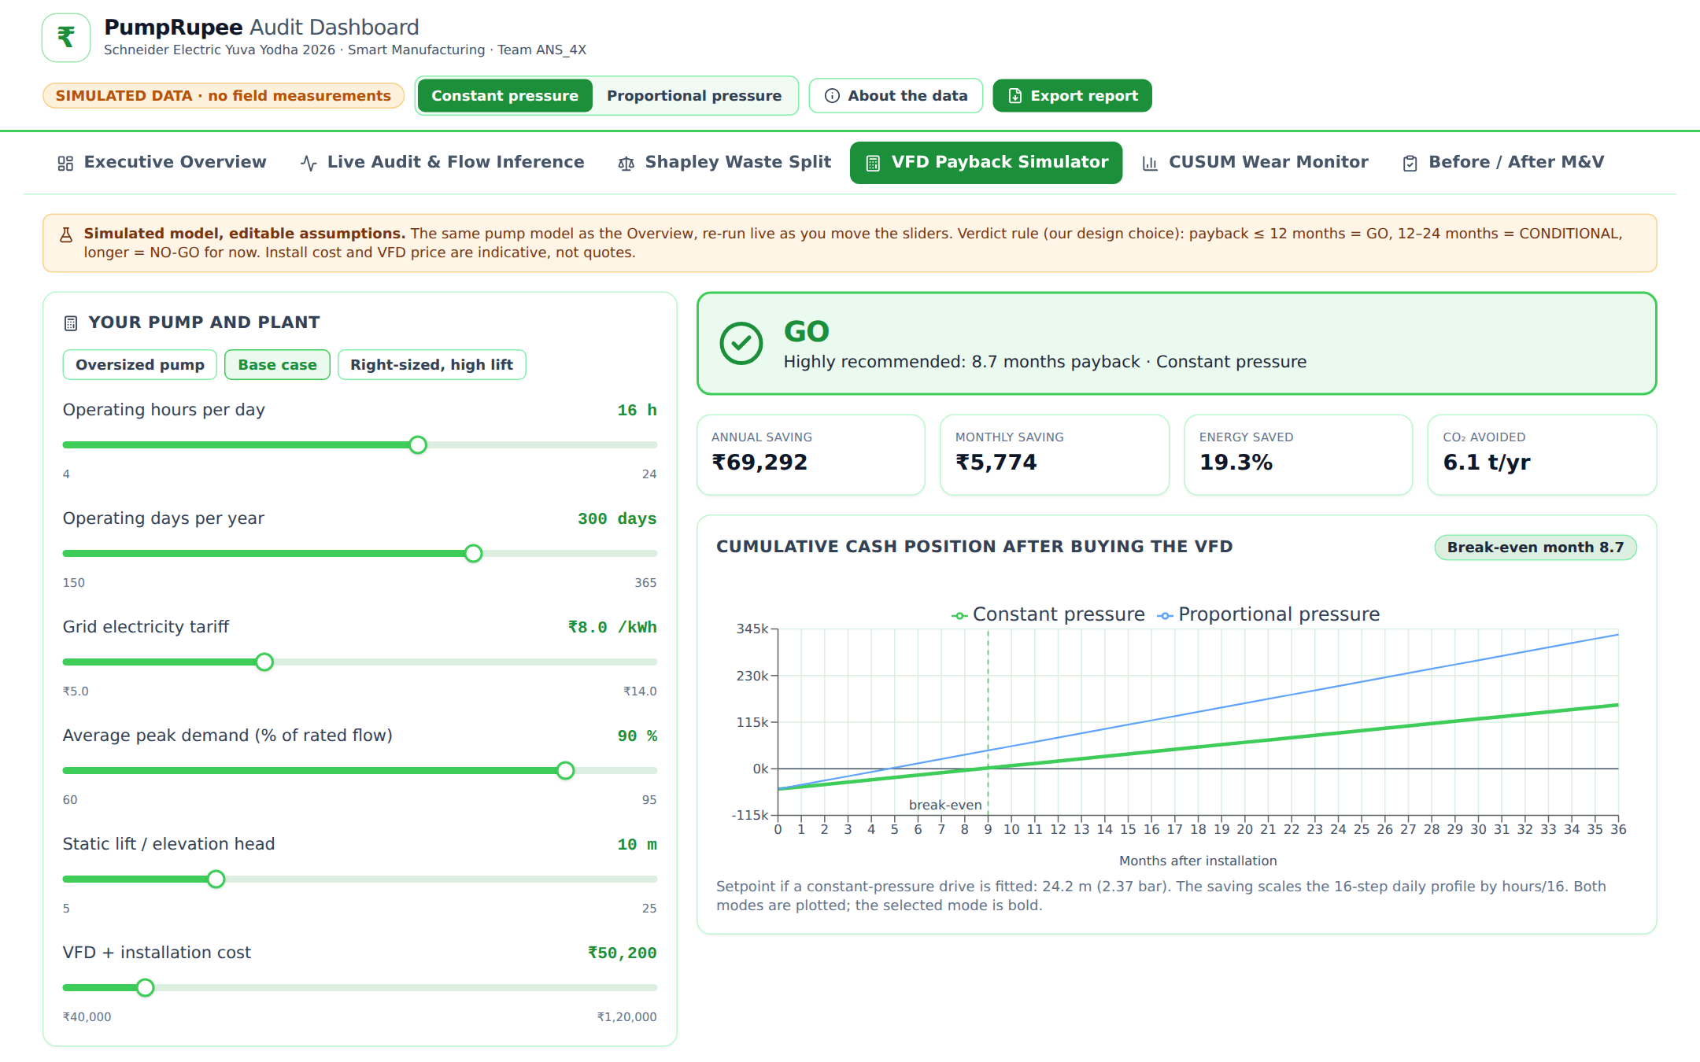

Proposed Solution
A clamp-on kit and a web dashboard turn power + pressure into “₹ wasted per year, and why”.
pumprupee-dashboard.vercel.app
Pressure transmitter
ESP32
logger
Power clamp (on motor cable)
Throttle valve
Motor
Pump
Strainer + optional
2nd transmitter
Working prototype dashboard · simulated data
Concept illustration of the kit on a pump skid
₹ waste per year, by cause
Cheapest fix first + safe setpoint
Clamp on → log 7–14 days → ₹ report → the right fix
VFD payback verdict for THIS pump
Verified saving after the fix
Audits and recommends. Does not control the pump.
Notes:
The dashboard shown is the working prototype with simulated data. The kit is clamp-on: no pipe cutting, no shutdown. It never controls the pump.

Slide 4


Alignment to Smart Manufacturing
Electrify · Automate · Digitalise, at an entry cost an MSME can afford.
Electrify
Automate
Digitalise
Makes motor energy visible with a clamp-on power measurement
Points owners to the pumps where a right-sized drive pays back
Automatic diagnosis of waste by cause
Wear-drift alarm (CUSUM) on the pump
Lowest safe VFD setpoint; the drive does the controlling
Logs become a ₹ business case on a dashboard
Before/after proof of the saving
Owner keeps the data and can use any drive
How PumpRupee feeds drives and energy management
1
2
3
4
5
PumpRupee audit
Clamp-on, 7–14 days
₹ business case
Waste by cause + VFD verdict
VFD installed
e.g. Altivar Process
PumpRupee re-measures
Same kit, after the fix
Verified saving
Feeds energy management, e.g. EcoStruxure
A low-cost front door that expands VFD and energy-management adoption into MSMEs that skip audits today. Concept only: no drive or platform integration built.
Notes:
Schneider products are named only as the natural next step after an audit. Say it positively: PumpRupee finds which pumps justify an Altivar-class drive.

Slide 5






Key Features & User Journey
Seven steps from clamp-on to a verified saving.
Clamp on Power clamp on the motor cable
pumprupee-dashboard.vercel.app
Fit sensors Pressure on existing gauge ports
Log 7–14 days ESP32 records power + pressure
1
2
Open the dashboard ₹ report by cause
Apply the fix Cheapest first; VFD verdict
3
Re-measure Verify the saving
Move the kit Next pump
₹ waste by cause
No flow meter
No shutdown
VFD verdict
Verified savings
Reusable kit
Working prototype dashboard · simulated data
Live prototype dashboard
https://pumprupee-dashboard.vercel.app/
Simulated data · scan the QR code
1
₹ saving per year with a VFD (simulated)
2
VFD payback range
3
Cheapest fix first, with the safe setpoint
Notes:
Walk the numbered callouts on the dashboard: 1 the rupee saving, 2 the payback range, 3 the cheapest-fix-first order. Everything shown is simulated.

Slide 6
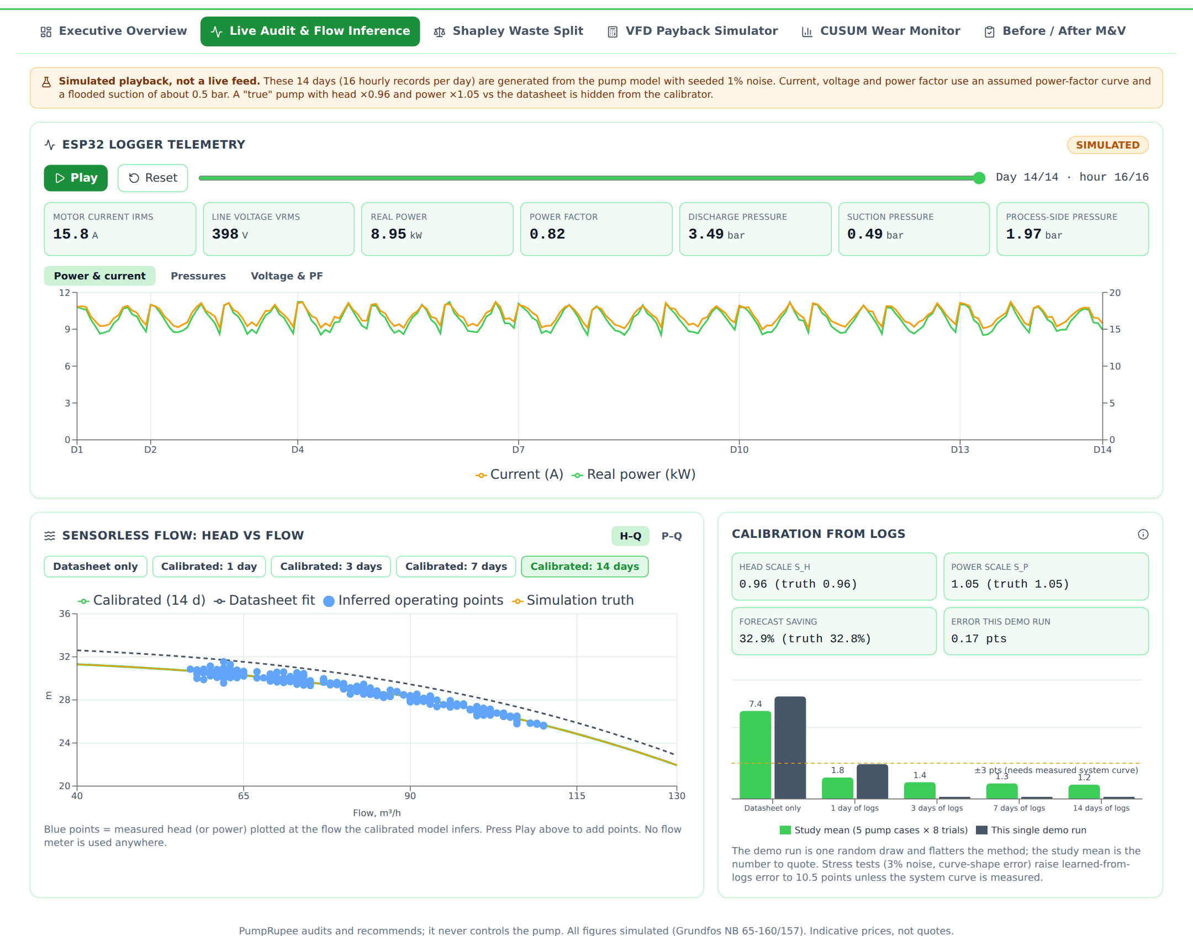
Technical Approach
Motor
Pump
Throttle valve
Process
pumprupee-dashboard.vercel.app
Power clamp
P1 suction (opt.)
P2 discharge
P3 process side
(optional)
1
Minimum kit: clamp + P2. Add P3 before a VFD purchase.
Logs
Calibrate
Infer flow
Shapley split
CUSUM check
₹ report
Shapley = fair split of blame between causes. CUSUM = early alarm when the pump slowly wears. SEC = electricity units per m³ pumped.
2
3
Grundfos NB 65-160/157 curves (fit to maker data)
Working prototype dashboard · simulated data
1
14 days of ESP32 logs (simulated playback)
2
Flow inferred from curve + power + head
At an off-peak 61.6 m³/h the throttled pump delivers 31.7 m; the pipe needs 15.4 m. The gap is priced in ₹. Simulated; system curve assumed.
3
Calibration error vs study mean
About ±3 points only with a measured system curve; otherwise about ±10.
Notes:
Calibration: two scale factors (head, power) are fitted from 7-14 days of logs by profile likelihood; no flow meter. The system curve is the biggest error source, which is why the optional P3 sensor exists.

Slide 7
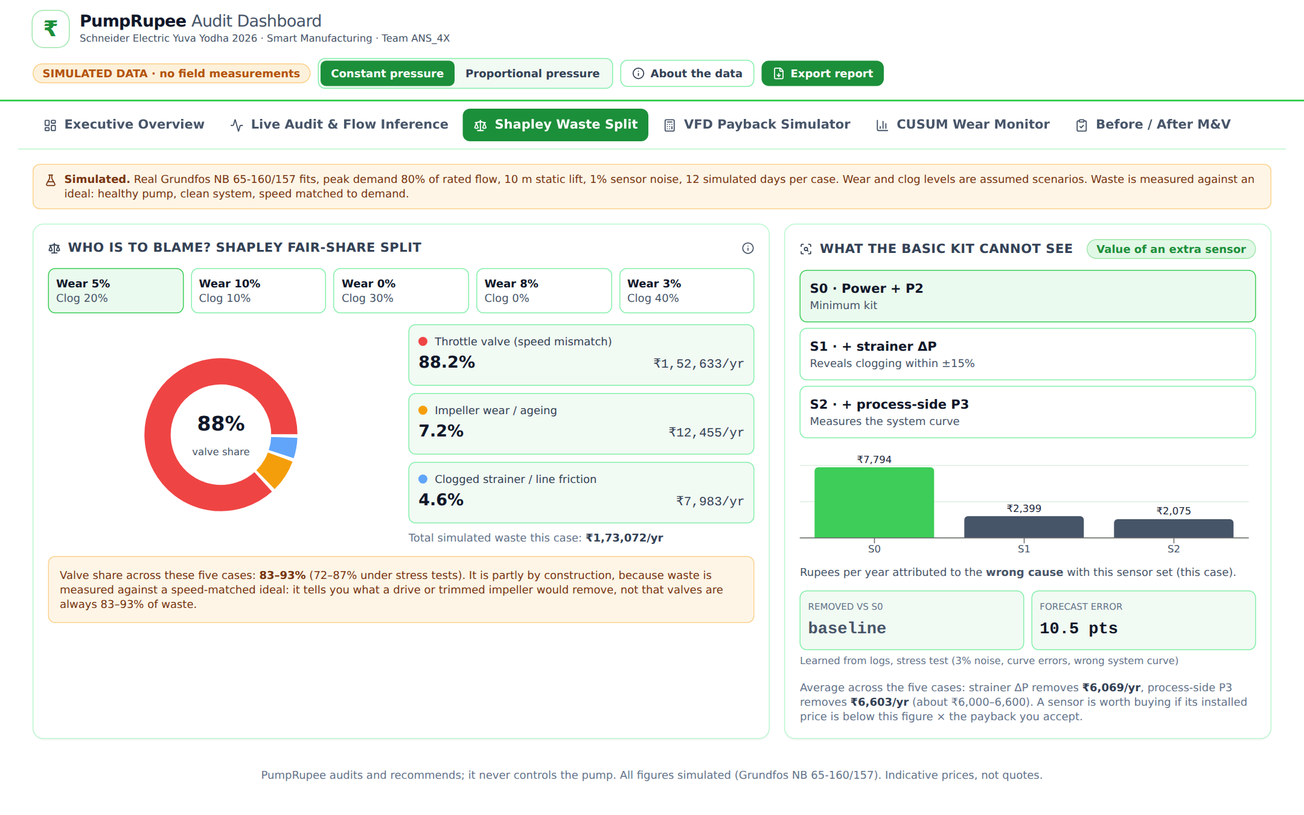
Prototype & Simulated Results
SIMULATED – Grundfos NB 65-160/157, 11 kW · 10 m lift · 5% margin · 16 h/day · 300 days · ₹8/kWh
pumprupee-dashboard.vercel.app
pumprupee-dashboard.vercel.app
1
2
1
3
3
2
Working prototype dashboard · simulated data
Working prototype dashboard · simulated data
1
Valve is the largest share of waste
1
GO / NO-GO verdict for this pump
2
₹/yr attributed to the wrong cause, by sensor tier
2
Annual saving in ₹
3
Valve share is partly by construction
3
Break-even month
₹69,292 / ₹1,27,178
per year (constant / proportional)
83–93%
of waste is the valve
4–19 months
VFD payback, oversized pump
±3 / ±10 pts
with / without measured system curve
Notes:
Screenshots are from the working prototype dashboard, simulated data. Forecast error: 1.4 points with a process-side sensor vs 10.5 points without, under stress. A +/-30% flow reading is worse than no calibration.

Slide 8


Innovation
We build on proven tools. The new part is the integration for MSMEs.
Already exists (we build on it)
Flow meter
Manual audit
Full platform
PumpRupee
KSB PumpMeter, US DOE PSAT
Samotics (motor-current efficiency)
Schneider Altivar Process (sensorless flow), EcoStruxure
Indian IoT vendors and ESCOs
Shapley split and CUSUM: known methods
Upfront cost, small plant
Meter + install
Fee per visit
Higher
₹6,100–13,300
No shutdown
Answer in ₹
Cause breakdown
Our integration
VFD verdict
₹ waste split by cause
Prices the value of an extra sensor
Low-cost shared kit, no flow meter
Built-in before/after verification
Pump-specific VFD verdict before capex
Verified savings
Fits small MSMEs
✔ yes ~ partly / varies ✘ no. Our general assessment; PumpRupee's ticks are design targets (simulated).
We found no low-cost shared kit that combines these. Full platforms are the next step after PumpRupee.
Notes:
Never say 'none exists'. Altivar Process does sensorless flow inside the drive after it is bought; PumpRupee helps decide which pumps deserve one and verifies the saving.

Slide 9



Expected Impact
SIMULATED – per 11 kW pump; prices indicative, not quotes
A one-time kit vs a yearly saving (₹)
6.1–11.3 t
CO₂ avoided per pump per year (0.710 kg/kWh)
Kit, one-time and reusable (top tier)
₹13,300
Saving per year, constant pressure
₹50,200–1,09,400
wrong VFD purchase avoided where it won't pay back
₹69,292
Saving per year, proportional pressure
₹1,27,178
4–19 months
payback, oversized pump (2–4+ years if right-sized, high lift)
One kit ≈ 5–19% of a year's simulated saving on one pump.
Who benefits
MSME plant owners
Maintenance teams
Energy auditors / ESCOs
Drive channel partners
India's industrial efficiency goals
Scale-up illustration, not a projection: total = N pumps × per-pump saving. For N = 10: ₹6,92,920–12,71,780 per year and 61–113 t CO₂ per year, using the 11 kW base case. The 54–60% saving for heavily oversized pumps is an upper bound only.
Notes:
5-19% = 6,100/127,178 = 4.8% up to 13,300/69,292 = 19.2%. N=10 is arithmetic, not a forecast.

Slide 10
Implementation Roadmap
What is done, what is next, and which limit each phase removes.
1
2
3
4
5
Simulation + dashboard
Real Grundfos curve fits, stress tests, working web dashboard (simulated data).
Limit removed: none yet
Bench test
Real pump, ESP32 kit and a reference flow meter.
Removes: flow-inference accuracy, head = discharge − suction
Pilot, 1–2 plants
Measure the system curve on site; log 7–14 days.
Removes: ±10 → ±3 points
Validate forecast
Compare the forecast with the measured saving after a fix.
Removes: optimistic system-curve fit
Rollout
Multi-pump, multi-plant; ESCO and channel use.
Widens: parallel pumps, drives, NPSH
DONE
NEXT
PLANNED
PLANNED
PLANNED
Honest limits we validate next
Simulation and software prototype only: no lab or field data, no real quotes
About ±3 points only with a measured system curve; otherwise about ±10; the curve fit is optimistic
Single pump, steady state. Out of scope: parallel pumps, closed loops, pumps already on drives, min-flow/NPSH, control dynamics
Notes:
Lead with 'done' and 'next'. Ask: a pilot plant and a reference flow meter.

Slide 11
Team Introduction
Team ANS_4X · Schneider Electric Yuva Yodha 2026 · Smart Manufacturing
Insert
photo
Insert
photo
Insert
photo
Insert
photo
Akshaya V G
Team Lead & Software/Dashboard
Data pipeline and the PumpRupee web dashboard
Adithyaa J
Embedded Hardware
ESP32 logger, power clamp and pressure-sensor integration
Nikilaesh B
Energy Analytics
Pump hydraulics model, Shapley waste split and VFD payback logic
Siva Subramaniam S
Simulation & Validation
Pump-curve simulation, CUSUM wear-drift testing, pilot and roadmap planning
Live prototype dashboard
https://pumprupee-dashboard.vercel.app/
Simulated data · scan the QR code
Cheap kit. Clever inference. Answers in rupees.
Notes:
Close: cheap kit, clever inference, answers in rupees. Share the live link.

