Slide 1
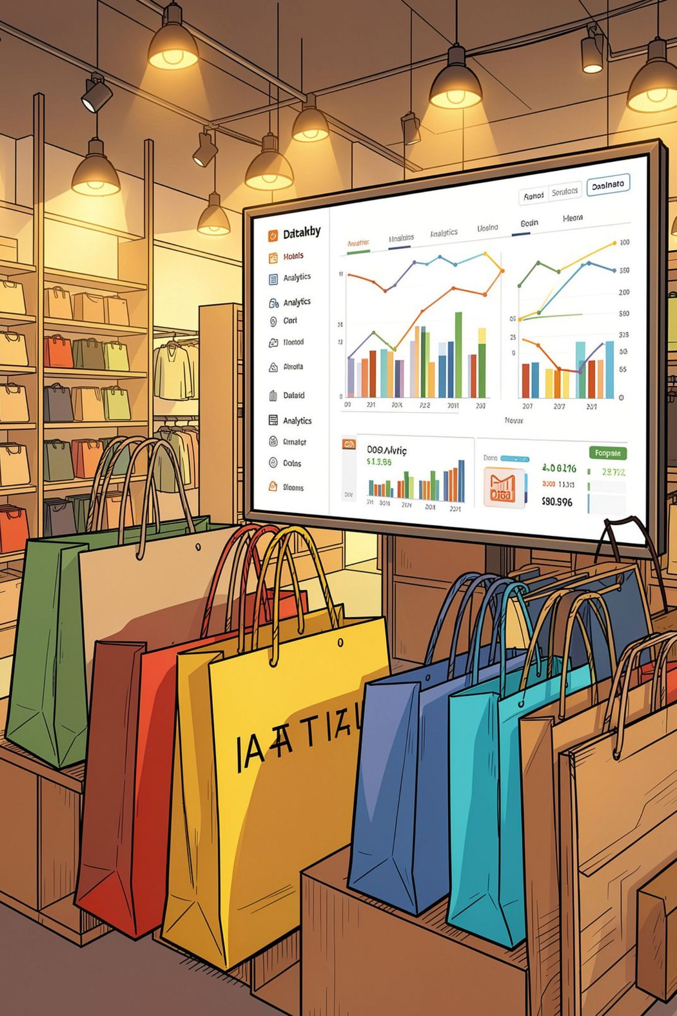
Customer Shopping Behavior Analysis
Uncovering spending patterns, customer segments, and product preferences from 3,900 transactions to guide strategic business decisions.

Slide 2
Dataset at a Glance
3,900
18
Purchases
Features
Transactional records analyzed
Demographics, purchase details, behavior
37
50
Missing Values
Locations
Only in Review Rating column
Unique geographic areas
Key features include customer demographics (Age, Gender, Location, Subscription Status), purchase details (Item, Category, Amount, Season, Size, Color), and shopping behavior (Discount, Frequency, Review Rating, Shipping Type).

Slide 3


Data Preparation in Python
Load & Explore
Imported via pandas; used df.info() and .describe() for structure and statistics.
Clean & Standardize
Imputed missing Review Ratings using median per category; renamed columns to snake_case.
Feature Engineering
Created age_group bins and purchase_frequency_days; dropped redundant promo_code_used.
Database Integration
Loaded cleaned DataFrame into PostgreSQL for SQL analysis.

Slide 4
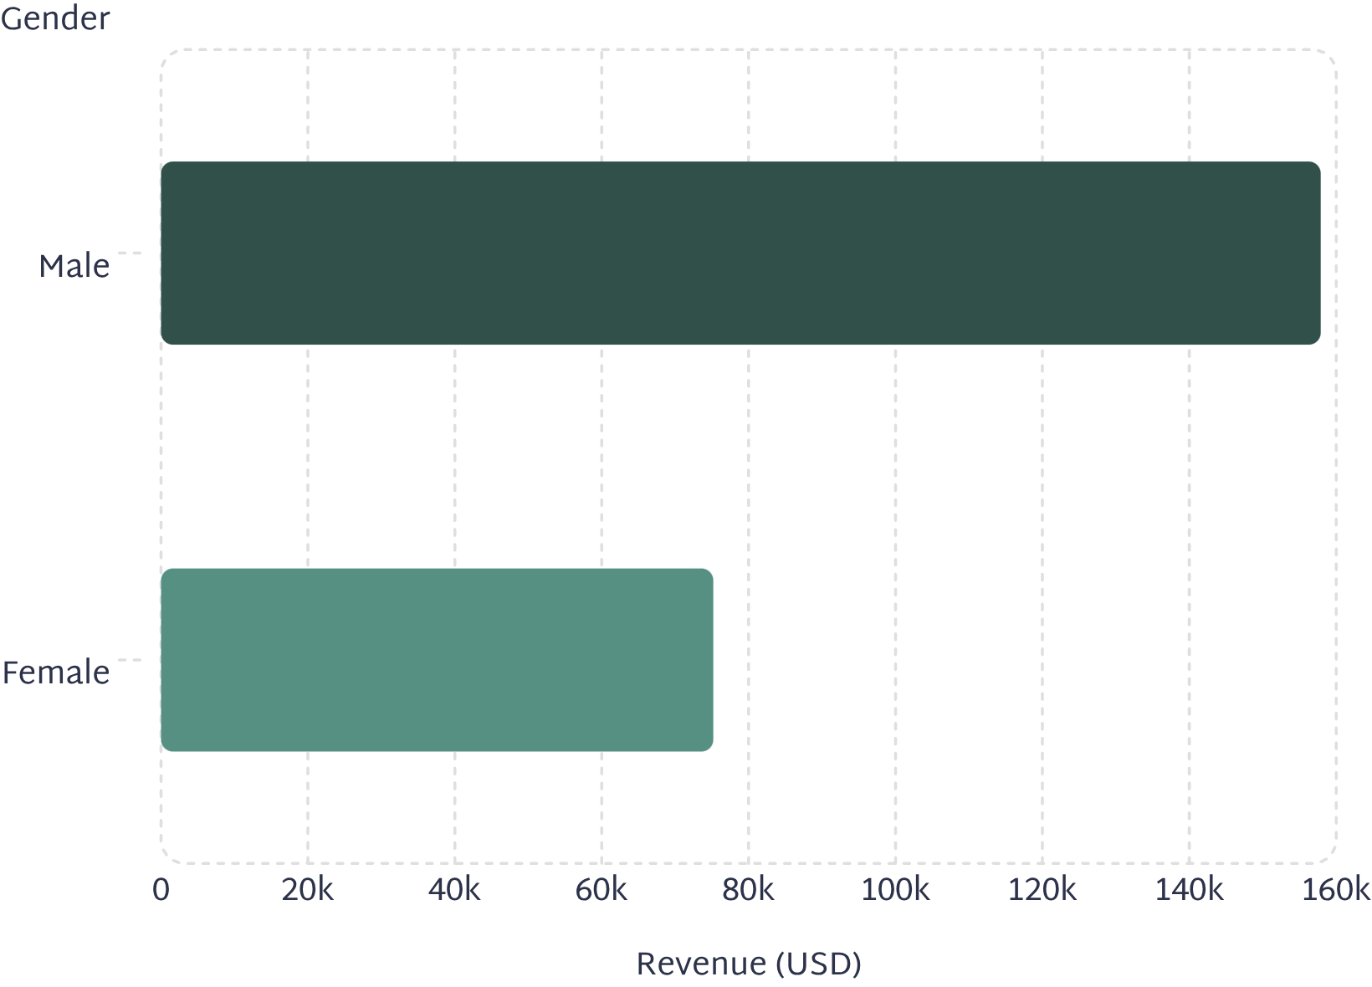
Revenue by Gender
Male Customers Drive 2× Revenue
Male customers generated $157,890 in total revenue compared to $75,191 from female customers — a significant gap worth investigating further.
This disparity suggests opportunities to better understand purchasing behavior differences and potentially develop targeted strategies to increase engagement among female shoppers.

Slide 5
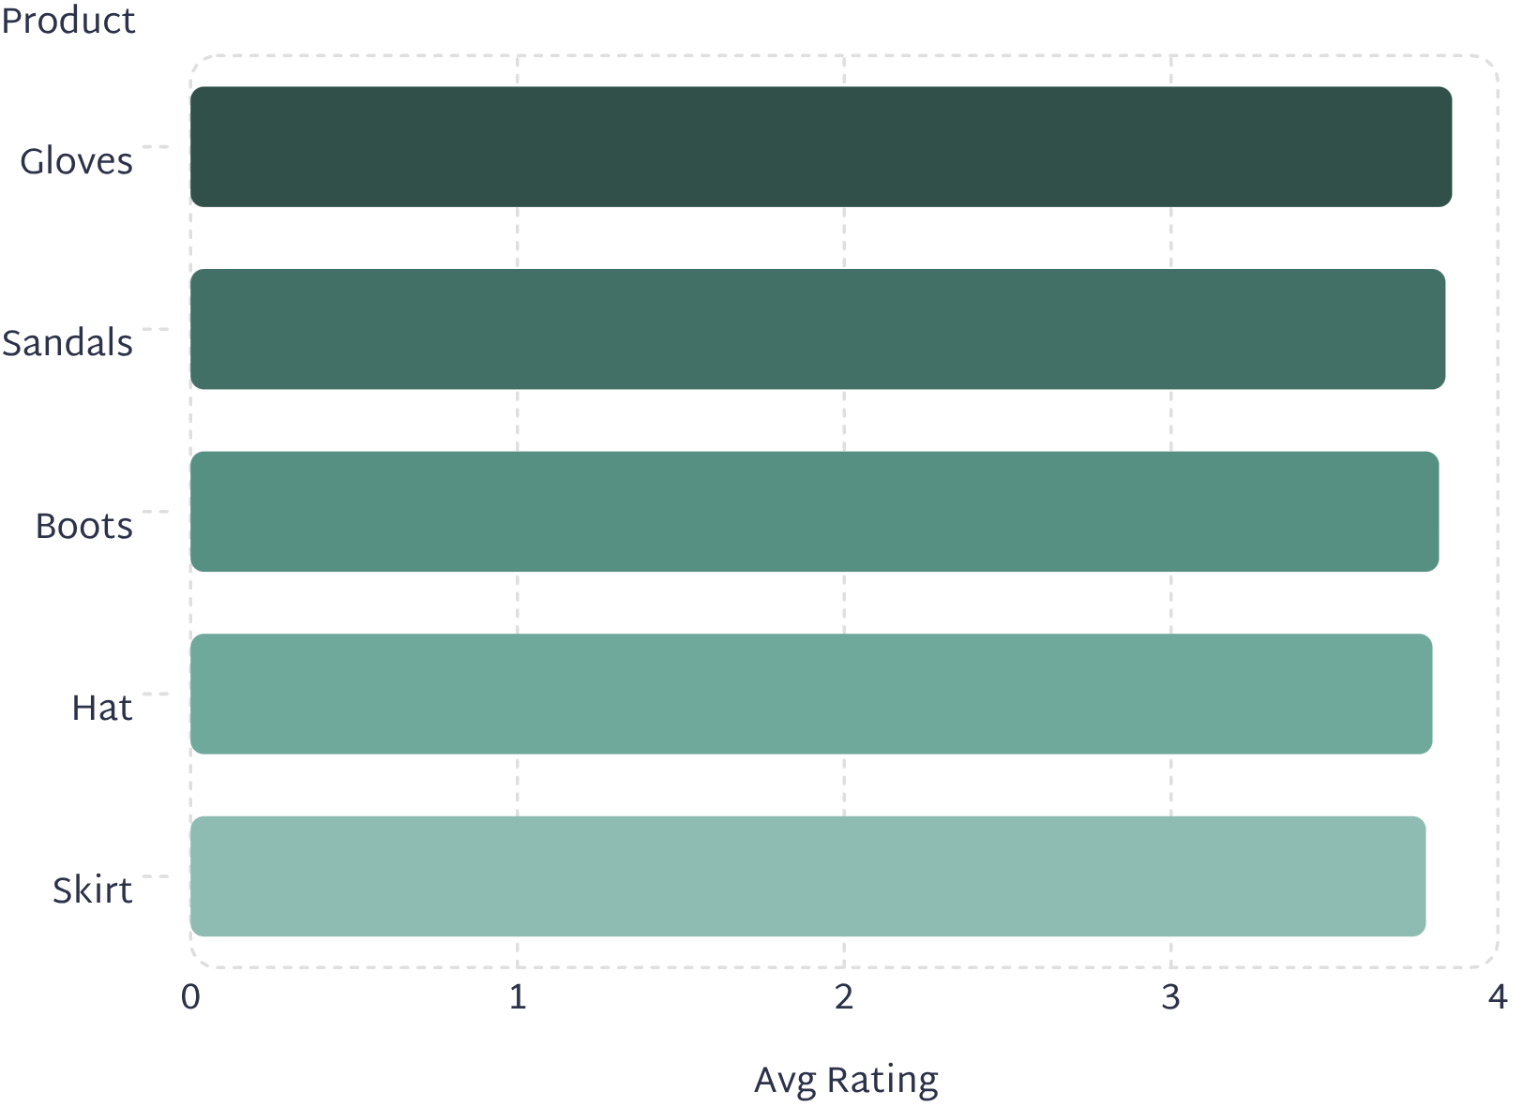
Top Products & Discount Insights
Top 5 Products by Average Rating
Most Discount-Dependent Products
These products had the highest share of discounted purchases:
Hat — 50.00% discounted
Sneakers — 49.66% discounted
Coat — 49.07% discounted
Sweater — 48.17% discounted
Pants — 47.37% discounted
Additionally, 839 customers used discounts while still spending above the average purchase amount, indicating strong discount-driven purchasing behavior.

Slide 6
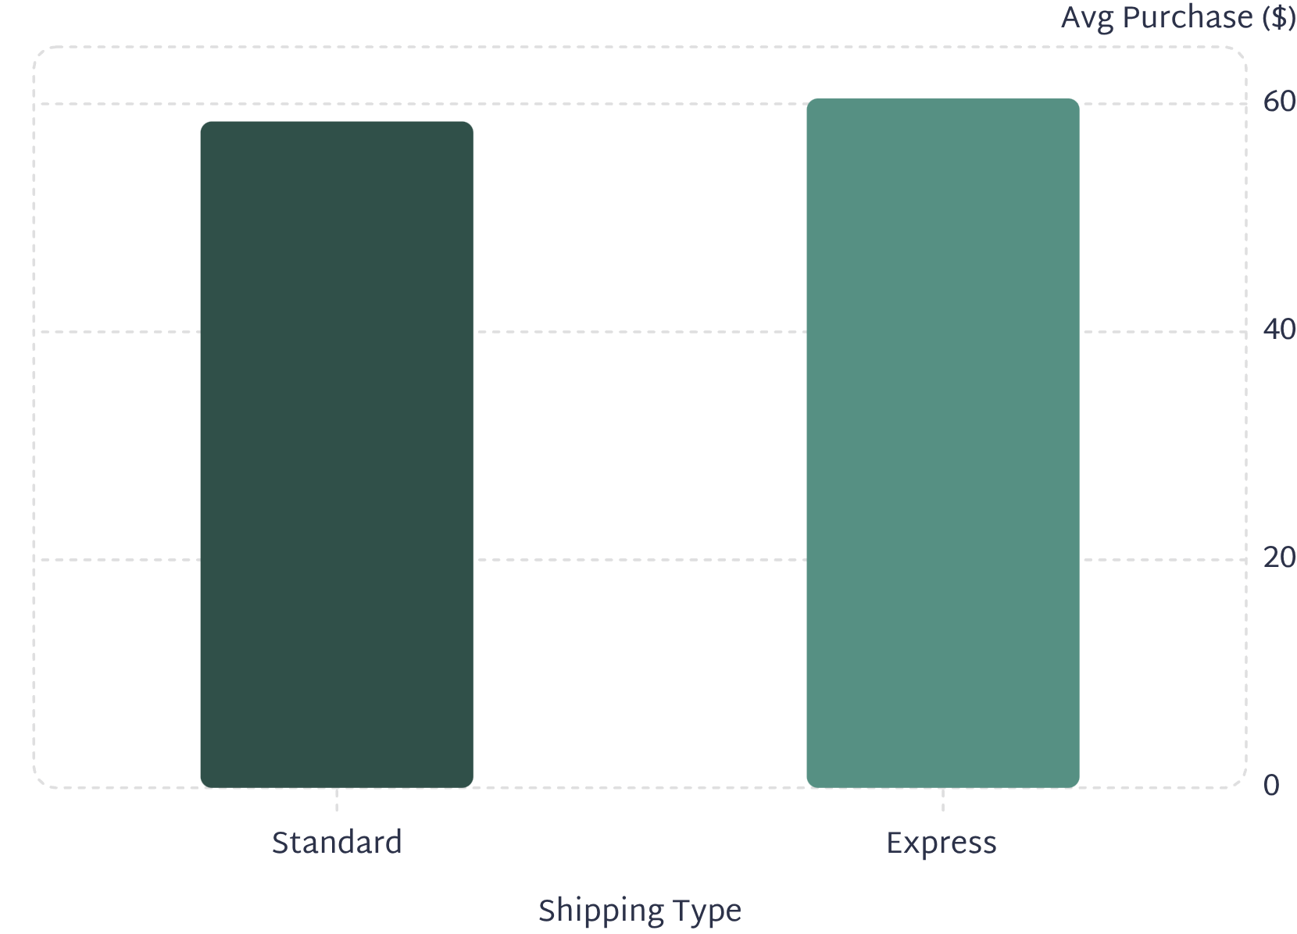
Shipping & Subscription Analysis
Avg. Purchase by Shipping Type
Subscribers vs. Non-Subscribers
Average spend is nearly identical, but non-subscribers drive more total revenue due to volume.
Among customers with more than 5 purchases, 958 are subscribers and 2,518 are not, suggesting repeat buyers are not necessarily converting to subscriptions.
Subscribers (Yes)
Non-Subscribers (No)
1,053 customers · $59.49 avg · $62,645 total
2,847 customers · $59.87 avg · $170,436 total

Slide 7
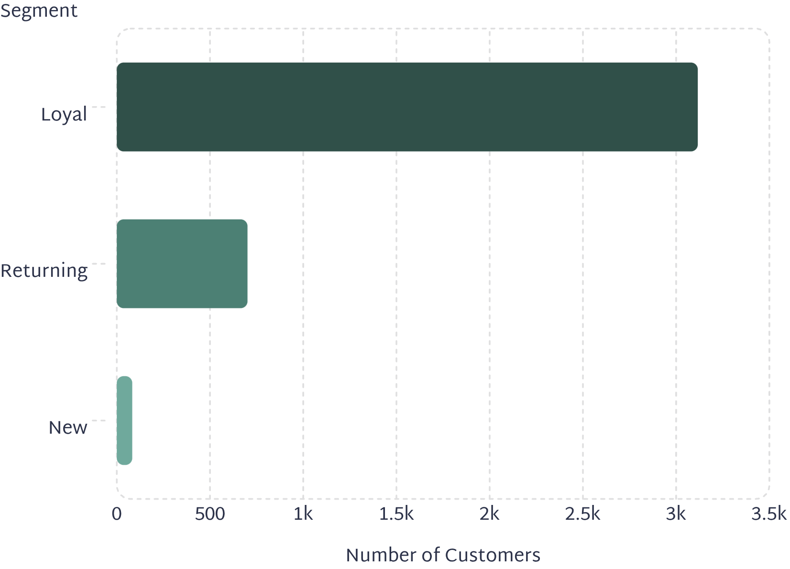
Customer Segmentation
Segment Breakdown
Customers classified by purchase history into three segments:
With 80% of customers already in the Loyal segment, the focus should shift toward converting Returning and New customers through targeted loyalty incentives and onboarding campaigns.
Loyal
Returning
New
3,116 customers — the dominant segment
701 customers — growing potential
83 customers — acquisition opportunity

Slide 8
Top Products by Category
Most purchased items within each of the four product categories:
Accessories
Clothing
Jewelry — 171 orders
Sunglasses — 161 orders
Belt — 161 orders
Blouse — 171 orders
Pants — 171 orders
Shirt — 169 orders
Footwear
Outerwear
Sandals — 160 orders
Shoes — 150 orders
Sneakers — 145 orders
Jacket — 163 orders
Coat — 161 orders

Slide 9
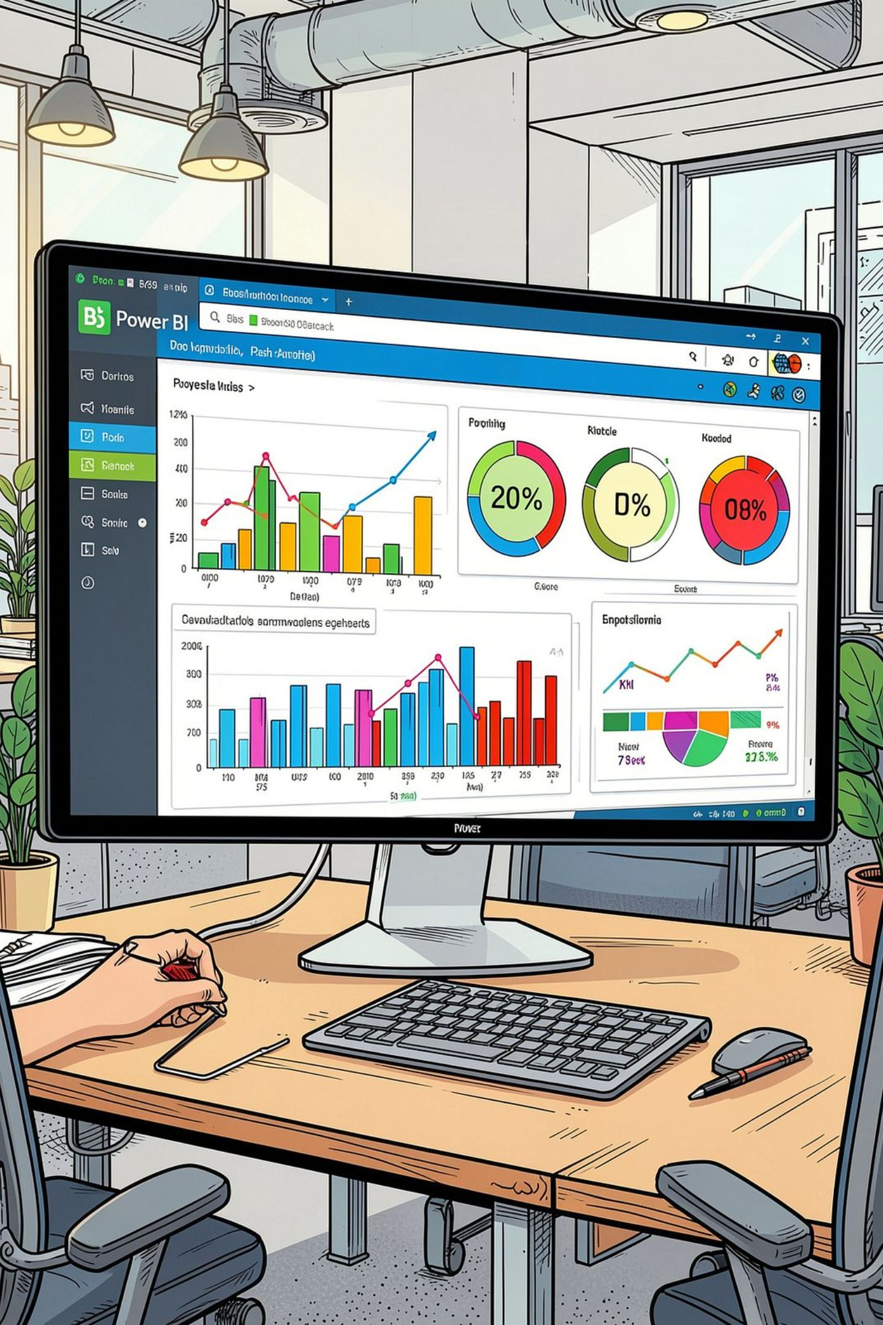
Power BI Dashboard
3.9K
$59.76
Customers
Avg Purchase
3.75
Avg Rating
The interactive dashboard enables filtering by Subscription Status, Gender, Category, and Shipping Type. Key visuals include Revenue by Category (Clothing ~$90K, Accessories ~$70K, Footwear ~$30K, Outerwear ~$15K), Sales by Age Group (Young Adult ~900, Middle-aged ~850, Senior ~800, Adult ~750), and Revenue by Age Group (Young Adult ~$55K, Middle-aged ~$50K, Adult ~$45K, Senior ~$40K). Subscription breakdown: 27% Yes, 73% No.

Slide 10




Business Recommendations
Boost Subscriptions
Loyalty Programs
Promote exclusive subscriber benefits to convert the 73% non-subscriber base.
Reward repeat buyers to advance them into the "Loyal" segment.
Review Discount Policy
Targeted Marketing
Balance sales boosts from discounts with margin control, especially for discount-dependent products.
Focus on high-revenue age groups and express-shipping users; highlight top-rated products in campaigns.

