Slide 1
Red Hat OpenShift Data Science Workshop - Licence plate recognition
.

Slide 2
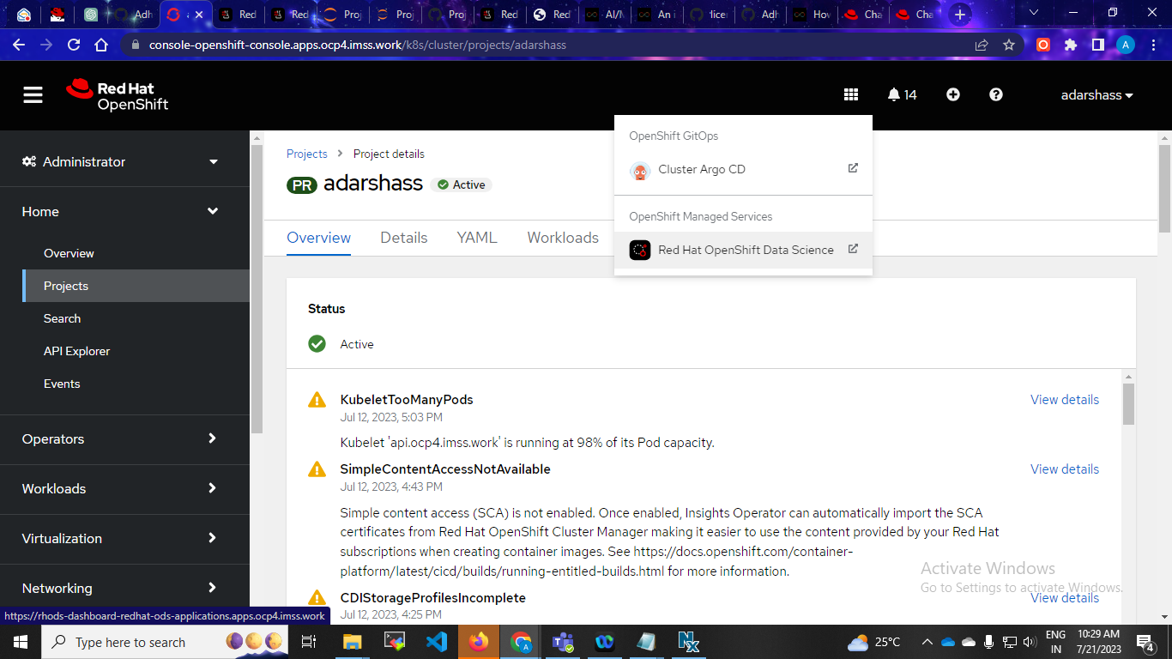
Step1: create namespace, and install red hat openshift data science open

Slide 3
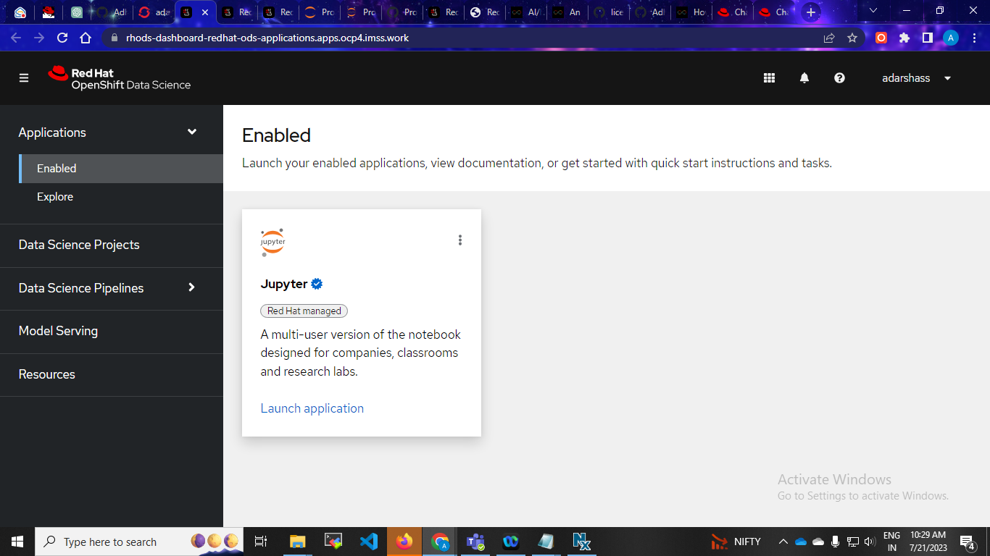
Starting a Jupyter environment

Slide 4
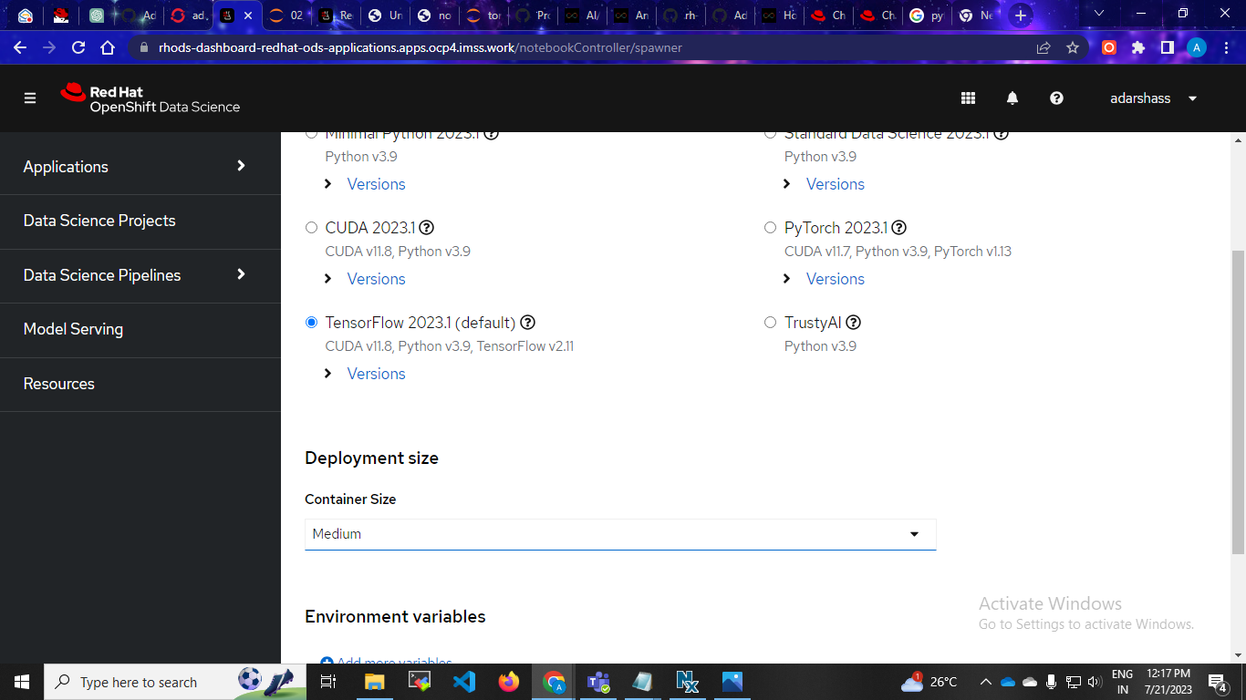
select TensorFlow, as this is the flavor of notebook we want to use. It includes the TensorFlow library, which is used to do image recognition

Slide 5
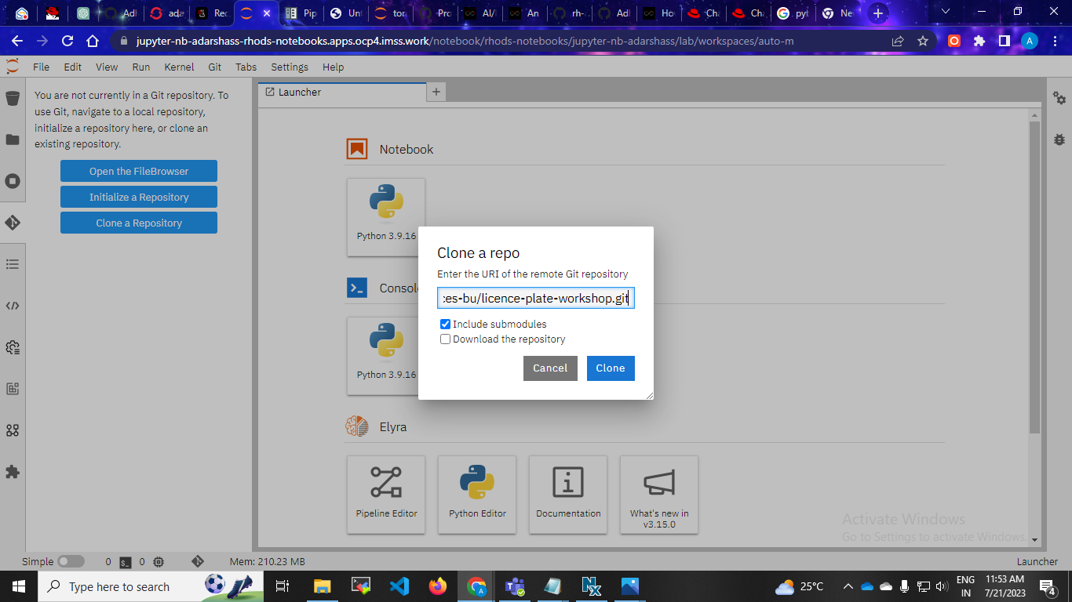
Clone git hub repository

Slide 6
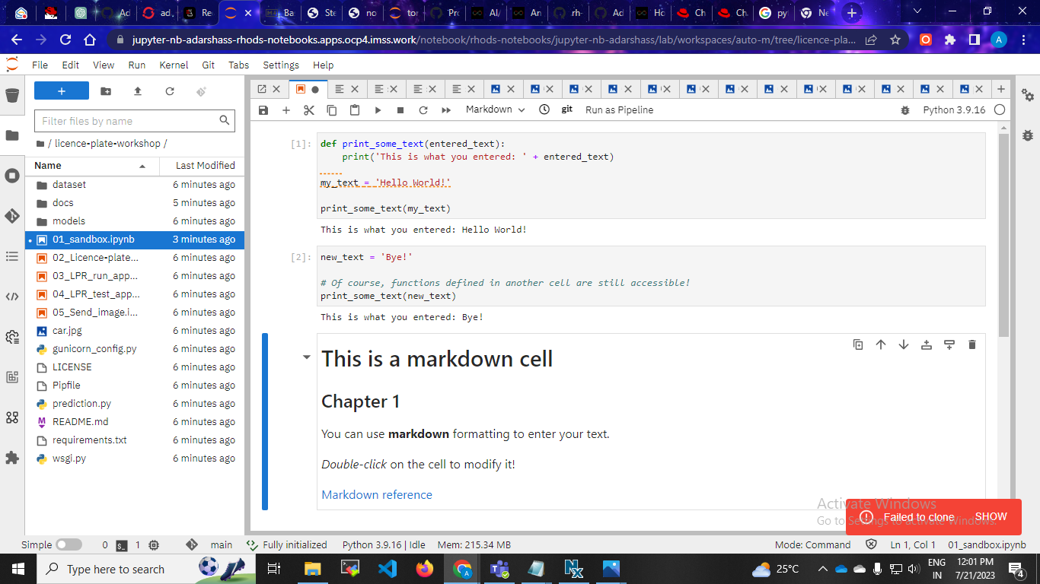
A notebook is an environment where you have cells that can display formatted text, or code.

Slide 7
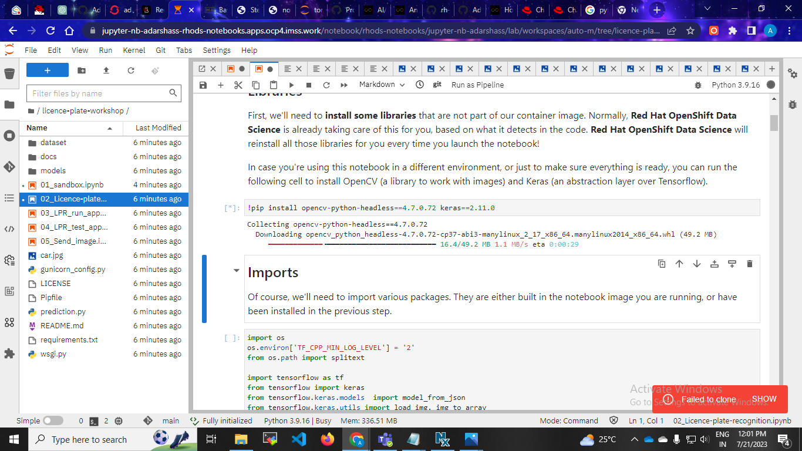
Start to downloding

Slide 8
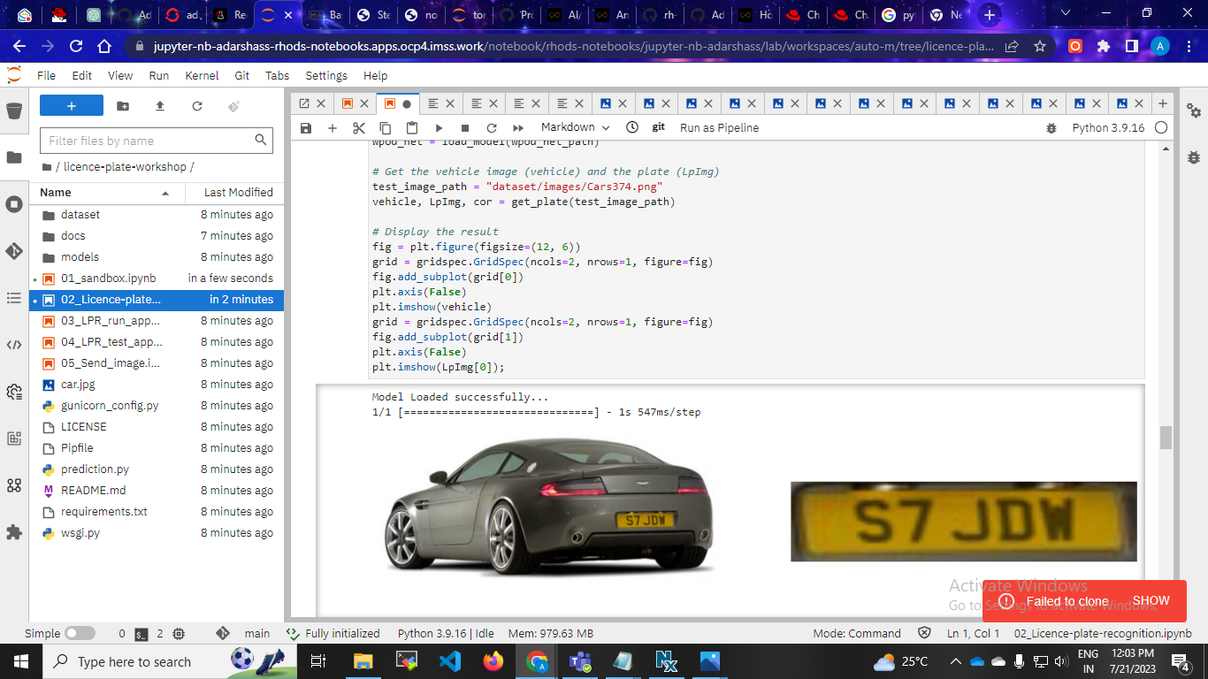
Licence plate recognition

Slide 9
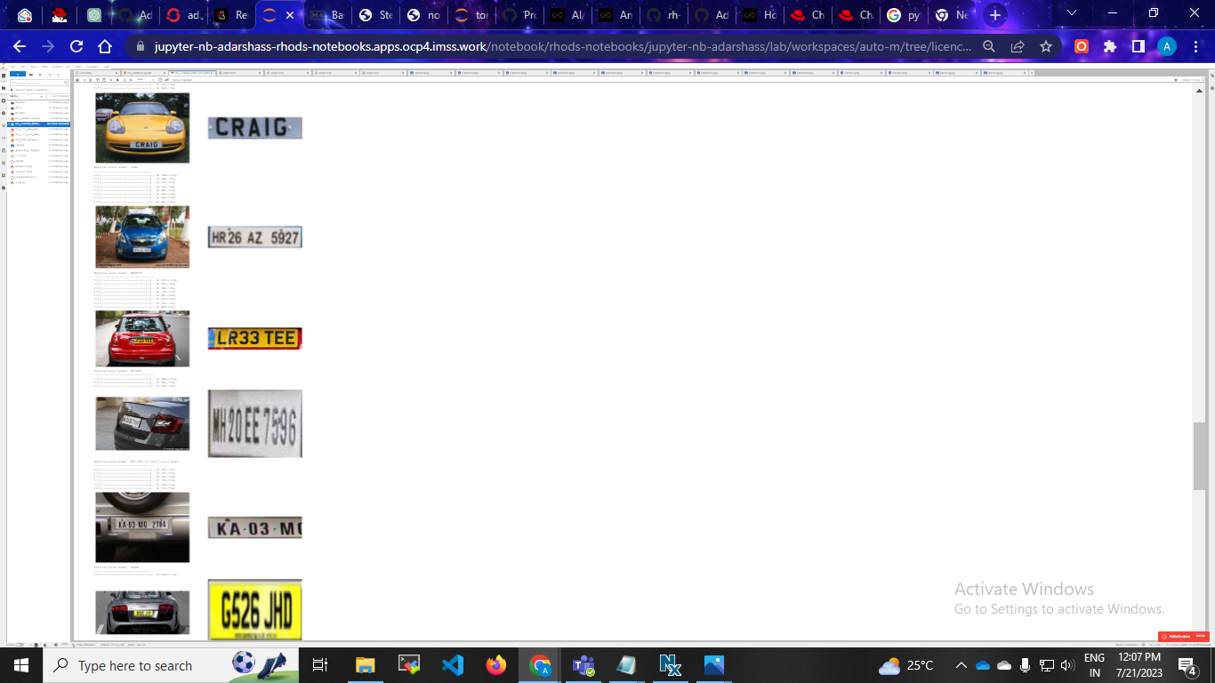
At the end of the notebook, it will look like this:

Slide 10
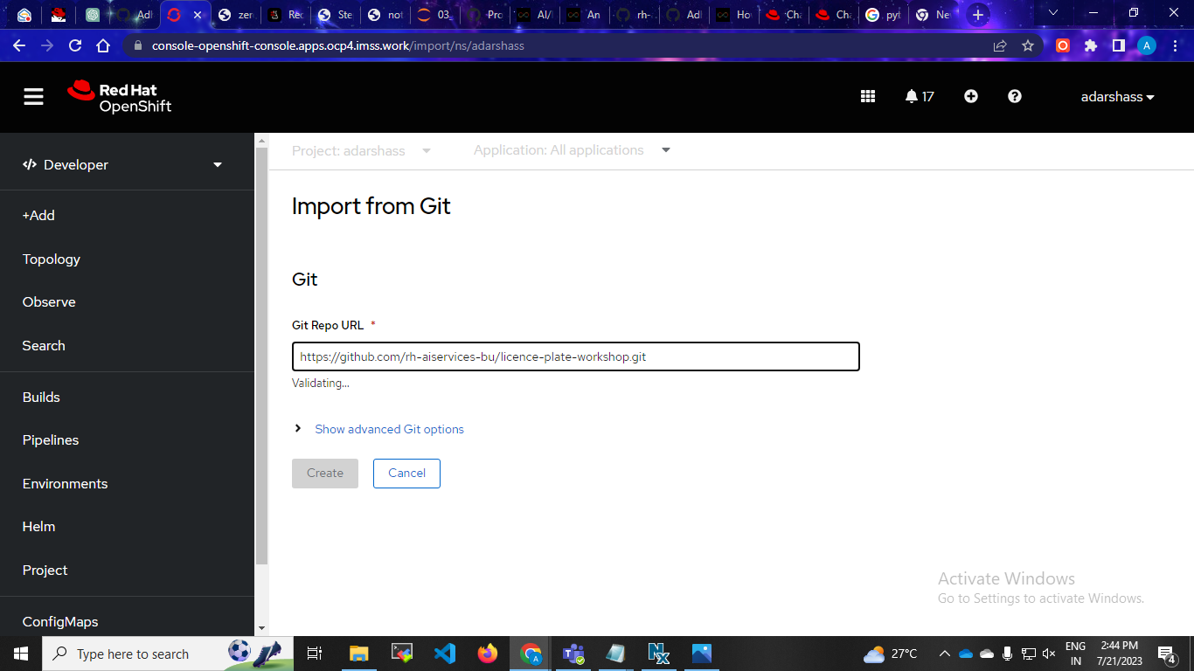
Packaging our application

Slide 11
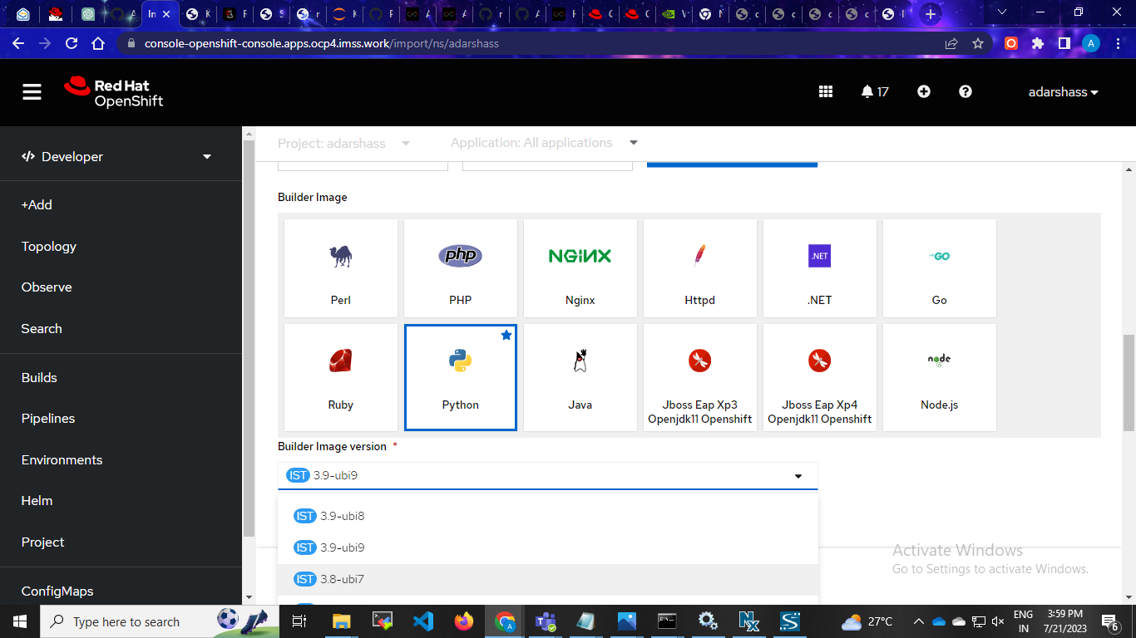

Slide 12
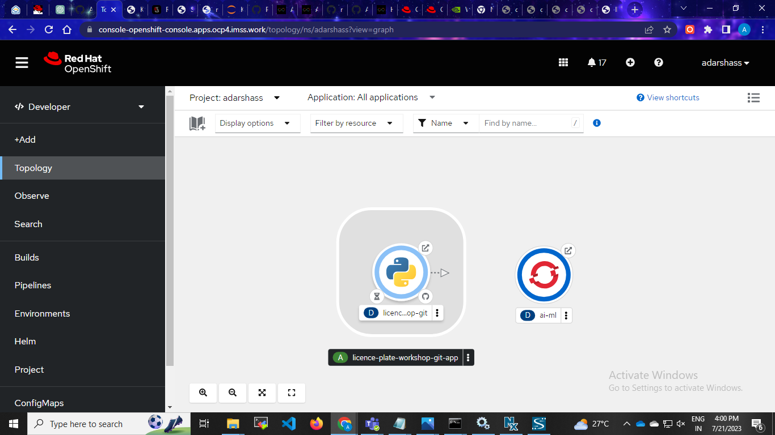
Waiting for build

Slide 13
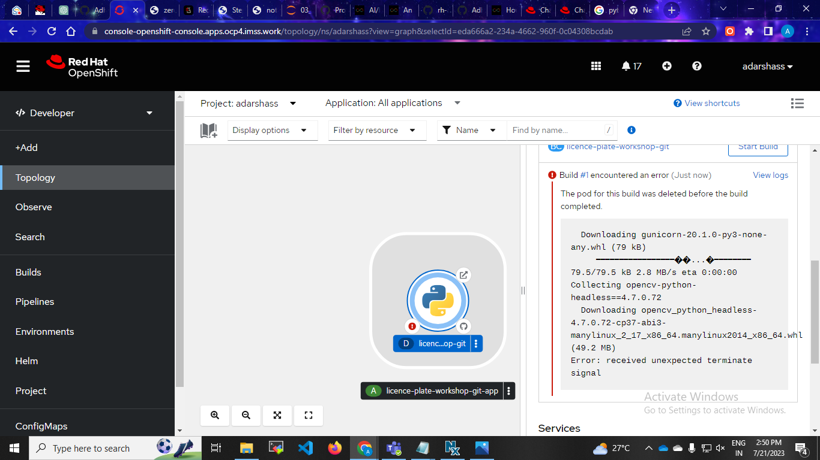
Error:received unexpected terminate signal

