Slide 1



CHURN PREDICTION
A Random Forest approach

Slide 2

Intro
Introduction
The telecom industry faces significant challenges in retaining customers due to fierce competition and evolving consumer preferences.
Customer churn, the phenomenon where customers terminate services, directly impacts revenue and profitability.
The project aims to develop predictive models to identify potential churners and implement proactive retention strategies.

Slide 3
Contents
Table Of Contents
Business and data understanding
03
Evaluation
01
02
Modeling
04
Conclusion

Slide 4
Chapter 1
Business Understanding
The primary stakeholder for this analysis is SyriaTel, a telecommunications company aiming to gain insights into customer churn patterns.
The company is interested in leveraging data to reduce churn rates, enhance customer satisfaction, and optimize profitability.
Key decision-makers within the organization, including marketing, customer service, and strategic planning teams, are the target audience for the analysis.

Slide 5
Objectives
Analyze historical customer data to understand churn patterns and factors influencing customer attrition.
Build predictive models capable of accurately forecasting customer churn.
Evaluate model performance and identify actionable insights to reduce churn rates and improve customer retention.

Slide 6
Data Understanding
The selected dataset is from Kaggle.
It encompasses a comprehensive set of customer information, encompassing variables such as account length, international plan usage, voice mail plan adoption, and customer service call history.
The focal point is the binary target variable "churn," indicating whether a customer has terminated their association with SyriaTel.
This dataset is vital for constructing a predictive model that identifies potential churners and aids in proactive customer retention strategies.

Slide 7
Modeling
1
2
3
Simple Baseline Model
Complex Model
Hyperparameter-Tuned Model:
Implemented a Random Forest classifier with default parameters as a foundational model.
Serves as a benchmark to gauge the inherent predictive capabilities of the dataset.
Utilized a Random Forest model with specific hyperparameters (100 estimators, max depth of 10).
Aims to capture more intricate relationships in the data, potentially improving predictive performance.
Employed GridSearchCV to fine-tune hyperparameters for the Random Forest model.
Aiming to identify the optimal configuration that enhances model accuracy.

Slide 8
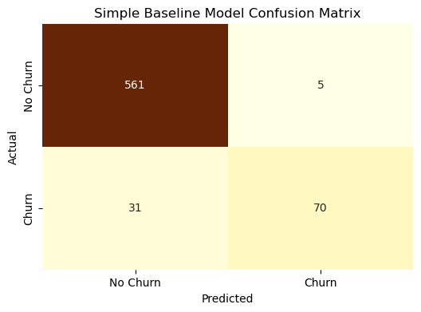

Slide 9


Slide 10
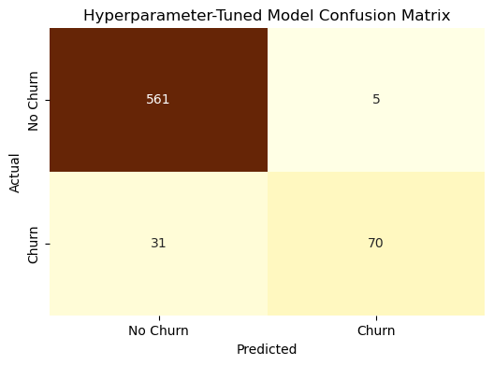

Slide 11
Evaluation
Simple Baseline Model
More-Complex Model
Hyperparameter-Tuned Model
Achieved an accuracy of approximately 94.6%, indicating overall robust performance.
Noted high precision and recall for Class 0 (no churn), while Class 1 (churn) had lower recall.
F1-score provides a balanced measure, considering both precision and recall.
Accuracy slightly improved to around 94.9%.
Enhanced recall for Class 1 indicates improved identification of potential churners.
F1-score demonstrates a better balance between precision and recall.
Identified the best hyperparameters as {'max_depth': None, 'n_estimators': 50}.
Similar performance to the Simple Baseline Model, suggesting limited improvement with hyperparameter tuning.

Slide 12
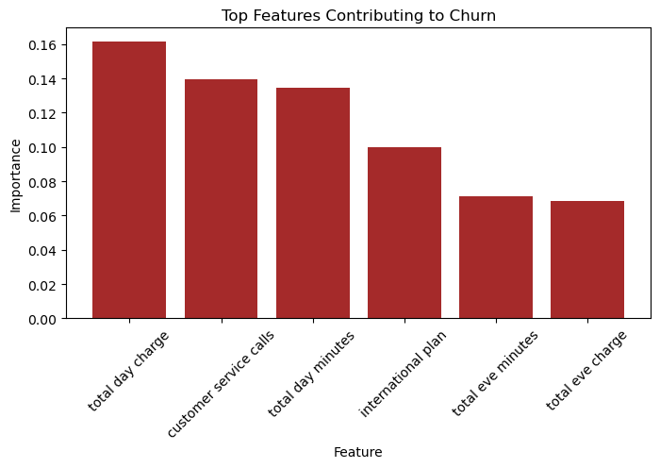

Slide 13
Conclusion
The top features contributing to churn include both usage-related factors (total day/evening minutes, charges) and customer service interactions.
Pricing, service quality during specific time periods, and customer service effectiveness are critical aspects influencing customer decisions to churn.
These insights can guide strategic efforts to improve service quality, adjust pricing plans, and enhance customer service to mitigate churn risk.

Slide 14
Recommendations to Reduce Churn
Optimize Pricing Plans:
Conduct pricing plan review, focusing on total day charges.
Introduce competitive pricing strategies and bundled offerings.
Enhance Customer Service:
Invest in training for efficient issue resolution and proactive support.
Improve overall customer service quality to reduce churn.
Refine International Plans:
Evaluate and adjust features, pricing, and communication strategies.
Tailor offerings to meet the needs of international plan subscribers.
Implement Proactive Engagement:
Launch targeted engagement programs for high-usage customers.
Offer personalized promotions and loyalty incentives to retain subscribers.

Slide 15
THANK YOU
By B.Adhiambo

