Slide 1
WhisperVault
Air-Gapped PII Redaction Engine
SNAPDRAGON® AI LAB — BUILD & PRESENT CHALLENGE
Adhibhu Dhar | KIIT

Slide 2
The Problem: Liability in Plaintext
Organizations face a catch-22 in sensitive transcription:
Cloud APIs are prohibited by policy/regulations (HIPAA, attorney-client privilege).
Local transcription leaves behind plaintext PII, making the file a liability.
Existing offline tools permanently destroy data (irreversible text blanking) preventing owners from re-identifying legitimate information.

Slide 3
WhisperVault: Reversible, Air-Gapped Redaction
A fully offline, on-device pipeline transcribing and pseudonymizing automatically.
Hexagon NPU Accelerated: Whisper-Base-EN (ASR) + DistilBERT-NER (NLP)
Two-Stage Architecture:
  Stage 1: ASR transcribes in overlapping 30s statically-compiled chunks to utilize the NPU without dynamic-shape decoding bottlenecks.
  Stage 2: Hybrid detection engine pseudonymizes spans consistently across the file.

Slide 4
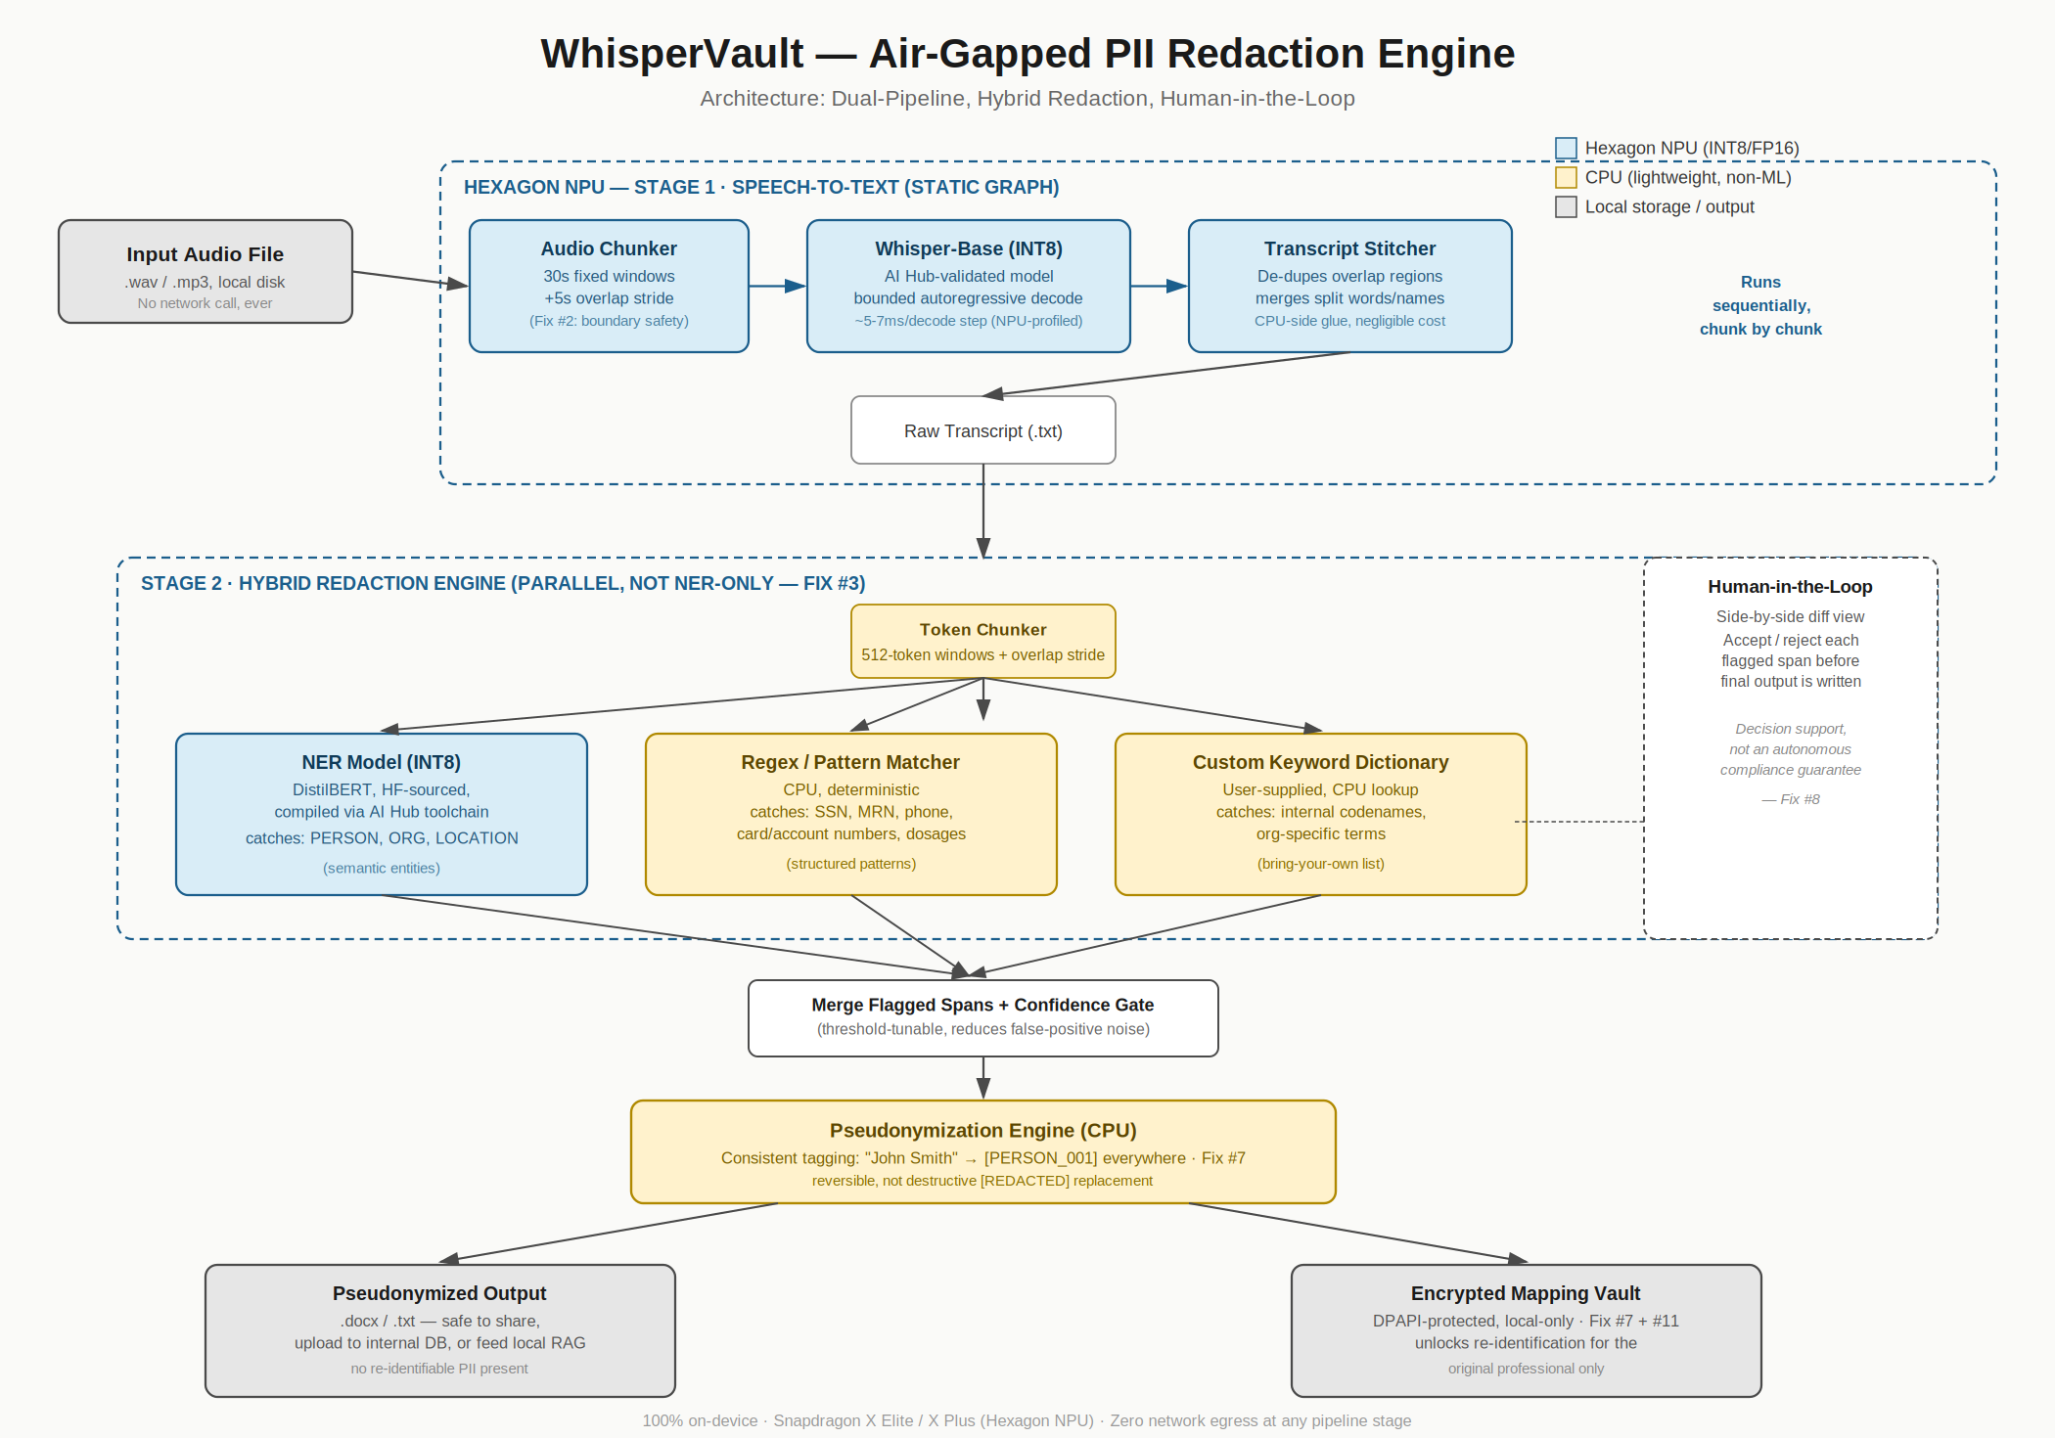
WhisperVault Architecture

Slide 5
Hexagon Implementation & Hardware Profiling
Designed specifically for static-graph NPU constraints.
No Dynamic Overheads: Both AI models use strictly static tensors.
Real Qualcomm AI Hub Profiling Metrics (Job: jpxl8zk8p):
  Target Device: Snapdragon X Elite CRD
  ~44.5ms inference latency per 512-token forward-pass.
  ~168MB peak memory footprint on-device.

