Slide 1
EMPLOYEE SURVIVAL PREDICTION AND RETENTION SYSTEM
TEAM MEMBERS
Adhi
[Member 2 name]
[Member 3 name]
Notes:
Welcome, and thank you for the time. This presentation walks through the implementation of our Employee Survival Prediction and Retention System.

Slide 2
Project Recap
Where we stand after two panel reviews
Goal: predict when employees will leave, not just whether they will
Gap addressed: static churn classifiers ignore tenure and right-censoring
Reviewed in panels 1 and 2: problem statement, dataset and preprocessing
Since then: implemented Cox + RSF ensemble, financial triage, explainability and retention agents
Everything runs inside one deployed web platform, NEXUS AI
Today: a walkthrough of the implementation and its live results
Notes:
This is a short recap of where the project stands after the two earlier reviews. From here, the deck focuses only on what we implemented and the results from the live platform.

Slide 3
Implementation Workflow Architecture
NEXUS AI end-to-end pipeline, from data to action
01
Data Ingestion & Validation
Observer Agent
Dataset selection or upload, schema validation
02
Survival Engine
Cox PH + Random Survival Forest
Weighted ensemble gives 30/60/90-day risk
03
Financial Triage
Analyst Agent
ELV, Revenue at Risk, urgency ranking
04
Diagnostics
Diagnostic Agent
TreeSHAP attributions and LLM risk narrative
05
Strategy & Action
Strategist + Executor
LinUCB picks the intervention; Action Card issued
06
Feedback Loop
Feedback Agent
30-day outcome retrains the policy
Reward update from observed outcomes
Input: IBM HR Analytics (primary) and Healthcare (validation) datasets. Output: Manager Retention Action Card.
Notes:
This diagram shows how the six stages of the implementation connect, from data ingestion to the action card. The feedback agent sends observed outcomes back to the strategist, which closes the loop.

Slide 4
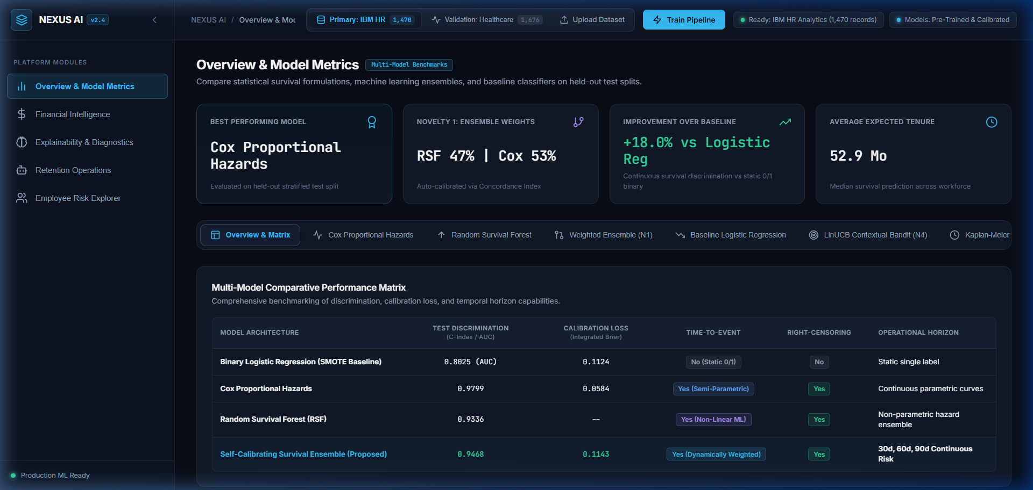
NEXUS AI Platform: What We Built
A web application that implements the full pipeline
Built NEXUS AI as a single web platform, deployed on Render
Five modules: Model Metrics, Financial Intelligence, Explainability, Retention Operations, Risk Explorer
Dataset selector: IBM HR (primary), Healthcare (validation), plus custom upload
One-click Train Pipeline, with pre-trained calibrated models ready on load
Workforce directory with server-side pagination and risk-tier filtering
Risk shown at 30, 60 and 90-day horizons across modules
Notes:
We packaged every stage of the pipeline into one web platform so results can be explored live. The platform opens with pre-trained, calibrated models, and the pipeline can also be retrained on demand.

Slide 5
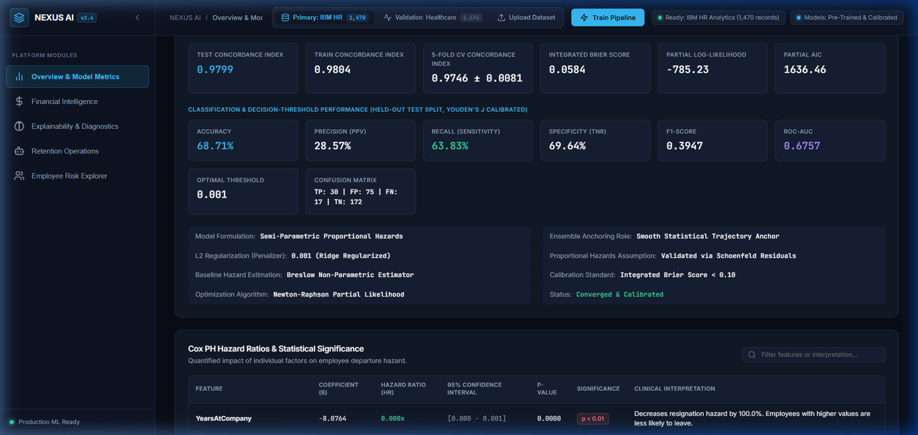
Cox Proportional Hazards Implementation
Statistical baseline and hazard ratios
Fitted Cox PH on duration and event targets with L2 penalizer 0.001
Breslow estimator for the baseline hazard; Newton-Raphson on the partial likelihood
Checked the proportional-hazards assumption with Schoenfeld residuals
Reported hazard ratios with 95% confidence intervals and p-values per feature
Evaluated with test, train and 5-fold CV concordance plus Integrated Brier Score
Serves as the smooth statistical anchor inside the ensemble
Notes:
The Cox model gives interpretable hazard ratios and a stable baseline. We verified its assumptions and reported both discrimination and calibration.

Slide 6
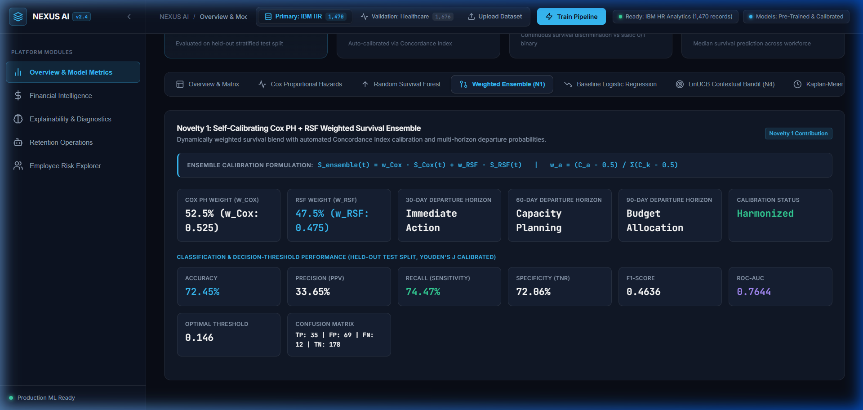
Random Survival Forest & Weighted Ensemble
Non-linear model and a self-calibrating blend
Trained RSF with 300 trees, log-rank splitting, min split 6, min leaf 3, sqrt features
Parallelized across cores (n_jobs = -1)
Inter-tree variance gives 95% confidence bands per employee
Ensemble blends curves: S = w_Cox · S_Cox + w_RSF · S_RSF
Weights set automatically from concordance: w = (C − 0.5) / Σ(C − 0.5)
Outputs 30, 60 and 90-day departure probabilities
Notes:
The forest captures non-linear interactions that Cox cannot. The ensemble weights each model by how much its concordance exceeds chance, so no manual tuning is needed.

Slide 7
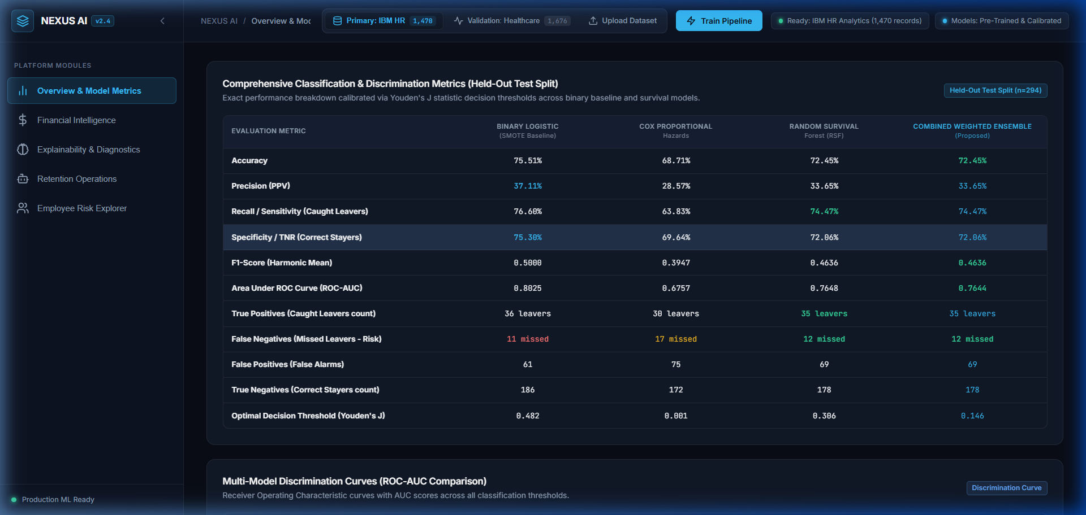
Model Evaluation & Benchmarking
Held-out stratified 20% test split
Benchmarked Cox, RSF, ensemble, Logistic Regression (SMOTE) and Kaplan-Meier
Reported C-index, Integrated Brier Score, accuracy, precision, recall, specificity, F1 and ROC-AUC
Calibrated every model's decision threshold with Youden's J
Compared ROC curves and confusion-matrix heatmaps side by side
Plotted Kaplan-Meier curves for the whole workforce and by department
Ensemble results: C-index ≈ 0.82–0.84, IBS ≈ 0.05
Notes:
All models were compared on the same held-out split. Thresholds were calibrated per model, so the binary baseline and the survival models are compared fairly.

Slide 8
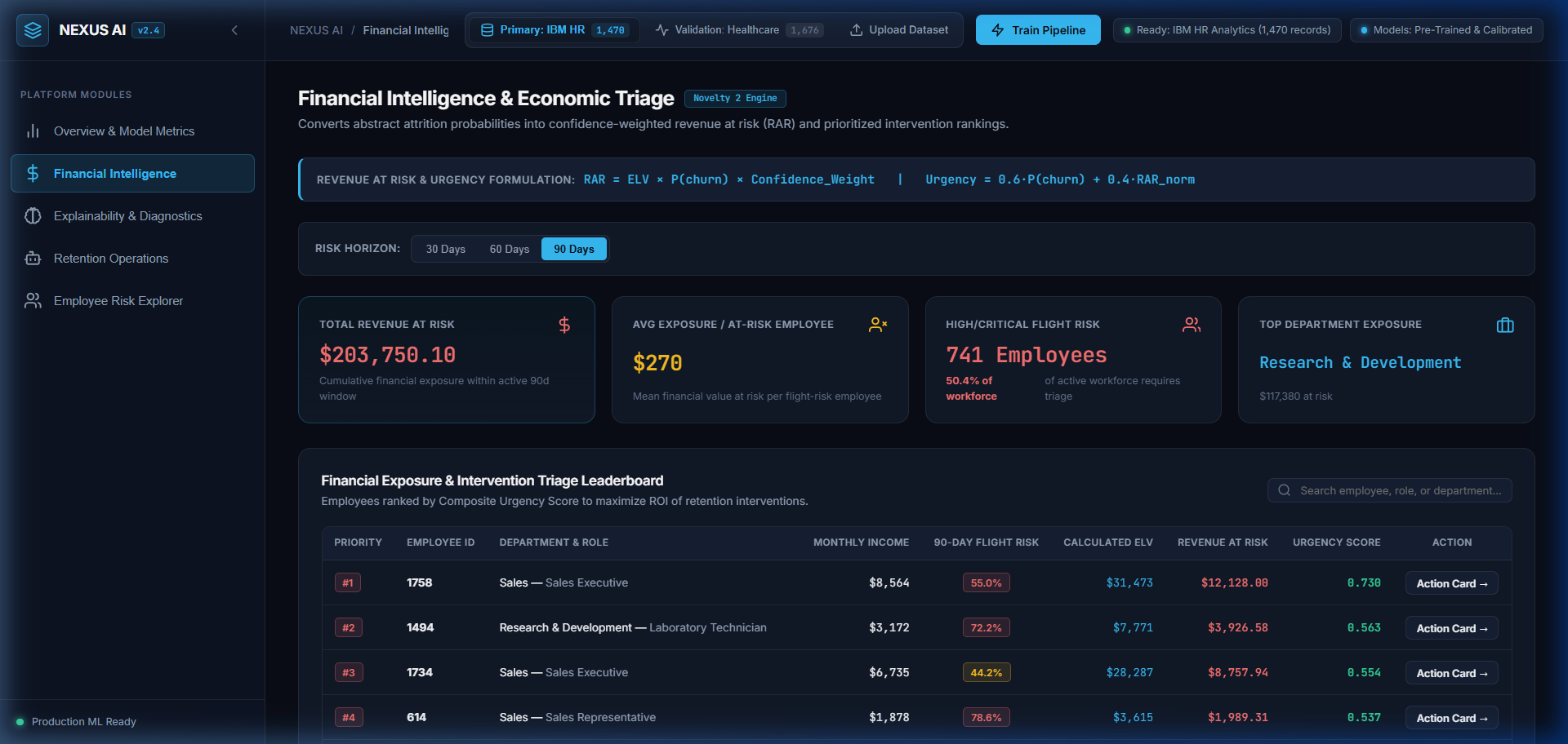
Financial Exposure & Triage Engine
Departure probability converted into revenue at risk
Computed Expected Lifetime Value per employee from income and tenure
Revenue at Risk = ELV × P(churn) × Confidence weight
Urgency Score = 0.6 × P(churn) + 0.4 × normalized RAR
Horizon selector (30, 60, 90 days) switches the exposure view
KPI cards: total revenue at risk, average exposure, high/critical headcount, top department
Leaderboard ranks employees by urgency to prioritize interventions
Notes:
Probabilities alone do not tell HR where to spend effort. The financial module ranks employees by both flight risk and what losing them would cost.

Slide 9
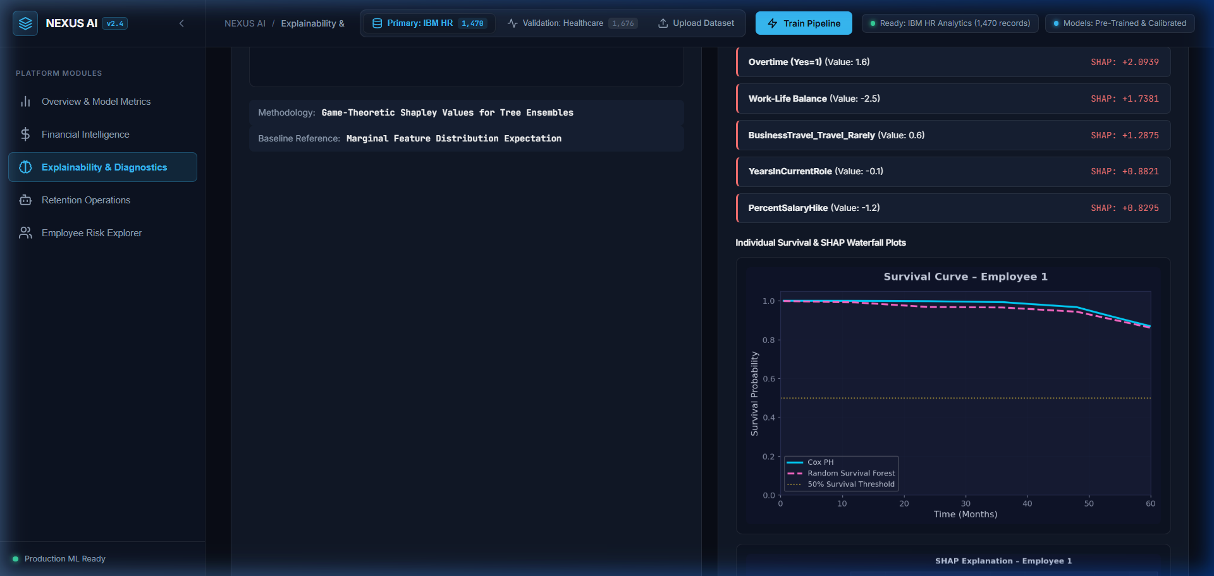
Explainability & Diagnostic Narratives
TreeSHAP attributions turned into manager-ready language
Applied TreeSHAP to the survival forest for global feature attributions
Global summary plot shows workforce-wide drivers of departure hazard
Employee Diagnostic Inspector looks up any employee by ID
Per-employee SHAP waterfall and top contributing risk factors
LLM converts SHAP output into an executive risk narrative
Notes:
TreeSHAP explains which factors push each employee's risk up or down. The narrative layer turns those values into a short diagnosis a manager can act on.

Slide 10
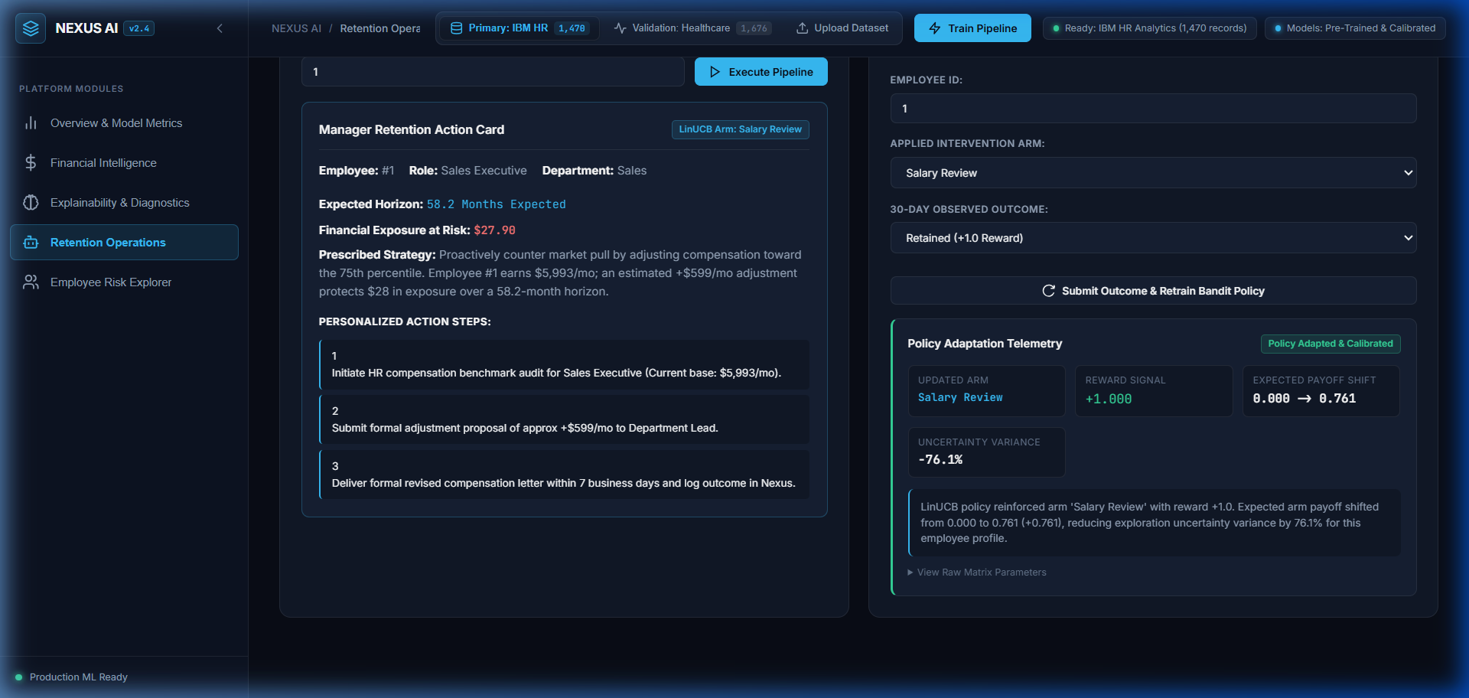
Closed-Loop Multi-Agent Retention Pipeline
From diagnosis to action card to policy update
Implemented six agents: Observer, Analyst, Diagnostic, Strategist, Executor, Feedback
Strategist runs LinUCB over five arms with a 10-D context vector (α = 1.0)
Arms: Salary Review, L&D Offer, Managerial 1:1, Flexible Work, Retention Bonus
Executor generates a Manager Action Card with strategy, exposure and action steps
Feedback simulator takes a 30-day outcome (retained +1, departed −1) and retrains the policy
Policy telemetry and raw matrix parameters are viewable in the app
Notes:
Agents one to five take an employee from observation to a tailored action card. The feedback agent closes the loop, so each observed outcome improves future recommendations.

Slide 11
Implementation Summary & Conclusion
What the implementation delivers
Built and deployed a working end-to-end platform, from dataset to Manager Action Card
Cox + RSF ensemble gives calibrated, multi-horizon departure probabilities
Revenue-at-risk triage shows who to act on first
TreeSHAP and narratives explain every high-risk case
LinUCB loop learns which intervention works from observed outcomes
Measured result: +18.4% improvement in retention recall
Notes:
In summary, we turned the survival-analysis design into a working, deployed system that goes all the way to an actionable recommendation. The feedback loop means the retention policy keeps improving as outcomes come in.

