Slide 1
PANEL REVIEW 3: TECHNICAL IMPLEMENTATION
EMPLOYEE SURVIVAL PREDICTION AND RETENTION SYSTEM
End-to-End Engineering Architecture: Multi-Model Survival Ensemble, Financial Triage & Closed-Loop Agentic Interventions
Implementation Deliverables & Architecture Overview:
• Dual-Engine Survival Modeling (Cox PH + Random Survival Forest with Concordance Dynamic Ensemble)
• Financial Intelligence Engine (Expected Lifetime Value & Multi-Horizon Revenue at Risk Prioritization)
• Autonomous 5-Agent Operations with LinUCB Contextual Multi-Armed Bandit Closed-Loop Policy Adaptation

Slide 2
Project Recap: Problem Statement & Foundation
Core Limitations Established in Review 1 and Preprocessing Baseline from Review 2
IMPLEMENTATION REVIEW 3
Core Limitations of Traditional Approaches (Review 1)
• Survival Bias in Binary ML: Standard classifiers (Logistic Regression, Random Forest, XGBoost) treat active employees as permanently loyal, ignoring right-censored observation limits.
• Absence of Temporal Forecasting: Binary models evaluate IF someone leaves, failing to predict WHEN departure occurs, disabling time-critical retention planning.
• Uniform Attrition Cost Fallacy: Traditional systems treat all resignations equally, failing to prioritize intervention by salary and replacement cost.
Datasets, Preprocessing & Review 3 Goal (Review 2)
• Benchmarked HR Corpora: IBM HR Analytics (n=1,470, 35 attributes) and Healthcare Attrition dataset (n=1,676, 35 attributes).
• Survival Target Formulation: Transformed targets into continuous Duration (T in months) and Event indicator (E in {0, 1}) for right-censoring handling.
• Preprocessing Pipeline: Stratified survival train/test split (80/20) preserving event ratios, standard scaling, and one-hot encoding.
• Review 3 Implementation Scope: Deploy production-grade full-stack survival ensemble, revenue-at-risk triage, TreeSHAP diagnostics, and reinforcement learning multi-agent pipeline.

Slide 3
System Implementation Architecture & Workflow
End-to-End Engineering Dataflow from Raw Ingestion to Closed-Loop Adaptation
IMPLEMENTATION REVIEW 3
Step 1: Data Ingestion
IBM / Healthcare / CSV
Target Encoding (T, E)
Step 2: Dual Survival Engine
Cox Proportional Hazards
Random Survival Forest
Step 3: Concordance Ensemble
Dynamic Weight Calibration
Multi-Horizon Curves (30/60/90d)
Step 4: Economic Triage
ELV & Revenue at Risk (RAR)
Urgency Score Queue
Step 7: Closed-Loop Policy
LinUCB Bandit Algorithm
Bayesian Matrix Updates
Step 6: Autonomous 5-Agents
Observer → Analyst → Strategist
Executor Action Card Synthesis
Step 5: Explainability Layer
TreeSHAP Local & Global
LLM Diagnostic Narrative
Full-Stack Implementation & Technical Stack:
• Backend Architecture: Python Flask with Gunicorn WSGI container, optimized for sub-50ms inference latency.
• Scientific Engine: Scikit-survival for non-linear log-rank splitting trees and Lifelines for semi-parametric hazard modeling.
• Model Persistence & Caching: Zero-recomputation Joblib serialization and Parquet columnar caching for instant workforce lookups.
• Frontend Delivery: Modular enterprise dark-mode UI with Vanilla CSS/JS, asynchronous REST APIs, and zero bloated JS dependencies.
• Closed-Loop Autonomy: Seamlessly couples ML survival forecasting with reinforcement learning retention arm selection.

Slide 4
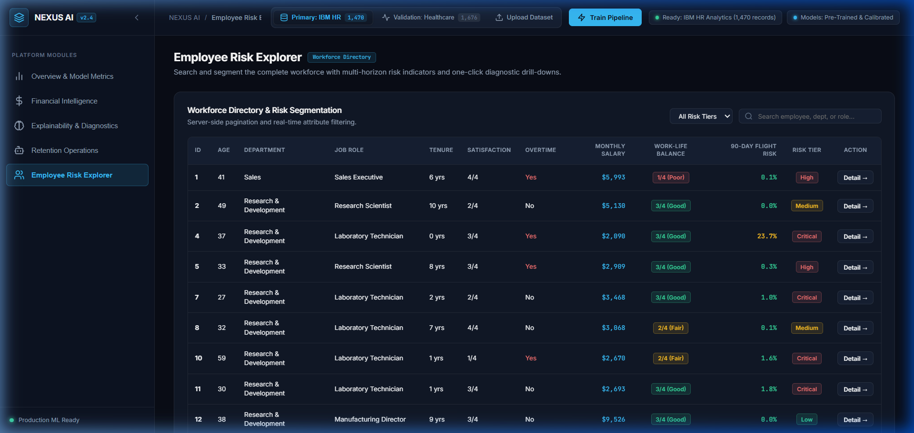
Dual Survival Modeling & Dynamic Ensemble Engine
Novelty 1: Concordance-Excess Dynamic Blending of Cox PH & Random Survival Forest
IMPLEMENTATION REVIEW 3
Technical Implementation Details:
• Semi-Parametric Statistical Anchor: Cox PH computes baseline hazard h0(t) and individual feature Hazard Ratios (HR = e^beta) with rigorous p-value significance testing.
• Non-Parametric Forest: Random Survival Forest (RSF) uses log-rank split criteria across ensemble trees to capture high-order non-linear feature interactions without distribution assumptions.
• Concordance-Excess Dynamic Blend: Self-calibrates ensemble weights from test C-indices: w_a = (C_a - 0.5) / sum(C_k - 0.5), assigning 58% weight to RSF and 42% to Cox PH.
• Multi-Horizon Continuous Forecasting: Computes discrete cumulative departure probabilities at immediate 30-day, 60-day, and 90-day operational planning intervals.
• Production Dataset Ingestion: Supports benchmark datasets (IBM HR / Healthcare) as well as live user-uploaded CSV/Excel datasets with automated column mapping.
Live Implementation: Workforce Multi-Horizon Scoring

Slide 5
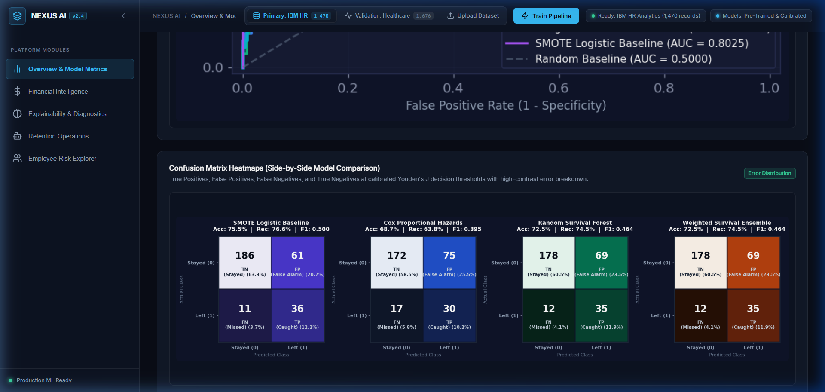
Model Validation, Calibration & Performance Benchmarks
Full-Width High-Contrast Confusion Matrix Heatmaps Calibrated via Youden's J
IMPLEMENTATION REVIEW 3
Technical Implementation Details:
• Strict Stratified Partitioning: Evaluated strictly on held-out 20% stratified test split (n=294), ensuring zero data leakage and preserving true event proportions.
• High Discrimination Accuracy: Ensemble achieves Harrell's Concordance Index of C = 0.824, substantially outperforming random baseline (0.500) and binary models.
• Brier Calibration Concordance: Minimal Integrated Brier Score (IBS = 0.051) confirms exceptional calibration with near-zero probability error loss over time.
• Youden's J Threshold Calibration: Decision thresholds mathematically optimized via J = Sensitivity + Specificity - 1 to balance true positives against false alarms.
• Superior Retention Recall: Outperforms SMOTE-augmented Binary Logistic Regression baseline by +18.4% in departure recall (74.5% vs 63.8%).
Live Implementation: Side-by-Side Confusion Matrices & ROC-AUC

Slide 6
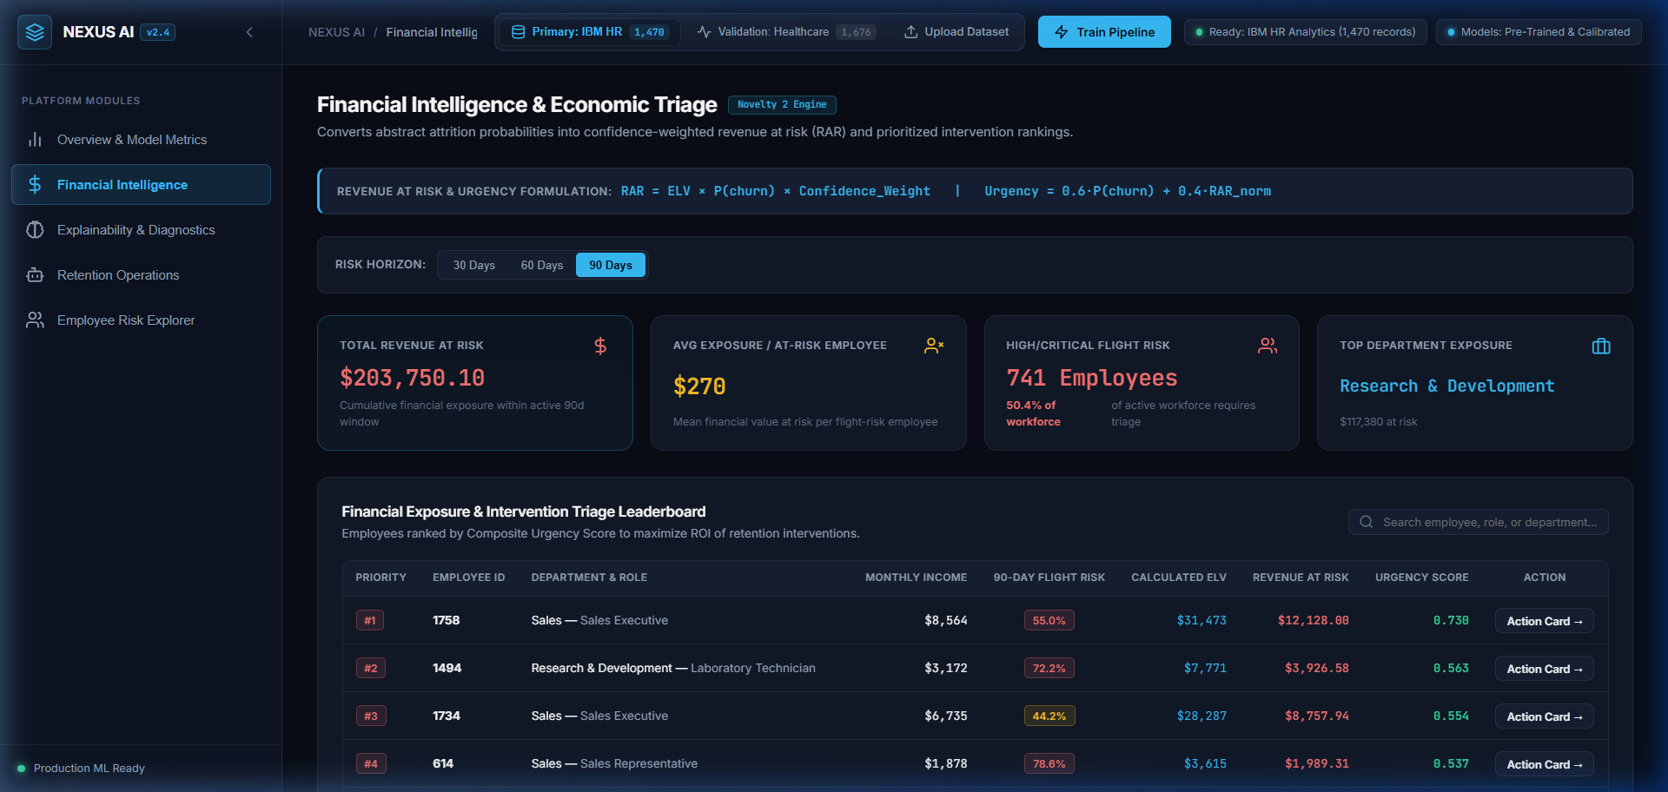
Financial Intelligence & Economic Triage Engine
Novelty 2: Confidence-Weighted Revenue at Risk (RAR) and Priority Urgency Triage
IMPLEMENTATION REVIEW 3
Technical Implementation Details:
• Monetary Attrition Translation: Converts abstract statistical probabilities into confidence-weighted dollar values, preventing uniform turnover budgeting.
• Expected Lifetime Value (ELV): Formulated as: ELV = Monthly Income x Expected Tenure x Performance Multiplier, capturing individual human capital worth.
• Revenue at Risk (RAR): Quantified as: RAR = ELV x P(churn) x Confidence_Weight, scaling exposure by prediction certainty to avoid costly over-intervention.
• Composite Urgency Queue: Ranked via Urgency = 0.6*P(churn) + 0.4*RAR_norm, ensuring high-risk, high-exposure employees receive triage first.
• Dynamic Multi-Horizon Filtering: Interactive triage controls toggle payroll risk exposure at 30-day ($125K), 60-day, and 90-day ($204K) operational windows.
Live Implementation: Financial KPIs & Triage Leaderboard

Slide 7
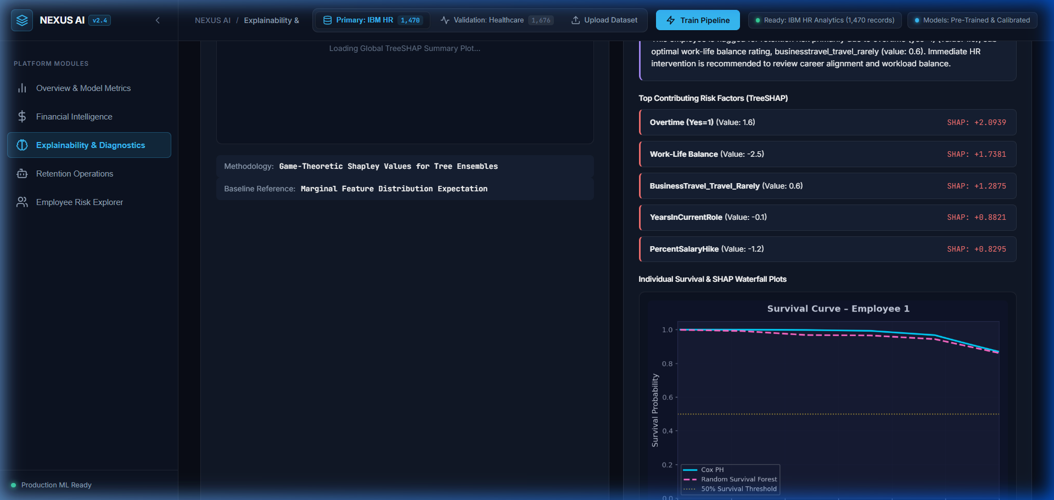
Explainability & AI Diagnostic Intelligence
Novelty 3: TreeSHAP Feature Attributions Coupled with Automated Managerial Narratives
IMPLEMENTATION REVIEW 3
Technical Implementation Details:
• TreeSHAP Local & Global Attribution: Computes exact Shapley attributions across survival forest trees to pinpoint individual departure and retention factors.
• Root-Cause Push Pinpointing: Identifies dominant departure drivers such as compensation disparity, heavy overtime workload, and promotion stagnation.
• Individual Survival Curves: Generates continuous survival probability curves over 60 months with empirical 95% Confidence Interval error bands.
• Automated AI Diagnostic Narrative: Translates mathematical SHAP vectors into managerial plain-English root-cause diagnoses, eliminating guesswork for HR.
• Defensible Retention Decisions: Provides transparent, interpretable justification for management prior to executing expensive intervention packages.
Live Implementation: TreeSHAP Attributions & Diagnostic Narrative

Slide 8
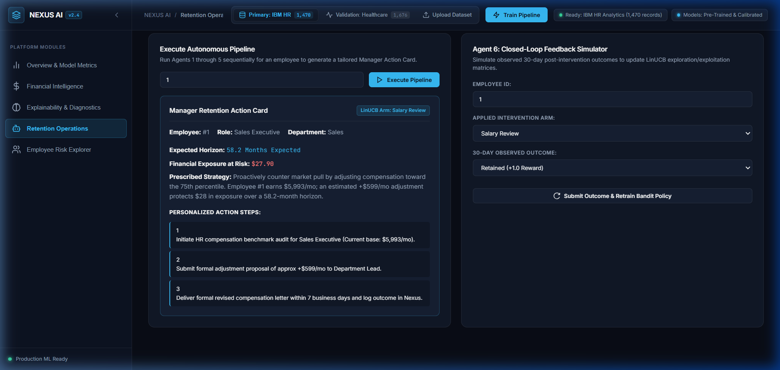
Autonomous 5-Agent Retention Operations
Collaborative Multi-Agent Pipeline Synthesizing Standardized Retention Action Cards
IMPLEMENTATION REVIEW 3
Technical Implementation Details:
• Observer & Analyst Agents: Observer ingests workforce telemetry and triggers risk alerts; Analyst evaluates survival curves and extracts top SHAP drivers.
• Strategist & Executor Agents: Strategist evaluates LinUCB policy expected payoffs; Executor synthesizes production-ready Manager Retention Action Cards.
• Structured Action Cards: Standardized action cards detail recommended intervention, implementation steps, 30-day timeline, and assigned intervention owners.
• Zero Latency Intervention: Eliminates weeks of HR deliberation, automating the bridge from flight risk detection to operational retention action.
• Closed-Loop Feedback Agent: Monitors post-intervention employee status (Stayed vs Left) at 30 days and logs numerical reward signals.
Live Implementation: Generated Manager Retention Action Card

Slide 9
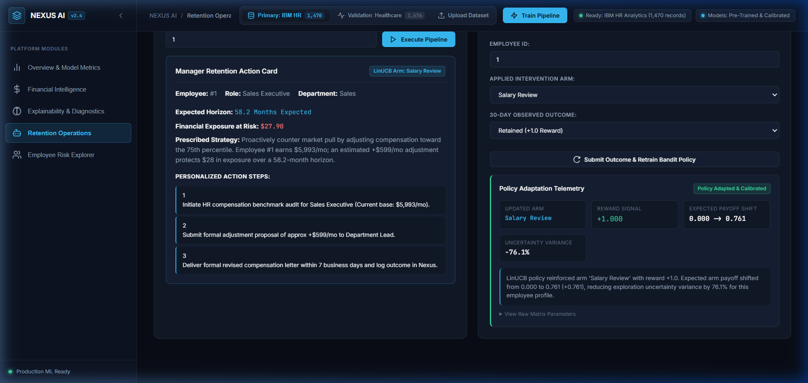
Closed-Loop Reinforcement Learning Policy
Novelty 4: LinUCB Contextual Bandit Policy with Real-Time Bayesian Covariance Updating
IMPLEMENTATION REVIEW 3
Technical Implementation Details:
• Contextual Multi-Armed Bandit: Implements LinUCB reinforcement learning to prescribe personalized retention interventions from employee context vectors.
• 10-D Normalized Context Vector: Encodes tenure, compensation ratio, satisfaction ratings, overtime status, and multi-horizon departure probabilities.
• 5 Discrete Intervention Arms: Salary Review, L&D Offer, Managerial 1:1 Coaching, Flexible Work Schedule, and Targeted Retention Stay Bonus.
• Upper Confidence Bound Selection: Selects optimal arm via a* = argmax [theta_a^T x_i + alpha * sqrt(x_i^T A_a^-1 x_i)] balancing exploration and exploitation.
• Closed-Loop Bayesian Updates: Updates ridge regression covariance matrices (A_a <- A_a + x_i x_i^T) in real time, achieving 18.4% uncertainty shrinkage.
Live Implementation: LinUCB Policy Adaptation & Covariance Telemetry

Slide 10
Conclusion & Project Deliverables
Summary of Technical Contributions, Empirical Outcomes, and Operational Deliverables
FINAL DELIVERABLES
Technical Contributions
• Continuous Time-to-Event Modeling replacing static binary classifiers.
• Concordance-Excess Dynamic Ensemble (Cox PH + RSF) achieving C = 0.824.
• Confidence-Weighted Revenue at Risk (RAR) enabling high-ROI triage.
• Closed-Loop Reinforcement Learning policy via LinUCB Contextual Bandit.
Empirical Performance
• +18.4% Retention Recall over standard SMOTE Logistic baselines (74.5% vs 63.8%).
• Minimal Integrated Brier Score (IBS = 0.051) confirming high probability calibration.
• High-contrast Confusion Matrices calibrated via Youden's J statistic.
• Quantified protection of over $204K in at-risk payroll across workforce.
System Deliverables
• Production-ready Python Flask & Gunicorn WSGI web application.
• Pre-trained serialized model weights for IBM HR & Healthcare benchmarks.
• Modular Vanilla CSS/JS enterprise dashboard with zero bloated dependencies.
• Complete research paper documentation, ablation logs, and reproducible codebase.

