Slide 1
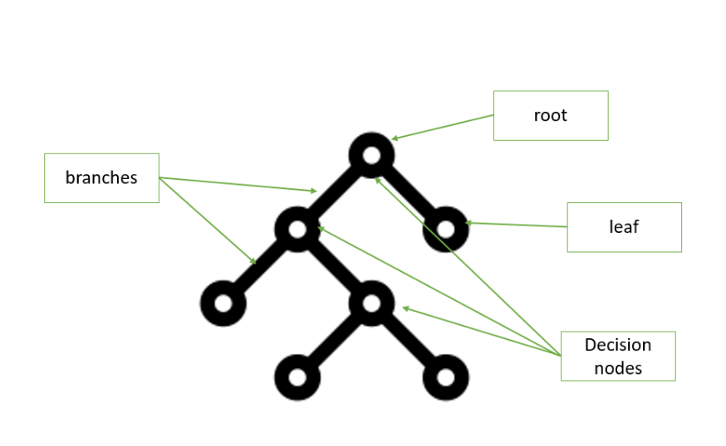
COMP 6210 BIG DATA : GROUP WORK
ASSIGNMENT 2 : SEMESTER 1 , 2025
Submitted ON 6th June 2025

Slide 2
Group Members
Name | Student ID | Email | Assigned Task
Anuj Adhikari | 48547743 | anuj.adhikari@students.mq.edu.au | Task 2
Bharat Poudel |  | bharat.poudel@students.mq.edu.au | Report
Gopal Bhatt |  | gopal.bhatt@students.mq.edu.au | Task 1

Slide 3

DISCUSSION TOPICS
Table of contents
Task 1 : Nearest Neighbour Search Presented By Gopal Bhat
Task 2 : Skyline Search Presented By Anuj Adhikari
Discussion on Assignment Report involving construction of R-trees Presented By Bharat Poudel

Slide 4
Task 2 Skyline Search
USING Sequential Scan, BBS, and Divide-and- Conquer Approaches
Presented By : Anuj Adhikari

Slide 5
Skyline Problem
What is Skyline?
Contextual Problem Definition: To find the best houses to buy from a large property selection pool
Criteria: Cost (lower is better)
AND
Size (higher is better)
Logic for Domination: House A dominates House B if A is cheaper AND larger
Skyline Points: Houses not dominated by any other house

Slide 6
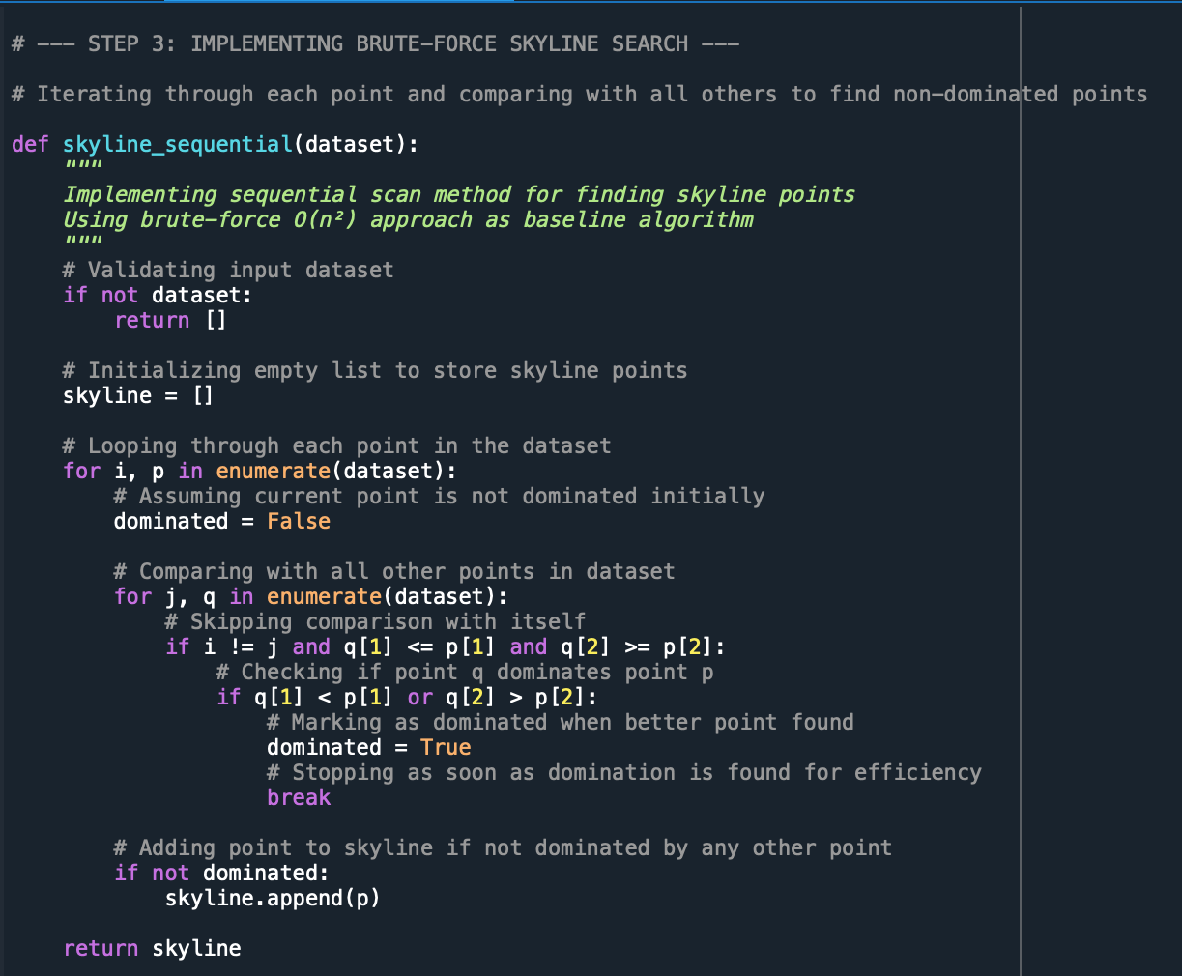
Algorithm 1 : Sequential Scan
BRUTE– FORCE APPROACH
In this approach we compare every house against every other house.
It is very slow for this particular “city1” dataset which has more than 300,000 data points.
For each house, we are using the pre-established domination logic to check if any other house dominates it.
It is very inefficient, hence has the highest execution time among the three algorithms used for skyline search.
Image

Slide 7
Algorithm 2 : Branch and Bound Skyline
Smart APPROACH : BBS with R-tree
Text
Image

