Slide 1


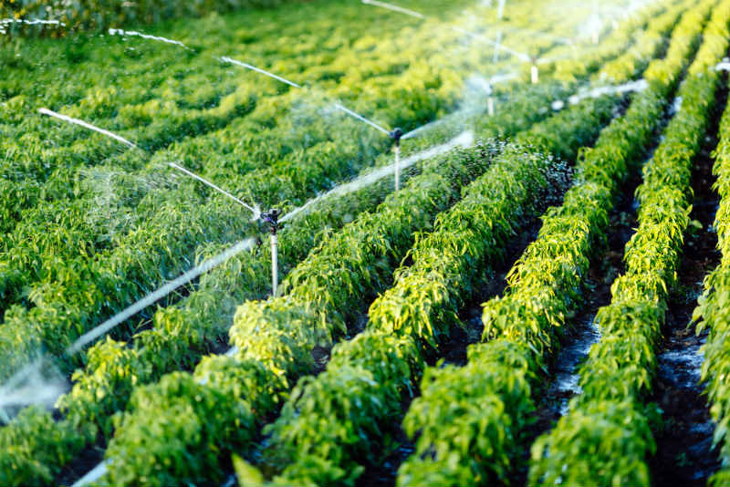
SMART IRRIGATION SYSTEM
Presented by:
Rubi Adhikari(022-368)
Aashika Pandey(022-391)
Shristi Dhakal(022-376)
1

Slide 2
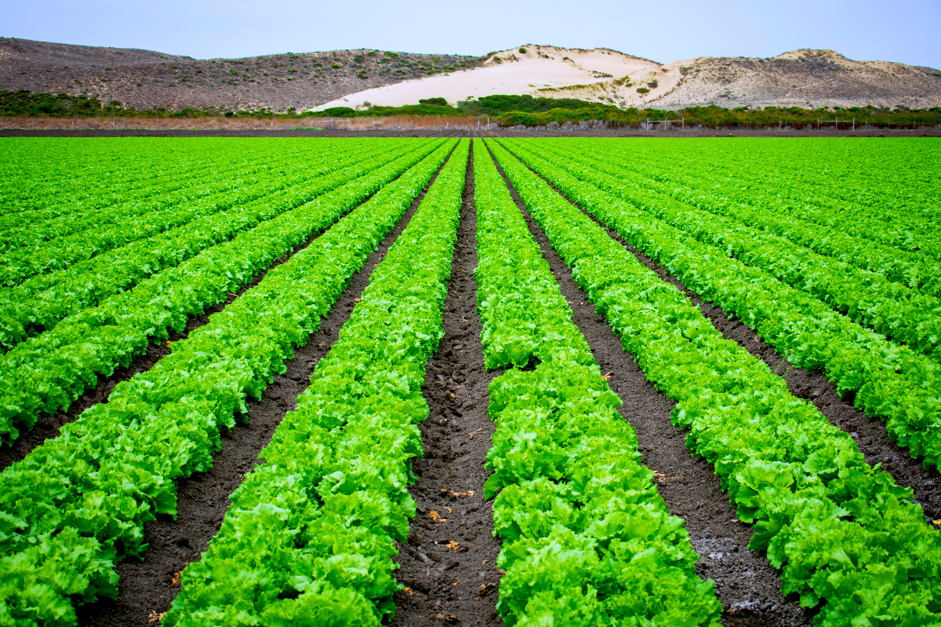
INTRODUCTION
Smart Irrigation System ??
2

Slide 3




OBJECTIVE
To reduce water wastage.
Fully automate the irrigation process to reduce manual effort.
Create a Blynk interface for live monitoring and control.
Establish a database connection to store and manage sensor data effectively.
3

Slide 4

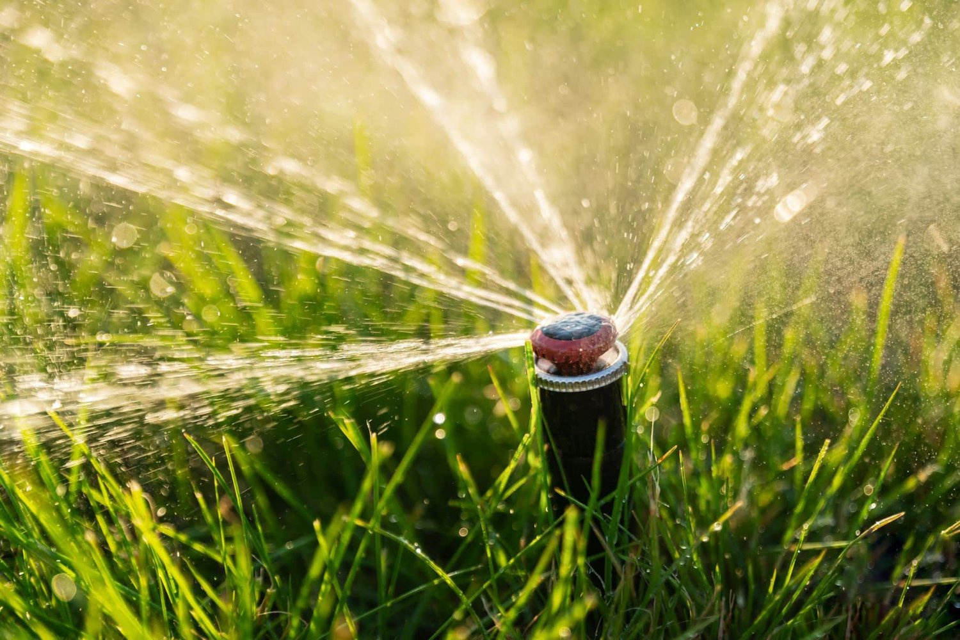
COMPONENTS
Frame Relay
ESP 8266
Soil Moisture Sensor
Buzzer
DC Water Pump
LED
Jumper Wires
Bread Board
4

Slide 5
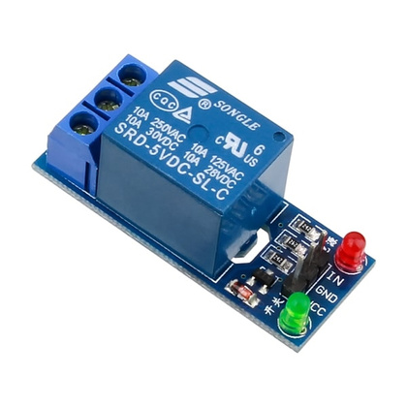
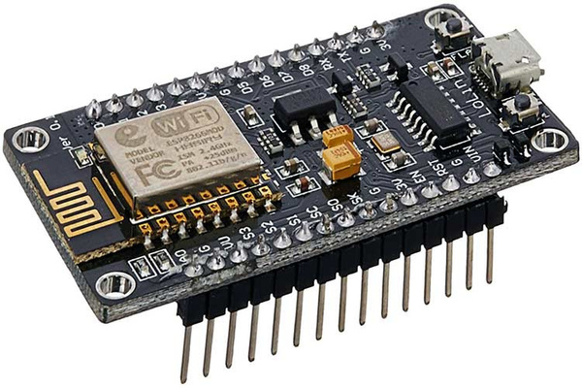
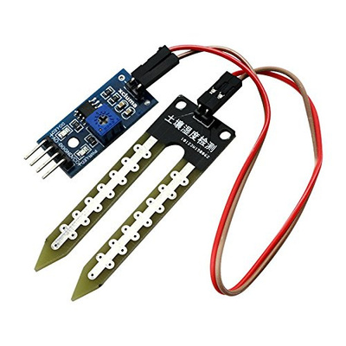

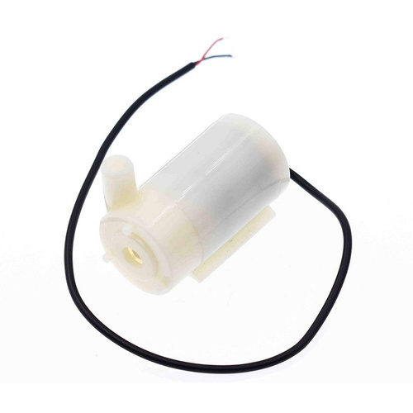
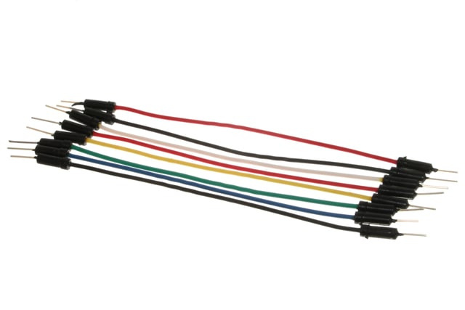
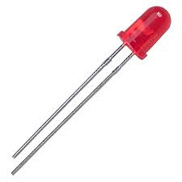
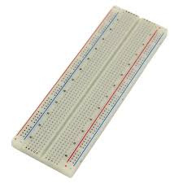
Frame Relay
ESP 8266
Soil Moisture Sensor
Buzzer
Water Pump
Jumper Wires
LED
Bread Board
5

Slide 6





APPLICATIONS
Agriculture
Landscaping
Urban Spaces
Home Gardening
6

Slide 7

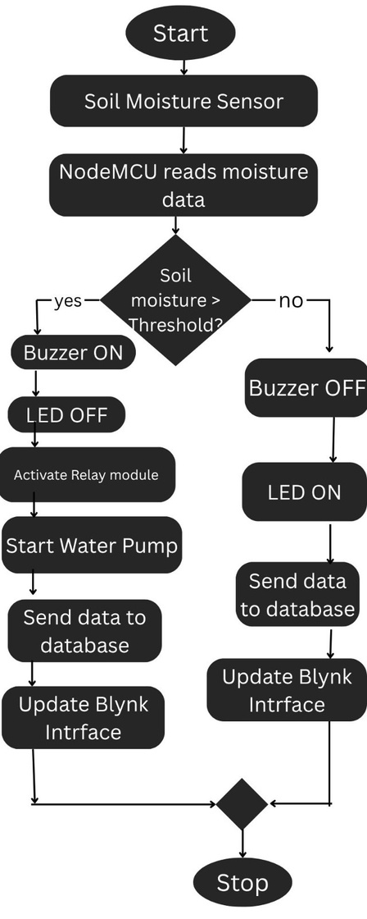
FLOWCHART
7

Slide 8
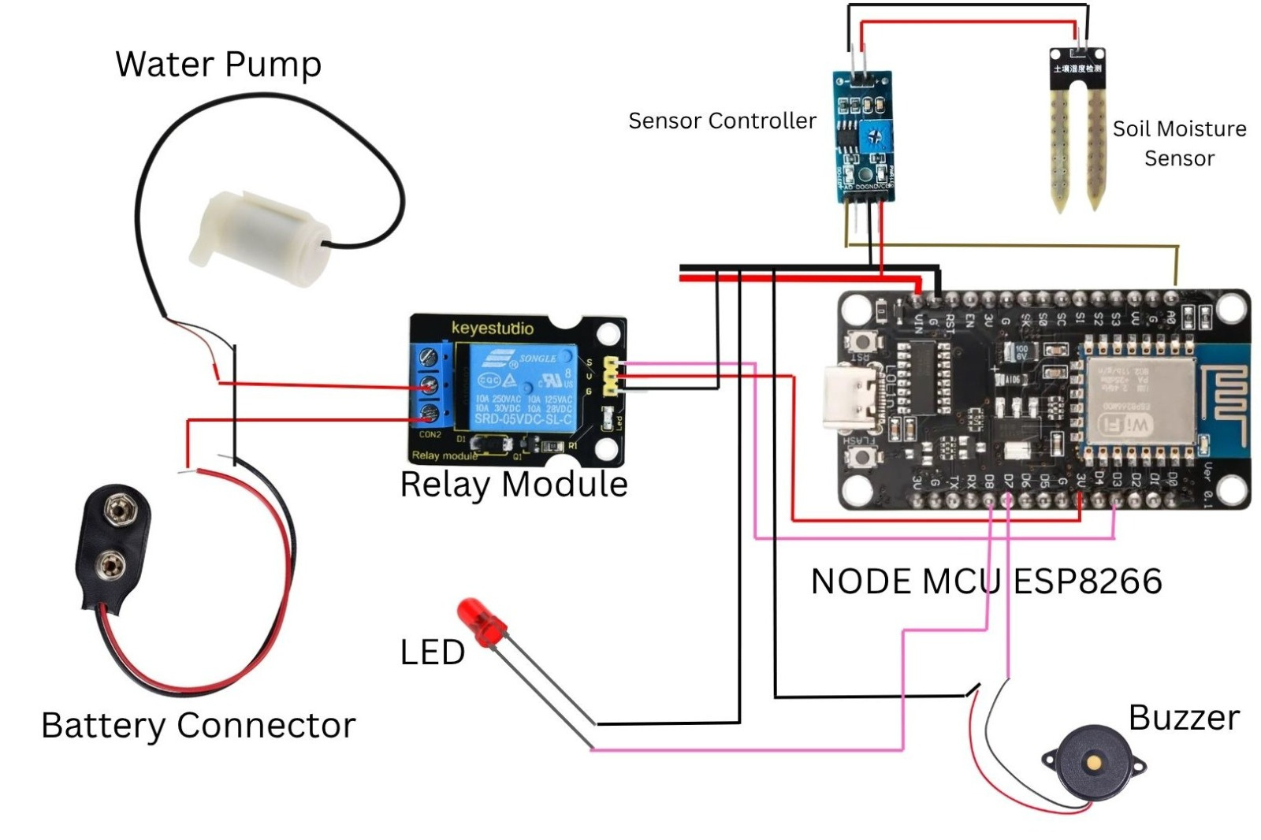
BOARD DIAGRAM
8

Slide 9


9

Slide 10
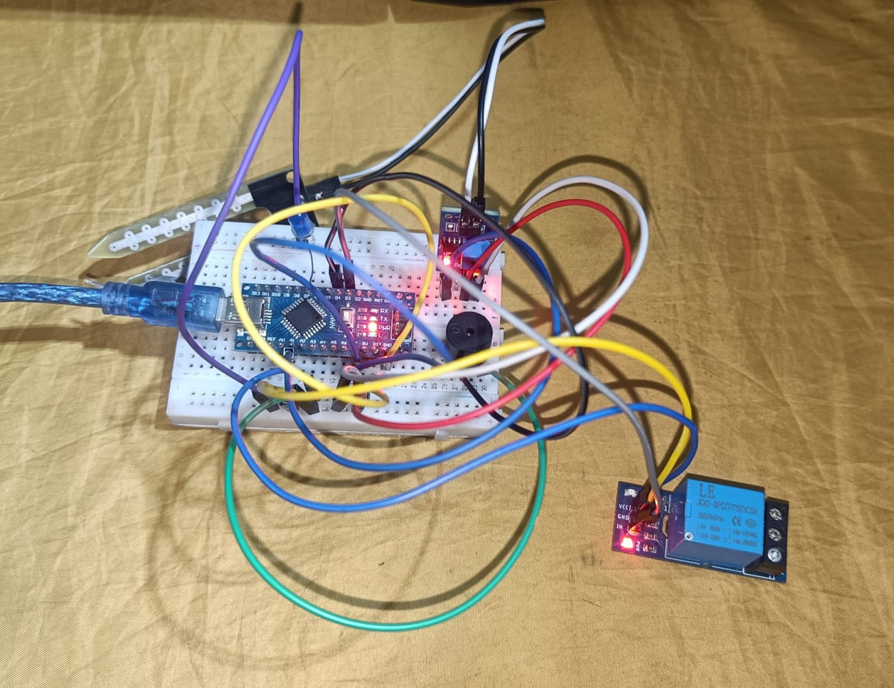
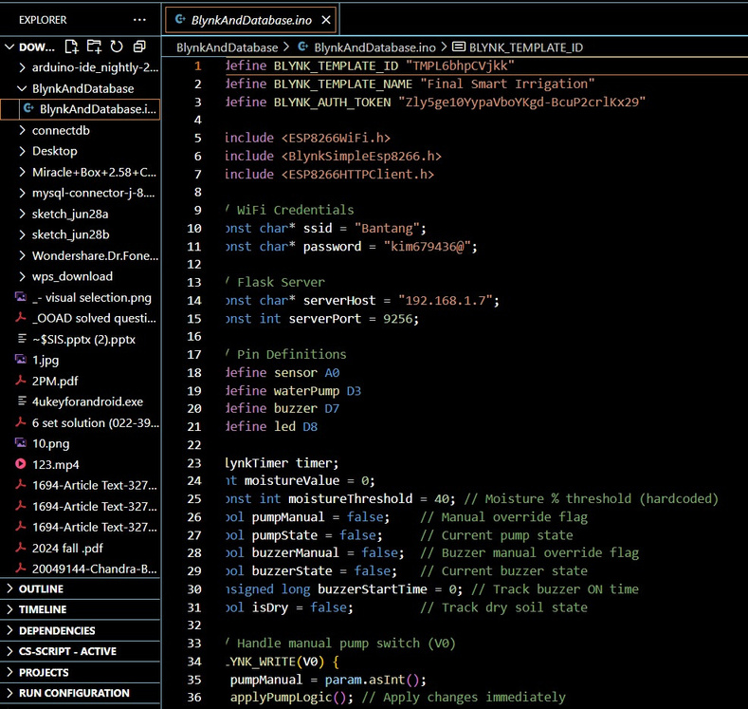
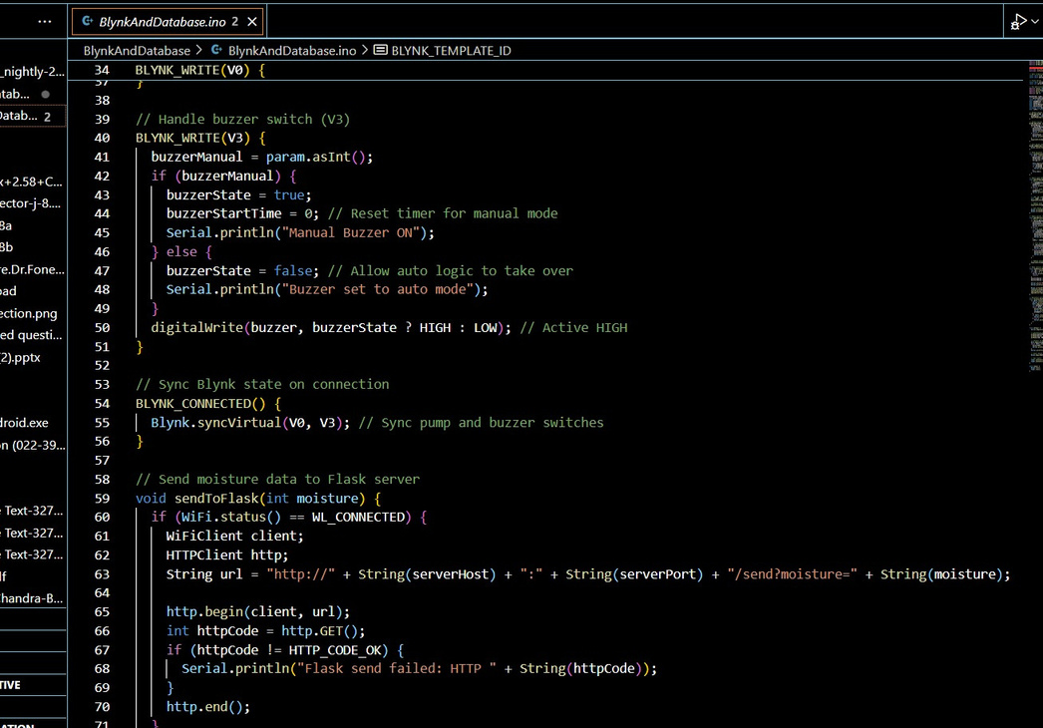
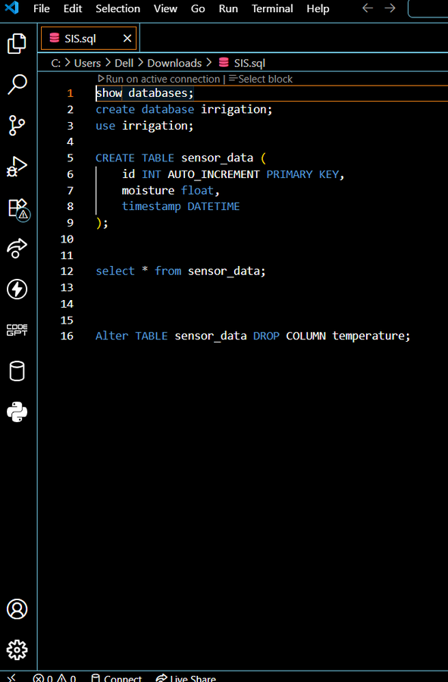
CODE
Arduino IDE Code
Database Code
10

Slide 11
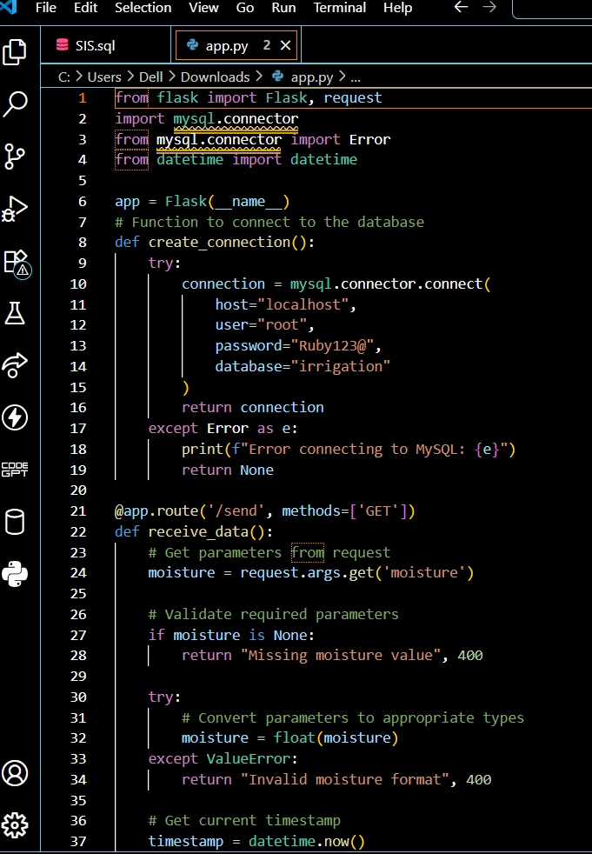
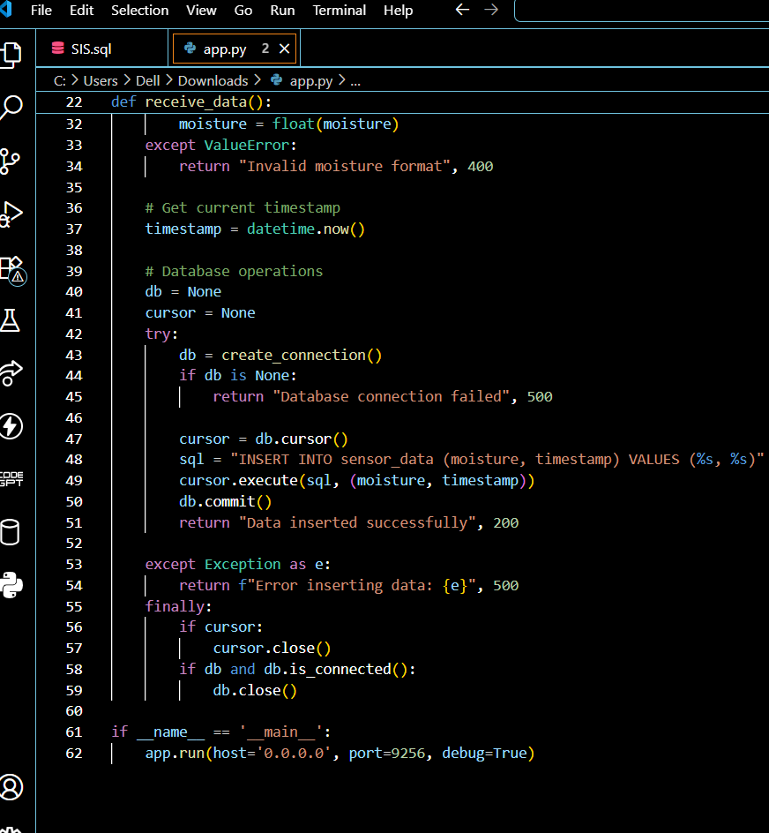
FLASK CODE
11

Slide 12


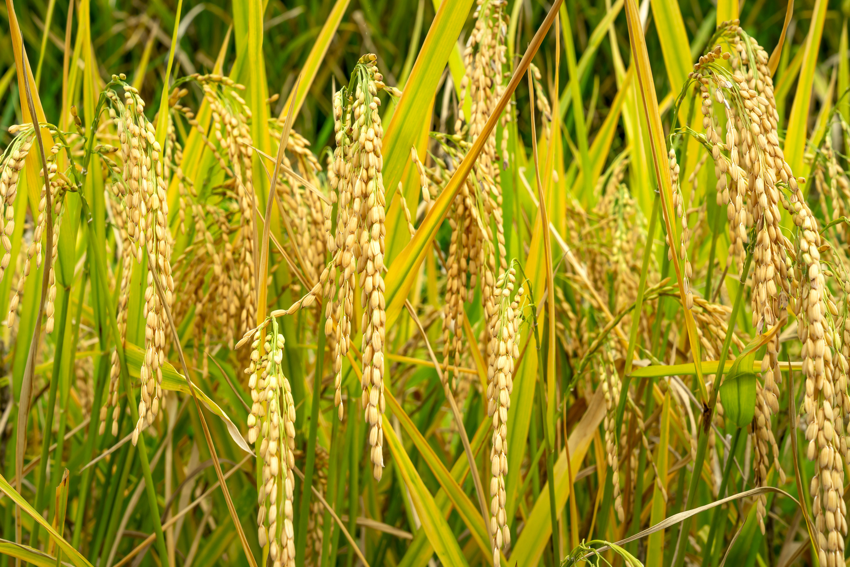

CODE EXPLANATION
We used C++ (Arduino IDE) to read sensor data and control the irrigation pump.
A Flask backend was built to receive data and connect with a database for storing historical records.
The system is integrated with the Blynk app for real-time mobile monitoring and control.
Together, it enables smart, automated irrigation based on soil moisture levels.
12

Slide 13
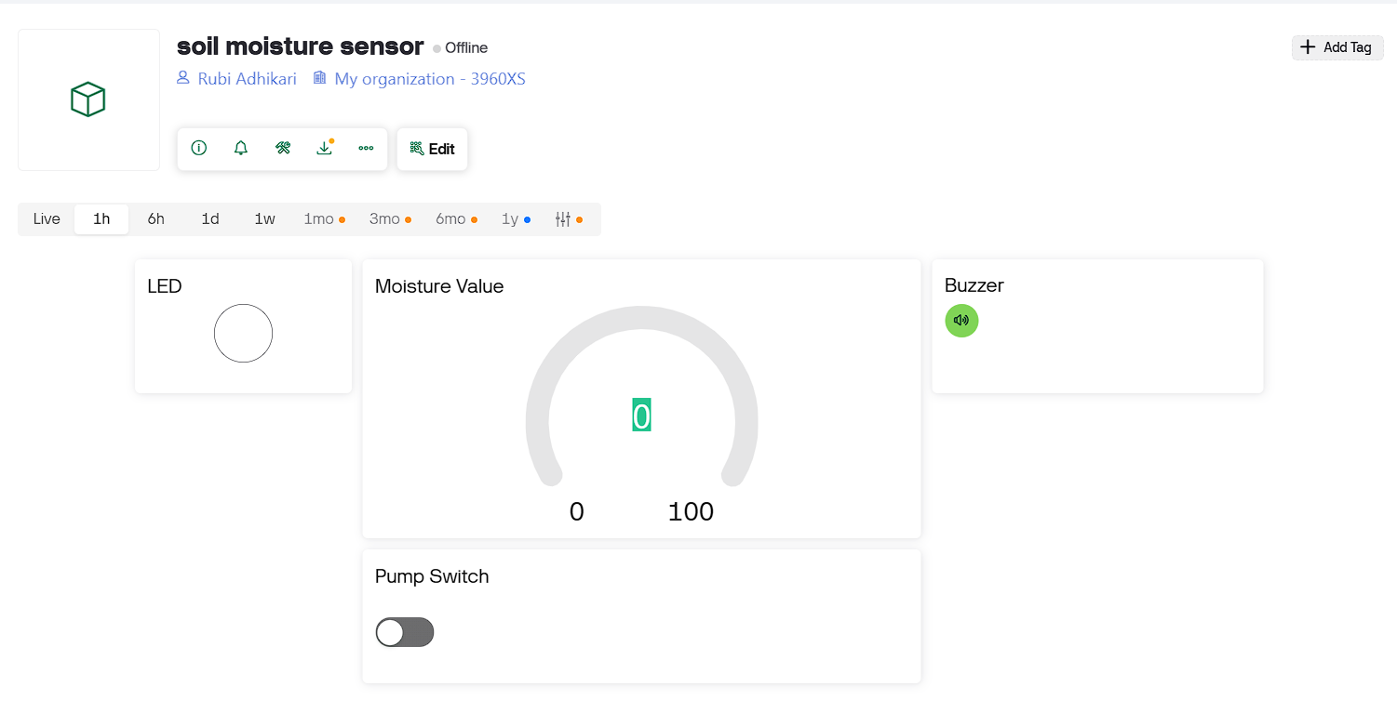
BLYNK INTERFACE
13

Slide 14


CONCLUSION
Saves water by preventing over-irrigation and wastage
Boosts crop productivity through precise watering
Reduces labor and operational costs
Useful in homes, cities, farms, and research centers
14

Slide 15
Thank you!!
Ask for any Queries!!
15

