Slide 1

Task recursion and Scheduling with Micrium uC/OS III on TI Stellaris Evalbot platform.
ES6153 Course Project.
By: ADHIKAR SAURABH ( Mat No: G1601326D )
KULKARNI ABHINAV (Mat No: G1601353G )
Team Name: Naruto

Slide 2
Index
Introduction
Data Structures
Task Structure
Task Recursion
Scheduling

Slide 3
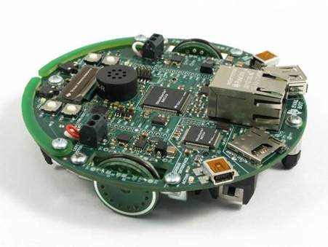

Introduction
Aim is to “ready” the tasks as per given task periods and schedule them. It implies the task is to be made ready at each periodic instance for recursion and then scheduled using specification.

Slide 4

Data Structures
Min Binary Heap: It is implemented for Task Recursion. Heapified on the basis of instant of next dispatch time.
Splay Tree: Implementation of Rate Monotonic Scheduling( RM). Tree traversed to find minimum period(thereby highest priority).

Slide 5
Task Recursion
The tree node structure is given as:
struct heap{
unsigned int size; // Size of the allocated memory
(in number of items)
unsigned int count; // Count of the elements in the
heap
TASK_TCB *TASK[5]; // Array with the elements
};

Slide 6
Scheduling
The tree node structure is given as:
struct heap{
unsigned int size; // Size of the allocated memory
(in number of items)
unsigned int count; // Count of the elements in the
heap
TASK_TCB *TASK[5]; // Array with the elements
};

Slide 7
Overheads per node
Overheads using Binary Heap:
Pop operation overhead -> 94 ticks
Push operation overhead->82 ticks

Slide 8
Distribution
->Implementation of data structures
-Adapting to embedded constrains (Static memory partitioning) using OSMemCreate() API.
->Task Recursion
-Use of hardware timer
-Polling of min-heap dispatch value with OSTickCtr value.
->Scheduling
-Finding task structure with minimum period value(highest priority), extracting it and inserting it into OSRdyList[] with a dummy priority.
-Removal of previous task from ready list
-The hardcoded priority values of tasks are used as dummy

Slide 9
Challenges and Limitations
Tasks with same period or synchronous value can be recursive (binary heap) but cannot be scheduled(splay tree) with current implementation.
The current implementation refreshes the stack at every dispatch which increases the overhead value.

Slide 10
THANK YOU

