Slide 1
FOUNDATIONS OF ARTIFICIAL INTELLIGENCE · SEMESTER 7 CAPSTONE
LiftZero
Multi-Agent Smart Elevator Fleet Coordinator
Contract Net agents · A* search · imitation-learned bidding · cooperative RL
Adhikkesh
Sisr Reddy
Kavin Karthic
Akash
CB.SC.U4CSE23101
CB.SC.U4CSE23129
CB.SC.U4CSE23161
CB.SC.U4CSE23162
Architecture & multi-agent coordination
Mission Control & frontend
Simulation environments & imitation learning
Deep RL, search & evaluation
Department of Computer Science and Engineering
Notes:
Presenter: Adhikkesh. Introduce the team and the one-line idea: every elevator car is an autonomous agent that bids for hall calls; we then learn how to bid.

Slide 2
The Elevator Group Control Problem (EGCP)
Every time someone presses a hall button, the fleet must decide — in real time — which car serves it. Decisions interact: today's assignment shapes every car's future route.
4²⁰ ≈ 10¹²
assignments for 4 cars and 20 open calls
Online: future passengers and their destinations are unknown (partially observable, stochastic)
Combinatorial: with N cars and k open calls there are N^k assignments
Multi-objective: average wait, worst-case (p95) wait, ride time, energy
Safety-critical: doors, capacity, faults and fire recall must never be violated
1 s
decision cycle: one simulation tick = one second
6 + N
cooperating agents per building (N cars)
Notes:
Presenter: Adhikkesh. Define EGCP: assign every hall call to one car, online, under uncertainty about future arrivals and destinations. Stress the combinatorics (N^k) and that the objective trades wait time, fairness and energy.

Slide 3
Why classic dispatchers fail at peak hours
1
Nearest car
Ignores each car's existing commitments → bunching, upper floors starve
2
Collective (LOOK)
Sweeps in one direction; no estimate of future cost
3
Fixed rules
Cannot adapt when traffic flips from up-peak to lunch to down-peak
Full system cuts up-peak wait by 47 % vs nearest car (29.9 s vs 56.2 s)
Notes:
Presenter: Adhikkesh. Use the measured up-peak numbers: nearest car ignores what a car is already committed to, so cars bunch and upper floors starve; collective control avoids reversing but still has no look-ahead. Planning (A*) and global re-optimisation halve the wait.

Slide 4
Multi-agent architecture and the Contract Net Protocol
Elevator (×N)
Dispatcher
One auction round (FIPA-ACL)
utility-based: bids marginal cost, A* routing
auctioneer: CFP, award, SA re-optimisation
1
CFP
Dispatcher broadcasts the hall call (floor, direction, urgency)
Floor
Traffic monitor
2
PROPOSE / REFUSE
senses waiting passengers, raises hall calls
learning agent: detects pattern, retunes weights
Each car prices the call from its own state; full or faulty cars refuse
3
ACCEPT / REJECT
Safety
Passenger
Lowest bid wins (ties → lowest car id)
rule-based: forward-chaining safety rules
simple reflex: board, ride, alight
4
INFORM
Winner updates its route; board and dashboard update
Notes:
Presenter: Adhikkesh. Six agent types, each with a PEAS description and an AIMA agent type. Agents never call each other's methods: they exchange FIPA-ACL messages through a bus and read a public status board. Walk through one Contract Net round on the right.

Slide 5
Physical model, search and safety
Kinematics
Routing as search
Safety
1 tick = 1 simulated second
2 s per floor, 2 s door open / close
1 s boarding per passenger, capacity 6–16
Door states: closed → opening → open → closing
State: car floor, direction, remaining stops
A* with an admissible, consistent heuristic
Bid = marginal cost of inserting the call
LOOK fallback above 10 stops (bounded rationality)
Never move with doors open
Never exceed capacity or floor bounds
Fire recall to lobby, fault ejection
Invariants checked every tick of every run
Evaluation at scale found a real safety bug (fire alarm mid-move); fixed and pinned by regression tests — 0 violations in 7,800 test runs
Notes:
Presenter: Adhikkesh. Explain the discrete-time kinematics (1 tick = 1 s), the A* stop-sequencing problem with an admissible heuristic, and the safety invariants checked every tick. Mention that our 100-seed evaluation found and fixed a fire-recall bug (car counted as moving with doors open).

Slide 6
Feature engineering and the learning environment
14
Call token
1.47 M
floor, direction, waiting, urgency, traffic pattern
expert decisions recorded from the real simulator (train / val / test)
26
Car token (each car)
position, direction, load, doors, plan summary, geometry to the call
2 M
extra learner-state decisions from two DAgger rounds
10
Global token
time, building, fleet load, public cost weights W1–W4
3.7×
Features are public only: what any car can read from the status board.
measured twin speed-up only → RL trains on the real simulator
Notes:
Presenter: Kavin Karthic. A decision is encoded as tokens: one call token, one global token, one token per car — so the network sees a set of cars of any size. Schema v2 added the public cost weights, which removed conflicting labels between the two teachers. Be honest about the twin: measured 3.7x faster than the real simulator and not faithful, so RL trains on the real simulator.

Slide 7
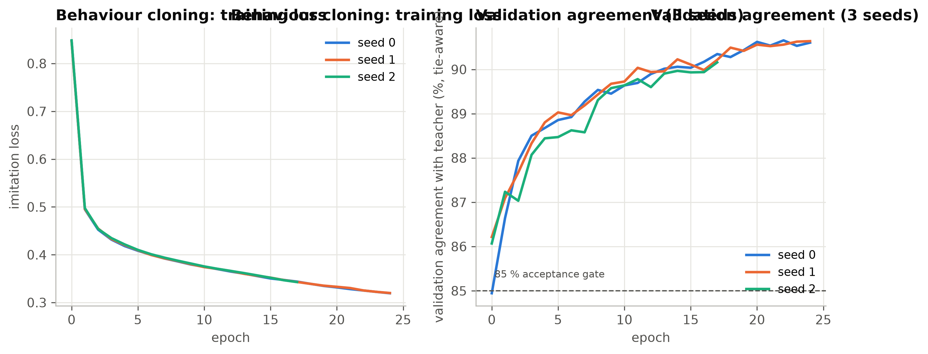
LiftZero-BC: a set-Transformer that learns to bid
88.3 ± 0.4 %
validation agreement, 3 seeds (gate 85 %)
89.9 %
agreement on unseen test decisions
0.19 ms
4-layer set-Transformer, 237,575 parameters, permutation-equivariant over cars
Loss: listwise CE + log-cost regression + rank + pairwise hinge on hard decisions
DAgger: learner drives, A* teacher labels — closed-loop gap shrank from +6.2 % to +1.1 %
CPU inference per decision (8 cars)
Notes:
Presenter: Kavin Karthic. The network replaces only the bid computation. It is permutation-equivariant (no car ids), 237k parameters. Behaviour cloning on 595k decisions reached 88.3% agreement over 3 seeds; DAgger fixed the one closed-loop regime that was outside the 5% band. ONNX inference is 0.19 ms per decision.

Slide 8
LiftZero-PPO: cooperative reinforcement learning (CTDE)
Objective
Status
L = −E[min(ρA, clip(ρ, 1±ε)A)] + c_v·(V_priv − R)² − c_e·H[π] + β·KL(π_BC ‖ π)
Implemented from scratch and unit-tested (GAE, clipping, KL, critic isolation, seed guards). End-to-end smoke run passes. Full training runs on Kaggle; results are added once available.
SMDP discount γ^(Δt/τ), GAE λ = 0.95, β: 0.2 → 0
Team reward: −(Σ waiting time + ½ Σ riding time)/100 − 0.02·floors − 0.5·long waits
Decentralised execution: every car runs the same public-information actor
Centralised training: the critic also sees per-floor queues and waiting ages
Trains directly on the real simulator (no sim-to-real gap)
1
Warm start from LiftZero-BC
2
Collect 8k decisions in parallel workers
3
Advantages from the privileged critic
4
4 epochs of clipped updates, KL early stop
Notes:
Presenter: Akash. Imitation can only match the teacher; RL optimises the real objective. Explain the SMDP (irregular decision times, gamma^(dt/5)), the shared team reward (cooperative), the asymmetric critic that sees privileged state during training only, and the KL anchor that keeps the policy close to the imitation policy. Status: implemented and unit-tested; full training runs on Kaggle.

Slide 9
Look-ahead arbitration with PUCT Monte-Carlo tree search
Selection rule
Implemented: live in the Brain panel
a* = argmaxₐ [ Q(s,a) + c_puct · P(s,a) · √(Σ_b N(s,b)) / (1 + N(s,a)) ]
~22 simulations to depth 3 in 50 ms. On 20 test seeds: up-peak wait 36.3 → 31.9 s, lower in all 4 regimes (not yet significant); 0 safety violations.
Prior P from the LiftZero network, leaf value from its public value head
Only cars that proposed are candidates; refusals stay classical
Hidden passenger destinations are sampled (determinisation, partial observability)
Hard real-time budget: ≤ 50 ms per contested decision
Reflex
learned bid: 0.19 ms, no look-ahead
Deliberative
search: simulates the next minute
Hybrid
search only when bids are close
Notes:
Presenter: Akash. The dispatcher, which sees all bids, runs a short PUCT look-ahead over contested calls: about 22 simulations to depth 3 inside a 50 ms budget, sampled hidden passengers, cost-greedy rollouts. Demo it live on the Brain page (strategy LiftZero + look-ahead).

Slide 10
Mission Control: the live React dashboard
1
Mission Control
2
Auction theatre
3
Agents
60 FPS canvas of shafts, cars, doors and passengers; live KPI sparklines
every Contract Net round: bids, breakdown, winner and reason
agent graph, FIPA-ACL swimlanes, PEAS inspector
4
Search lab
5
Experiments
6
LiftZero Brain
BFS / UCS / Greedy / A* step-through, SA and minimax demos
multi-seed benchmarks and side-by-side compare mode
live network bids, attention, search visits and Q, 'Why?' saliency
React 19 + TypeScript, WebSocket streaming from FastAPI · 66 Vitest unit tests · LiftZero strategies selectable live
Notes:
Presenter: Sisr Reddy. Launch with `uv run elevator serve` and open localhost:8000. Show the shaft canvas, the auction theatre (live CFP/PROPOSE/ACCEPT with bid breakdown), compare mode, and story mode. Switch the strategy to LiftZero-BC: the decision trace shows the network's bids.

Slide 11
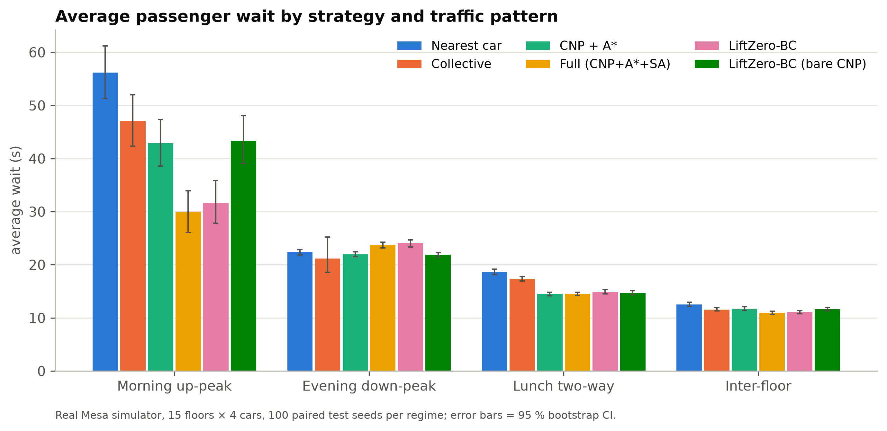
Results: average wait across traffic patterns
Up-peak: Full 29.9 s vs Nearest 56.2 s (−47 %) · LiftZero-BC within ±3 % of its teacher in 3 of 4 patterns · 0 safety violations in 7,800 runs
Notes:
Presenter: Akash. 100 paired test seeds per regime in the real simulator. The full multi-agent system is strongest overall; LiftZero-BC tracks its teacher closely. Point out down-peak, where simple collective control is competitive — the motivation for RL.

Slide 12
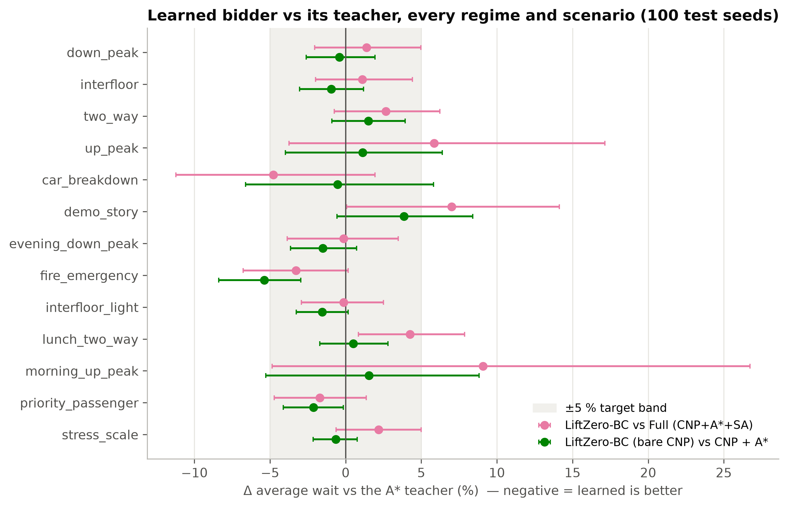
Does the learned bidder match the A* teacher?
13 / 13
regimes within ±5 % for the bare-CNP learned bidder
10 / 13
regimes within ±5 % for LiftZero-BC vs Full
Ablation ladder (up-peak wait)
Nearest 56.2 → Collective 47.1 → CNP+A* 42.9 → Full 29.9 → LiftZero-BC 31.6 s
Notes:
Presenter: Akash. Each learned strategy differs from its teacher only in the bidder (single-variable comparison). The bare-CNP pair is within the ±5% band in all 13 regimes and scenarios; the full-system pair misses in three, where passenger streams diverge because annealing shares the random stream — wide confidence intervals.

Slide 13
Team contributions
Adhikkesh
Sisr Reddy
Kavin Karthic
Akash
CB.SC.U4CSE23101
CB.SC.U4CSE23129
CB.SC.U4CSE23161
CB.SC.U4CSE23162
Mesa 3 multi-agent engine
FIPA-ACL + Contract Net
Kinematics, A* routing, safety
Slides 1–5, demo launch
React 19 Mission Control
60 FPS canvas, auction theatre
Compare & story modes
Slide 10, live UI demo
Feature schema, expert recorder
Set-Transformer, BC + DAgger
ONNX runtime, learned bidder
Slides 6–7, CLI demo
Cooperative PPO (CTDE)
PUCT-MCTS look-ahead
Benchmarks & statistics
Slides 8–9, 11–12
Notes:
Each member presents their own slides: Adhikkesh 1–5, Kavin 6–7, Akash 8–9 and 11–12, Sisr 10 and the live demo; everyone fields questions on their modules.

Slide 14
Conclusion and next steps
−47 %
0.19 ms
0
up-peak wait vs nearest car (full system)
learned bid vs an A* search per car
safety violations in 7,800 test runs
What we built
Next steps
Message-driven multi-agent system with Contract Net, A* and safety rules
Imitation-learned bidder (BC + DAgger) matching its teacher, shipped as ONNX
Live dashboard and a reproducible evaluation pipeline (444 + 66 tests)
Complete PPO training (code and tests ready) and compare with the teacher
Tune the look-ahead budget; value-head leaves once PPO is trained
Real building traces and multi-lobby buildings
Thank you — questions?
Notes:
Presenter: Adhikkesh (with all). Summarise: a working multi-agent system with search and safety, a learned bidder that matches the A* teacher at a fraction of the compute, and an RL pipeline ready to train. Then invite questions.

