Slide 1
MOBILE APPLICATIONS DEVELOPMENT

Slide 2
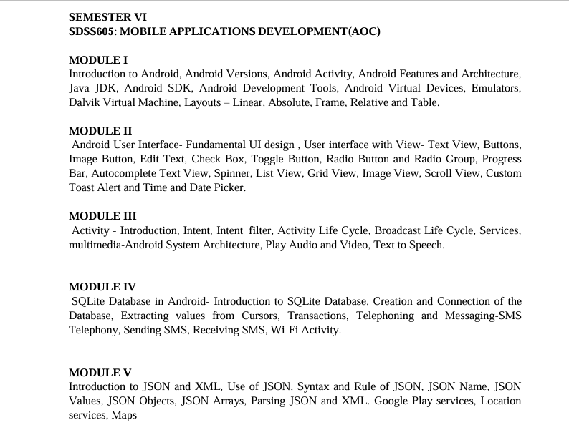

Slide 3
Activity Lifecycle in Android
In Android, an activity is referred to as one screen in an application.
It is very similar to a single window of any desktop application.
An Android app consists of one or more screens or activities.
Each activity goes through various stages or a lifecycle and is managed by activity stacks.
So when a new activity starts, the previous one always remains below it.

Slide 4
There are four stages of an activity.
If an activity is in the foreground of the screen i.e at the top of the stack, then it is said to be active or running. This is usually the activity that the user is currently interacting with.
If an activity has lost focus and a non-full-sized or transparent activity has focused on top of your activity. In such a case either another activity has a higher position in multi-window mode or the activity itself is not focusable in the current window mode. Such activity is completely alive.
If an activity is completely hidden by another activity, it is stopped or hidden. It still retains all the information, and as its window is hidden thus it will often be killed by the system when memory is needed elsewhere.
The system can destroy the activity from memory by either asking it to finish or simply killing its process. When it is displayed again to the user, it must be completely restarted and restored to its previous state.

Slide 5
An activity in Android can be in four main stages:
Active / Running
The activity is on the screen and at the top.
The user is directly interacting with it.
Example: You are typing in an app.
Paused
The activity is still visible but has lost focus.
Another small or transparent activity appears on top of it.
It is alive, but the user cannot interact with it fully.
Stopped
The activity is completely hidden by another activity.
It keeps its data, but the screen is not visible.
The system may close it if memory is needed.
Destroyed
The system removes the activity from memory.
This can happen when the user closes it or the system needs resources.
When opened again, the activity starts fresh and restores its state.

Slide 6
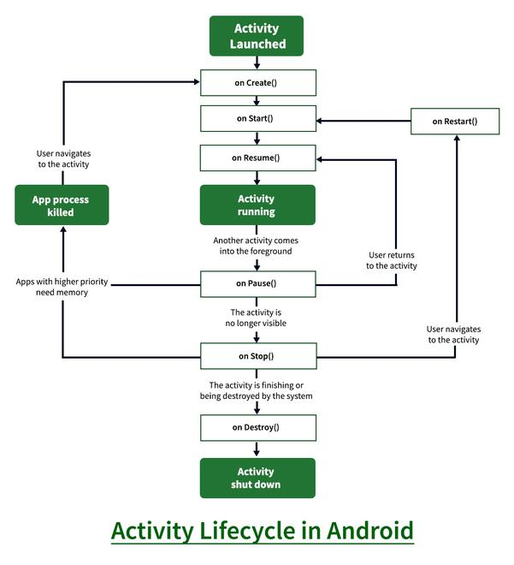

Slide 7
1. onCreate()
Called when the activity is created for the first time.
Used to initialize the activity.
Set the layout using setContentView().
Initialize variables, UI components, databases, etc.
Example use:
Load UI
Initialize buttons, text views
Set listeners

Slide 8
2. onStart()
Called when the activity becomes visible to the user.
Activity is not yet interactive.
Example use:
Prepare UI
Register listeners or receivers

Slide 9
3. onRestart()
Called after onStop(), when the activity is coming back to the foreground.
Followed by onStart().
Example use:
Re-initialize components that were released

Slide 10
4. onResume()
Called when the activity comes to the foreground and the user can interact with it.
This is the active/running state.
Example use:
Start animations
Start camera, sensors, music
Resume paused tasks

Slide 11
5. onPause()
Called when the activity is partially hidden.
Another activity comes in front (dialog, call, notification).
Important points:
Activity is still visible but not in focus.
Must be quick.
Example use:
Pause video or music
Save unsaved data
Release system resources

Slide 12
6. onStop()
Called when the activity is completely hidden.
Activity is no longer visible.
Example use:
Stop background tasks
Unregister receivers
Release heavy resources

Slide 13
7. onDestroy()
Called before the activity is destroyed.
This is the last method in the lifecycle.
When it occurs:
User presses back
Activity is finished
System destroys activity to free memory
Example use:
Clean up resources
Close database connections

Slide 14
Simple Real-Life Example
Opening an App
onCreate() – App is created
onStart() – App becomes visible
onResume() – User starts using the app
Incoming Call
onPause() – App loses focus
onStop() – App goes to background
User returns to app
onRestart() → onStart() → onResume()
User closes app
onDestroy()

Slide 15
Introduction to JSON in Android
JSON (JavaScript Object Notation) is a lightweight, text-based data format used to store and exchange data. In Android application development, JSON is mainly used to send and receive data between an Android app and a server (web services / APIs).

Slide 16
What is JSON?
Easy-to-read and easy-to-write format
Language-independent (used with Java, Kotlin, Python, PHP, etc.)
Commonly used in RESTful web services
Features of JSON
Simple structure
Uses key–value pairs
Supports arrays and nested objects
Platform independent

Slide 17
JSON Data Types
JSON supports the following data types:
Data Type | Example
String | "name": “LULU"
Number | "age": 20
Boolean | "isStudent": true
Object | { "id": 1 }
Array | [10, 20, 30]
Null | "result": null

Slide 18
Advantages of JSON
Simple syntax
Less data size
Easy to learn
High performance
Disadvantages of JSON
Limited data type support
No comments allowed
Not suitable for very complex documents

Slide 19
INDENT IN ANDROID
In Android, indent refers to the space (blank area) given from the left, right, top, or bottom of a view or text to improve readability and layout alignment.

Slide 20
1. Indent in Code (Formatting)
Indentation means adding spaces or tabs at the beginning of lines in XML or Java/Kotlin code to make the structure clear and readable.
<LinearLayout
android:layout_width="match_parent"
android:layout_height="wrap_content">
<TextView
android:layout_width="wrap_content"
android:layout_height="wrap_content"
android:text="Hello Android"/>
</LinearLayout>
This indent shows that TextView is inside LinearLayout.

Slide 21
Indent in UI (Layout / Design)
(a) Padding – Inside Indent
Space inside a view, between the content and its border.
android:paddingLeft="16dp"
android:padding="16dp“
(b) Margin – Outside Indent
Space outside a view, between it and other views.
android:layout_marginLeft="16dp"
android:layout_margin="16dp"

Slide 22
SQLite Database in Android
Android applications often need to store data permanently so that the data is not lost when the application is closed. For this purpose, Android provides SQLite, which is a lightweight, relational database management system.
SQLite is embedded directly into the Android operating system, so no separate database server or installation is required.
SQLite uses SQL (Structured Query Language) for performing database operations such as storing, retrieving, updating, and deleting data.
It is mainly used for local data storage in Android applications.

Slide 23
Features of SQLite
SQLite has several important features that make it suitable for mobile applications:
It is serverless, meaning it does not need a separate server.
It requires zero configuration.
It is fast and efficient for small and medium-sized data.
It supports standard SQL commands.
It occupies very less memory.
It supports ACID properties, which ensure data reliability.
It works offline, without internet connection.

Slide 24
SQLite Architecture in Android
Android provides built-in classes to work with SQLite databases. The important components are:
SQLiteOpenHelper – Helps in creating and upgrading the database.
SQLiteDatabase – Used to perform database operations.
ContentValues – Used to store values while inserting or updating data.
Cursor – Used to read data returned from a query.
These components together help developers manage database operations easily.

Slide 25
SQLite Data Types
SQLite supports dynamic data types. Commonly used data types are:
INTEGER – Used for whole numbers.
TEXT – Used for storing strings.
REAL – Used for decimal values.
BLOB – Used for binary data like images.
NULL – Represents empty value.

Slide 26
Cursor Class
A Cursor is an interface that provides access to the result set returned by a database query. It allows moving through rows and retrieving column values.
Common Cursor Methods:
moveToFirst()
moveToNext()
getString()
getInt()
getCount()

Slide 27
Advantages of SQLite in Android
No need for internet connection.
Easy to use and maintain.
Secure local data storage.
High performance for mobile applications.
Built-in support in Android.
Limitations of SQLite
Not suitable for very large databases.
Supports limited concurrency.
Not ideal for multi-user applications.

Slide 28
Applications of SQLite
SQLite is used in many Android applications such as:
Student management systems
Attendance applications
Notes and diary apps
Offline mobile applications
Contact and message storage

Slide 29
Google Play Services
Google Play Services is a system-level support package developed by Google.
It acts as a bridge between Android apps and Google’s advanced features.
Why Google Play Services Is Needed
Android devices come from different manufacturers (Samsung, Xiaomi, etc.)
OS versions may be different
Google Play Services provides uniform APIs for all devices

Slide 30
Important Characteristics
Runs silently in the background
Automatically updates through Play Store
Reduces developer effort
Improves app compatibility
Services Included
Location APIs
Maps APIs
Authentication APIs
Cloud Messaging (notifications)
Google Analytics
Without Google Play Services, apps like Maps, Gmail, Uber will not work properly.

Slide 31
Location Services
Location Services is a component of Google Play Services used to determine the geographical location of a device.
Fused Location Provider
Instead of using only GPS, Google uses a Fused Location Provider, which combines:
GPS (high accuracy, more battery usage)
Wi-Fi (medium accuracy)
Mobile towers (low accuracy, less battery)
Sensors (accelerometer, gyroscope)
This gives better accuracy with less battery consumption.

Slide 32
Location Permissions
Apps must request permission from users:
ACCESS_FINE_LOCATION → precise location
ACCESS_COARSE_LOCATION → approximate location
From Android 6.0 onwards:
Permission is asked at runtime
User can allow or deny anytime

Slide 33
Google Maps
Google Maps API allows developers to embed maps inside Android apps.
Map Types
Normal (default map)
Satellite
Terrain
Hybrid
Map Elements
Markers → show places
Polylines → show routes
Polygons → show areas
Camera → controls zoom and position

Slide 34
Google Maps API Key
A unique key generated from Google Cloud Console
Used to authenticate the app
Prevents misuse of maps service
Advantages of Google Maps
Accurate and real-time data
Traffic information
Easy navigation support
Trusted by millions of users
Example An app showing nearby:
ATMs
Hospitals
Colleges
Restaurants

Slide 35
How These Three Work Together
Step-by-Step Flow
Google Play Services provides APIs
Location Services detects current location
Google Maps displays that location on a map
Real-Time Example: Food Delivery App
App starts
Google Play Services initializes
Location Services fetch user location
Google Maps shows:
Restaurant location
Delivery route
Rider movement

Slide 36
Advantages of Using Google Services
✔ Less coding ✔ Accurate location ✔ Battery efficient ✔ Secure and reliable

