Slide 1
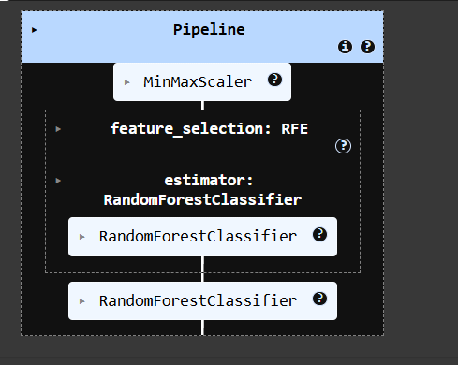
PIPE LINE METHOD

Slide 2
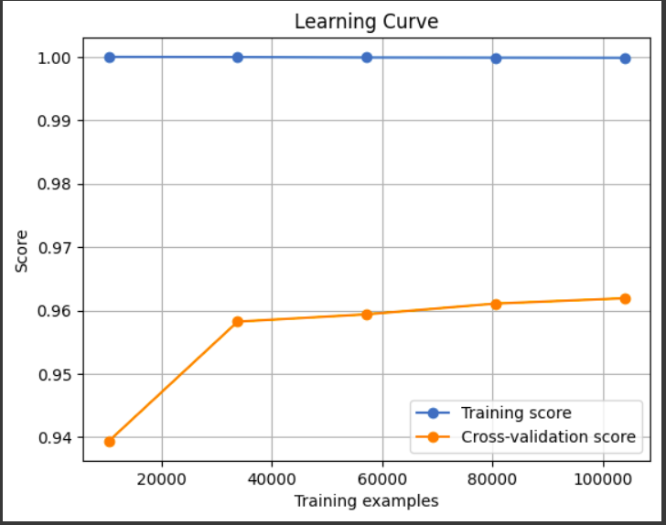
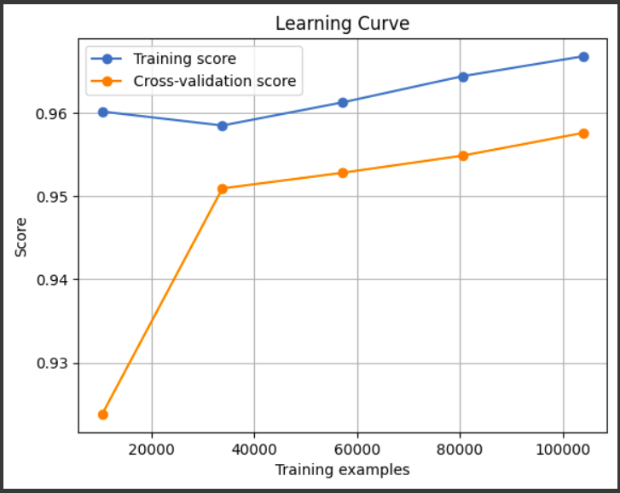
LEARNING CURVE ANALYSIS
BEFORE
AFTER
Fig 1: Its shows After Model Building and Tuning. The Blue Line shows 100% of Training Score, and orange line shows cross-validation. From this we get it’s Overfitted. So, prediction will go on a single result. So I edit the model’s parameters.
Fig 2: Its shows After Editing the Model(Random Forest) as reduce it’s max depth(30-20) and add another parameter min-sample-leaf(10. After that overfitting was removed the model makes good prediction.

Slide 3
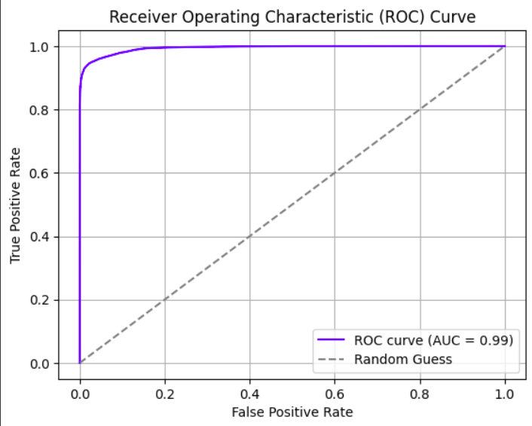
ROC CURVE ANALYSIS
Fig 3: The purple curve show the model is ideal. It’s highly focused of
True Positive Prediction and less focused on False Positive Prediction.
Area Under Curve(AUC) shows outstanding performance.

Slide 4
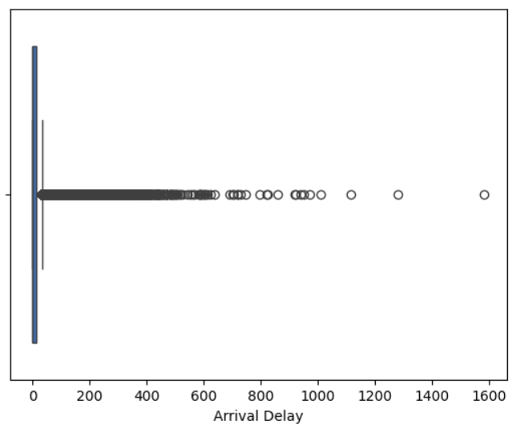
FIND OUTLIER USING BOXPLOT
Fig4: This show the column ‘Arrival Delay’ have outlier and having many missing values. so i prefer median for fill the values.

Slide 5
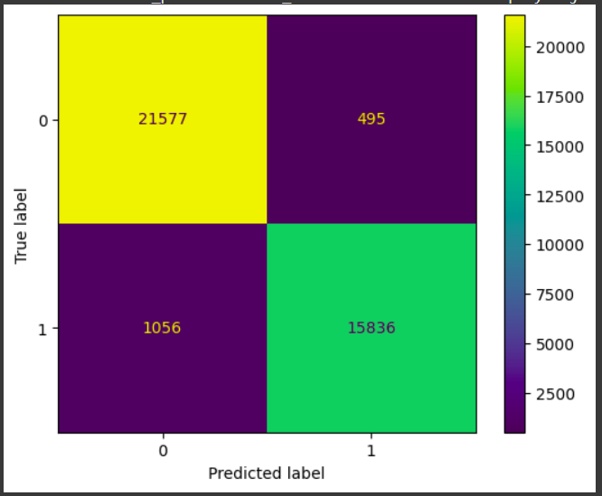
CONFUSIONMATRIXDISPLAY
Fig 5: The Confusion Matrix Display shows that TN-21577, TP-15836, FN-1056, FP-495

Slide 6
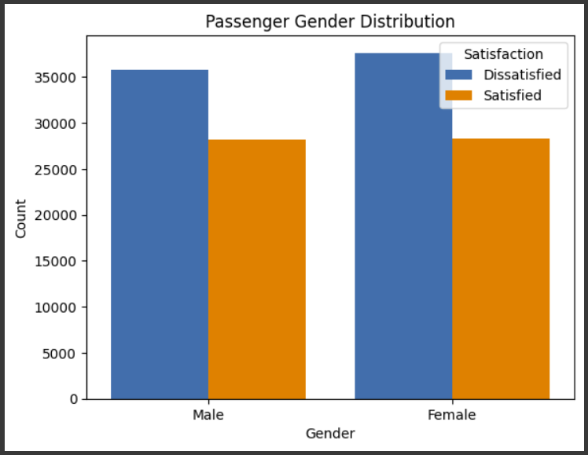
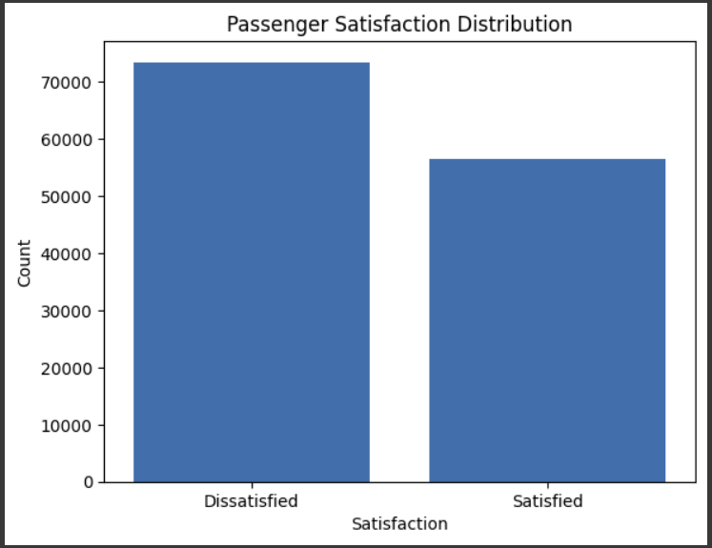
COUNTPLOTS
Fig 6: The chart shows that the data have more number of Female than Male. And most of them are Dissatisfied.
Fig 7: The chart shows Most of the Passengers are Dissatisfied. And Less Passengers are Satisfied

Slide 7
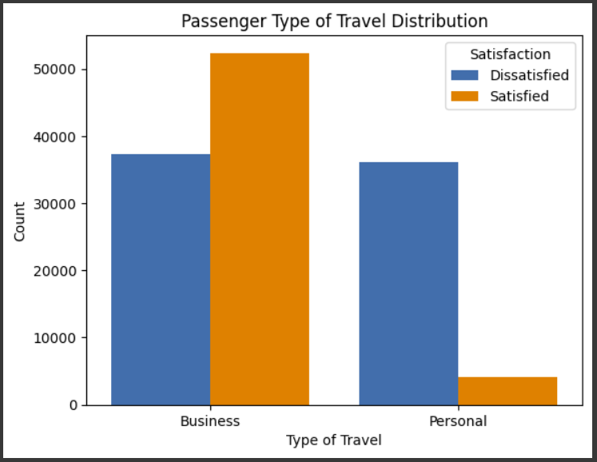
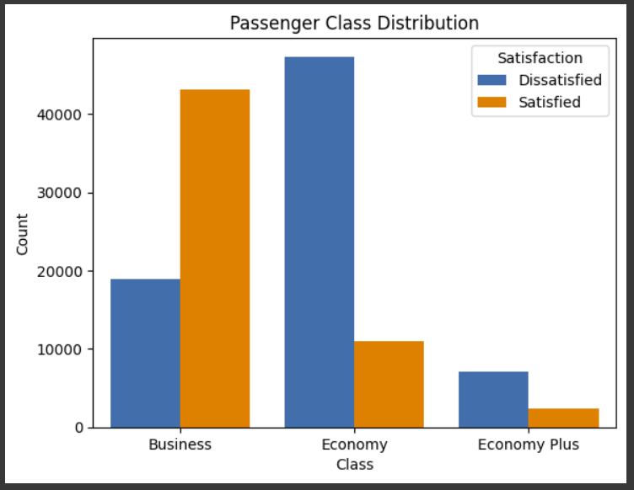
Fig 8: The chart shows that the most of the Passengers are travel for Business Purpose. And most of the Business persons are satisfied. But Passengers Travel of personal purpose have Dissatisfied.
Fig 9: The chart shows that the most the Passengers are choose Business Class and they are only people who have Satisfied about Airplane Services. But the Economy class and Economy Plus Class Passengers are very Dissatisfied

Slide 8
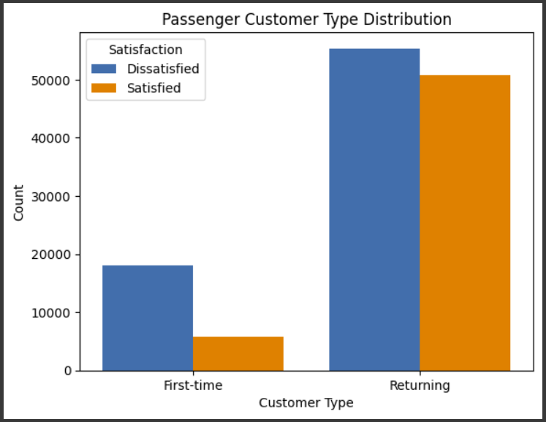
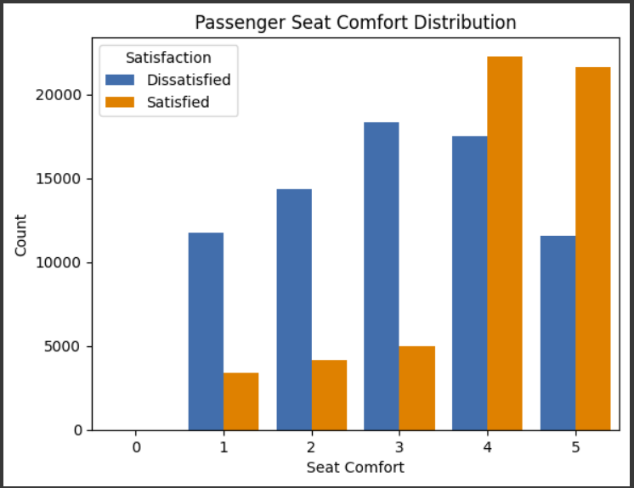
Fig 10: The chart shows that the most of the Passengers are going Second-Time(Returning) for Travel in Airplane and most of them are dissatisfied also some are satisfied. But the Passengers Travel in First-time have Dissatisfied.
Fig 11: The chart shows that the most of the Passengers are given 4&5 rating for Seat Comfort. But According Total number of Passenger most of them are Dissatisfied.

Slide 9
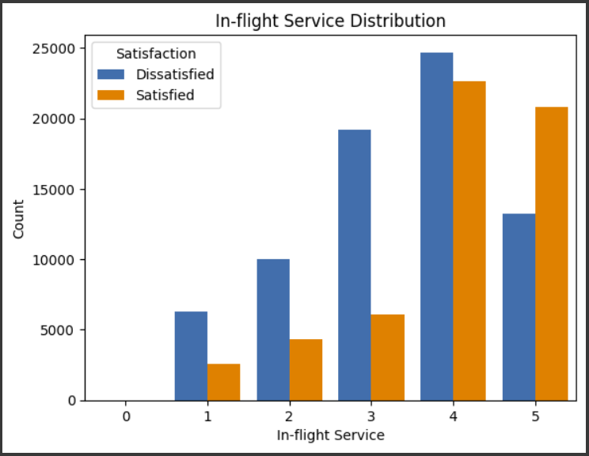
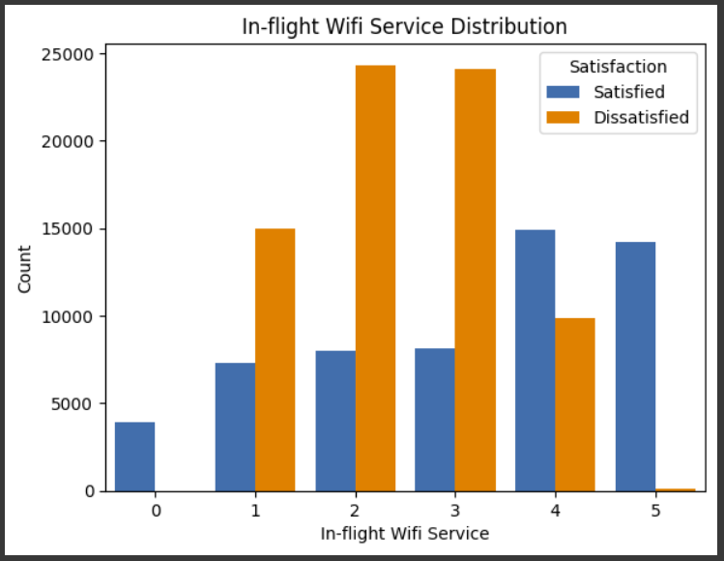
Fig 12: The chart shows that the most of the Passengers are give good rating for In-flight Services. And also some dissatisfied passengers are also give good rating. But According to Total number of Passengers most of them are Dissatisfied.
Fig 13: The chart shows that the most of the Passengers are give very low rating for In-flight Wifi Services. Very less passengers are give good rating. This shows that Wifi Service is very bad

Slide 10
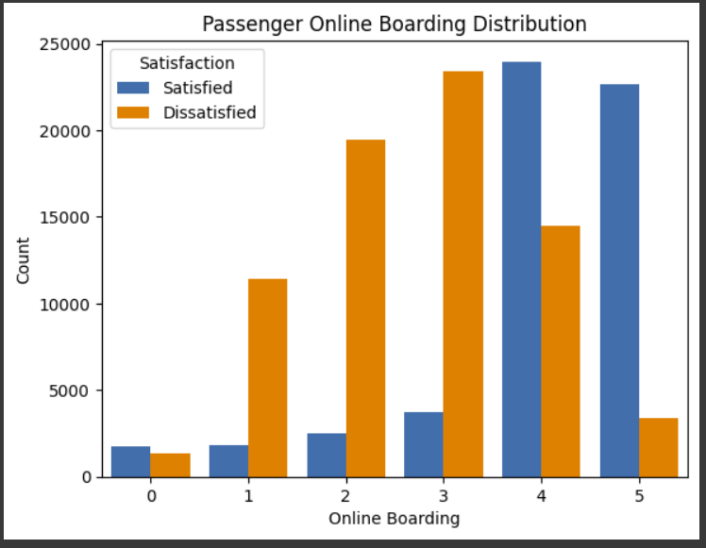
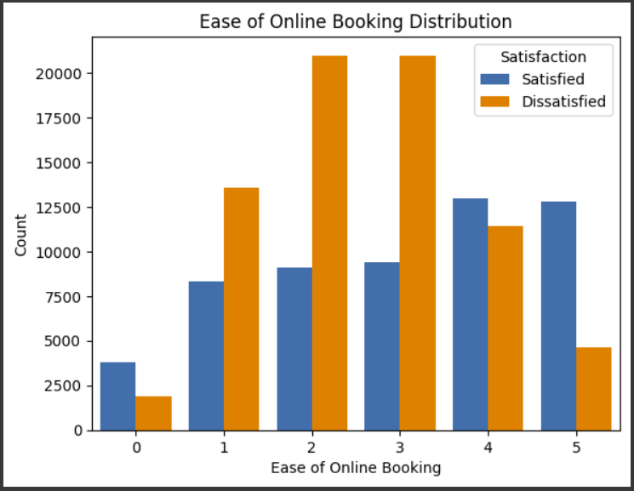
Fig 14: The chart shows that the most of the satisfied Passengers are give good rating in Online Boarding but most of them are dissatisfied.
Fig 15: The chart shows that the most of the Passengers are
Give very low rating in Online booking. Very few of them are give good rating in online booking.

