Slide 1

ML in Fashion: Using Deep Learning to recognise Indian Classical Sarees
Sudip Kumar Kar & Ritadip Bharati
Batch 19
Instructor: Dr. Subhankar Mishra

Slide 2
Recap
The Original idea was to train a Machine learning algorithm to learn to recognize Indian Classical Sarees.
This was to be done in two steps: first, a dataset was to be collected and next, this dataset was to be used to train the model.
As a starting point, it was decided that a simple algorithm like Tiny VGG would suffice.
If successful then we were to move to more sophisticated algorithms like Mobilenet.
Here, we present our progress on this path thus far.

Slide 3

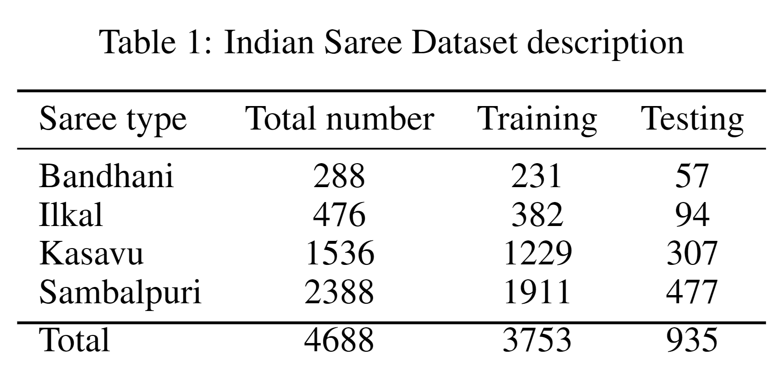
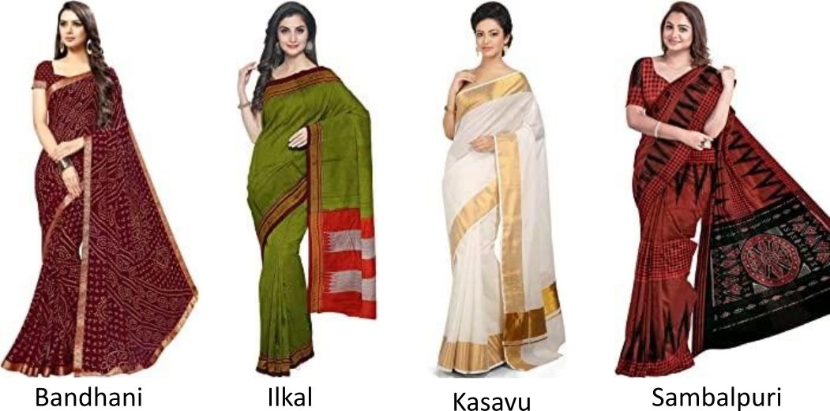
Dataset
Web Scraping was done using Python selenium libraries
Four different kinds of sarees were chosen: Sambalpuri, Ilkal, Kasavu, and Bandhani.
After this we had about 4.5k images to work with.

Slide 4
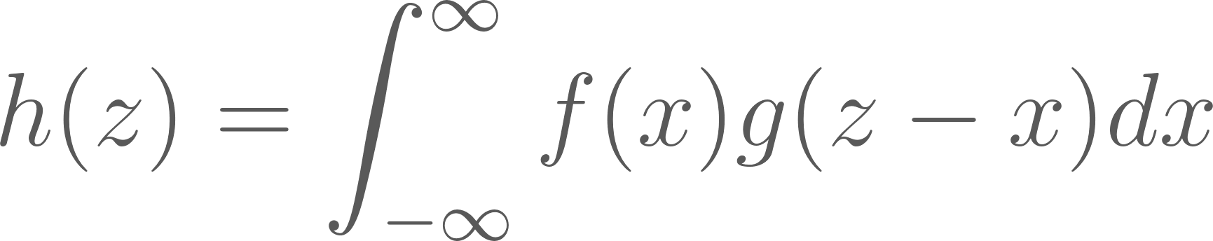
Convolutional Neural Networks
In one dimension, convolution is given as
Convolution can be thought of as looking at something through a different perspective, literally! Visualise it as a window sliding over the original distribution to yield a new one.
Doing so augments the original image data, this is leveraged by the algorithm to classify effectively.
GIF credits: [7]

Slide 5
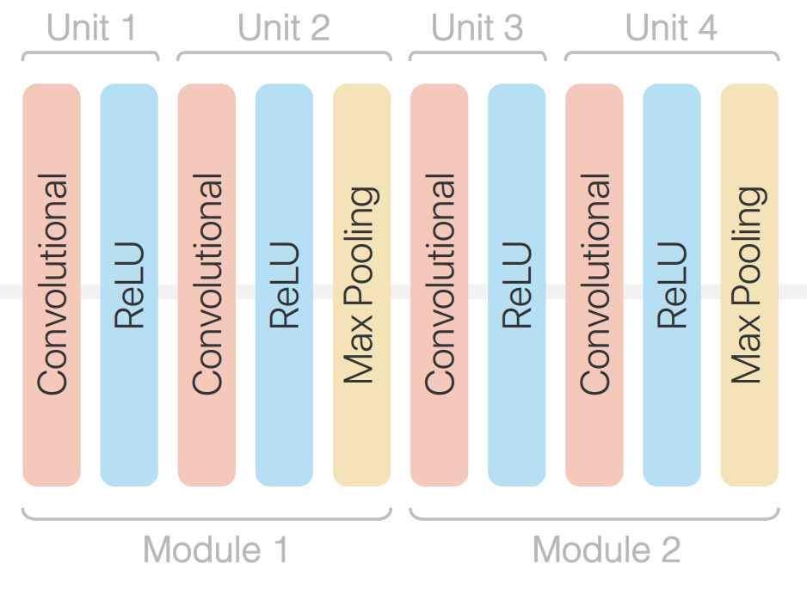
Tiny VGG
The Tiny VGG architecture uses multiple convolutional layers to effectively classify images.
The output of this is fed into a flattening layer with linear activation to give logits that can be used to determine the linear activation
Image credits: [6]

Slide 6
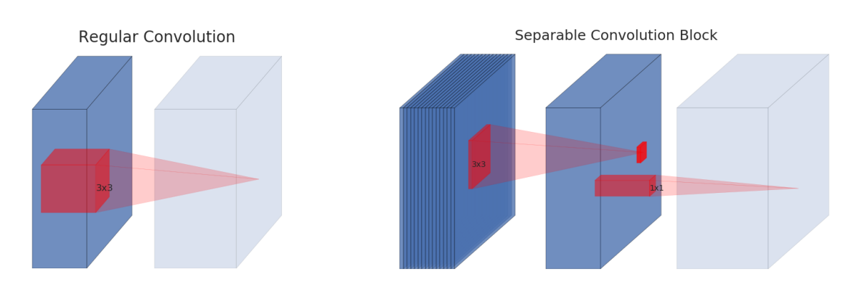
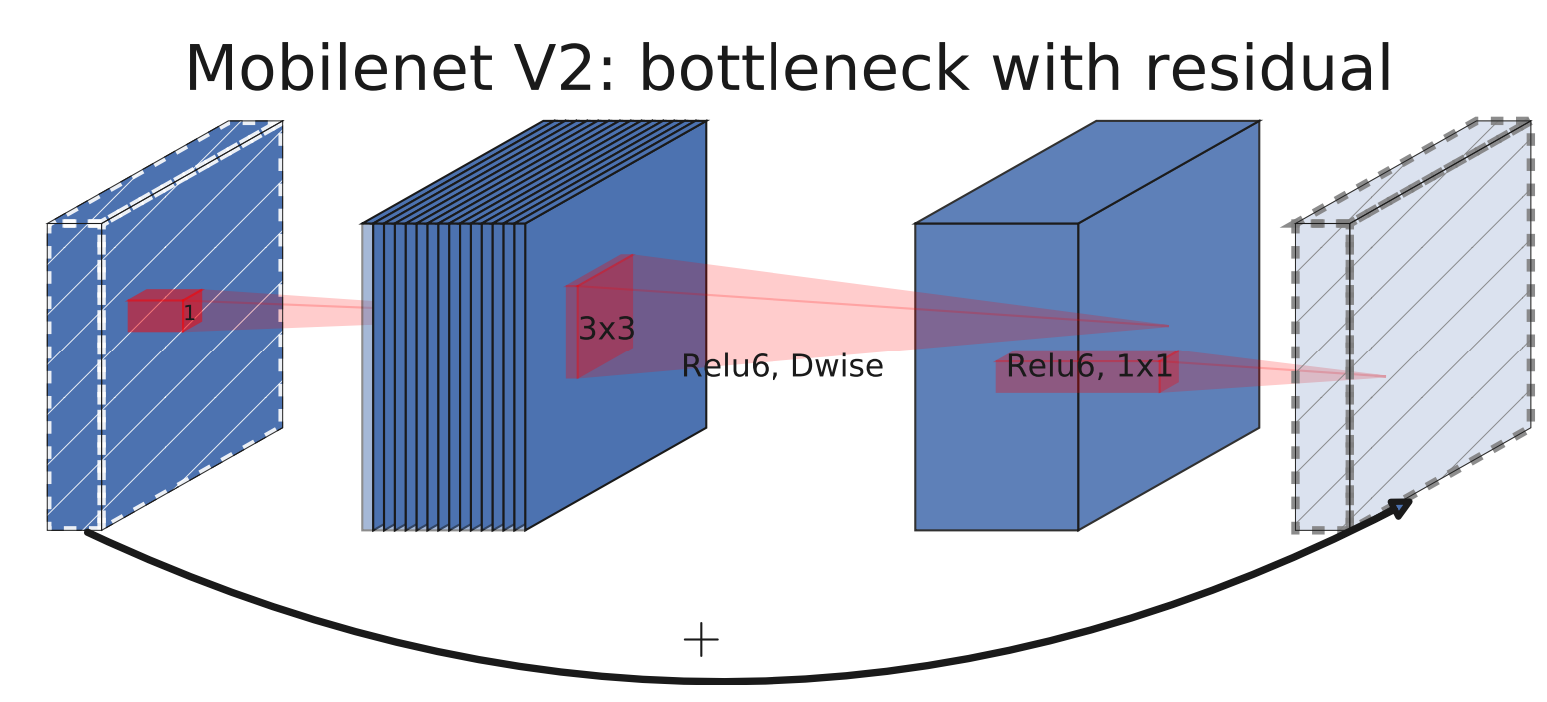
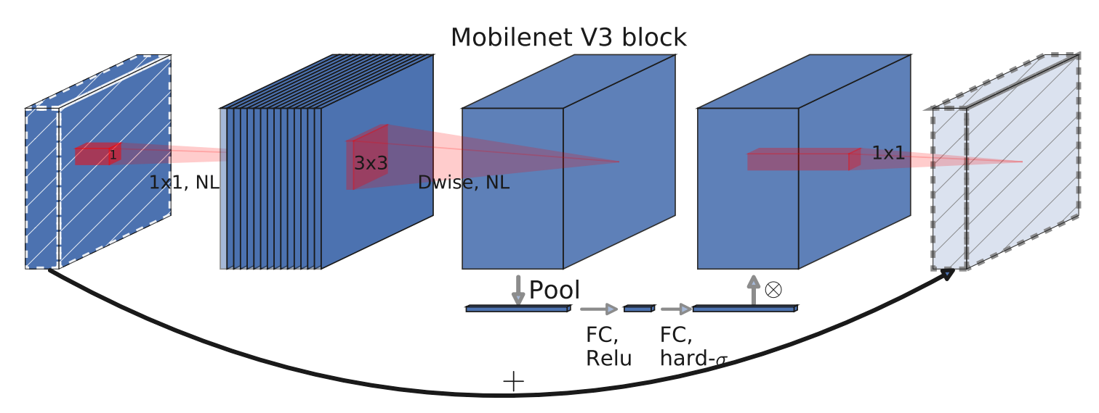
Mobilenet
Mobilenet is a series of Image Classification models designed for low end mobile devices, it reduces computational cost by splitting convolution into a Depthwise and a Pointwise block, the upgraded version uses additional Inverted residuals and squeeze and excite layer to improve efficiency.
Image credits: [1]

Slide 7
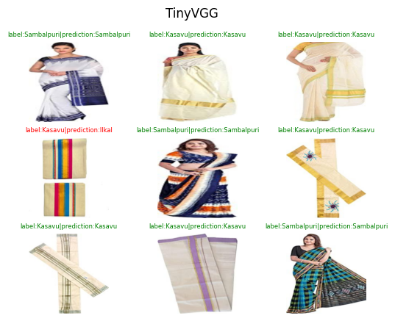
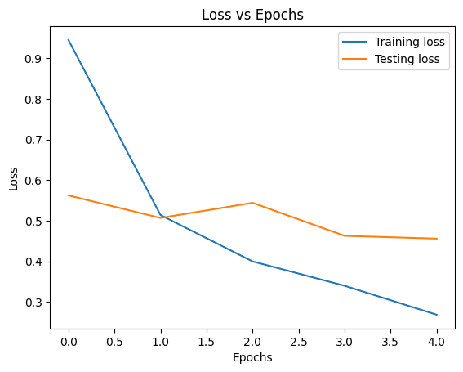
Experiments
Tiny VGG performed surprisingly well for a small model.

Slide 8
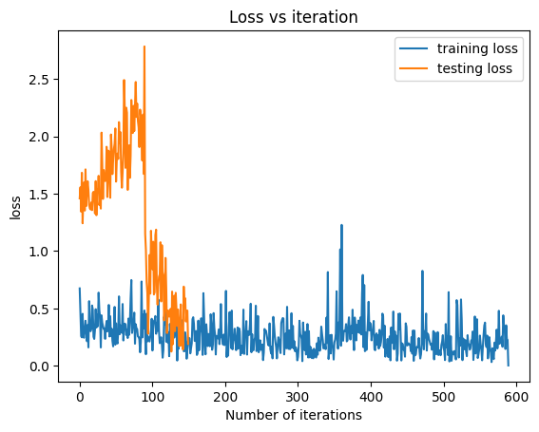
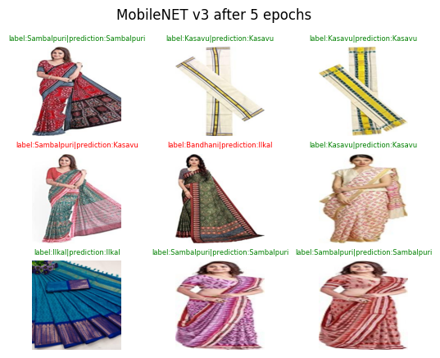
Experiments
MobileNet V3, despite being a larger model, underperformed.

Slide 9
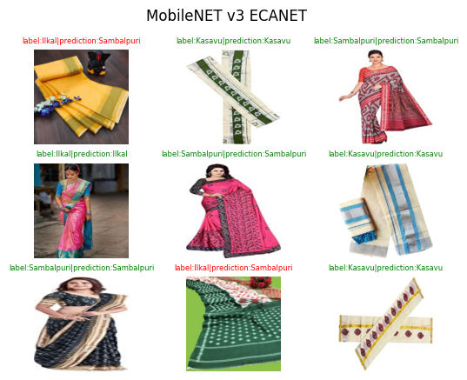
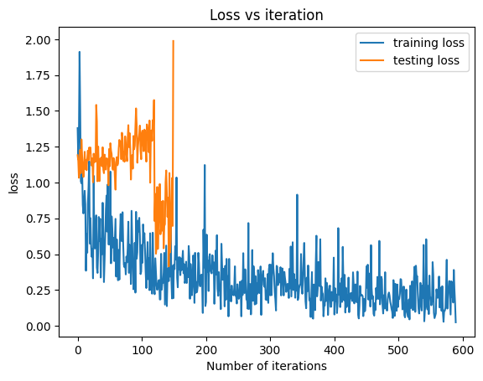
Experiments
The modification of MobilenetV3 by including ECA layers did not affect its effectiveness.

Slide 10
Future Plans
Improve upon the current accuracy by extending dataset, tweaking hyperparameters and trying out new models that are specialised for fashion.
Try out some non-CNN based models to gauge the relative accuracy of CNN models
Try to build a Generative Adversarial network that can replicate Indian Saree patterns.

Slide 11
References
Andrew Howard, Mark Sandler, Grace Chu, Liang-Chieh Chen, Bo Chen, Mingxing Tan, Weijun Wang, Yukun Zhu, Ruoming Pang, Vijay Vasudevan, Quoc V. Le, and Hartwig Adam. Searching for mobilenetv3.CoRR, abs/1905.02244, 2019.
Harshil Jain, Rohit Patil, Utsav Jethva, Ronak Kaoshik, Shaurya Agarawal, Ritik Dutta, and Nipun Batra. Generative fashion for indian clothing. InProceedings of the 3rd ACM India Joint International Conference on Data Science &; Management of Data (8th ACM IKDD CODS &; 26th COMAD), CODS-COMAD ’21, page 415, New York, NY, USA, 2021. Association for Computing Machinery.
Mark Sandler, Andrew Howard, Menglong Zhu, Andrey Zhmoginov, and Liang-Chieh Chen. Mobilenetv2: Inverted residuals and linear bottlenecks. 2018.
Karen Simonyan and Andrew Zisserman. Very deep convolutional networks for large-scale image recognition, 2014.
Qilong Wang, Banggu Wu, Pengfei Zhu, Peihua Li, Wangmeng Zuo, and Qinghua Hu. Eca-net: Efficient channel attention for deep convolutional neural networks. CoRR, abs/1910.03151, 2019.
Zijie J. Wang, Robert Turko, Omar Shaikh, Haekyu Park, Nilaksh Das, Fred Hohman, Minsuk Kahng, and Duen Horng Chau. CNN explainer: Learning convolutional neural networks with interactive visualization.CoRR, abs/2004.15004, 2020.
Vincent Dumoulin and Francesco Visin. A guide to convolution arithmetic for deep learning.ArXiv e-prints, mar 2016.

