Slide 1
Positional
Embeddings
aka positional encodings

Slide 2
Table of Contents
01 | Positional Embeddings
02 | Transformers and need of positional embeddings
03 | Requirements of a good Positional Embedding
04 | Absolute Positional Embeddings
05 | Relative Positional Embeddings
06 | Rotary Positional Embedding
07 | Learned Positional Embedding
08 | References

Slide 3
Introduction
Positional embeddings play a crucial role in the world of Natural Language Processing (NLP), particularly in the context of transformer-based models. These models have revolutionized NLP tasks but lack inherent knowledge of word order, necessitating the incorporation of positional information. In this comprehensive set of notes, we will delve into the fundamental importance of positional embeddings in transformers. We will explore the requirements for effective positional embeddings, including the widely used sine and cosine-based absolute positional encodings, and delve into relative positional encodings, which are vital for understanding the contextual relationships between tokens. Additionally, we will touch upon the innovative concept of rotary positional embeddings that have emerged to further enhance the capabilities of these models.

Slide 4
Positional Embedding
01
Definitions and intuition

Slide 5
Positional Embedding
Positional embedding is used to provide the positional information of the input to the non-recurrent architecture of multi-head attention.
It has been widely used in NLP to represent relative or absolute positions of words in a sentence. OTher than this, it can also be used in Time series data, DNA sequences, Graphs etc.
Integrating Positional embeddings is to add a tensor (of same shape as input) that contains the relevant information to the input sequence.

Slide 6
02
Transformers and need of Positional Embeddings

Slide 7
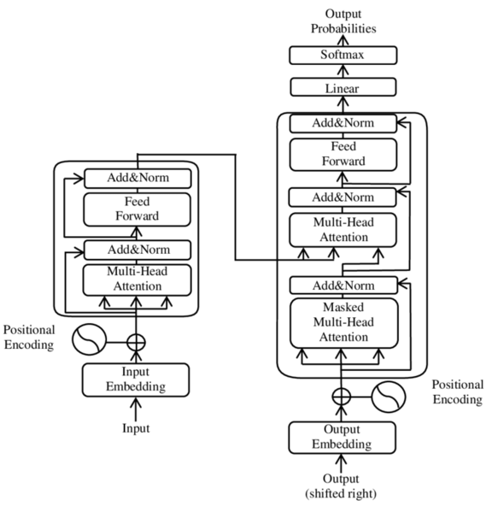
Positional embedding in Transformers
For Recurrent neural networks , the sequential order (ordering of time-steps/ sequence) is implicitly defined by the input.
However, the Transformer's Multi-Head Attention layer processes the entire sequence simultaneously, which means it lacks inherent knowledge of the order. It treats each element in the sequence independently, which can result in the loss of context related to their order.
This issue also applies to convolutional layers, which have a limited local context for sequential ordering determined by their kernel size, making them less suitable for tasks that require capturing long-range dependencies in the data.

Slide 8
Requirements of a good Positional Embedding
03

Slide 9
Challenges and requirements of Positional Embeddings
Varying sequence length is challenge encountered here.
Trials: Absolute index (size could go very high) , normalized index (meaning changes with varying length) etc.
Need: Every position should have the same identifier irrespective of the sequence length or the input values (order of inputs too).
The positional informations should not br prioritized over the semantics, that could def the purpose.
Need: The values should be relatively smaller such that it the meaning of semantics (in NLP context) is not lost.

Slide 10
Absolute Positional Embeddings
04

Slide 11

Absolute positional embedding
Absolute positional encoding assigns a unique label to each position in a sequence based on its distance from the beginning of that sequence, creating a global coordinate system relative to the sequence's start.
A simple and naive example would be using the index as the positional value to be embedded, which has the drawback of having unnaturally high size in large sequences and normalization wouldn't help as the same value could mean different position in different sequence length.
Authors of [Vaswani et al., 2017] however proposed a different absolute positional encoding based on the sine and cosine functions:
Where pos is the position in time/sequence, d_{model} is the dimension index in input tensor

Slide 12
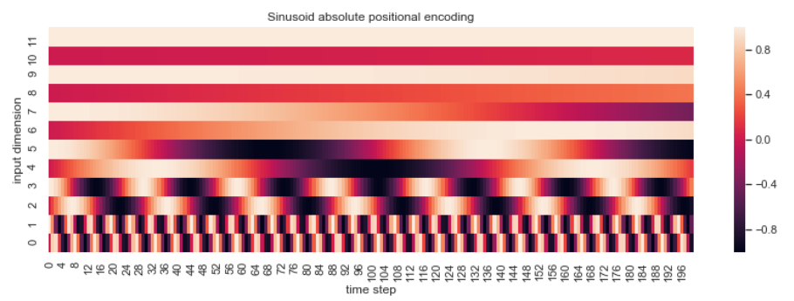
Sinusoid absolute positional embedding
Credits: https://www.inovex.de/de/blog/positional-encoding-everything-you-need-to-know/

Slide 13
Challenge
Even if the dataset had an equal distribution of sequence lengths, the model would still favor learning embeddings for the initial positions.This bias occurs because shorter sequences appear more frequently during training.
As a result, the model becomes better at understanding and representing the starting positions, potentially leading to suboptimal performance when dealing with longer sequences during testing or real-world use.
Add vs concatenate (balance vs computational expense)
Following the initial research, a subsequent study by [Shaw et al. , 2018] addressed the challenge of adapting to various input sequence lengths. In this study, they introduced relative positional encoding as a solution to this issue.

Slide 14
Relative Positional Embeddings
05

Slide 15
Relative Positional Embeddings
In Relative Positional Embeddings, the relative distance between the elements in sequence (or graph etc), rather than their absolute order.
Rather than a single positional embedding for an element in sequence, here they can have as many embeddings as the total number of elements in the sequence, each characterizing the relative positional relationship. (including itself)
Here, (as in [Shaw et al. , 2018] ), the relation to itself is taken as w₀ and w₊₁, w₊₂ to the right and w₋₁ , w₋₂ to the left.
These embeddings, ( ……w₋₁ , w₋₂ , w₀ , w₋₁ , w₋₂ ,..... ) doesnt change its value regardless of the element it is representing. This takes care of the sequence length as well as the requirement for the good positional embedding.

Slide 16
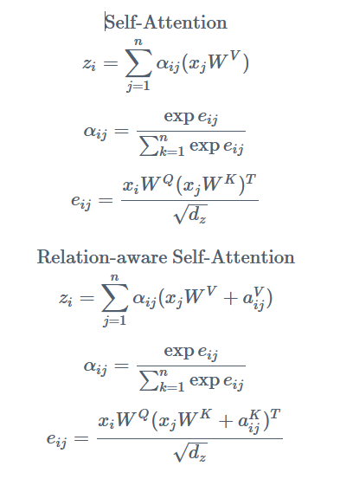
Additionally, they have also done clipping, in which after certain distance, the positional embedding remain the same, reducing the total number of embeddings required.
For Integrating this, we modify the self attention: [ a_{(i,j)} = a_{(pos, related pos)} ]

Slide 17
Rotary Positional Embeddings
05

Slide 18
Rotary Positional Embeddings (RoPE)
Relative positional embeddings are slower due to the additional step in the self attention layer. RoPE is a combination of relative and absolute positional embedding ideas. [Su, Jianlin et al. 2021]
For representation, consider an element in sequence represent in 2 dimension, the rotary embedding rotates the element embedding by (m*theta) where m is the position and theta is a fixed angle. This means the farther words will be rotated more.
The relative position is conserved here, as the relative rotations angles corresponds to the relative distances of the words. Adding words before or after doesn't affect it.

Slide 19
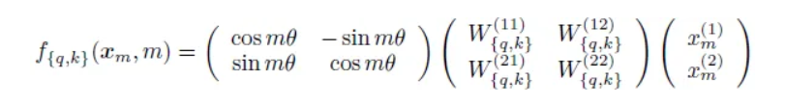
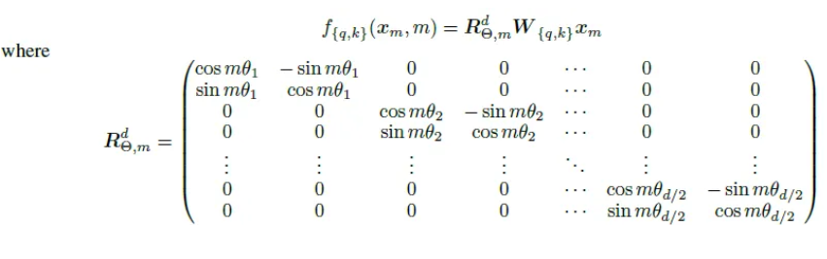
The example case equation.
In general dimensions:

Slide 20
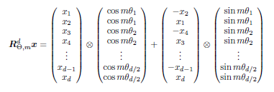
Computer efficient general form of Rotational matrix:
:

Slide 21
Learned Positional Embeddings
07

Slide 22
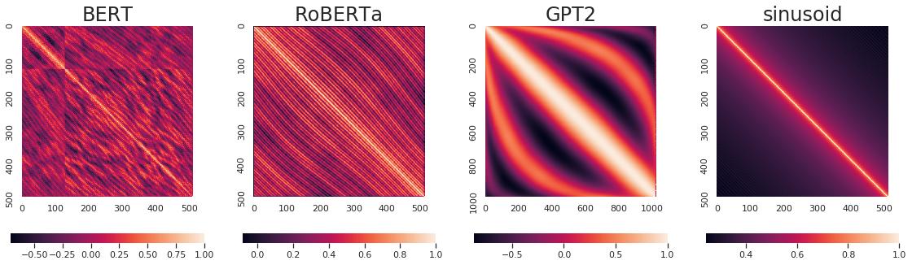
Learned Positional Embedding
Instead of crafting the positional embedding manually, we can treat those as any other parameter and learn using SGD and backpropagation.
This has been implemented in BERT, RoBERTa, GPT2 etc. [Wang et. al. 2020]

Slide 23
References
08

Slide 24
References
Ashish Vaswani, Noam Shazeer, Niki Parmar, Jakob Uszkoreit, Llion Jones, Aidan N. Gomez, Łukasz Kaiser, and Illia Polosukhin. 2017. Attention is all you need. In Proceedings of the 31st International Conference on Neural Information Processing Systems (NIPS'17). Curran Associates Inc., Red Hook, NY, USA, 6000–6010.
Peter Shaw, Jakob Uszkoreit, and Ashish Vaswani. 2018. Self-Attention with Relative Position Representations. In Proceedings of the 2018 Conference of the North American Chapter of the Association for Computational Linguistics: Human Language Technologies, Volume 2 (Short Papers), pages 464–468, New Orleans, Louisiana. Association for Computational Linguistics.
Yu-An Wang and Yun-Nung Chen. 2020. What Do Position Embeddings Learn? An Empirical Study of Pre-Trained Language Model Positional Encoding. In Proceedings of the 2020 Conference on Empirical Methods in Natural Language Processing (EMNLP), pages 6840–6849, Online. Association for Computational Linguistics.
Su, Jianlin, Yu Lu, Shengfeng Pan, Bo Wen and Yunfeng Liu. 2021. RoFormer: Enhanced Transformer with Rotary Position Embedding. ArXiv abs/2104.09864

