Slide 1
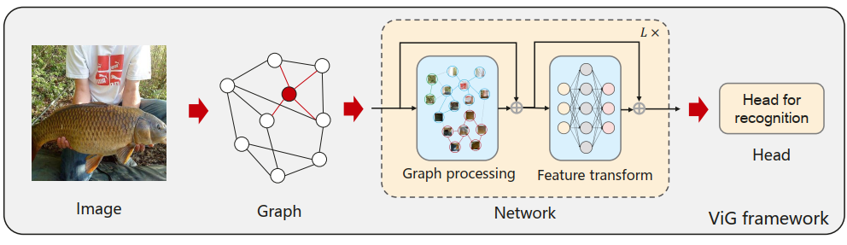
Vision GNN-Powered Object Detection
Sagar Prakash Barad
Harnessing Vision GNNs as Backbone Feature Extractors for RetinaNet and Mask R-CNNs
RetinaNet
ResNet + FPN + Focal Loss
Vision GNN
Dataset(s) – COCO Dataset, PubTables 1M Dataset, FinTab Dataset
Wang, X., Liu, Z., Zhang, S., Li, B., Wang, T., & Zhang, J. (2022). Vision GNN: An Image is Worth Graph of Nodes. Advances in Neural Information Processing Systems, 35. Retrieved from https://arxiv.org/abs/2206.00272

Slide 2
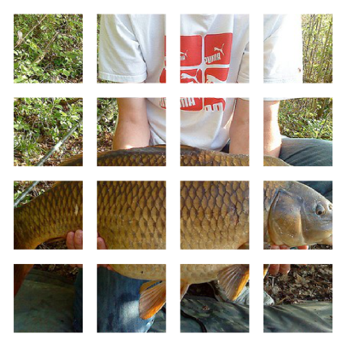

Vision GNN Works by…
CNN
Feature Extractor
1
2
3
4
N-1
N

Slide 3
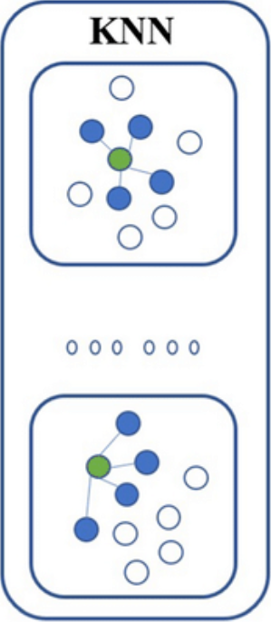
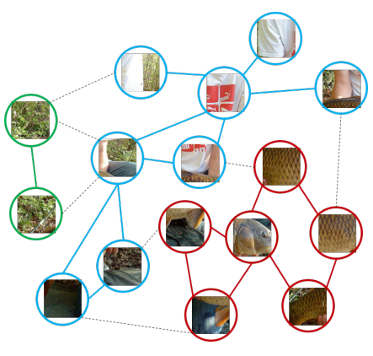
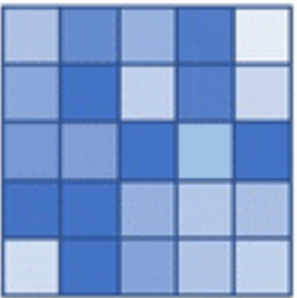
Graph Represnation
Directed Graph
Benefits
Generalized Data Structure
Flexibility for Complex Objects
Part-Object Relationships

Slide 4
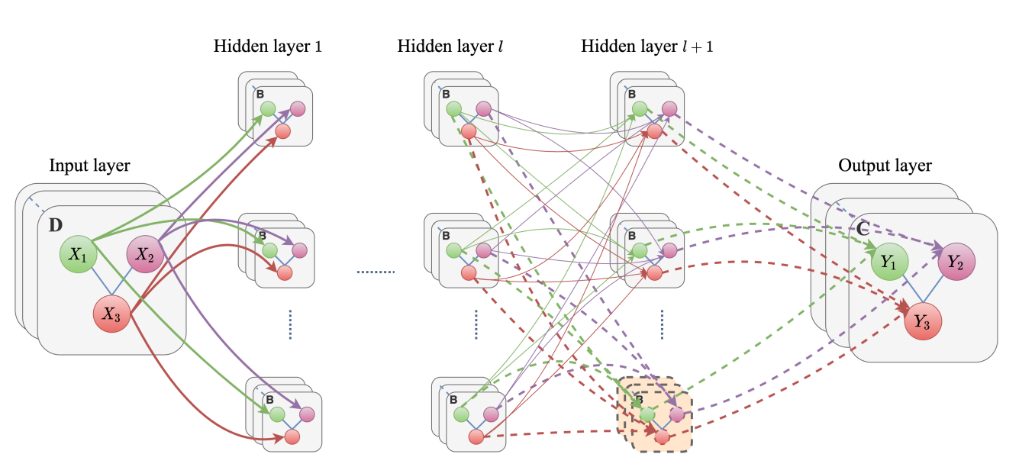
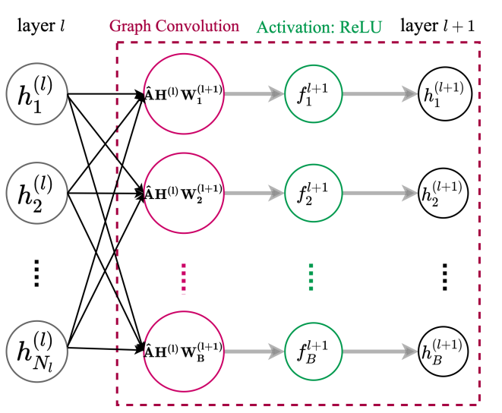
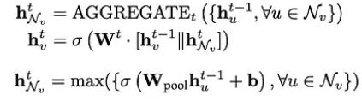
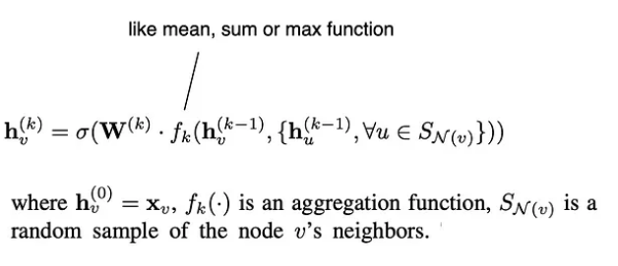
Graph Convolution
Heidari, N. (2020, March 27). Progressive Graph Convolutional networks for Semi-Supervised Node Classification. arXiv.org. https://arxiv.org/abs/2003.12277

Slide 5
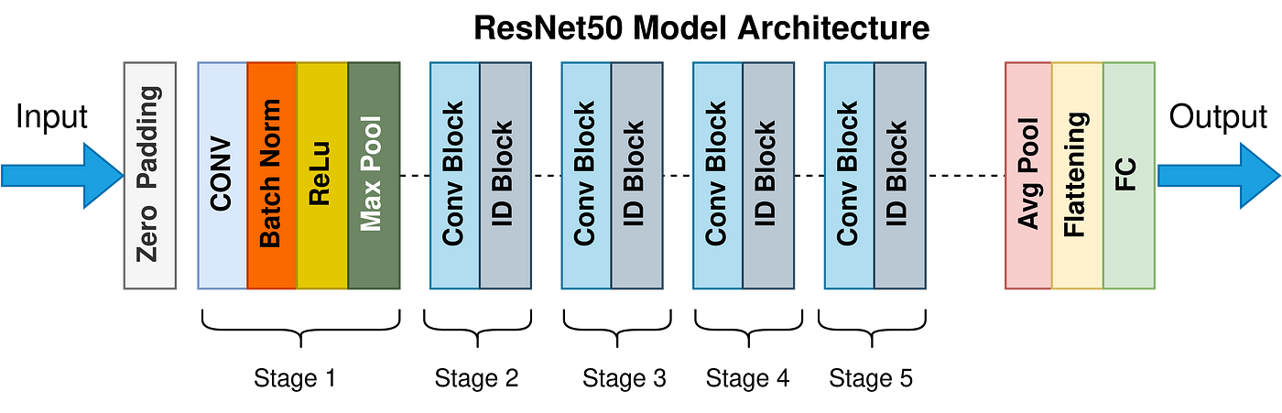
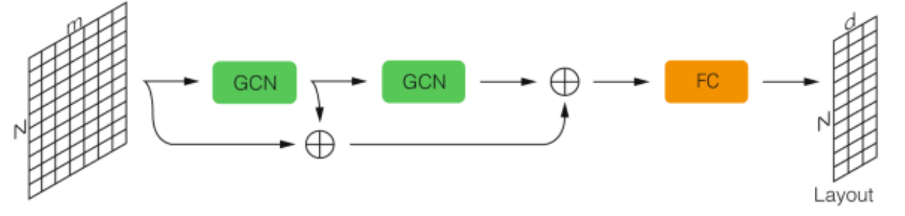
Comparision with CNNS
Sapireddy, S. R. (2023, July 1). ReSNEt-50: Introduction - Srinivas Rahul Sapireddy - Medium. Medium. https://srsapireddy.medium.com/resnet-50-introduction-b5435fdba66f
Both, C., Dehmamy, N., Yu, R. et al. Accelerating network layouts using graph neural networks. Nat Commun 14, 1560 (2023). https://doi.org/10.1038/s41467-023-37189-2

Slide 6
ViG Models
ViG-Ti
Flops(B): 7.1
Params(M): 1.3
ViG-S
Flops(B): 4.5
Params(M): 22.7
ViG-B
Flops(B): 17.7
Params(M): 86.8
ResNet -18
Flops(B): 1.82
Params(M6): 11.7
ResNet -50
Flops(B): 3.86
Params(M): 25.6
ResNet -101
Flops(B): 7.1
Params(M): 44.6
Model | Depth | Dimension D
ViG-Ti | 12 | 192
ViG-S | 16 | 320
iG-B | 16 | 640

Slide 7
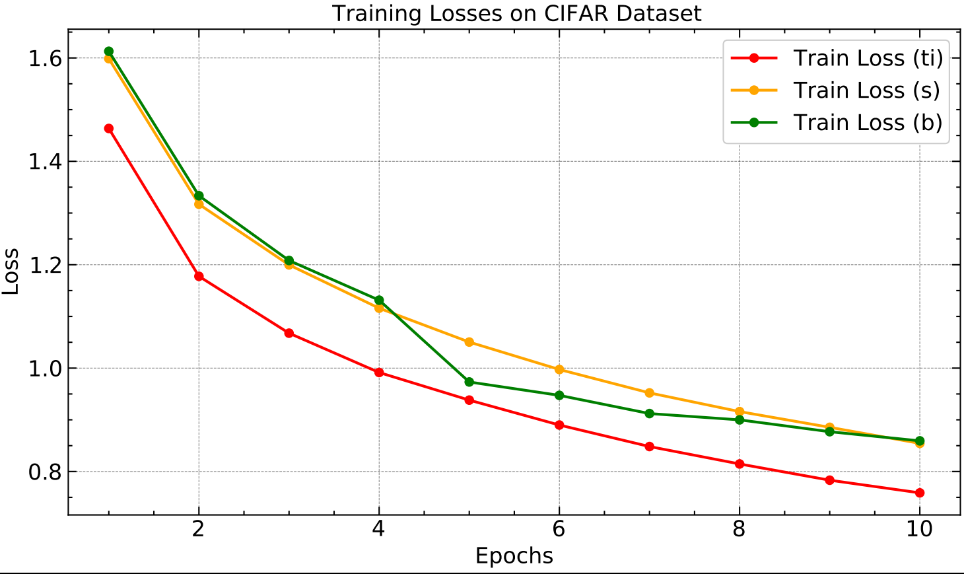
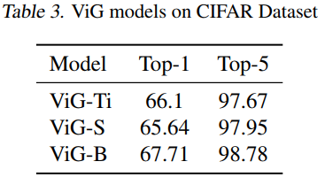
Results on CIFAR

Slide 8
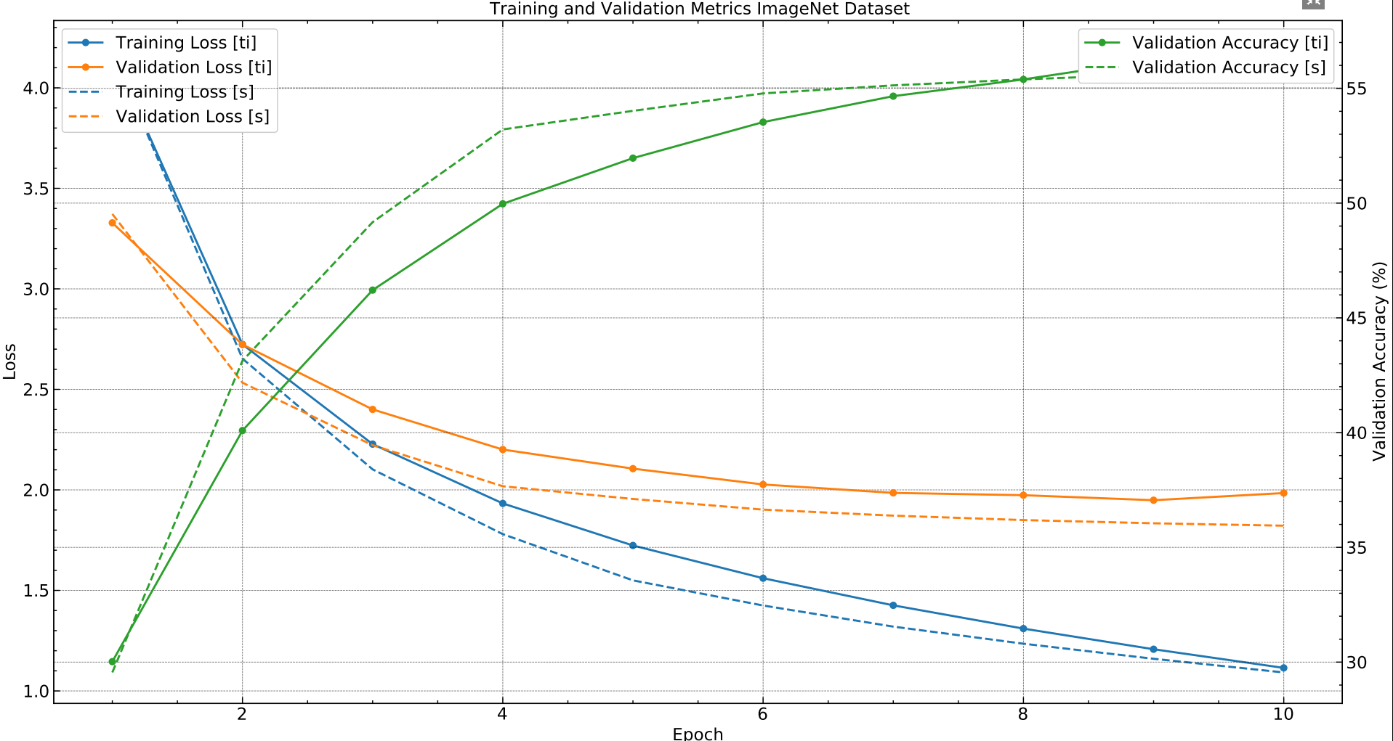
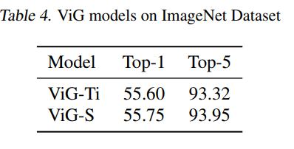
Results on ImageNet 1k

Slide 9
Conclsuion
ViG models (ViG-Ti, ViG-S, ViG-B) show promise in our training, with potential for comparable or superior performance to ResNet variants (ResNet-18, ResNet-50, ResNet-101) as we increase training epochs.
2. ViG models match ResNet models in size (FLOPs and parameters) but outperform them in image classification.

