Slide 1
AMBA VILLAGE TOURISM WEBSITE
By Adhiraj Sagar Kolekar
Diploma in Computer Engineering
BSIET

Slide 2
INTRODUCTION
The Amba Village Tourism Website is a responsive tourism website.
It provides information about tourist attractions and important places.
The website is designed using HTML, CSS, and Bootstrap.
It has an attractive and user-friendly interface.
It helps tourists explore and plan their visit easily.

Slide 3
PROJECT OBJECTIVES
Promote tourism in Amba Village.
Provide information about tourist attractions.
Showcase natural beauty through images.
Create a responsive and user-friendly website.
Help tourists plan their visit.

Slide 4
WEBSITE FEATURES
Responsive Design
Navigation Bar
Scrolling News Ticker
Tourist Information
Contact Form
Attractive Footer

Slide 5
TECHNOLOGIES USED
HTML – Structure of webpages
CSS – Styling and design
Bootstrap – Responsive layout
JavaScript – Interactive components
Visual Studio Code – Development Environment

Slide 6
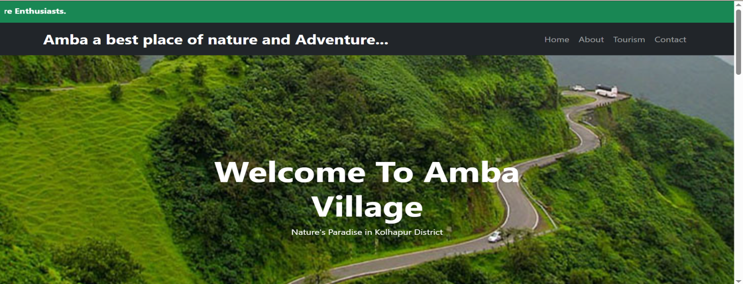
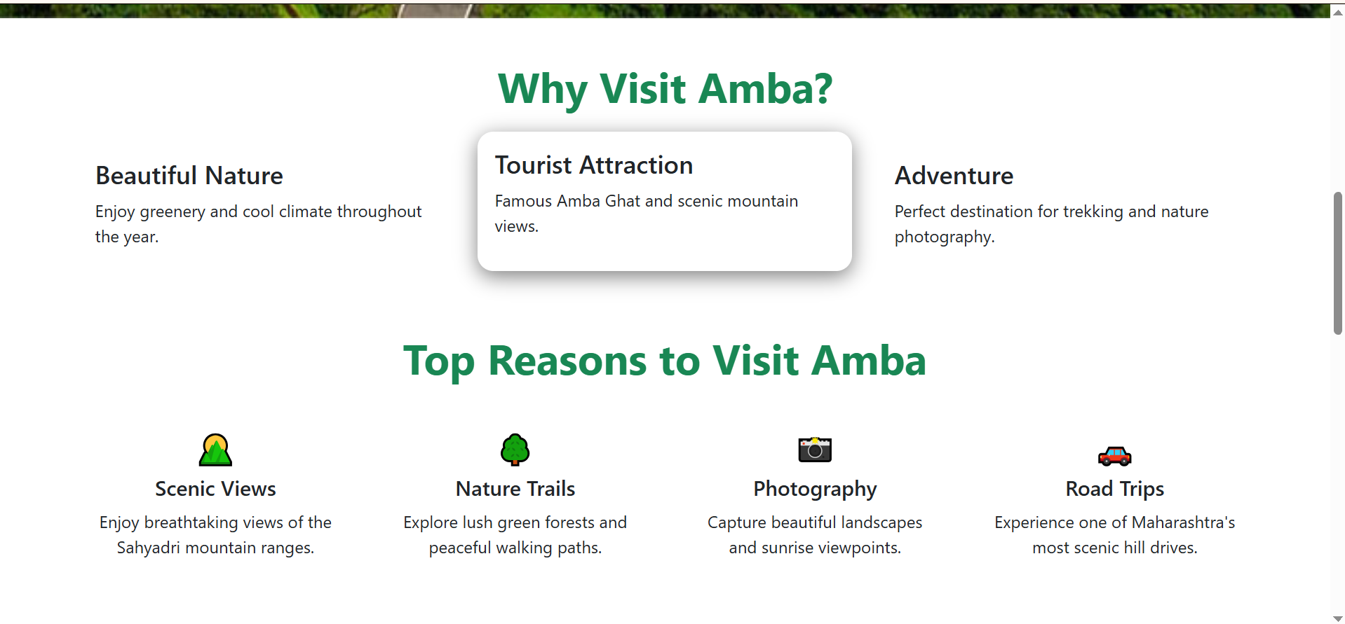
HOME PAGE

Slide 7
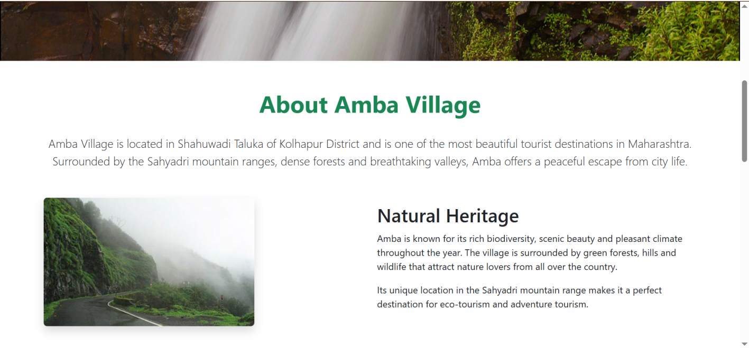
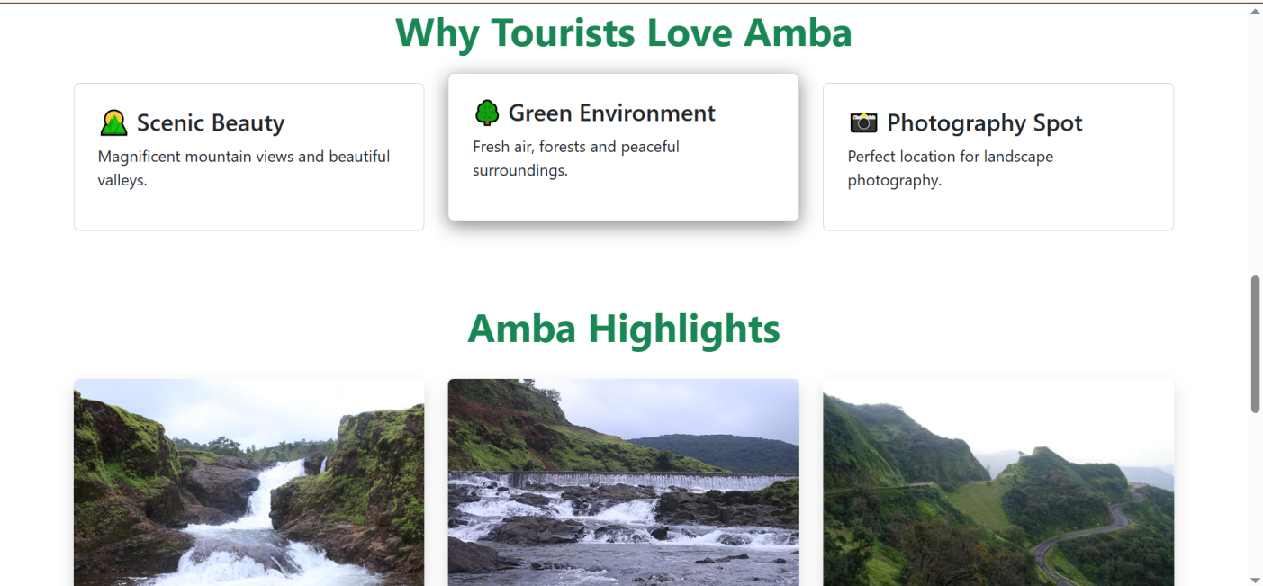
About Us page

Slide 8
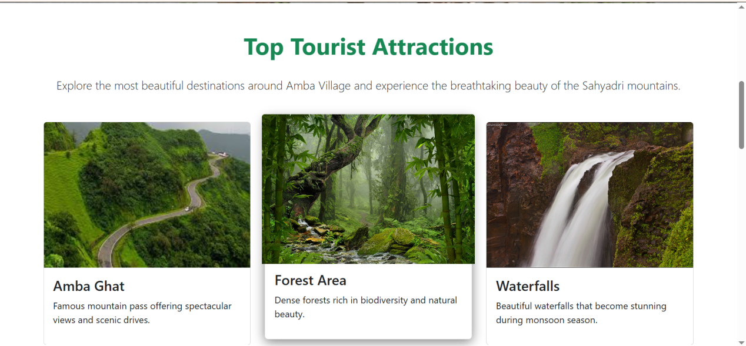
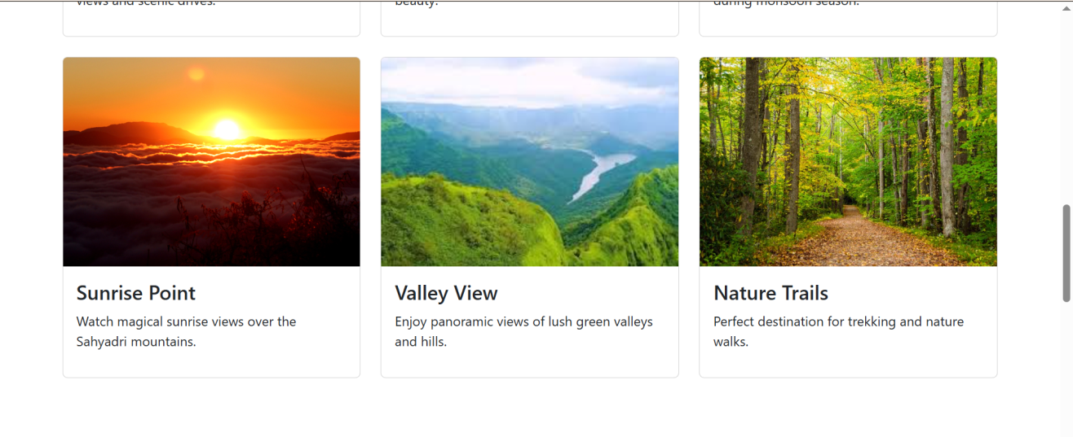
Tourism Page

Slide 9
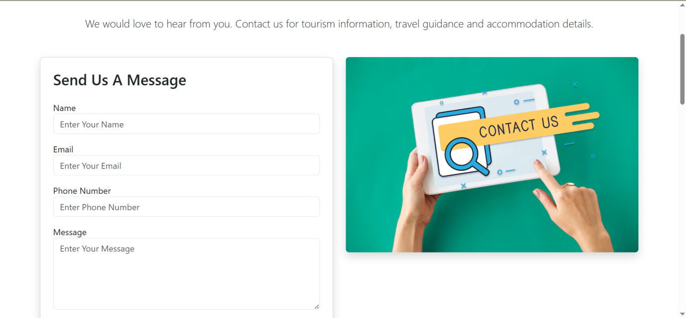
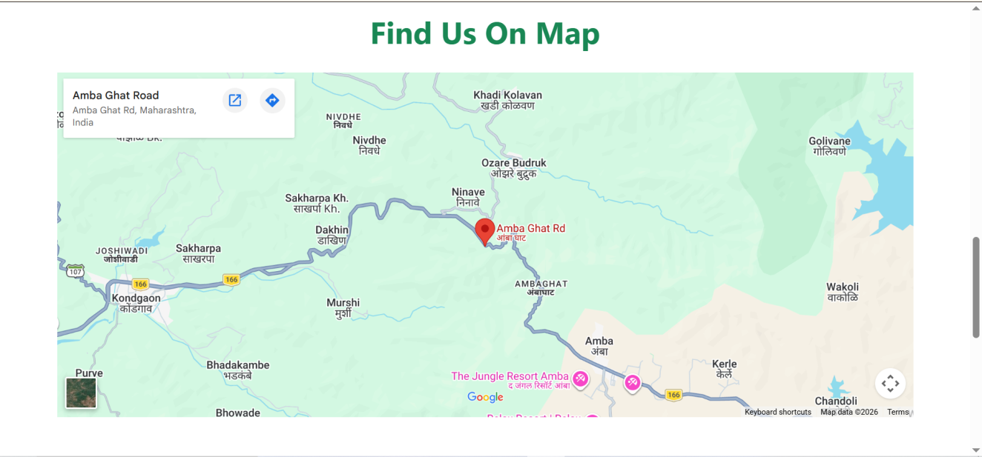
Contact page

Slide 10
Conclusion
The Amba Village Tourism Website successfully promotes tourism by providing useful information in an attractive and responsive format.
The website showcases the beauty of Amba Village and helps tourists plan their visit effectively.

Slide 11
Thank You
Any Questions?

