Slide 1
Systems of Linear Equations
Direct Methods

Slide 2
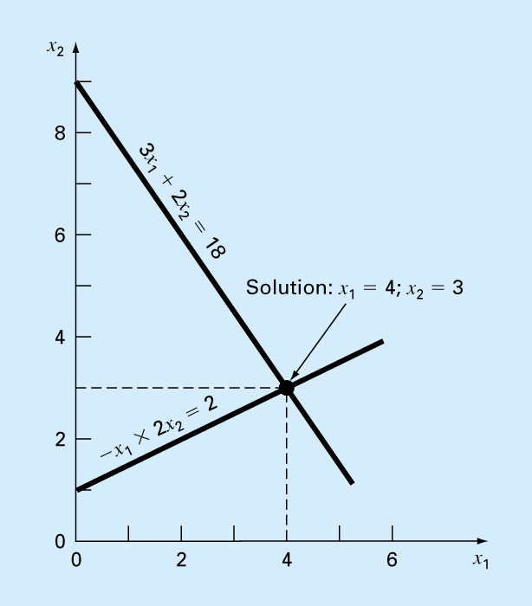
Solving Linear Equations
Two simultaneous equations – the solution is the intersection of two straight lines.
Three simultaneous equations – the solution is the point where three planes intersect.

Slide 3
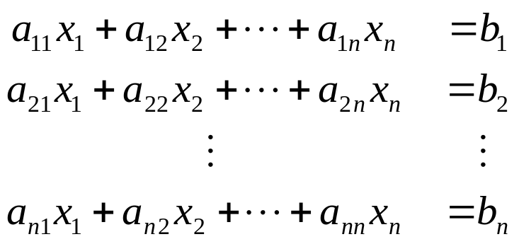
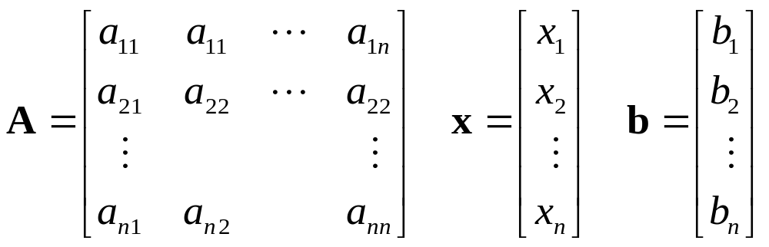
The solution of n simultaneous linear equations with n unknowns
In matrix notation Ax = b, when
The linear system is said to be of order n and has a unique solution if det(A) ≠ 0.

Slide 4
Two approaches for solving systems of linear equations
Direct Methods
  Assuming negligible computational round-off errors, direct methods solve a system of linear equations in a finite number of operations.
  These direct techniques are useful when the number of equations involved is not too large (typically of the order of 40 or fewer equations).
  Examples of direct methods: Gauss Elimination and Gauss-Jordan Elimination.

Slide 5
Two approaches for solving systems of linear equations
Iterative Methods
  These iterative methods are more appropriate when the number of equations involved is large (typically of the order of 100 or more), or when the matrix is sparse.
  They are more economical in memory requirements.
  Examples of iterative methods: Jacobi method and Gauss Seidel iterative methods

Slide 6
Direct Methods
Gauss Elimination
  Naïve Gauss Eliminiation
  Pivoting Strategies
  Scaling
Gauss-Jordan Elimination
LU Decomposition

Slide 7
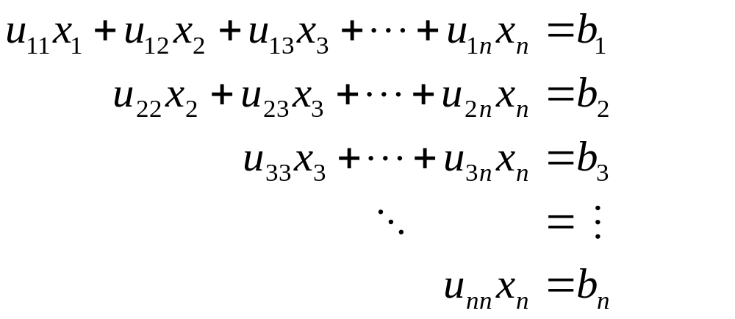
Gauss Elimination
Linear systems of equations where the matrix is triangular are particularly easy to solve.

Slide 8
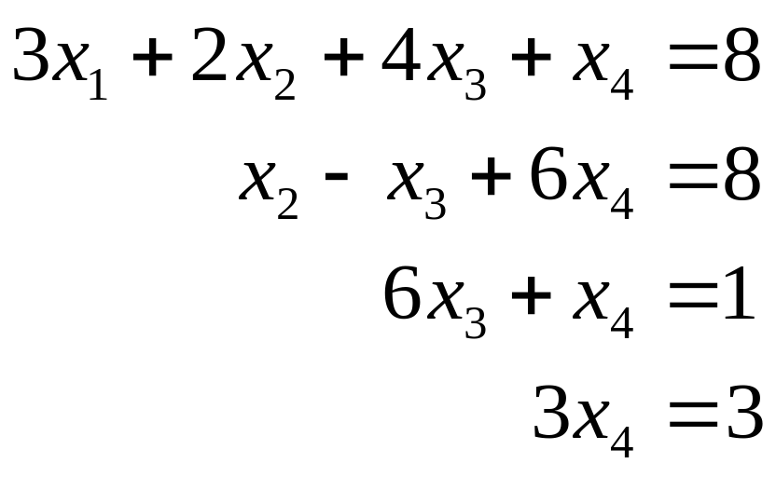
Exercise
What are the values of x₁, x₂, x₃, and x₄?

Slide 9
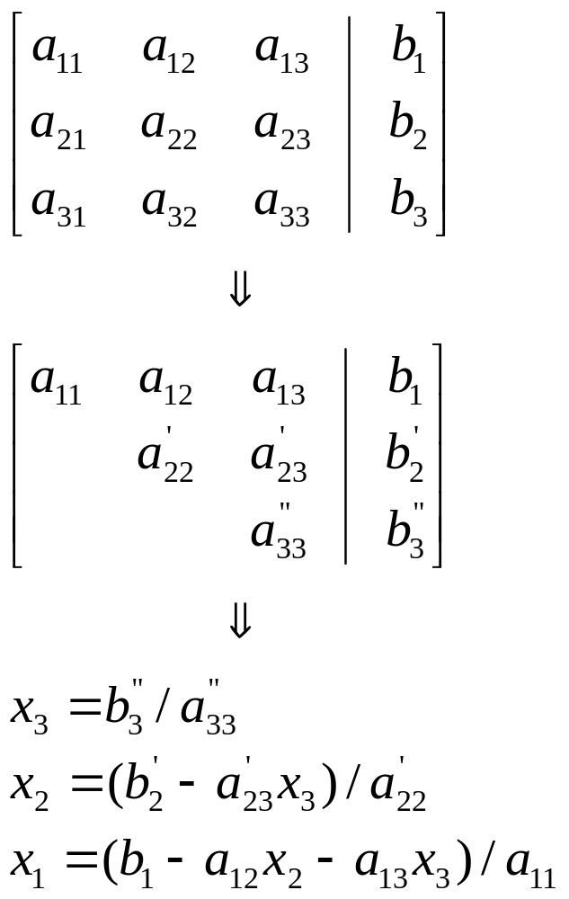
Gauss Elimination
Two steps of the
Gaussian Elimination
Forward Elimination –
To transform the set of equations to an upper triangular system.
Back Substitution –
To find the values of x's.

Slide 10
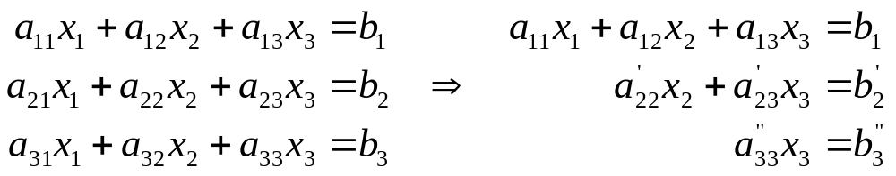
Naive Gauss Elimination
It is called "Naïve" Gauss Elimination because it does not avoid the problem of division by zero.
Forward Elimination
Purpose: to reduce the set of equations to an upper triangular system

Slide 11
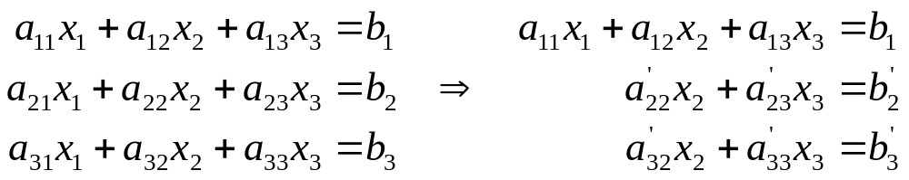
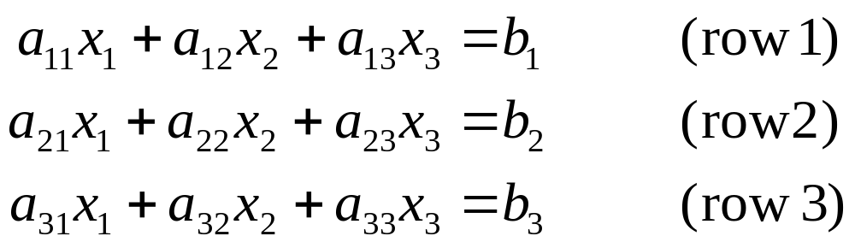
Forward Elimination
Step 1: Remove x₁ from all equations except the first equation (which serves as the pivot equation.)
Let's focus on removing x₁ from (row 2) first.

Slide 12
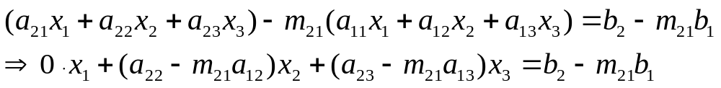
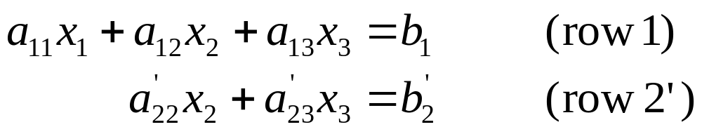
Forward Elimination
Note:a₁₁ is called the pivot coefficient.
If a₁₁ ≠ 0, define m₂₁ = a₂₁ / a₁₁.
We can replace (row 2) by {(row 2) – m₂₁ x (row 1)} to yield
Put
We have
(row 3') can be obtained in the similar fashion.

Slide 13
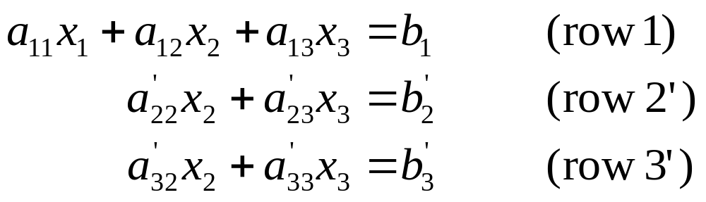
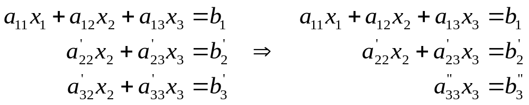
Forward Elimination
After step 1, we have
Step 2: Remove x₂ from all equations except the first two equations (row 1) and (row 2'). That is
(Basically repeat step 1 on the subsystem.)

Slide 14
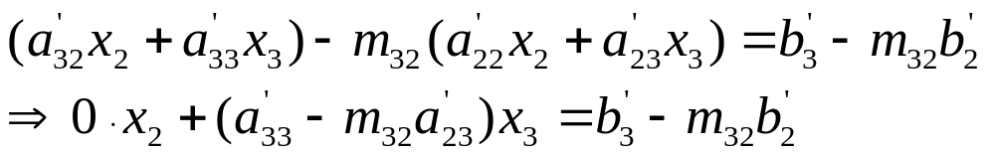
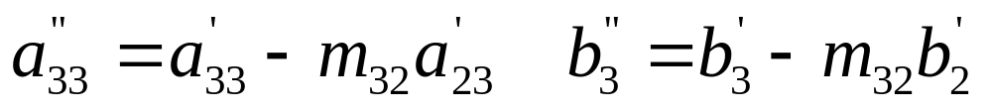
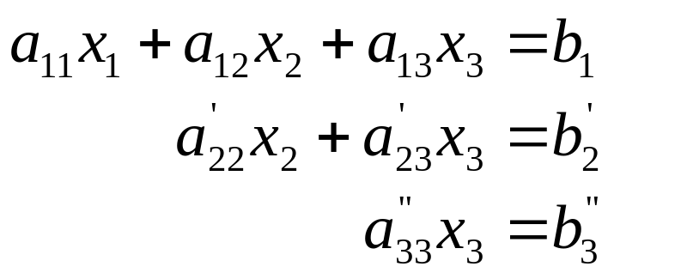
Forward Elimination
If a'₂₂ ≠ 0, define m₃₂ = a'₃₂ / a'₂₂.
We can replace (row 3') by {(row 3') – m₃₂ x (row 2')} to yield
Put
We have

Slide 15
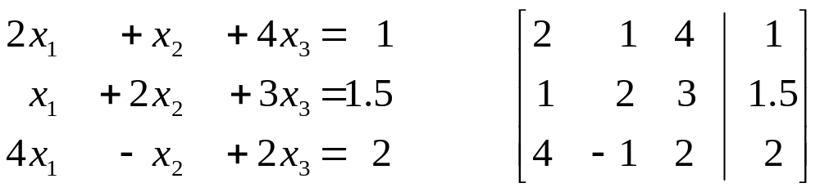
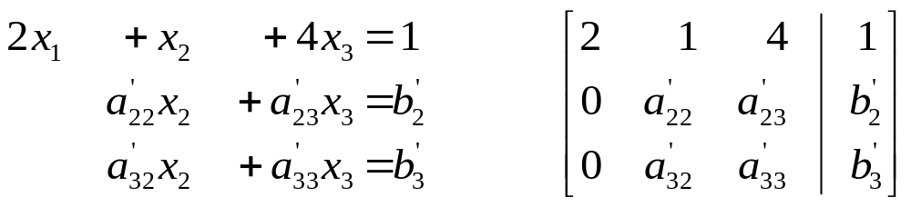
Exercise
What are the values of a'₂₂, a'₂₃, a'₃₂, a'₃₃, b'₂, b'₃ ?

Slide 16
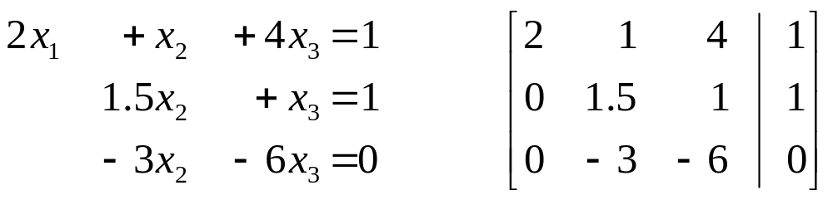
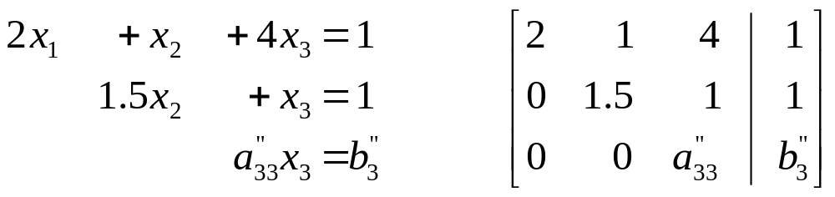
Exercise (continue)
What are the values of a"₃₃ and b"₃₃ ?

Slide 17
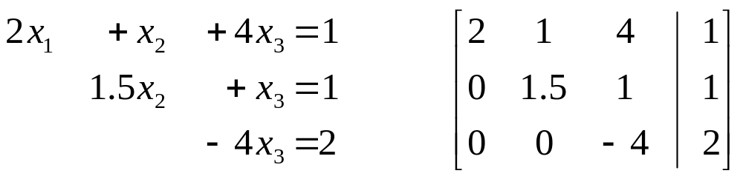
Exercise (continue)
What are the values of x₁, x₂, x₃?

Slide 18
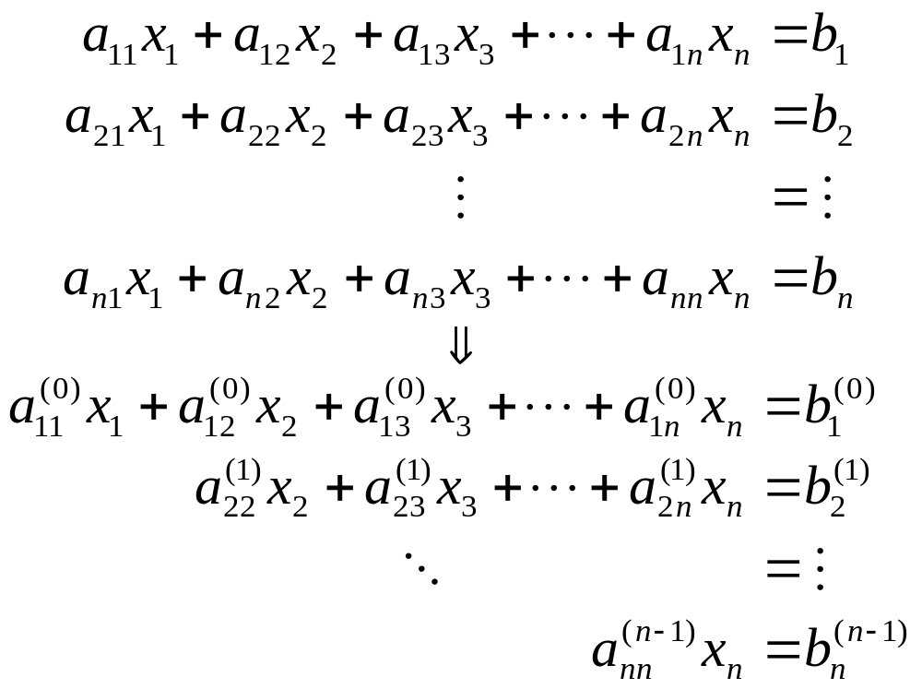
Forward Elimination
In general, given a linear system of n equations, we repeat the procedure until the system has been transformed into an upper triangular system.

Slide 19
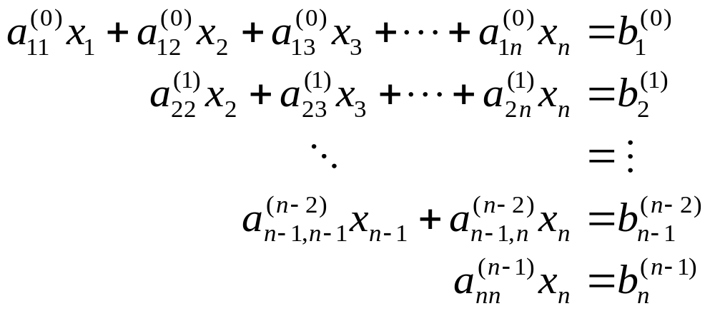
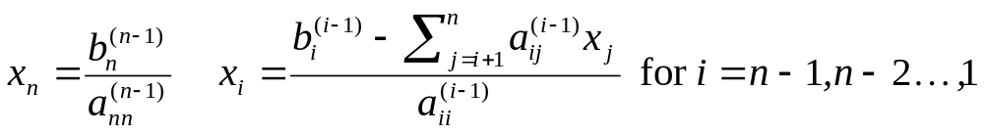
Back Substitution
After reducing the system of equations into an upper triangular system,
we can start solving for x's in backward manner.

Slide 20
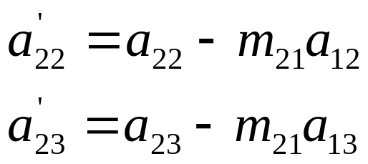
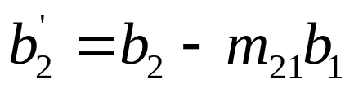
Pseudocode to perform
Forward Elimination
for k = 1 to n-1
for i = k+1 to n
factor = a_{ik} / a_{kk}
for j = k+1 to n
a_{ij} = a_{ij} – factor * a_{kj}
b_{i} = b_{i} – factor * b_{k}
m₂₁ = a₂₁ / a₁₁

Slide 21
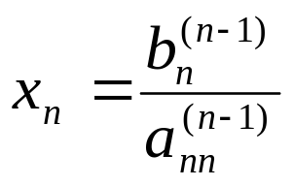
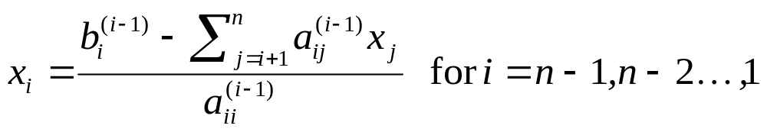
Pseudocode to perform
Back Substitution
x_{n} = b_{n} / a_{nn}
for i = n-1 downto 1
sum = 0
for j = i+1 to n
sum = sum + a_{ij} * x_{j}
x_{i} = (b_{i} – sum) / a_{ii}

Slide 22
Operation Count
The execution time of Gauss Elimination is measured in terms of floating-point operations (FLOPS).

Slide 23
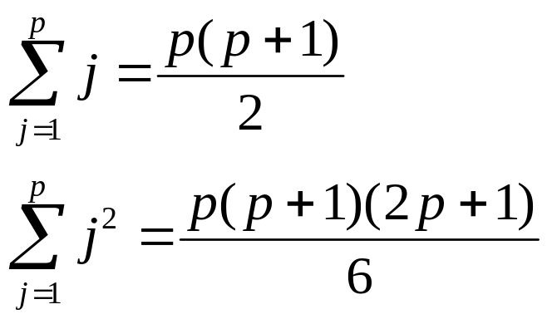
Operation Count (Forward Elimination)
Note:
for k = 1 to n-1
for i = k+1 to n
factor = a_{ik} / a_{kk}
for j = k+1 to n
a_{ij} = a_{ij} – factor * a_{kj}
b_{i} = b_{i} – factor * b_{k}
Step k | a_{ik} / a_{kk} | a_{ij} – factor * a_{kj} |  | b_{i} – factor * b_{k}
 | * and / | + and - | * and / | + and - | * and /
1 | (n-1) | (n-1)² | (n-1)² | (n-1) | (n-1)
2 | (n-2) | (n-2)² | (n-2)² | (n-2) | (n-2)
… | … | … | … | … | …
n-2 | 2 | 2² | 2² | 2 | 2
n-1 | 1 | 1² | 1² | 1 | 1
Total | n(n-1)/2 | n(n-1)(2n-1)/6 | n(n-1)(2n-1)/6 | n(n-1)/2 | n(n-1)/2

Slide 24
Operation Count (Back Substitution)
x_{n} = b_{n} / a_{nn}
for i = n-1 downto 1
sum = 0
for j = i+1 to n
sum = sum + a_{ij} * x_{j}
x_{i} = (b_{i} – sum) / a_{ii}
 | + | - | * | /
x_{n} | 0 | 0 | 0 | 1
x_{n-1} (i=n-1) | 1 | 1 | 1 | 1
 | … | … | … | …
x₂ (i=2) | (n-2) | 1 | n-2 | 1
x₁ (i=1) | n-1 | 1 | n-1 | 1
Total | n(n-1)/2 | n-1 | n(n-1)/2 | n

Slide 25
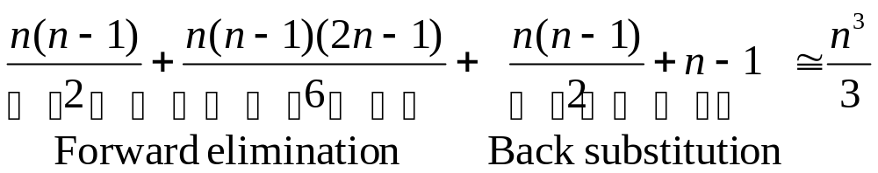
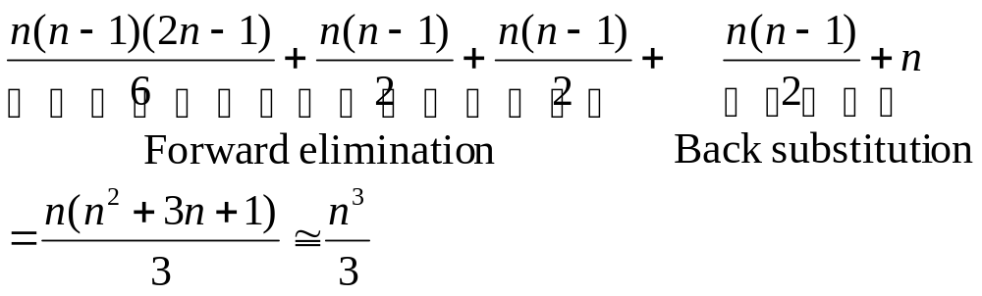
Total Number of FLOPS
Addition/Subtraction
Multiplication/Division

Slide 26
Total Number of FLOPS
Total number of FLOPS – O(n³)
For large n, the operation count for Gauss Elimination is about n³. This means that as n doubled, the cost of solving the linear equations goes up by a factor of 8.
It is also easy to see that most of the cost of Gauss Elimination is in the elimination step.

Slide 27
Direct Methods
Gauss Elimination
  Naïve Gauss Eliminiation
  Pivoting Strategies
  Scaling
Gauss-Jordan Elimination
LU Decomposition

Slide 28
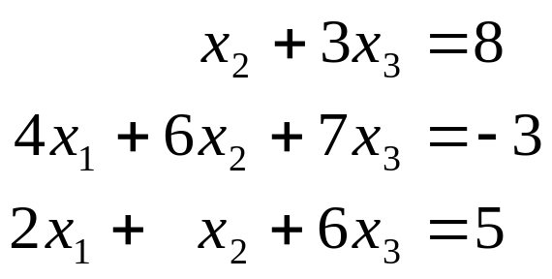
Pitfalls of Elimination Methods
Division by zero
  When the pivot coefficient is equal to or close to zero. Example:
Round-off error
  Round-off error propagates significantly when we calculate the solution of a large number of equations.
Ill-conditioned system
  When the determinant is close to zero

Slide 29
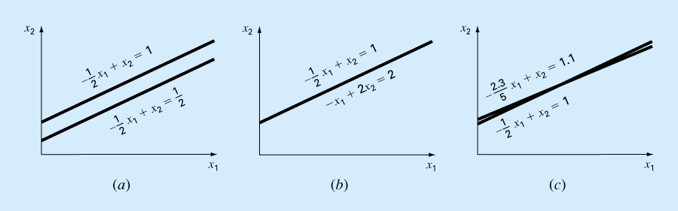
Cases that cause problem
Singular (no solution)
Singular (infinite solution)
Ill-condition system (Near-singular)

Slide 30
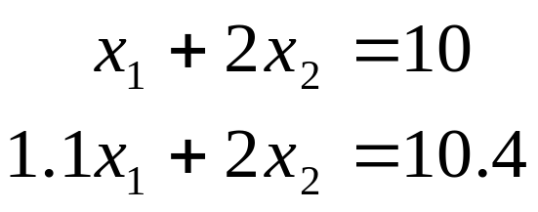
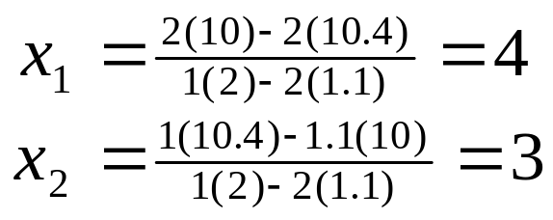
Ill-condition System
When there is a small change in one or more of the coefficients in a system,
  Well condition system – results in a similar small change in the solution.
  Ill-condition system – results in large changes in the solution.
An example of an ill-conditioned system and its solution

Slide 31
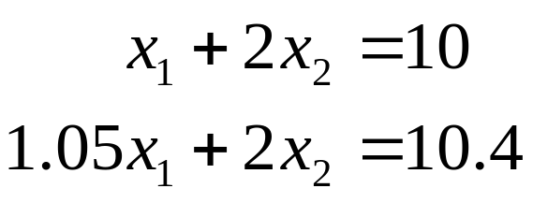
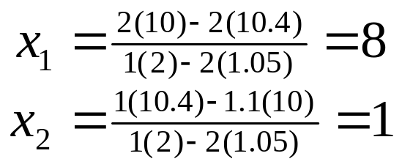
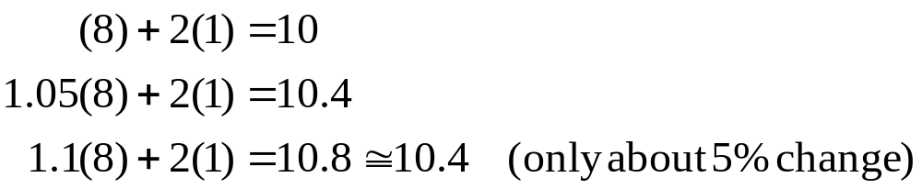
Ill-condition System
If we change the coefficient a₂₁ from 1.1 to 1.05, we have the equations and the corresponding solution as
Substituting the solutions back to the equations,
A change of 0.05 in one of the coefficients results in a large change in the solution. However, when substituting the solutions back to the equations, we are unable to discover a large deviation.

Slide 32
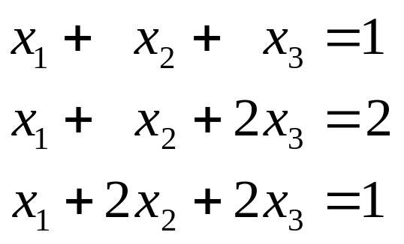
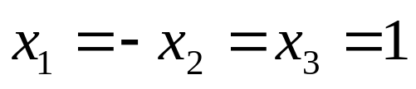
Pivoting Strategies
Pivoting – making the magnitude of the diagonal elements (pivots) as large as possible by interchanging equations.
In Gauss Elimination, if pivot coefficient a_{kk}^{(k)} = 0 for some k, the method breaks down.
Example:
This system is non-singular and has a unique solution

Slide 33
However, after the 1st step in the elimination, we get
x₁ + x₂ + x₃ = 1
x₃ = 1
x₂ + x₃ = 0
Note that a₂₂ = 0, we can't proceed as usual. But by interchanging Row 2 and Row 3, we have the triangular system
x₁ + x₂ + x₃ = 1
x₂ + x₃ = 0
x₃ = 1

Slide 34
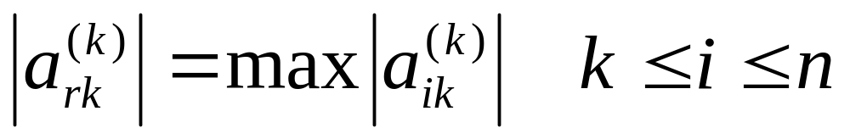
Pivoting Strategies
Partial Pivoting
  Interchange equations (rows) only
  Choose r, the smallest integer for which
  i.e. choose the largest coefficient in the column to become the pivot coefficient.
  interchange rows k and r

Slide 35
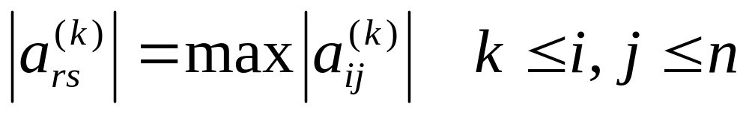
Pivoting Strategies
Complete Pivoting
  Interchange both equations and unknown elements (pivots)
  Choose r and s, the smallest integer for which
  i.e. choose the largest coefficient in the sub-matrix to become the pivot coefficient.
  interchange rows k and r, and columns k and s.

Slide 36
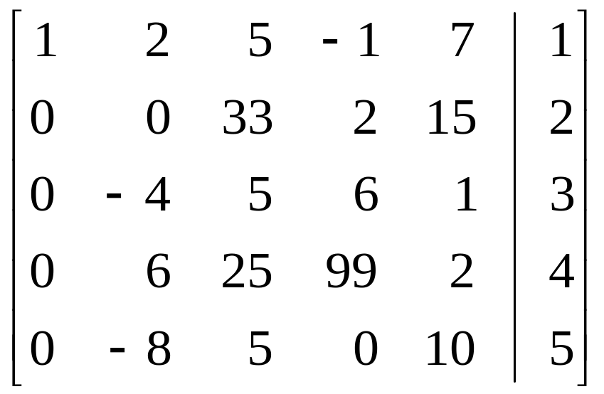
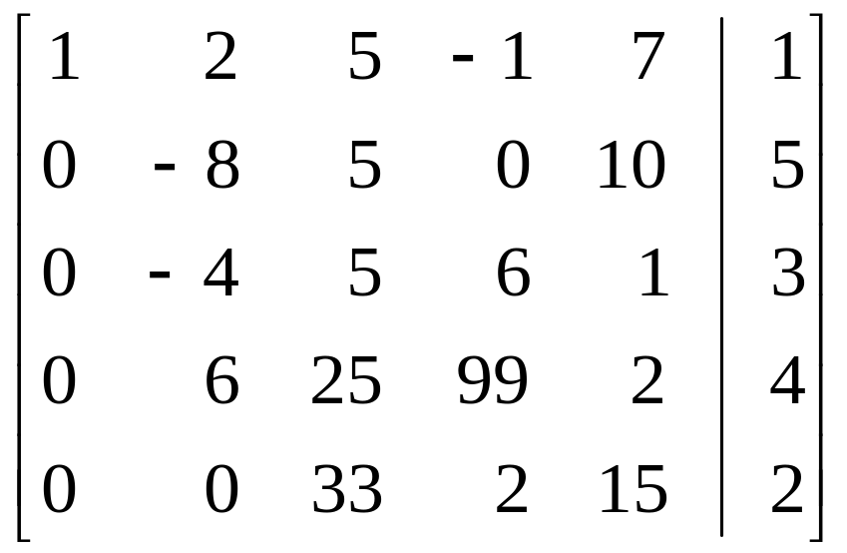
Exercise (Partial Pivoting)
Suppose k = 2 (2nd iteration). Which row should be selected as the pivot row?

Slide 37
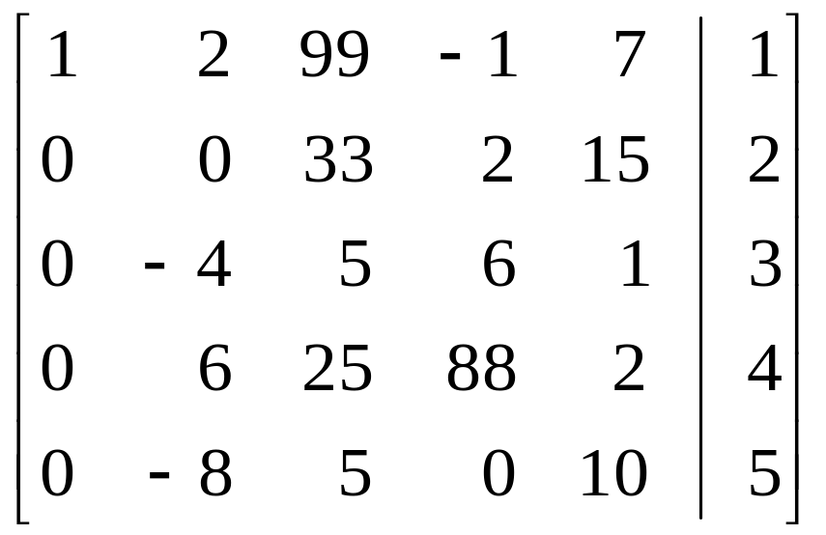
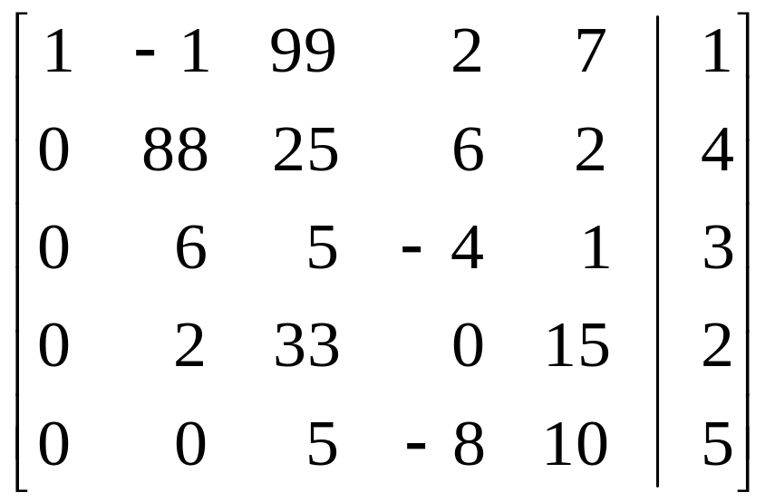
Exercise (Complete Pivoting)
Suppose k = 2 (2nd iteration). Which row should be selected as the pivot row?

Slide 38
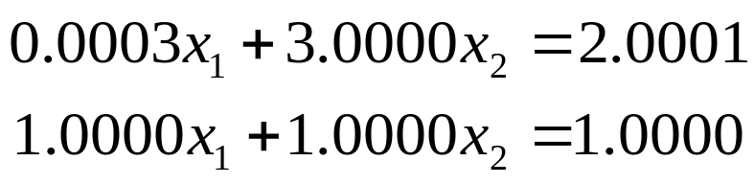
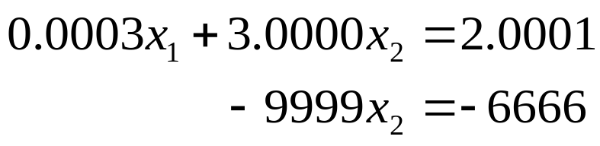
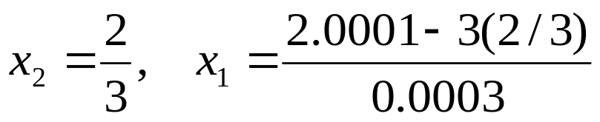
Example (Without partial pivoting)
Use Gauss elimination to solve
(Ans: x₁ = 1/3, x₂ = 2/3)
Note that the first pivoting element a₁₁ is close to 0.
Forward elimination gives
Backward substitution gives

Slide 39
(Ans: x₁ = 1/3, x₂ = 2/3)
Significant Figures | x₂ | x₁ | x₁ |ε_{t}| (%)
3 | 0.667 | -3.33 | 1099
4 | 0.6667 | 0.0000 | 100
5 | 0.66667 | 0.30000 | 10
6 | 0.666667 | 0.330000 | 1
7 | 0.6666667 | 0.3330000 | 0.1
Error!
The solution is sensitive to the number of significant figures in the computation, since we are subtracting two almost equal numbers.

Slide 40
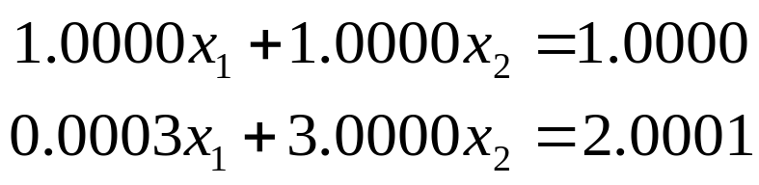


Example (With partial pivoting)
Reverse order
(Ans: x₁ = 1/3, x₂ = 2/3)
Forward elimination gives
Backward substitution gives

Slide 41
(Ans: x₁ = 1/3, x₂ = 2/3)
Significant Figures | x₂ | x₁ | x₁ |ε_{t}| (%)
3 | 0.667 | 0.333 | 0.1
4 | 0.6667 | 0.3333 | 0.01
5 | 0.66667 | 0.33333 | 0.001
6 | 0.666667 | 0.333333 | 0.0001
7 | 0.6666667 | 0.3333333 | 0.00001
Error!
The solution is less sensitive to the number of significant figures in the computation.

Slide 42
Singularity
Now consider
x₁ + x₂ + x₃ = 4
2x₁ – x₂ – x₃ = 7
x₁ – 2x₂ – 2x₃ = 12
x₁ + x₂ + x₃ = 4
– 3x₂ – 3x₃ = -1
– 3x₂ – 3x₃ = 8
x₁ + x₂ + x₃ = 4
– 3x₂ – 3x₃ = -1
0x₃ = 9
We can detect singularity during the elimination process.

Slide 43
Summary of Pivoting
How to perform partial and complete pivoting
Reasons for performing pivoting
  Avoid division by zero
  Minimize the effect of rounding error

Slide 44
Direct Methods
Gauss Elimination
  Naïve Gauss Eliminiation
  Pivoting Strategies
  Scaling
Gauss-Jordan Elimination
LU Decomposition

Slide 45
Scaling
Rescale all coefficients in a row to make the largest coefficient equal to 1.
Example:

Slide 46
Questions
What is the effect of scaling?
What do we need to scale?

Slide 47

Example of Scaling
Use Gauss Elimination to solve
(Ans: x₁ = 1.00002, x₂ = 0.99998)

Slide 48

Example of Scaling (Assume 3 significant digits)
Solution (a): Without pivoting and scaling
Forward elimination gives
Back substitution gives
x₂ = 1.00, x₁ = 1.00 (Right)

Slide 49


Example of Scaling (Assume 3 significant digits)
Solution (b): With partial pivoting but no scaling
Forward elimination gives
Back substitution gives
x₂ = 1.00, x₁ = 0.00 (Wrong)

Slide 50


Example of Scaling (Assume 3 significant digits)
Solution (c): With partial pivoting and scaling
Forward elimination gives
Back substitution gives
x₂ = 1.00, x₁ = 1.00 (Right)

Slide 51

Observation
Scaling was useful in determining whether pivoting was necessary.
Scaling introduces round-off error. Example,
It is sometimes suggested that the scaling values should be used to determining the pivoting, but the original coefficient values are retained for the actual elimination and substitution computation.

Slide 52
Pseudocode for Gauss Elimination with Partial Pivoting
// Assume arrays start with index 1 instead of 0.
// a: Coef. of matrix A; 2-D array
// b: Coef. of vector b; 1-D array
// n: Dimension of the system of equations
// x: Coef. of vector x (to store the solution)
// tol: Tolerance; smallest possible scaled pivot allowed.
// er: Pass back -1 if matrix is singular. (Reference var.)
Gauss(a, b, n, x, tol, er) {
Declare s[n] // as an n-element array for storing scaling factors
// s_{i} = the largest coef. of row i.
for i = 1 to n
s_{i} = abs(a_{i,1})
for j = 2 to n
if (abs(a_{i,j}) > s_{i})
s_{i} = abs(a_{i,j})
Eliminate(a, s, n, b, tol, er) // Forward Elimination
if (er ≠ -1) // If not singular
Substitute(a, n, b, x) // Back Substitution
}

Slide 53
Pseudocode for Gauss Elimination with Partial Pivoting
// Partial Pivoting
Pivot(a, b, s, n, k) {
p = k // Assume row k is the pivot row
// Find the largest scaled coefficient in column k
big = abs(a_{k,k} / s_{k})
for i = k+1 to n {
dummy = abs(a_{i,k} / s_{i})
if (dummy > big) {
big = dummy
p = i // Record new pivoting row
}
}
// Next: Swap row p and row k if p != k
// Continue next page

Slide 54
Pseudocode for Gauss Elimination with Partial Pivoting
if (p != k) {
// Swap row p and row k
for j = k to n {
dummy = a_{p,j}
a_{p,j} = a_{k,j}
a_{k,j} = dummy
}
// swap b_{p} and b_{k}
dummy = b_{p}
b_{p} = b_{k}
b_{k} = dummy
// swap s_{p} and s_{k}
dummy = s_{p}
s_{p} = b_{k}
s_{k} = dummy
}
}

Slide 55
Pseudocode for Gauss Elimination with Partial Pivoting
Eliminate(a, b, n, x, tol, er) {
for k = 1 to n-1 {
Pivot(a, b, s, n, k) // Partial Pivoting
if (abs(a_{k,k}/s_{k}) < tol) { // Check for singularity
er = -1;
return;
}
for i = k+1 to n
factor = a_{i,k} / a_{k,k}
for j = k+1 to n
a_{i,j} = a_{i,j} – factor * a_{k,j}
b_{i} = b_{i} – factor * b_{k}
}
if (abs(a_{n,n}/s_{n}) < tol) // Check for singularity
er = -1;
}
Forward Elimination

Slide 56
Pseudocode for Gauss Elimination with Partial Pivoting
// Back Subsitution
Substitute(a, n, b, x) {
x_{n} = b_{n} / a_{n,n}
for i = n-1 downto 1 {
sum = 0
for j = i+1 to n
sum = sum + a_{i,j} * x_{j};
x_{i} = (b_{i} – sum) / a_{i,i}
}
}

Slide 57
Question
Why don't we replace the coefficients by the scaled values in the pseudo code?
Note: In the pseudo code, the equation are not scaled, but scaled values of the elements are used to determine whether pivoting is to be implemented.

Slide 58
Summary of Scaling
Scaling gives us a "true picture" which element is more dominating so that we can correctly carry out pivoting.
Why do we need to perform pivoting again?

Slide 59
Summary
Gauss Elimination
  Forward Elimination and its complexity
  Back substitution and its complexity
Effect of pivoting and scaling

