Slide 1
Systems of Linear Equations
Gauss-Jordan Elimination
and
LU Decomposition

Slide 2
Direct Methods
Gauss Elimination
  Naïve Gauss Eliminiation
  Pivoting Strategies
  Scaling
Gauss-Jordan Elimination
LU Decomposition

Slide 3
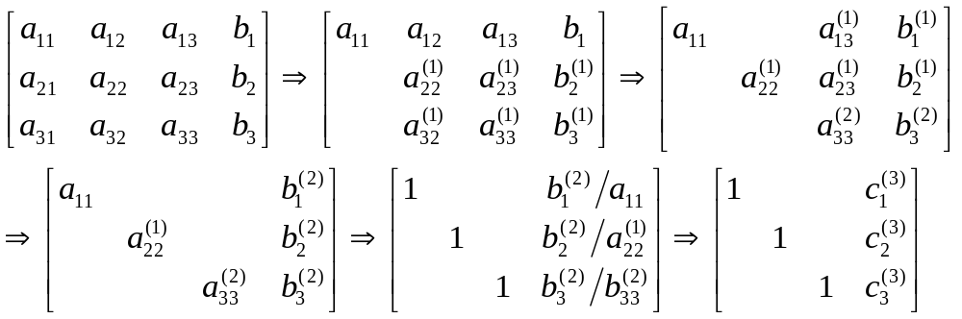
Gauss-Jordan Elimination
Similar to the Gauss elimination except
Elimination is applied to all equations (excluding the pivot equation) instead of just the subsequent equations.
All rows are normalized by dividing them by their pivot elements.
No back substitution is required.

Slide 4
Pitfalls and Improvements
Pitfalls: Same as those found in the Gauss elimination.
  Division-by-zero, round-off error, and ill-conditioned systems.
Improvement strategies: Same as those used in the Gauss elimination
  Use pivoting and scaling to avoid division-by-zero and to reduce round-off error.

Slide 5
Computing Cost
Which of Gauss elimination and Gauss-Jordan elimination involves more FLOPS?
 | Gauss Elimination | Gauss-Jordan Elimination
Elimination Step | Forward Elimination – only needs to eliminate the coefficients below the diagonal. Cost ~ 2n³/3 | Needs to eliminate coefficients below and above the diagonal. Cost ~ 2 * (2n³/3)
Substitution Step | Back Substitution Cost ~ O(n²) | No substitution step
Total | 2n³/3 + O(n²) | 4n³/3 (More costly when n is big)

Slide 6
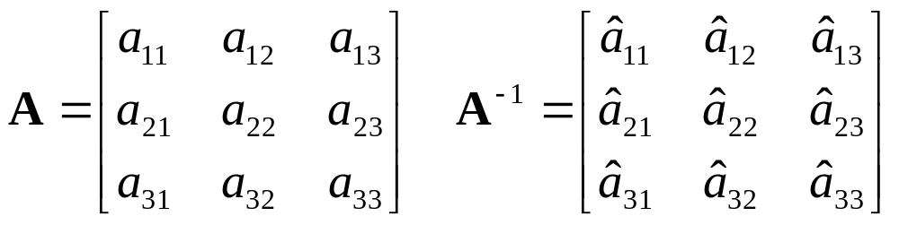
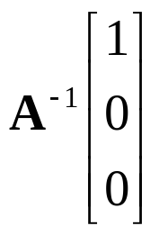
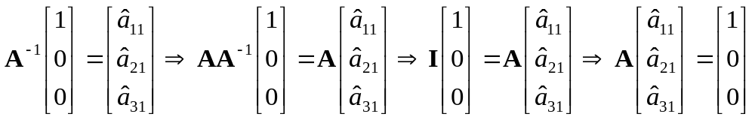
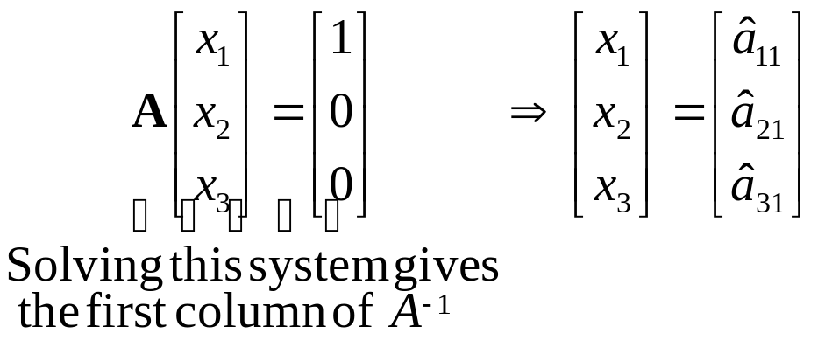
Question
What is
?

Slide 7
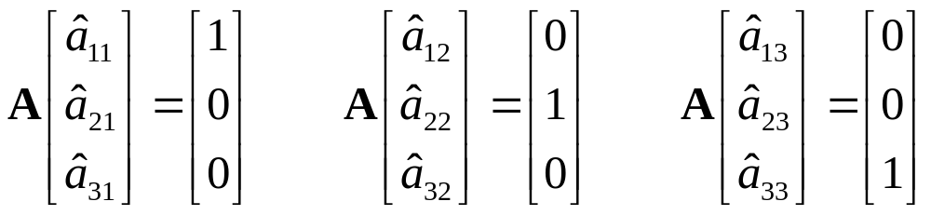
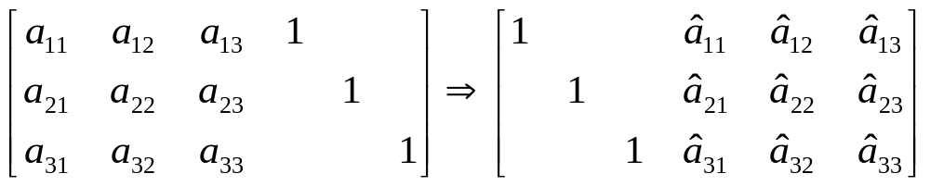
Computing Matrix Inverse
Let
Gauss Elimination
Solve
Gauss-Jordan

Slide 8
Summary
Algorithms
  Gauss elimination
    Forward elimination + back substitution
  Gauss-Jordan elimination
Calculate the computing cost of Gauss Elimination in terms of FLOPS
To avoid division-by-zero, use pivoting (partial or complete).
To reduce round-off error, use pivoting and scaling.
If a system is ill-conditioned, then substituting solution back to the system to check if the solution is accurate is not reliable.
  How to determine if a matrix is ill-conditioned?

Slide 9
Direct Methods
Gauss Elimination
  Naïve Gauss Eliminiation
  Pivoting Strategies
  Scaling
Gauss-Jordan Elimination
LU Decomposition

Slide 10
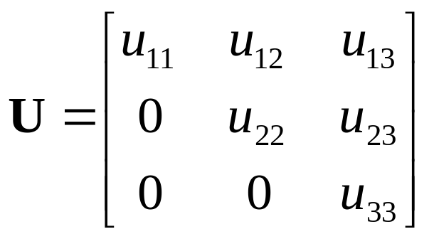
Back Substitution
Use to solve the system Ux = b where U is an upper triangular matrix.
Example:
3x₁ + 2x₂ + x₃ = 6
2x₂ + 3x₃ = 7
2x₃ = 4
Step 1: Solve for x₃
2x₃ = 4 => x₃ = 4/2 = 2
Step 2: Solve for x₂
2x₂ + 3(2) = 7
=> x₂ = [7 – 3(2)] / 2 = 0.5
Step 3: Solve for x₁
3x₁ + 2(0.5) + (2) = 6
=> x₁ = [6 – 2(0.5) – 2] / 3 = 1

Slide 11
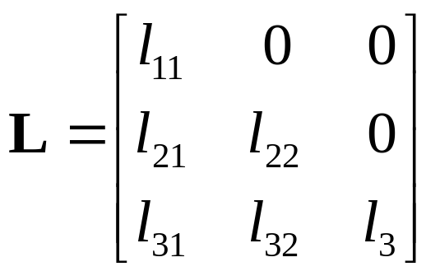
Forward Substitution
Use to solve the system Lx = b where L is a lower triangular matrix.
Example:
2x₁ = 4
3x₁ + 2x₂ = 7
x₁ + 2x₂ + 3x₃ = 6
Step 1: Solve for x₁
2x₁ = 4 => x₁ = 4/2 = 2
Step 2: Solve for x₂
3(2) + 2x₂ = 7
=> x₂ = [7 – 3(2)] / 2 = 0.5
Step 3: Solve for x₃
(2) + 2(0.5) + 3x₃ = 6
x₃ = [6 – 2 – 2(0.5)] / 3 = 1

Slide 12
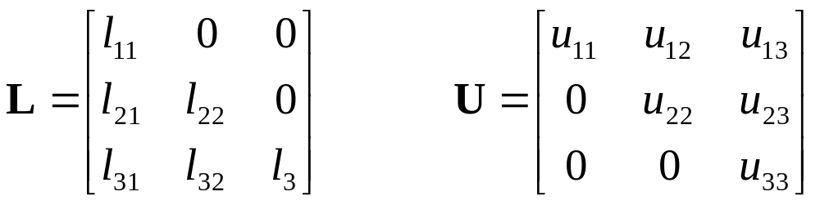
LU Decomposition
Idea: To solve Ax = b
Step 1: Decompose A into L and U such that
A = LU where
Step 2: Solve LUx = b using forward and back substitution.
We will discuss later how to compute L and U when given A. For now, let's assume we can!

Slide 13
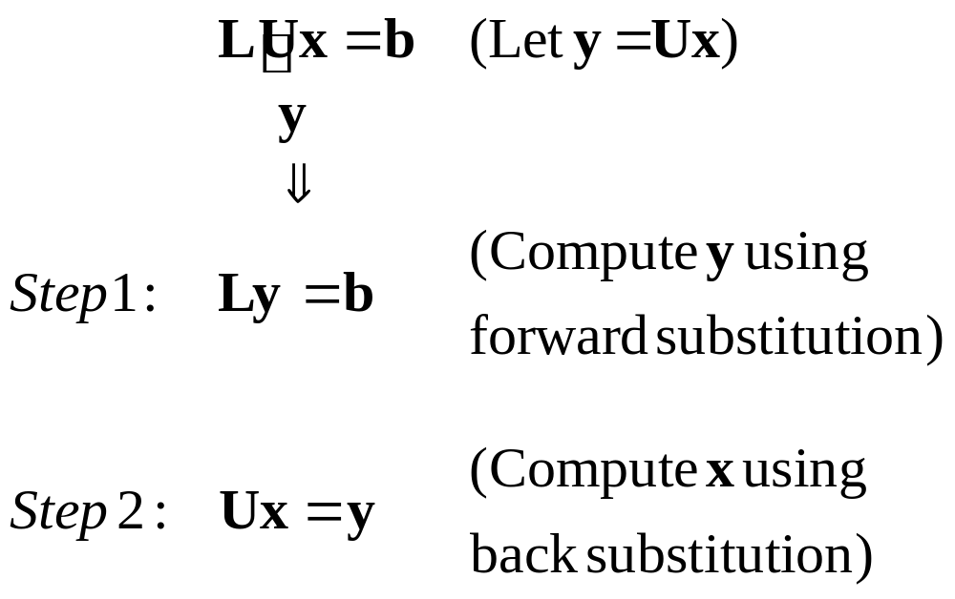
Solving LUx = b

Slide 14
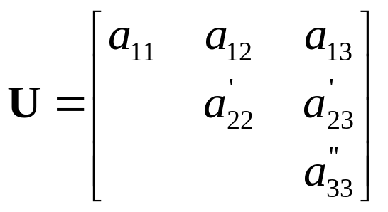
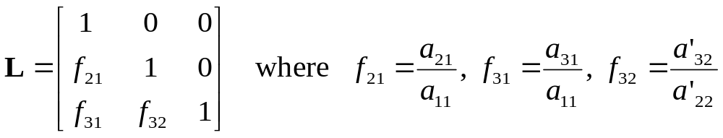
Decomposing A using Gauss Elimination
U is formed by applying the forward elimination of Gauss Elimination (without including the right hand side vector)
L is formed by the factors used to eliminate each elements during the forward elimination process as

Slide 15
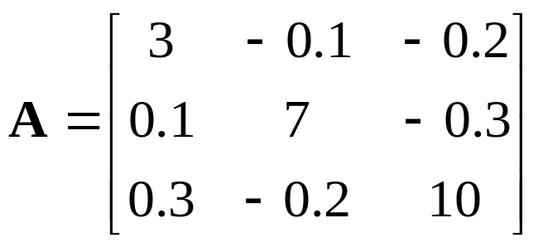
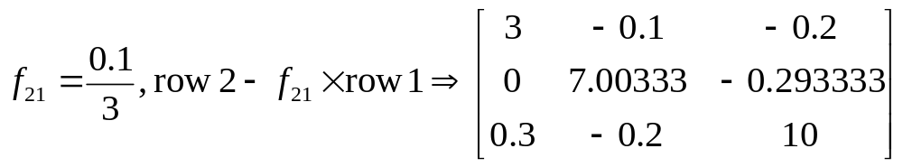
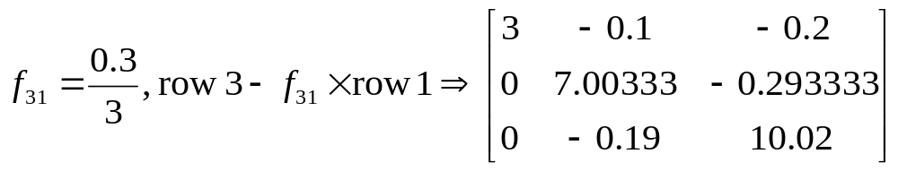
Decomposing A into L and U -- Example
1st iteration (1st column), eliminating a₂₁
1st iteration (1st column), eliminating a₂₂

Slide 16
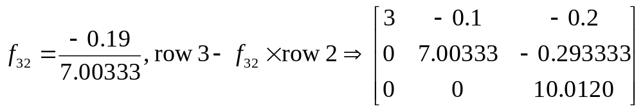
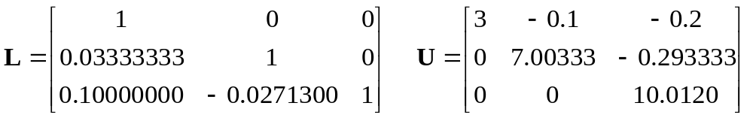
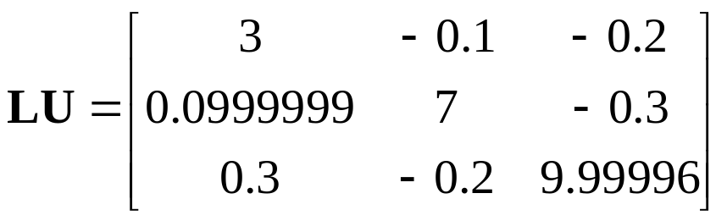
Decomposing A into L and U -- Example
2st iteration (2st column), eliminating a₃₂
Thus we can express A as LU where
Due to round-off error

Slide 17
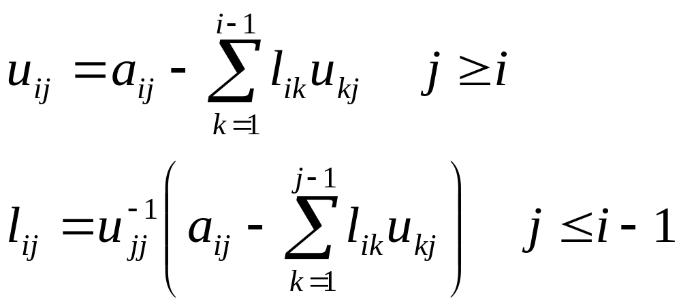
LU Decomposition
In LU decomposition, the l and u values are obtained from
Note: These are just mathematical expressions representing the steps involved in Gauss Elimination.

Slide 18

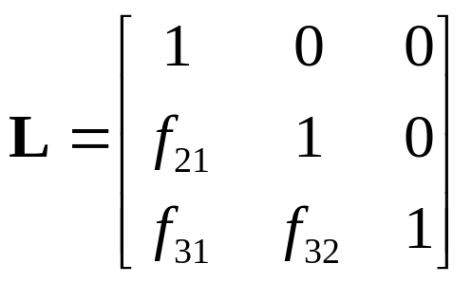
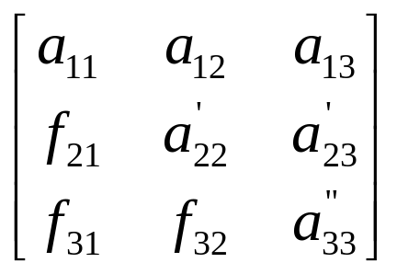
Compact Representation
For U, the lower part are all 0's.
For L, the diagonal elements are all 1's and the upper part are all 0's.
When implementing the algorithm, we can store both U and L back into A.

Slide 19
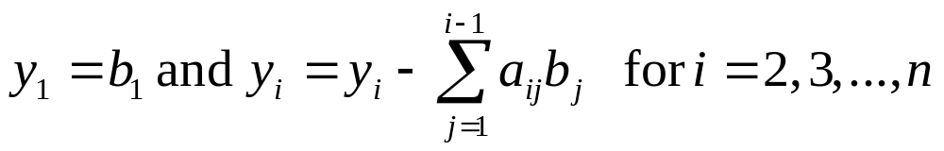
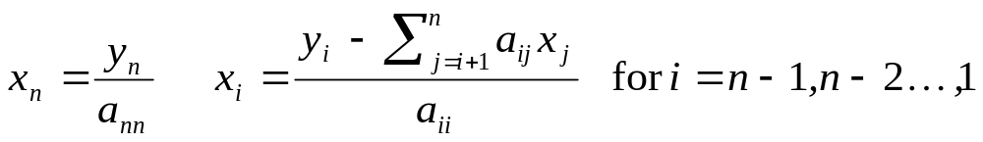
Forward and Back Substitution
To solve Ly = b, we use forward substitution
To solve Ux = y, we use back substitution
Note: Here the a_{ij} represents the coefficients of the resulting matrix A produced by the LU Decomposition algorithm.

Slide 20
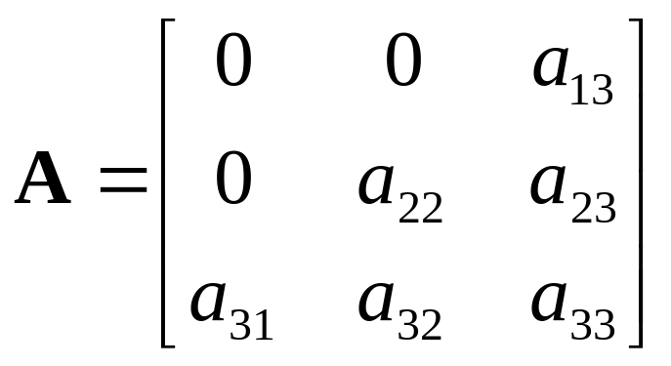
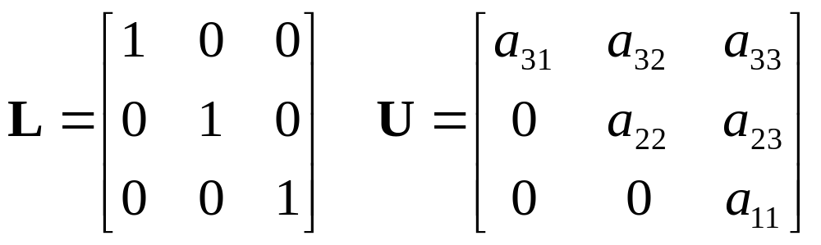
Effect of Pivoting
Let
Pivot row in 1st iteration
If we directly apply Gauss elimination algorithm (with pivoting), we will need to swap row 3 with row 1 and eventually yield L and U as

Slide 21
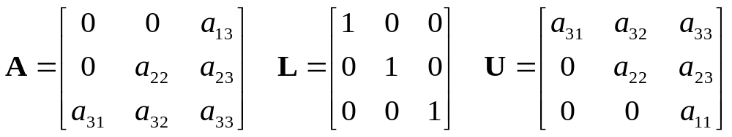
Effect of Pivoting
If we are given a vector b, can we solve Ax = b as LUx = b?
No! We can't because we have swapped the rows during the elimination step.
In implementing the LU decomposition, we have to remember how the rows were swapped so that we can reorder the elements in x and b accordingly.

Slide 22
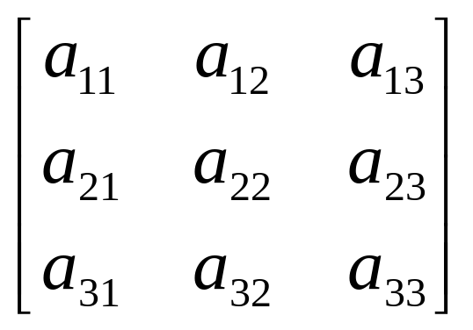
Addressing the issue of row swapping in implementation
To remember how the rows were swapped, we can introduce an array, o[] , to store the indexes to the rows.
Initially, o[i] = i for i = 1, 2, …, N.
i | o[i]
1 | 1
2 | 2
3 | 3
Whenever we need to swap rows, we only swap the indexes stored in o[]. For example, after swapping row 1 with row 3
i | o[i]
1 | 3
2 | 2
3 | 1

Slide 23
Addressing the issue of row swapping in implementation
LU Decomposition with pivoting
A
L'
A'
U'
=
If rows were swapped, A ≠A'. However, o[i] tells us that row i in A corresponds row o[i] in A'. To solve Ax = b, we can first reorder the elements in x and b to produce x' and b' as
x'_{i} = x_{o[i]} and b'_{i} = b_{o[i]}
and then solve A'x' = b' as L'U'x' = b'.
Note: In actual implementation, we do not need to explicitly create x' and b'. We can refer to their elements directly as x_{o[i]} and b_{o[i]}.

Slide 24
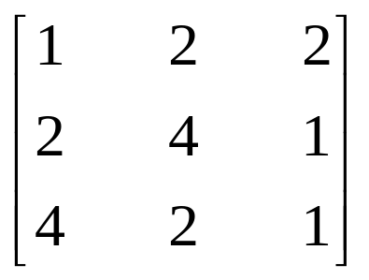
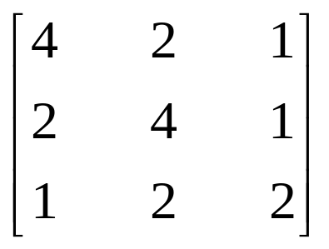
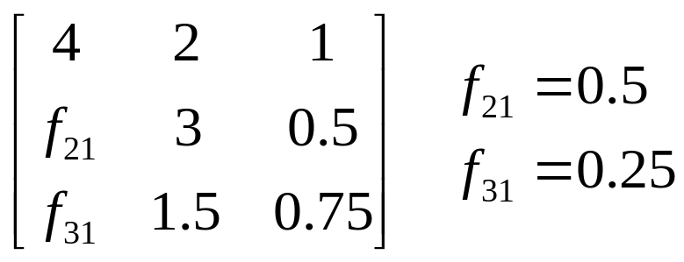
Illustration: Using o[]
Implementation
i | o[i]
1 | 1
2 | 2
3 | 3
Array A
Initial states.
Pick row 3 as pivot row
1 | 2 | 2
2 | 4 | 1
4 | 2 | 1
i | o[i]
1 | 3
2 | 2
3 | 1
Array A
After swapping row 3 with row 1
1 | 2 | 2
2 | 4 | 1
4 | 2 | 1
After the 1st iteration.
i | o[i]
1 | 3
2 | 2
3 | 1
Array A
0.25 | 1.5 | 0.75
0.5 | 3 | 0.5
4 | 2 | 1
f₃₁ is calculated as
A[o[3],1] / A[o[1],1] and the result is stored back to A[o[3],1].

Slide 25
Pseudocode for LU Decomposition
// Assume arrays start with index 1 instead of 0.
// a: Coef. of matrix A; 2-D array. Upon successful
// completion, it contains the coefficients of
// both L and U.
// b: Coef. of vector b; 1-D array
// n: Dimension of the system of equations
// x: Coef. of vector x (to store the solution)
// tol: Tolerance; smallest possible scaled
// pivot allowed.
// er: Pass back -1 if matrix is singular.
// (Reference var.)
LUDecomp(a, b, n, x, tol, er) {
Declare s[n] // An n-element array for storing scaling factors
Declare o[n] // Use as indexes to pivot rows.
// o_{i} or o(i) stores row number of the i^{th} pivot row.
er = 0
Decompose(a, n, tol, o, s, er)
if (er != -1)
Substitute(a, o, n, b, x)
}

Slide 26
Pseudocode for decomposing A into L and U
Decompose(a, n, tol, o, s, er) {
for i = 1 to n { // Find scaling factors
o[i] = i
s[i] = abs(a[i,1])
for j = 2 to n
if (abs(a[i,j]) > s[i])
s[i] = abs(a[i,j])
}
for k = 1 to n-1 {
Pivot(a, o, s, n, k) // Locate the k^{th} pivot row
// Check for singular or near-singular cases
if (abs(a[o[k],k]) / s[o[k]]) < tol) {
er = -1
return
}
// Continue next page

Slide 27
for i = k+1 to n {
factor = a[o[i],k] / a[o[k],k]
// Instead of storing the factors
// in another matrix (2D array) L,
// We reuse the space in A to store
// the coefficients of L.
a[o[i],k] = factor
// Eliminate the coefficients at column j
// in the subsequent rows
for j = k+1 to n
a[o[i],j] = a[o[i],j] – factor * a[o[k],j]
}
} // end of "for k" loop from previous page
// Check for singular or near-singular cases
if (abs(a[o[n],n]) / s[o[n]]) < tol)
er = -1
}

Slide 28
Psuedocode for finding the pivot row
Pivot(a, o, s, n, k) {
// Find the largest scaled coefficient in column k
p = k // p is the index to the pivot row
big = abs(a[o[k],k]) / s[o[k]])
for i = k+1 to n {
dummy = abs(a[o[i],k] / s[o(i)])
if (dummy > big) {
big = dummy
p = i
}
}
// Swap row k with the pivot row by swapping the
// indexes. The actual rows remain unchanged
dummy = o[p]
o[p] = o[k]
o[k] = dummy
}

Slide 29
Psuedocode for solving LUx = b
Substitute(a, o, n, b, x) {
Declare y[n]
y[o[1]] = b[o[1]]
for i = 2 to n {
sum = b[o[i]]
for j = 1 to i-1
sum = sum – a[o[i],j] * b[o[j]]
y[o[i]] = sum
}
x[n] = y[o[n]] / a[o[n],n]
for i = n-1 downto 1 {
sum = 0
for j = i+1 to n
sum = sum + a[o[i],j] * x[j]
x[i] = (y[o[i]] – sum) / a[o[i],i]
}
}
Forward
substitution
Back
substitution

Slide 30
About the LU Decomposition Pseudocode
If the LU decomposition algorithm is to be used to solve Ax = b for various b's, then both array "a" and array "o" have to be saved.
Subroutine substitute() can be applied repeatedly for various b's.
In subroutine substitute(), we can also reuse the space in "b" to store the elements of "y" instead of declaring the new array "y".

Slide 31
Question
What is the cost to decompose A into L and U?

Slide 32
LU Decomposition vs. Gauss Elimination
To solve Ax = b_{i}, i = 1, 2, 3, …, K
LU Decomposition
Compute L and U once – O(n³)
Forward and back substitution – O(n²)
Total cost = O(n³) + K * O(n²)
Gauss Elimination
Total cost: K * O(n³)

Slide 33
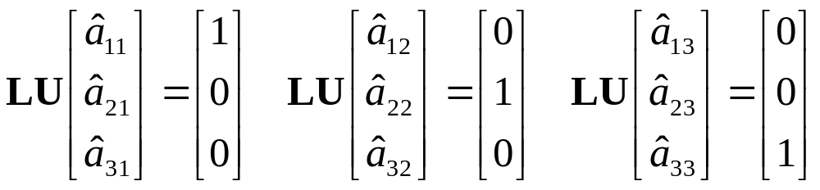
Computing Matrix Inverse
Let
First, decompose A into L and U, then
Solve

Slide 34
Pseudocode for finding matrix inverse using LU Decomposition
// a: Given matrix A; 2-D array.
// ai: Stores the coefficients of A⁻¹
// n: Dimension of A
// tol: Smallest possible scaled pivot allowed.
// er: Pass back -1 if matrix is singular.
LU_MatrixInverse(a, ai, n, tol, er) {
Declare s[n], o[n], b[n], x[n]
Decompose(a, n, tol, o, s, er)
if (er != -1) {
for i = 1 to n {
for j = 1 to n // Construct the unit vector
b[j] = 0
b[i] = 1
Substitute(a, o, n, b, x)
for j = 1 to n
ai[j,i] = x[j]
}
}
}

Slide 35
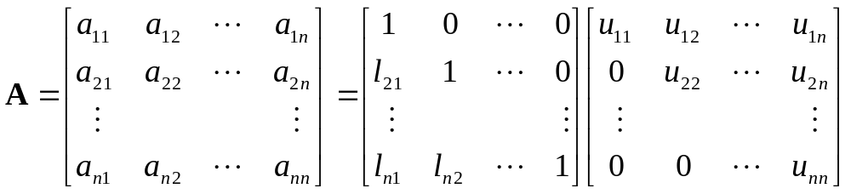
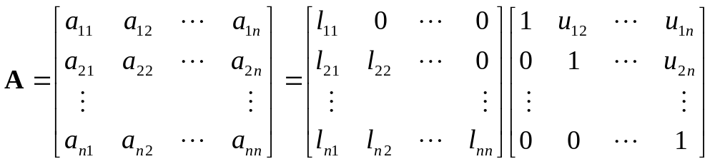
Two types of LU decomposition
Doolittle Decomposition or factorization
Crout Decomposition

Slide 36
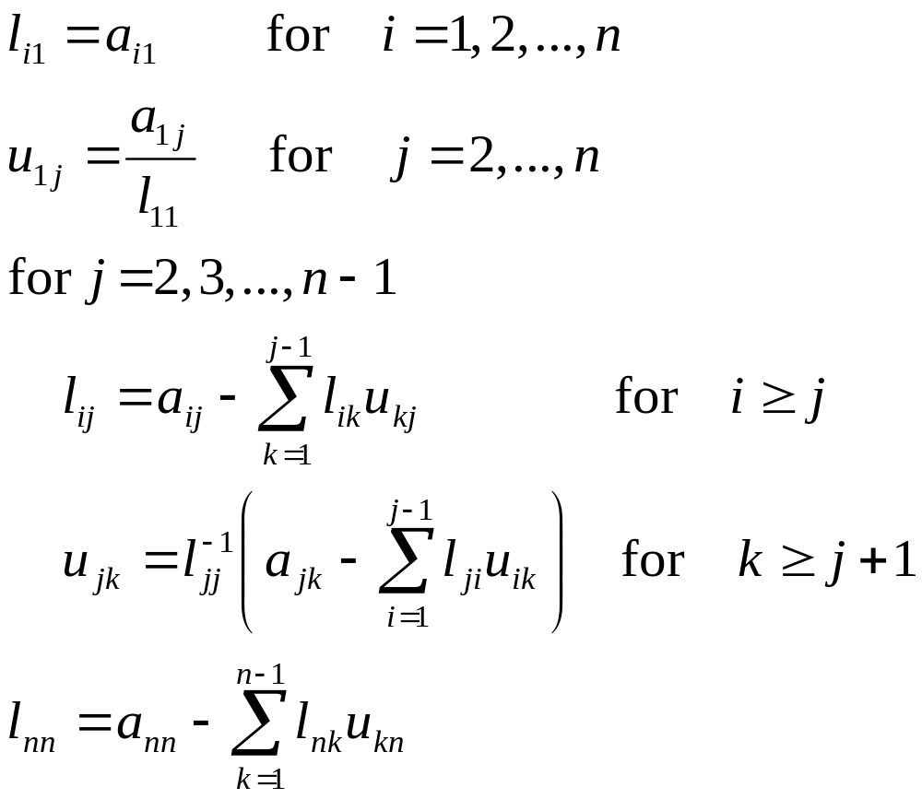
Crout Decomposition

Slide 37
Summary
LU Decomposition Algorithm
LU Decomposition vs. Gauss Elimination
  Similarity
  Advantages (Disadvantages)
  Computing Cost

