Slide 1
Systems of Linear Equations
Iterative Methods

Slide 2
B. Iterative Methods
Jacobi method and Gauss Seidel
Relaxation method for iterative methods

Slide 3
Iterative Methods
Iterative methods are more appropriate when
  the number of equations involved is large (typically of the order of 100 or more)
  and/or
  the matrix is sparse (less memory requirements)

Slide 4
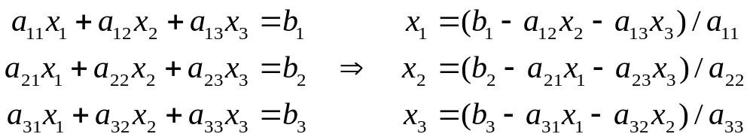
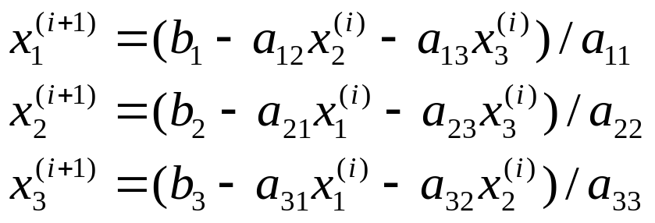
Jacobi Iteration
Step 1: Construct updating formula as
Step 2: Starts with initial guesses x₁⁽⁰⁾, x₂⁽⁰⁾, x₃⁽⁰⁾
Step 3: Iteratively compute x₁^{(i+1)}, x₂^{(i+1)}, x₃^{(i+1)} based on the updating formula for i = 0, 1, …, until the x's converge

Slide 5
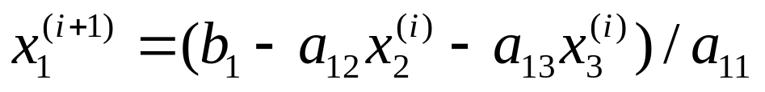
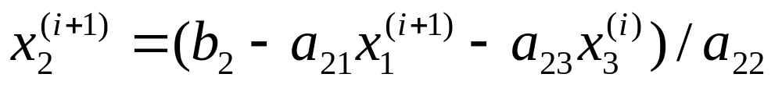
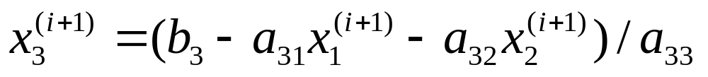
Gauss-Seidel Iteration
Improved version of Jacobi Iteration
Observation: If x's converge, then after computing
x₁^{(i+1)} should be a better approximation of x₁ than x₁^{(i)}.
Thus the updating formula of Gauss-Seidel Iteration becomes

Slide 6
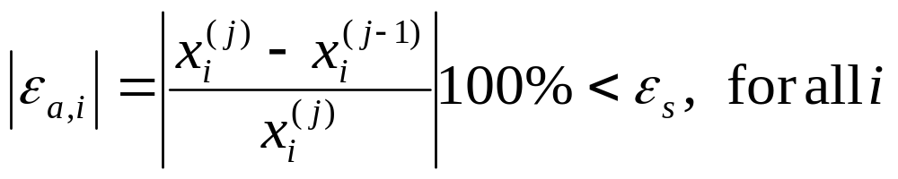
Stopping Criteria
When the estimated percentage relative error of every x's is less then the acceptable error.

Slide 7
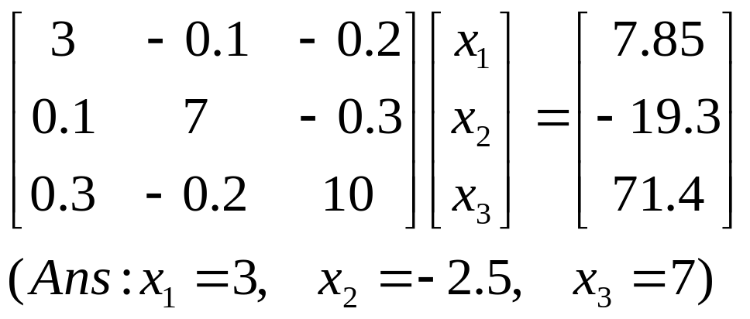
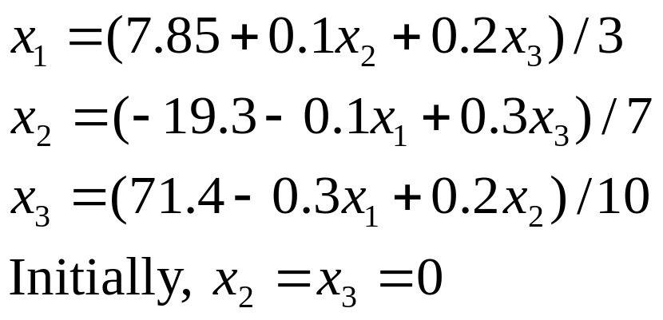
Example: Gauss-Seidel Method
Solve
Use Gauss-Seidel Method and obtain the following updating equation.

Slide 8
Example: Gauss-Seidel Method
x₁ | x₂ | x₃
2.616667 | 0 | 0
2.616667 | -2.794524 | 0
2.616667 | 2.794524 | 7.005610
2.990557 | 2.794524 | 7.005610 | |ε_{t}| of x₁ = 0.31%
2.990557 | -2.499625 | 7.005610 | |ε_{t}| of x₂ = 0.015%
2.990557 | -2.499625 | 7.00291 | |ε_{t}| of x₃ = 0.0042%
What would happen if we swap the rows?

Slide 9
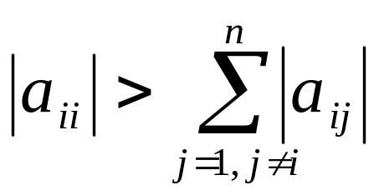
Convergence
A simple way to determine the convergence is to inspect the diagonal elements.
All of the diagonal elements must be non-zero.
Convergence is guaranteed if the system is diagonally dominant.

Slide 10
Convergence
Good initial guess can greatly improve the chance of convergence.
Convergent rate depends on the properties of the matrix.
The higher the condition number, the slower the convergent rate.

Slide 11
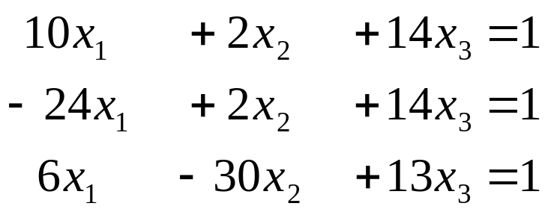
Exercise
How would you solve the following system of equations using the Gauss-Seidel method with guarantee of convergence?

Slide 12
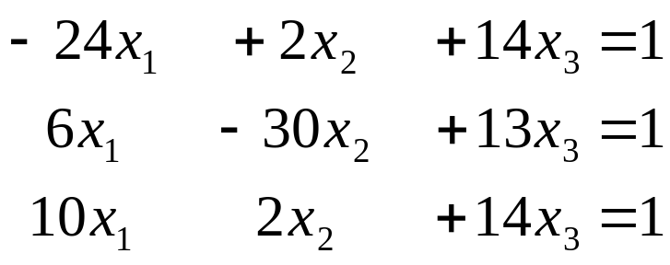
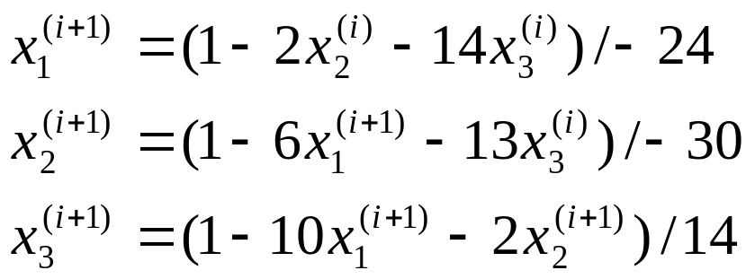
Solution
To guarantee convergence, the matrix on the L.H.S. of the equations must be diagonal dominant.
For the given system of equations, we can reorder the equations so that the system becomes
and construct the updating formula as

Slide 13
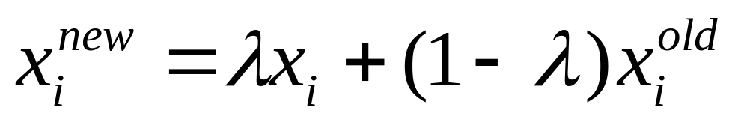
Successive Over-Relaxation (SOR) **
Successive Over-Relaxation is a modification of the Gauss-Seidel method to enhance convergence.
where
λis a weighting factor between 0 and 2.
x_{i} is the value computed from the original Gauss-Seidel updating equation (i.e. before applying SOR).
x_{i}^{old} is the value of x_{i} in the previous iteration
x_{i}^{new} is the new value of x_{i}, used for updating.

Slide 14
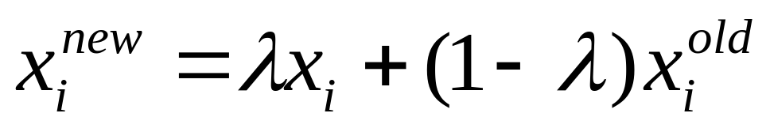
Relaxation **
λ=1, x_{i}^{new =} x_{i}
underrelaxation, 0 ≤ λ < 1
to make a non-convergent system converge, or to speedup convergence by avoiding oscillations.
overrelaxation, 1 < λ ≤ 2
to accelerate the convergence, if x_{i} is moving toward the solution at a slow rate. More weighing is given to the current value of x.

Slide 15
How to determine λ? **
Problem specific
Usually determined empirically
Not useful when the system is only solved once
If the system are solved many times, a carefully selected value of λ can greatly improve the rate of convergence.

Slide 16
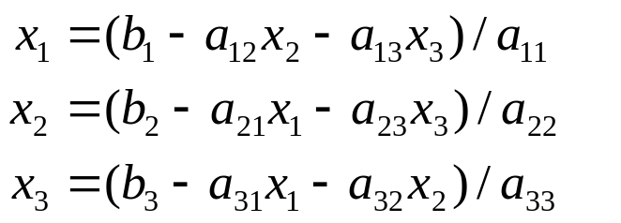
Pseudocode for Gauss-Seidel Iteration
// Assume arrays start with index 1 instead of 0.
// a: Matrix A
// b: Vector b
// n: Dimension of the system of equations
// x: Vector x; contains initial values and
// will be used to store the solution
// imax: maximum number of iterations allowed
// es: Acceptable percentage relative error
// lambda: Use to "relax" x's
Gauss_Seidel(a, b, n, x, imax, es, lambda) {
// Normalize elements in every row by
// dividing them by the diagonal
// element. Doing so can save some
// division operations later.
for i = 1 to n {
dummy = a[i, i]
for j = 1 to n
a[i,j] = a[i,j] / dummy
b[i] = b[i] / dummy
}

Slide 17
Pseudocode for Gauss-Seidel Iteration
// Assuming the initial guess (the values in x)
// is not reliable.
// So carry out one iteration of Gauss-Seidel
// without relaxation (to get a better approximation
// of x's)
for i = 1 to n {
sum = b[i]
for j = 1 to n {
if (i != j)
sum = sum - a[i,j] * x[j]
}
x[i] = sum
}
iter = 1;

Slide 18
do {
sentinel = 1 // Assuming iteration converges
// set to 0 if error is still big
for i = 1 to n {
old = x[i] // Save the previous x
// Compute new x and apply relaxation
sum = b[i]
for j = 1 to n
if (i != j)
sum = sum – a[i,j] * x[j]
x[i] = lambda * sum + (1 – lambda) * old
// If "necessary", check if error is too big
if (sentinel == 1 AND x[i] != 0) {
ea = abs((x[i] – old) / x[i]) * 100
if (ea > es)
sentinel = 0
}
}
iter = iter + 1;
} while (sentinel == 0 AND iter < imax)
}

Slide 19
Summary
Iterative vs. Direct methods (Adv. / Disadv. )
Jacobi and Gauss-Seidel Iteration Methods
Iterative methods
  Efficient, especially when an approximate solution is known
  May not converge
  Stopping criteria?
  Converging criteria?

