Slide 1
Text Classification Dengan TF-IDF dan SVM
Oleh:
Muhammad Azka Adhisetama 21/477807/TK/52628

Slide 2
Latar Belakang
Sentiment Analysis → topik NLP yang sangat umum
Text Classification adalah tool yang powerful
Cara membuat ?
Mudah, tetapi cukup efektif: TF-IDF dan Machine Learning (SVM)
Membuat AI untuk klasifikasi teks
Menampilkan secara user-friendly model dan konsep dibaliknya

Slide 3








AI Model
vocabulary
+ or -
5
1
TF-IDF
SVM
1. Train
$${\{\overset{⃑}{x}}_{i}, y_{i}\}$$
$$\overset{⃑}{w}, b$$
2
Feature vectors
AI model for classification
Train documents/texts
$$\{t_{i}, {idf}_{t_{i}}\}$$
3
4
2. Test
$$\{t_{i}, {idf}_{t_{i}}\}$$
$$\overset{⃑}{x}$$
$$\overset{⃑}{w}, b$$
$$\hat{y}$$
Feature vector
Predicted class (sentiment)
Test document/text

Slide 4
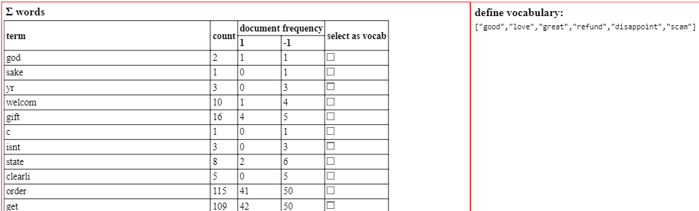
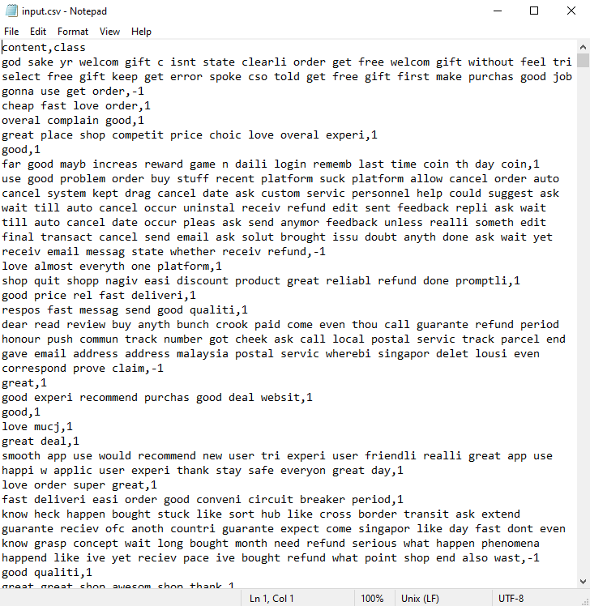
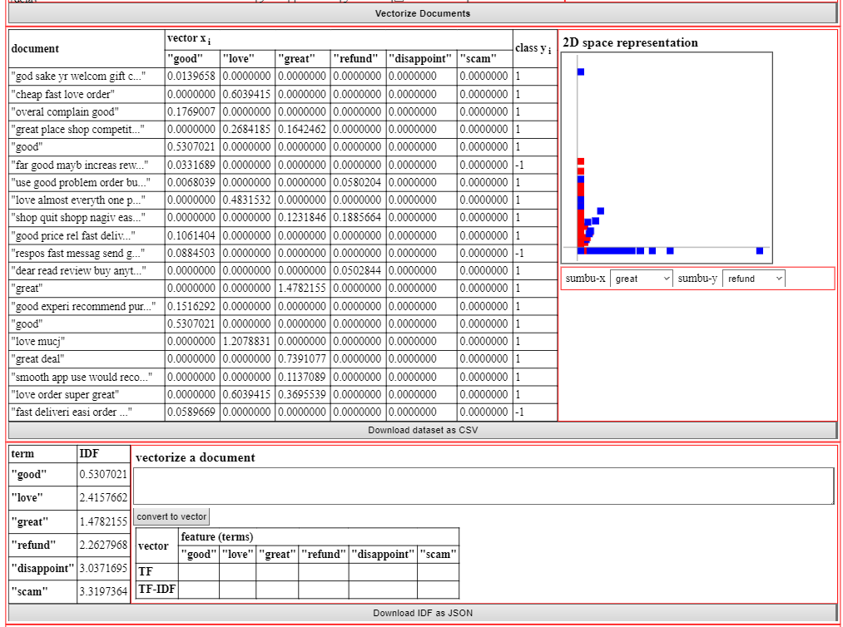
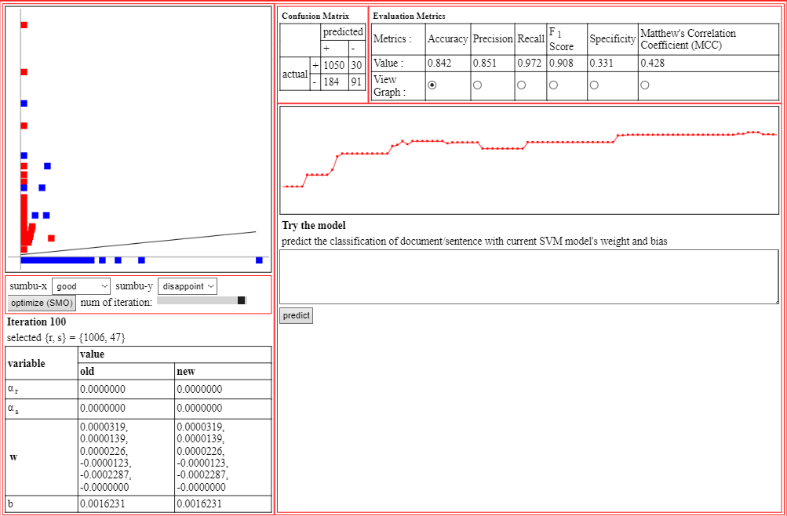
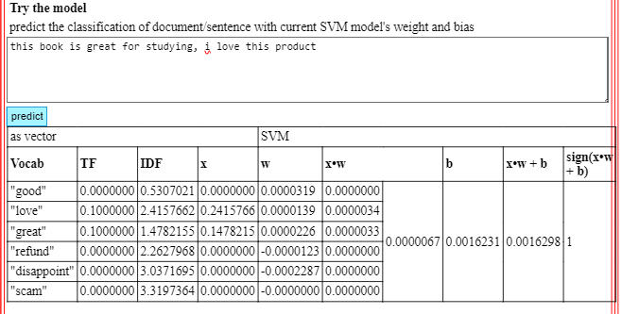
AI Model (screenshots)
TF-IDF
1. Train
define vocabulary
SVM
Train documents/texts
2. Test
idf and feature vectors (tf * idf)
AI model for classification

Slide 5
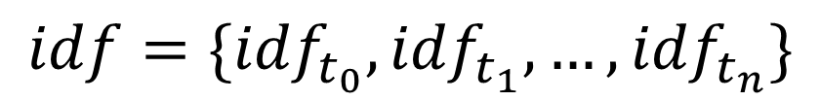
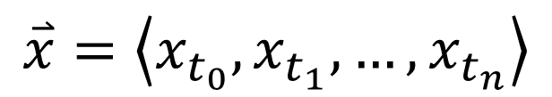

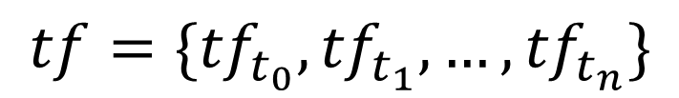
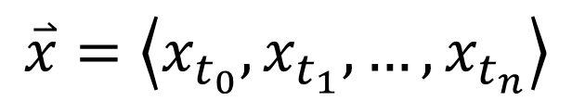
Text → Vector: TF-IDF
$$\overset{⃑}{x}=\left\langle x_{t_{0}},x_{t_{1}},…,x_{t_{n}}\right\rangle$$
$$V=\{t_{0},t_{1},…,t_{n}\}$$
$$tf={\{tf}_{t_{0}},{tf}_{t_{1}},…,{tf}_{t_{n}}\}$$
Feature vector
$$\overset{⃑}{x}=\left\langle x_{t_{0}},x_{t_{1}},…,x_{t_{n}}\right\rangle$$
$$idf=\{{idf}_{t_{0}},{idf}_{t_{1}},…,{idf}_{t_{n}}\}$$

Slide 6
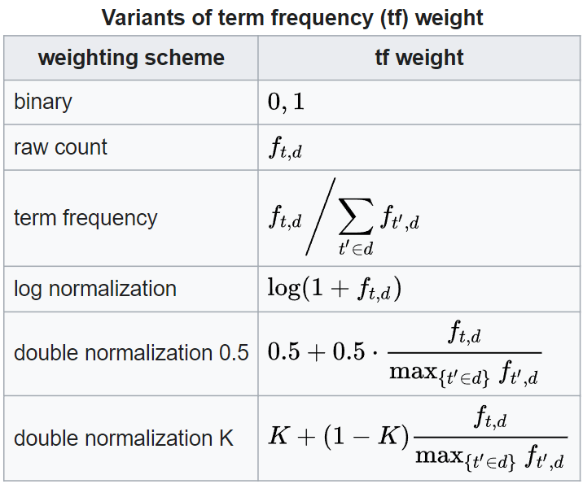
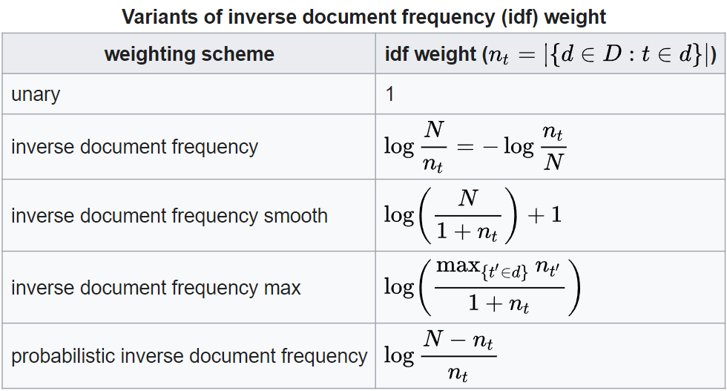
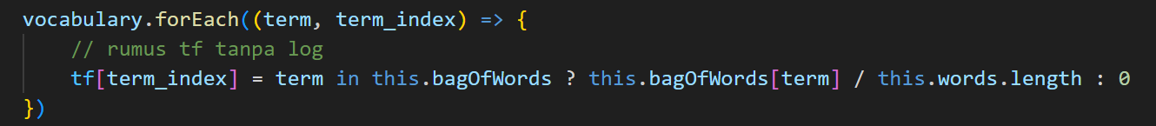
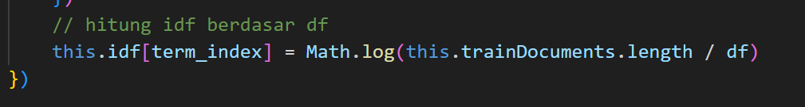
Text → Vector: TF-IDF
$$\overset{⃑}{x}=\left\langle x_{t_{0}},x_{t_{1}},…,x_{t_{n}}\right\rangle$$

Slide 7
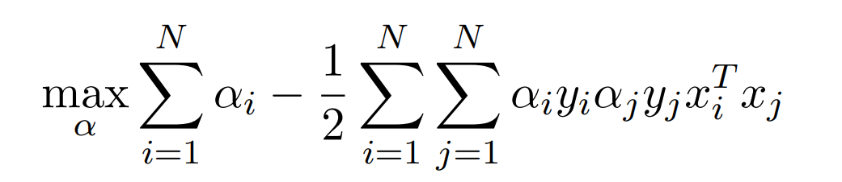
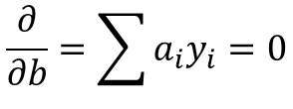

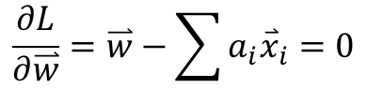

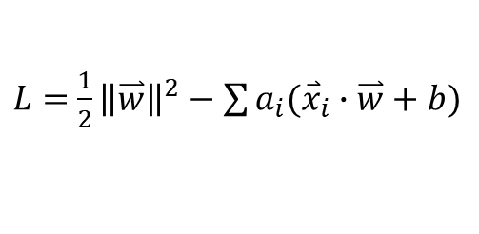


SVM Classification
Sequential Minimal Optimization (SMO)
$$\{\left({\overset{⃑}{x}}_{0}, y_{0}\right),\left({\overset{⃑}{x}}_{1}, y_{1}\right),…,({\overset{⃑}{x}}_{n}, y_{n})\}$$
$$length= \frac{2}{\left\|\overset{⃑}{w}\right\|}$$
optimization
$$max\left(length\right)→\min\left(\left\|\overset{⃑}{w}\right\|\right)→min⁡(\frac{1}{2}{\left\|\overset{⃑}{w}\right\|}^{2})$$
SVM
$L=$ $\frac{1}{2}{\left\|\overset{⃑}{w}\right\|}^{2}−\sum{a_{i}({\overset{⃑}{x}}_{i}∙\overset{⃑}{w}+b)}$
$$\overset{⃑}{w}, b$$
$$\frac{∂L}{∂\overset{⃑}{w}}=\overset{⃑}{w}−\sum{a_{i}{\overset{⃑}{x}}_{i}=0}$$
$$\frac{∂}{∂b}=\sum{a_{i}y_{i}=0}$$

Slide 8
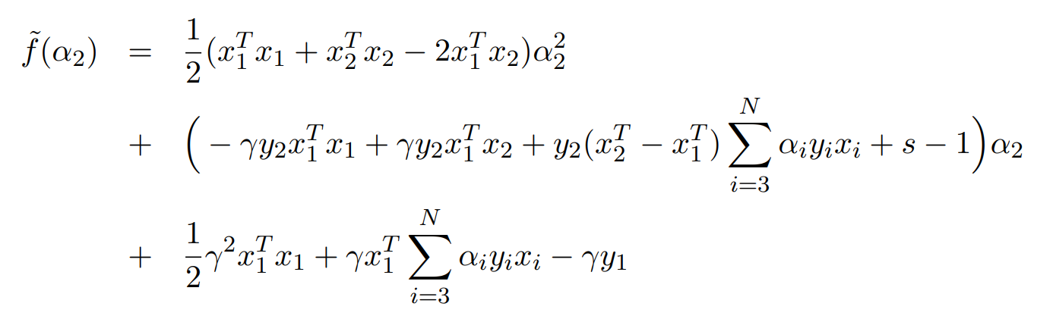




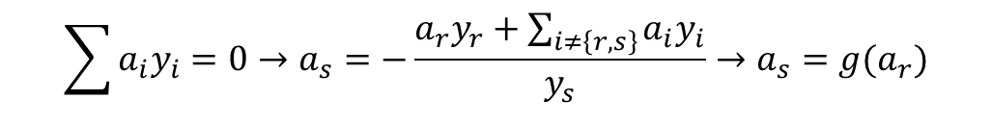
SMO Optimization
$$L=f(a_{0},a_{1},…,a_{n})$$
$$\sum{a_{i}y_{i}=0}→a_{s}=−\frac{a_{r}y_{r}+\sum_{i≠\left\{r,s\right\}}{a_{i}y_{i}}}{y_{s}}→a_{s}=g(a_{r})$$
Pilih 2 indeks random {r, s}, anggap lainnya konstan
Anggap as sebagai fungsi dari ar, substitusikan ke L
$$L=f(a_{r},a_{s})$$
$$L=f\left(a_{r}\right)=a{a_{r}}^{2}+ba_{r}+c$$
Cari ar di titik minimum
$$\frac{df\left(a_{r}\right)}{da_{r}}=\frac{b}{2a}$$

Slide 9
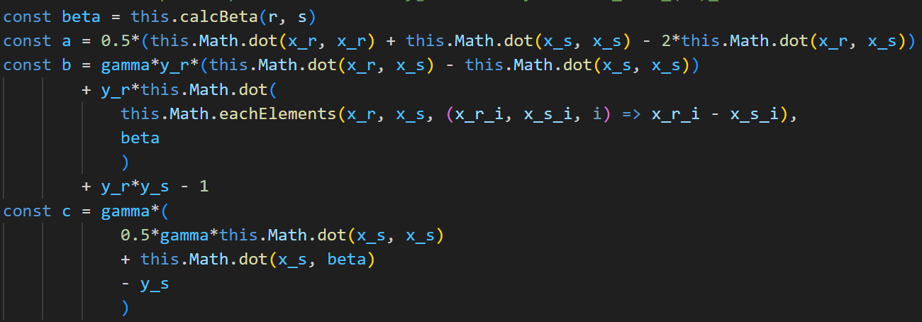
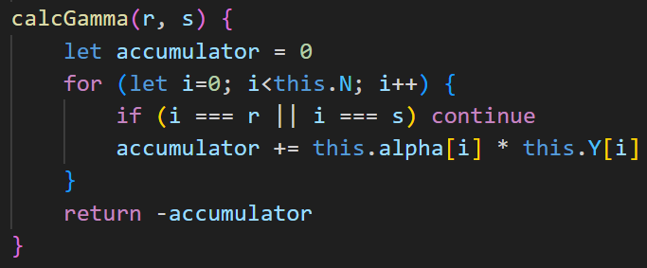
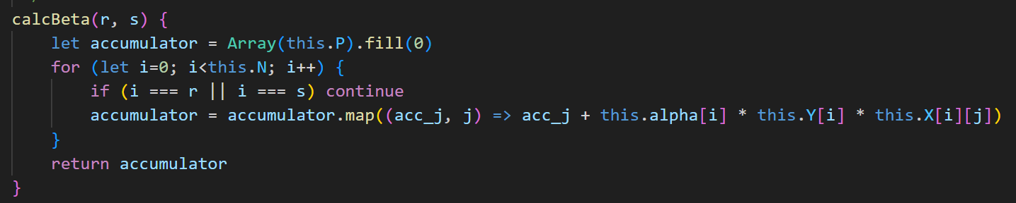
SMO Optimization

Slide 10
Terima Kasih
</> Repository Program

