Slide 1



REAL-TIME CREDIT CARD FRAUD DETECTION
KONGU ENGINEERING COLLEGE
TEAM ID 14
PROJECT MEMBERS:
Bhavani.J 24ADR022
Gokul pranav.N 24ADR048
Adhish.E 24ADR004

Slide 2
PROBLEM STATEMENT
Financial institutions process millions of transactions daily, making fraud detection complex
Fraud types include unauthorized purchases, identity theft, and card cloning
Traditional systems are rule-based and static, lacking adaptability
Existing models treat transactions independently, ignoring sequence patterns
Fraud often occurs as suspicious patterns over multiple transactions
Fraud patterns are constantly evolving, making detection difficult
Data is highly imbalanced, with very few fraud cases
Need for a real-time system to detect fraud instantly
Requirement for high recall (detect maximum fraud) with low false positives

Slide 3
LITERATURE SURVEY
Author / Year | Method Used | Key Idea | Advantages | Limitations
Singh et al., 2024 | LSTM + XGBoost | LSTM for feature extraction, XGBoost for classification | High precision, better performance | Hard deployment, not fully real-time
Patel et al., 2024 | GRU Ensemble | Combines forward-backward learning with GRU | high accuracy | High latency, complex model
Lee et al., 2024 | LSTM | Hyperparameter tuning improves performance | Better accuracy | Requires heavy computation
Ali et al., 2024 | GRU/LSTM | Efficient sequential fraud detection | Solves imbalance | Slightly less powerful for long sequences
Chen et al., 2023 | LSTM | Focuses on important transactions | Improved accuracy | Increased complexity
Kumar et al., 2023 | LSTM/GRU | RNN classifies fraud | Supports real-time processing | Complex deployment

Slide 4
OBJECTIVES
Develop a real-time credit card fraud detection system
Analyze customer transaction sequences instead of individual transactions
Capture temporal patterns and behavioral changes using deep learning models
Implement and compare LSTM, GRU and Transformer architectures
Generate a fraud probability score for each transaction
Achieve high recall (detect maximum fraud cases)
Minimize false positives to avoid inconvenience to customers
Handle class imbalance using appropriate techniques (weighted loss / focal loss)
Evaluate model performance using ROC-AUC, Precision-Recall and Confusion Matrix
Build a scalable and deployment-ready real-time prediction system\

Slide 5
PROPOSED WORK
Collect and preprocess customer transaction data
Sort transactions and create sequential sliding windows
Perform feature engineering (time gap, amount, location, merchant)
Train LSTM, GRU models
Handle class imbalance using weighted or focal loss
Evaluate using ROC-AUC, Precision-Recall and Recall
Generate fraud probability score for each transaction
Develop a real-time fraud detection and alert system

Slide 6
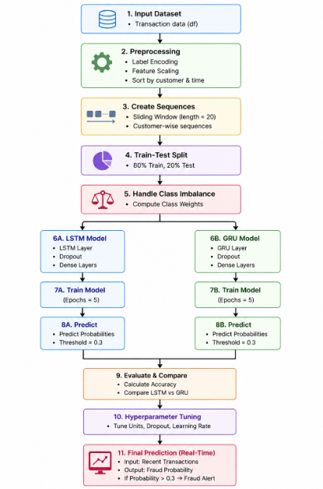
FLOW DIAGRAM

Slide 7
DATASET DESCRIPTION
Features Included
step ,customer ,age ,gender ,zipcodeOri ,Merchant ,zipMerchant ,category ,amount ,fraud
Dataset Description
Dataset Name: Transaction Fraud Detection Dataset
Total Records: 594,643 transactions
Total Features: 10 attributes
Performance Metrix:
Accuracy – Measures the overall correctness of the model predictions.
Recall – Measures how many actual fraud cases are correctly detected.
Precision – Measures how many predicted fraud transactions are actually fraud.
F1-Score – Harmonic mean of Precision and Recall.
ROC-AUC Score – Evaluates the model’s ability to distinguish between fraudulent and genuine

Slide 8
TECHNIQUES/ TOOLS USED
Hardware Requirements
Processor: Intel i5 / i7 or higher
RAM: Minimum 8 GB (16 GB recommended)
Storage: 256 GB SSD or higher
GPU (Optional): NVIDIA GPU (for faster deep learning training)
Software Requirements
Operating System: Windows / Linux / macOS
Programming Language: Python (3.8 or above)
Development Tools: Jupyter Notebook / Google Colab / VS Code
Libraries & Frameworks: NumPy, Pandas,Scikit-learn,TensorFlow / PyTorch

Slide 9
MODULE DESCRIPTION
Data Collection: Gather customer and transaction data
Preprocessing: Clean, encode and normalize data
Feature Engineering: Extract patterns like time gap and spending behavior
Sequence Generation: Create ordered transaction sequences
Model Training: Train LSTM, GRU, Transformer models
Evaluation: Measure performance using key metrics
Prediction: Generate fraud probability for new transactions
Alert System: Flag and notify suspicious transactions

Slide 10
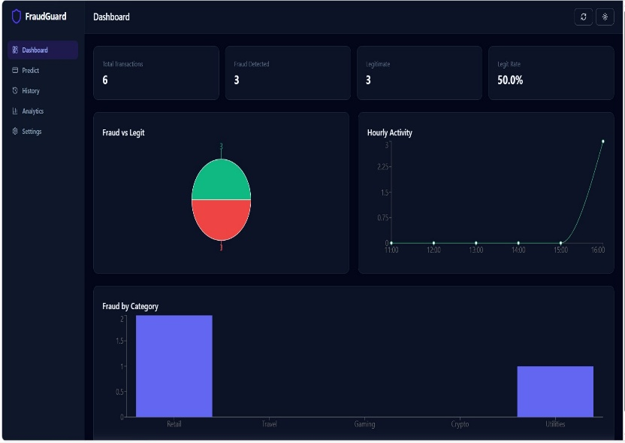
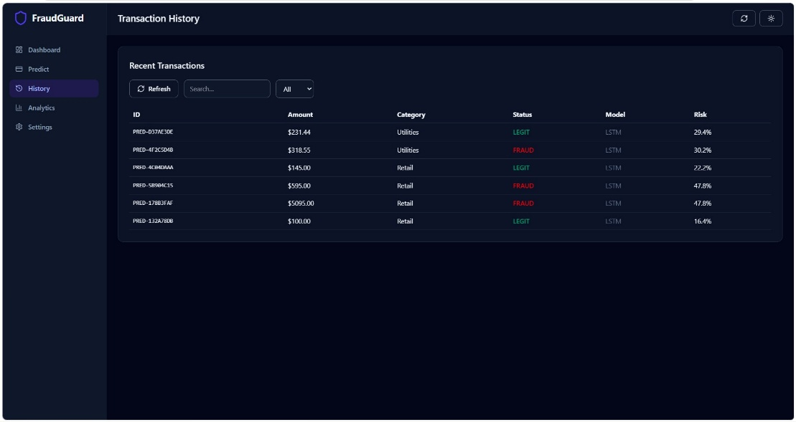
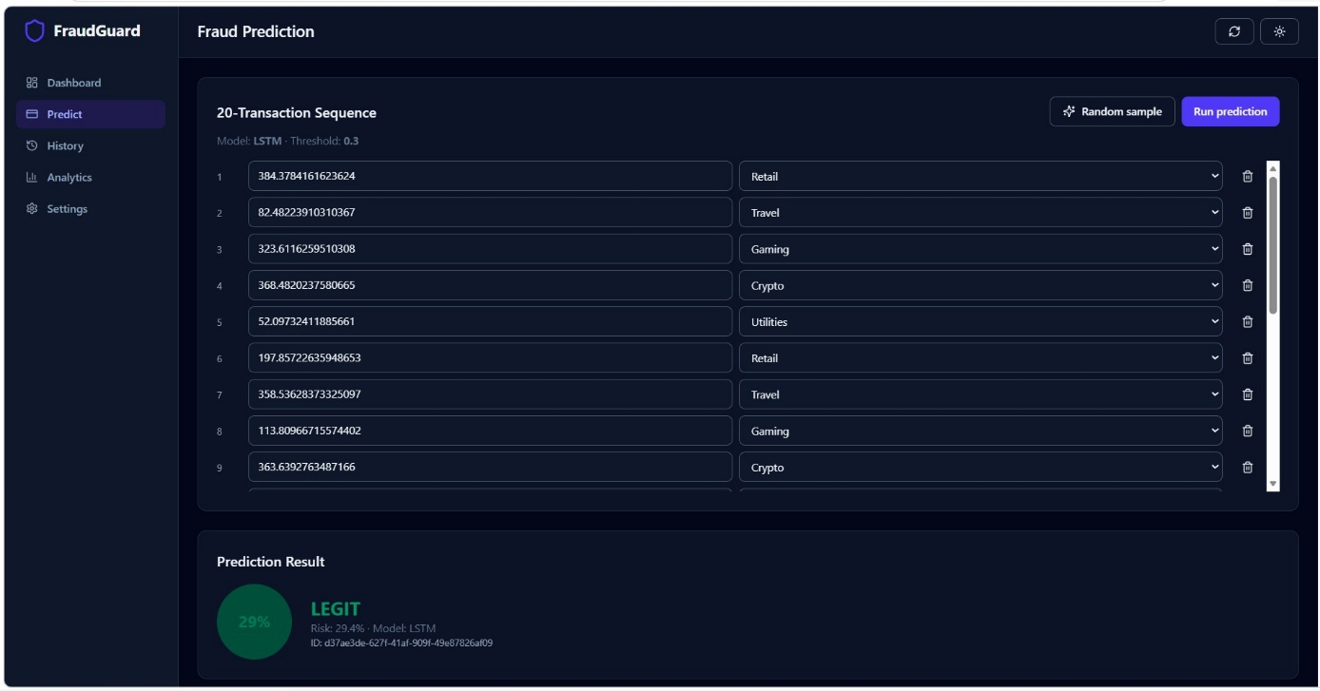
SCREENSHOT

Slide 11
CONCLUSION
Sequential models improve fraud detection by capturing transaction patterns over time
LSTM, GRU effectively identify complex fraud behavior
System achieves high recall, detecting maximum fraud cases
Reduces false positives, improving customer experience
Enables real-time fraud prediction and alert system
More effective than traditional rule-based and static ML models
Helps banks reduce financial losses and enhance security
Provides a scalable and deployment-ready solution

Slide 12
REFERENCES
Bhattacharyya, S., Jha, S., Tharakunnel, K., & Westland, J. C. (2011). Data mining for credit card fraud: A comparative study. Decision Support Systems.
Dal Pozzolo, A., Caelen, O., Johnson, R. A., & Bontempi, G. (2015). Calibrating Probability with Undersampling for Unbalanced Classification. IEEE Symposium on Computational Intelligence.
Jurgovsky, J., Granitzer, M., Ziegler, K., et al. (2018). Sequence classification for credit-card fraud detection. Expert Systems with Applications.
Roy, A., Sun, J., Mahoney, M., et al. (2018). Deep learning detecting fraud in credit card transactions. IEEE Big Data.
Vaswani, A., et al. (2017). Attention Is All You Need. Advances in Neural Information Processing Systems (NeurIPS).

Slide 13
THANK YOU

