Slide 1



Multi Class Animal Recognition for wildlife conservation using AI
Name: Angothu Adhisheshu
AICTE Internship Student Registration ID: STU679b74f8cf4971738241272

Slide 2

Learning Objectives
Apply Convolutional Neural Networks for Animal Recognition: Understand and implement CNN architectures for accurate identification of animal species from image data.
Gain Proficiency in MobileNetV2: Explore the lightweight and efficient MobileNetV2 model and leverage it for transfer learning in image classification tasks.
Develop a Multi-Class Classification Model: Build and train a deep learning model capable of recognizing 90 distinct animal classes from visual input.
Evaluate Model Performance: Analyze the model's accuracy and classification metrics to assess its effectiveness in multi-class recognition.
Understand Real-World Applications: Recognize the impact of animal recognition models in conservation, ecological monitoring, and wildlife surveillance.
Bridge AI with Environmental Sustainability: Explore how AI-powered classification can support biodiversity studies, anti-poaching efforts, and sustainable wildlife management.
GOAL
Source :
www.freepik.com/

Slide 3
Tools and Technology used
Programming Language – Python: Python was used for its simplicity and powerful ecosystem in machine learning and deep learning applications.
Framework – TensorFlow & Keras: TensorFlow and its high-level API Keras were used to design, train, and evaluate the convolutional neural network efficiently.
Pretrained Model – MobileNetV2: MobileNetV2, a lightweight and high-performance CNN model, was used for transfer learning to enhance classification accuracy.
Development Environment – Google Colab: Google Colab provided a cloud-based, GPU-enabled platform for training and experimenting with deep learning models.
Dataset Source: Animal Image Dataset (90 Classes) – Kaggle
link: https://www.kaggle.com/datasets/iamsouravbanerjee/animal-image-dataset-90-different-animals/data
Additional Tools: Libraries such as NumPy, Matplotlib, and scikit-learn were used for data manipulation, visualization, and performance evaluation.

Slide 4
Methodology
Data Collection: Collected a comprehensive dataset of animal images spanning 90 different species from Kaggle’s open-source repository.
Data Preprocessing: Resized images, normalized pixel values, and applied data augmentation techniques to enhance model generalization.
Model Selection: Chose the MobileNetV2 pretrained architecture for its efficiency and accuracy in image classification tasks.
Model Training: Trained the network using labeled image data, applying transfer learning and fine-tuning on top layers for optimal performance.
Model Evaluation: Evaluated model performance using metrics such as accuracy, precision, recall, and confusion matrix to validate classification strength.
Model Testing: Tested the final model on unseen data to confirm its ability to accurately classify animal images in real-world scenarios.

Slide 5
Problem Statement:
The increasing threat to biodiversity calls for advanced systems that can assist in wildlife conservation and monitoring. Traditional methods of species identification are time-consuming and prone to error.
Monitor Wildlife Through Automated Detection: Utilize image-based recognition to support real-time animal monitoring in natural habitats.
Support Extinction Surveillance: Enable the early identification of endangered species to help track and protect them.
Accurately Categorize 90 Animal Species: Build a robust classification model capable of distinguishing between 90 unique animal classes using visual input.

Slide 6
Solution:
Adopted MobileNetV2 Architecture: Utilized the MobileNetV2 pretrained model, known for its balance of performance and computational efficiency.
Trained on 90 Animal Classes: Fine-tuned the model to accurately recognize and classify 90 different animal species from the dataset.
Achieved Strong Classification Performance: The model demonstrated effective learning and accurate predictions, validated through evaluation metrics.
Optimized for Mobile and Edge Devices: Due to its lightweight architecture, the model is suitable for deployment in resource-constrained environments like mobile apps or field sensors.

Slide 7
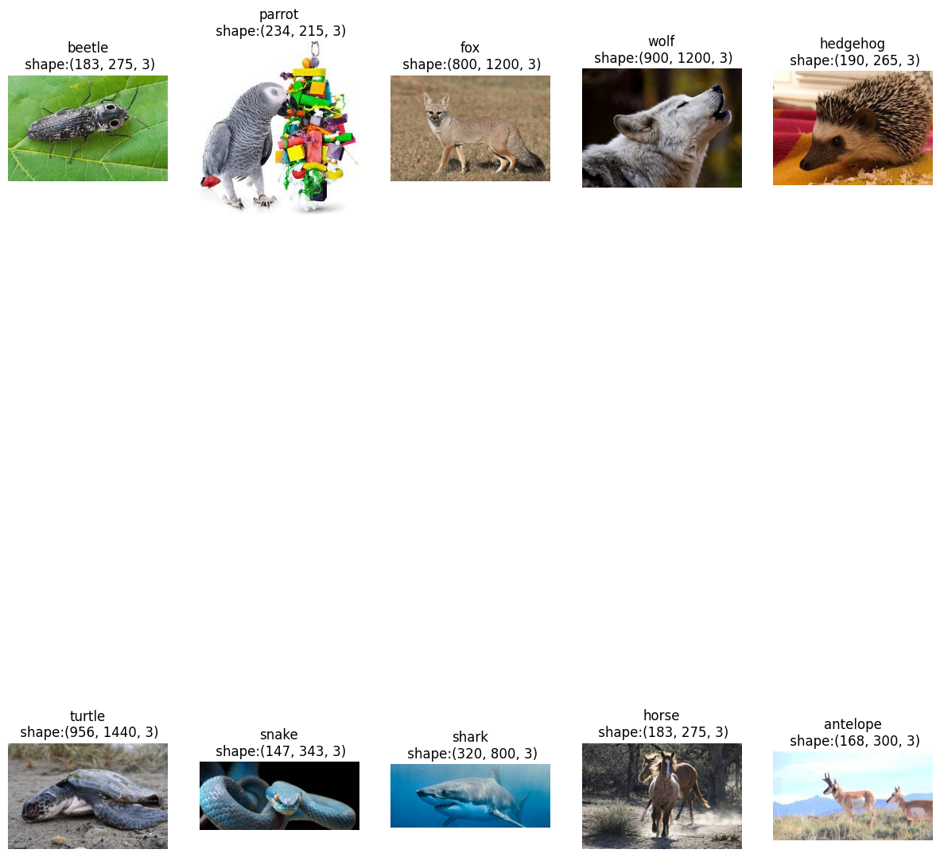
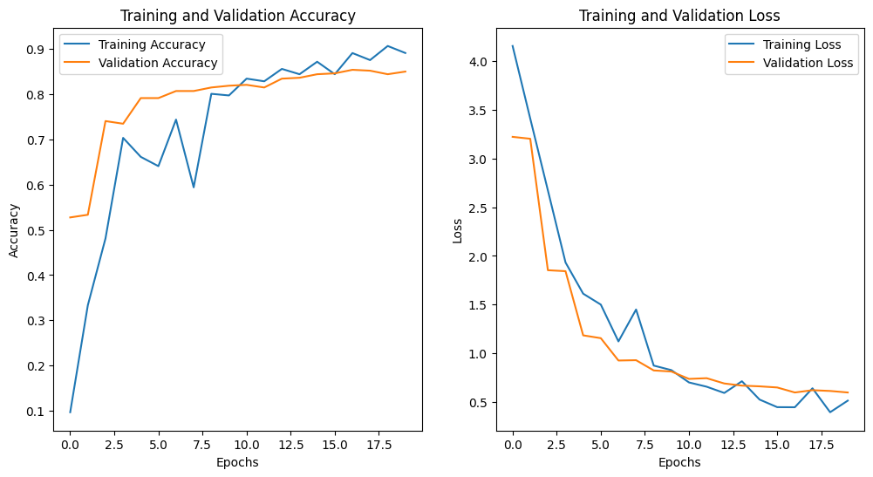
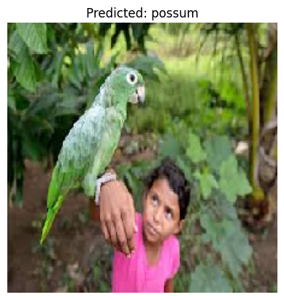
Screenshot of Output:

Slide 8
Conclusion:
In this multi-class animal classification project, we developed a machine learning model capable of classifying images of animals into distinct categories. By using a dataset with multiple classes (e.g., mammals, birds, reptiles, etc.), we implemented various machine learning techniques, including deep learning models such as Convolutional Neural Networks (CNNs), to achieve classification.
Model Performance: The model showed strong performance on larger and more distinct classes, but struggled with smaller or visually similar classes.
Data Augmentation: Implementing data augmentation techniques helped in reducing overfitting and increasing the robustness of the model.
Challenges: Handling class imbalance and identifying animals with similar features remain areas for improvement.
Future Work: Future improvements could involve using more sophisticated models (e.g., transfer learning with pre-trained networks like ResNet or VGG), incorporating more diverse data, and fine-tuning the model for better performance on challenging classes.
Git hub repository link: https://github.com/Adhisheshu1210/Internships-2025.git

