Slide 1
MongoDB Log Anomaly & Security Monitor
--Angothu Adhisheshu

Slide 2
Project Details
Project Overview
AI-powered real-time monitoring platform for MongoDB logs that automatically detects:
Security threats
Anomalies
Slow queries
Performance issues
Suspicious activities
Users
Admin: Full system control — manage users/roles, settings, model lifecycle, and all data (create/update/delete).
Analyst (User): Investigate and triage alerts, annotate/resolve anomalies, run searches, and request model retraining.
Viewer: Read-only access to dashboards, logs, and alert summaries without modification rights.
Core Features
Real-time log monitoring
AI anomaly detection
NLP-based log classification
Interactive dashboard
Live alerts & notifications
Role-based access control
Docker & Kubernetes deployment
Purpose: Centralized log ingestion, AI-driven anomaly detection, classification, alerting, and dashboarding for security/operational monitoring.
Scope: Ingest logs, store in MongoDB, run ML/NLP models to detect anomalies/classify logs, surface alerts to users via backend APIs and frontend UI, and support notifications and dataset management.

Slide 3


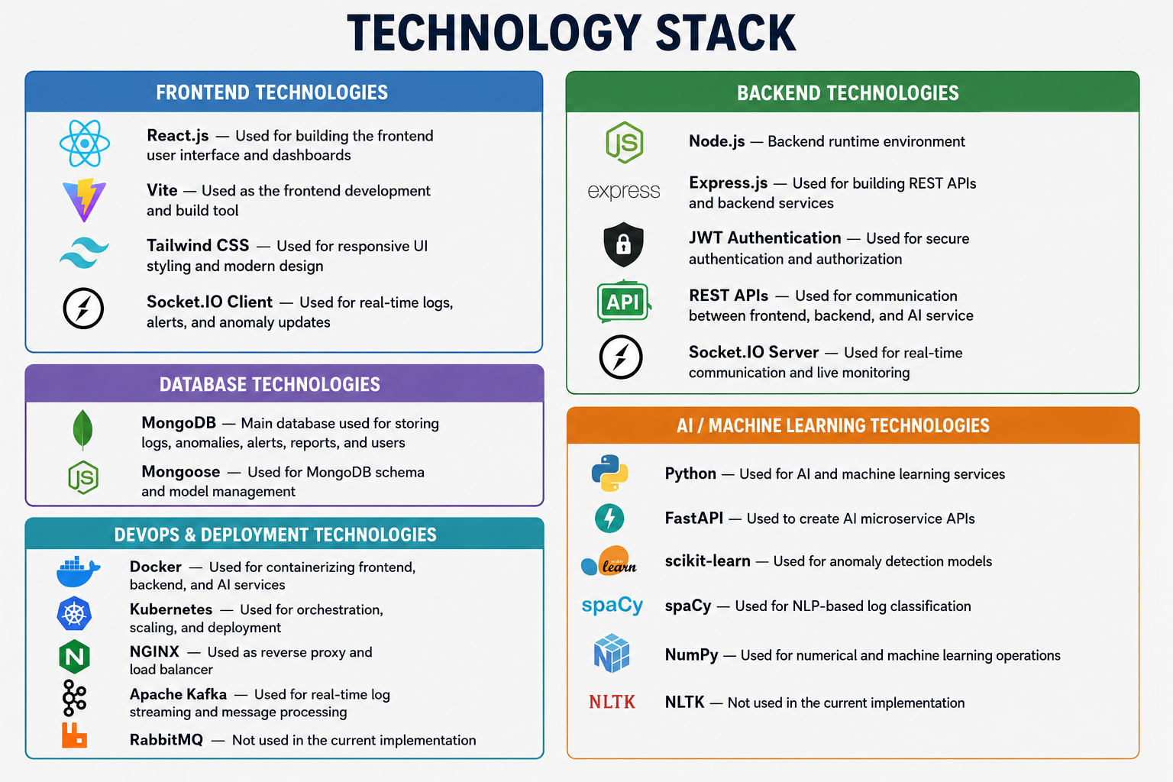
Technology Stack
Frontend:
React.js — Used for building the frontend user interface and dashboards
Vite — Used as the frontend development and build tool
Tailwind CSS — Used for responsive UI styling and modern design
Socket.IO Client — Used for real-time logs, alerts, and anomaly updates
Backend:
Node.js — Backend runtime environment
Express.js — Used for building REST APIs and backend services
JWT Authentication — Used for secure authentication and authorization
REST APIs — Used for communication between frontend, backend, and AI service
Socket.IO Server — Used for real-time communication and live monitoring
Database:
MongoDB — Main database used for storing logs, anomalies, alerts, reports, and users
Mongoose — Used for MongoDB schema and model management
AI / Machine Learning:
Python — Used for AI and machine learning services
FastAPI — Used to create AI microservice APIs
scikit-learn — Used for anomaly detection models
spaCy — Used for NLP-based log classification
NumPy — Used for numerical and machine learning operations
NLTK — Not used in the current implementation
DevOps & Deployment:
Docker — Used for containerizing frontend, backend, and AI services
Kubernetes — Used for orchestration, scaling, and deployment
NGINX — Used as reverse proxy and load balancer
Apache Kafka — Used for real-time log streaming and message processing
RabbitMQ — Not used in the current implementation
Technology Flow:
MongoDB Logs
↓
Kafka Streaming
↓
Python AI Service
↓
Anomaly Detection & NLP
↓
MongoDB Storage
↓
Node.js Backend APIs
↓
Socket.IO Real-Time Events
↓
React Dashboard

Slide 4
How & Where MongoDB and AI are Used?
MongoDB Usage
MongoDB is the main database used in the project
Stores:
Raw MongoDB logs
Processed log data
Detected anomalies
Alerts & notifications
User details and settings
SIEM training datasets
MongoDB helps with:
Real-time log storage
Fast data retrieval
Historical log analysis
Scalable high-volume data handling
AI Usage
AI service is built using Python + FastAPI
AI analyzes MongoDB logs in real time
AI Components
anomaly_detector.py
Detects unusual activities and anomalies
Uses Isolation Forest & LOF algorithms
log_classifier.py : Uses NLP to classify logs
Identifies:
Security threats
Slow queries
Authentication failures
Replication errors
log_processor.py
Parses and converts raw logs into AI-ready features

Slide 5
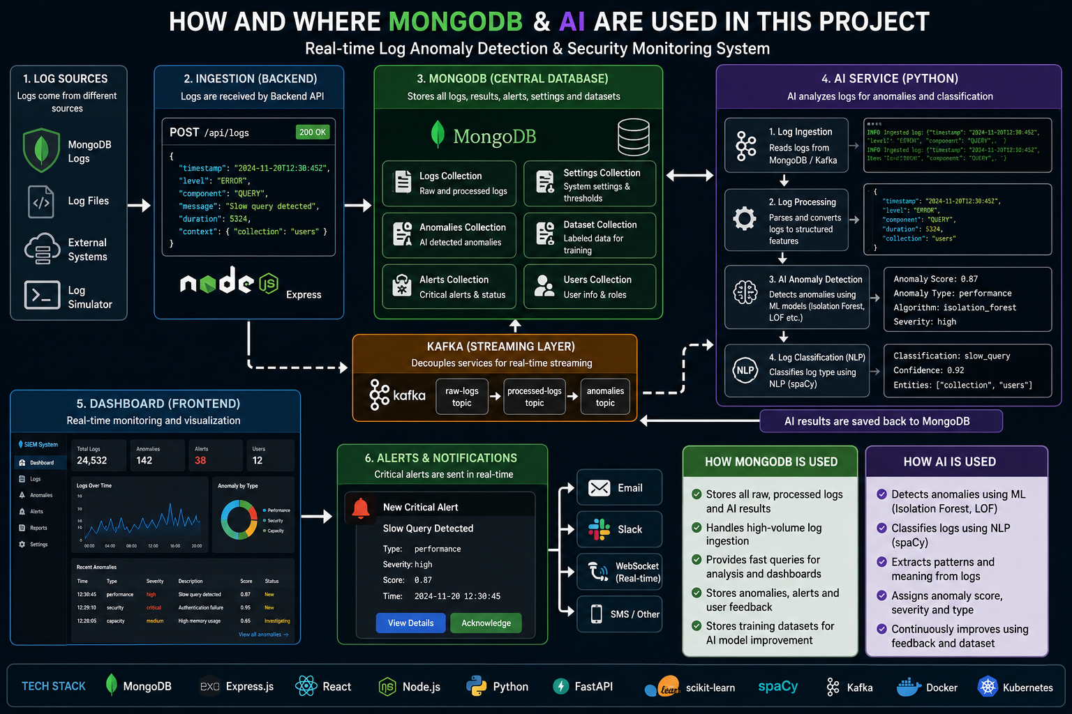

Slide 6
Problem Statement & Solution
Problem Statement:
MongoDB generates huge volumes of logs continuously, making manual monitoring difficult
Logs are noisy, complex, and contain mixed information from security, performance, and operational events
Detecting real security threats and meaningful anomalies with low false-positive rates is challenging
Critical incidents such as unauthorized access, slow queries, and replication failures may go unnoticed
Operators need fast alerting, contextualized monitoring, and an auditable incident history
AI/ML models require quality labeled datasets and historical logs for accurate detection and retraining
System Flow
Proposed Solution:
MongoDB Log Anomaly & Security Monitor
Collects MongoDB logs in real time through ingestion pipelines
Uses AI & NLP models to preprocess, classify, and analyze logs
Detects anomalies, suspicious activities, and performance issues automatically
Stores raw logs, processed data, anomalies, and alerts in MongoDB
Provides real-time dashboards and live alerts using React and Socket.IO
Supports notifications through Email, Slack, Telegram, and in-app alerts
Uses feedback and labeled datasets stored in MongoDB to continuously improve AI models
Log Ingestion
↓
MongoDB Storage
↓
AI Processing & NLP Analysis
↓
Anomaly Detection
↓
Alert Generation
↓
Backend APIs
↓
React Dashboard & Notifications
↓
Feedback & Model Improvement

Slide 7
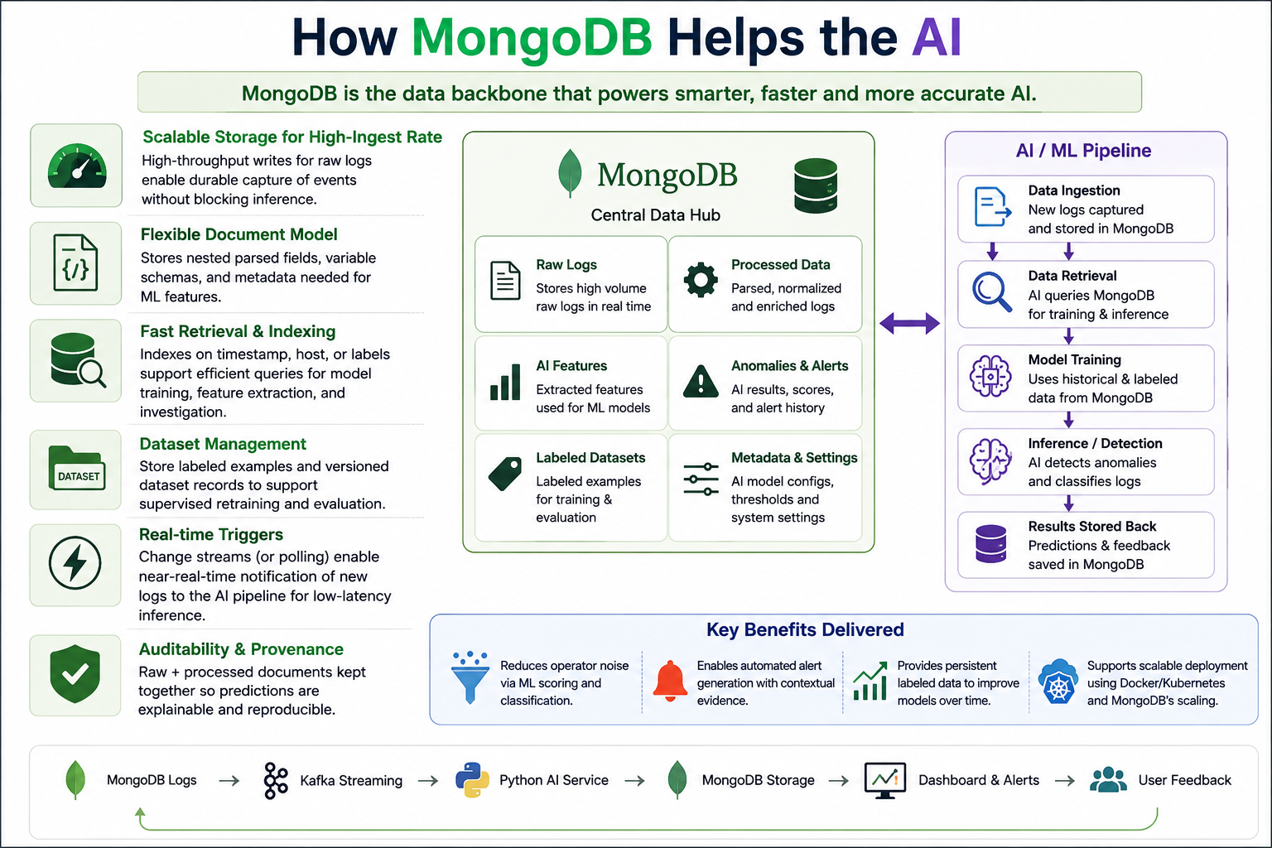
How MongoDB Helps the AI

Slide 8
Future Enhancements
Add Cloud Platform Integrations:
AWS CloudWatch
Azure Monitor
Google Cloud Logging
Implement AI Feedback Learning:
Users can label alerts
Continuous AI model improvement
Better anomaly detection accuracy
Improve Scalability & Performance:
Kubernetes auto-scaling
Distributed Kafka streaming
MongoDB sharding
Build Advanced Analytics Dashboard:
Predictive insights
Threat trend analysis
Security heatmaps
Implement Advanced AI Models:
LSTM
Transformers
Deep Learning models
Integrate MongoDB Atlas Vector Search for:
Similarity detection
Root cause analysis
Add Explainable AI Features:
Feature importance
Prediction explanations
AI confidence analysis
Extend Multi-Database Support:
MySQL
PostgreSQL
Redis

Slide 9
THANK YOU

