Slide 1
Introduction
Embark on a journey of innovation and skill-building as we delve into the exciting realm of Web development. Our internship is not just about lines of code; it's about crafting digital experiences. Let's navigate through three captivating projects that will elevate your skills and immerse you in the dynamic world of technology.
Projects Overview:
Live Language Translator: Revolutionize communication through real-time language translation. Dive into HTML, CSS, and JS to create an app that transcends linguistic barriers.
Basic Text Editor: Unleash your creativity! Build a responsive and user-friendly text editor using HTML/CSS and JS. Learn to enhance the writing experience for users.
Expense Tracker: Explore the synergy of ReactJS and Node.js in developing a comprehensive expense tracker. Gain hands-on experience in full-stack development and financial management.

Slide 2
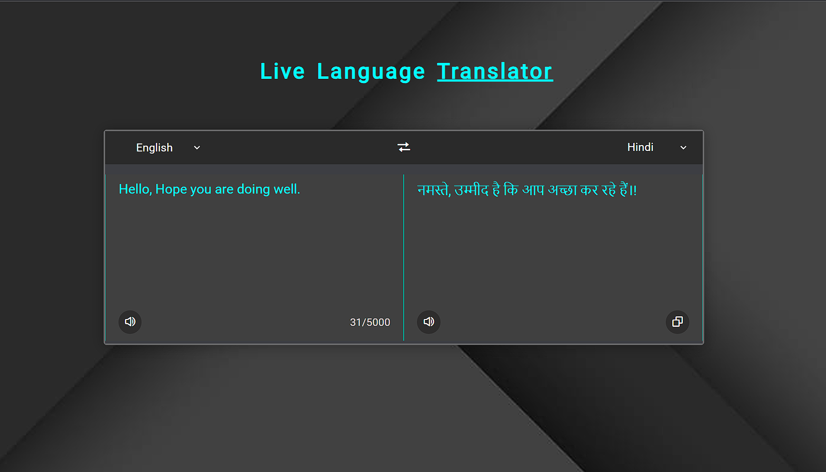
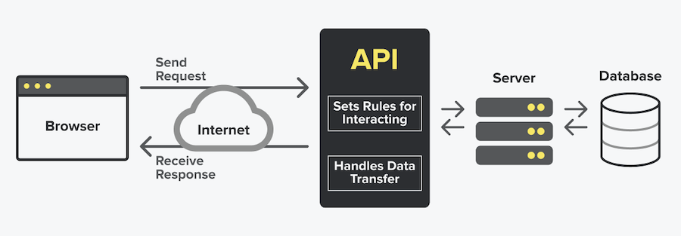
Live Language Translator
App for real-time language translation.
Breaking communication barriers
Key Features : Real-time text translation and Text-to-Voice translation .
Technology Used : HTML/CSS , Javascript , RapidAPI.

Slide 3
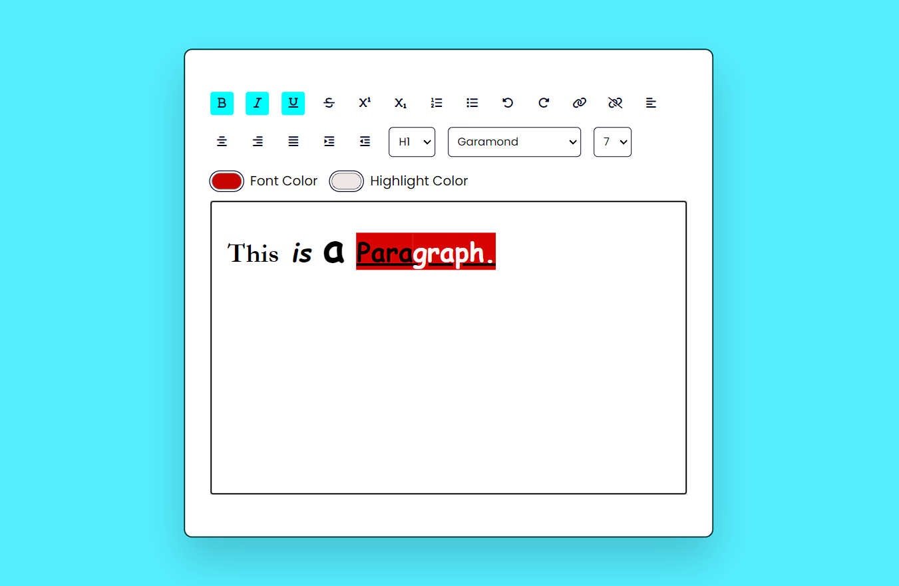
Basic Text Editor
A versatile text editor simplifying writing tasks with intuitive features and user-friendly interface
Content
Key Features : Rich text editing, collaboration features, and cross-platform compatibility for seamless writing experiences
Technologies Used : HTML/CSS , Javascript.

Slide 4
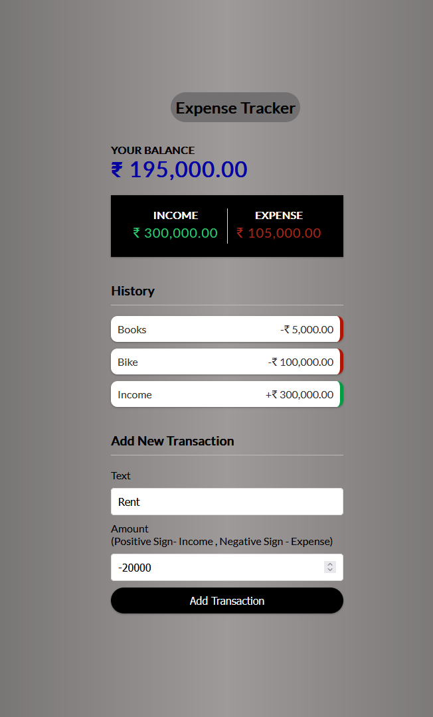
Expense Tracker
An efficient expense tracker app simplifying financial management with intuitive features and insightful analytics.
Budget tracking, expense categorization, and data visualization for effective financial planning and management.
Key Features : Add and Delete Transactions and Keep the history of your Transactions.
Technologies Used : ReactJS , Node.js , CSS .

Slide 5
CONCLUSION
HTML, CSS, JS Mastery:
Proficiently utilized HTML, CSS, and JavaScript to craft visually appealing and interactive web pages.
ReactJS Basics:
Developed Basics in ReactJS for creating dynamic user interfaces, enhancing the overall user experience.
NODE.js Basics:
Acquired Basics of in NODE.js, enabling the creation of efficient and scalable server-side applications.
Full-Stack Capability:
Integrated ReactJS and NODE.js to achieve full-stack capability, building comprehensive web solutions.
Basics of Web Development:
Gained foundational knowledge in web development, providing a solid understanding of key concepts and practices.

Slide 6

Slide 6: References
Title: References
Content
List of references in IEEE format, including books, book chapters, journal articles, and conference proceedings
Author
Example: W.K. Chen
Author
Example: J.E. Bourne
Author
Example: G. Pevere
Author

