Slide 1
Employee Data Analysis using Excel
STUDENT NAME: ADHILAKSHMI S
REGISTER NO: 312216898
DEPARTMENT: B.COM (GENERAL)
COLLEGE : SHRI KRISHNASWAMY COLLEGE FOR WOMEN

Slide 2
PROJECT TITLE
EMPLOYEE PERFORMANCE ANALYSIS USING EXCEL

Slide 3


AGENDA
Problem Statement
Project Overview
End Users
Our Solution and Proposition
Dataset Description
Modelling Approach
Results and Discussion
Conclusion
3/21/2024 Annual Review

Slide 4

PROBLEM STATEMENT
•We have to track the performance of employees work motive for the organization and So that we can completely focus on the growth and structure of the organization and also to develop their personal skills and talents.
•We have to motivate the best and executive employees with increments, promotion and bonus.
•We have to train and motivate the under developed employees in a and effective manner with proper specifications.

Slide 5

PROJECT OVERVIEW
.
EMPLOYEE DATA ANALYSIS
Analysing the performance of the employees by considering the various factors like Gender, Performance score , Ratings and their Achievements , in order to identify the trends and patterns of different categories of employees like high, medium and low.

Slide 6

WHO ARE THE END USERS?
HR Business Partners: To inform talent management decisions and ensure fair and competitive compensation practices.
Compensation Analysts : To analyze and interpret compensation data, identify trends, and make recommendations.
Finance Team: To inform budgeting and financial planning decisions related to salaries, bonuses, and benefits.
Management and Leadership: To make strategic decisions about talent acquisition, retention, and development.
Employees: Indirectly, as the project aims to ensure fair and equitable compensation practices, which can impact employee satisfaction and engagement.

Slide 7

OUR SOLUTION AND ITS VALUE PROPOSITION
CONDITIONAL FORMATTING – TO IDENTIFY THE MISSING DATA FILTER – FOR THE PURPOSE OF REMOVING THE UNWANTED DATA.
FORMULA- FOR IDENTIFYING THE PERFORMANCRE THE EMPLOYEES.
PIVOT TABLE - TO CONVERT THE DATA INTO SHORT SUMMARY . GRAPH – DATA VISUALIZATION

Slide 8
Dataset Description
EMPLOYEE = KAGGLE 26- FEATURES 9- FEATURES EMPLOYEE – ID – NUMERICAL VALUES.
NAME – TEXT
EMPLOYEE TYPE
PERFORMANCE LEVEL GENDER – MALE , FEMALE EMPLOYEE RATING – NUMERICAL VALUES

Slide 9

THE "WOW" IN OUR SOLUTION
PERFORMANCE LEVEL=IFS(Z8>=5,"VERY HIGH“,Z8>=4, "HIGH",Z8>=3,"MEDIUM",TRUE,"LOW"
3/21/2024 Annual Review
9

Slide 10
MODELLING
DATA COLLECTION
➢Downloaded the employee data performance from EDUNET DASHBOARD
FEATURE COLLECTION
➢Identified each features
➢ Add Performance Level Feature
DATA CLEANING
➢Identified the missing values.
➢Filtered the missing values.
PERFORMANCE LEVEL
➢Using formula =IFS(Z8>=5,”VERY HIGH”,Z8>=4,”HIGH”,Z8>=3,”MED”,TRUE,”LOW”)
SUMMARY
➢PIVOT TABLE
➢PIE CHART
VISUALIZATION
➢Graph
➢ Pie chart
10

Slide 11
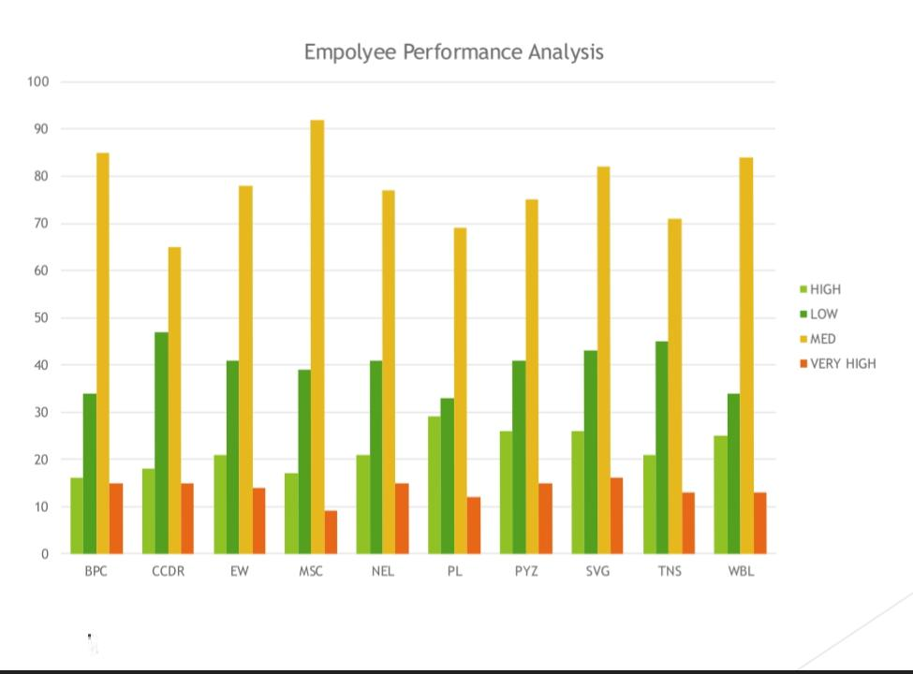
RESULTS
11

Slide 12
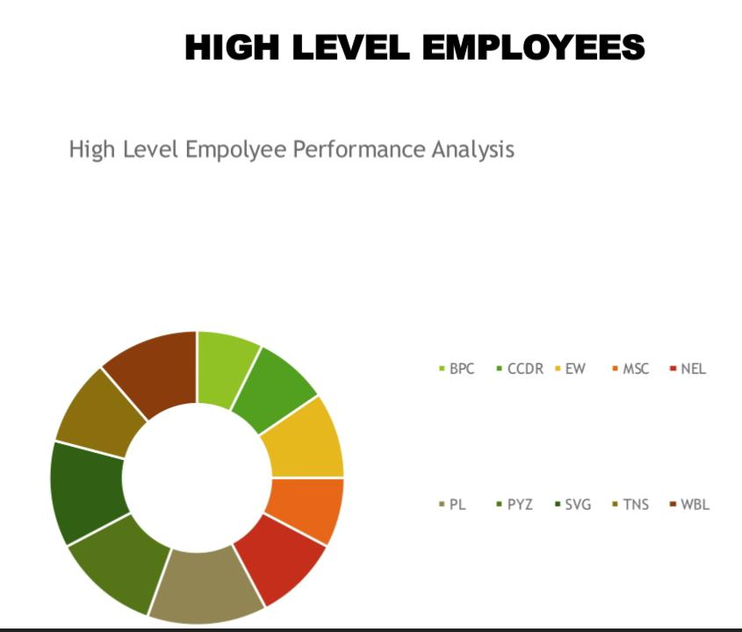
RESULTS

Slide 13
conclusion
EMPLOYEE PERFORMANCE ANALYSIS
•BY COMPARING THE PERFORMANCE OF THE EMPLOYEES. THE EMPLOYEES ARE HIGHER IN NUMBER. THERE ARE MORE PEOPLE IN AVERAGE LEVEL EMPLOYEES.
•WE HAVE TO MOTIVAYE THE EMPLOYEES TO DEVELOP THEIR SKILLS AND TALENTS TO ACHIEVE THE ORGANISATIONAL GOALS AND OBJECTIVES TO REACH THE PLACE OF HIGH LEVEL PERFORMANCE TO SUSTAIN THE GOALS AND TARGETS.
•WE HAVE TO TRAIN AND DEVELOP THE EMPLOYEES WITH BETTER OUTCOME TOREACH THE ORGANISATIONAL GOALS.

