Slide 1
Face Mask and Social Distance Detection for COVID Protocol Automation
BY:
P. ADHITHAN CB.EN.U4AIE19003
N. KABILAN CB.EN.U4AIE19033

Slide 2
ABOUT NEON CYBER MONDAY INFOGRAPHICS
This template contains an assortment of complementary infographic resources for the Neon Cyber Monday presentation.
These infographics are adapted to the style of the aforementioned presentation, so you can insert them easily and have them completely integrated at once. You just need to do the following:
Select the element that you want to copy
Right-click and choose “Copy”
Go to the slide where you want the element to appear
Right-click and choose “Paste”

Slide 3
NEON CYBER MONDAY INFOGRAPHICS
OBJECTIVE
METHODOLOGY
FUTURE WORKS
CONCLUSION
Problem Statement
FACE MASK DETECTION
SOCIAL DISTANCE DETECTION
?

Slide 4
OBJECTIVE
To enforce social distancing and facemask detection.
The face mask detection model and the estimation of distance between people have been combined to give the user a risk level based on the parameters.
If a person is alone and not wearing a mask then it will be No Risk.
If more than one person:
If both are apart and wearing a mask then it will be Low Risk
If both are near and wearing a mask then it will be Risk
If both are apart and not wearing a mask then it will be Risk
If both are near and not wearing a mask then it will be High Risk

Slide 5
METHODOLOGY
FACE MASK DETECTION
Face Detection
SSD Basic Architecture
Face Mask Classification
Data Preprocessing
MobileNetV2
SOCIAL DISTANCE DETECTION
Person Detection
Distance Computing
JOINING FACE MASK DETECTION and SOCIAL DISTANCE DETECTION

Slide 6
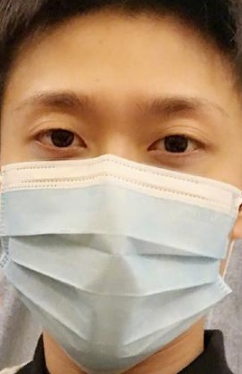
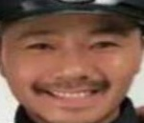
FACE MASK DETECTION
Dataset Details :
The dataset consists of 4092 images.
With Mask : 2162 images
Without Mask : 1932 images
Additional data augmentation is done on the following parameters :
Rotation range = 40
zoom range = 0.2
width shift range = 0.3
height shift range = 0.3
shear range = 0.2
horizontal flip = True
brightness range = (0.5, 1.5)
Data Preprocessing:
With Mask
Without Mask

Slide 7
METHODOLOGY
- FACE MASK DETECTION
PART 1
Load Face Mask dataset
Train Face Mask Detector using MobileNet V2
Face Mask Classifier Model
PART 2
Bounding Box locations of faces present
Face Mask Classifier Model
(Part 1)
Input Frame
Face Detection using DNN
Mask or No Mask for each faces

Slide 8
METHODOLOGY
- SOCIAL DISTANCE DETECTION
Bounding Box locations of faces present
Finding centroids
(for each boxes)
Input Frame
Face Detection using DNN
Centroids for boxes Respectively
Threshold
Near and Not Near for faces Respectively
Green and Red Boxes for respective distances
Finding Violating Points
Finding Euclidean distance
(from each centroid)

Slide 9
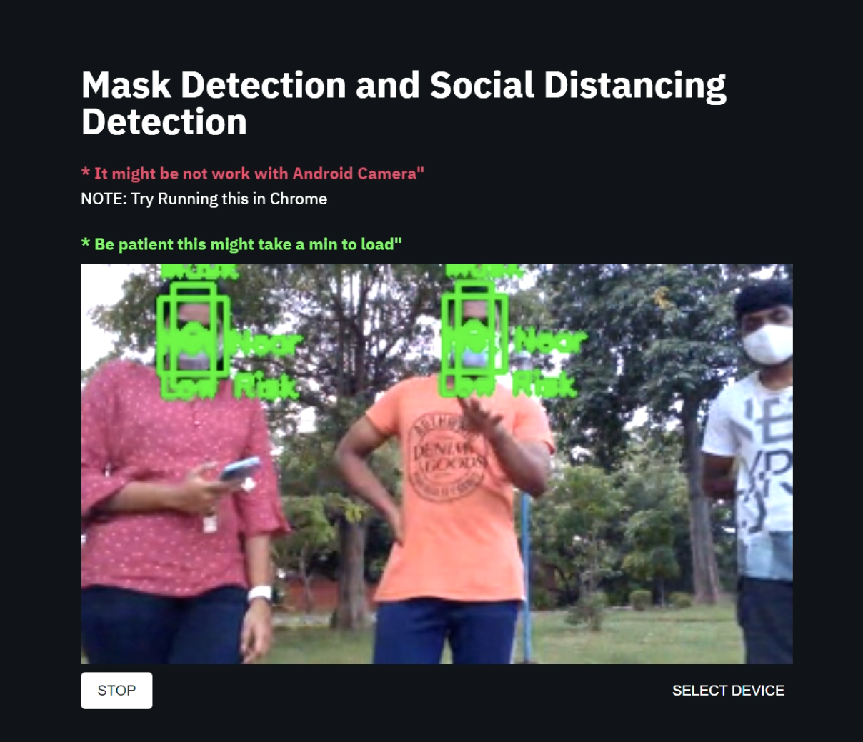
WEB APP:
This Algorithm is Deployed using streamlit package.
This App is deployed on streamlit share and hosted publicly on GitHub.
Link for Web App
https://share.streamlit.io/kabilan-n/face-detection-and-social-distancing/main/Streamlit/mask_det_app.py

Slide 10
What we learnt :
Gained knowledge on how to deploy an end to end model with the help of streamlit services.
Application of mathematics in real life problems (Euclidean distance is used to find distance between people)
Deep Neural Networks. In this case we learned about mobilenet which uses depth-wise separable convolutions.
Use of pre trained weights of ImageNet to further improve accuracy of our model using Transfer Learning.
Reducing the number of processes or workload on the system.
It is not necessary to always build or train a model in order to make a prediction, in the case of finding distance between two people, no model is used.

Slide 11
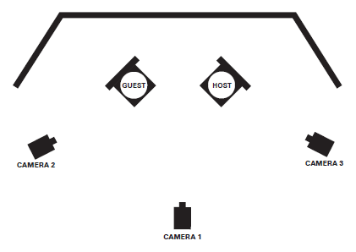

Future Work :
Deployment of the complete model using multiple cameras at different locations, to obtain inputs from different directions.
Notifying the person captured in the camera (Access to public database is needed), as well as authorities.
Using heat sensors to detect a relation between the temperature and the known factors to provide a more accurate risk value.
With the knowledge of risk in various areas, creating a path or a route that has the least risk possible.

Slide 12
Links :
Web App
https://share.streamlit.io/kabilan-n/face-detection-and-social-distancing/main/Streamlit/mask_det_app.py
Web App Github page
Face-Detection-and-social-Distancing/Streamlit at main · Kabilan-n/Face-Detection-and-social-Distancing · GitHub
IPYNB file
https://github.com/Adhithan007/Mask-Detection-and-Social-Distancing/blob/main/mask_distance.ipynb
Test Video:
https://drive.google.com/file/d/14AMs4ockT6Cp-Q5bevdXSYH_GDgLqb9x/view?usp=sharing

Slide 13
Thank You

