Slide 1
Gradient Ai Hackathon Team – Runtime errors
AI-Powered Smart Saving Planner:
Team Members
Suraj Sreedhara
Adhithi C Iyer
Yashaswini K C
Zeenat Khan

Slide 2
Problem Statement
To create an AI-Powered Smart Saving Planner, a web-based application designed to assist users in managing their finances effectively. The platform includes:
Expense Tracker: Enables users to log their daily expenses, track loans taken or given, and visualize their financial data through dynamic pie charts, providing a clear understanding of their spending patterns.
Savings Planner: Features an AI-driven chatbot that users can interact with to receive tailored financial advice. The chatbot, trained on financial data, will provide actionable insights, such as evaluating the feasibility of discretionary spending (e.g., vacations) based on the user’s financial situation and goals.
This solution aims to simplify financial planning by merging intuitive expense tracking with intelligent, personalized savings recommendations, empowering users to make informed decisions and achieve their financial goals.

Slide 3
Tech stack
Frontend:
HTML/CSS/JavaScript
React.js
Chart.js or D3.js
Bootstrap or Tailwind CSS
Backend:
Node.js with Express.js (or Python with Flask/Django)
PostgreSQL or MySQL
Redis (optional)

Slide 4
AI Model for predictions
Pandas: For data loading and preprocessing.
Scikit-Learn: For machine learning model development (RandomForestRegressor).
Flask: Web framework to create the user interface and handle input-output requests.
Jinja2: Templating engine used to render dynamic content in HTML.

Slide 5
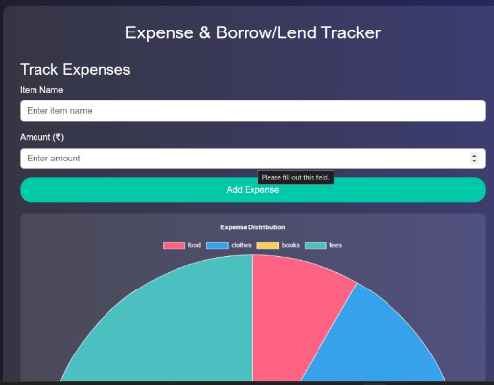
Work Done:-
This layout is for a dual-purpose expense and borrow/lend tracking web application. The goal is to provide a visually appealing and user-friendly interface for users to input and manage their financial data, such as daily expenses and money borrowed or lent, while also visualizing the data using pie charts.
Purpose:
This layout is designed for Financial Management: Users can easily record and review their financial activities.
Data Visualization: Pie charts make it easier to analyse spending patterns and money flow at a glance.
Interactive User Experience: Modern aesthetics and animations ensure the application is enjoyable to use while maintaining functionality.

Slide 6
How It Works:
Data Preparation:
Dataset: We use a CSV file (realdata.csv) containing financial data with columns like Income, Rent, Grocery, Travelling, Others, and Savings.
Preprocessing: Pandas is used to clean the dataset by stripping extra spaces from column names.
Model Training:
Algorithm: We use RandomForestRegressor from Scikit-Learn, a robust ensemble learning algorithm that builds multiple decision trees and averages their predictions for accuracy.
Training: The model is trained with Income, Rent, Grocery, Travel, and Others as input features (X) and Savings as the target (y).
Web Integration:
Flask Framework: We created a web interface using Flask to collect user inputs via a form.
Data Handling: User inputs are sent to the backend, where the trained model predicts the potential savings.
Prediction Display: The result is sent back to the webpage and displayed using HTML.
Expense Adjustment Function:
An additional function checks if user-provided expenses can be adjusted to accommodate extra costs (e.g., unexpected expenses).
It applies limits on how much can be reduced for each category (Grocery, Travel, Others) while ensuring rent remains unchanged.

Slide 7
THANKYOU

