Slide 1
Foundations of AI · Course Project
Agentic Debate Arena with MCTS & Neuro-Symbolic Logic Verification
Two AI agents debate. Search chooses the move. Logic checks the claim.
TEAM MEMBERS
S Adhithya
Adithya S
Roll No: 2116240701017
Roll No: 2116240701019

Slide 2
Abstract
Online debate and AI-assisted argumentation increasingly shape how people form opinions. Large language models now write fluent arguments on any topic, but fluency is not the same as logical soundness. Traditional debate systems let a single LLM write, judge and fact-check its own arguments. They choose rebuttals by prompting rather than by search, and they cannot prove when an argument contradicts itself. The proposed Agentic Debate Arena frames each topic as two explicit positions and grounds the debate in a generated fact base. On every turn the LLM proposes candidate arguments, Monte Carlo Tree Search (UCB1) chooses one through resolution-based simulations, and CNF propositional resolution proves each refutation and self-contradiction. The verdict is the net count of proven refutations. In a 10-turn case study on gaming versus business laptops, Agent A won 2–0, and the implementation passes 223 automated tests.

Slide 3
Problem Statement
Design a two-agent debate system in which MCTS and propositional resolution, not the LLM, choose each move and verify consistency, so that every claim is grounded in a fact base and every contradiction is proved.
Syllabus link
Unit I
KB agent, TELL/ASK
LLM debaters can contradict themselves, repeat points and invent facts.
Move choice and consistency checks must be separated from language generation.
Search should pick rebuttals; logic should prove contradictions.
Every claim should trace back to a fixed fact base so results can be audited.
Unit II
Semantic retrieval
Unit III
MCTS
Unit IV
Resolution

Slide 4
Literature Survey
Work | Approach | Limitation
Irving et al., 2018 | Two agents debate, a human judges | Human judge; no logic check
Du et al., 2023 | Several LLMs debate to improve factuality | LLM picks moves; no proof
Pan et al., 2023 | Logic-LM: LLM plus symbolic solver | Single-agent QA only
Kocsis & Szepesvári, 2006 | UCT: tree search with UCB1 | Games, not arguments
Robinson, 1965 | Resolution refutation | Formal clauses only

Slide 5
Research Gap
01
No formal consistency check
An LLM can contradict itself across turns and nothing detects or proves it.
02
No strategic move selection
Rebuttals come from prompts, with no lookahead over candidate moves.
03
Ungrounded claims
Facts are generated on the fly, so hallucinations pass unchecked.
04
One model does everything
The same LLM reasons, judges and speaks, so its reasoning cannot be audited.

Slide 6
Research Objective
No formal consistency check
→
Verify every claim with CNF resolution refutation and record the proof steps
No strategic move selection
→
Choose each argument with MCTS (UCB1, 32 resolution-scored simulations)
Ungrounded claims
→
Build a 20-fact base once and retrieve the best fact by cosine similarity
One model does everything
→
Let the LLM only propose and phrase candidates; MCTS decides

Slide 7
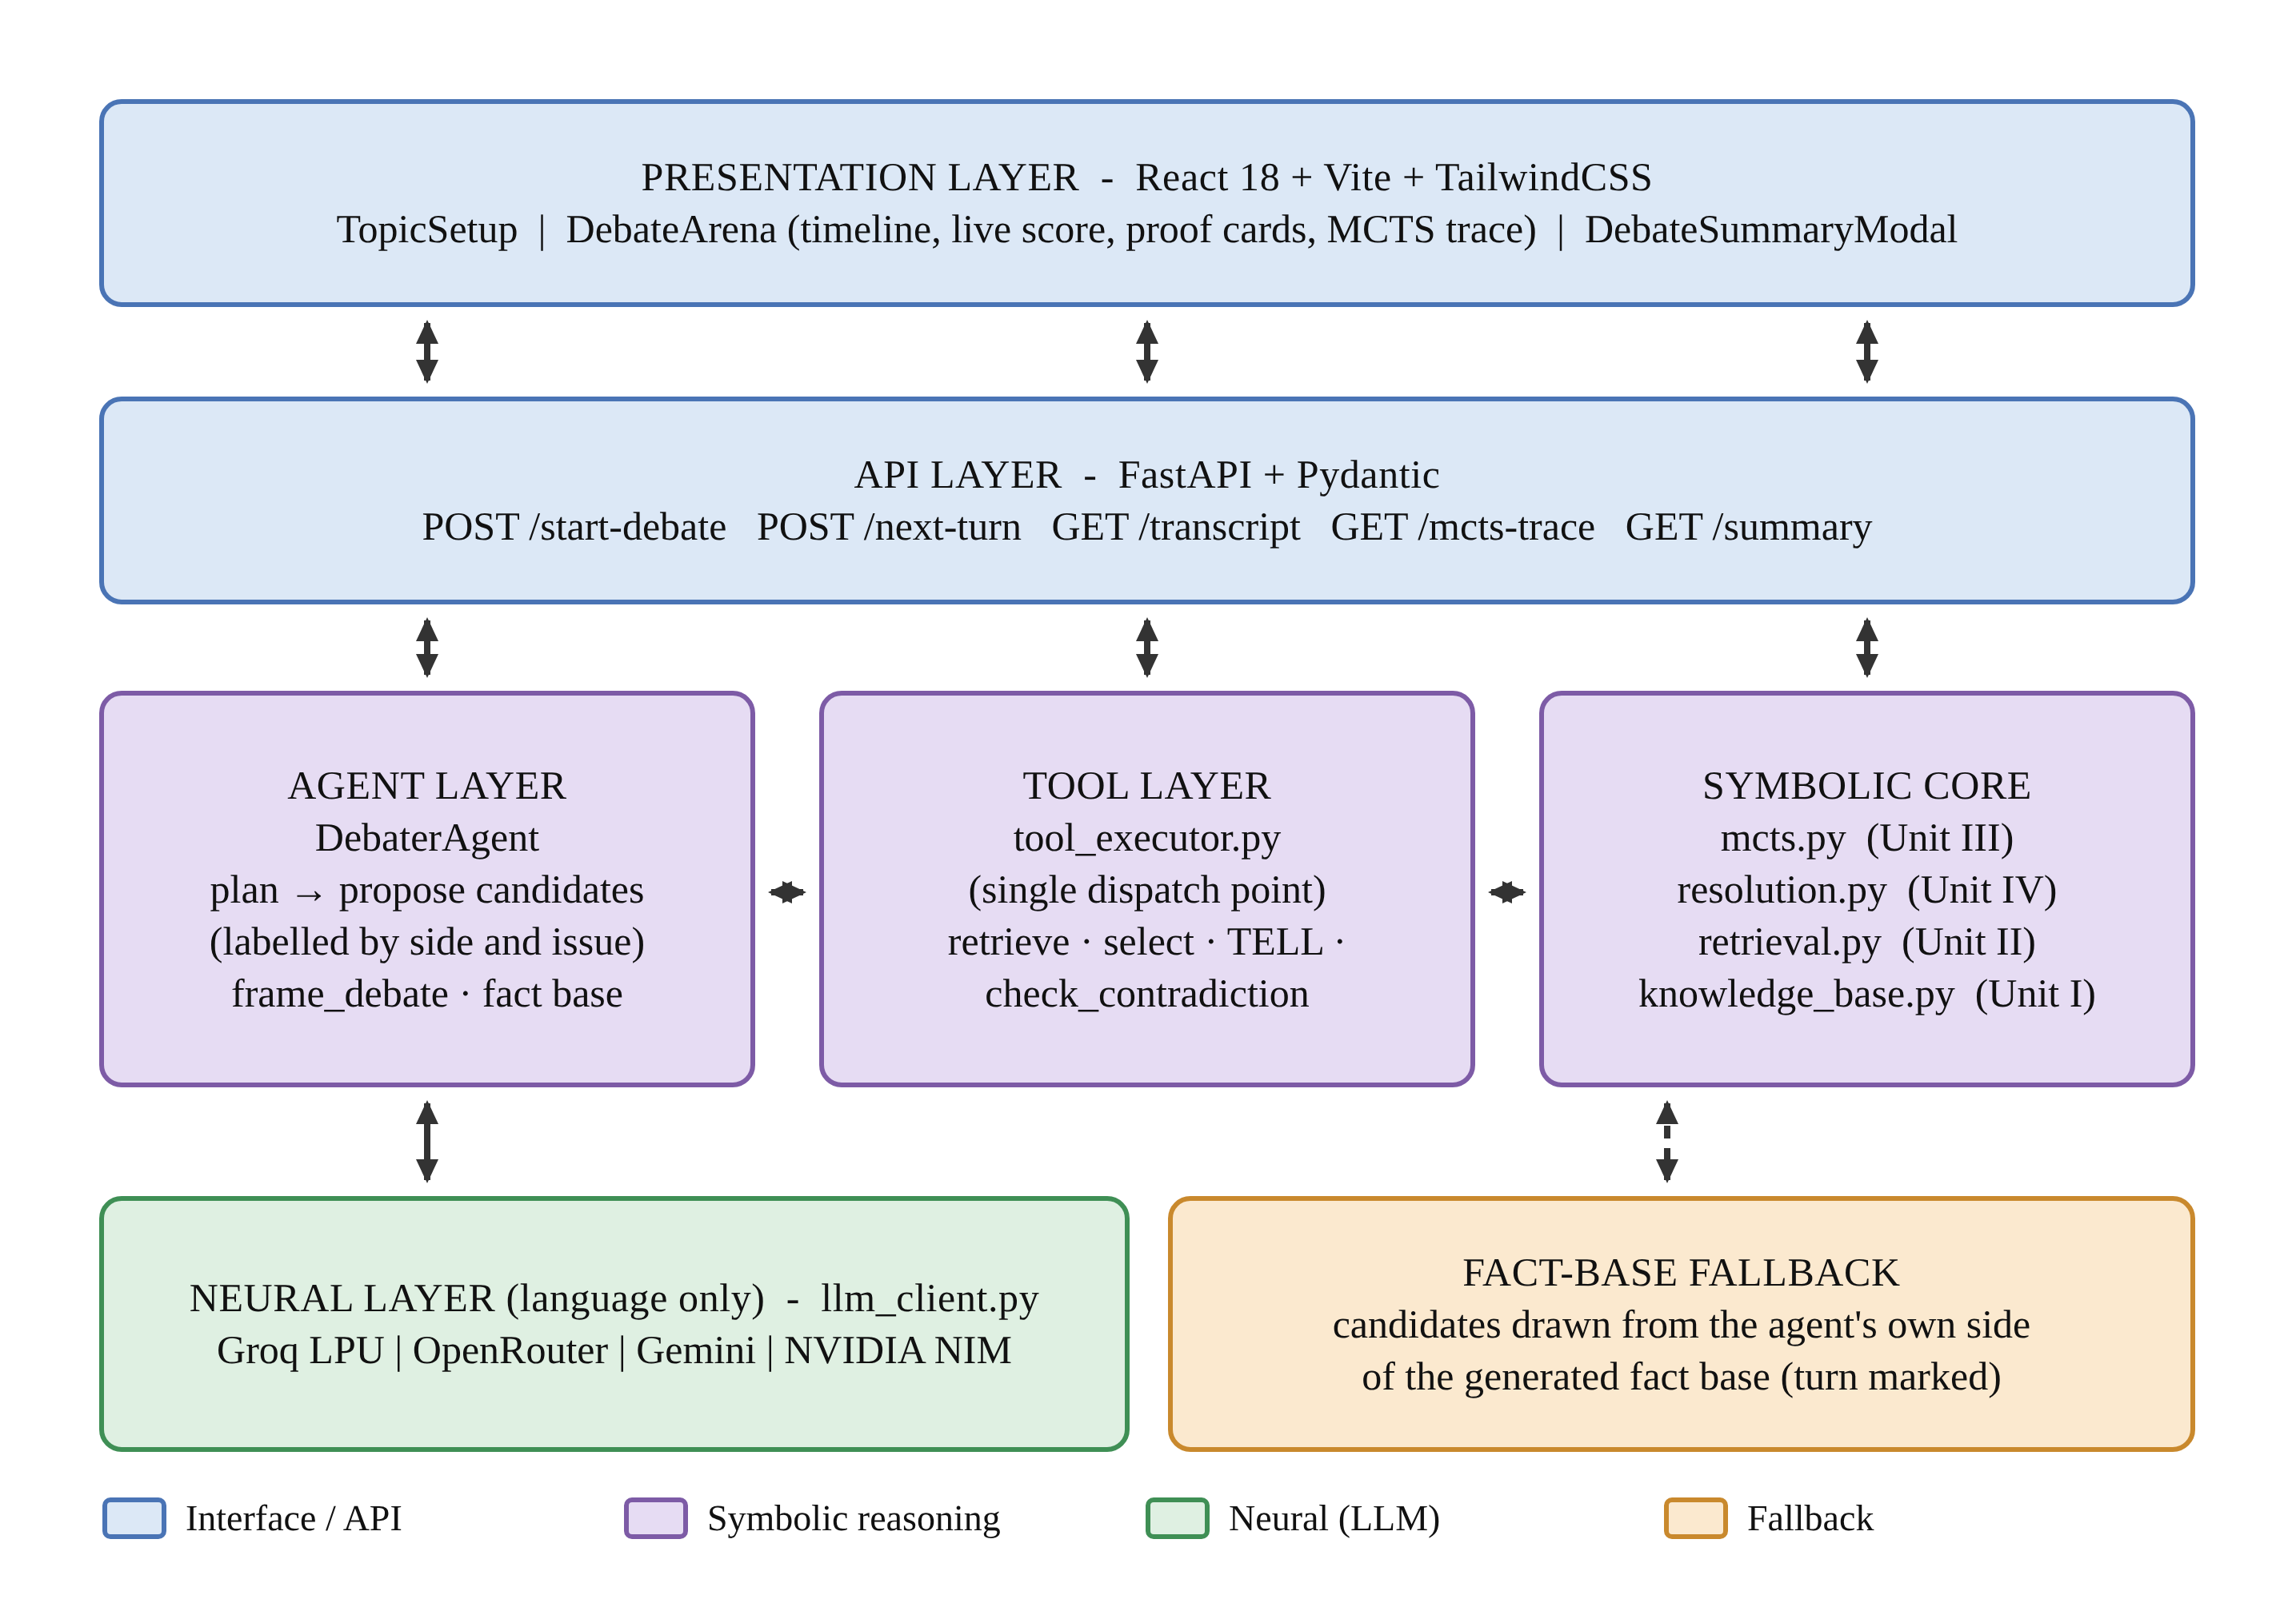
Proposed Work: Architecture

Slide 8
Proposed Work: Algorithm
MCTS: pick the rebuttal
Resolution: prove contradiction
1
Selection by highest UCB1
1
Convert each claim to a CNF clause
2
Expansion with an untried candidate
2
Resolve pairs holding L and ¬L
3
Simulation by resolution rollout
3
Add the new resolvents
4
Backpropagation of value
4
Empty clause ⊥ means contradiction
UCB1 = W/N + √2 · √(ln Np / N)
(A ∨ B), (¬A ∨ C) ⊢ (B ∨ C)

Slide 9
Implementation
Hardware
Software
Specifications
Standard laptop or PC
No local GPU needed
LLMs via Groq, OpenRouter, Gemini, NVIDIA NIM
Internet access for LLM APIs
Browser for the React UI
Python 3.10+
FastAPI, Pydantic, NumPy
React 18, Vite 5, TailwindCSS
Google GenAI and OpenAI SDKs
pytest for testing
20 facts per debate
32 MCTS simulations per turn
~4 LLM-proposed candidates per turn
4 LLM providers with fallbacks
223 tests in 12 files

Slide 10
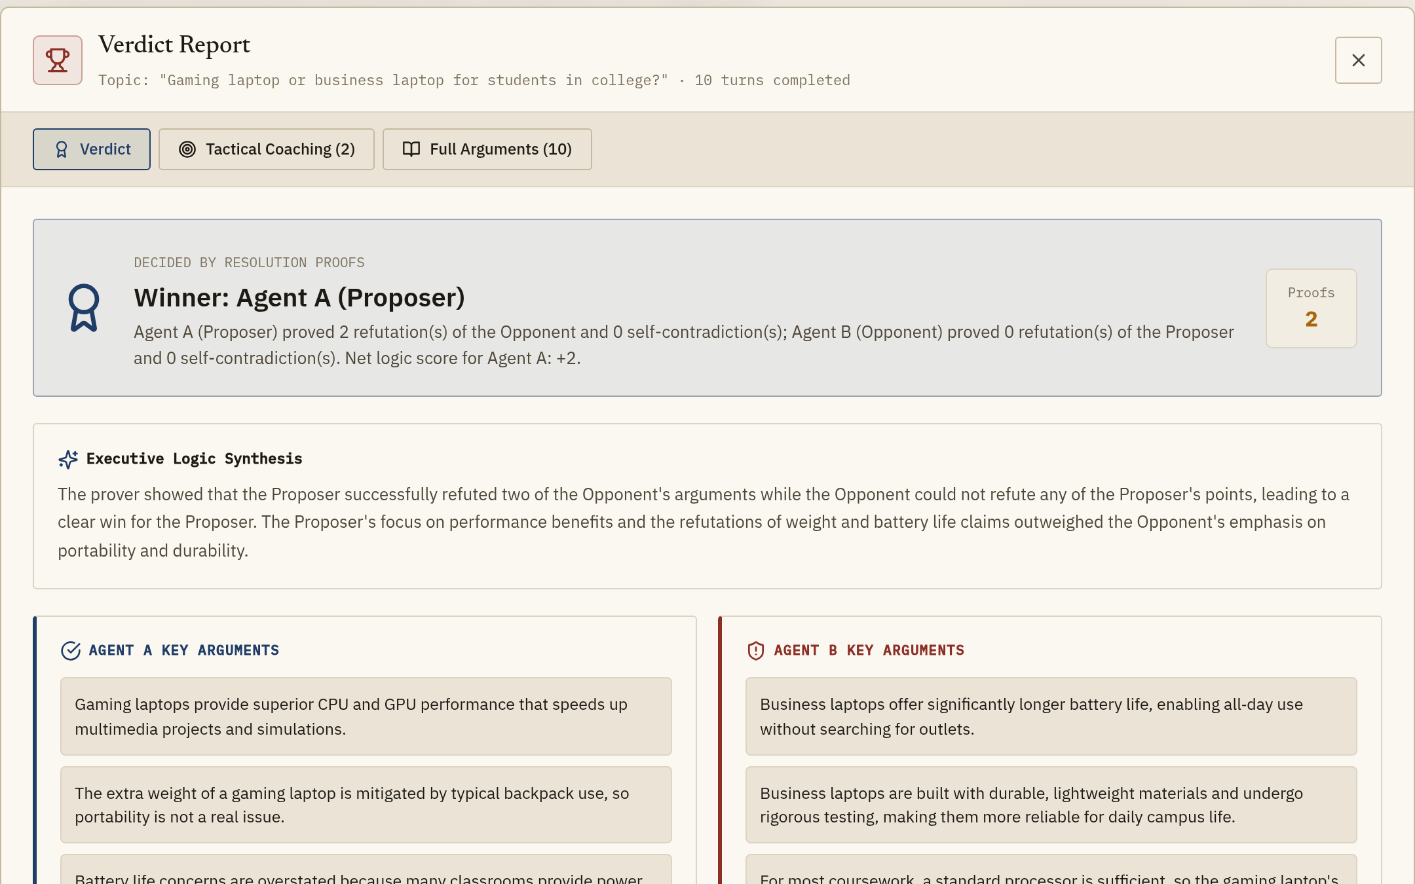
Result and Conclusion
Result
10-turn debate on gaming vs. business laptops: Agent A wins 2–0 on proven refutations.
Conclusion
MCTS with resolution rollouts chooses each argument and CNF resolution proves every refutation; the LLM only proposes and phrases.

Slide 11
Future Enhancement
First-order logic
Deeper search
Extend resolution to predicates and quantifiers.
Multi-step rollouts between both agents and a learned value function.
Live fact-checking
Human vs. AI mode
Ground claims in retrieved web sources with citations.
A person debates an agent and gets the same analysis.
Multi-agent panels
Voice and multilingual
Three or more debaters with a moderator agent.
Spoken debates and regional-language support.

