Slide 1
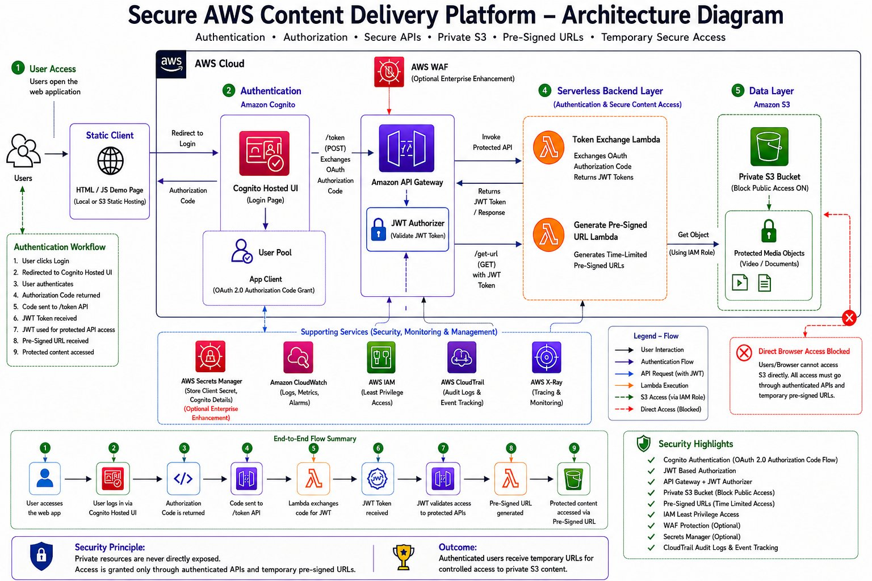
SECURE AWS
CONTENT DELIVERY PLATFORM
Secure content access using authentication, authorization and temporary controlled access mechanisms
Amazon Cognito
API Gateway
AWS Lambda
Private S3
Pre-Signed URLs
Prepared by
Adhithyan Sivaraman T
GitHub: github.com/Adhithyan-10
LinkedIn: linkedin.com/in/adhithyan-sivaraman-t-399b5b362
Cloud Engineering Portfolio • AWS Serverless Architecture

Slide 2
Secure AWS Content Delivery Platform
Adhithyan Sivaraman T
TABLE OF CONTENTS
01
Project Overview
08
Secure S3 Access
Problem statement & solution architecture
Private bucket, access denial & pre-signed URLs
02
Real World Scenario
09
IAM Security
Netflix-style secure content delivery use case
Least privilege IAM policy configuration
03
Architecture Overview
10
Challenges & Solutions
End-to-end system design walkthrough
CORS, JWT issues & configuration fixes
04
AWS Services Used
11
Security Principles
Services, purpose, and design rationale
Key lessons in cloud security design
05
Authentication Flow
12
Future Enhancements
Cognito Hosted UI & OAuth Authorization Code
WAF, Secrets Manager & CloudWatch monitoring
06
Token Exchange & JWT
13
Interview Q&A
Backend token exchange and JWT validation
10 key questions with detailed answers
07
Secure API Protection
14
Conclusion
API Gateway + JWT Authorizer in action
Summary & portfolio statement
2

Slide 3


Secure AWS Content Delivery Platform
Adhithyan Sivaraman T
01 · PROJECT OVERVIEW
Project Overview
BEFORE — The Problem
AFTER — The Solution
Public API Exposure
Amazon Cognito
APIs were publicly accessible — no authentication or authorization gates in place.
User Pool with Hosted UI handles authentication, user management and OAuth 2.0 flows.
No Access Control
API Gateway + JWT Authorizer
Any user could call backend endpoints directly, bypassing security checks.
Every API request is validated against a Cognito-issued JWT token before reaching Lambda.
Direct S3 Access Risk
Private S3 + IAM Roles
S3 objects were potentially reachable with a direct URL — no bucket-level protection.
Bucket has Block Public Access enabled; Lambda accesses it only via a scoped IAM role.
3
No Identity Verification
Pre-Signed URLs
No mechanism to verify who the user is before serving sensitive content.
Lambda generates time-limited, cryptographically signed S3 URLs — no direct bucket exposure.

Slide 4

Secure AWS Content Delivery Platform
Adhithyan Sivaraman T
02 · REAL WORLD SCENARIO
Real World Scenario
Netflix-Style Secure Video Delivery
Consider a streaming platform where video content (stored in S3) must only be accessible to paid, authenticated users. A direct S3 URL would expose all content to anyone with the link — including bots, scrapers, and unauthorized users.
WITHOUT SECURITY
WITH THIS ARCHITECTURE
Direct S3 URL works for anyone — no login required
User must authenticate via Cognito — no token, no access
Scraper bots can download and redistribute content freely
JWT is validated on every single API request by API Gateway
No audit trail of who accessed what and when
Lambda generates a time-limited URL (e.g. 15 minutes) per request
URLs never expire — shared links work indefinitely
Direct S3 access is blocked — content only reachable via signed URL
4
No way to revoke access for a suspended user
CloudTrail logs every API call and S3 access for full auditability

Slide 5
Secure AWS Content Delivery Platform
Adhithyan Sivaraman T
03 · ARCHITECTURE OVERVIEW
Architecture Overview
5

Slide 6

Secure AWS Content Delivery Platform
Adhithyan Sivaraman T
03 · ARCHITECTURE WALKTHROUGH
End-to-End Request Flow
User Access
JWT Validation
1
User opens the web app and clicks Login.
5
For every protected API call, the JWT Authorizer in API Gateway validates the token.
Cognito Hosted UI
Lambda Invocation
2
Redirected to Cognito's managed login page — email/password authentication.
6
Validated request reaches Lambda, which uses its IAM role to call S3.
Authorization Code
Pre-Signed URL
3
After login, Cognito redirects back with a one-time authorization code.
7
Lambda generates a time-limited signed URL for the S3 object.
6
Token Exchange
Content Access
4
Frontend sends code to /token API. Lambda exchanges it with Cognito for JWT tokens.
8
User's browser uses the pre-signed URL to securely stream/download content.

Slide 7
Secure AWS Content Delivery Platform
Adhithyan Sivaraman T
04 · AWS SERVICES USED
AWS Services Used
Service | Purpose | Why Used
Amazon Cognito | User identity and authentication management | Provides managed OAuth 2.0 Hosted UI, User Pools, App Clients and JWT token issuance without building custom auth.
API Gateway | HTTP API frontend — routes and protects all requests | Integrates natively with Cognito JWT Authorizer to block unauthenticated requests before they reach Lambda.
AWS Lambda | Serverless backend logic | Handles token exchange with Cognito and generates pre-signed S3 URLs on authenticated request — no servers to manage.
Amazon S3 | Private object storage for protected content | Block Public Access ensures content is never directly reachable; only accessible via Lambda-generated signed URLs.
AWS IAM | Role-based access control for Lambda | Lambda's execution role is granted only s3:GetObject — enforcing least privilege so it cannot modify or delete objects.
JWT Authorizer | Validates JWT on every incoming API request | Decodes and verifies the Cognito-issued id_token against the JWKS endpoint — rejects expired or tampered tokens.
CloudTrail | Audit logging for all AWS API calls | Every Lambda invocation, S3 access, and Cognito event is logged — providing a full tamper-evident audit trail.
7

Slide 8
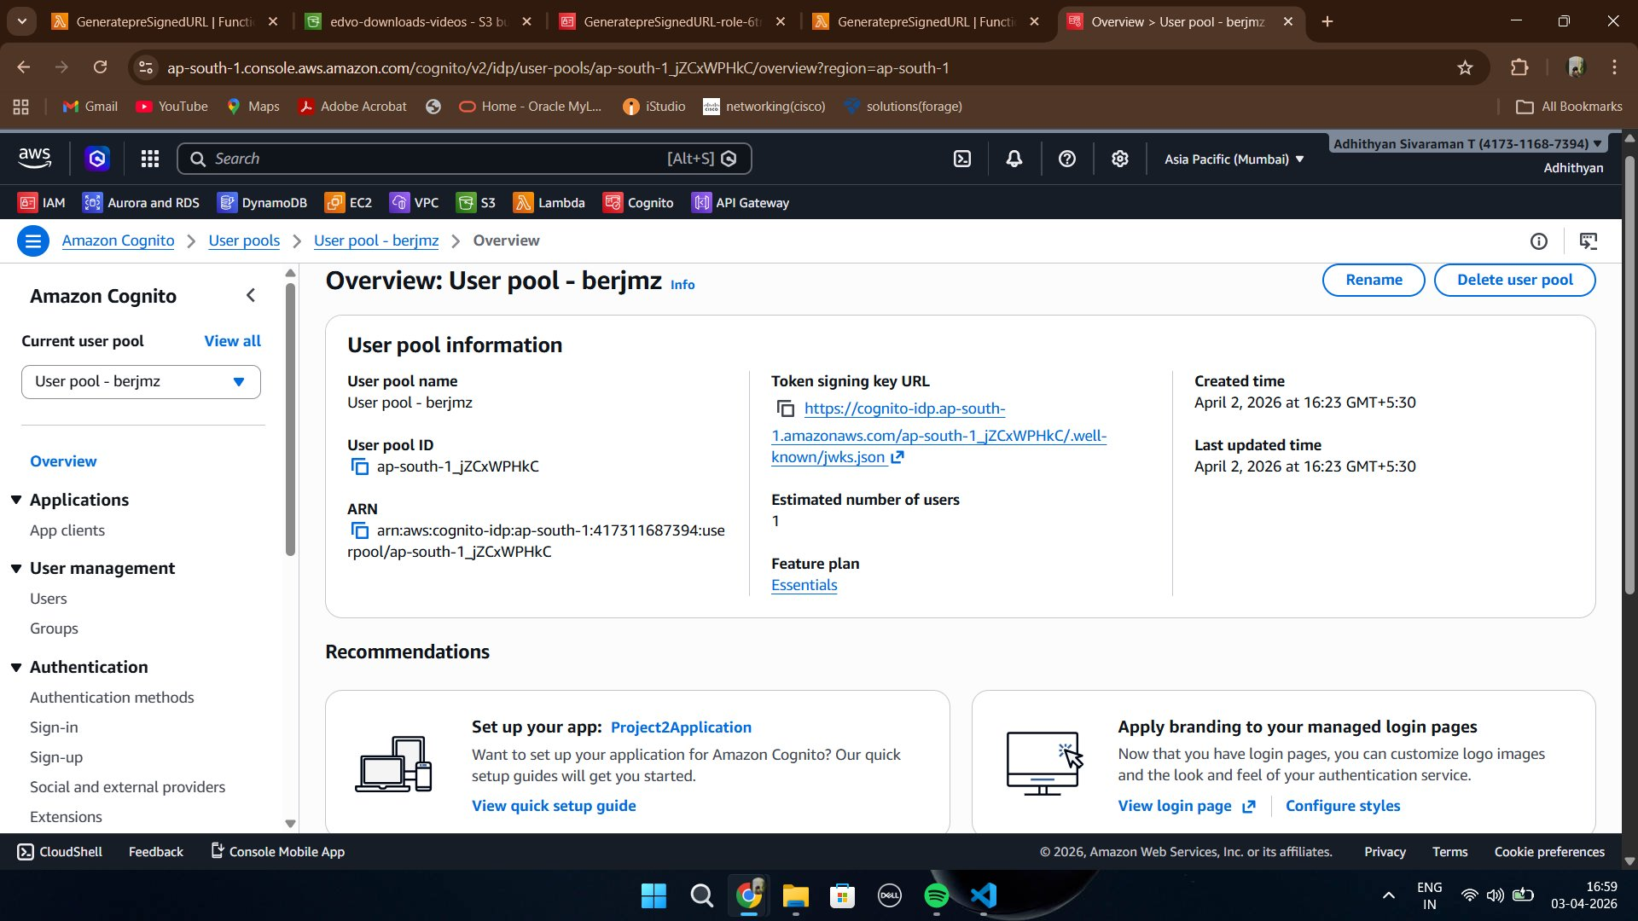
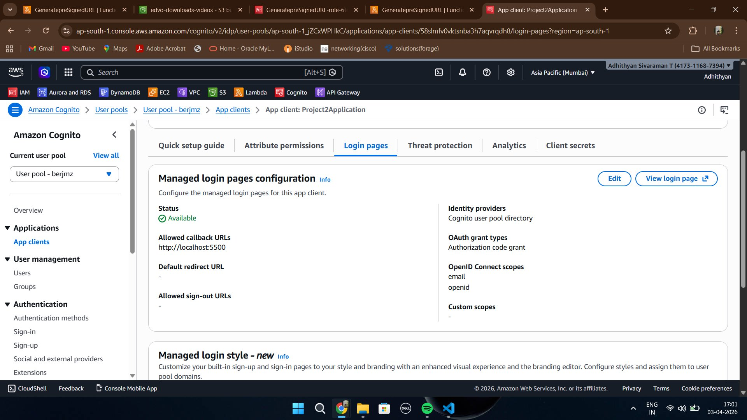
Secure AWS Content Delivery Platform
Adhithyan Sivaraman T
05 · AUTHENTICATION FLOW
Cognito Configuration
Figure 1 — Cognito User Pool Overview
Figure 2 — App Client with OAuth 2.0 Authorization Code Grant enabled
User Pool:
An Amazon Cognito User Pool was created in ap-south-1. It stores user credentials and manages sign-in flows.
8
App Client:
The App Client is configured with Authorization Code Grant, allowing OAuth 2.0 flows with email/openid scopes.
Callback URL:
Development callback URL configured for local testing environment. The token exchange happens server-side — client secret stays hidden.

Slide 9
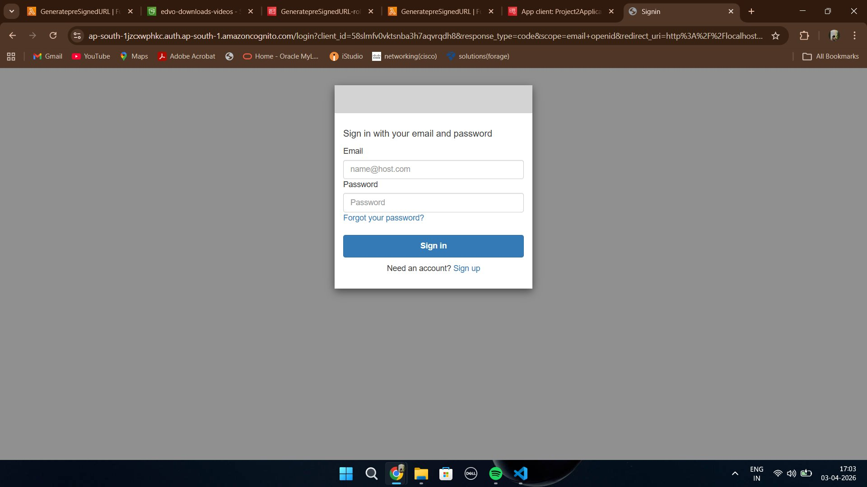
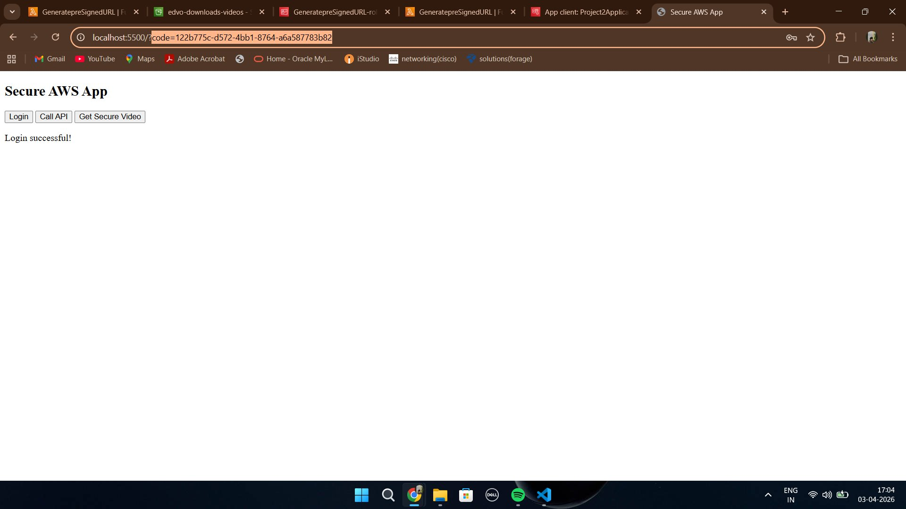
Secure AWS Content Delivery Platform
Adhithyan Sivaraman T
05 · AUTHENTICATION FLOW
Hosted UI & Authorization Code
Figure 4 — Authorization Code appended to redirect URL after login
Figure 3 — Cognito Hosted UI Login Page
9
Hosted UI:
Cognito manages the login page — no custom auth UI needs to be built. The URL includes the client_id, response_type=code, scope, and redirect_uri.
Authorization Code:
After successful login, Cognito redirects the user back to the callback URL with a short-lived authorization code appended as a query parameter (?code=...).
Why Code, Not Token?:
The code grant pattern prevents tokens from appearing in browser history or server logs. The actual token exchange happens server-side via Lambda.

Slide 10






Secure AWS Content Delivery Platform
Adhithyan Sivaraman T
06 · TOKEN EXCHANGE & JWT FLOW
Token Exchange & JWT Flow
Authorization Code
POST /token API
Lambda Handler
Cognito Token Endpoint
JWT Tokens Returned
from Cognito redirect URL
sent to API Gateway endpoint
receives the authorization code
backend POSTs code + client secret
id_token, access_token, refresh_token
Why Backend Token Exchange?
The client secret attached to the Cognito App Client must NEVER be exposed in frontend JavaScript. If the token exchange happened in the browser, the secret would be visible in the source code. By routing it through Lambda, the secret stays in the backend environment — inaccessible to users.
What's Inside the JWT?
sub
email
exp
iss
token_use
Unique user identifier from Cognito
User's verified email address
Token expiration timestamp (Unix)
Issuer — Cognito User Pool URL
id or access — defines token purpose
10

Slide 11
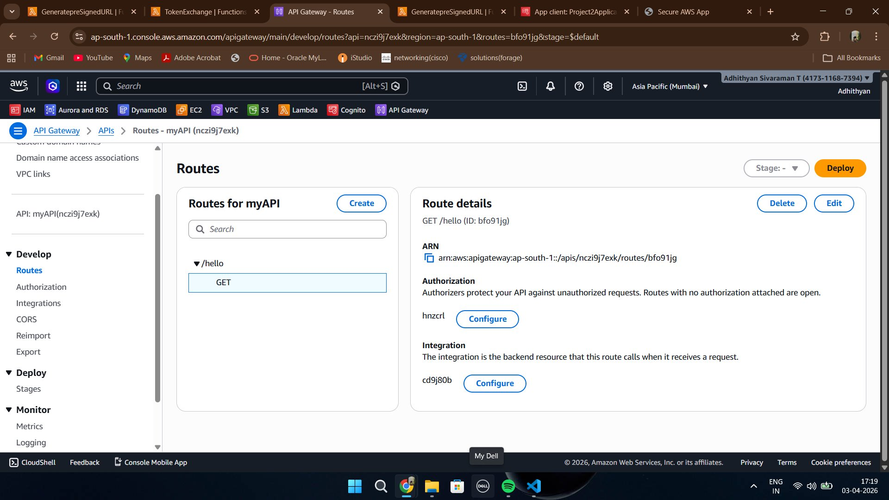
Secure AWS Content Delivery Platform
Adhithyan Sivaraman T
07 · SECURE API PROTECTION
Secure API Protection
Route: GET /hello
The protected endpoint is configured in API Gateway. Without a JWT Authorizer attached, it is open to the world.
JWT Authorizer
The authorizer is configured with the Cognito User Pool's JWKS endpoint. It validates the token signature, issuer, and expiry on every request.
Integration (Lambda)
Only after successful JWT validation does API Gateway forward the request to the backend Lambda function.
11
Figure 5 — API Gateway route /hello with JWT Authorizer attached

Slide 12
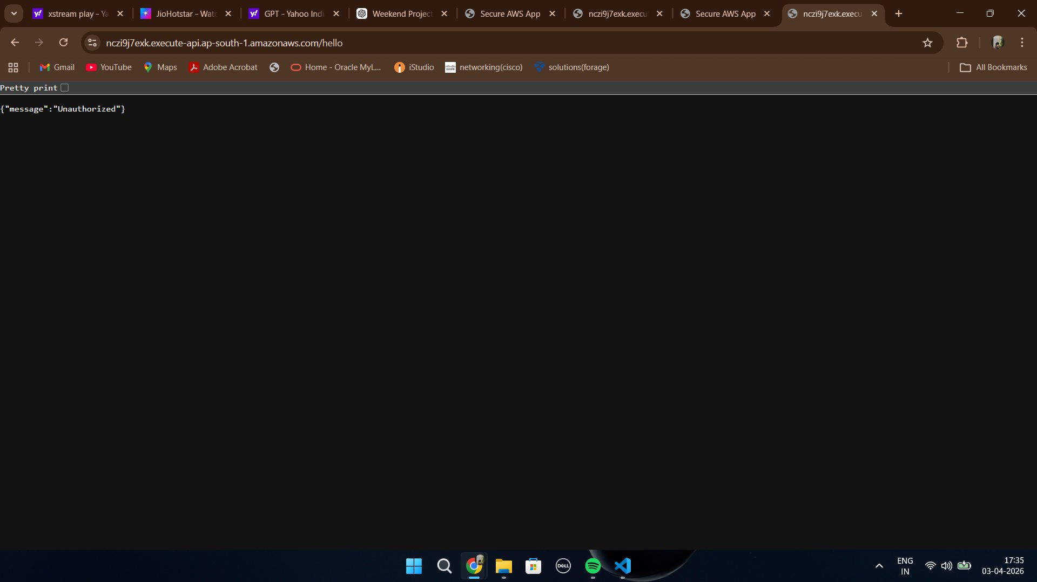
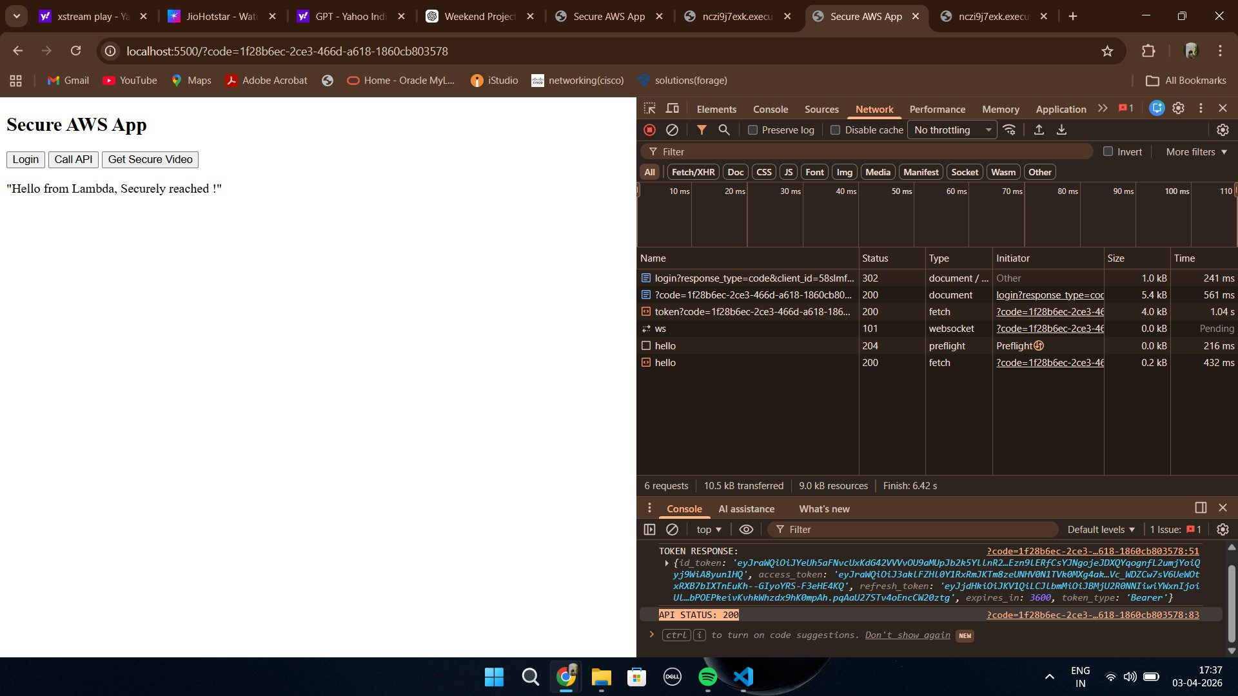

Secure AWS Content Delivery Platform
Adhithyan Sivaraman T
07 · SECURE API PROTECTION
Unauthorized vs Authorized API Access
401 UNAUTHORIZED
200 SUCCESS
Direct browser access to API endpoint — no JWT token provided
Lambda responds with 200 after JWT is validated by API Gateway Authorizer
12
Security in Action:
The JWT Authorizer acts as a gate before the Lambda function is ever reached. Expired, missing, or tampered tokens all result in a 401 response — Lambda is never invoked, reducing attack surface and compute costs simultaneously.

Slide 13
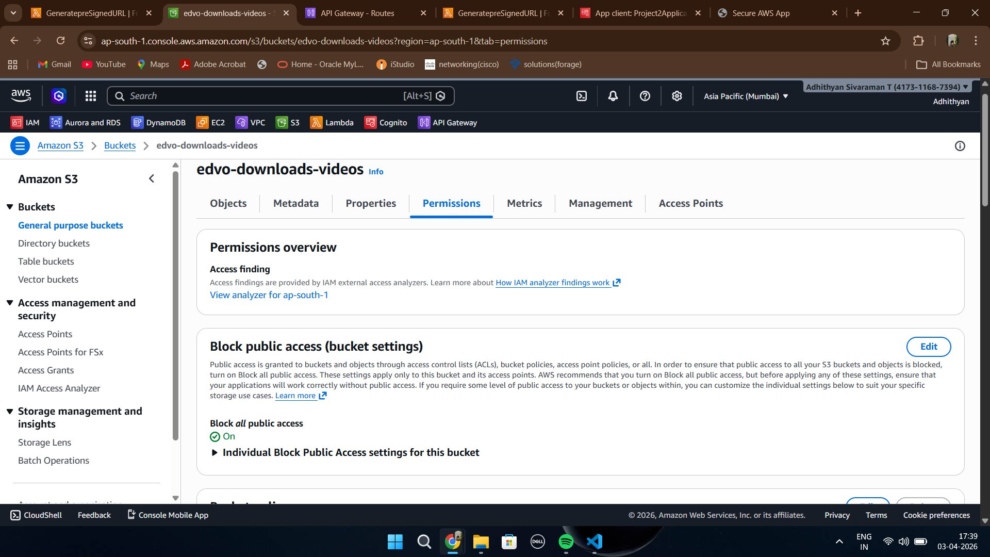
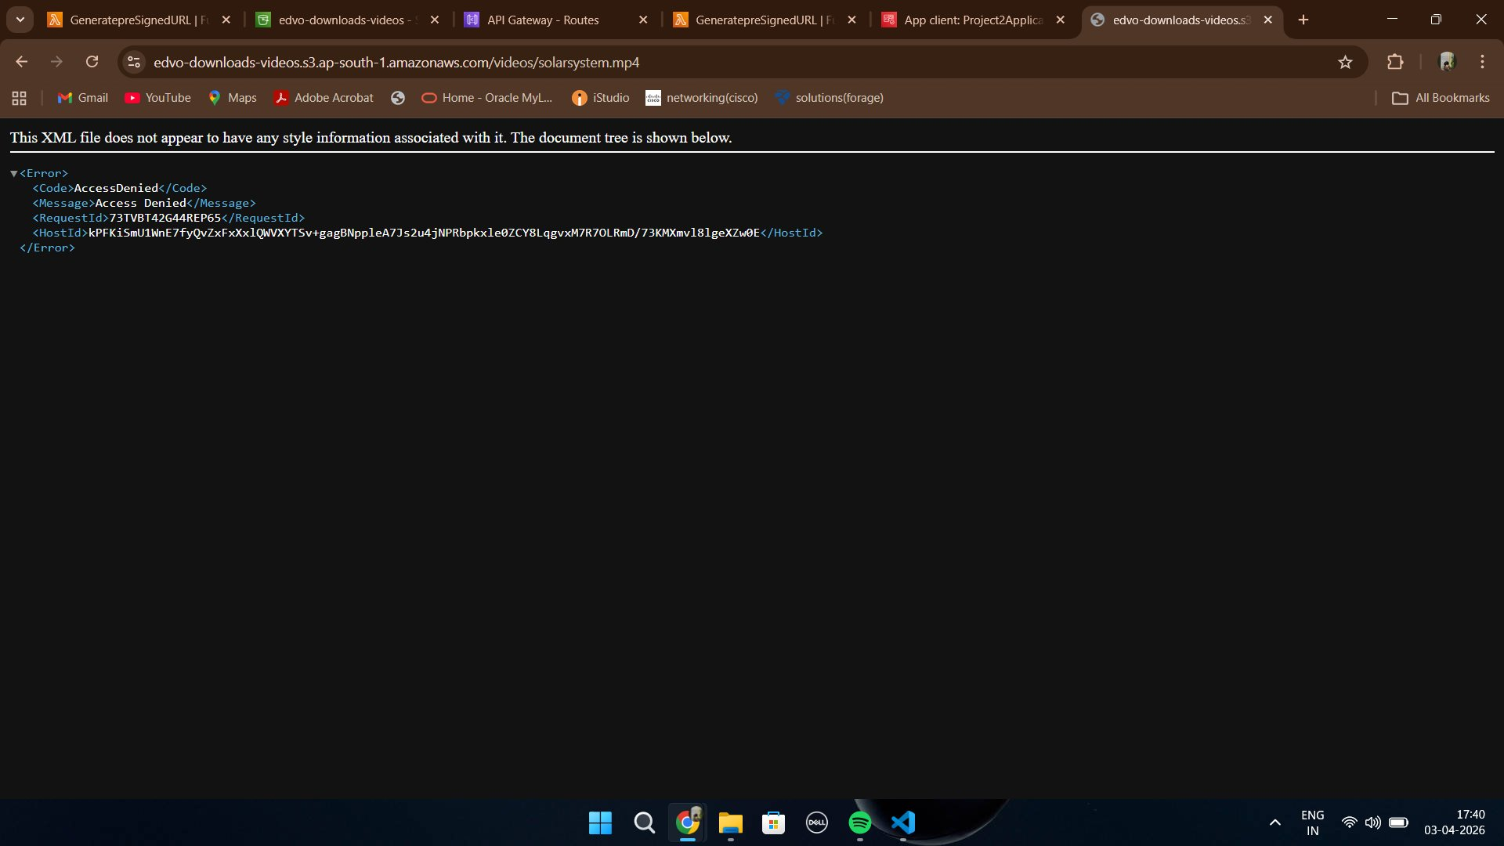
Secure AWS Content Delivery Platform
Adhithyan Sivaraman T
08 · SECURE S3 ACCESS
Private S3 Bucket Configuration
Figure 6 — S3 Bucket (edvo-downloads-videos) with Block All Public Access: ON
Figure 7 — Direct S3 URL returns AccessDenied — security validation successful
Block All Public Access: ON:
This single setting prevents any S3 object from being reachable via a public URL, regardless of object-level ACLs.
13
Direct URL: AccessDenied:
Attempting to access the S3 object directly returns an XML AccessDenied error — confirming the bucket is truly private.
Forced Pre-Signed Flow:
The only valid access path is through Lambda, which holds the IAM role with s3:GetObject permission for this specific bucket.

Slide 14
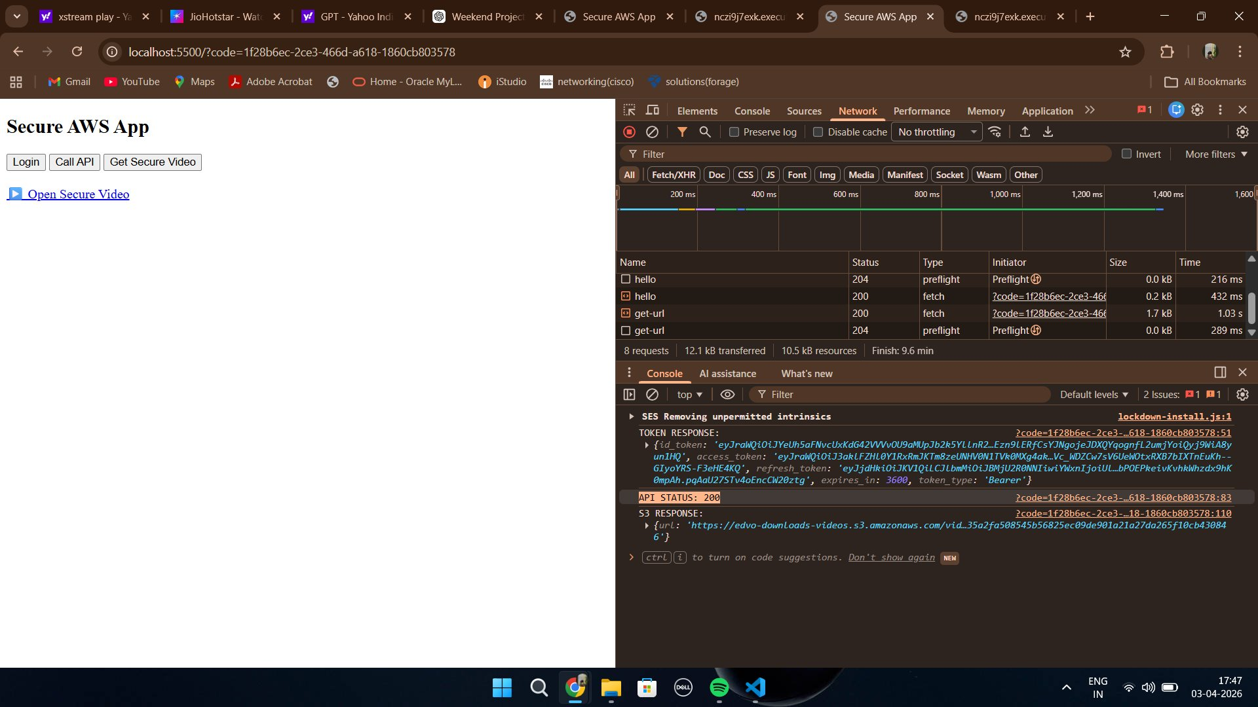
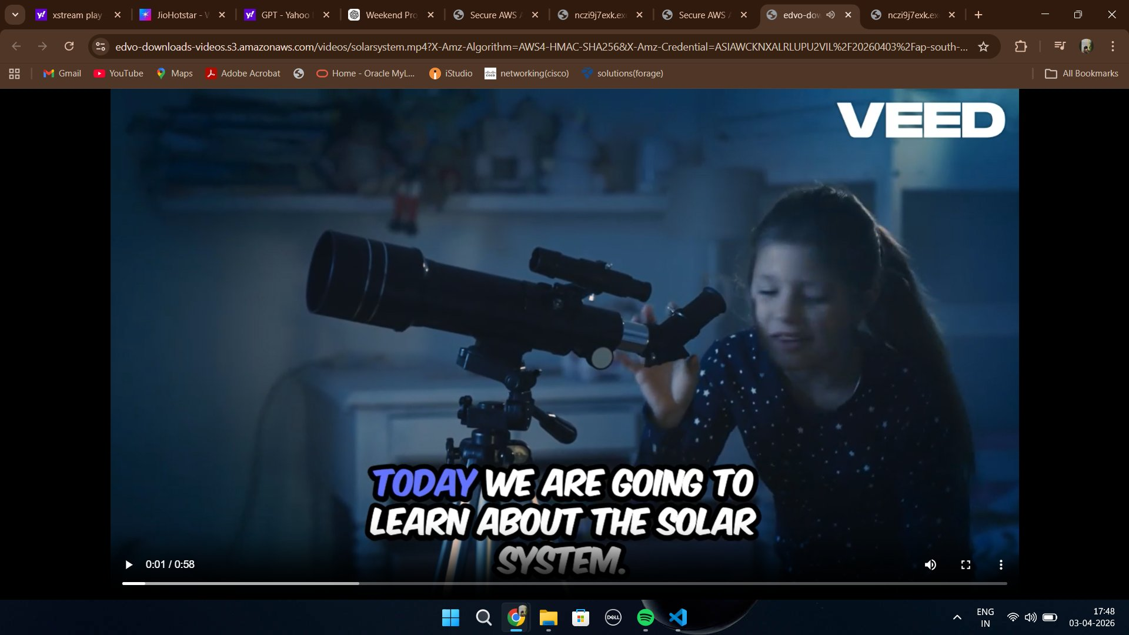
Secure AWS Content Delivery Platform
Adhithyan Sivaraman T
08 · PRE-SIGNED URL FLOW
Pre-Signed URL Generation & Access
Figure 8 — Pre-signed S3 URL returned in API response (with S3 RESPONSE visible in console)
Figure 9 — Private video (solarsystem.mp4) accessible via pre-signed URL — time-limited access
How Pre-Signed URLs Work:
Lambda calls boto3's generate_presigned_url() with the bucket name, object key, and expiry duration. AWS embeds the credentials cryptographically in the URL itself.
14
Time-Limited Access:
The URL includes X-Amz-Expires in the query string. After expiry (e.g. 900 seconds), S3 rejects the request — even with the exact same URL.
No Bucket Policy Change:
The bucket remains fully private. Pre-signed URLs work because Lambda's IAM role has s3:GetObject — the URL borrows that permission temporarily.

Slide 15
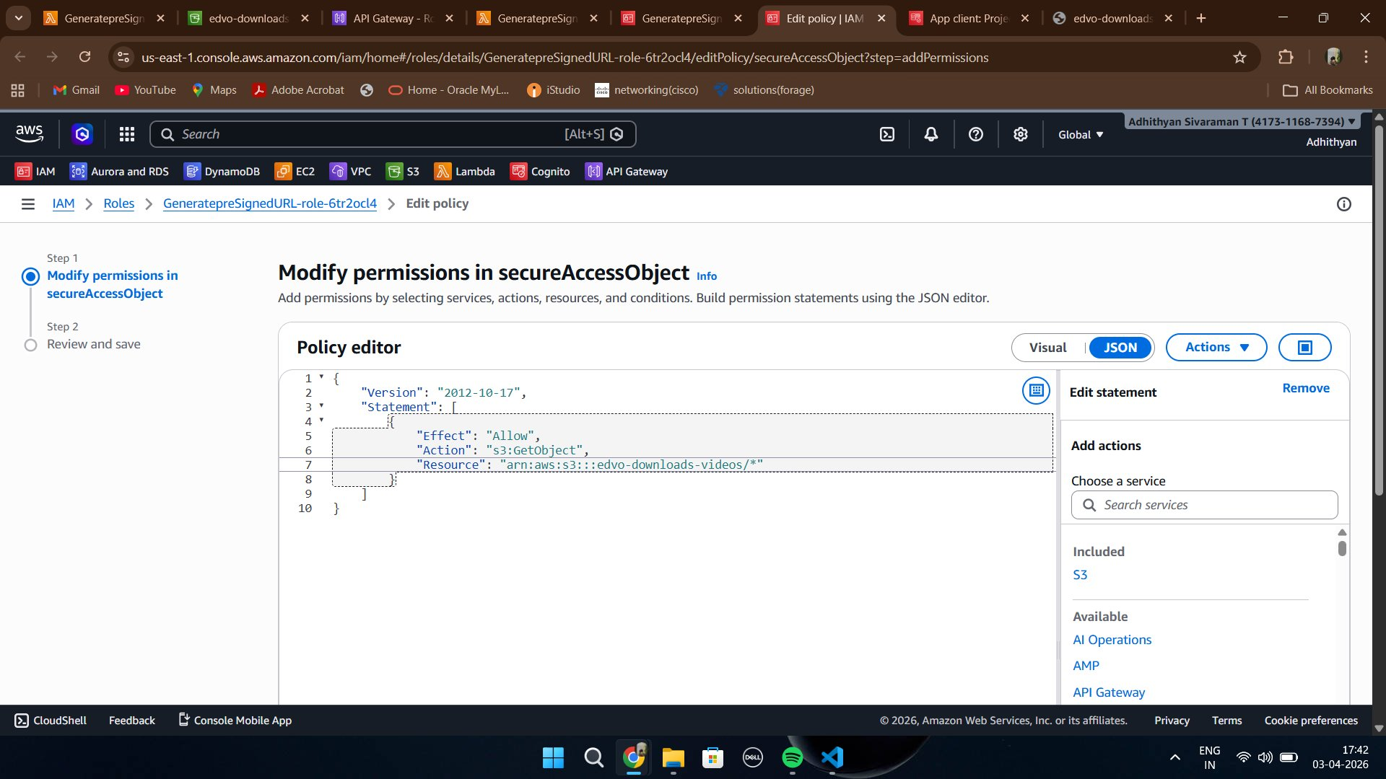
Secure AWS Content Delivery Platform
Adhithyan Sivaraman T
09 · IAM SECURITY
IAM — Least Privilege Access
Exact Action
Effect: Allow, Action: s3:GetObject. No s3:PutObject, s3:DeleteObject, or s3:ListBucket — Lambda can read only.
Specific Resource
Resource: arn:aws:s3:::edvo-downloads-videos/* — scoped to this bucket only. Not *.
Role, Not Keys
Lambda assumes an IAM Role at runtime. No access keys stored in code or environment variables.
15
Audit Trail
Figure 10 — IAM Policy granting only s3:GetObject on the edvo-downloads-videos bucket
Every IAM role assumption and S3:GetObject call is logged in CloudTrail automatically.

Slide 16

Secure AWS Content Delivery Platform
Adhithyan Sivaraman T
10 · CHALLENGES FACED
Challenges & How I Fixed Them
01
Unauthorized Access Despite Valid Token
03
Wrong Callback URL Configuration
Problem:
Problem:
API kept returning 401 even after the token exchange succeeded.
Cognito rejected the redirect after login with an OAuth error.
Fix:
Fix:
Resolved by configuring the correct Cognito issuer URL and validating JWT settings.
The callback URL in the Cognito App Client must exactly match the redirect_uri in the frontend request — including protocol, host, and port. Development callback URL configured for local testing environment.
02
CORS Errors on Token Exchange
04
Pre-Signed URL Expired Too Quickly
Problem:
Problem:
Browser blocked the POST /token request due to missing CORS headers.
URL expired before the video could fully load in the browser.
16
Fix:
Fix:
Added explicit CORS configuration in API Gateway for the /token route — allowed origins, methods (POST), and headers (Content-Type, Authorization).
Increased the ExpiresIn parameter in generate_presigned_url() from 60 to 900 seconds. For production, the right value depends on expected file size and connection speed.

Slide 17


Secure AWS Content Delivery Platform
Adhithyan Sivaraman T
11 · SECURITY PRINCIPLES LEARNED
Security Principles Learned
Authentication vs Authorization
Never Expose Private Resources
Authentication asks 'who are you?' (Cognito answers this). Authorization asks 'what are you allowed to do?' (JWT Authorizer + IAM answers this). Both are required.
Private S3 objects must never be directly linked. All access must route through an authenticated API that validates identity before granting temporary access.
Temporary Access Pattern
Least Privilege by Default
Pre-signed URLs embody the principle of time-limited access — credentials that expire by design reduce the blast radius of a leaked URL significantly.
IAM roles should grant only the exact actions needed. A Lambda that reads S3 objects does not need s3:PutObject, s3:DeleteObject, or s3:ListBucket.
Backend Token Exchange
Validate on Every Request
17
Client secrets must never leave the server. The OAuth Authorization Code flow with backend exchange ensures the Cognito App Client secret stays hidden from browser clients.
JWTs are stateless — there is no session. The JWT Authorizer re-validates the signature and expiry on every single API request, providing continuous verification.

Slide 18
Secure AWS Content Delivery Platform
Adhithyan Sivaraman T
12 · FUTURE ENHANCEMENTS
Future Enhancements
AWS WAF
AWS Secrets Manager
CloudWatch Monitoring
Web Application Firewall
Secure credential rotation
Observability & alerting
Attach WAF to API Gateway to block SQL injection, XSS, and rate-limit by IP. Essential for production APIs exposed to the public internet.
Move the Cognito client secret out of Lambda environment variables and into Secrets Manager with automatic rotation on a schedule.
Add Lambda error rate alarms, API Gateway 4xx/5xx dashboards, and S3 access anomaly detection to catch security events in real time.
CloudFront Distribution
Auto URL Regeneration
User Groups & Roles
Global CDN + signed cookies
Frontend refresh logic
Fine-grained authorization
Place CloudFront in front of S3 with signed cookies or signed URLs issued by CloudFront — enabling geo-restriction and edge caching of content.
Implement a frontend timer that automatically requests a new pre-signed URL before expiry — providing seamless access without re-authentication.
Use Cognito User Groups to define roles (admin, premium, free). Lambda reads group claims from the JWT and returns different content tiers accordingly.
18

Slide 19
Secure AWS Content Delivery Platform
Adhithyan Sivaraman T
13 · INTERVIEW Q&A
Interview Questions & Answers
Q
What is the difference between Authentication and Authorization?
A
Authentication verifies identity — Cognito does this via the Hosted UI login. Authorization decides what the authenticated user can access — the JWT Authorizer and IAM roles handle this. Both are required for secure systems.
Q
Why use Authorization Code flow instead of Implicit flow?
A
The Implicit flow returns tokens directly in the URL, exposing them to browser history and server logs. Authorization Code flow keeps tokens out of the URL and exchanges the code server-side, keeping the client secret hidden.
Q
What happens if a JWT token is expired when hitting the API?
A
The JWT Authorizer in API Gateway validates the exp claim. An expired token results in a 401 Unauthorized response immediately — Lambda is never invoked. The user must re-authenticate to get a fresh token.
Q
Why must token exchange happen in Lambda and not the browser?
A
The Cognito App Client secret is required for the token exchange request. Placing this logic in the frontend would expose the secret in JavaScript source code. Lambda keeps it server-side and secure.
19
Q
How does a pre-signed URL grant access without making S3 public?
A
Pre-signed URLs embed the IAM credentials of the signer (Lambda's role) cryptographically in the URL. S3 validates these credentials against the policy at request time — granting temporary access without changing the bucket's public access settings.

Slide 20
Secure AWS Content Delivery Platform
Adhithyan Sivaraman T
13 · INTERVIEW Q&A
Interview Questions & Answers
Q
What is the Principle of Least Privilege and how did you implement it?
A
Least privilege means granting only the permissions required to perform a specific task. Lambda's IAM role was granted only s3:GetObject on the specific bucket ARN — not s3:* or even s3:ListBucket.
Q
What are JWKS and how does the JWT Authorizer validate tokens?
A
JWKS (JSON Web Key Set) is a public endpoint published by Cognito containing the RSA public keys used to sign JWTs. The JWT Authorizer fetches the key matching the kid header in the token and verifies the signature — no database lookup needed.
Q
How would you prevent a leaked pre-signed URL from being misused?
A
Set a short expiry (15-30 minutes). In production, bind the URL to the requester's IP using S3 condition keys (aws:SourceIp). Use CloudFront Signed URLs with geographic restrictions for stronger control.
Q
What is the difference between id_token and access_token in Cognito?
A
The id_token contains user identity claims (email, sub, phone). The access_token is used to call Cognito APIs (e.g. get user info). For API Gateway JWT Authorizer, the id_token is used to validate the user's identity.
20
Q
How would you scale this architecture for 10,000 concurrent users?
A
Lambda auto-scales by default. API Gateway handles horizontal scaling automatically. Increase Cognito's token refresh intervals to reduce auth traffic. Add CloudFront in front of API Gateway for edge caching. Use SQS to buffer Lambda invocations under burst load.

Slide 21

Conclusion
Designed and implemented a fully serverless, secure AWS content delivery architecture that demonstrates real-world application of identity management, API security, and private resource access control. The system enforces authentication through Amazon Cognito, validates every request via a JWT Authorizer in API Gateway, and delivers private S3 content exclusively through time-limited pre-signed URLs — ensuring that no resource is ever directly exposed.
7+
0
100%
Full
AWS Services Integrated
Private S3 Access Enforced
APIs JWT Protected
Serverless Architecture
What This Project Demonstrates
Identity & Access Management — Cognito, OAuth 2.0, JWT
API Security Design — JWT Authorizers, CORS, route protection
Cloud Storage Security — Private S3, IAM roles, pre-signed URLs
Serverless Architecture — Lambda, API Gateway, event-driven design
Adhithyan Sivaraman T • github.com/Adhithyan-10 • linkedin.com/in/adhithyan-sivaraman-t-399b5b362

