Slide 1

License Plate Recognition
_{by : aelwen and anindhito}

Slide 3





Slide 4
What is license plate recognition
License plate recognition is a software where the computer could detect a vehicle license plate and store them in a designed place.

Slide 5
ProblemS around here
Deficient navigation system where people can still bypass the rule in applied ODD-EVEN road in Jakarta
Many hit and run event, where the authorized party could not recognize the responsible party car plate
Lack of police officer to observe all vehicle that was passing the road

Slide 6
What are the solutions
Sudden high road security check – up
Using a program to take a picture of the car license plate that will show the output whether the car was violating the rule or not

Slide 7



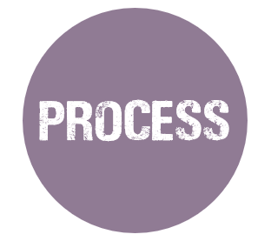
HOW IT WORKS

Slide 8
Input the computing result to the violate txt as a documentation
A UI will appear to show the car license plate
Computing to check the vehicle number whether it is odd or even number
Detect vehicle number plate

Slide 9
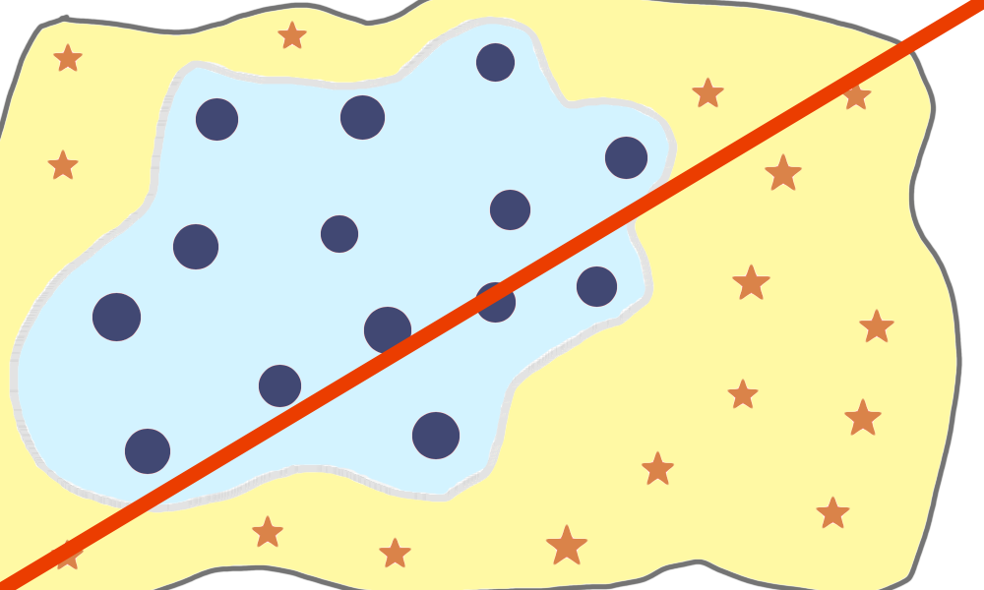
WHY WE USE KNn
KNN is a non-parametric machine learning algorithm
KNN algorithm is easy to understand and to implement

Slide 10
THANK YOU

