Slide 1

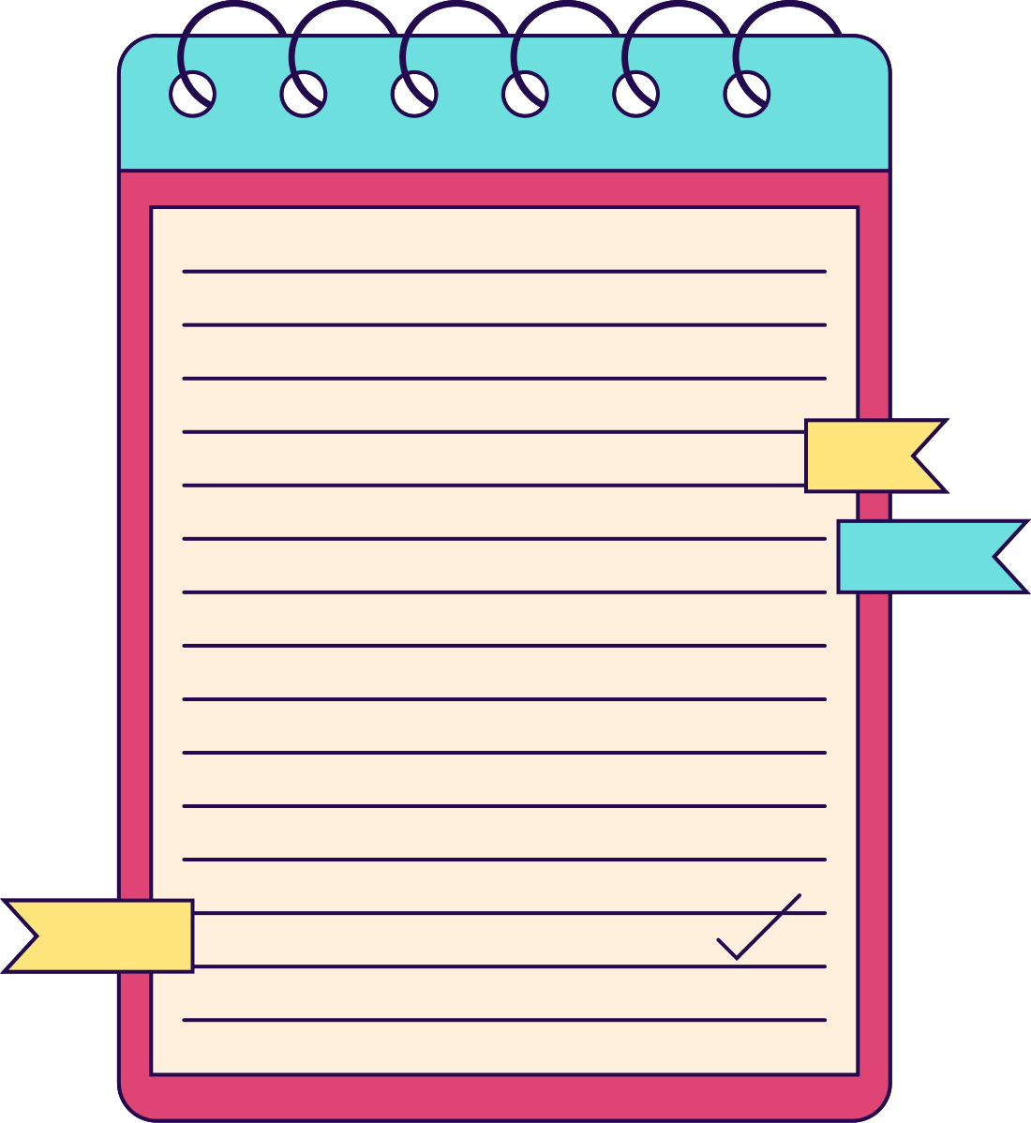


STUDENT
FEEDBACK
FOR PRIMARY SCHOOL STUDENTS

Slide 2



DESIGN DIRECTIONS OF DEVICE

Slide 3

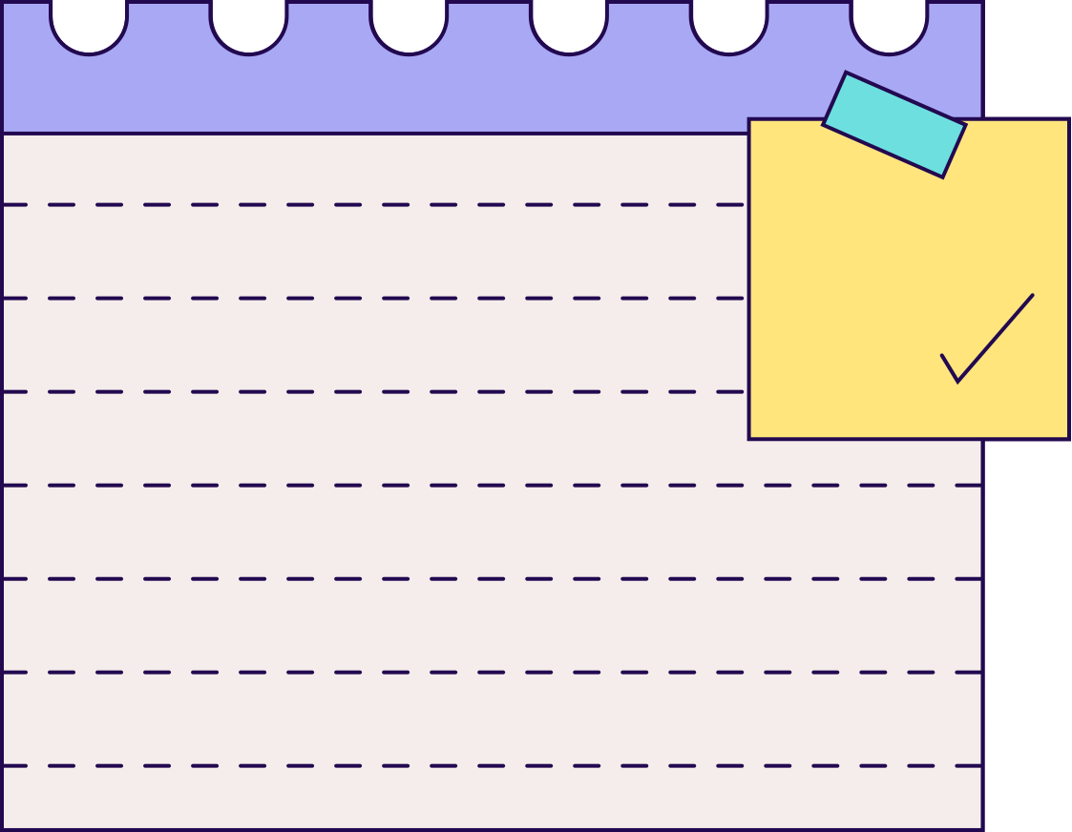


BUTTONS
01
ON/OFF
02
REPEAT
the major purpose of this button is to on the device
when a student is unable to answer a question then he can use this for repeating the question or to know how to answer it

Slide 4



DISPLAY
The rectangular display is preferred, as the interaction is touch-based chiefly, this type of display has minimal false touches mainly at the edges.
to do the activities the child should be able to cover the whole display for which the rectangular would be easy to use

Slide 5
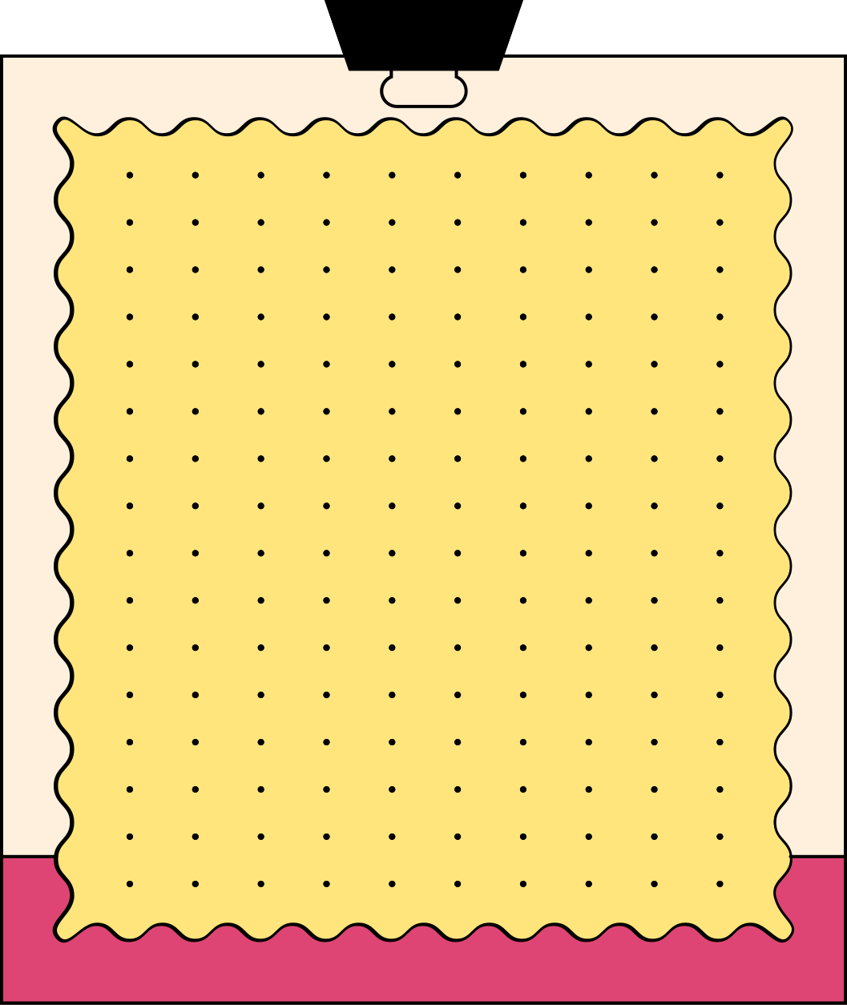
REASONS
1
2
3
The aspect ratio of a rectangle can be easily adjusted to match the content being displayed
As we are working on the UI as well these both combination would be over whelming for children , its like over doing it
For the display to be in the shape of a for example apple or some more curved one the technology of this time is not that advanced to have a touch display of that type

Slide 6
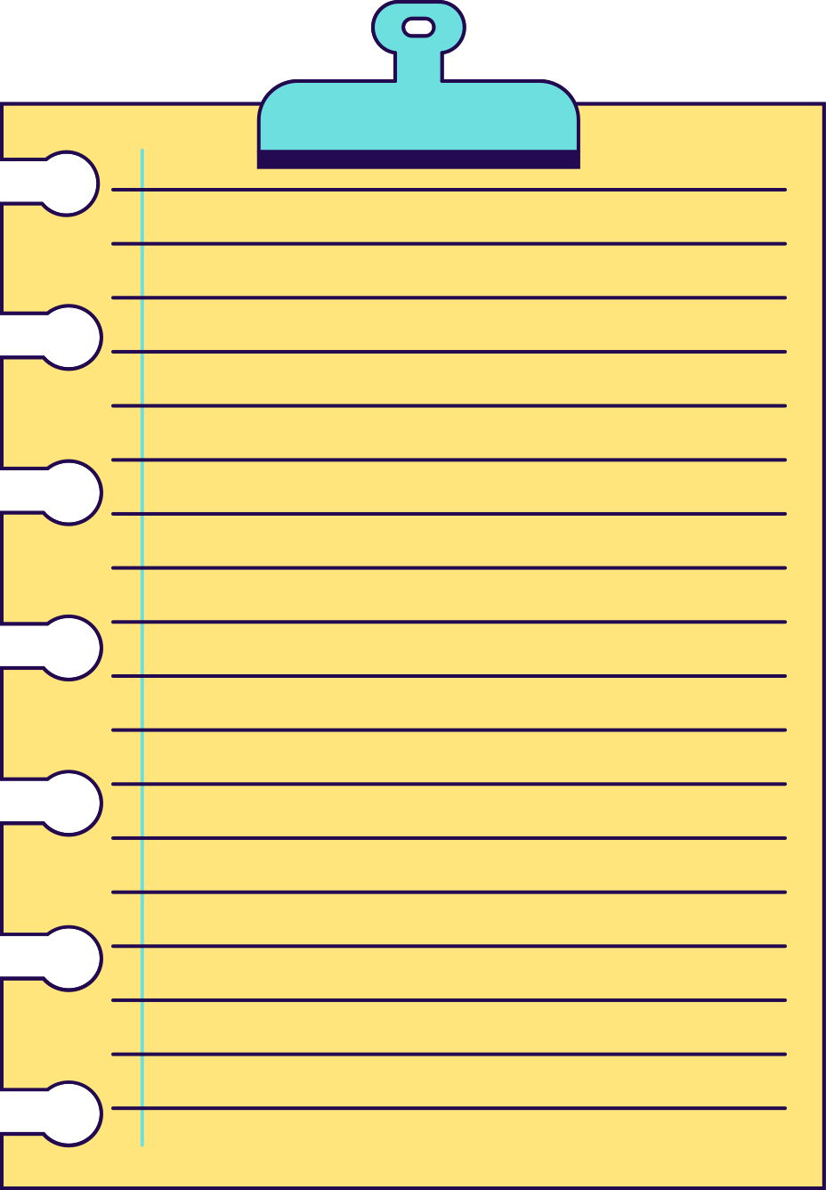
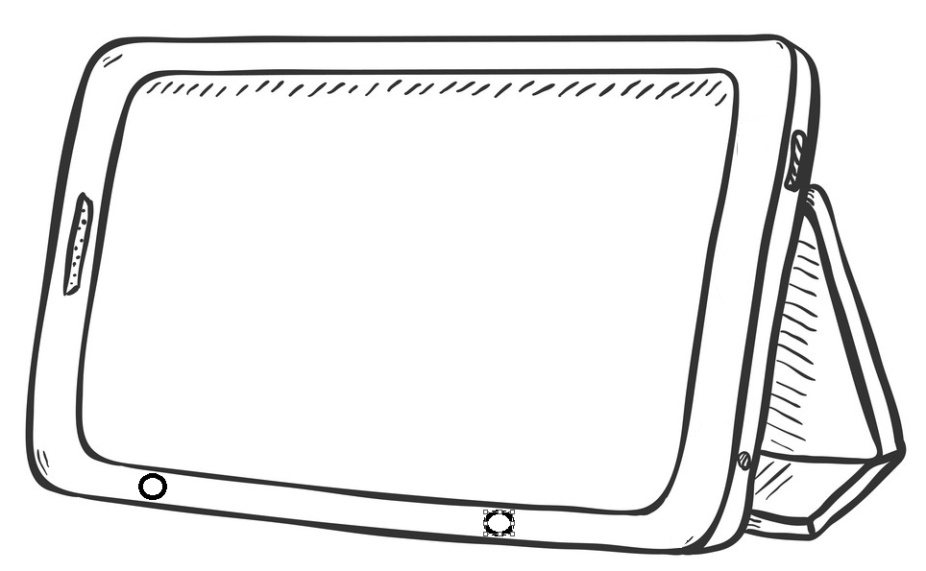
GROUND DESIGN
POINTS TO NOTE
Decent spacing between the border and display to avoid false touches
Placement of the buttons according to the frequency of use and ease of access
Design for children
Rounded corners and soft edges to reduce injuries
STAND as children may not be able to hold it for long hours

Slide 7
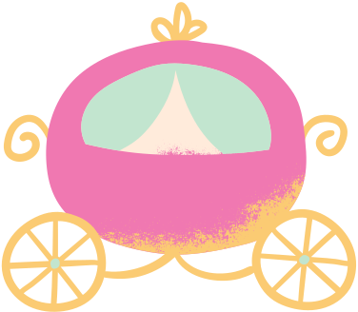
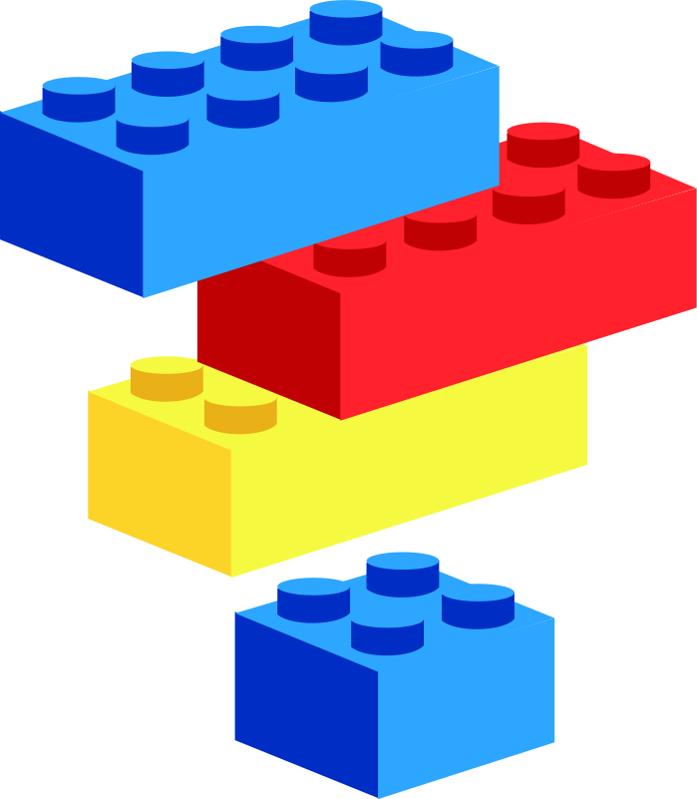

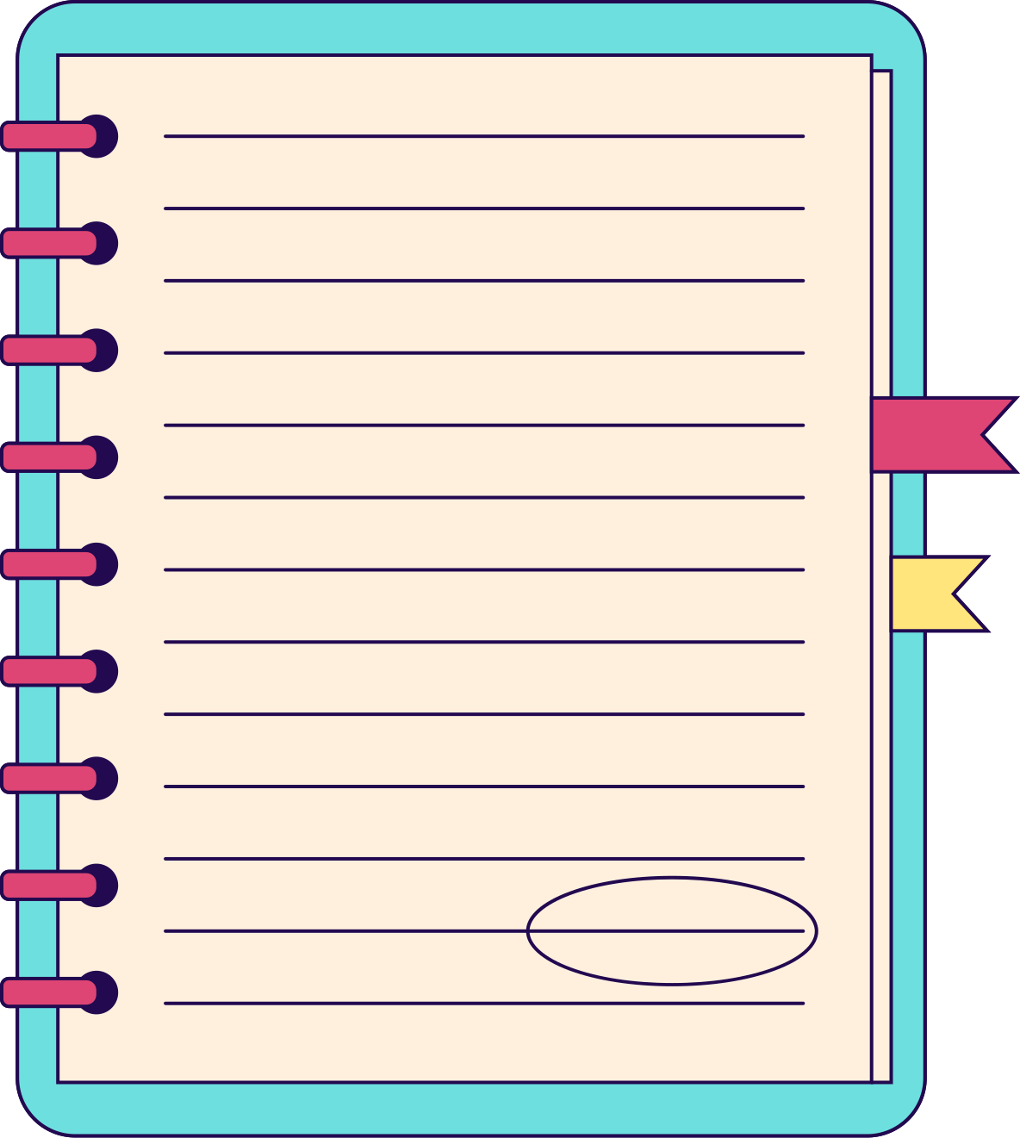
SCOPE OF JUGGLING WITH SHAPE
looking as a vehcile
looking as a book
cartoon inspiration
as a lego build
Note: keeping the display shape as rectangualr only

Slide 8
UI OF THE DEVICE

Slide 9

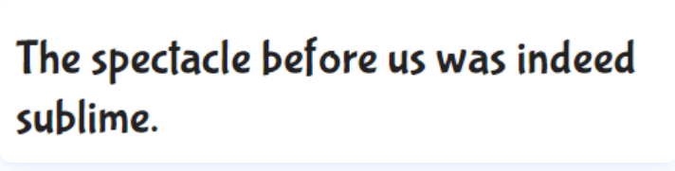

FONTS FOR THE DEVICE

Slide 10
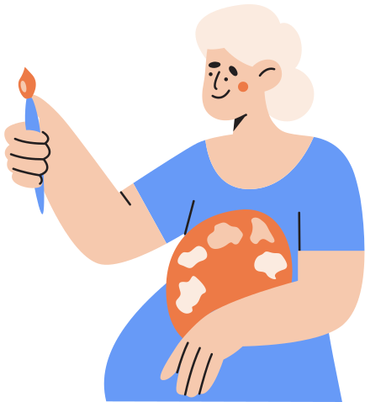
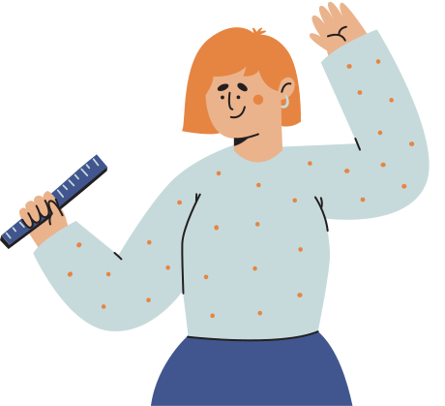
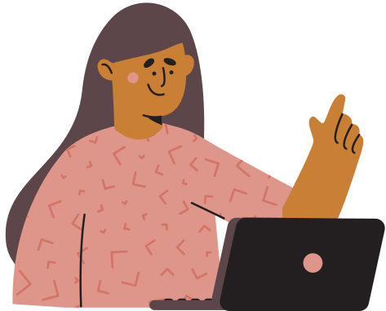
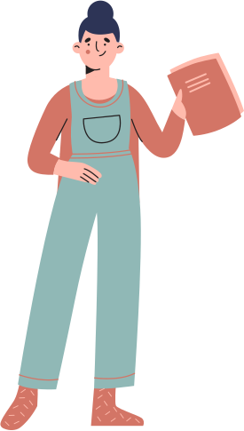
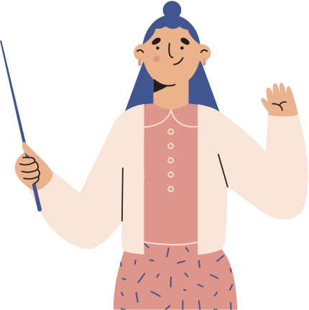


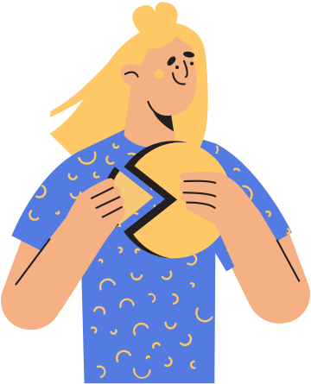
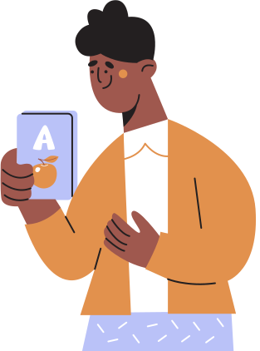

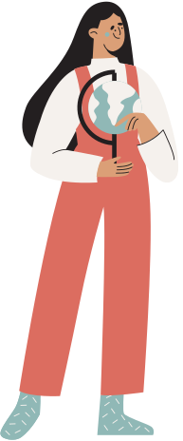
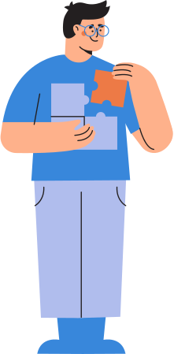
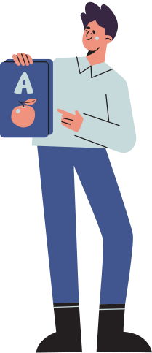
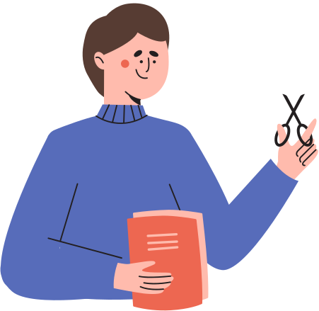



TESTING SOME ACTIO ICONS

Slide 11
ACTIVITIES

Slide 12
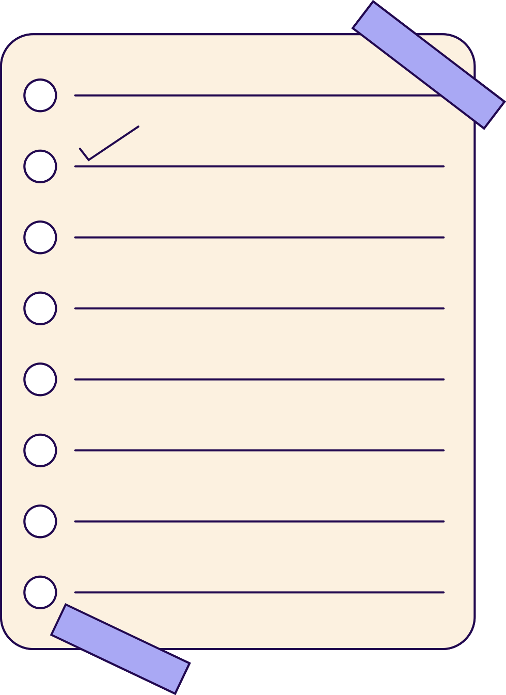
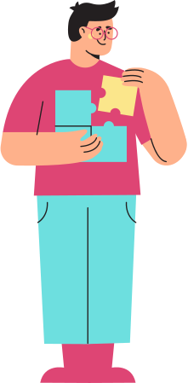
HOW TO MAKE THEM UNBIASED?
SHAPES
most of the children have a favourite animal, flower or fruit, but what they don't have is shape (square, circle etc..)
this can be induced in the activity of choosing

Slide 13
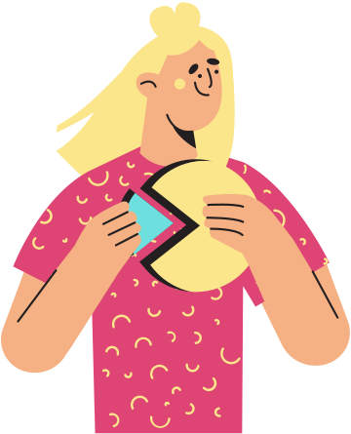
ATTENTION TOWARDS ANIMAL?
ANIMALS
Not just the cartoons they are attracted to the animal to the wild ones which are not usually seen in the surroundings like crocodiles, a animal which they are not familiar with

