Slide 1

FastX
Online Bus Ticket Booking System
Developer
Trainer
Adhitya B
Mr. Javeed

Slide 2
Project Overview
FastX is a full-featured, role-based web platform that streamlines the entire bus travel lifecycle from search to seat selection, payment, and post-booking management. The system enforces strict access control across three distinct user roles.
1
3
Passenger (User)
System Administrator
Searches buses, selects seats, books tickets, manages profile, and requests cancellations or refunds.
Oversees platform-wide metrics, verifies operators, manages user accounts, and audits all transactions.
2
Bus Operator
Manages bus schedules, fares, passenger manifests, and approves or rejects refund requests.

Slide 3
Technical Stack
FastX follows a decoupled three-tier architecture separating concerns across frontend, backend, database, and DevOps layers for scalability and maintainability.
Backend
Frontend
Spring Boot (Java 17) — Core REST API framework
Spring Security 6 — JWT stateless auth, BCrypt, @PreAuthorize
Hibernate / Spring Data JPA — ORM layer for database access
JavaMailSender — HTML/CSS responsive MIME email templates
Razorpay Java SDK — Payment creation, verification, refunds
Scheduled Tasks — Cron-based expiry scanning for seat locks
React.js + Vite — Fast HMR and optimized compilation
Bootstrap & CSS — Custom premium components, responsive layouts
React Router DOM — Role-based private route guards, 404 handling
Context API — Global auth state and session management
Axios — JWT interceptor for automatic authorization headers
React Icons — Fa, Md, Io icon sets
Database & DevOps
MySQL 8.x — Relational schema with FK constraints, indexes, soft-delete
Docker & Docker Compose — Isolated backend, frontend, and DB services
Nginx — Static file server + reverse proxy to Spring Boot API
Cloud
AWS — EC2 instance are used to deploy the project

Slide 4
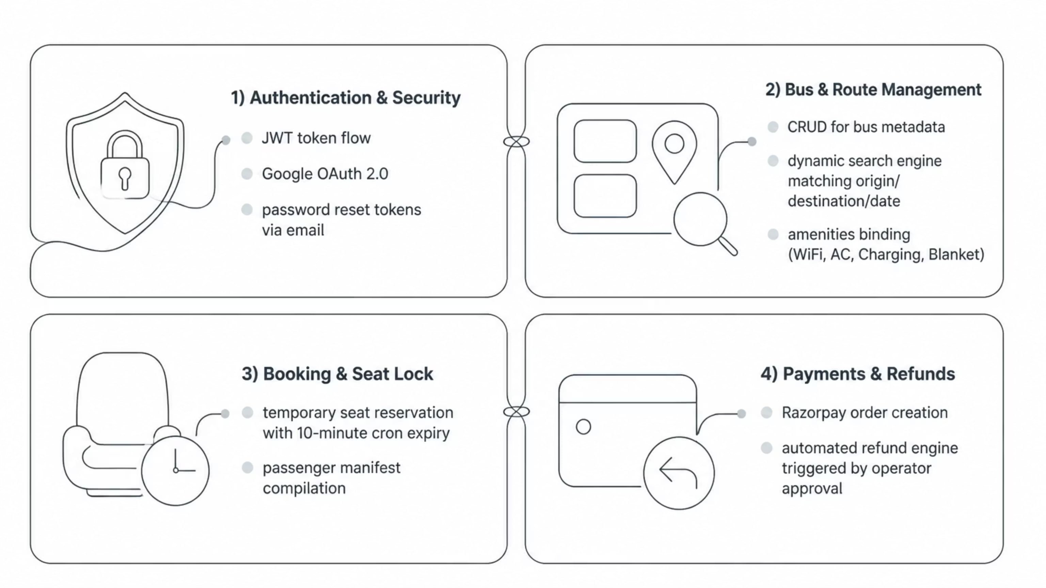
Core Modules
FastX is organized into four tightly integrated modules, each responsible for a critical domain of the booking lifecycle. The backend coordinates all module interactions through a unified Spring Boot API layer.

Slide 5



Module & Pages
FastX provides a tailored experience for each role, with dedicated pages and dashboards designed for clarity and efficiency.
Public & Auth Pages
Passenger Dashboard
Operator & Admin Dashboards
Landing Page — Interactive search field with various components
Search Results — Filterable by bus type and departure time
Login / Sign-Up — Local credentials or Google OAuth 2.0
Password Reset — Token-based recovery via email
Overview — Booking history, upcoming journeys, quick stats
Profile — Update name, phone, address, gender
Ticket Details — PDF download, cancellation requests
Payment — Checkout with countdown timer synced to seat lock
Operator Overview — Daily bookings, active buses, revenue
My Buses (CRUD) — Add/edit trips, fares, schedules
Refund Approvals — Approve (triggers Razorpay) or reject
Admin Console — Platform metrics, operator verification, user management, global refund audit

Slide 6
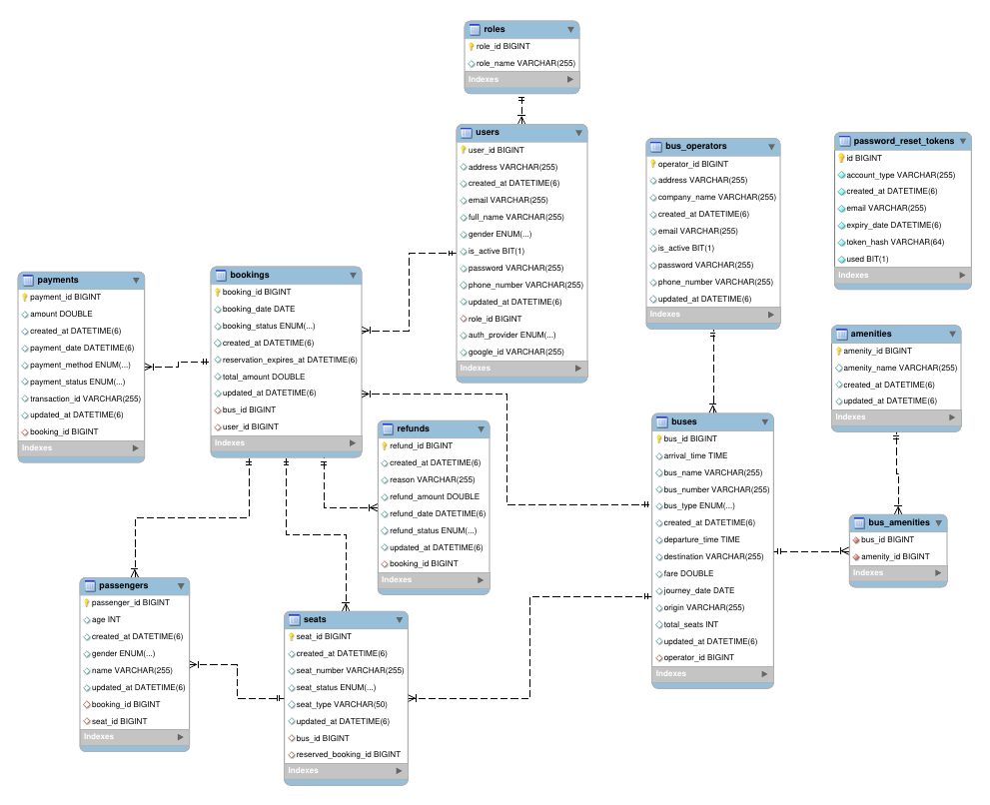
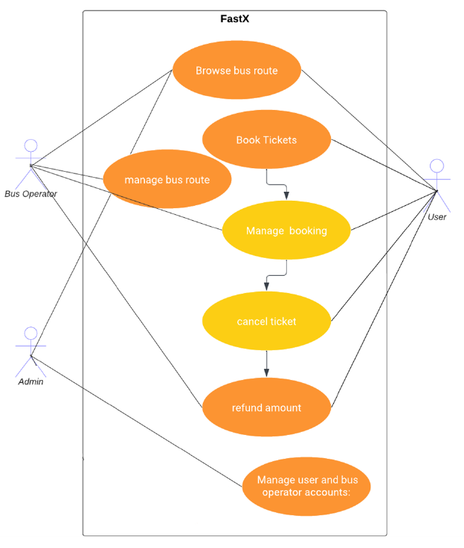
Use Case Diagram
ER Diagram

Slide 7
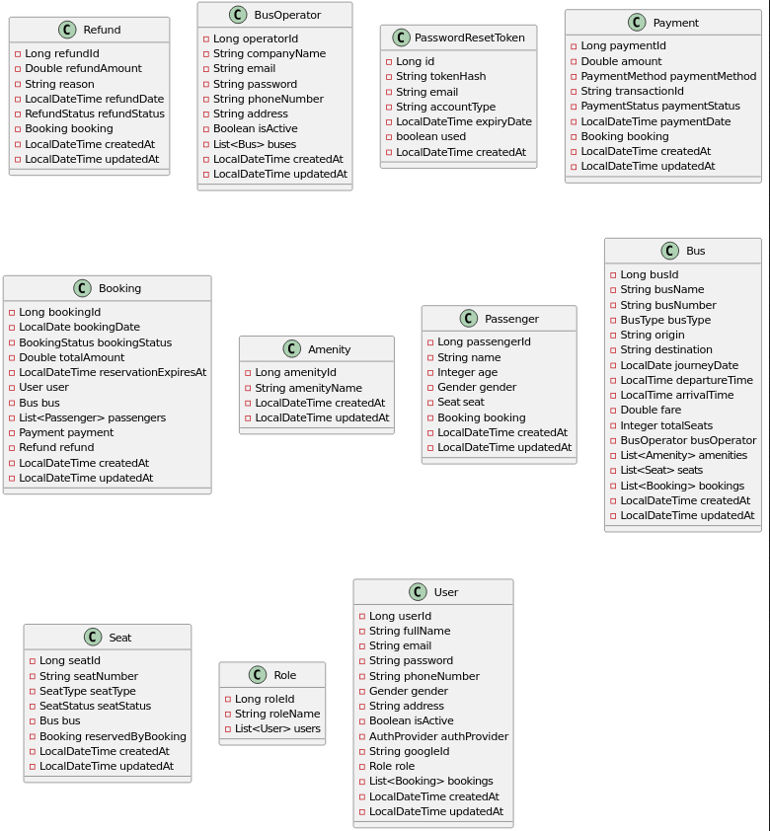
Class Diagram

Slide 8
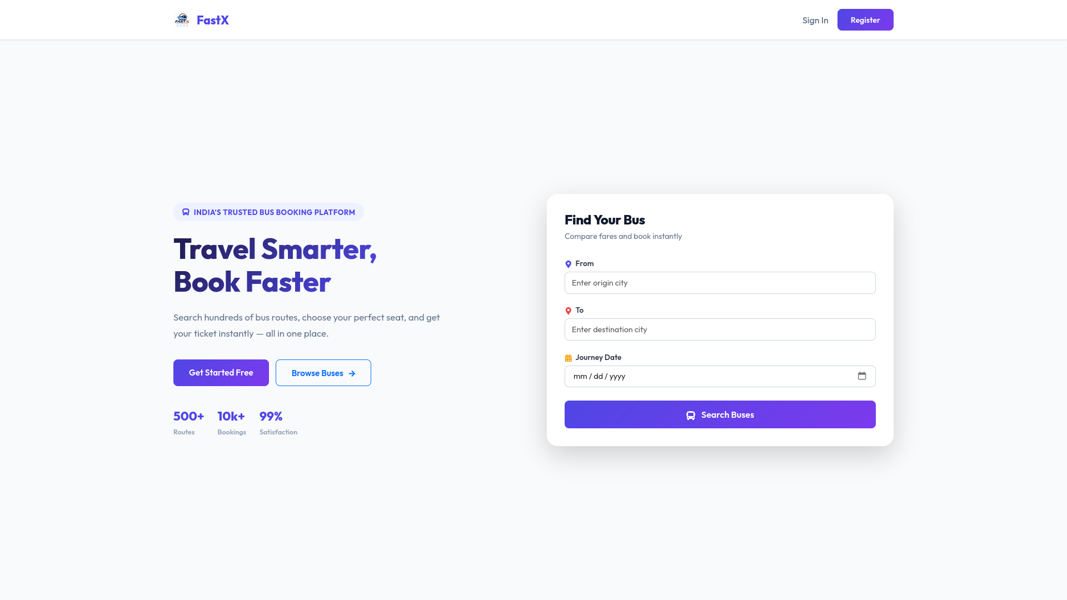
Output Screen Shots

Slide 9
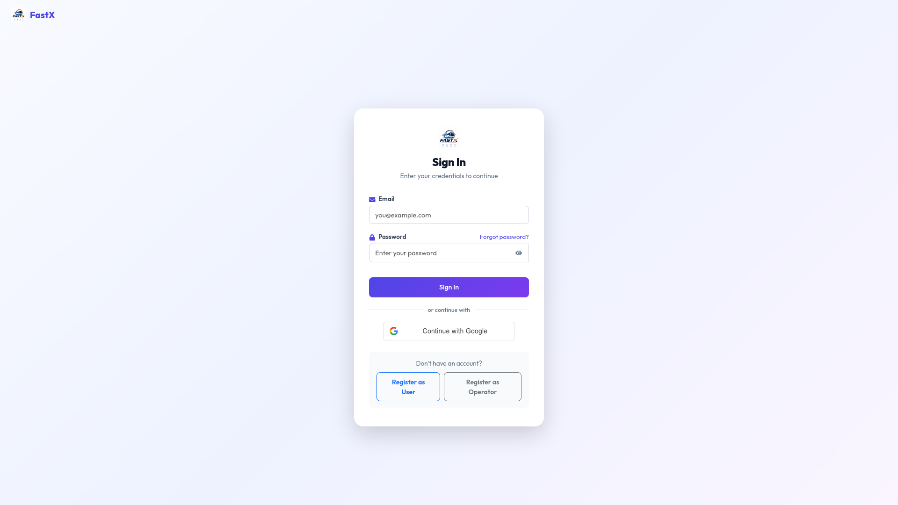

Slide 10
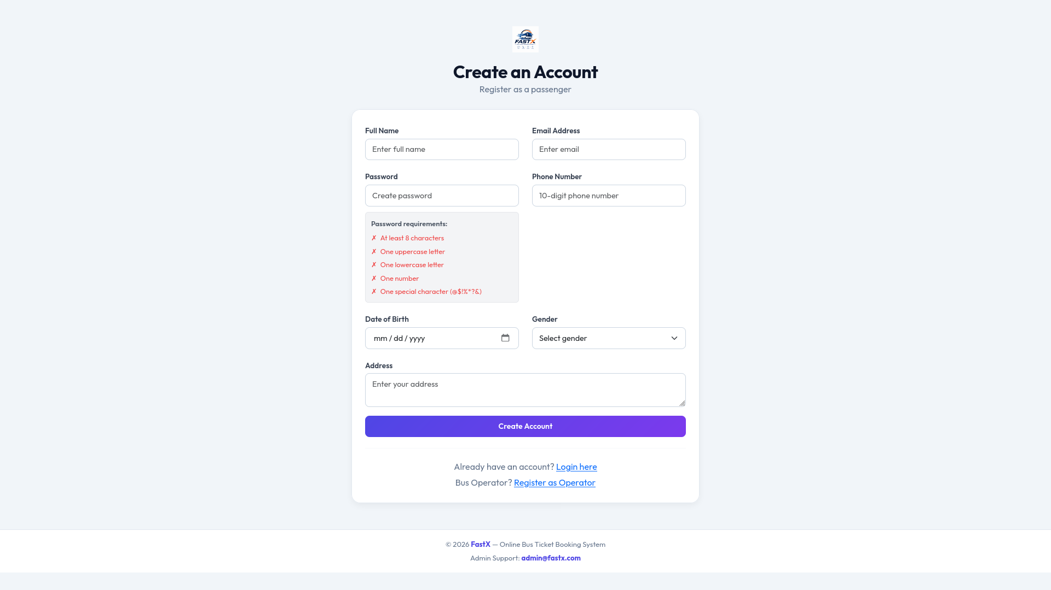

Slide 11
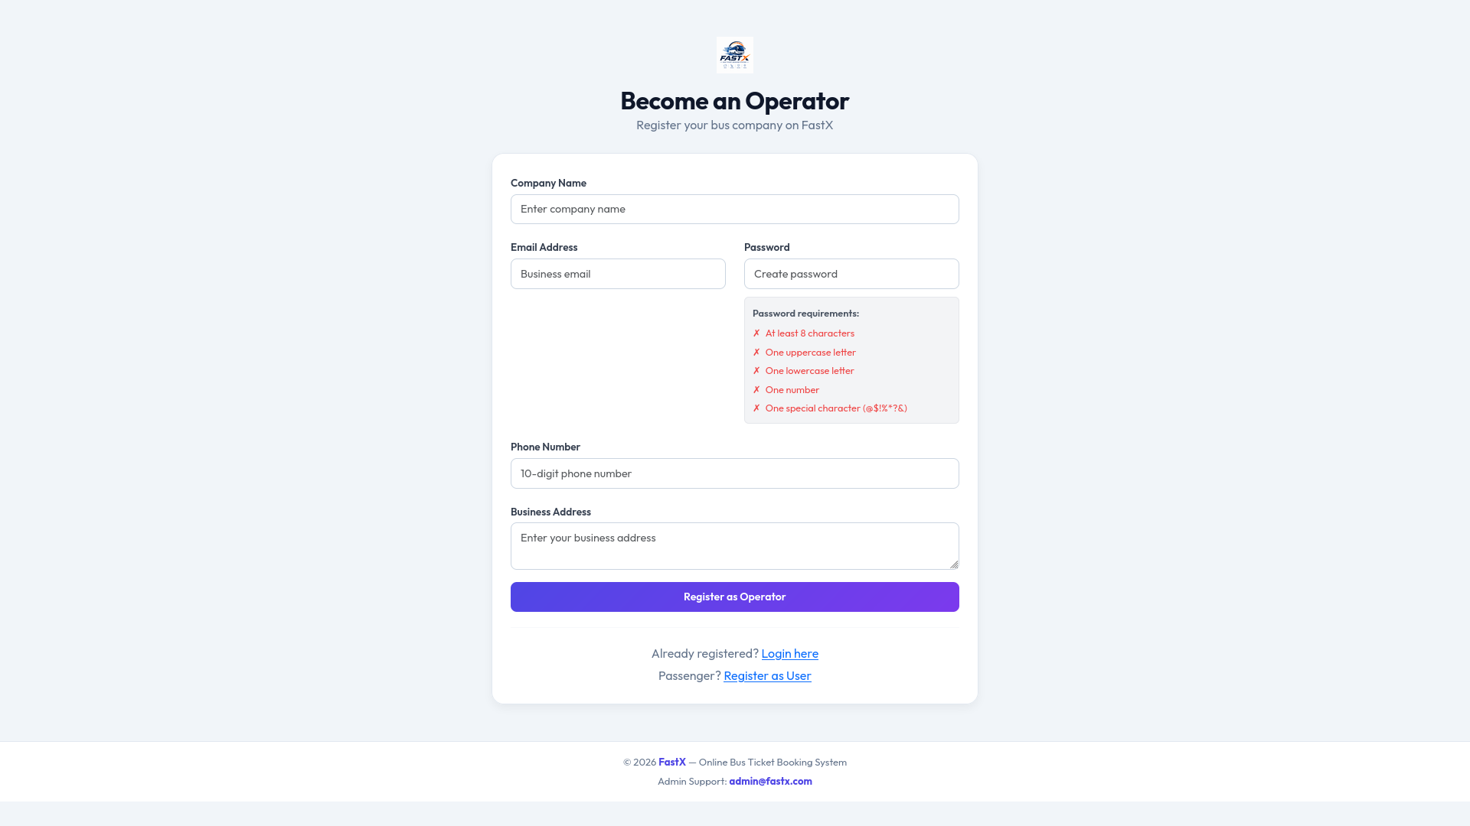

Slide 12
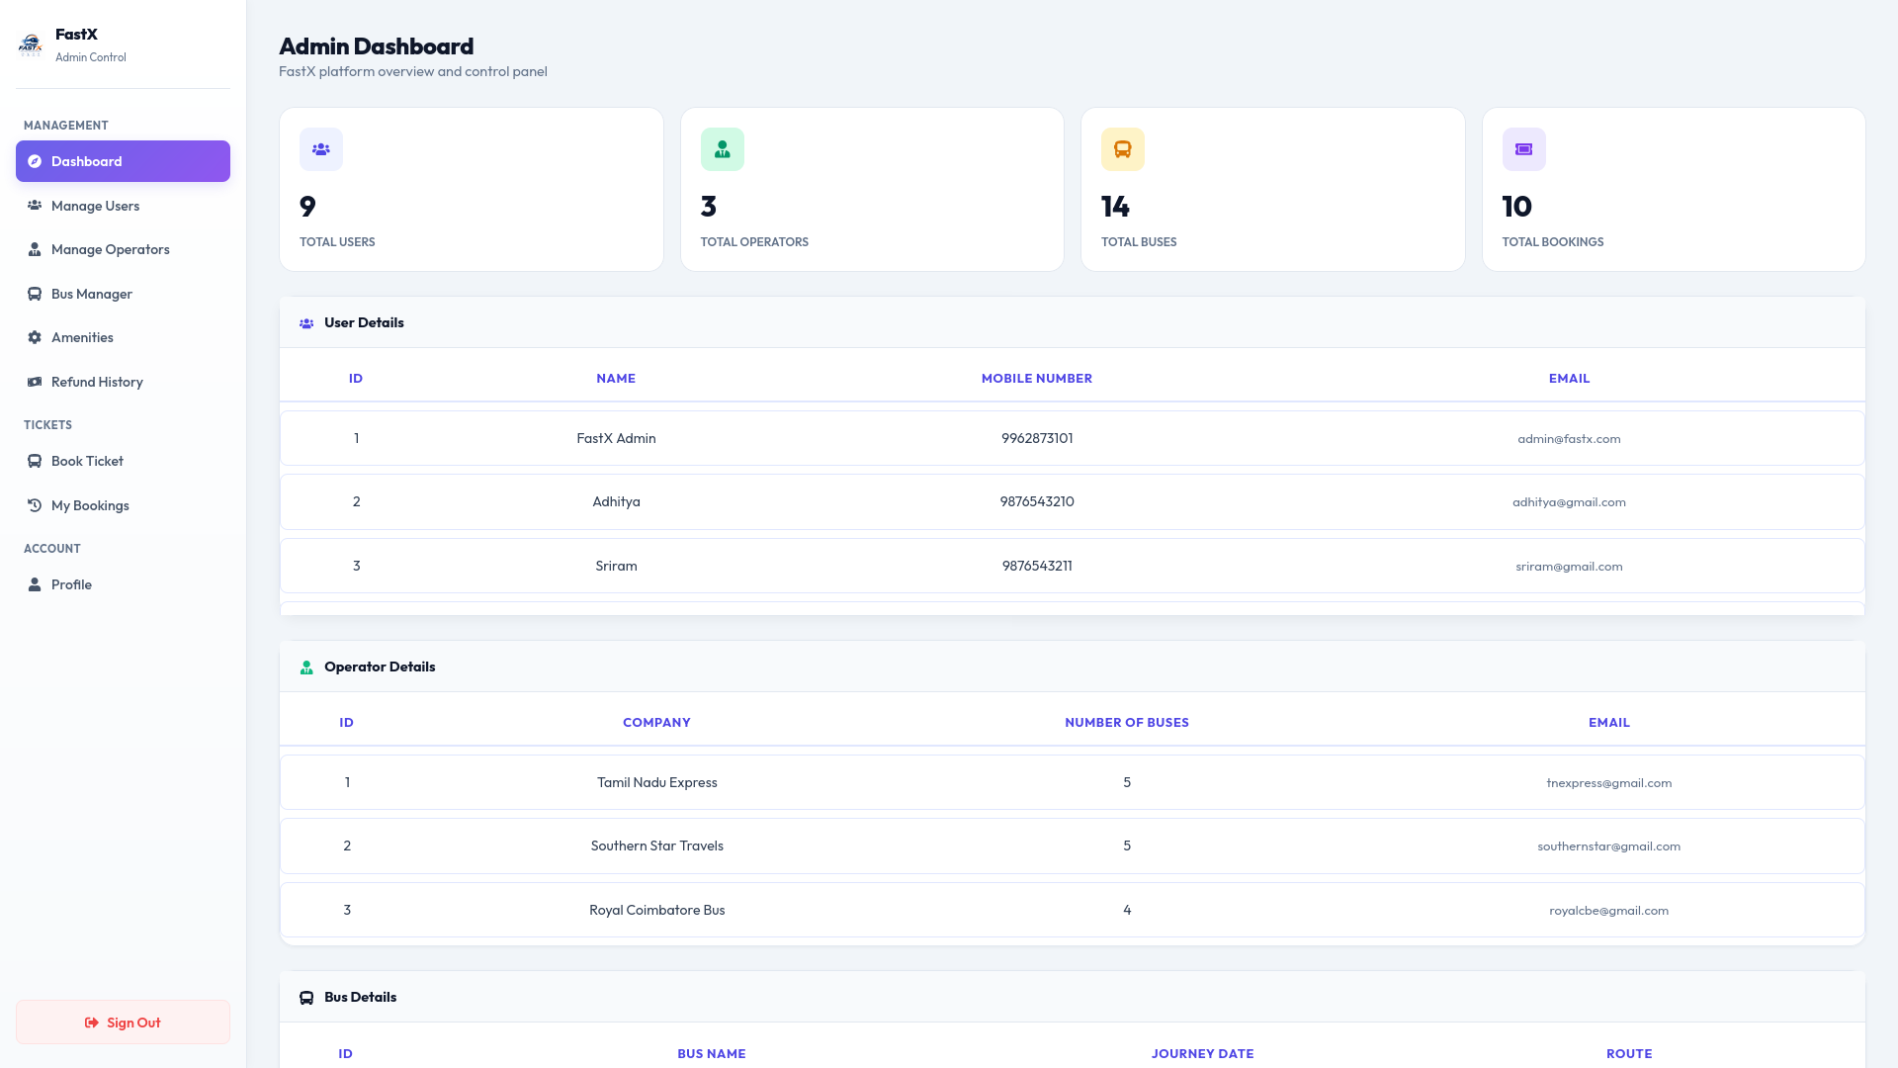

Slide 13
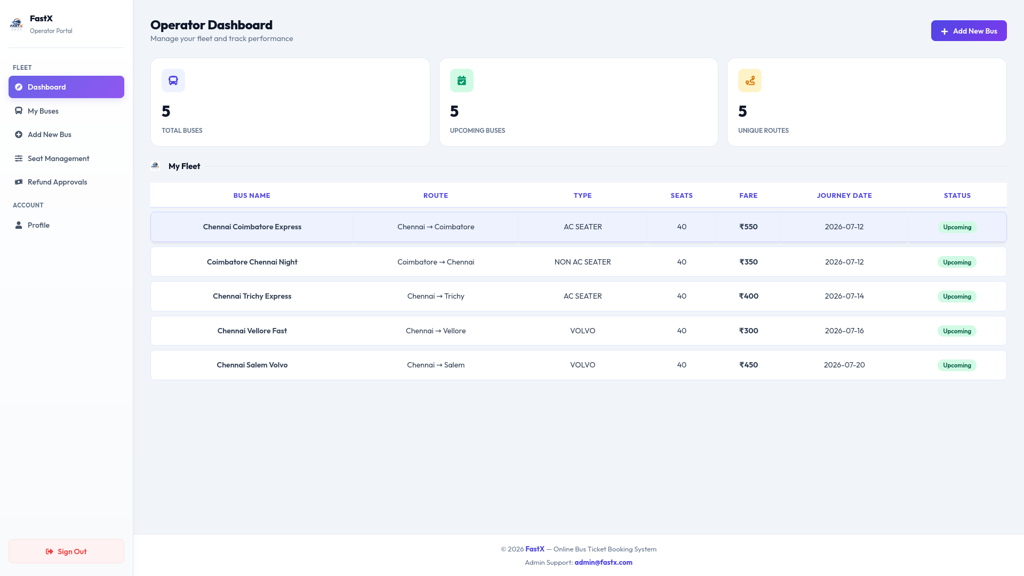

Slide 14
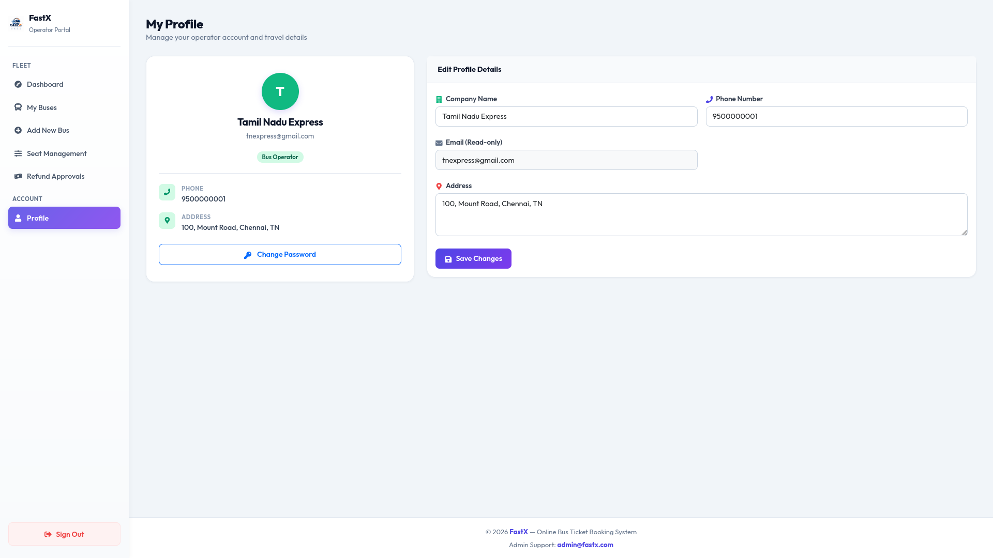

Slide 15
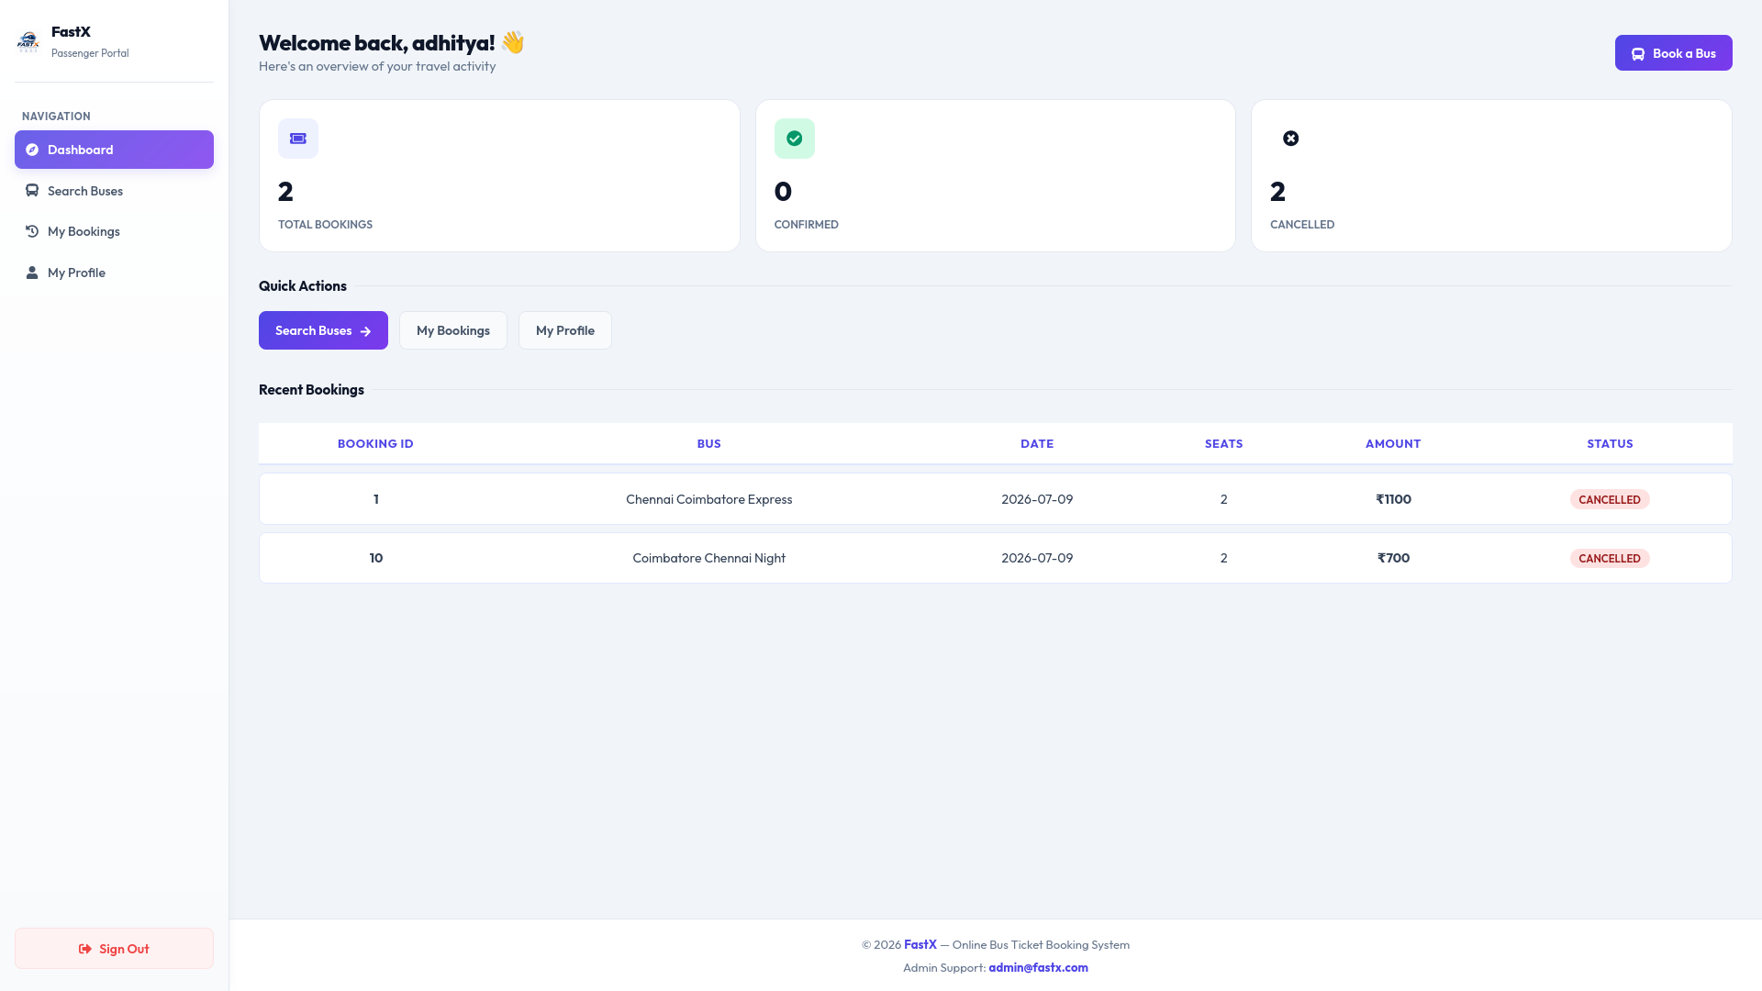

Slide 16
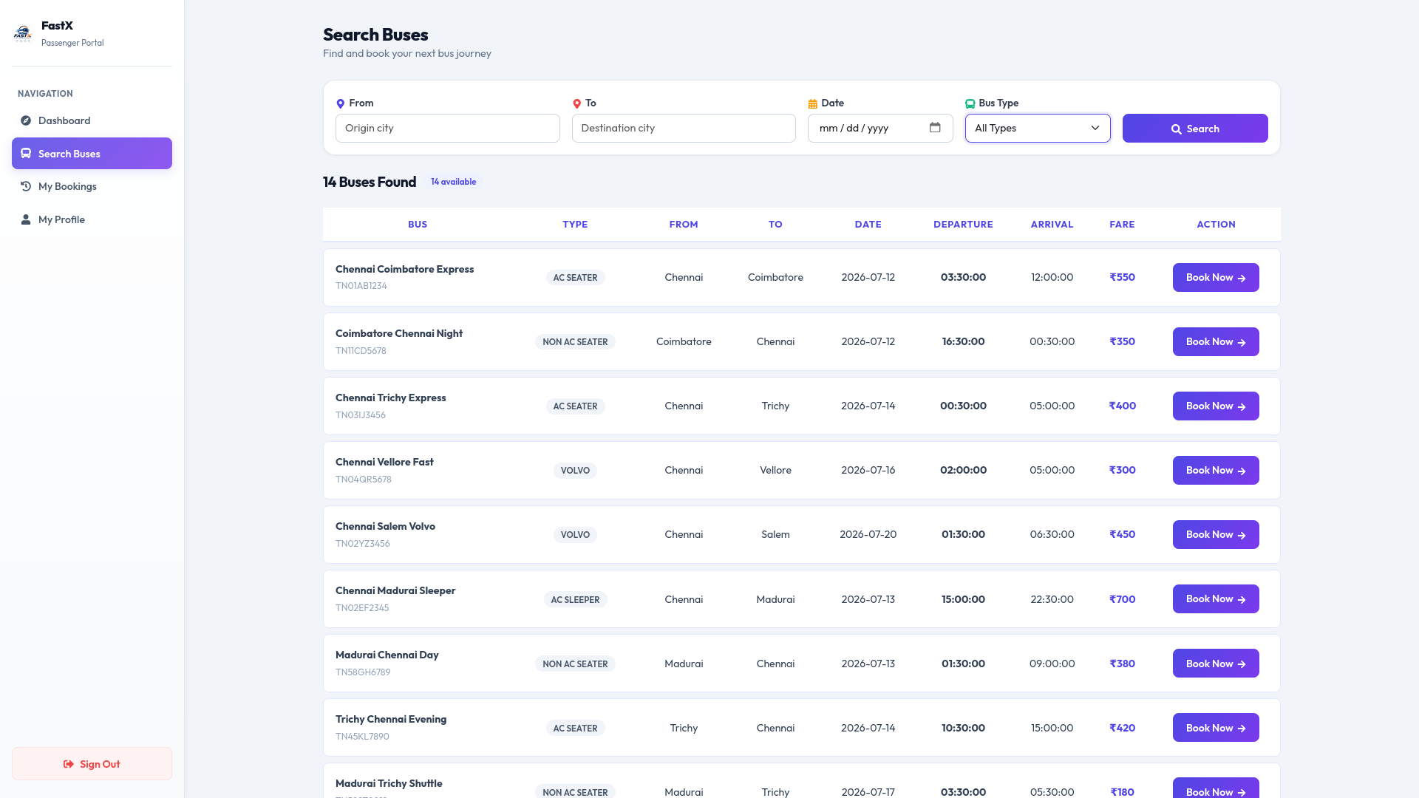

Slide 17
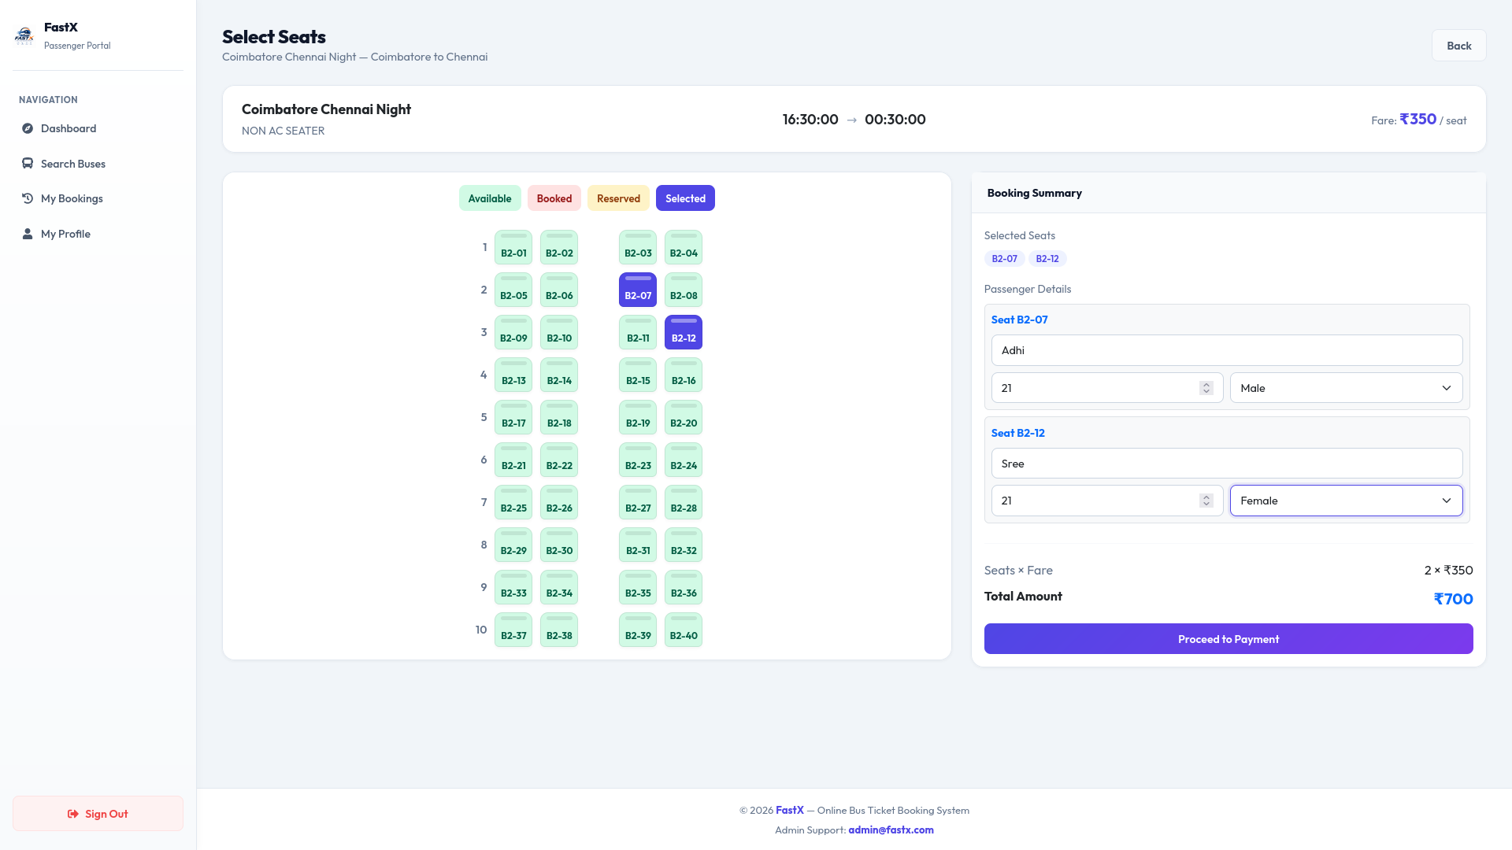

Slide 18
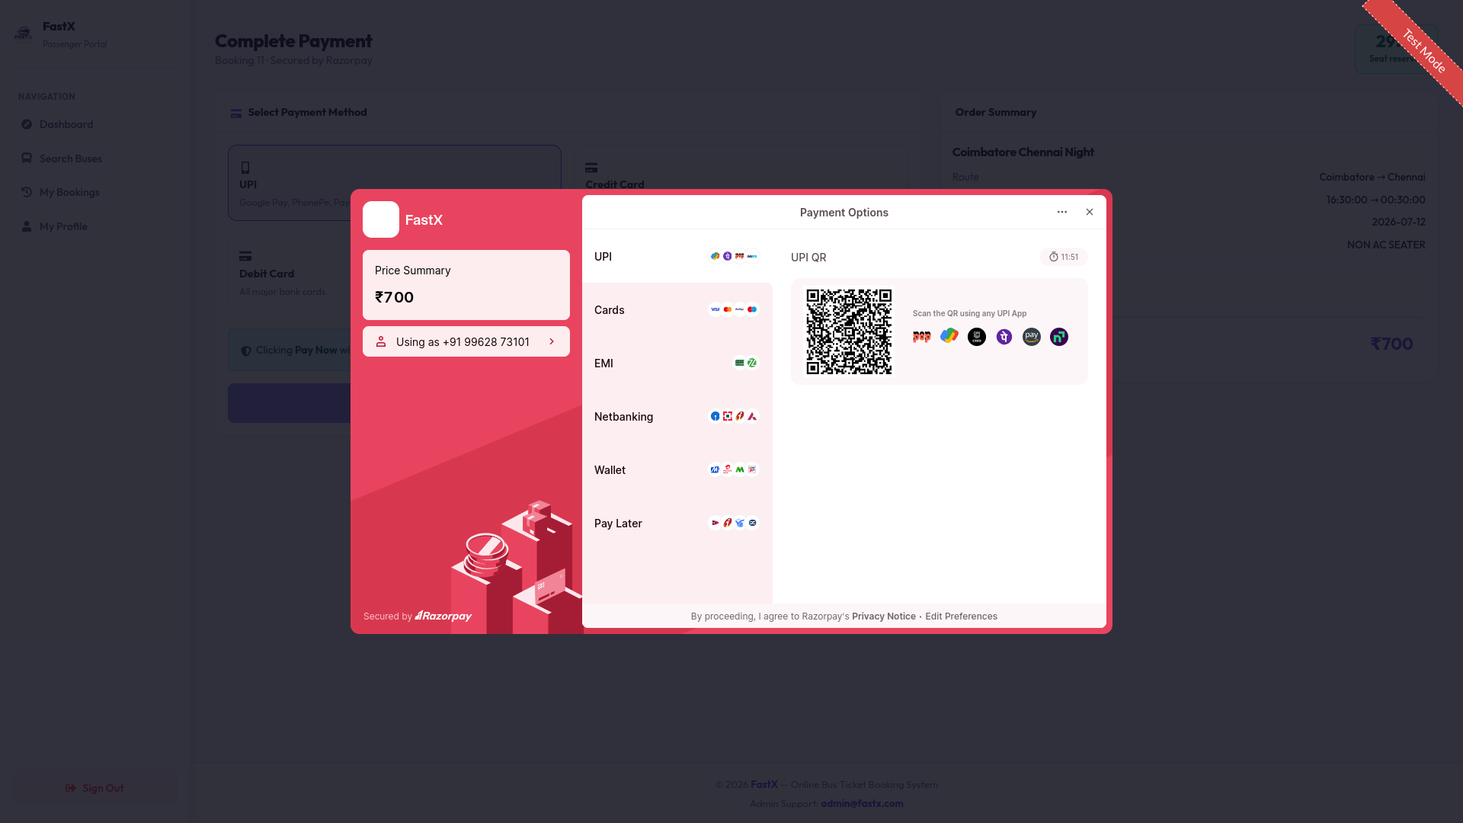

Slide 19
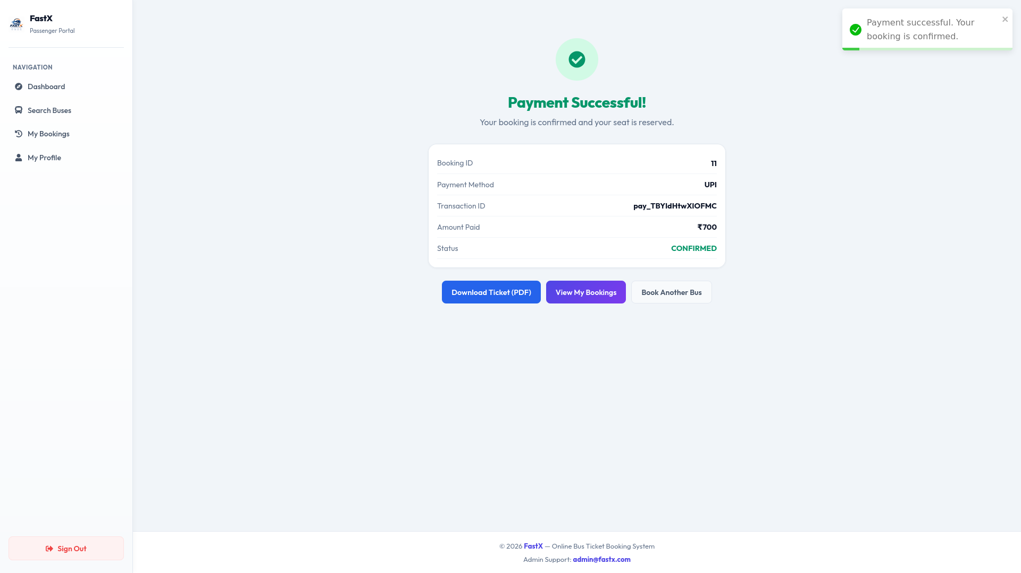

Slide 20
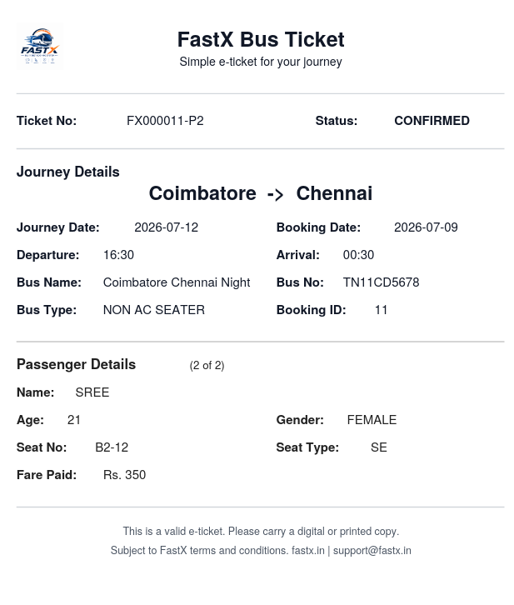
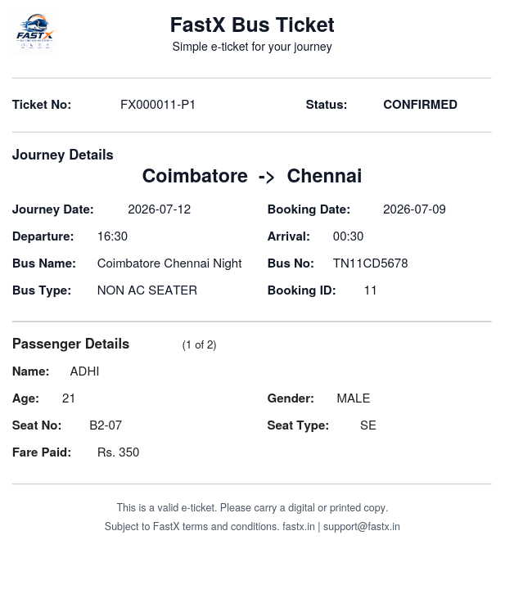

Slide 21
THANK
YOU!!!

