Slide 1
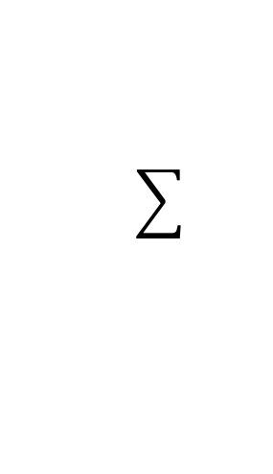
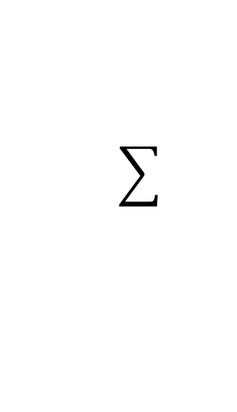
BEFORE COMMUNICATION
0
4
8
0
4
8
AFTER COMMUNICATION

