Slide 1
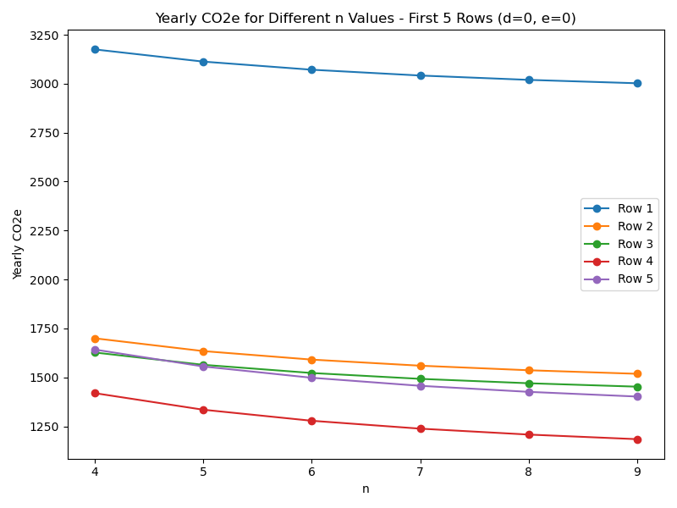
yearly_co2e= new_scope3 + new_scope2 , where
-> new_scope3 = yearly_scope3*4/n
->new_scope2 = yearly_scope2
AS d=0 and e=0
Notes:
Increasing the lifetime, yearly co2e reduces.—base case.

Slide 2
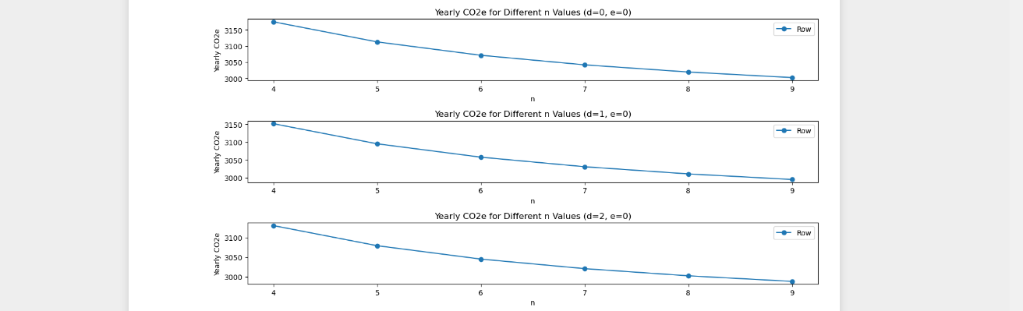
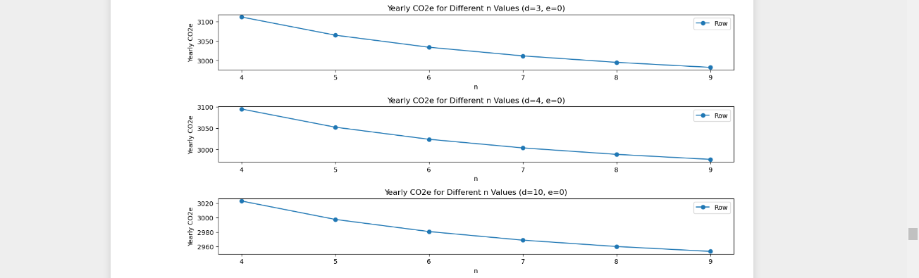
n changes and d increases from 0,2,4,6,8,10. but e=0. Yearly CO2e value is decreasing as d value is increasing & e=0.
Notes:
Takeaway: As d value gets higher and higher , embodied carbon gets cheaper which means it is not very helpful to have longer lifetime

Slide 3
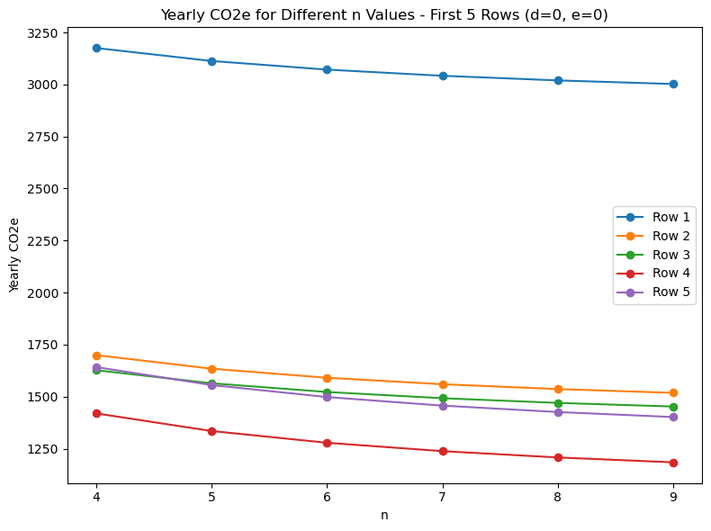
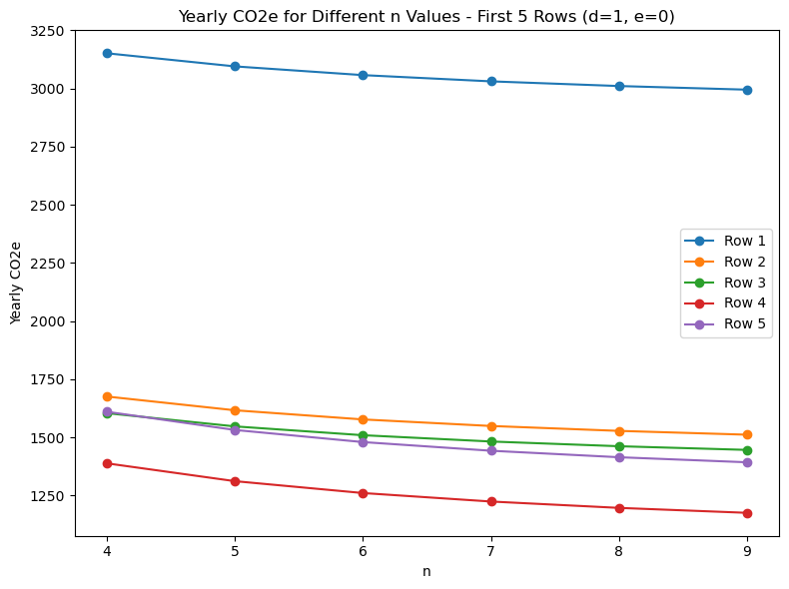
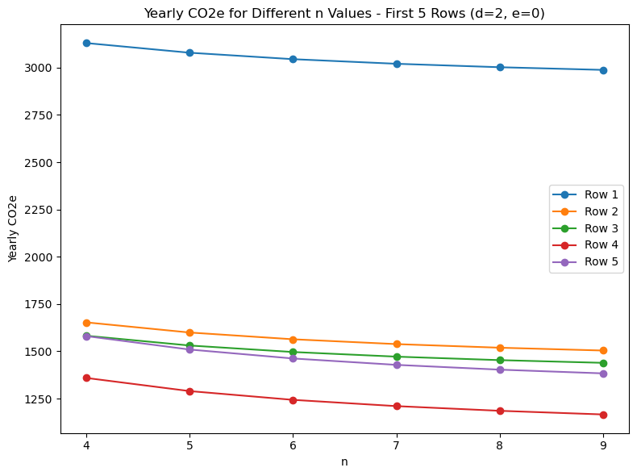
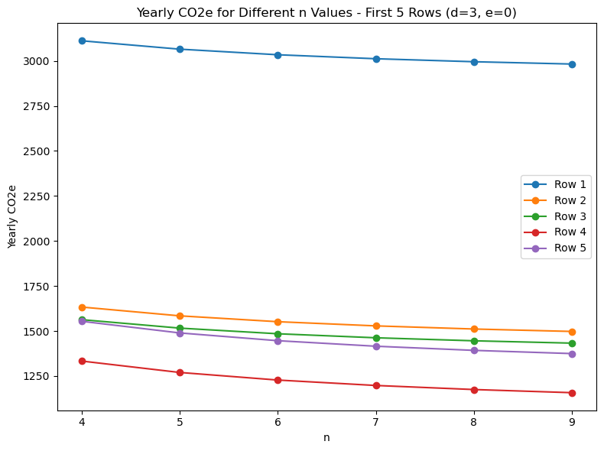

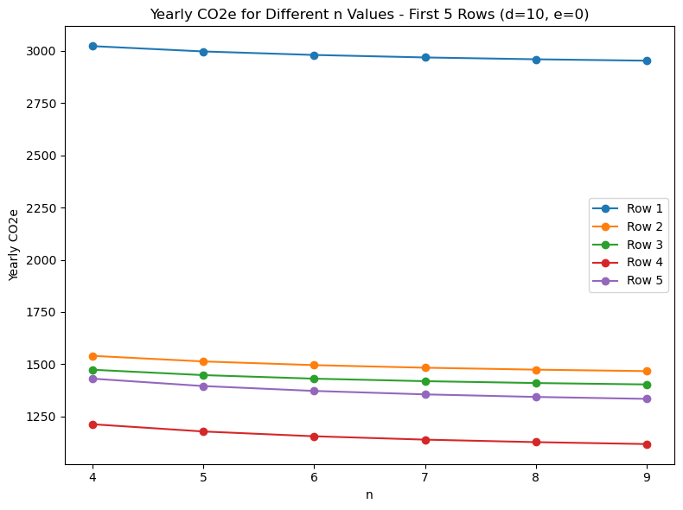
With efficiency being zero and d value increasing the carbon emitted is decreasing and over n years also the carbon emitted is decreasing
Notes:
The curve trend is similar to the base case and as d value gets higher and higher , embodied carbon gets cheaper, which means it is not very helpful to have longer lifetime.

Slide 4
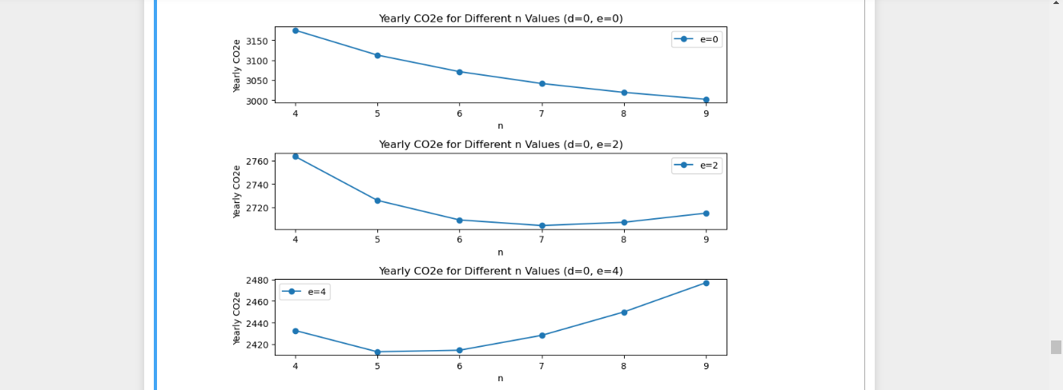
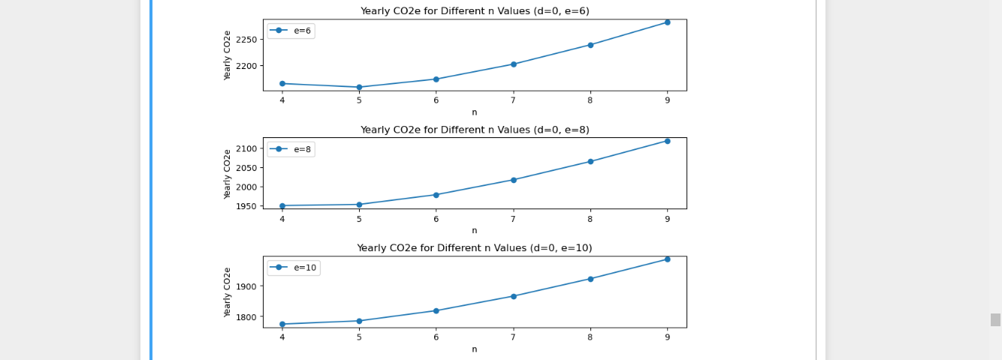
n changes and e increases from 0,2,4,6,8,10. but d=0 . Yearly CO2e value is decreasing as e value is increasing and d=0 ,also we can notice the optimal lifetime years is decreasing
Notes:
Takeaway: As e value is increasing it gets more efficient, which means increasing lifetime should not be helpful.( We can notice the minima decreasing as e value is increasing).

Slide 5
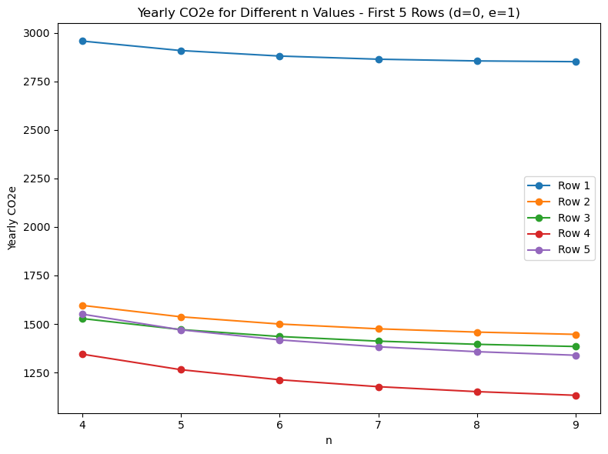
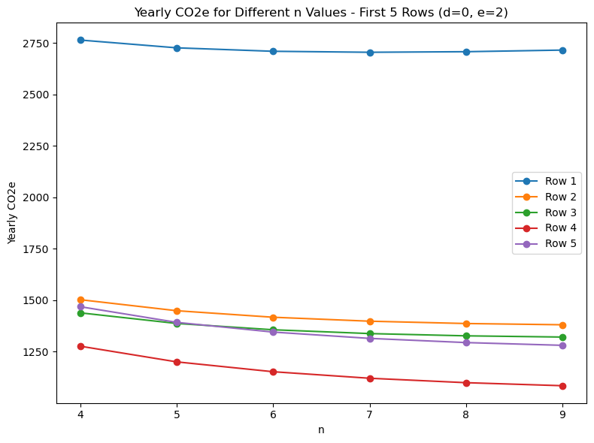
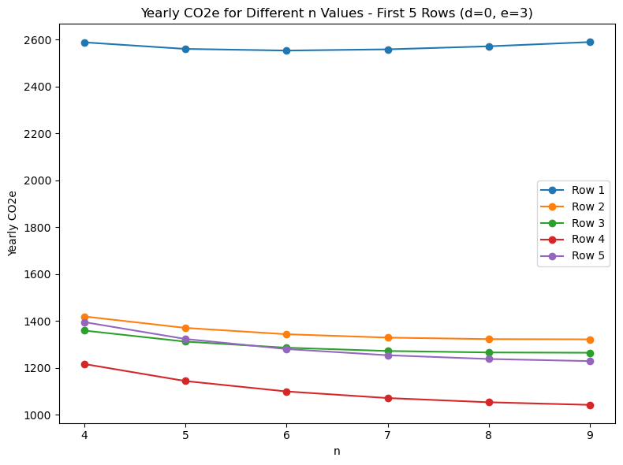
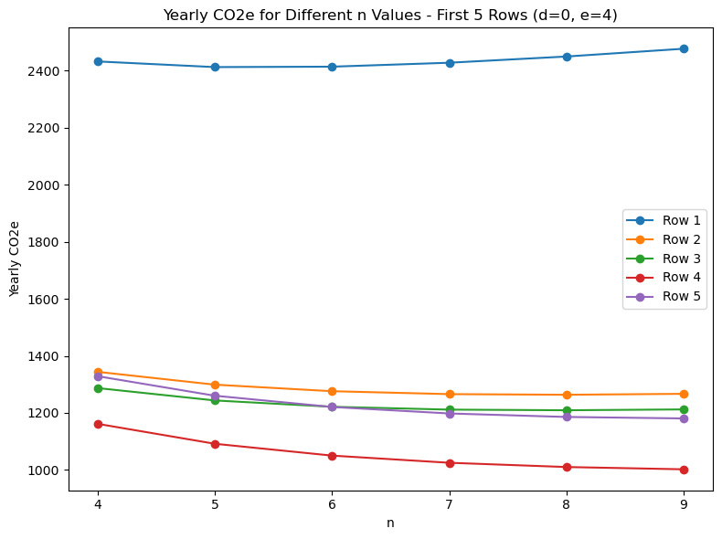
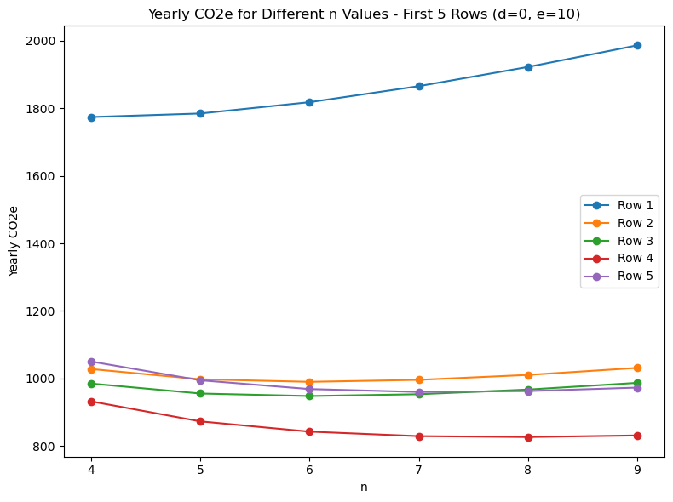
As the d value is increasing with e value being zero , the yearly co2e value is decreasing as d represents how much lower is embodied carbon every year. as the efficiency parameter (e) increases, there is a more noticeable reduction in yearly CO2e values, It reflects the potential benefits of improved efficiency in mitigating embodied carbon emissions over time.
Notes:
Takeaway: The curve trend is similar to the base case ie., as e value is increasing it gets more efficient, which means increasing lifetime should not be helpful.

Slide 6
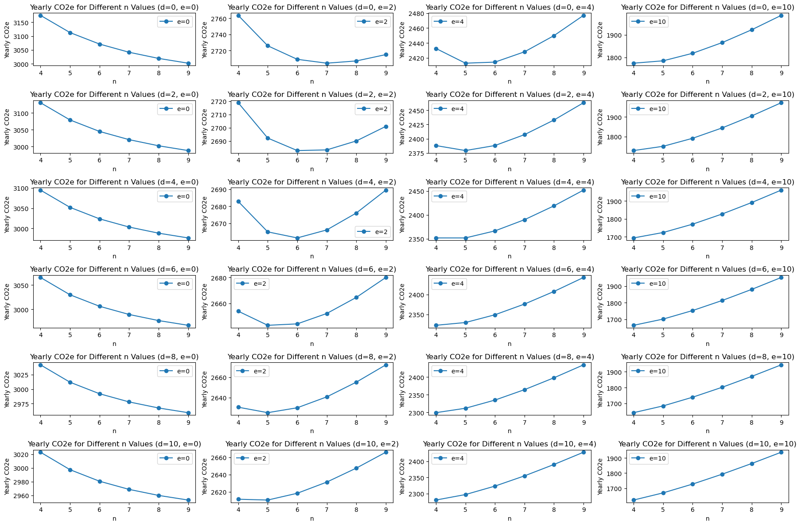
The below graph is for {Dell- PowerEdge C4130 } and e increases from 0, 2, 4, 10 & d=0, 2, 4, 6, 8, 10. when d=0 the and e value is increasing, the carbon emission is decreasing . And when d is increasing and e=0 the carbon emission is decreasing (The increase in d value is not effecting as much as increase in e value is effecting the carbon emission comparing (d=2,e=2) with (d=2,e=4) & (d=4,e=2))
Notes:
. The curve trend is same for different manufacturers in case where e=0 and d is increasing as the optimal lifetime is 9 years and also in case where curve trend for d=0 and as e is increasing the optimal lifetime is decreasing (values are different but the curve trend is similar)
-----The optimal lifetime at d=0,e=10 is at ‘4th year’
-----comparing d=2,e=2 with d=4,e=2 , the curve dip doesn’t have much difference whereas d=2,e=2 being compared with d=2,e=4, the curve dip has higher changes i.e, it has moved from 7th year to 5th year, it means that as it gets more efficient optimal life is being effected & reduced majorly over years

Slide 7
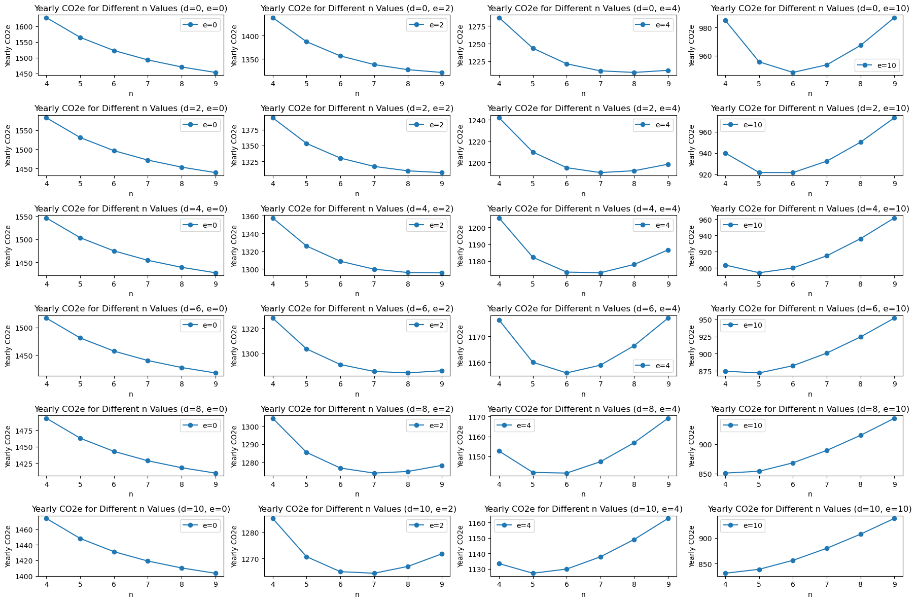
The below graph is for {Dell PowerEdge C4140 } and e increases from 0, 2, 4, 10 & d=0, 2, 4, 6, 8, 10. when d=0 the and e value is increasing, the carbon emission is decreasing . And when d is increasing and e=0 the carbon emission is decreasing (The increase in d value is not effecting as much as increase in e value is effecting the carbon emission)
Notes:
. The curve trend is same for different manufacturers in case where e=0 and d is increasing as the optimal lifetime is 9 years and also in case where curve trend for d=0 and as e is increasing the optimal lifetime is decreasing (values are different but the curve trend is similar)
-----The optimal lifetime at d=0,e=10 is at ‘6th year’
-----comparing d=2,e=2 with d=4,e=2 , the curve dip doesn’t have much difference whereas d=2,e=2 being compared with d=2,e=4, the curve dip has higher changes i.e, it has moved from 8th year to 7th year, it means that optimal life is being effected & reduced majorly over years

Slide 8
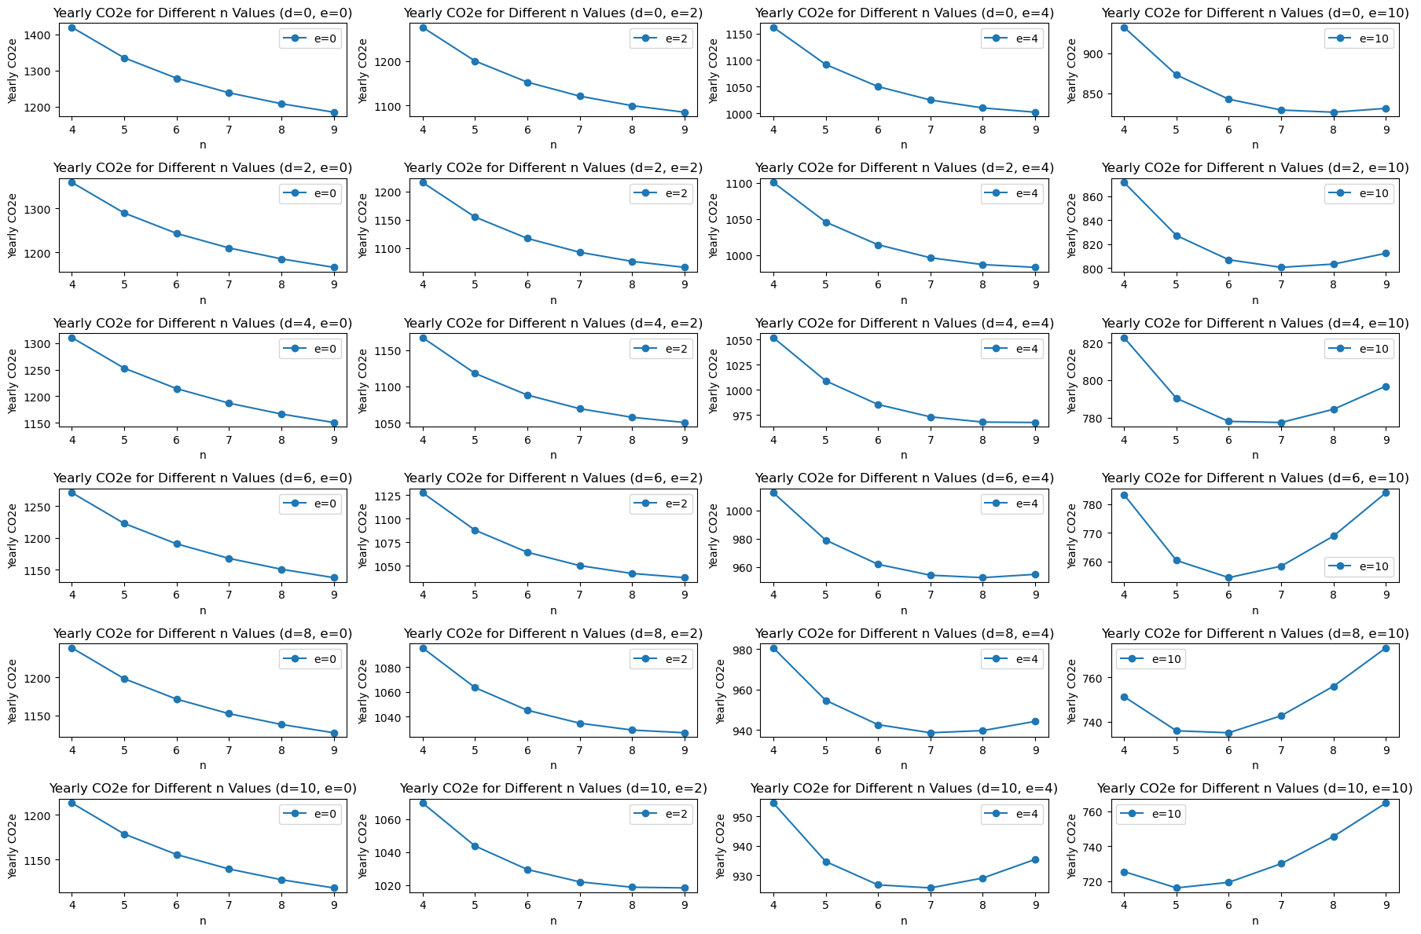
The below graph is for {Dell PowerEdge C6420} when d=0 the and e value is increasing, the carbon emission is decreasing . And when d is increasing and e=0 the carbon emission is decreasing
Notes:
. The curve trend is same for different manufacturers in case where e=0 and d is increasing as the optimal lifetime is 9 years and also in case where curve trend for d=0 and as e is increasing the optimal lifetime is decreasing (values are different but the curve trend is similar)
-----The optimal lifetime at d=0,e=10 is at ‘8th year’
------The increase in d value is not effecting as much as increase in e value is effecting the carbon emission ,comparing (d=2,e=2) with (d=2,e=4)&(d=2,e=10) and also with (d=4,e=2))

Slide 9
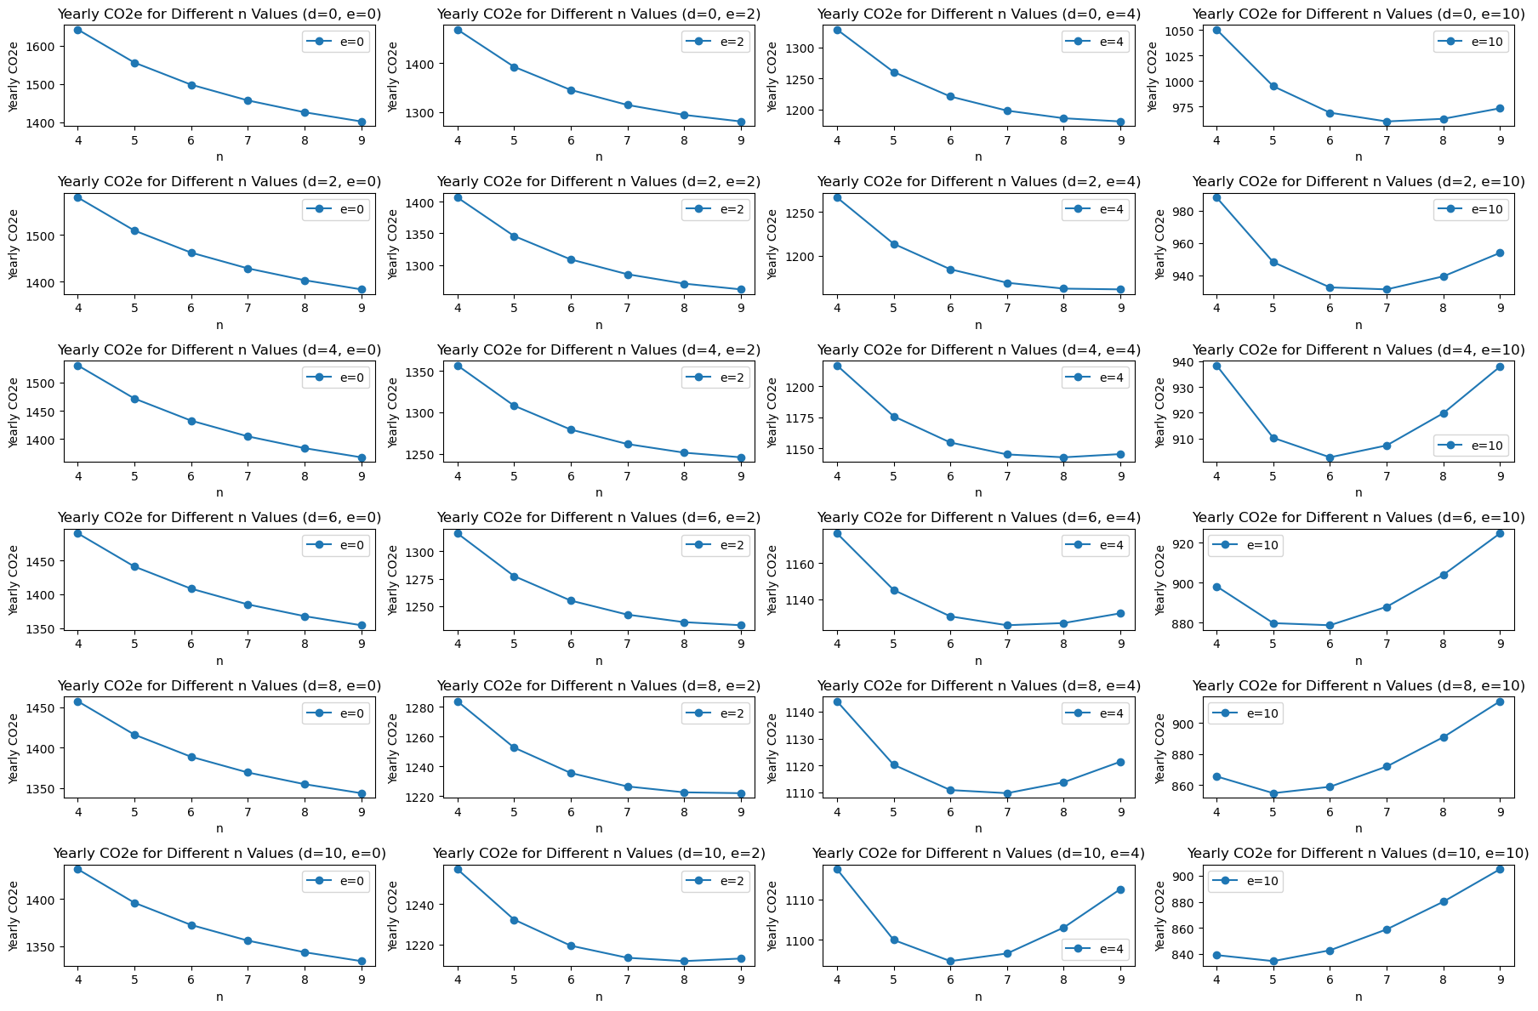
The below graph is for {Dell PowerEdge FC430} when d=0 the and e value is increasing, the carbon emission is decreasing . And when d is increasing and e=0 the carbon emission is decreasing
Notes:
. The curve trend is same for different manufacturers in case where e=0 and d is increasing as the optimal lifetime is 9 years and also in case where curve trend for d=0 and as e is increasing the optimal lifetime is decreasing (values are different but the curve trend is similar)
-----The optimal lifetime at d=0,e=10 is at ‘7th year’
------ The increase in d value is not effecting as much as increase in e value is effecting the carbon emission ,comparing (d=2,e=2) with (d=2,e=4)&(d=2,e=10) and also with (d=4,e=2))

Slide 10
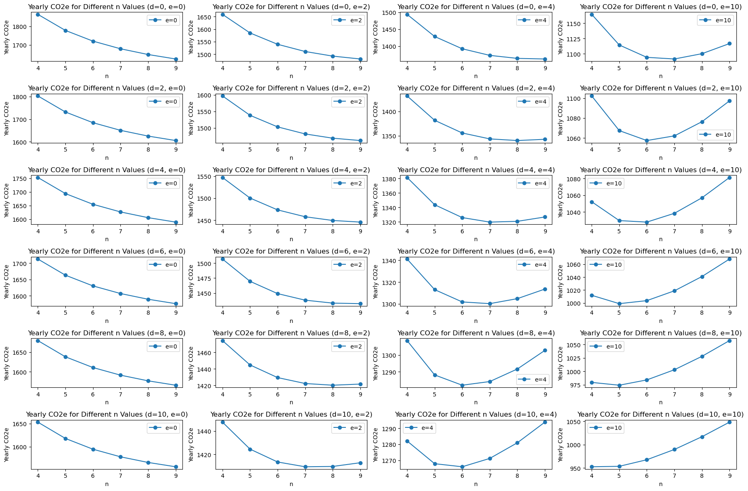
The below graph is for{Dell PowerEdge FC630 } when d=0 the and e value is increasing, the carbon emission is decreasing . And when d is increasing and e=0 the carbon emission is decreasing
Notes:
. The curve trend is same for different manufacturers in case where e=0 and d is increasing as the optimal lifetime is 9 years and also in case where curve trend for d=0 and as e is increasing the optimal lifetime is decreasing (values are different but the curve trend is similar)
-----The optimal lifetime at d=0,e=10 is at ‘7th year’
------ The increase in d value is not effecting as much as increase in e value is effecting the carbon emission ,comparing (d=2,e=2) with (d=2,e=4)&(d=2,e=10) and also with (d=4,e=2))

