Slide 1
Classifying Customer Subscription Based on Demographical & Marketing Data
Presented by : Meher Adheeth Hundi
UMID: 36920130
Graduate Student – Data Science
College of Engineering & Computer Sciences

Slide 2

Walk Through
Dataset Overview
Exploratory Data Analysis
Feature Engineering
Model Selection
Model Tuning
Model Results
Conclusion
Problem Definition
Sampling Data

Slide 3
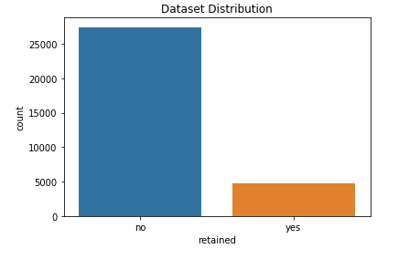
Dataset Overview
A Portuguese bank Marketing data from year 2008
Has, 16 variables & 1 target variable
Overall – 45,000 rows
Imbalanced towards Negative (0) target values with 88%
Overall Feature generalization :
Bank Customers Demographics features (Age, Occupation, Marital, Education)
Customer Banking demographic features (balance, default credit, housing & personal loan)
Previous Campaign features (contact, day, month, duration)
Current Campaign Features (campaign, pdays, poutcome, previous)
Notes:
The data is related with direct marketing campaigns of a Portuguese banking institution. The marketing campaigns were based on phone calls. Often, more than one contact to the same client was required, in order to access if the product (bank term deposit) would be (or not) subscribed. Dataset has a total of 42,511 instances & 16 variables excluding output variable.
Categorical Variables: Job (type of job ex: management, entrepreneur etc.), marital (marital status of the client ex: married, single etc.), education (highest education attained ex: primary, secondary etc.), default (has credit in default ? yes/no), housing (has housing loan? Yes/no), loan (has personal loan? Yes/no), contact (contact information type ex: cellular, home etc), month (last month of year contacted ex: jan, feb etc.), poutcome (outcome of previous marketing campaign on the client ex: success, failure etc.)
Numerical Variables: Age, balance (average yearly balance in euros), day (last contact day of the month), duration (last contact duration in secs), campaign (number of times contacted the client during current campaign), pdays (days passed after the client is contacted from the previous campaign), previous (number of times contacted this client before this campaign),
Target: subscribed (whether the client subscribed to the term deposit campaign? Yes/no)
Moreover, The dataset is unbalanced with 85% of the data being people not subscribed for the term deposit campaign. Dataset is very robust, has no missing values.

Slide 4
Problem Definition
What are the major factors effecting the customer subscribing to the term deposit campaign?
How important are demographics features in predicting the deposit campaign?
How does previous marketing campaign influence the future marketing campaigns?
How does Monthly campaigns effect the subscription ability ? / What are the best periods to conduct the campaigns if any ?
How does loans effect the subscription for a term deposit ?

Slide 5
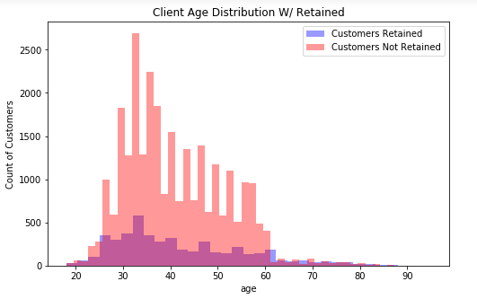
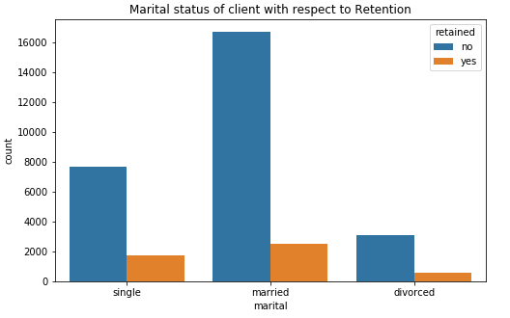
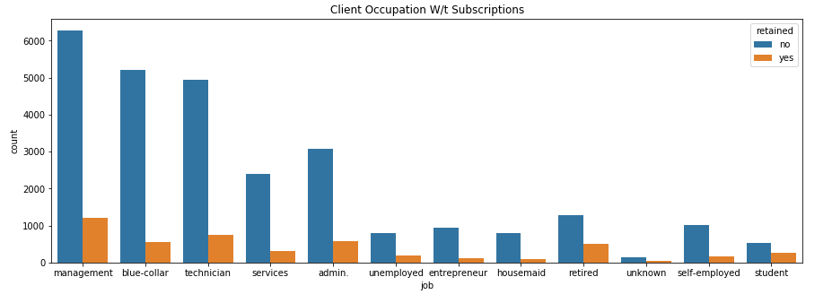
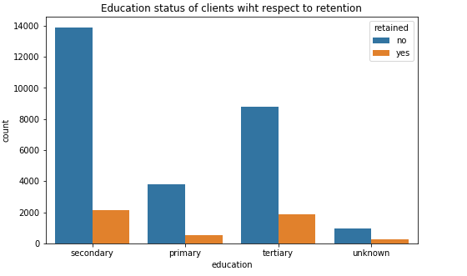
Exploratory Data Analysis : Demographical Features
Most of the customers are in the range 30-40 years
More number of clients are Married
Client occupation demographics is very broad
Most of the clients are well educated
Notes:
Looking above, most of the clients are aged between 30-40 years and they tend to turnout more for the marketing campaign. On the Marital Status, Since they are in high number, the retention rate for those is also high considerably. But Single customers are also turning high than the married ones. Apart from that the occupations of the clients are very broad, also the turn over among the subscription by the clients is also almost equally distributed with respect to the overall count. Hence, the job rate wont be that much of a factor to consider while making a decision.

Slide 6
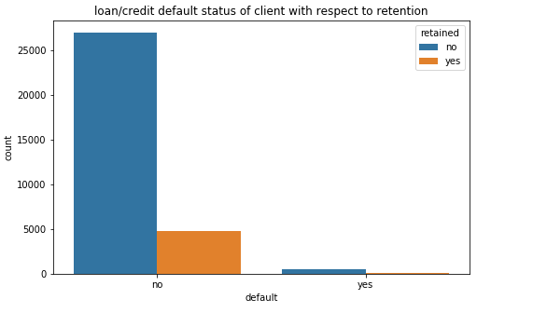
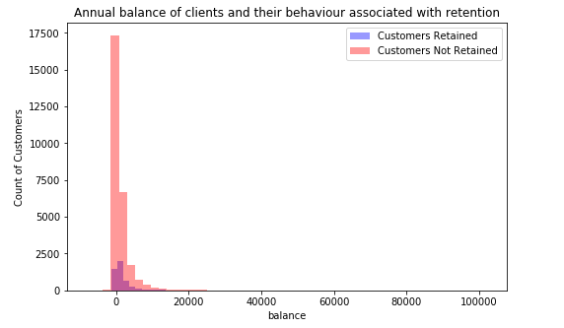
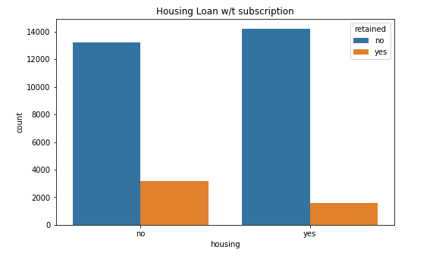
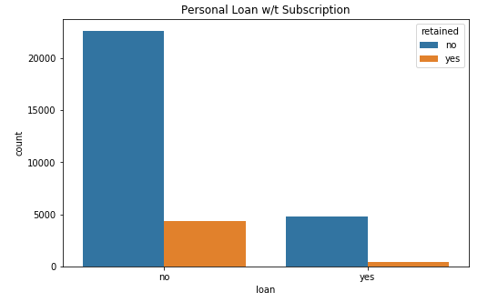
Exploratory Data Analysis : Customer Banking Demographical Features
High Non defaulter rates & so the retained customers
Mostly, Annual balance is concentrated at same point for both retained & Non retained
People with no loans tend to accept the marketing campaigns
Notes:
Glancing at the Client banking demographics, most of the clients have no credit defaults as well they tend to get more into the marketing campaigns. Also, Most of the employees don’t have any personal loans with the bank as well the retained customers. But, there are almost equal number of clients who do and don’t have housing loans, but in general retained are those clients who don’t have housing loans. Hence this can be a good factor to look at. Finally, the customers have annual balance in their account is having almost the same distribution for both the retained & non-retained customers.

Slide 7
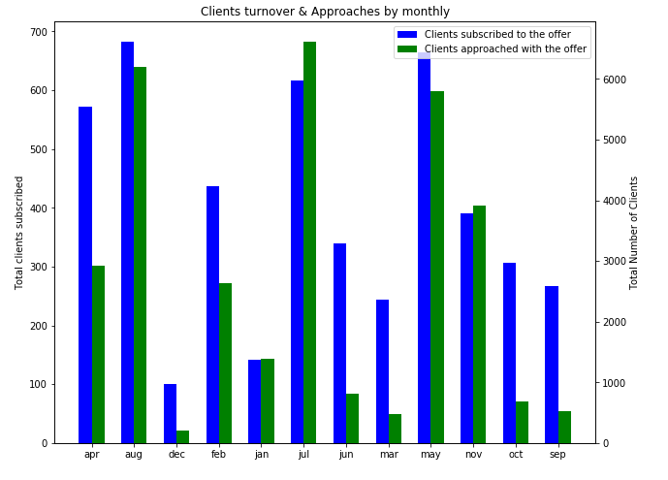
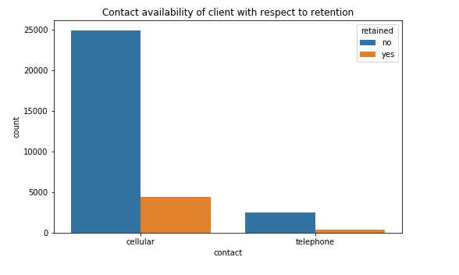
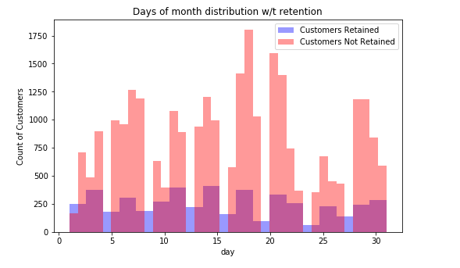
Exploratory Data Analysis : Current Campaign Features
Contact Data – Cellular tends to have high impact. But I don’t think that really matters ?
Generally, more contacts are done during the middle of the month and hence is the higher retention
Similarly, May-Jun-Jul-Aug show better retention rates, as well the total number of contacts done are high.
Notes:
Coming to the contact data, the feature just tells the way client was contacted to. Hence this wont be that much of an importance as we can contact them through what ever available way possible. Apart from that, The above features describe the retention rate based on the days when they are contacted and the months. /subscription among clients is high during starting, ending and middle days of the months whereas there is high turnover during the May, July & August months. Also it can be interpreted that the higher the number of approaches, the higher the conversion.

Slide 8
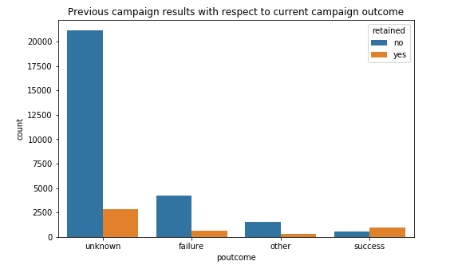
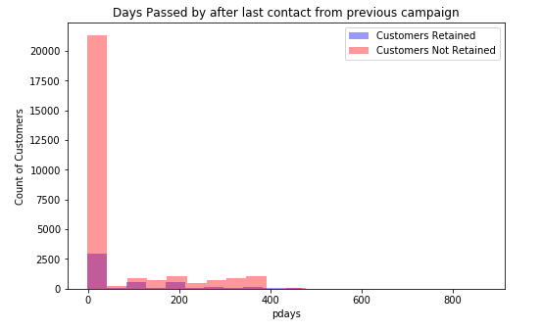
Exploratory Data Analysis : Previous Campaign Features
Previously retained clients are most probably the ones to get back
The earlier clients are contacted, the better the retention
Notes:
Moreover, Previous contacts to the clients makes an impact as we see the trend that customers contacted around 5-6 times previously and present combined tend to turn over, that means they are less annoyed and bound to think about the offers & more than that will not result in turnover. Whereas, previously who have successfully subscribed to the campaigns tend to subscribe to the current campaigns as well.

Slide 9
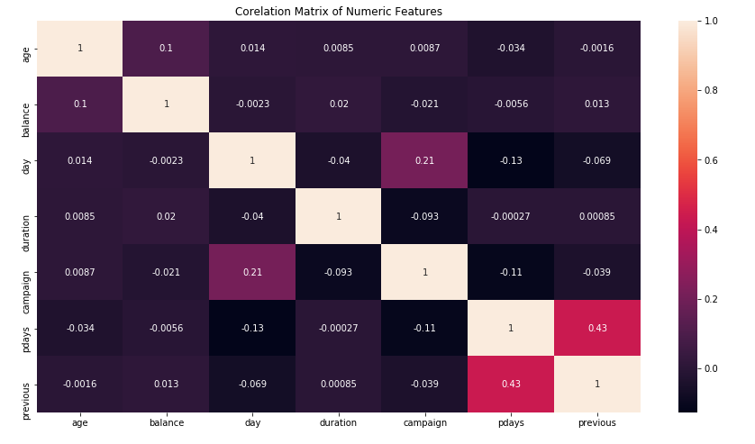
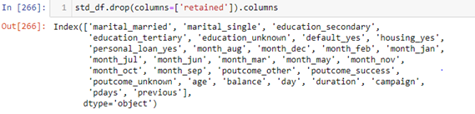
Feature Engineering
Contact & Job features have been removed from the final features as part of feature selection
This decreased model complexity from 40 to 29 features
Visualizing only Numeric feature correlations – and they don’t have any compounded effect
Notes:
Looking at the compounded effect of only the numeric variables, we see there are no variables which give away same information for classification. Well, the same has been performed for all the variables (matrix is in the code file – not included because of its size) & there seem to be almost no correlation between the variables and hence all the features can be considered for modeling. Even though, the contact feature has the type of contact Ex: cellular, home – It also has unknown as value. But, Features like 1. Contact – It gives a categorical value of the type of device/phone reached to contact the client and more than half of the feature values are unknown, hence the feature has been completely eliminated. Since, from the business perspective it doesn’t make sense on how they were reached and if we try to remove just the values of unknown, we will be ending up losing all the other features which might help the model in building a better decision boundary. 2. job – as we can see earlier the retention rate is almost equally distributed among the occupation of the clients & we have all the clients subscribing to the offer independent to the occupation, so it doesn’t make any difference & hence these are eliminated which reduces the final feature set drastically from 40 to 29

Slide 10
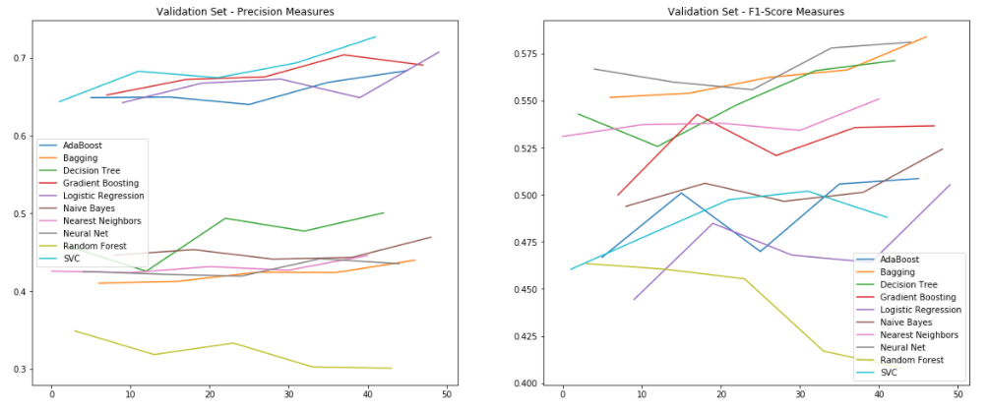
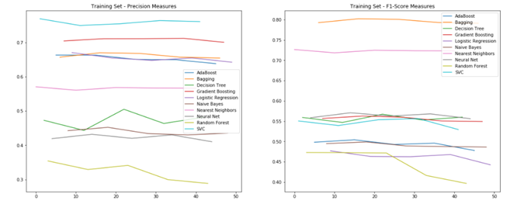
Model Selection
Wide variety classifiers are trained with 60% training & 20% validation data
The performance of the models are measured by Precision & F1-Score
The classifiers are trained randomly for 5 times, making sure the classification is not at random.
Gradient Boosting is selected because of consistent performance with Validation dataset
Notes:
It can be analyzed that Bagging Model is a classic example of overfitting, it is performing well on the training data but bad in the validation set. Neural Networks, Decision Trees & Random forest are sub optimum and had performed bad than other classifiers in both training & validation sets. AdaBoost, Logistic Regression, Nearest Neighbors & Naïve Bayes were optimal but could not achieve better F1 and Precision scores. It came down to SVC and Gradient Boosting, SVC actually outperformed Gradient boosting in both training and validation sets among precision but was not good at F1-score. This was an indicator that it is learning the Positive rate well, but unable to distinguish the Negative values. Hence, overall Gradient boosting method was selected as it has better Precision & F1-score values among the other classifiers & is consistent.

Slide 11
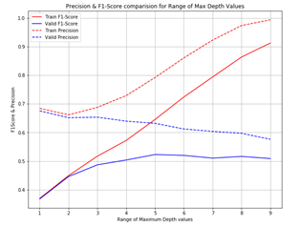
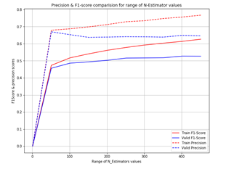
Model Tuning
Max_depth, N_estimators & learning rate hyper-parameters have been chosen for tuning
Validation dataset is considered for decision making
Max_depts of 3, Extimators 300 & learning rate = 0.07 is chosen for optimum performance.
Notes:
Based on the Validation data behavior of precision & F1score, the maximum depth is chosen as 3 as beyond that there is a decrease in F1 score but precision remains to be constant, where as N_Estimartors is decided as 300, since the F1-score has moved above 50% and almost remains constant there after & precision has been constant overall after 100 mark so it was more to improve the F1score of the model. Learning rate is interesting, as we increase it keeps on increasing the F1-score, but F1-score is very bad till 0.05 as it was below 50% and after that it had peak at 0.07, but with precision it was constantly decreasing and beyond 0.07 the decremental steep was high, hence 0.07 is decided. But, Training data variability is also monitored to make sure there is no strange behavior and then finally the values were validated by the performance analysis on Validation dataset only.

Slide 12
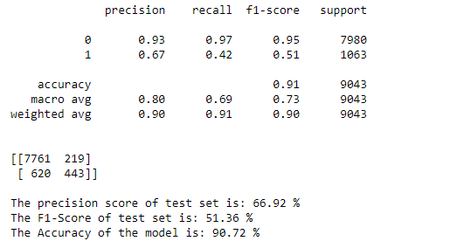
Model Results
Precision & F1-scores are pretty low at 67% & 51%
But, they performed well than other models
This might be due to Data Imbalance
More Deeper models can be implemented for better understanding
Notes:
The final model with Max_depth = 3, N_Estimators = 300 & learning_rate = 0.07 is built and used to classify the test set with 9000 features containing 88% on negative values. Model obtained around 67% Precision & 51% F1-Score. The accuracy of the model wont be a good estimate but for a simple comparison, the base line being 88% we have achieved accuracy of 91% which is an increase of 3%. Hence, Still there is a lot of randomness which need to be understood by the model and this might be due to the imbalanced data & there might be a requirement of deeper models such as Neural Networks.

Slide 13
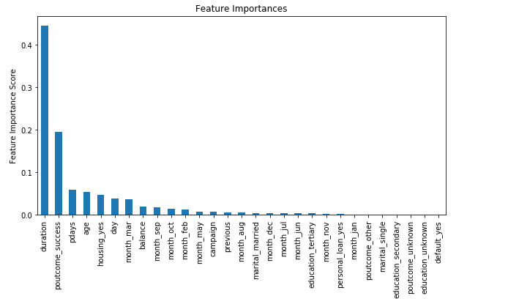
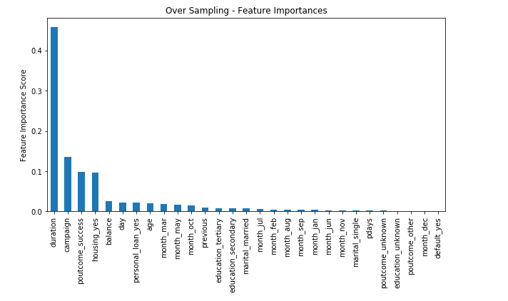
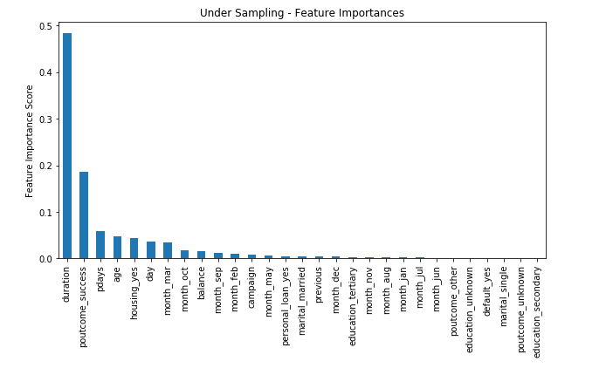
Sampling Data
Over & Under sampling of data to check the robustness of feature importance
Top 5, from the original data model, duration ; poutcome_success & pdays are same for all the models
Hence, the model is performing well & these can be considered as the important features for describing a potential customer.

Slide 14
Conclusion
The Customer Demographics (Age, housing loan) do play an important role in identifying a potential customer
Previous campaign results are very crucial in deciding the target customer
The above claims are validated by over & under sampling techniques and to make sure the feature importance are robust
Given these features and others, Gradient Boosting Classifier can classify the customer with 67% Precision & 91% Accuracy – for now better than 3% baseline. But, can be improved.

Slide 15
THANK YOU

