Slide 1
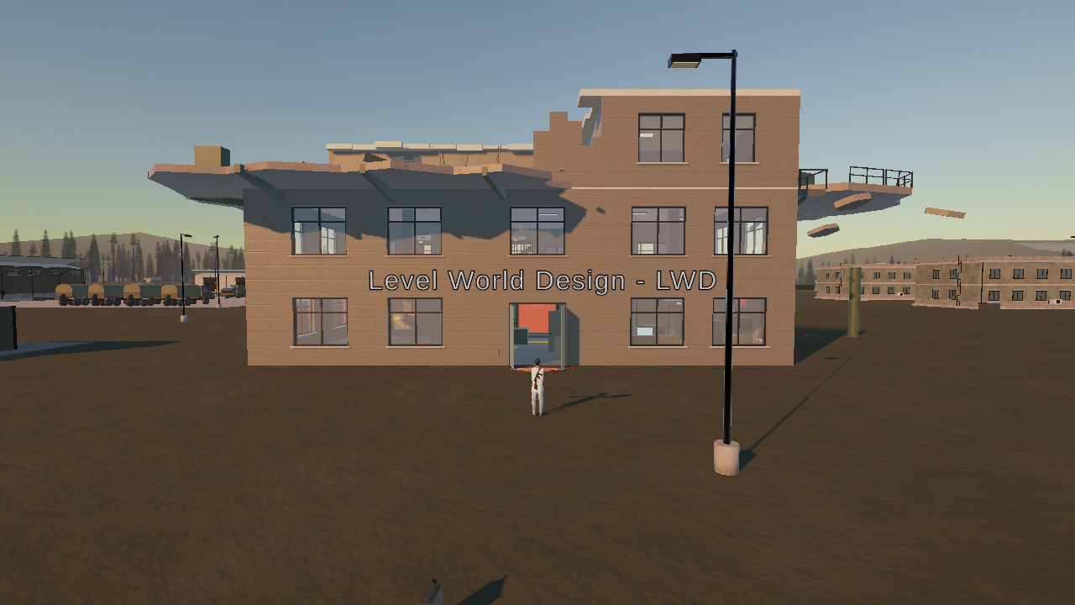
VANTAGE
A tower assault in a captured training base
Three floors, a lock on each, ONLY one way out
Adhurim Thaqi
Level & World Design (I.BA_LWD), HS26 · current state
Notes:
About 20 seconds. Hi, I'm Adhurim. My level is VANTAGE: a third-person shooter level in a military training base that has been overrun. You fight your way up a three-floor tower. Every floor has its own kind of lock, and the only way out is a helicopter from the helipad.

Slide 2
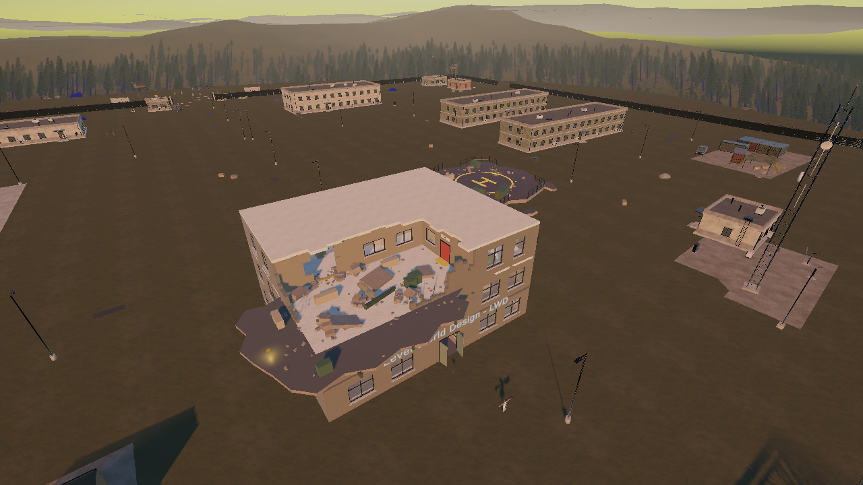
One tower, four spaces, a different lock on each
FINALE
Helipad
Two soldiers, then the boss; the helicopter lands
CLIMAX
RELEASE
LEVEL 3
Destroyed floor
Robot room, then two patrols outside: a kill-door
AWE
DREAD
LEVEL 2
Armory
Find the rifle and the key, use the key slot
The tower in the base: the blown-out top floor and the helipad beside it are visible from the approach.
PRESSURE
RELIEF
1 km
3 + 1
0
LEVEL 1
Ground floor
A trap locks you in: clear the floor to get out
forested valley,
my own Blender world
floors plus the
helipad finale
weapons at the start:
the pistol is at the door
SHOCK
CONTROL
Notes:
About 35 seconds. The world is my own Blender scene: a one-kilometre valley with the base, and the tower on a plot in the middle. On the right is the level as a cross-section, read from the bottom up. Each floor has its own space, its own lock and its own emotion: a trap on the ground floor, a key on the armory floor, a robot and a patrol door on the destroyed floor, and a boss on the helipad.

Slide 3
Bubble diagram: how the spaces connect
LEVEL 1 Ground floor
LEVEL 2 Armory
LEVEL 3 Destroyed floor
FINALE Helipad
Stairwell
up to L3
C
West Wing
from level 2
outside stairs
Room C
Armory
rifle
C
Comms
Exit
to the roof
Office
key
Barracks
Turret hall
turret
Helipad
boss
C
Room B
key slot [E]
+ floor clear
Stairs
up to L2
Hall
everyone dead
Hall
turrets, drones
SE room
C
shutter:
floor clear
Room A
camera
boss dead
locked in lockdown
Entrance
alarm trap
indoor soldiers dead
Extraction
helicopter
Robot room
rifle only
both patrols dead
Outside
pistol
Destroyed
the breach
C
Slab
2 patrols
from level 1
space (size = how big)
pickup
trap / boss
way up / out
coin (5, off the route)
open way
locked until ...
Every floor is a hub or a loop with one locked way up, so the layout itself sets the order: trap, key, robot, boss.
Notes:
This is the level as a bubble diagram: every bubble is a space, its size is roughly how big it is in play, and the lines are the ways between them. Yellow lines are open; red dashed lines are locked until the condition next to them is met. Level 1 is a loop: the trap in the entrance closes the shutter to the stairs and the left door, so the only way is Room A, B, C, the West Wing and the turret hall back round. Level 2 is one hall as a hub with the Armory and the Office off it; the key slot opens the stairwell once the floor is clear. Level 3 is two rooms into a hall, then the robot room, the breach out to the patrols, the SE room and the exit. The finale is the helipad, the boss, then the helicopter. Five coins sit in spaces the route does not need.

Slide 4
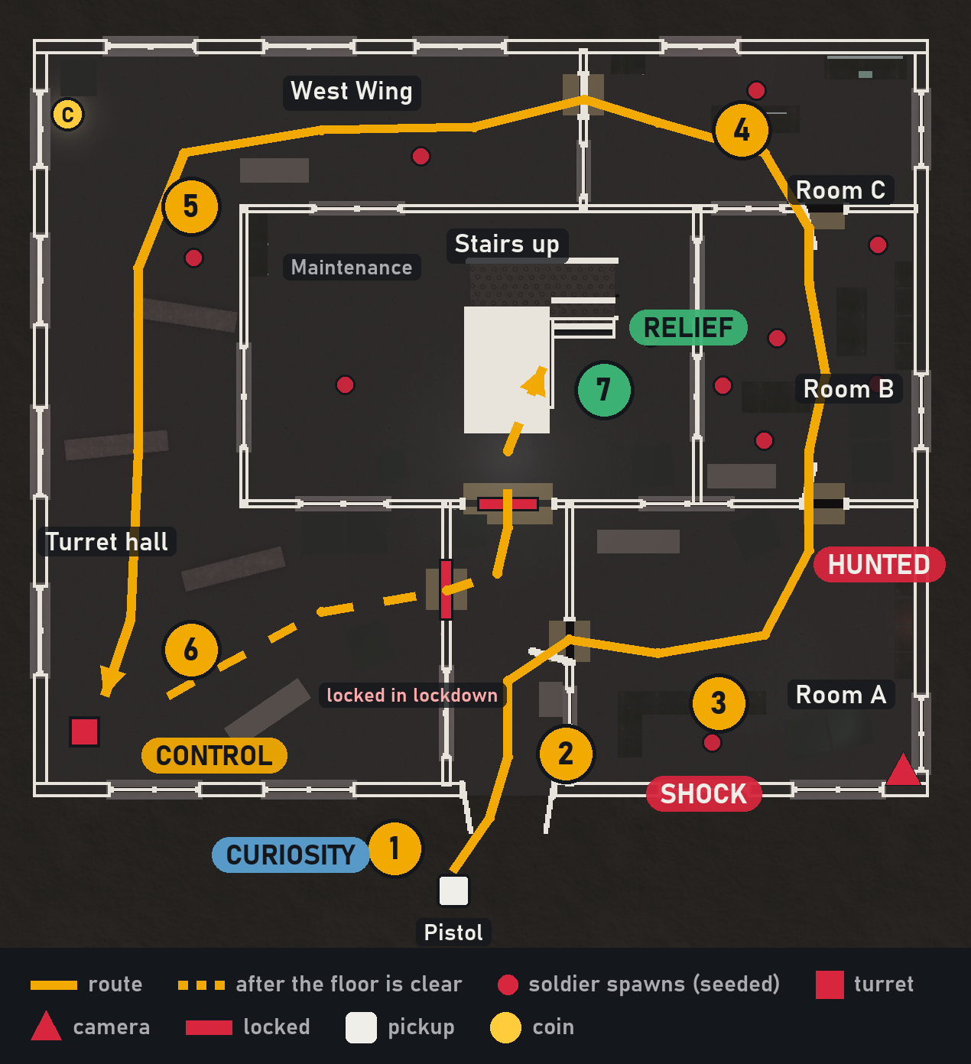
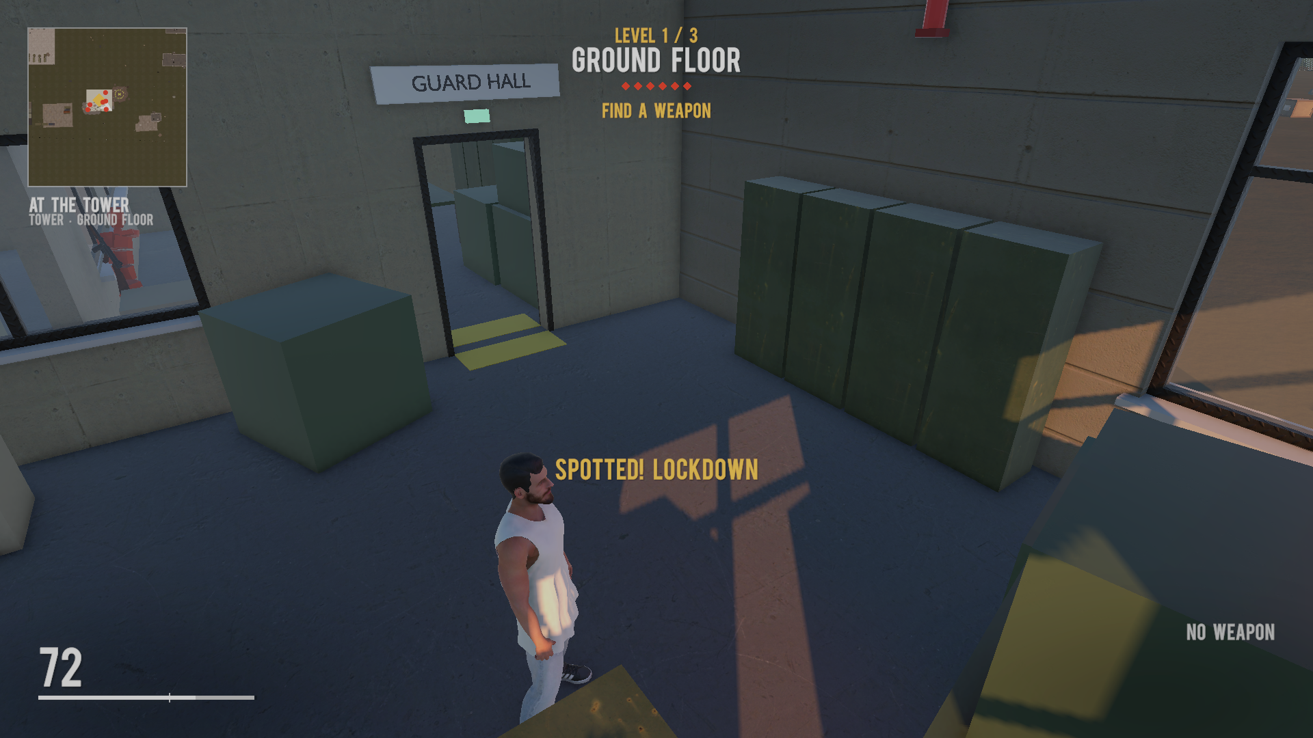
Level 1 · The lockdown
1
Pistol outside the door, the tower is quiet
2
The trap springs: shutter down, siren, red light
3
Every soldier hunts you. The camera in Room A can set it off first
4
Rooms A → B → C: the left door stays locked, one way on
5
West Wing into the turret hall
6
Turret down, floor clear: the alarm stops
7
The shutter rolls up, the stairs open
EMOTION
CURIOSITY
SHOCK
HUNTED
CONTROL
RELIEF
In game: “Spotted! Lockdown”
Notes:
About 45 seconds. Level 1 is a trap. You pick up the pistol outside, walk in, and just inside the door the alarm trigger drops the shutter in front of the stairs: siren, red light, and every soldier on the floor comes for you. If the security camera in Room A sees you first, it sets the alarm off early, so shooting it is a choice before the trap. During the lockdown the left door stays locked, so there is one way on: Rooms A, B and C, the West Wing and the turret hall. When the last enemy and the turret are down, the alarm stops and the shutter rolls up. Shock first, then control, then relief.

Slide 5
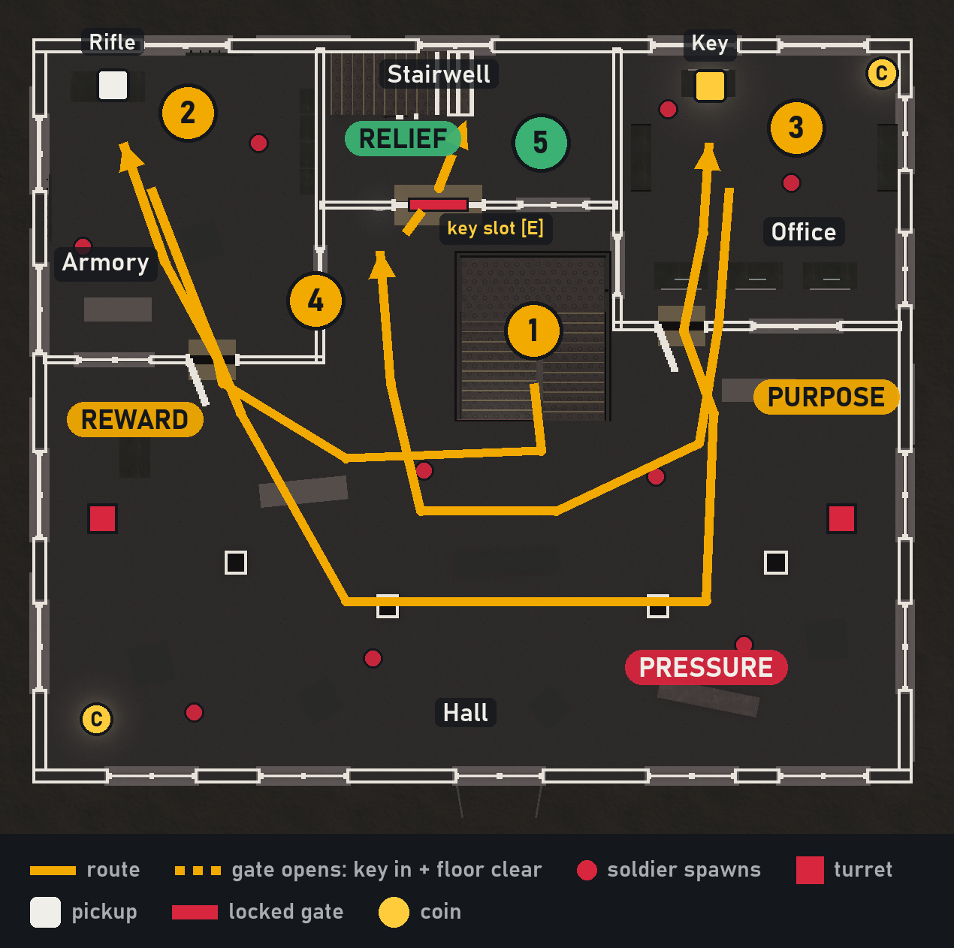
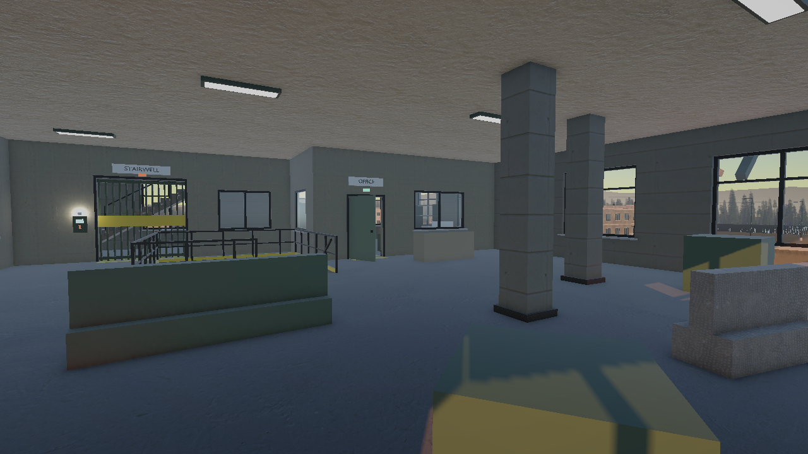
Level 2 · The armory: rifle and key
1
Up the stairs into the hall: soldiers, two turrets, drones
2
The Armory: the rifle
3
The Office: the key floats and glows on the desk
4
Key slot [E]: the key turns, the lamp goes red → green
5
Key in and the floor clear: the stairwell gate rolls up
EMOTION
PRESSURE
REWARD
PURPOSE
RELIEF
The stairwell gate and its key slot, seen from the hall
Notes:
About 40 seconds. Level 2 is a puzzle under fire. You come up into a big hall with turrets and drones, so the pressure stays up. The goal is visible from the start: the stairwell gate with its red lamp. The rifle is in the Armory and the key is on the office desk, floating and glowing so it reads as important. The key slot is the only thing in the whole game you use with E, so it stands out. When the key turns the lamp goes green, and once the floor is clear the gate opens: reward, purpose, relief.

Slide 6
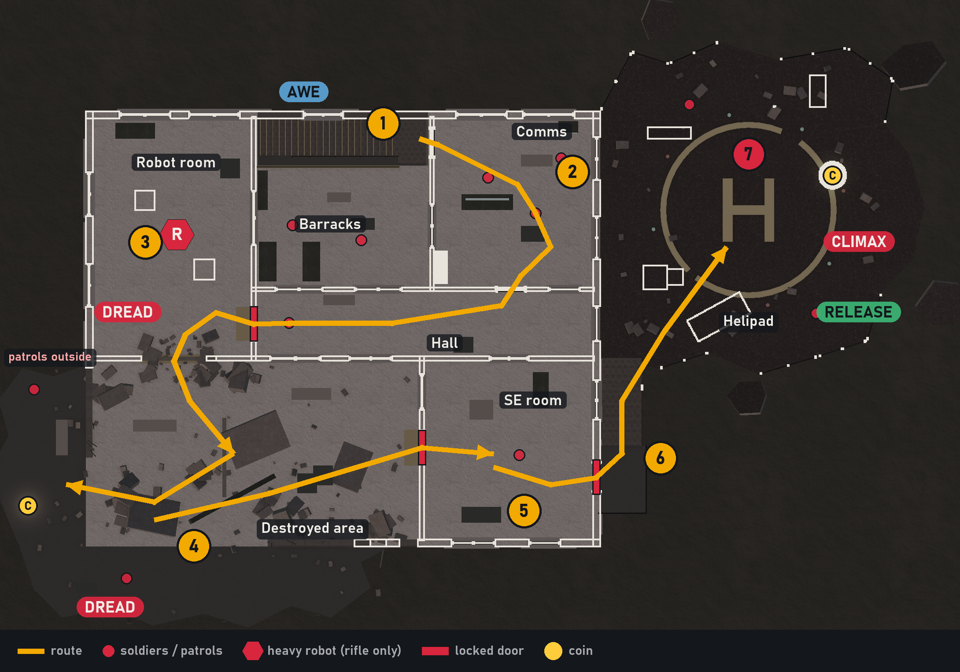
Level 3 and the helipad · Awe, dread, climax
1
Arrival: daylight through the blown-out floor
2
Clear the barracks and comms
3
The robot room opens; only the rifle hurts the robot
4
Through the breach: two patrols on the broken slab
5
Both patrols dead: the SE room opens
6
Exit to the outside stairs
7
Helipad: the boss, then the helicopter
AWE
→
DREAD
→
CLIMAX
→
RELEASE
Notes:
About 45 seconds. Level 3 is the destroyed floor. You arrive and see daylight through the blown-out side of the building: awe, and also a warning. When the indoor soldiers are down, the robot room opens. The heavy robot only takes damage from the rifle, which tests that you found it on level 2. Through the breach two patrols guard the broken slab, and killing both unlocks the SE room and the exit to the outside stairs. On the helipad two soldiers wait, then stepping on the pad brings the boss. When it dies the helicopter lands: the climax, then the release.

Slide 7
The emotion curve
Level 1
Level 2
Level 3
Finale
Each level rises and falls: a sudden spike at the trap, a long build on level 3, the boss as the highest peak, then the release.
Notes:
About 30 seconds. This is the curve I design for. Every level has its own rise and fall: the trap is a sudden spike on level 1, level 2 is steady pressure that ends in relief at the key slot, level 3 builds dread up to the robot, and the boss is the highest peak. The helicopter is the release afterwards, because a level that only stops at its peak feels unfinished.

Slide 8
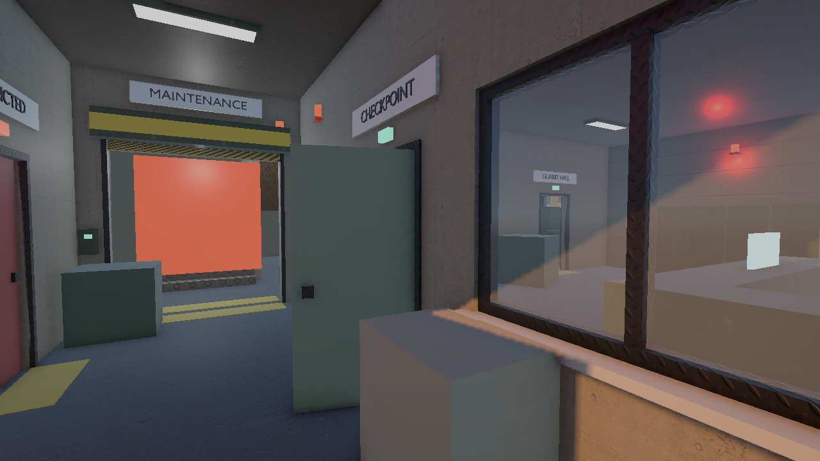
Telling the player what to do with the space
Frame the goal
Colour is a rule
The entrance corridor points straight at the shutter and the stairs behind it, and that is what the trap closes.
Red means locked or danger, green means open, yellow stripes mark gates and the key slot.
Show the threat first
One interaction
The camera's sweeping light cone is visible before it sees you: shoot it or slip past.
Only the key slot uses [E], so the one thing to press stands out.
The first view inside: the corridor frames the shutter in front of the stairs.
After Peter Field, “Spatial Communication in Level Design”: the level should explain itself through layout, light and colour before any HUD text does.
Open means the way
Light pulls you on
Doors on the route stand open, locked doors stay shut: the path reads at a glance.
Daylight through the breach and the “HELIPAD →” sign lead to the finale.
Notes:
About 40 seconds. The video you recommended, Peter Field's talk on spatial communication, says the level should explain itself before the HUD does. That is how I guide the player. The first corridor frames the shutter in front of the stairs, the exact thing the trap closes. Colours are rules: red is locked or danger, green is open. You can see the camera's light cone before it sees you. Only one object in the game uses E, so it stands out. Doors on the route are open and locked ones are shut. On level 3, daylight and a helipad sign pull you towards the finale.

Slide 9
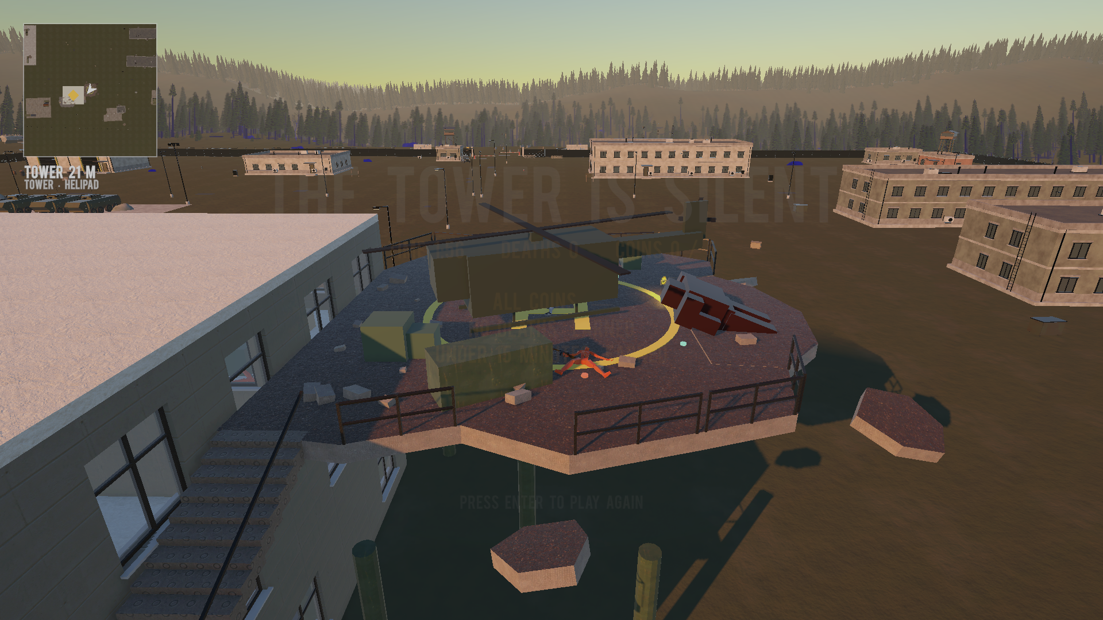
Where it stands
PLAYABLE TODAY
NEXT
✓
All three floors and the helipad, start to end screen
1
My own Blender models for the robot, the boss and the helicopter (placeholders now)
✓
Alarm trap, security camera, key and key slot
2
Environmental storytelling: props that show how the base was overrun
✓
Rifle-only heavy robot, boss, helicopter extraction
3
A mood per space: post-processing for the lockdown, the breach, the roof
✓
Five hidden coins, checkpoint per level, achievements
4
Peer playtests, especially the balance of the lockdown with only a pistol
✓
Procedural part: seeded soldier placement per play
✓
Automated playtest bot plays the whole level and runs 30+ checks on every change
The extraction: the helicopter on the pad
Notes:
About 30 seconds. Everything you saw is playable today, from the trap to the end screen. The procedural part is the seeded soldier placement, and an automated bot plays the whole level on every change. Next I'm modelling the robot, the boss and the helicopter in Blender, adding props for environmental storytelling and a mood per space, and running peer playtests, especially to balance the lockdown when you only have a pistol. Thank you.

