Slide 1

Stock Target Movement Prediction
- T. Adhvik Vithun

Slide 2
INTRODUCTION:
The "Stock Target Movement Prediction" project represents a significant endeavor in the realm of financial analysis and predictive modeling, with the primary aim of enhancing the accuracy of stock price movement forecasts. In today's fast-paced financial markets, where decision making needs to be both informed and timely, the ability to predict stock price changes is of paramount importance for investors, traders, and financial analysts.
The project focuses on the company "META" and leverages a comprehensive ensemble approach, combining various machine learning techniques and time-series analysis to develop a robust predictive model. The chosen timeframe for historical data collection spans from 2007 to 2023, allowing for an extensive examination of market dynamics over time.
To gain deeper insights into the stock's behavior, technical indicators such as the Relative Strength Index (RSI) and Exponential Moving Averages (EMA) are calculated and incorporated into the analysis.
These indicators help in capturing market sentiment and trends, providing valuable features for the predictive models. The core of the project's methodology lies in the ensemble approach, which integrates three distinct predictive models: a Long Short-Term Memory (LSTM) autoencoder for feature extraction, an XGBoost regressor, and Exponential Smoothing.
Each of these models contributes unique strengths to the overall predictive power, making the ensemble approach a well-rounded and adaptable solution for stock price forecasting.

Slide 3
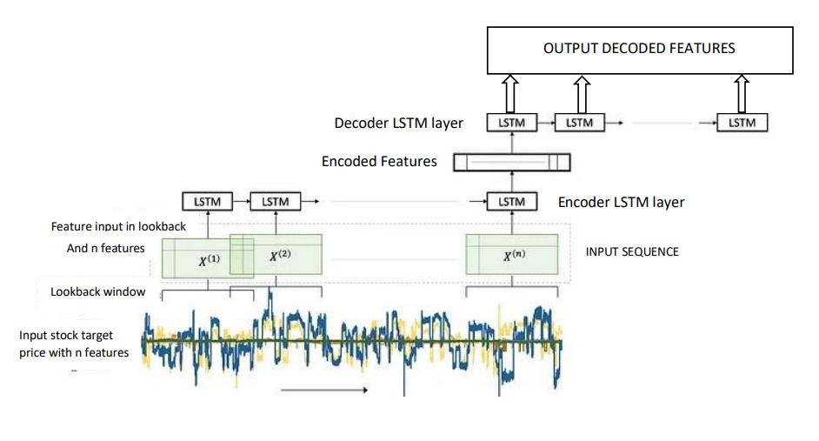
LSTM AutoEncoder feeded to XGBoost
Feature Extraction:
The LSTM autoencoder is used to perform feature extraction from the input data. Feature extraction is a crucial step in machine learning and time series analysis to capture essential patterns and reduce the dimensionality of the data while retaining critical information.
Model Initialization:
The LSTM autoencoder is initialized as model_autoencoder using the Keras library. The autoencoder comprises several layers of LSTM units, designed to encode and decode the input data effectively.
Model Architecture:
The architecture of the LSTM autoencoder consists of the following layers:
LSTM Layer 1: This layer, with 64 units and a ReLU activation function, captures sequential patterns in the input data.
LSTM Layer 2: A second LSTM layer with 32 units, also using ReLU activation.
RepeatVector Layer: This layer repeats the encoded representation for multiple time steps, preparing it for decoding.
LSTM Layer 3: Another LSTM layer with 32 units to decode the repeated representation.
LSTM Layer 4: A final LSTM layer with 64 units to further decode the data.
TimeDistributed Layer: This layer applies a dense layer to each time step, enabling the reconstruction of the original input data.
Training the Autoencoder:
The LSTM autoencoder is trained using the input data (train_X) and the same input data as the target variable (train_X). The autoencoder learns to reconstruct the input data from its encoded representation, capturing essential features.
Encoding and Decoding:
After training, the model's encoder part is used to transform the input data into a lower-dimensional encoded representation. This encoded representation retains the most critical features of the input data.
The decoder part is not explicitly used for reconstruction but is retained for its ability to capture the inverse relationships in the data.

Slide 4
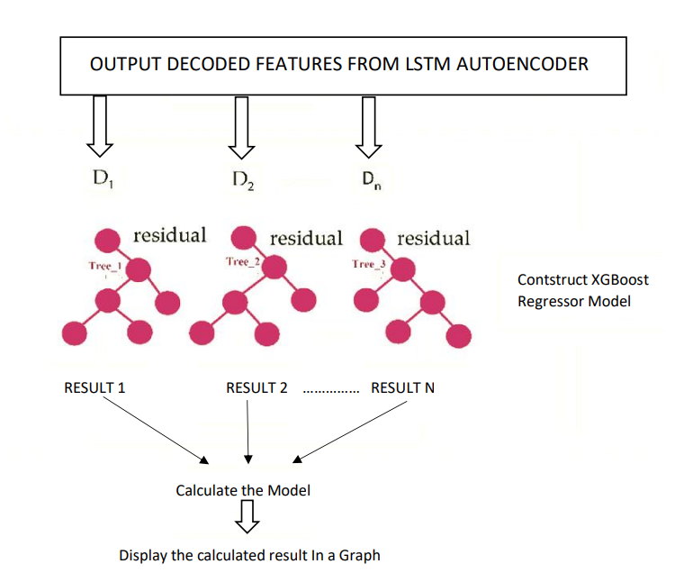
Model Initialization:
XGBoost is first imported and initialized as model_xgb with specific hyperparameters. These hyperparameters define the behavior of the XGBoost model, such as the learning rate, maximum depth of trees, and the number of estimators.
Feature Extraction:
Before applying XGBoost, the data undergoes feature extraction using an LSTM autoencoder. This process reduces the dimensionality of the input data while preserving essential features. The resulting encoded representations are then used as input features for XGBoost.
Training the XGBoost Model:
The XGBoost model is trained on the encoded feature data, represented as train_X1. The target variable for training is train_y, which represents the target price movements.
XGBoost uses an ensemble of decision trees to learn the relationship between the input features and the target variable.
Prediction:
Once the XGBoost model is trained, it is used to make predictions on the test data. The encoded representations of the test data (test_X1) are fed into the model to forecast stock price movements.
Evaluation:
After making predictions, the performance of the XGBoost model is assessed. This evaluation is carried out using a regression metric, such as Mean Absolute Error (MAE), to measure the accuracy of the predictions.

Slide 5
RESULT AND CONCLUSION
The "Stock Target Movement Prediction" project represents a comprehensive endeavor in the domain of financial analysis and predictive modeling. This project sought to address the intricate challenge of accurately forecasting stock price movements, essential for informed investment and trading decisions.
By focusing on the company "META" and adopting a multifaceted ensemble approach, combining machine learning techniques and time-series analysis, this research aimed to develop a robust predictive model. The project began with the collection of historical stock data spanning from 2007 to 2023.
Technical indicators, including the Relative Strength Index (RSI) and Exponential Moving Averages (EMA), were computed to gain deeper insights into market behavior. Subsequently, a target variable, representing the difference between "Adjusted Close" and "Open" prices, was created, along with a binary classification variable, "TargetClass," indicating price movement direction.
The ensemble approach was the project's core methodology, encompassing three distinct models: an LSTM autoencoder for feature extraction, an XGBoost regressor, and Exponential Smoothing. Each model contributed unique strengths, collectively addressing the challenges of volatility, data complexity, and model selection.
Model performance was assessed using metrics such as Mean Absolute Error (MAE), Root Mean Squared Error (RMSE), and visual representations. The results demonstrated the efficacy of the ensemble approach, offering a promising solution for enhanced stock price movement predictions. Furthermore, the project emphasized the significance of multifaceted model selection in stock market prediction, underscoring the need for a comprehensive understanding of financial data and the potential for further improvements in forecasting accuracy.
In conclusion, the "Stock Target Movement Prediction" project provides valuable insights and methodologies for investors, traders, and financial analysts, enabling them to make well-informed decisions in the dynamic landscape of financial markets. The ensemble approach, leveraging the strengths of various models, represents a step forward in enhancing stock price forecasting accuracy and offers potential avenues for further research and improvement in this critical domain

Slide 6
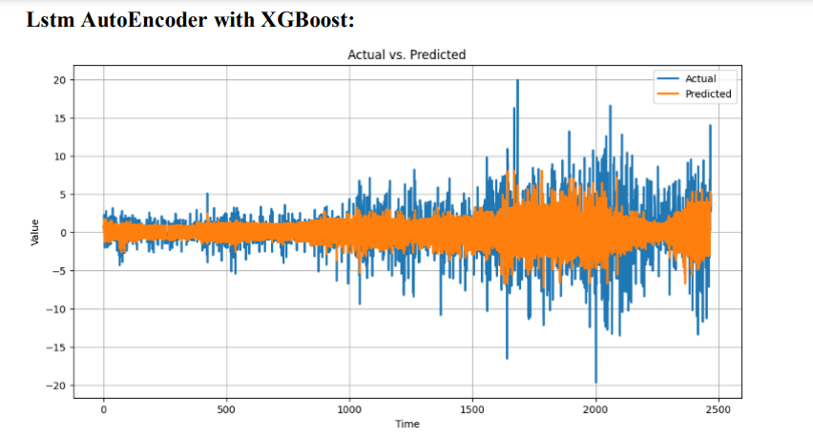
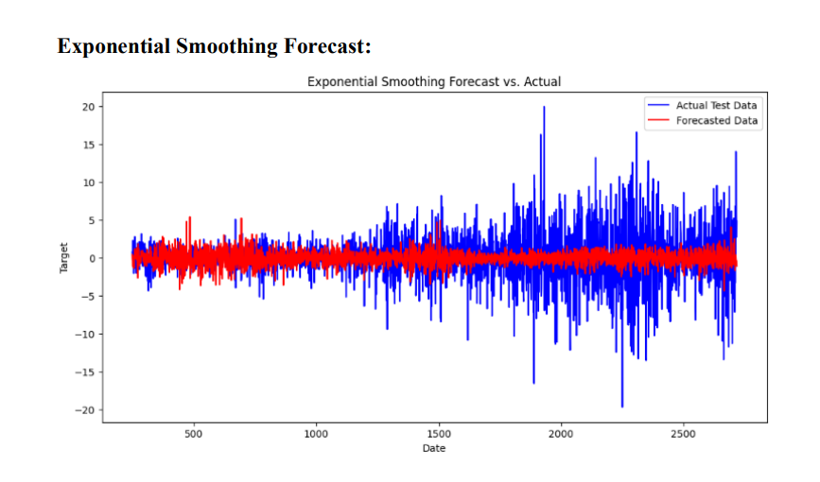

Slide 7
