Slide 1

PRE-IDEATHON TEMPLATE
GENESIS
IDEATHON
TEAM & DOMAIN
Team Name – The Notre Dame
Team Members – URMIKA PRASANTH – CB.EN.U4MEE26244
T PRANAV – CB.EN.U4MEE26242
MANTRA ASTHANA – CB.EN.U4MEE26221
BANDI VASMATH SAI REDDY – CB.EN.U4MEE26206
Selected Domain – Domain 6
Problem Statement – Inavailability of Joint Care Facilities

Slide 2


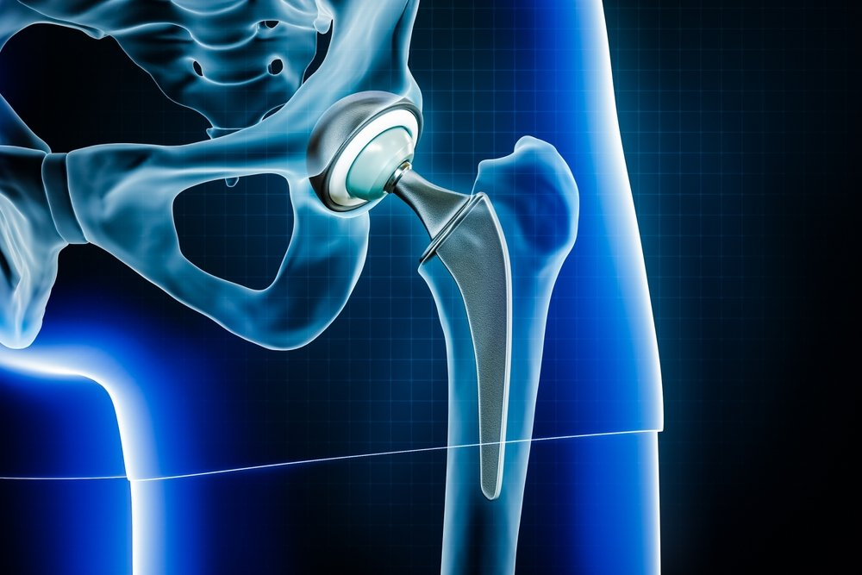
DOMAIN PROBLEM IN OUR WORDS
TEAM
THE NOTRE DAME
Explain the problem in your domain simply, in your own words
Joint transplants are not an available option for a lot of households in India. It is also a risky affair if not met with regular care and aid.
The truth of the matter is that these kind of hurdles often stop people in need from getting transplants or procedures done. This is an issue that is highly prevalent.
We aim to significantly improve the quality of life of the affected individuals while ensuring they are both cost-effective and easily accessible.
Credit: https://www.barringtonortho.com/

Slide 3
WHO IS AFFECTED?
TEAM
THE NOTRE DAME
Target users, stakeholders, beneficiaries
Primary users are going to be users of the older demographic. Patients who are permanently injured and are not monetarily fulfilled enough to solve it themselves. Specifically people with mild osteoarthritis.
Secondary stakeholders can be performance athletes who need to support their joints in movement during high stress.
These people benefit if problem is solved.

Slide 4
CURRENT SITUATION & CONTEXT
TEAM
THE NOTRE DAME
Existing scenario, background and how things work today
The last two decades have witnessed tremendous strides in the evolution of acceptable and successful methods of prosthetic replacement for the arthritic joint.
By and large, these techniques are predictable and durable, though not always to the complete satisfaction of the patient and surgeon.
Despite the recent emphasis on alternative forms of implant fixation, cemented total joint replacements remain the standard by which all others are judged.
The long-term function and durability of these non-cemented components remains to be seen. The future of joint replacement lies in the development of new "composite" materials which can more closely match the structural characteristics of the bone into which they are being implanted.
The current workflow is to either import it or to not do anything about it as is the case in most places, when people prevent to get knee transplants. People with mild disorders who don’t need such procedures often suffer the most due to inaction.
Source: https://pubmed.ncbi.nlm.nih.gov/2404900/

Slide 5

KEY CHALLENGES
TEAM
THE NOTRE DAME
Main difficulties, bottlenecks, root causes and consequences
The problems are:
The human biology is extremely dynamic, making something common to all people is extremely difficult. This will require bespoke solution, which may increase the cost of the device.
The device will need to regulate the weights and have a long battery life.
It may not be the most comfortable solution.
The root cause behind most of these is a common problem almost all biomechanical machines face, which is that every body and anatomy is unique and secondly, substituting the human body is next to impossible.
The consequences of leaving these problems unsolved is that this will render the device to be an additional machine rather than an accessory to assist people in their daily usage.
Credit:https://www.magnific.com/

Slide 6
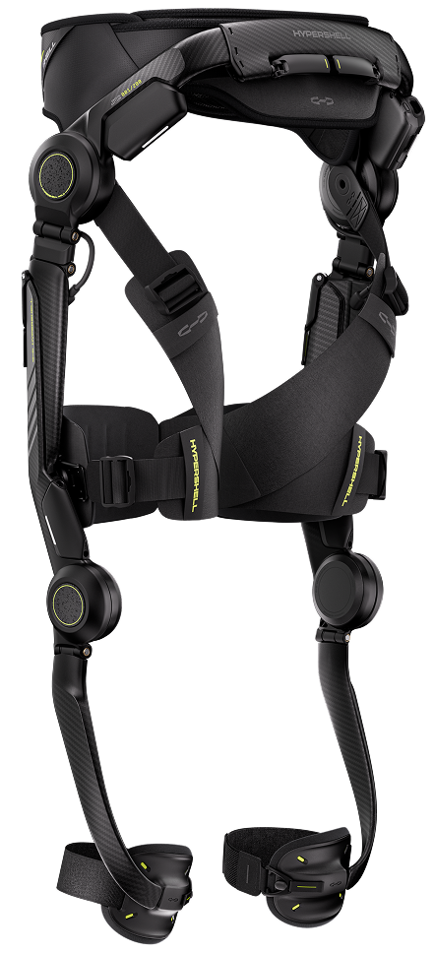
EXISTING SOLUTIONS / APPROACHES
TEAM
THE NOTRE DAME
What is already being done, and where it falls short
Currently, there are systems built by Roam Robotics, Hypershell Halo and Arc’teryx and Skip MO/GO.
Roam robotics – Solves this by fabric integration and using pneumatic return systems
Hypershell halo – Mostly for performance athletes, Solves the problems by making the bulky components into Pants, which ensure comfort.
Skip MO/GO – similar to Hypershell Halo
The limitations of each for the average Indian consumer are as follows.
Roam robotics – Way too expensive for The Indian consumer after import costs to operate and use
Hypershell Halo/ Skip MO/GO – More focused on athletes and hikers than osteoporosis patients
The limitations of each of them is that these are from outside India and they are outsourced. The second problem is that these are more athletically inclined than making it for patients.
Credit:https://eu.hypershell.tech/

Slide 7

PROBLEM INSIGHTS & OPPORTUNITY AREAS
TEAM
THE NOTRE DAME
Resources required to solve the problem
Hardware Requirements
Thigh and shank frame - Aluminium or nylon (PETG)
Cuffs and straps
Gear reduction
Mounting plates, fasteners and bearings
Bench test rig
Brushless DC motor
Motor driver
Microcontroller
Sensors: 2 IMUs (MPU6050 or BNO055, with the BNO055)
Power – Lithium ion or LiPo batteries
Arduino, etc
Software Requirements
Python, PyTorch, MATLAB, NumPy, Pandas, Arduino IDE, SimpleFOC, Bluetooth logging Software, GitHub, CAD, Cura, Jupyter
Human Resources
1-2 people can assemble them
Credit:https://www.istockphoto.com/

Slide 8
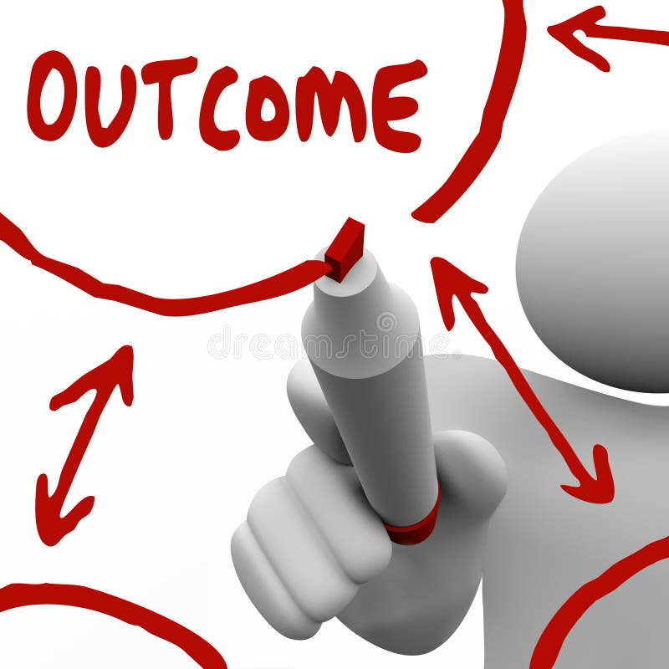
INITIAL DIRECTION & EXPECTED OUTCOME
TEAM
THE NOTRE DAME
What Is Your Expected Outcome?
The team intends to put in the peak of its efforts to create a machine for the overlooked, which chooses to flag a genuinely solvable issue as an inconvenient fact of life they continue to suffer through.
Our motive is to improve our horizon and the system’s comfort & convenience, which is the biggest problem as of now.
We wish to improve comfort by introduction of clothes and fibres into the design, while not jeopardising the strength and quality of the design.
Credit:https://www.dreamstime.com/

Slide 9
TEAM CONTRIBUTION
TEAM
THE NOTRE DAME
Who will handle which part of the execution
Team Member | Role | Responsibility in Execution
Member 1 name | Role | What they will handle
Member 2 name | Role | What they will handle
Member 3 name | Role | What they will handle
Member 4 name | Role | What they will handle

